Slide 1

Lecture #10
Power Generation Alternatives
Power System Management
EECS 4460/5460-901

Slide 2

Recap: Our Appetite for Electricity
KWH
(billions)
Annual U.S. Electricity Consumption 1950-2040
Projected
Source: Energy Information Administration, Annual Energy Outlook 2015
Notes:
Total electricity demand increases by 22 percent by 2040
Electricity demand increases in response to population growth and economic growth and fluctuates in the short term in response to business cycles and weather trends
Over the long term, electricity demand growth has slowed progressively in each decade since the 1950s
Electricity use boomed in the 50s, when technological advances led to household products that offered increased efficiency and labor-saving features
Sales of televisions and other home appliances skyrocketed
Slower growth continues as increased demand for electricity is offset by efficiency gains from new appliance efficiency standards and investment in energy-efficient equipment
Largest percentage increase is in the commercial sector, with service industries continuing to lead the growth

Slide 3
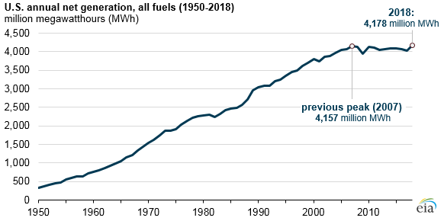
Including Record Consumption in 2018

Slide 4
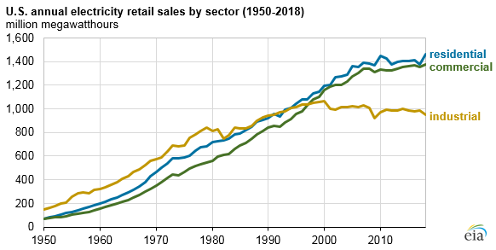
In fact, it is us … the consumer …

Slide 5
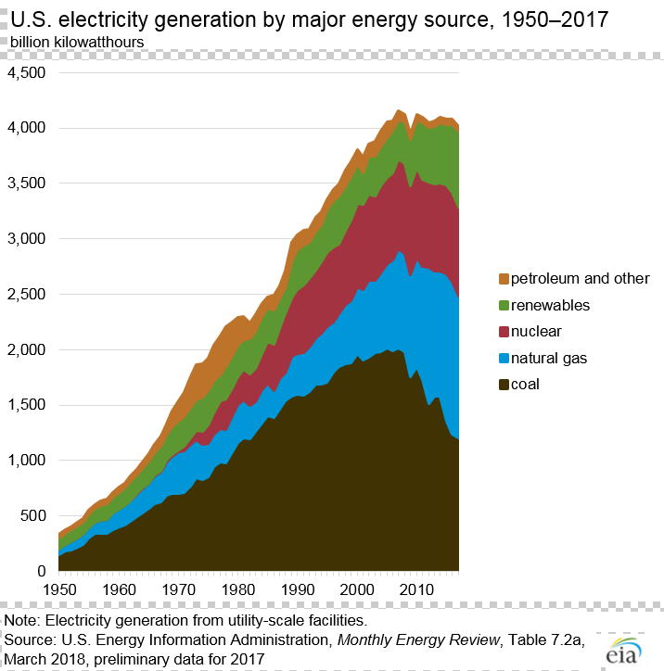
The Historical View…

Slide 6
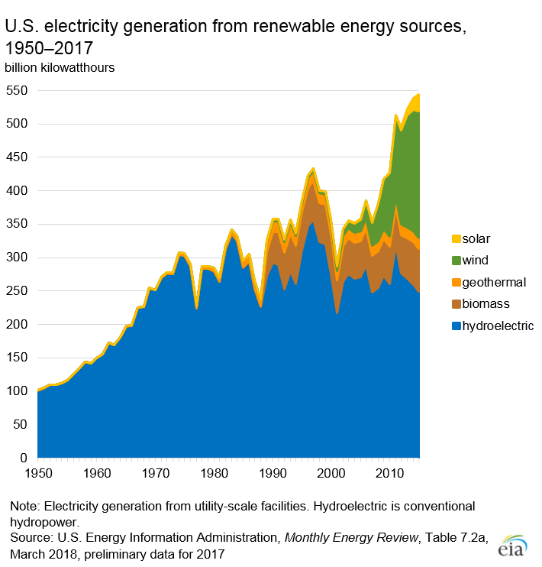
And the Historical Renewable Growth …

Slide 7
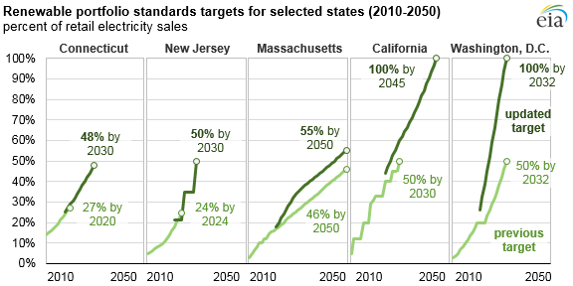
State Renewable Portfolio Standards are Driving Renewable Growth

Slide 8
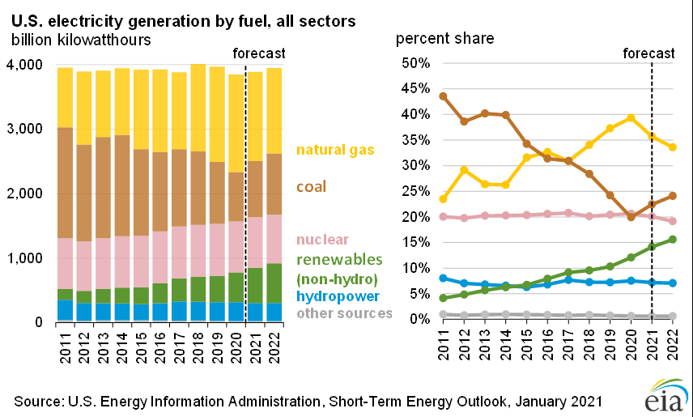
Recap: Renewable Generation Growth
Overall, (non-hydro) Renewable Generation in 2019 was 440B Kwhr, or 10.6% of the total (4.1 Trillion Kwhr)

Slide 9
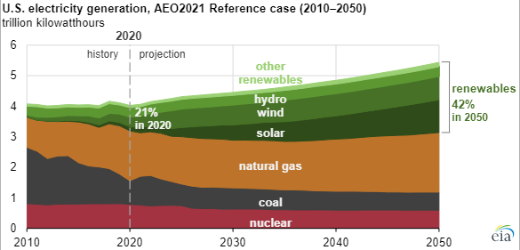
Recap: 2021Long-Term Forecast

Slide 10
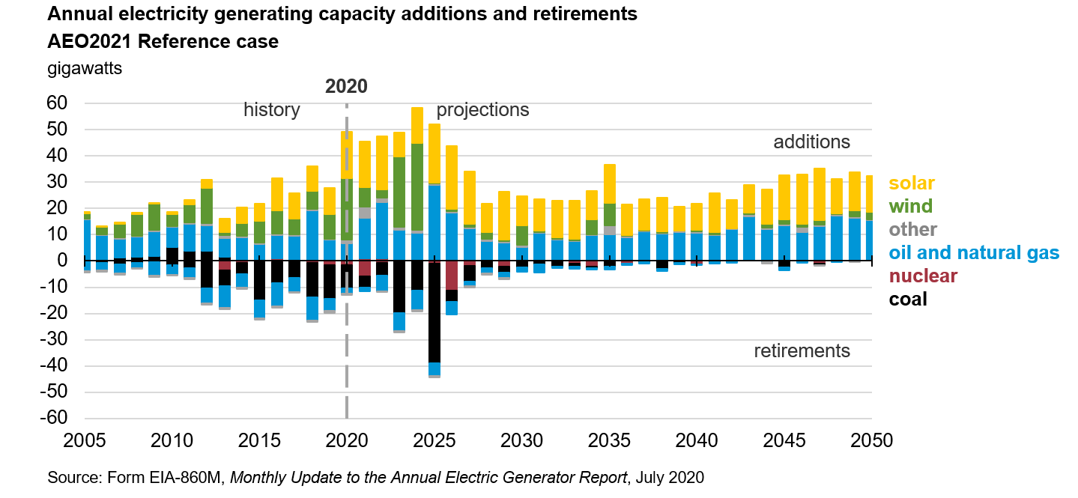
Long Term Planned Additions are Primarily Renewables and Natural Gas

Slide 11
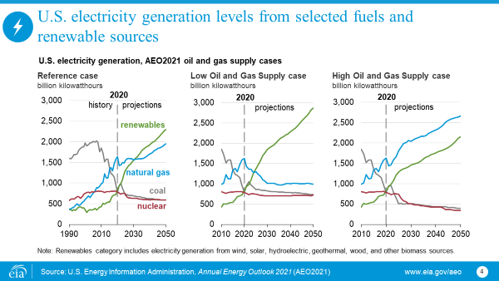
Natural Gas Drives the Long-Term Forecast

Slide 12
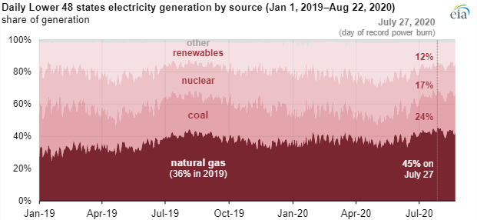
Natural Gas has Emerged as the Top Generation Source*
*EIA, August 26, 2020

Slide 13
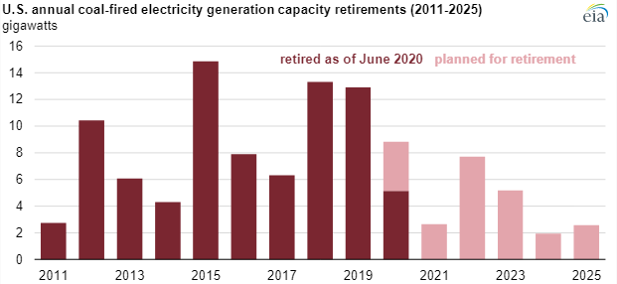
Coal Plant Retirement Update*
*EIA, September 1, 2020

Slide 14
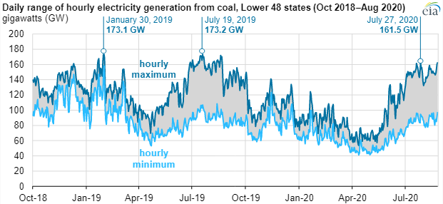
Coal Generation has Become More Seasonal*
*EIA, September 1,2020

Slide 15
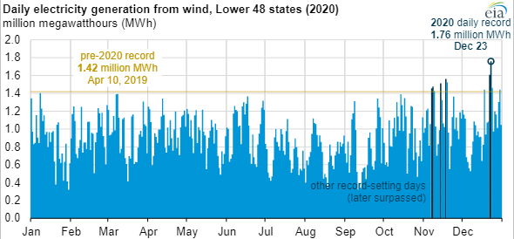
Wind Generation Sets Record at Year-End 2020

Slide 16
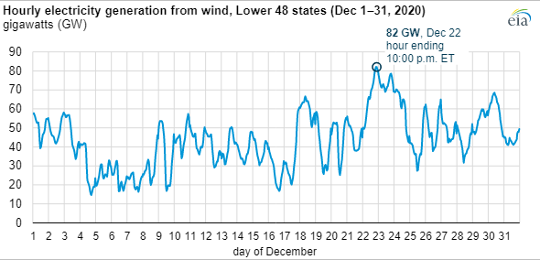
December 2020 Wind Generation

Slide 17
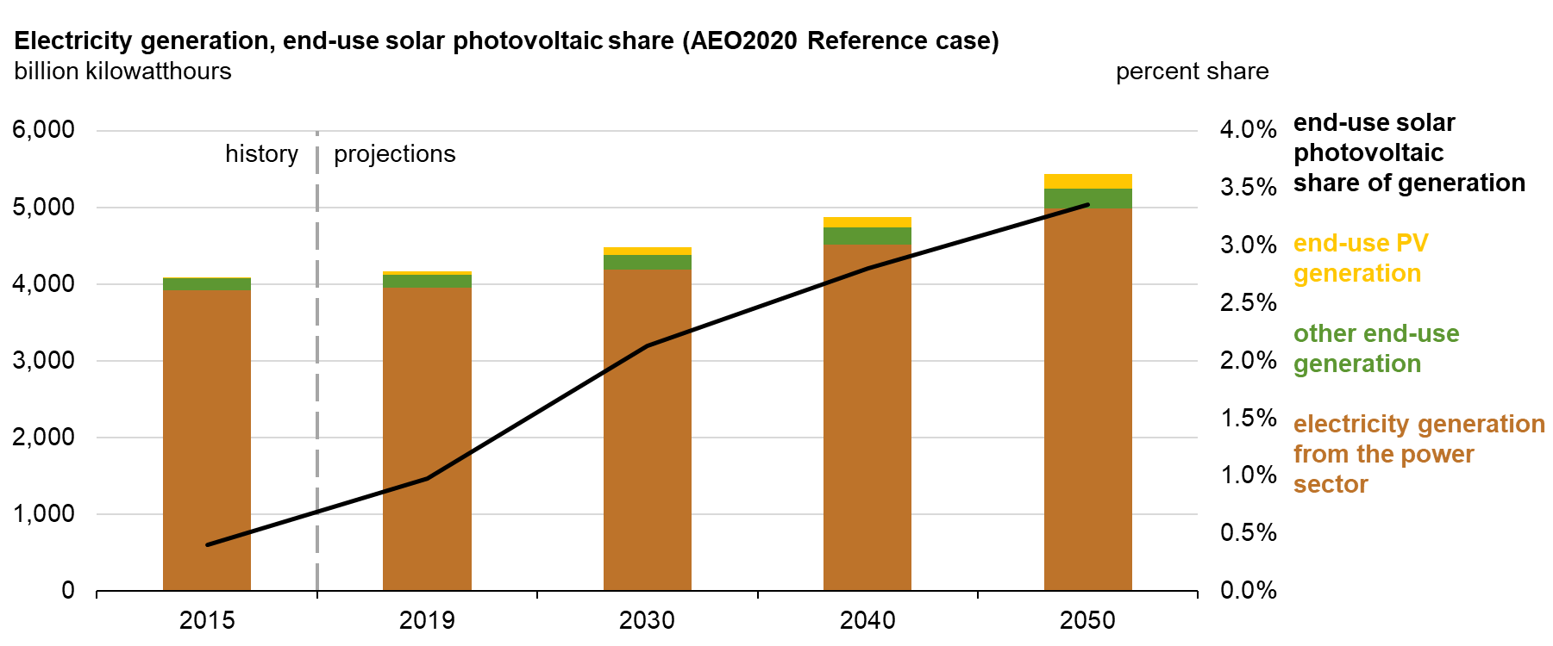
Customer-Owned Generation Increases

Slide 18
Adding Generation to the Power System
Load Forecast – “Needs Analysis”
    State Regulatory vs. Market Driven
Financial Considerations
    Potential Return on Investment
    Cost Recovery Mechanisms
Capital Costs and Time to Build
    Assessing Technological Risks
    Four-year nominal build time
Operating Costs
    Fixed and Variable
Fuel Costs
    Assessing Cost and Supply Risks
Transmission Interface Costs
    Siting and System Interface
Political and Regulatory Landscape

Slide 19
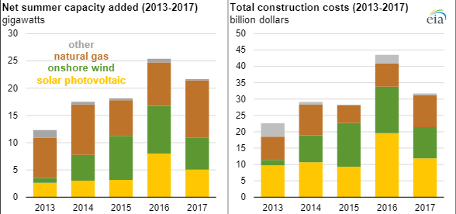
Capacity Additions and Cost

Slide 20
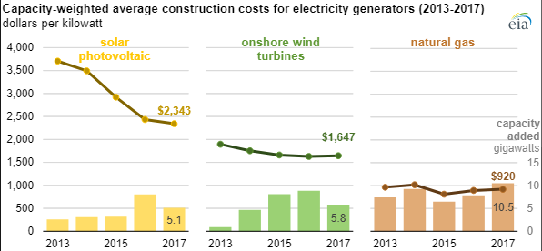
Construction Costs

Slide 21
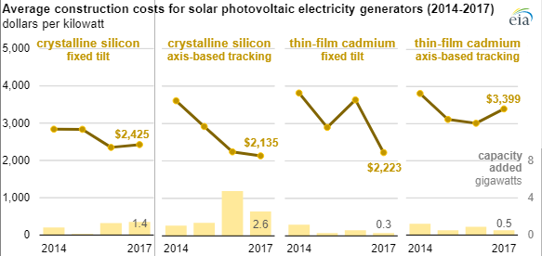
Solar Construction Costs

Slide 22
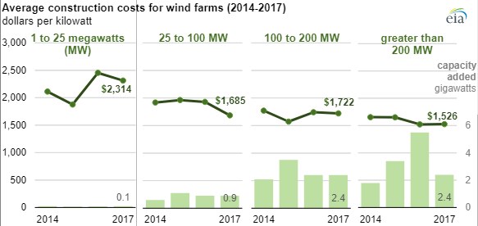
Wind Farm Construction Costs

Slide 23
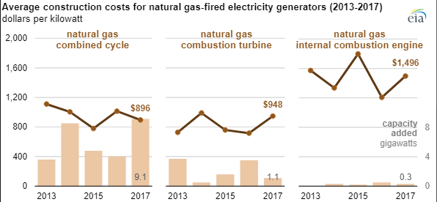
Natural Gas-Fired Plant Construction Costs

Slide 24
One Way to Figure the Costs…
Levelized Cost of Electricity (LCOE)
Average Revenue per Unit of Electricity Generated that would be required to recover the costs of building and operating a generating or battery storage plant at an assumed financial life and duty cycle.
Includes: Capital Cost: $/MW
Fuel Costs: $/MWhr
Fixed O&M: $/MW-yr
Variable O&M: $/MWhr
Financing Costs: $

Slide 25
LCOE for Dispatchable Technologies ($/MWhr)
 | Capacity Factor (%) | Levelized Capital Cost | Levelized Fixed O&M | Levelized Variable O&M | Total LCOE
Combined Cycle | 87 | 7.78 | 1.61 | 26.68 | 37.11
Combustion Turbine | 10 | 45.41 | 8.03 | 132.38 | 194.87
Advanced Nuclear | 90 | 50.51 | 15.51 | 2.38 | 69.39
Geothermal | 90 | 19.03 | 14.92 | 1.17 | 36.40
Biomass | 83 | 34.96 | 17.38 | 35.78 | 89.21
Battery Storage | 10 | 57.98 | 28.48 | 23.85 | 119.84
Coal | NB | NB | NB | NB | NB
Total Includes Transmission Costs, excludes tax credits for Nuclear and Geothermal . Source: EIA February 2021 Update
For Units Entering Service in 2026

Slide 26
LCOE for Non-Dispatchable Technologies ($/MWhr)
 | Capacity Factor (%) | Levelized Capital Cost | Levelized Fixed O&M | Levelized Variable O&M | Total LCOE | Tax Credit* | LOCE w/ Tax Credit
Wind, Onshore | 41 | 27.01 | 7.47 | 0.0 | 36.93 | -6.1 | 30.83
Wind, Offshore | 44 | 89.20 | 28.96 | 0.0 | 120.52 | -12.9 | 107.62
Solar, PV | 29 | 23.52 | 6.07 | 0.0 | 32.78 | -14.3 | 18.48
Solar with storage | 28 | 31.13 | 13.25 | 0.0 | 47.67 | -14.3 | 33.37
Hydro | 55 | 38.62 | 11.23 | 3.58 | 55.26 | NA | 55.26
*Current tax credits (ITC and PTC) shown – most expire before 2026, but will likely renew
Total Includes Transmission Costs
Source: EIA 2021 Update For Units Entering Service in 2026

Slide 27
ReCap: Factors Affecting New Generation Decisions
Regulatory Framework
    State Regulatory Resource Plan
    Merchant Generation
    Financial Impact – Rates and Shareholders
Projected Utilization Rate
Regional Resource Mix
    Area “Margins”
Capital and Operating Costs
Fuel Supply and Costs
Transmission Costs & Approval
Environmental Risk Assessment
“And …the Political Environment”

Slide 28
Next Lecture(s)
Power Generation Alternatives…Continued
Focus on FUEL
  Sourcing
  Process
  Costs
  Considerations

