Slide 1
Criminology and the Sociological Perspective
PLUS: Criminology as a social science
Chapter 1

Slide 2
How to be successful in this course
Prepare to spend 10-12 hours a week on this course.
First, read the assigned chapters in Barkan and take notes. Highlighting will help you understand the information, writing it will help you remember it and apply it in the ways I ask you to!
Second, review my PowerPoint slides and videos for a discussion of some of the key information from the book. Do not use slides in place of reading and taking notes.
  My slides will organize key information, offer additional explanation in some cases and examples in some cases. I will make connections back to social scientific literacy themes, ask students to fill in the blanks, and sometimes offer additional new information to review (government reports, news stories, etc.)

Slide 3
How to be successful in this course (cont.)
Ask questions about the information you want to understand better in the Discussion Board Assignment and in emails to me. Sometimes I will ask questions, like, offer an example of a criminology issue that is in the news right now. I will redirect Discussion Board questions that do not address the class material.
All material in the readings, PowerPoint slides, and videos are subject to quiz and exam questions. You will be asked to remember information and to apply information in a new setting.
Study for the Reading Quiz and Exam just like an in class test. Time is limited and you should use only your notes. NO cutting and pasting from websites or the book. NO PLAGIARISM!

Slide 4
Introduction
Current Observations about Crime in America:
  Our prison/jail population is more than 1.8million inmates
  The criminal justice system costs us more than $300 billion annually
  Our view of crime is distorted by media depictions (news and entertainment)
  The fear of crime level is not consistent with data on levels of crime
We experience crime through
  Personal experiences as victims, criminals, and witnesses
  Through vicarious experiences shared in stories from friends, neighbors, media, pastors, etc.

Slide 5
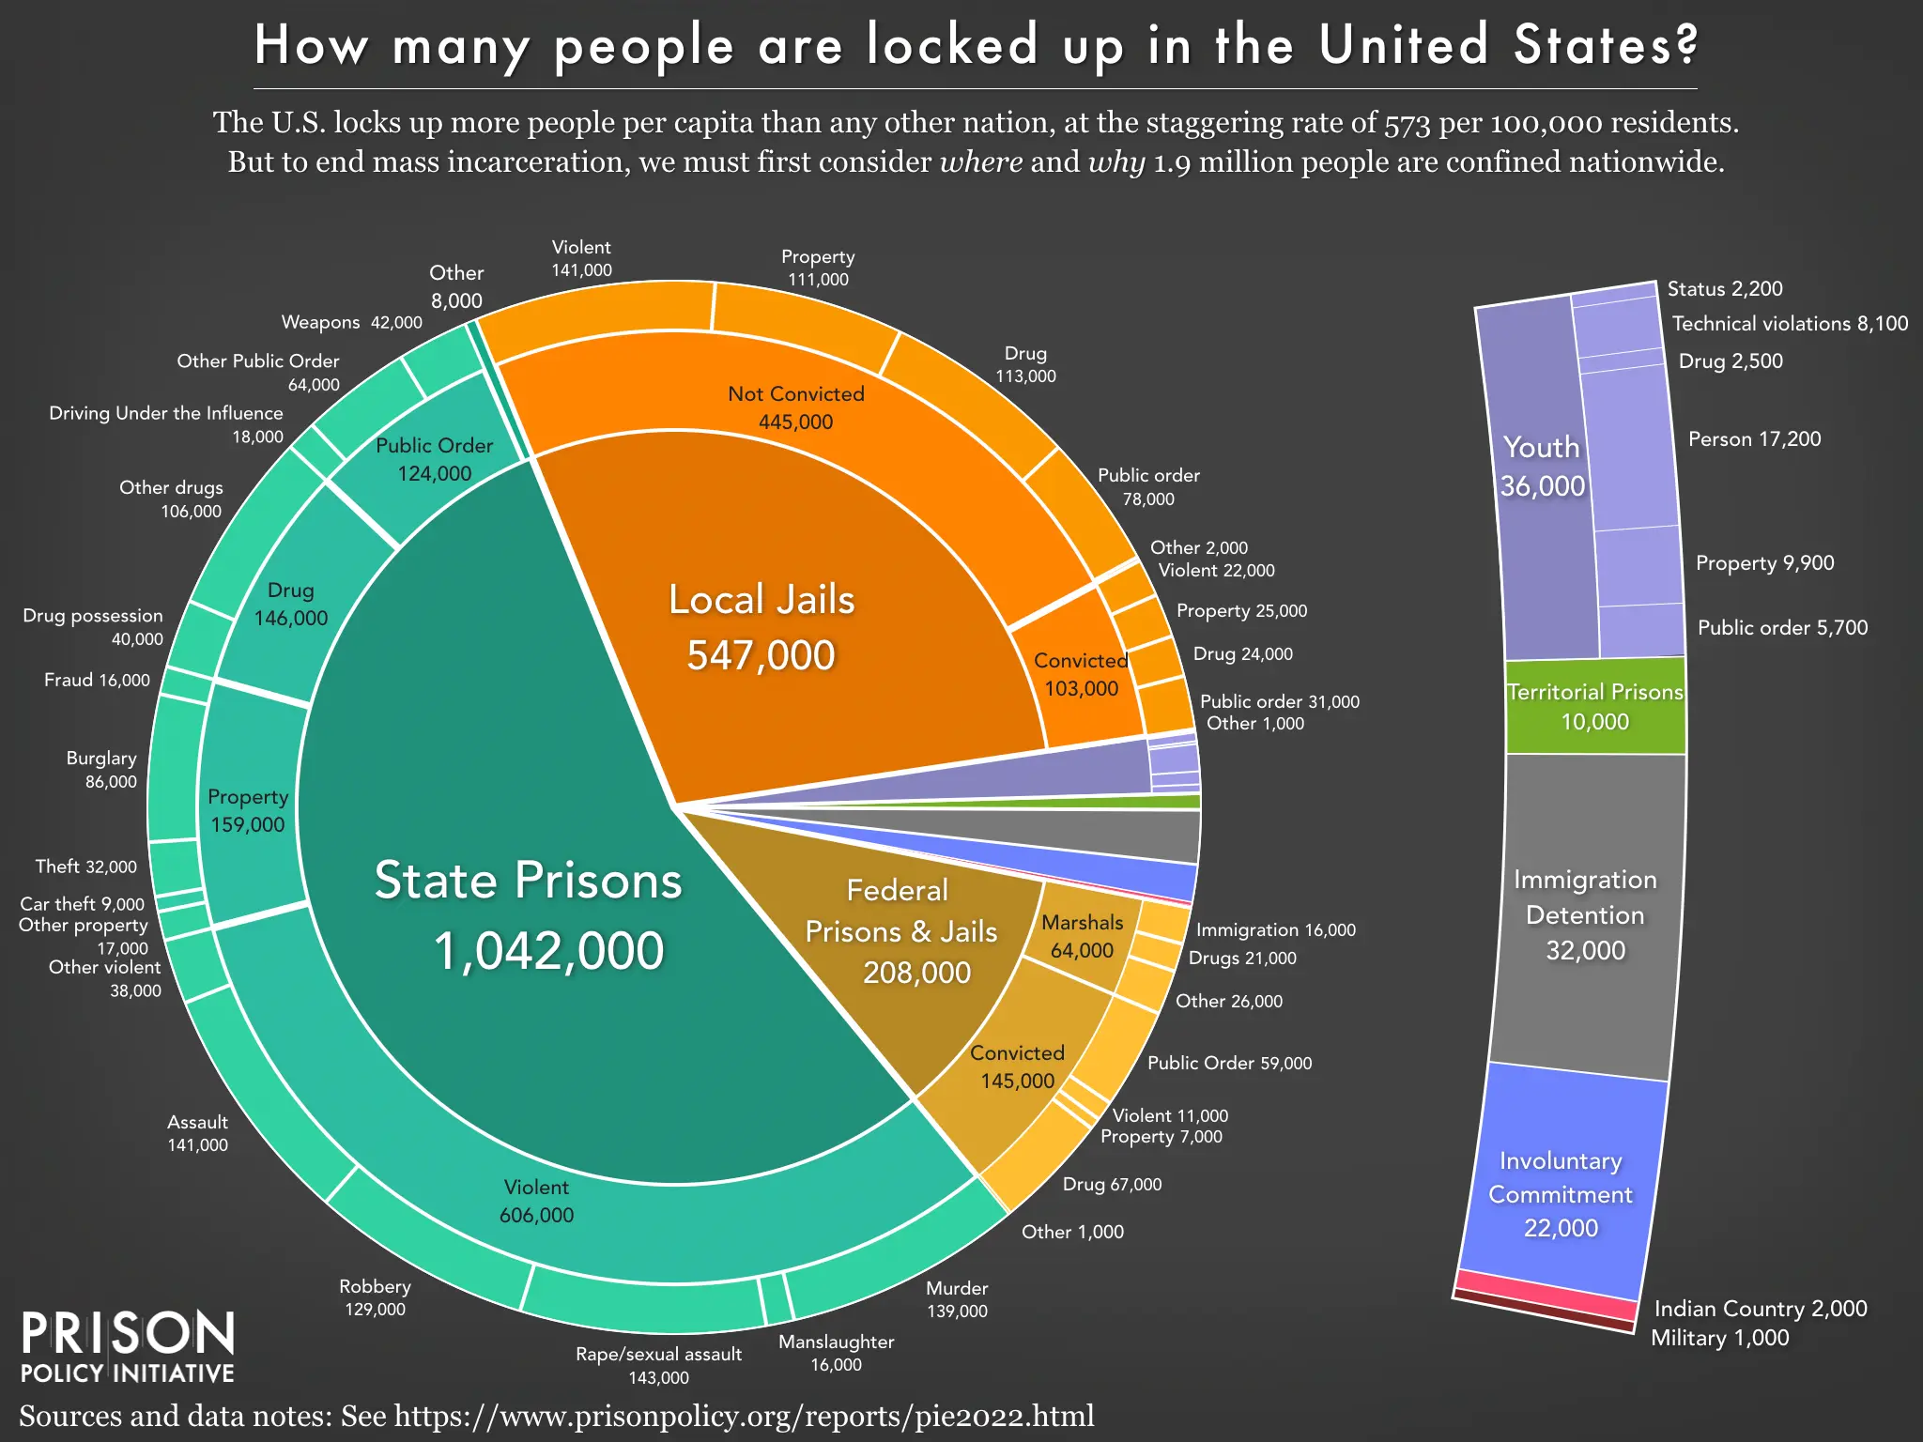

Slide 6
Sociological Criminology Questions (pg. 2-3)
“Why do crime rates differ across locations and over time?”
“Why do crime rates differ according to key dimensions of structured social inequality, and race and ethnicity, social class, and gender?”
“How and why is the legal response to crime shaped by race and ethnicity, social class, gender, and by other extralegal variables

Slide 7
Introduction, cont.
Is crime an individual problem or a social problem? (hint: both)
  Individuals commit crime
  Individuals experience crime victimization
  Crime is also a social phenomenon – social structure is key (pg 3)
However,
  As individuals, we are shaped by our social background and material circumstances
  Crime is shaped by social roots in our social structure and the resulting social inequality (see definition pg. 4)

Slide 8
The Sociological Perspective
We are social beings. We are socialized through our upbringing (family, friends, school, religion).
These personal experiences and the society we live in each shape our
  behaviors, opinions, feelings, attitudes;
  even our life chances (employment, education, etc)
Finally, we want to debunk incorrect perceptions bout crime and crime control strategies.

Slide 9
Key concepts in the Sociological Perspective of Criminology: Social Structure (pg 3-4)
A society is organized in terms of social relationships and social interaction (2 types)
  Horizontal: social/physical characteristics of communities and our social networks (friends/gangs, churches, etc)
    Can you think of other examples?
  Vertical: social inequality – social rankings of perceived superiority/inferiority on the basis of race, ethnicity, gender, class, age, nationality, citizenship status, etc.
    Can you think of any other basis for personal or group bias?
C. Wright Mills: social structure is the root of private troubles, private troubles are really social issues
  What examples can you think of?
    Unemployment and labor force participation are linked to the economic availability of jobs in your neighborhood
    Personal illness can be part of an epidemic (Opioid addiction is epidemic)

Slide 10
Mutual Relevance of Sociology and Criminology (4-5)
“ If crime and victimization derive from community characteristics, social relationships, and social inequality, criminological insights both reinforce and advance sociological understanding of all these areas.” (pg 4)
Intersectionality: “…the ways in which people’s race and ethnicity, social class, and gender interact to produce outcomes reflecting the combined influence of these backgrounds, often to these individual’s disadvantage” (pg 5)

Slide 11
The Rise of Sociological Criminology (pg 5-7)
Crime and Victimization are private troubles and also public issues
  Many criminological concepts derive from Sociology
    Sociology seen as the “parent field” of social science
    All societies have norms about deviance
      What is the definition of deviance? norms? Custom, social control, and laws? Add these to your notes
    All societies have formal (laws) and informal (customs) controls on deviance. These norms are taught through education, religion, media, etc.
Criminological concepts are rooted in Sociology (Sociology emerges as a discipline first, then Criminology – which adds some biological and psychological elements)
  Most studies of crime will reflect sociological dimensions

Slide 12
Rise in Sociological Criminology as a social science (fill in the blanks from the readings to your notes)
For most of history, crime was a function of religious forces: good vs evil
  God vs the Devil
Review Classical School – age of reason in Western Europe (18th century)
  Man is rational and makes own decisions
Emergence of Positivism (19th Century) as rules for social science: empirical evidence and determinism are key
  Who were these early scientists and what did they study? (remember one)
  When and where did American study of crime emerge? (remember one)
  What does criminogenic mean? (pg 6)

Slide 13
What are Edwin Sutherland’s three key areas of study for Criminology that can be stated as social science questions? (pg 7)
Add this information to your notes (This is a test question!)
1)
2)
3)

Slide 14
Remember key concepts and definitions
Crime (a concept)
  Behavior so harmful it is banned by statutory law
Deviance (a concept)
  The result of what other people think about a type of behavior as good or bad/appropriate or inappropriate
  There is no law against deviant behavior, however, some deviant behaviors become the focus of laws
These concepts are relative over time and space
  What does deviance as a relative concept mean? (see pg 7)
  How has the definition of rape changed overtime?
    Originally, rape was only the vaginal penetration of a woman not your wife, and has expanded to definitions that include men as victims, oral and anal penetration and the use of objects, with no restriction by marriage

Slide 15
The Creation of Criminal Law: Theoretical Underpinnings (pg 8)
Two opposing views of why we have the laws that we have (be able to describe and critique each)
Consensus theory
  There exists a general and natural agreement among people in a society on what the social norms of behavior are or should be – both good and bad behavior
  Linked to social contract in Philosophy and Political Science
  Can you think of examples? Violent crimes? Murder?
Conflict theory
  Members of the public disagree on many societal norms; law is created by the powerful to protect their own interests (also the lack of law)
    Golden rule: those who have the gold make the rules
    What examples can you think of?
      We can’t have people doing drugs that keep them from being productive workers (review the origins of the Marijuana Tax Act of 1937)
Which perspective do you find most convincing for why we have the laws that we have today? Why do you think this way? Use logic and evidence to answer the question, not feelings or opinion.
  Be prepared to answer questions with evidence, not “I feel” or “I believe”
  Note, I did not use the word to define the word.

Slide 16
Three Key Goals of Criminal Law in American Society (pg 9; Put information into your own words; NOTE, a Google search of this question may not give you the correct answer on the Readig Quiz.)
“Keep the public safe from crime and criminals” – through prevention and control
  EX: criminal punishment is deterrence
2. “Articulate a society’s moral values and concerns”
EX: hate crime laws, pornography, drugs, etc.
3. “Protect the rights and freedoms of the nation’s citizenry” from the power of the government
EX: Bill of Rights in the US Constitution

Slide 17
Criminal Law: Origins, types of crimes (9-10)
Historical origins: English Common Law
  Derived from English case law
  Brought to U.S. by colonists
Important terms for types of crimes
  Mala en se and mala prohibita (know definitions and examples)
  Felonies and Misdemeanors (know definitions and examples)
Important terms for intent
  Mens reus and actus rea (know definitions and examples)
Skip liability and defenses discussion (10-11)

Slide 18
Key takeaways
Develop a sociological imagination (CR Mills. Pg 4 and 14)
Challenge your common perceptions of crime and criminality – what does social science say?

Slide 19
Research Methods in Criminology reflect the nature of Social Science (11-14)
Review Social Science Terms
  Theory a plausible attempt to explain something observed in our social world by posing a relationship made up of concepts and hypothesis (research question informed by theory, made up of variables)
  Concepts (abstract ideas) and variables (measurable version of concepts): independent, dependent and control variables
Quantitative data sources:
  Surveys – for opinions and self-report of deviance/victimization
  Experiments – rare in CJ; artificial circumstances in lab
  Existing data from the CJ agencies -arrest reports, sentencing files, correction classification, etc.
  Comparative and Historical Research
Qualitative Scientific study of crime utilizes:
  Observation of behavior – police ride a longs, participant observer in gang
  Intensive interviews – attorneys, victims, offenders

