Slide 1

Fire Investigation
CRJ344 – Fire & Arson Investigation

Slide 2
Exterior

Slide 3

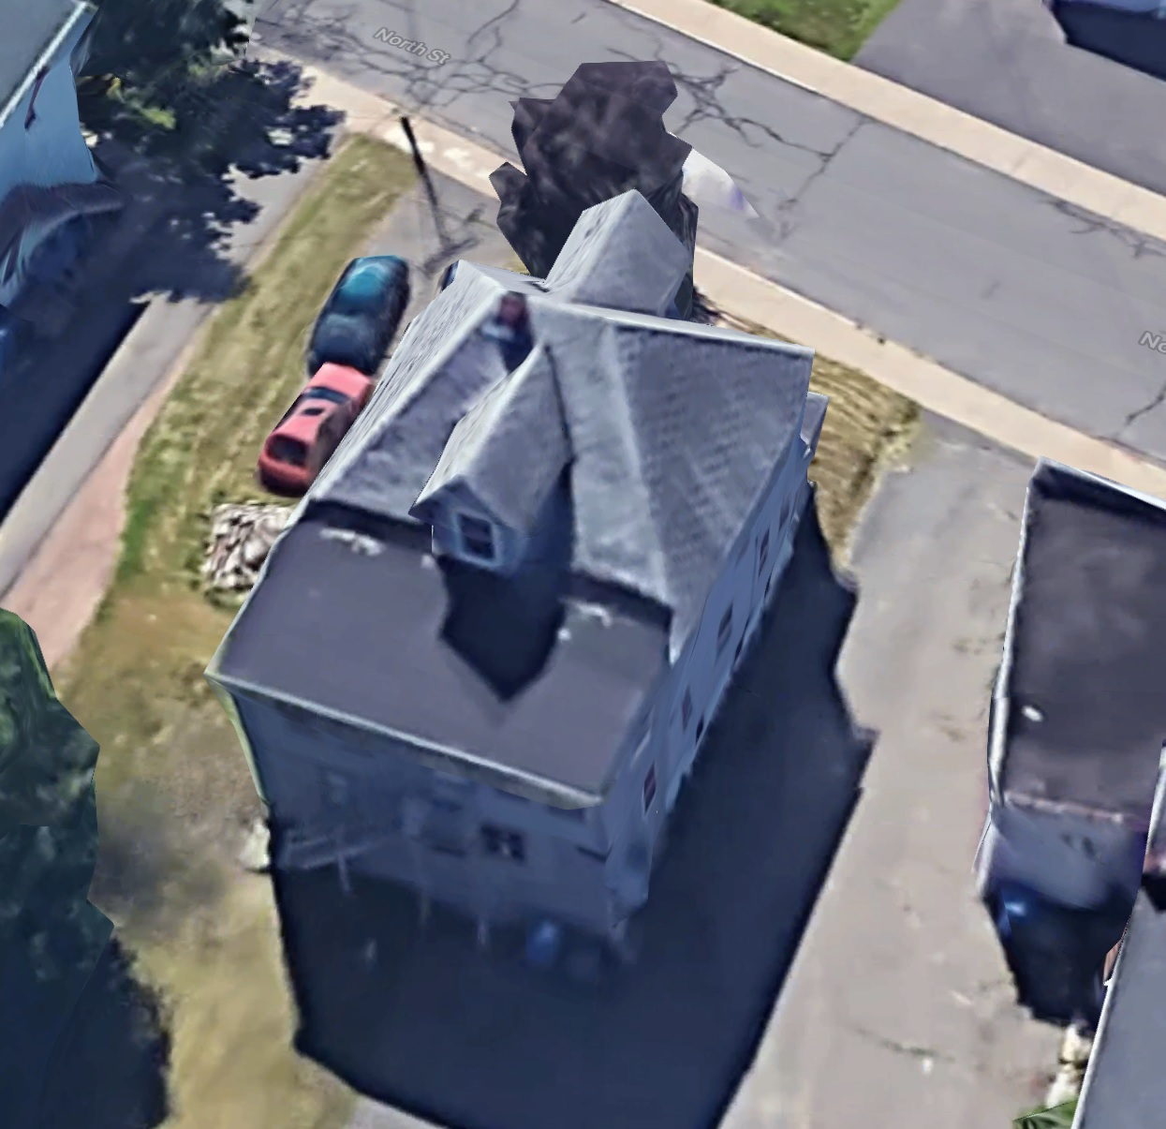
Overhead View

Slide 4
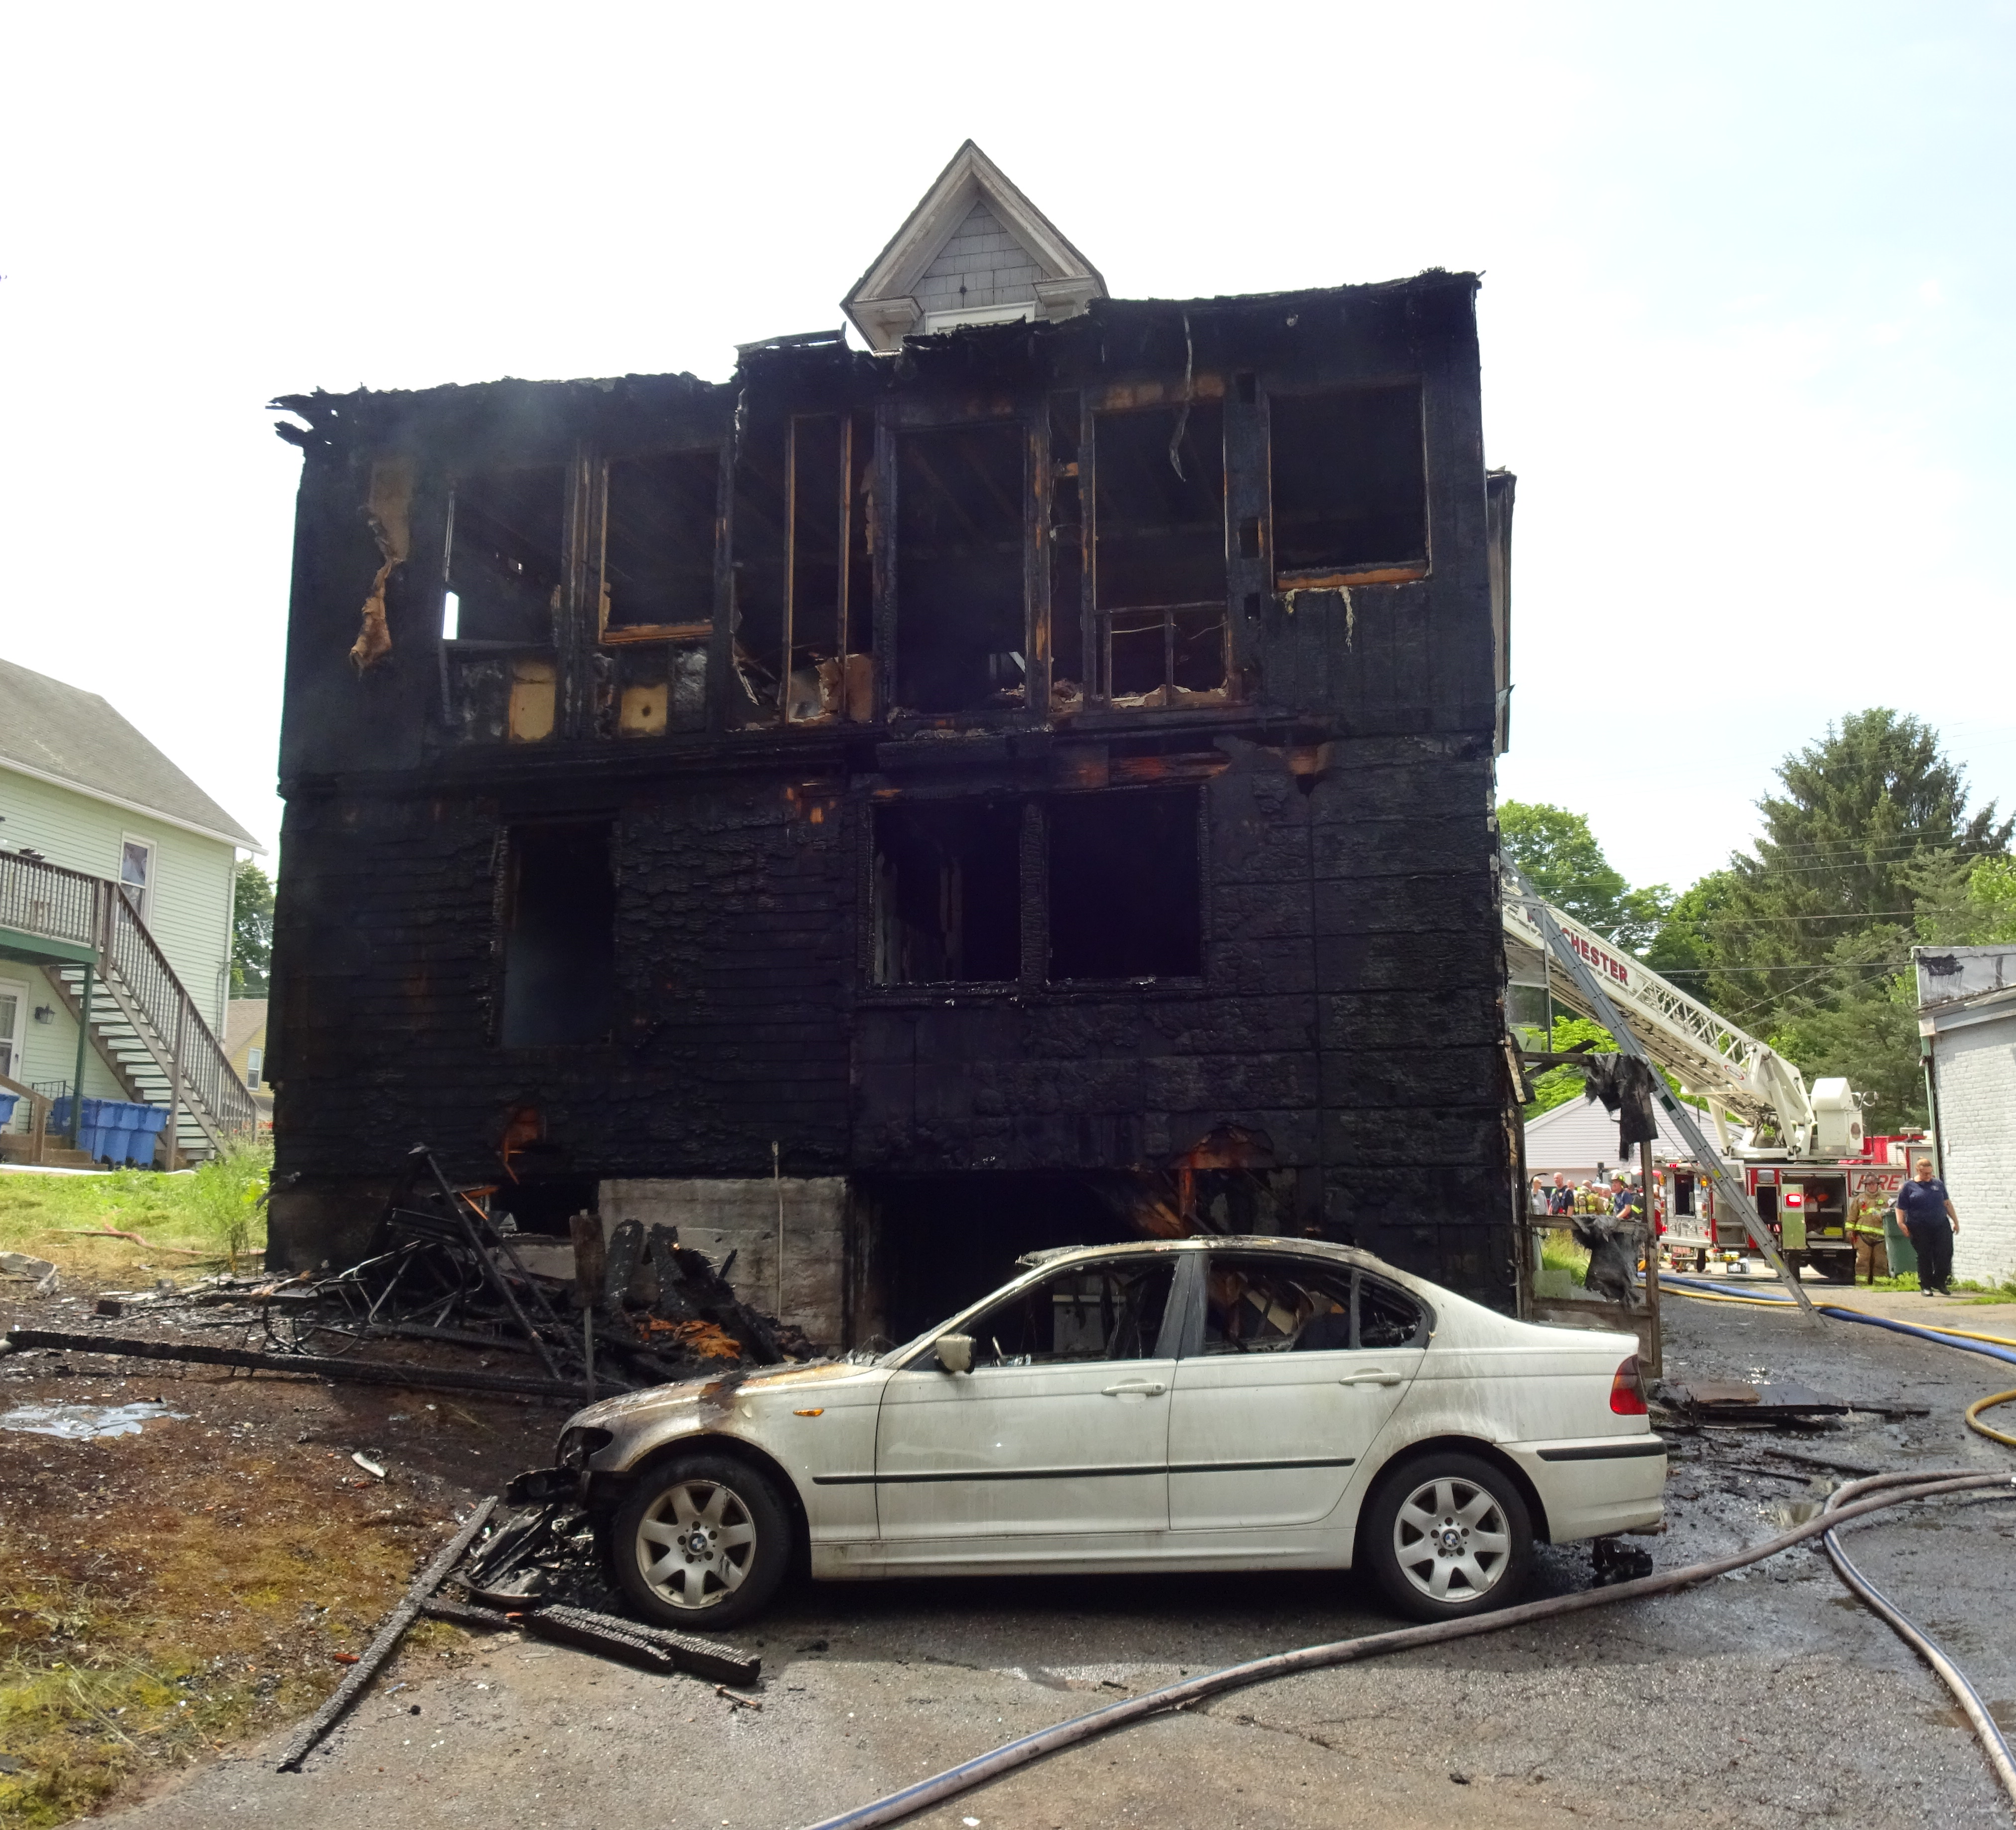
Exterior South

Slide 5
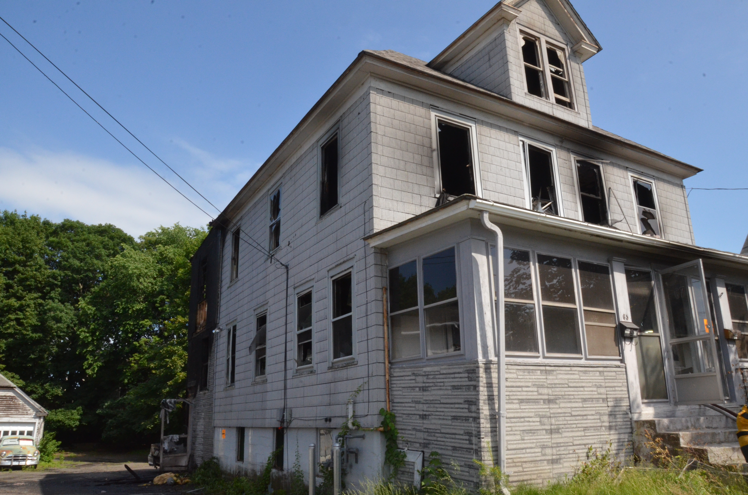
Exterior North East

Slide 6
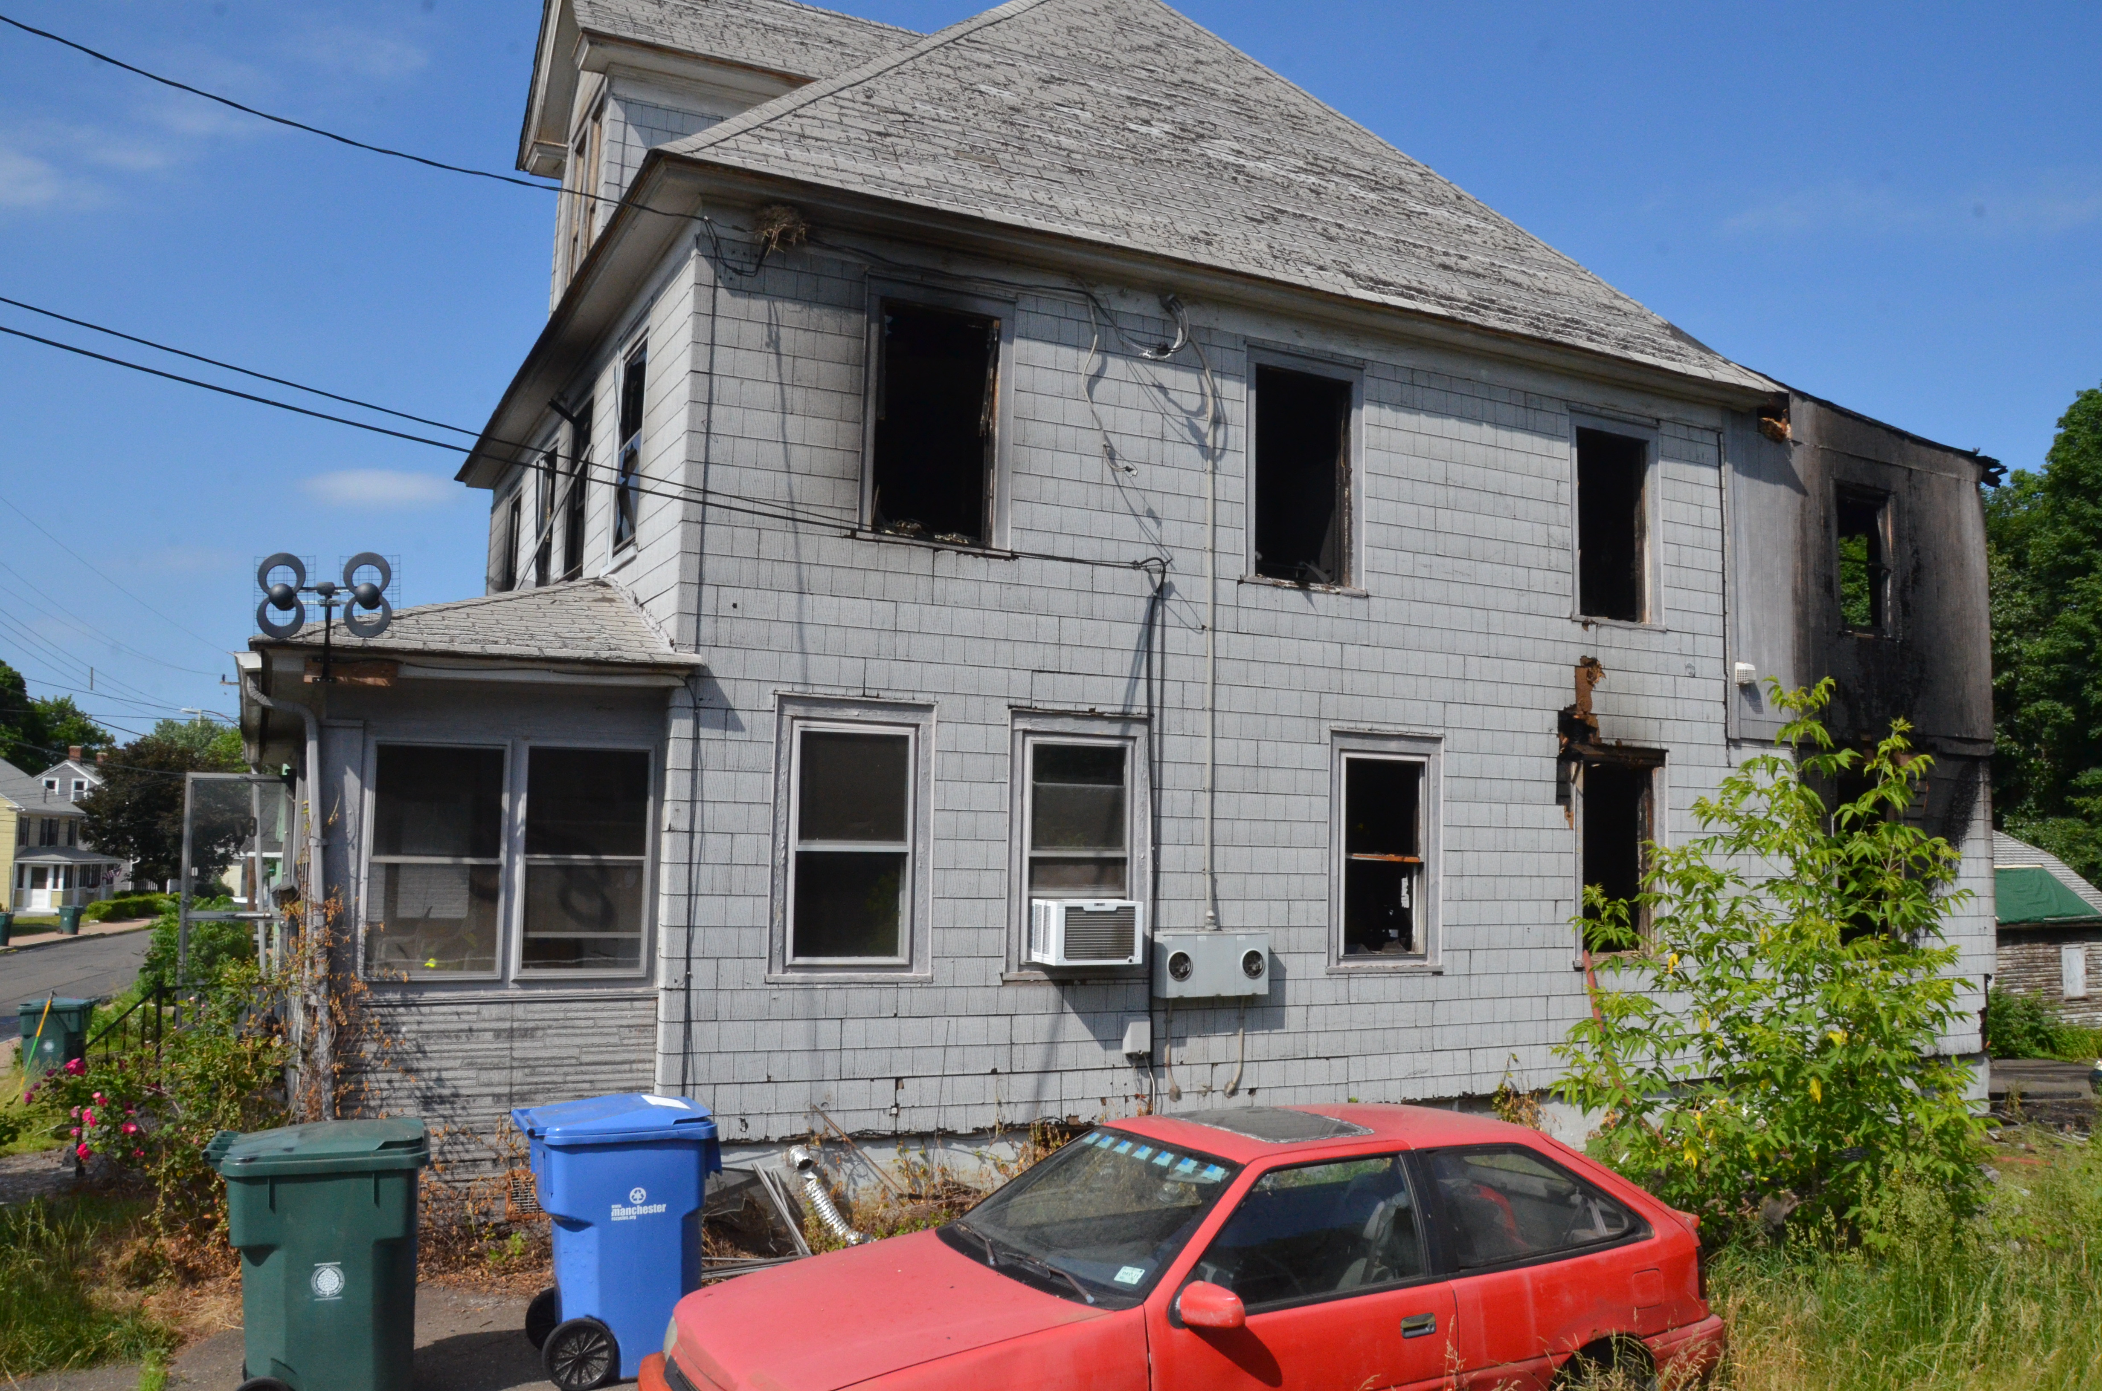
Exterior North West

Slide 7
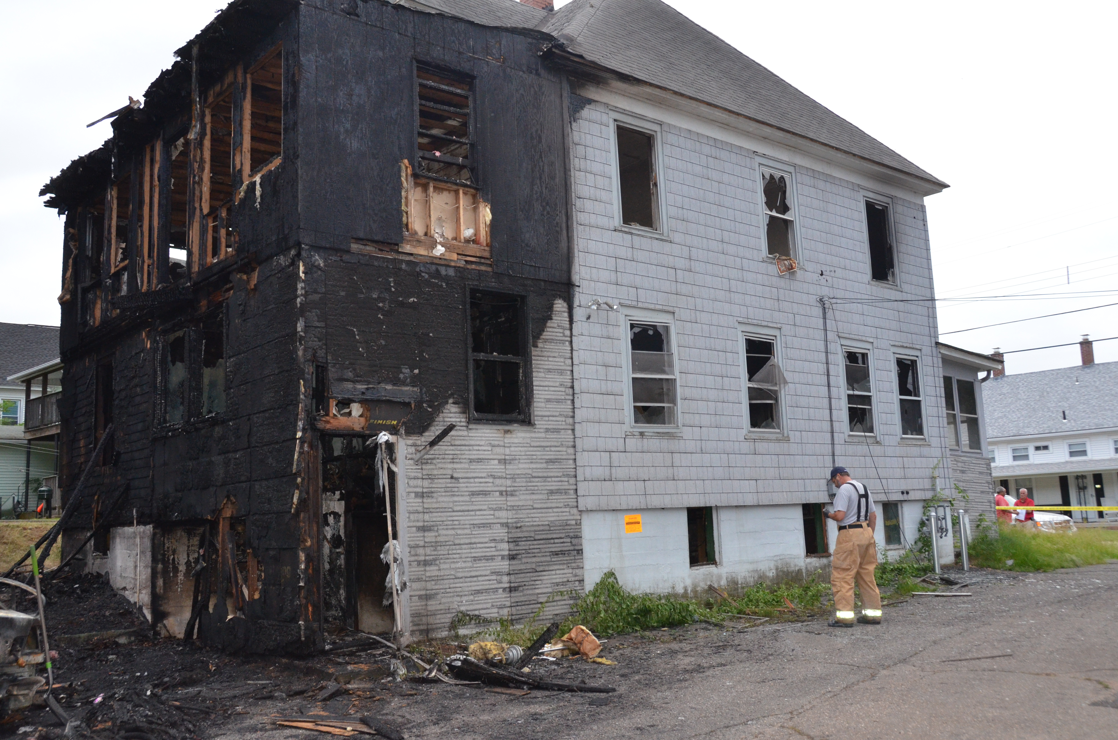
Exterior South East

Slide 8
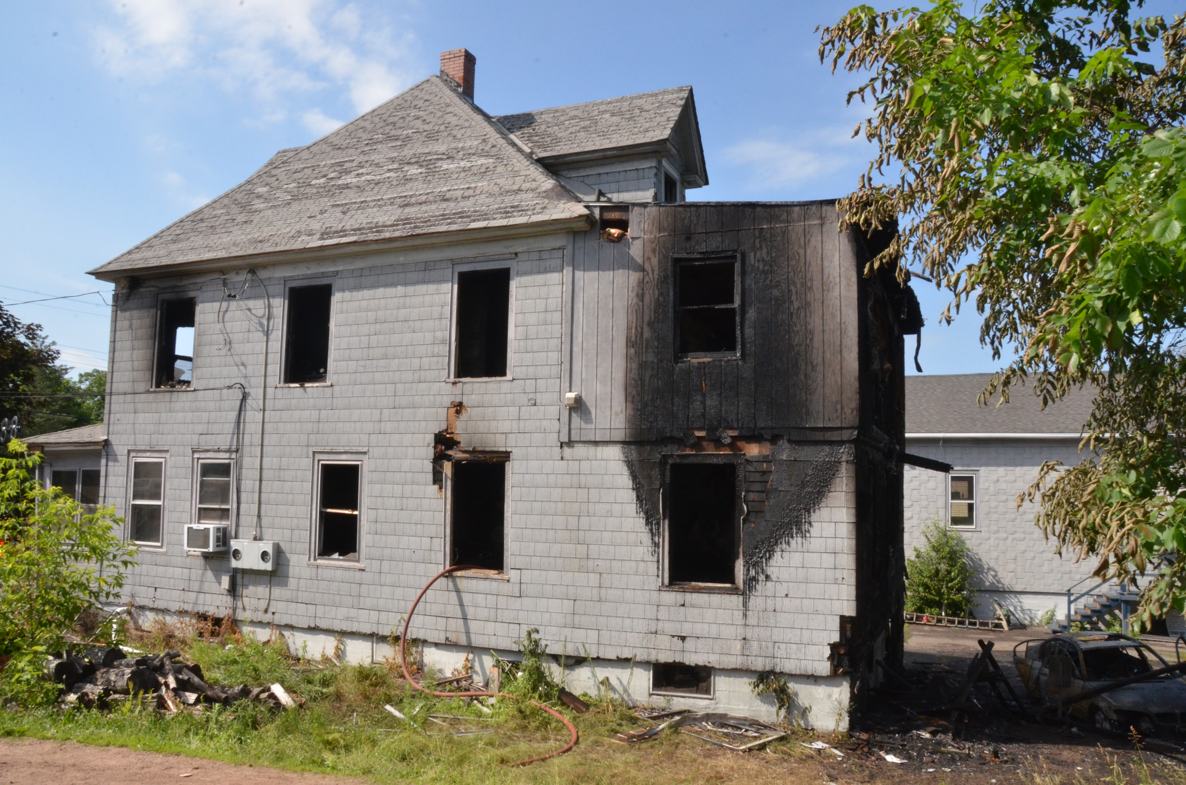
Exterior West

Slide 9
Interior

Slide 10
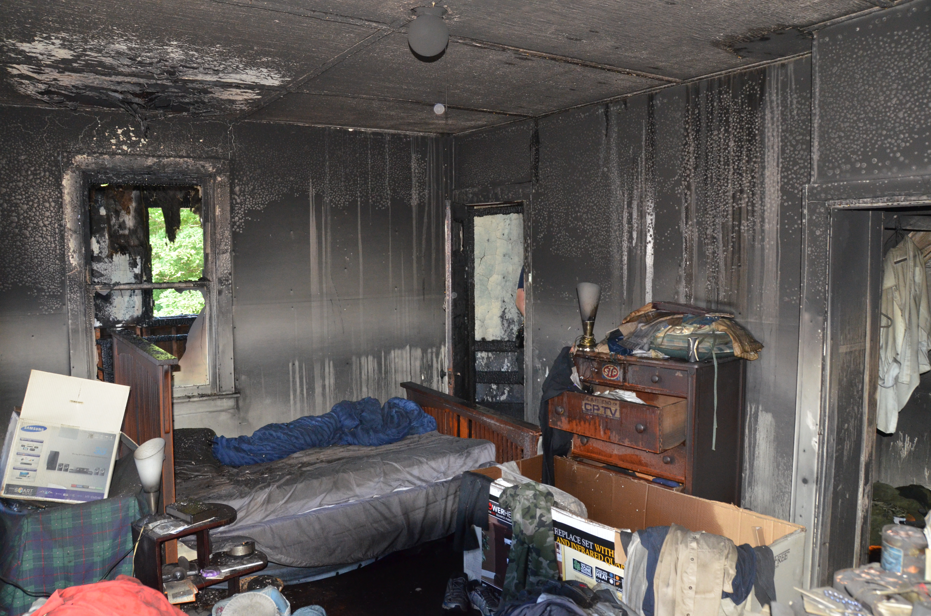
Interior Bedroom 1

Slide 11
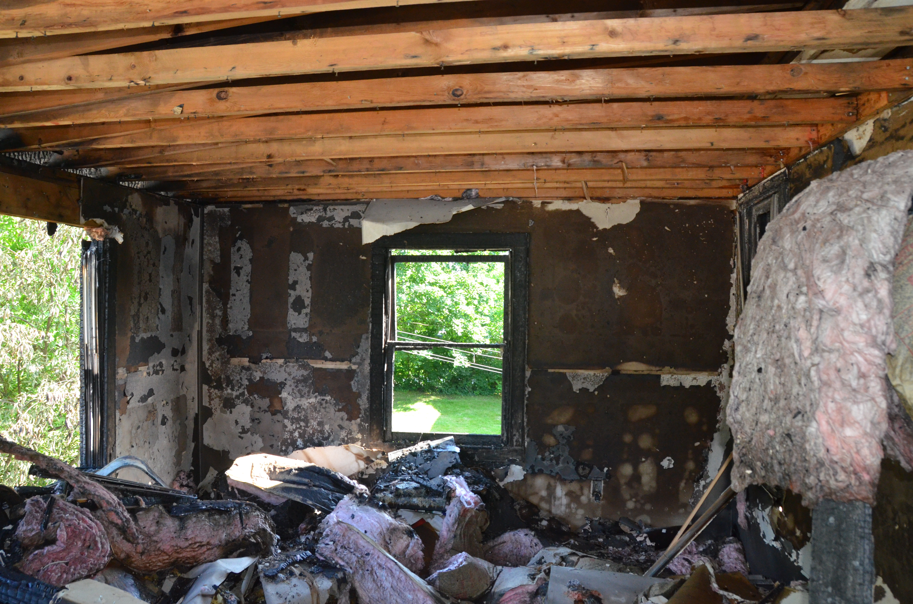
Interior Bedroom 2

Slide 12
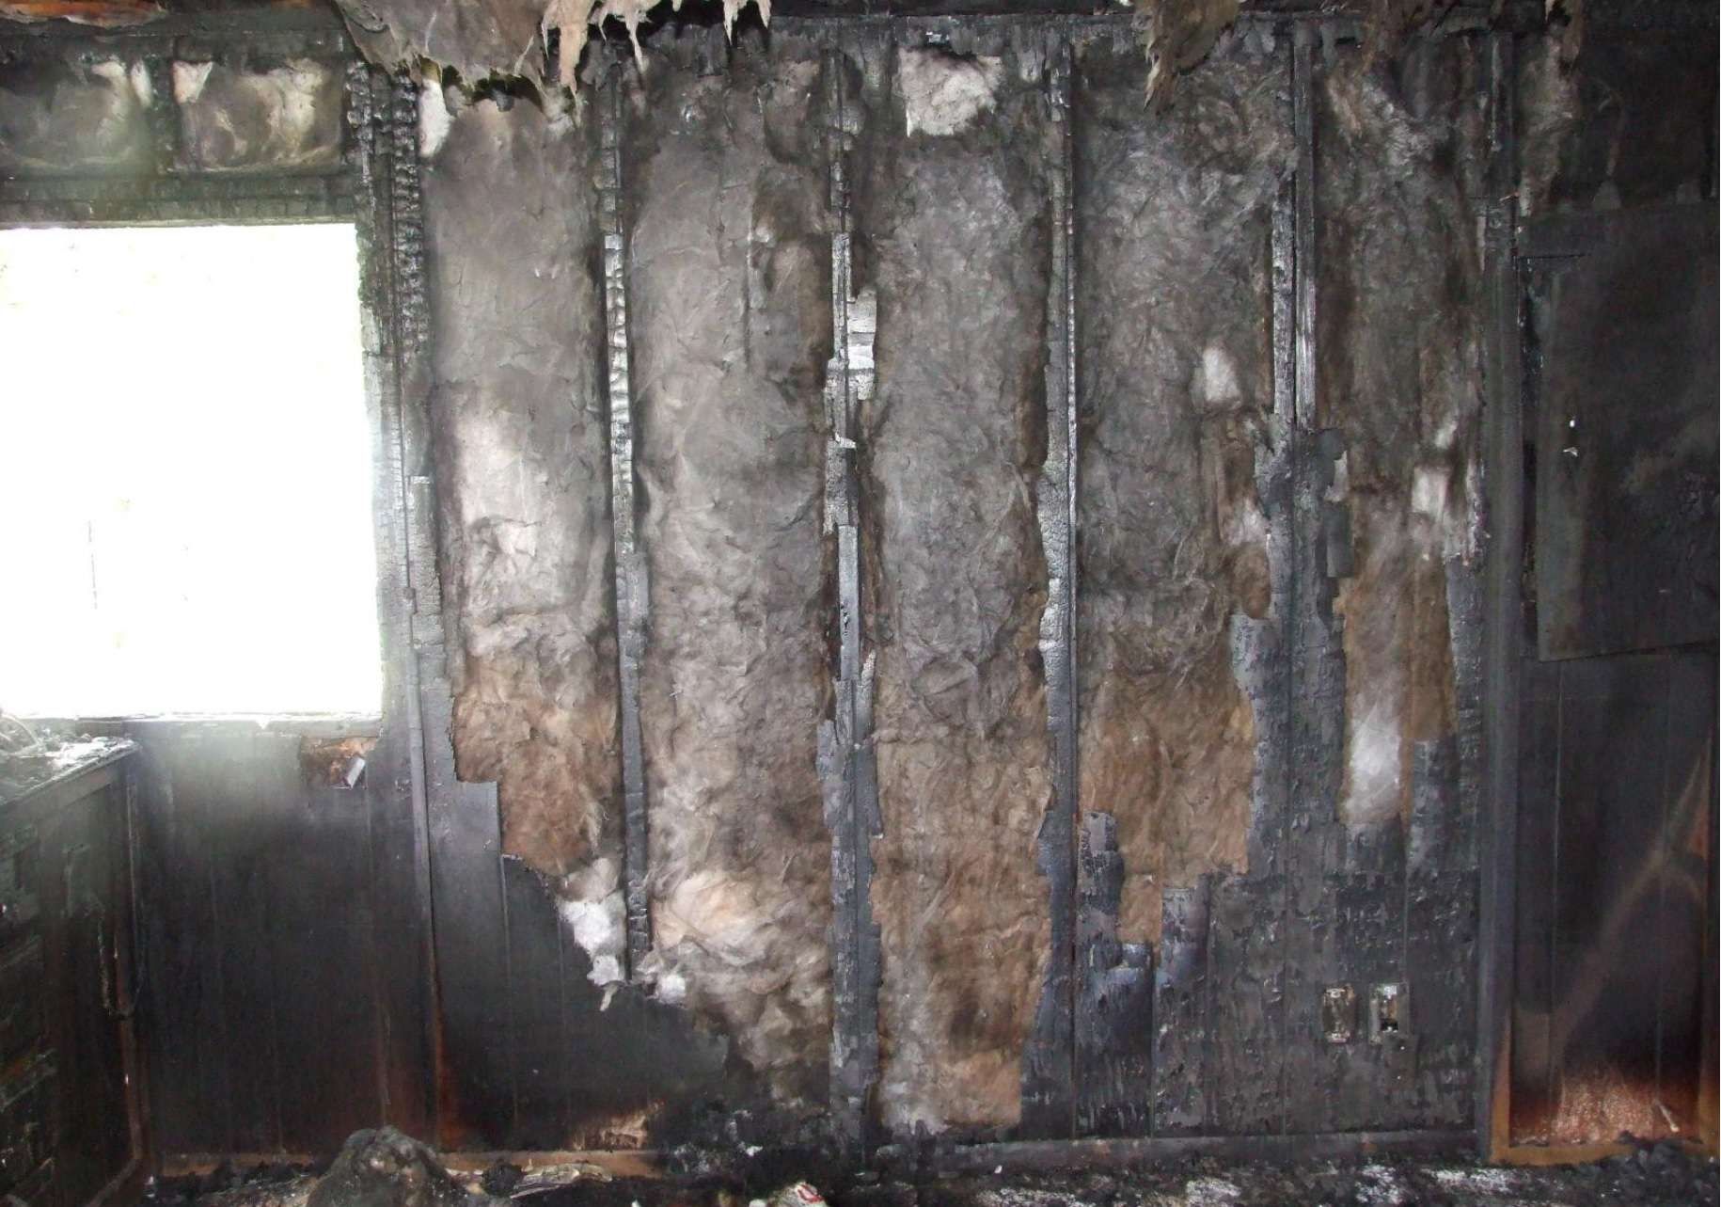
Interior Bedroom 2 South Wall

Slide 13
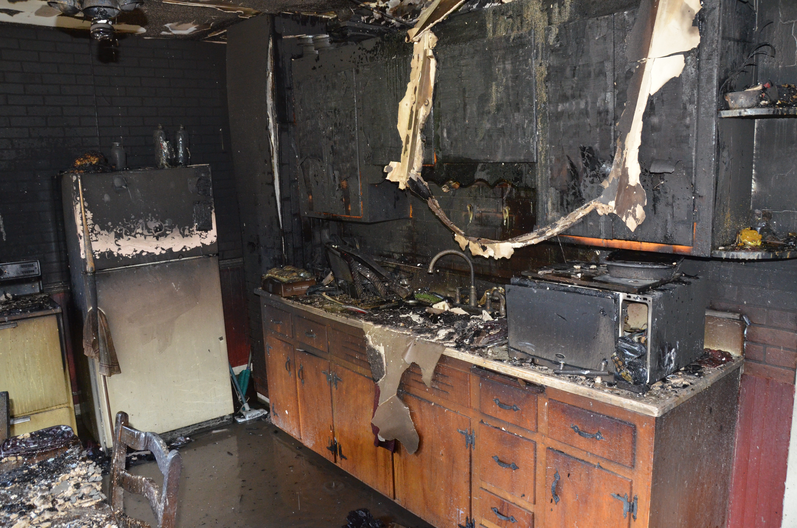
Interior Kitchen

Slide 14
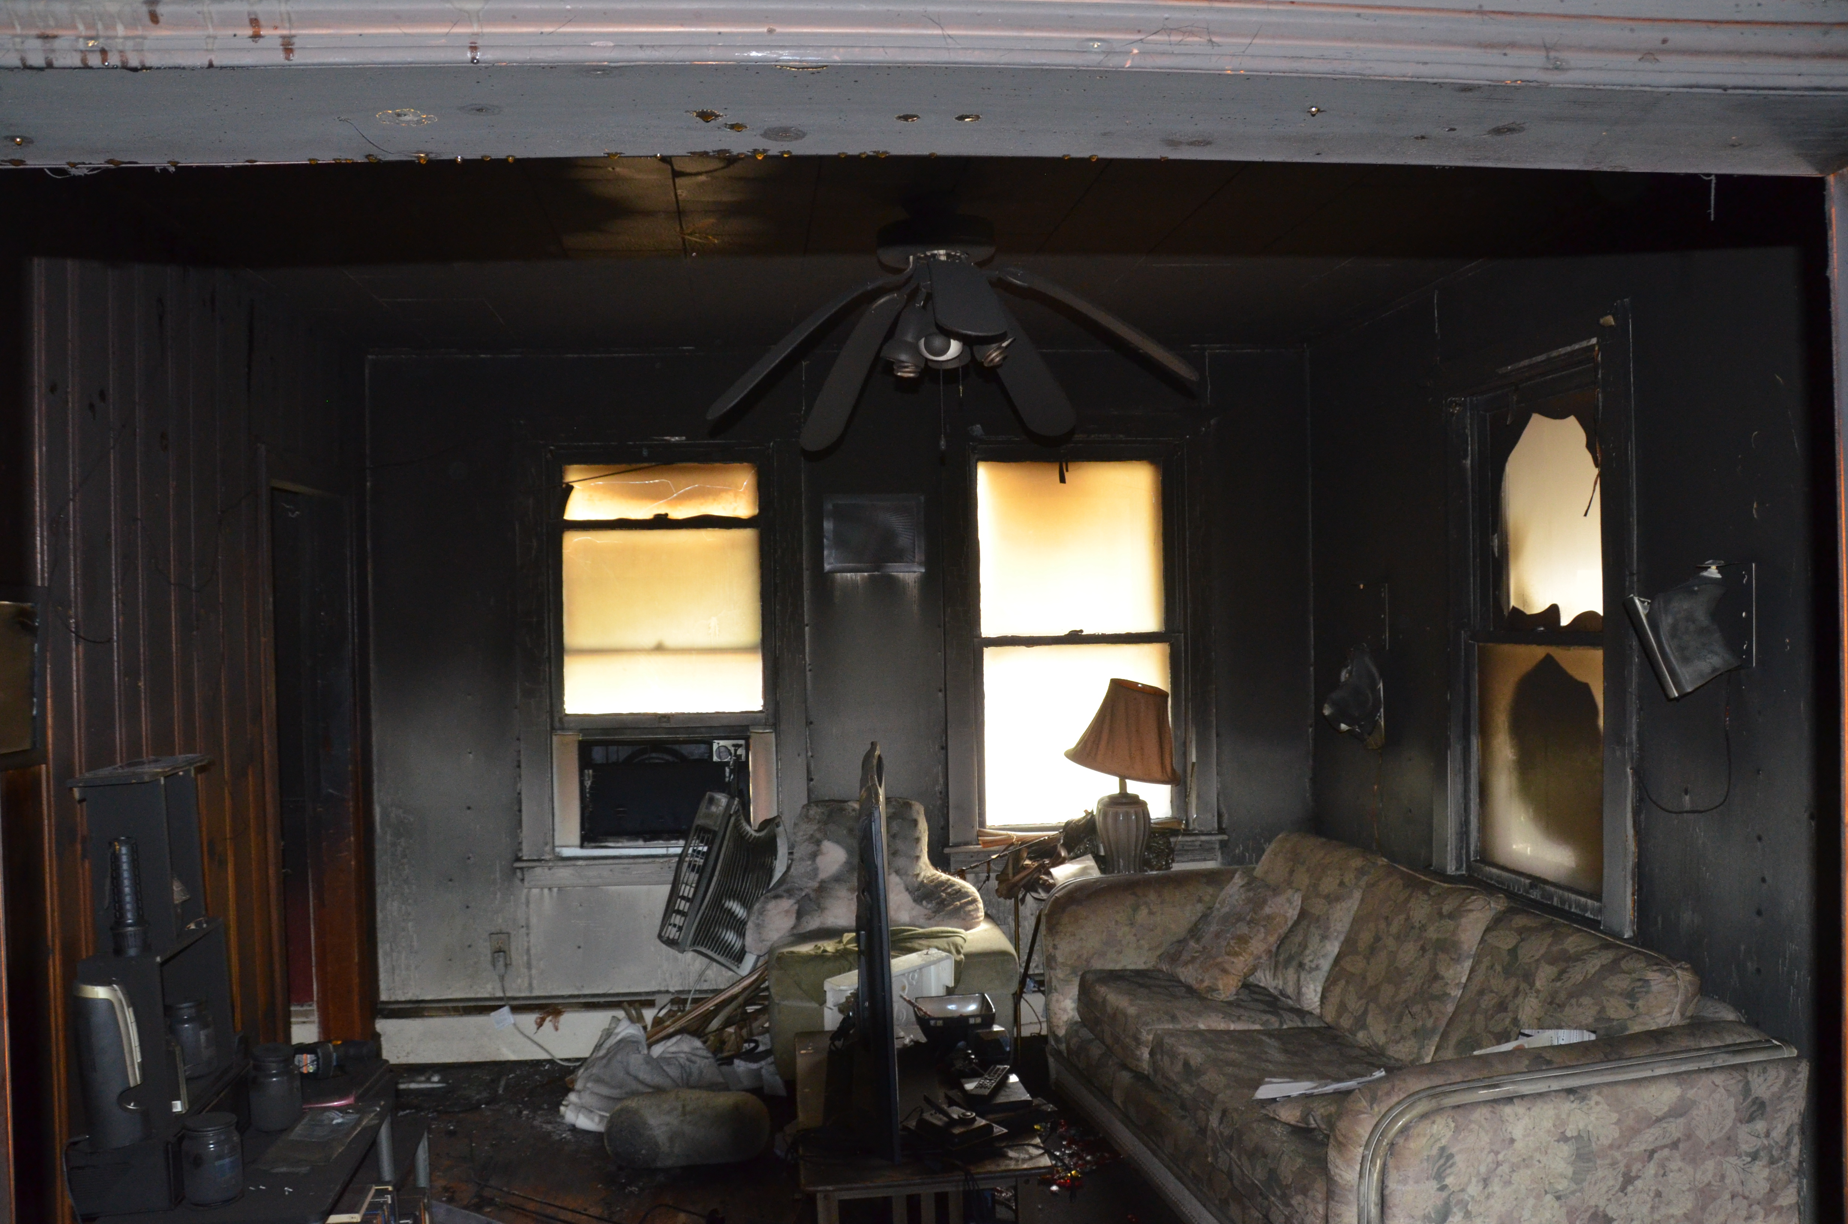
Interior Living Room

