Slide 1
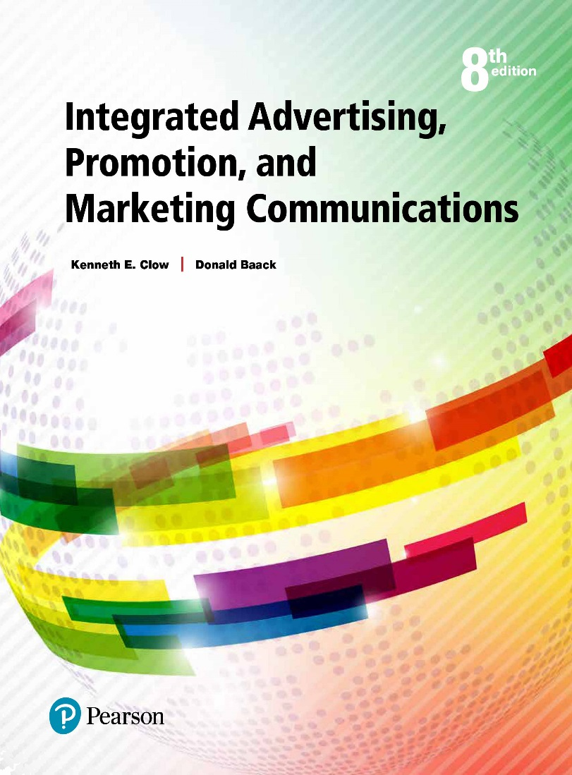
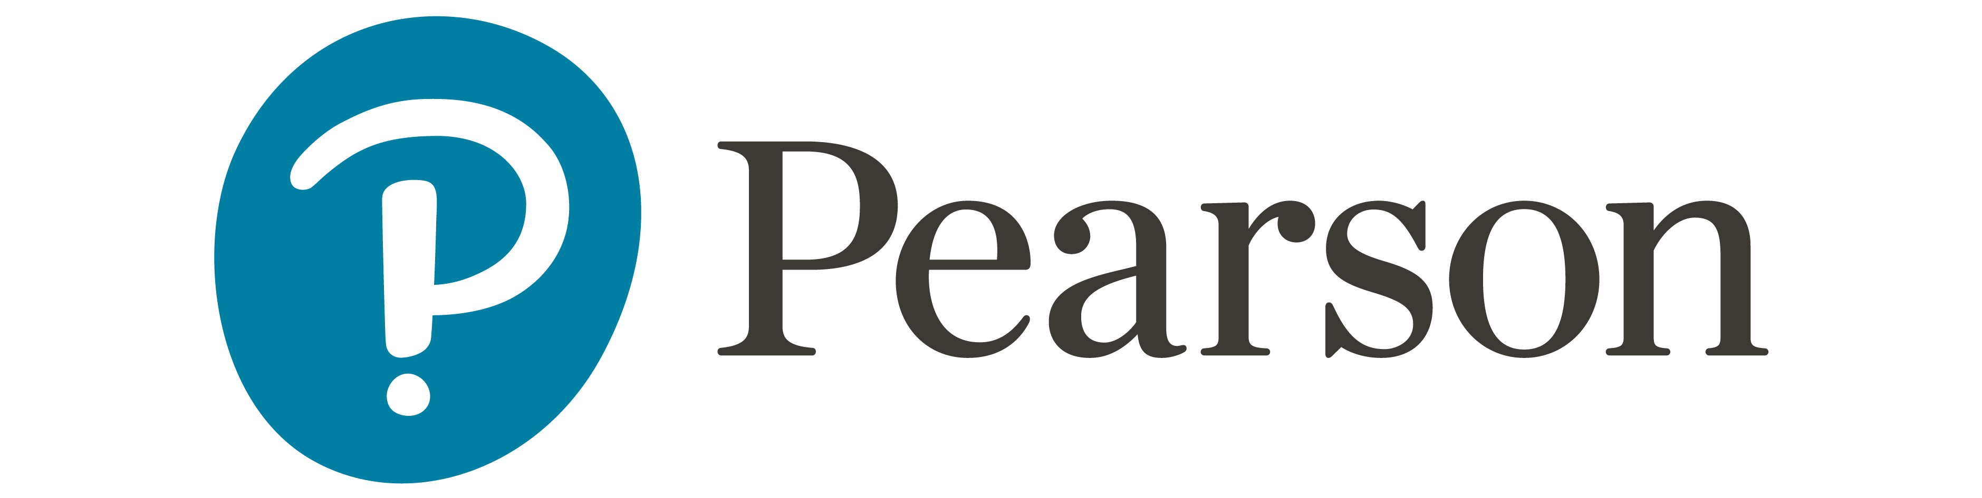
Integrated Advertising, Promotion, and Marketing Communications
Eighth Edition
Chapter 4
The I M C Planning Process
Copyright © 2018, 2016, 2014 Pearson Education, Inc. All Rights Reserved
Notes:
If this PowerPoint presentation contains mathematical equations, you may need to check that your computer has the following installed:
1) MathType Plugin
2) Math Player (free versions available)
3) NVDA Reader (free versions available)
Slides in this presentation contain hyperlinks. JAWS users should be able to get a list of links by using INSERT+F7
Chapter 3 covers both consumer and business-to-business buyer behaviors. Understanding how and why consumers and businesses make purchases is important in developing integrated marketing communications.

Slide 2
Chapter Objectives (1 of 2)
4.1 What makes marketing research critical to the I M C planning process?
4.2 What categories are used to identify consumer target markets or market segments?
4.3 What categories are used to identify business-to-business market segments?
4.4 How do the various approaches to positioning influence the I M C planning process?
Notes:
These are the objectives for Chapter 4.

Slide 3
Chapter Objectives (2 of 2)
4.5 How do marketing communication objectives interact with the other elements of the I M C planning process?
4.6 How are communications budgets established?
4.7 What elements are considered in developing an I M C program?
Notes:
Additional objectives for Chapter 4.

Slide 4

McBreakfast
All day breakfast
Integrated campaign
Generate new excitement
Large budget for rollout
Year-long campaign
Notes:
This opening vignette is about McDonald’s decision to serve breakfast all day. The launch included traditional media as well as digital elements. The challenge was that McDonald’s already served breakfast. The goal was to create excitement and engagement about the All Day Breakfast. A large budget was designated for the rollout, with the campaign lasting a full year.

Slide 5

Chapter Overview
I M C planning process
Communications research
  Target markets
  Positioning strategies
  Communication objectives
I M C components
Notes:
The IMC planning process involves a number of steps and decisions. Planning begins with research, decisions about target markets, market segmentation, and positioning. Once these factors are investigated and decisions made, then communication objectives can be created. A budget is then appropriated. The last part of the planning process is to think about the IMC components and how they will work together to create synergy.

Slide 6
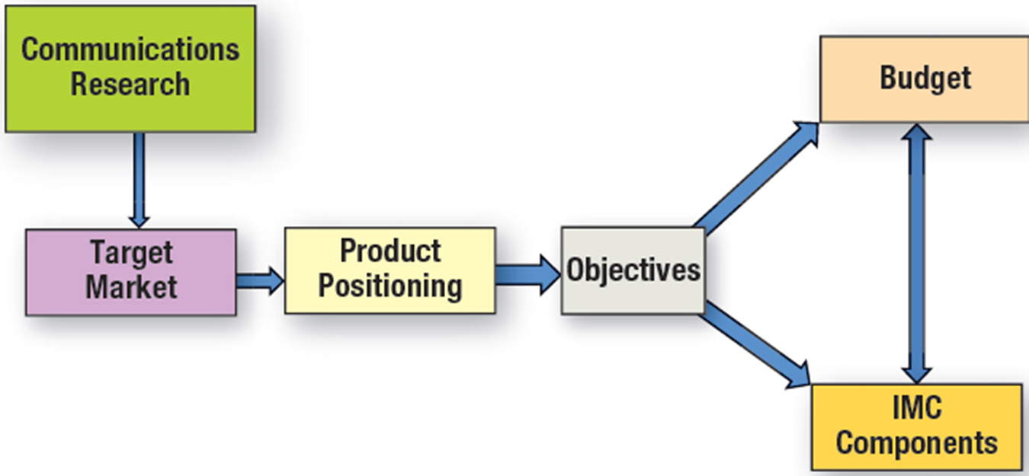
Figure 4.1 The IMC Planning Process
Notes:
The IMC planning process begins with communications research. From this research, decisions about the target market and product positioning can be made. These are joint decisions because one decision affects the other. Next, communication objectives are formulated. From the objectives come the budget and a selection of the appropriate IMC components. Again, it is a mutual decision because the budget impacts which IMC components can be used and the selection of the IMC components affects the budget.

Slide 7
Communication Research
Understand customers purchase benefits
Product-specific research
  Key selling points
  Desirable features
Consumer-oriented research
  Context of product use
  Anthropological approach
  Sociological analysis
  Psychological motives
Target-market research
  Identifies feasible market segments
Notes:
The first step in IMC planning is conducting research. If an advertising agency is used, then it is the responsibility of the agency to conduct this research so they understand the customer. What are the key benefits customers derive from the product? Consumers buy benefits, not attributes, so it is important to think in those terms, i.e. what does this product do for customers, how does it help them? Product-specific research involves identifying the key selling points of a product and the desirable features. To develop an advertising campaign, the creative staff should understand the product. Customer-oriented research focuses on the users of the product and how, when, and why the product is used. Researchers can use approaches based in anthropology, sociology, and psychology. A common method used by agencies for customer-oriented research is the focus group. Target-market research utilizes the information gathered through product and customer research to determine the best target market for the brand, product, or particular campaign.

Slide 8
Tests to Determine if a Particular Market Segment Is Viable
The individuals or businesses within the segment are homogeneous.
The market segment is different from the population as a whole and distinct from other market segments.
The market segment is large enough to be financially viable to target with a separate marketing campaign.
The market segment must be reachable through some type of media or marketing communications method.
Notes:
To be a viable market segment, it must meet four criteria. First, the individuals or businesses within the segment should be homogeneous, that is they should be alike. Second, the market segment must differ from the general population and also be different than other market segments. Third, the market segment has to be large enough to be financially viable to support a separate marketing campaign. While some market segments meet the first two criteria, they are too small to support a different campaign. Based on the last criteria, the market segment must be reachable through some type of media or marketing communications method. There are some market segments in Africa and other parts of the world that meet the first three criteria, but not the fourth. There is no feasible way to reach them with a marketing message.

Slide 9
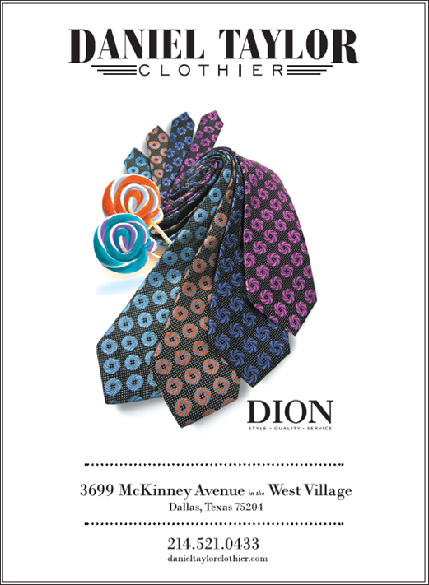
Figure 4.2 Methods of Segmenting Consumer Markets
Demographics
Psychographics
Generations
Geographic
Geodemographics
Benefits
Usage
Notes:
Consumer markets can be segmented, or divided, along a number of dimensions. The most common is demographics because it is the easiest. Other methods used include psychographics, generations, geographic, geodemographics, benefits, and usage.

Slide 10
Gender Segments Based on Demographics
Gender-based products
Gender differences in communications
Female consumers
  Control 66% of spending ($12 trillion)
  Involved in purchasing high-priced electronics (96%)
  Deal with financial advisors (90%)
  Buy and sell stocks (80%)
  Household’s primary accountant (70%)
Notes:
Gender is a common demographic segmentation variable because there are significant differences between males and females and because it is easy to identify each market segment. Men and women purchase different products. They also use the same products, but in different ways. The way marketers communicate to the genders can vary. For instance, females now control about $12 trillion in spending, or 66%. They are involved in product purchases that in the past were dominated by males. For example, 90% of women are involved in purchasing high-priced electronics, 90% deal with financial advisors, 80% buy and sell stocks, and 70% are their household’s primary accountant.

Slide 11
Tips for Marketing to Women
Focus on how brand can improve life
Engage them with the brand
Focus on practical, not trivial
Tell a story that resonates
Provide details
Be positive
Bonus Slide
Notes:
(Bonus slide, not in text) When marketing to women, a few tips should be observed. 1) The focus should be on how the brand can improve the woman’s life, not on what the brand can do. 2) It is important to engage the female with the brand and make her feel a part of the brand. 3) Focus on the practical, not on the trivial. Women want to know the facts and how a product can benefit them. 4) Tell a story that resonates. Women like stories, they like brands that create feelings and emotions among people. 5) Provide details. While it may seem unimportant, it is not. Women want all of the information so they can make good decisions. 6) Be positive. Negative selling doesn’t work.

Slide 12

Marketing to Mothers
Buyers of iPhones
Like media websites
Share photos/news
20% of online users
Largest web spenders
  Online
  Mobile devices
Bonus Slide
Notes:
(Bonus slide, not in text) Mothers represent an attractive market. They are the fastest growing buyers of iPhones. They listen to Pandora and access other media sites more often and listen longer than the average consumer. They share news and photos on Facebook. They represent 20% of online users and a higher percentage of mobile users. They spend on the web either through mobile apps or directly online.

Slide 13

Marketing to Men
Shopping more
Focus on product performance
Prefer looking for specific information
Favor products that reflect status
Like well-known brands
Notes:
Men are shopping more now for clothes, groceries, and other types of home supplies. Men tend to focus on a product’s performance more than its appearance. They do not like to browse; they prefer companies providing specific information about a product or brand. They prefer products that reflect status and demonstrate a wise purchase decision, which is why they tend to favor well-known brands, especially brands with status.

Slide 14

Age Segments Based on Demographics
Target specific age group
Combine with other demographic variables
Children attractive group
Notes:
Age is another demographic variable that is easy to use for segmentation. Obviously, there is a huge difference in the products children use versus the products adults use. Differences are also present between someone 20 and someone 70. Few marketing messages resonate with all age groups. Therefore, focus on a specific age group. Age segmentation often works well when combined with another demographic variable, such as males ages 20 to 35, or females 18 to 40. One age group that is attractive to marketers is children. Children spend $30 billion a year themselves and influence another $500 billion. It is not just toys they influence. Children influence parents on the purchase of everything from food to cameras to furniture to vehicles.

Slide 15
Figure 4.3 Influence of Tweens
Influence/Opinion | Percent
Want instant gratification | 56%
Want customized product | 59%
Want what others have | 41%
Sometimes visit online stores | 31%
Shop online | 28%
Influence on household purchases | Percent
Movies | 55%
Food | 29%
Personal care products | 26%
Family vacation destination | 27%
Technology | 23%
Source: Based on Lucia Moses, “Tweens Have a Big Say in Household Spending,”
Adweek
, June 26, 2013.

Slide 16

Income
Closely related to education
Lower income – necessities
Higher income - luxuries
Ad directed to “exhausted affluent”
Notes:
Other demographic segmentation variables include education and income. Each can be used alone, or combined with other demographic variables to create smaller, more homogeneous segments. This ad for Thomasville furniture is directed to a segment called the “exhausted affluent.” The exhausted affluent bridge the gap between the haves and the have nots. They desire style and quality, but not something overly fancy.

Slide 17

Ethnicity
Buying power - $2.5 trillion
Significant part of identity
Need to understand ethnic groups
Translation insufficient
Holistic approach
Notes:
Ethnicity is an important demographic variable since minorities control $2.5 trillion in buying power. For many, ethnicity is a significant part of their identity. It is important to create advertising that understands each ethnic group. Translations of white ads is not sufficient. In recent years, advertising agencies have moved to a “holistic” approach. Rather than creating separate campaigns, they are designing a single campaign that incorporates insights from various ethnic groups.

Slide 18
Psychographic Segmentation
Describe consumers
A I O measures
  Activities
  Interests
  Opinions
Combine with demographic profiles
Notes:
Demographics are relatively easy to identify, but they do not fully explain consumer purchase behavior. Psychographics are an individual’s activities, interests, and opinions. They help marketers to understand why consumers buy what they buy. Psychographics are often combined with demographic profiles to provide a much richer description of a target segment.

Slide 19
V A L S Psychographic Segmentation
Innovators – successful, sophisticated – upscale products
Thinkers – educated, conservative, practical – durability, value
Achievers – goal-oriented, conservative, career, and family
Experiencers – young, enthusiastic, impulsive, fashion, social
Believers – conservative, conventional, traditional
Strivers – trendy, fun-loving, peers important
Makers – self-sufficient, respect authority, not materialistic
Survivors – safety, security, focus on needs, price
Notes:
A well-known measurement of psychographics is the VALS typology. Consumers are divided into 8 different segments based on their AIO measures (activities, interests, and opinions). This type of information helps marketers design more effective communication. For instance, reaching achievers requires ads that stress careers, families, goals, and a conservative lifestyle. On the other hand, reaching experiencers requires ads that convey youthfulness, enthusiasm, impulsiveness, fashion, and social acceptance.

Slide 20
Figure 4.4 Characteristics of Generation Segments
Name of Segment | Year of Birth | Characteristics
Millennials | 1978-2002 | Spend money on clothes, automobiles, college, televisions, and stereos. Ninety percent live at home or in a dorm or rent an apartment.
Generation X | 1965-1977 | Focus on family and children. Spend on food, housing, transportation, and personal services.
Younger Boomers | 1954-1964 | Focus on home and family. Spend on home mortgage, pets, toys, playground equipment, and large recreational items.
Older Boomers | 1952-1953 | Spend on upgrading homes, ensuring education and independence of their children, and luxury items, such as boats.
Seniors | Up to 1951 | Most have fixed incomes. Spend heavily on health care and related medical items.
Source: Author-created from Dana-Nicoleta Lascu and Kenneth E. Clow, Marketing Principles (Cincinnati, O H: Textbook Media Press, 2012).
Notes:
Markets can be segmented based on generations. This table shows the five major generation groups, when they were born, and the primary characteristics of each group. The idea behind generation segmentation is that people who grow up experiencing common events will become similar in their AIO measures. These groups often enjoy the same music, foods, and products.

Slide 21
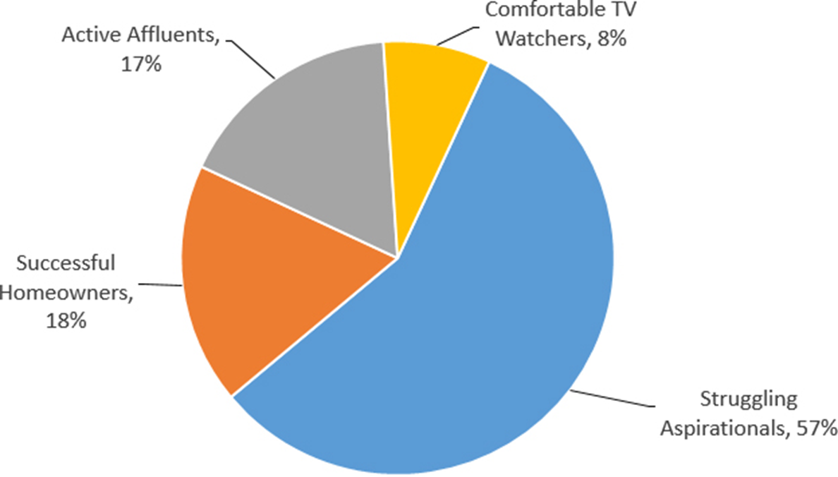
Figure 4.5 The Millennial Generation
Source: Based on “Infographic: Marketers Are Spending 500% More on Millennials than all Others Combined,” Adweek, November 7, 2015,
http://www.adweek.com/news/technology/infographic-marketers-are-spending-500-more-millennials-all-others-combined-168176
.
Notes:
Markets can be segmented based on generations. This table shows the breakdown of the millennial generation. The largest group (struggling aspirationals) are healthy, fit, and concerned about the environment. They look for bargains, sales, and promotions. The successful homeowners have the highest income. Active affluents love the outdoors, leisure travel, and most are new parents. Most traditional group is the comfortable TV watchers.

Slide 22

Geo-Targeting
Geographic area or region
Retailers use
Smartphones – G P S devices
Digital ads
Notes:
Sending messages to individuals in specific regions is geo-targeting. Used by retailers. Smartphones with GPS technology allow for targeted ads based on location.

Slide 23
Geodemographic Segmentation
Combines
  Demographic census data
  Geographic information
  Psychographic information
P R I Z M
  66 market segments
    Southside City
    Towns and Gowns
Notes:
Geodemographic segmentation combines demographic information, geographic information, and psychographic information. Geodemographic segmentation is beneficial for national firms conducting direct mail campaigns and for retailers in targeting customers in a geographic area around the store. The most well known geodemographic segmentation system is PRIZM. It consists of 62 different market segments. For every zip code in the United States, PRIZM identifies the market segments that reside there. For instance, in downtown Jackson, MS the two primary clusters are “Southside City” and “Towns and Gowns.” The Southside City cluster contains primarily young and elderly African-Americans, who are employed in low-paying blue-collar jobs, have lower education levels, rent apartments, and read sports and fashion magazines.

Slide 24
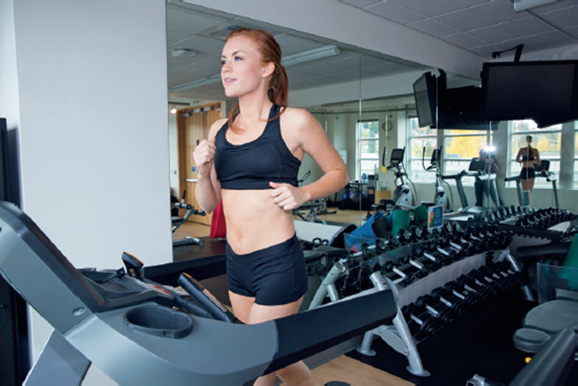
Benefit Segmentation
Fitness Industry
Winners
Dieters
Self-improvers
Notes:
Benefit segmentation focuses on the advantages consumers receive from a product rather than the characteristics of the consumer. An excellent example of benefit segmentation is the fitness industry. People exercise for different reasons. The three most common benefit segments are winners, dieters, and self-improvers. The winners exercise because they like to exercise. It is a way of life for them. The dieters join a fitness center to lose weight, or maintain their weight. Self-improvers are there primarily because a physician told them to be there. They have experienced a medical problem and realize they must exercise to regain body functions or maintain their health.

Slide 25

Usage Segmentation
Usage or purchase history
Create clusters
Target specific clusters
Create marketing programs for each cluster
Measure growth and migration
Notes:
Usage segmentation focuses on how consumers use a product or on their purchase history. Marketers can create clusters of heavy users, light users, or any other category of users. By dividing the market in terms of usage, companies can target a specific cluster creating a unique marketing approach. The message to a light user of a product will certainly be different than a heavy user of a product. One of the goals of targeting light or average users is to move them up into a higher group in terms of usage.

Slide 26
Figure 4.6 Methods of Segmenting B-to-B Markets
Industry (N A I C S/S I C codes)
Size of business
Geographic location
Product usage
Customer value
Notes:
Segmentation in business-to-business markets can be based on industry, size of businesses, geographic location, product usage, or customer value. Because most businesses have records of their business customers, segmentation is often easier than with consumers, at least in identifying customers. NAICS codes are one of the most popular methods of segmentation because the federal government has developed the code and there are lists of businesses within each code. Segmentation based on size is necessary when a firm wants to focus on small firms, medium-size firms, or even large firms. Industries often locate together, e.g. computers in the Silicon Valley in California. How firms use a product can be a method of segmentation and the value of customers. Many packaged goods manufacturers have a Wal-Mart team to service that account since it is so large and has such value.

Slide 27

Methods of Segmenting B-to-B Markets
A business-to-business ad that can be targeted to a specific N A I C S code.
Notes:
This ad for Scott Powerline & Utility Equipment targets energy companies that maintain powerlines.

Slide 28
Product Positioning
Is the perception created in the consumer’s mind regarding the nature of the company and its products relative to the competition?
Positioning is created by factors such as product quality, price, distribution, image, and marketing communications.
Notes:
Product positioning is the perception in consumers’ minds of the nature of a company and its products relative to competitors. It is important to recognize the two major points – in consumers’ minds and relative to the competition. Positioning is created by factors such as product quality, price, distribution, image, and marketing communications. Companies need to consider carefully where they are positioned in the market place and then develop ads to reinforce that image or move consumers to the image that is desired.

Slide 29

Figure 4.7 Product Positioning Approaches
Product Attributes
Competitors
Use or application
Price/quality
Product user
Product class
Cultural symbol
Notes:
Effective positioning can be accomplished in seven different ways. Positioning by product attributes involves promoting a unique attribute that is superior or different from the competition. Using competitors to establish a position can be accomplished by contrasting the company’s brand against competing brands. Use or application involves creating a memorable set of uses for a product, or applications that allow it to stand out. Price/quality positioning can occur in two ways – by emphasizing value (low price) or by emphasizing high quality, with little mention of the higher price. The product user approach emphasizes who uses the product, such as educators for Apple computers. Positioning can be based on the product class, such as beverages, breakfast foods, or sports cars. The last approach is cultural symbol, which strives to connect the brand to some cultural symbol that is recognized and known by consumers.

Slide 30
Elements of Positioning
Never completely fixed
Applies to business-to-business also
International positioning important
Critical component of image and brand management
Notes:
Product positioning is never fixed because consumers and society change. The same holds true for business products. In the international arena, product positioning is very challenging, but important. However, the position that is used in one country may not be appropriate for another country. Product positioning is a critical component of image and brand management because it is how consumers (or businesses) view the brand compared to competing brands.

Slide 31
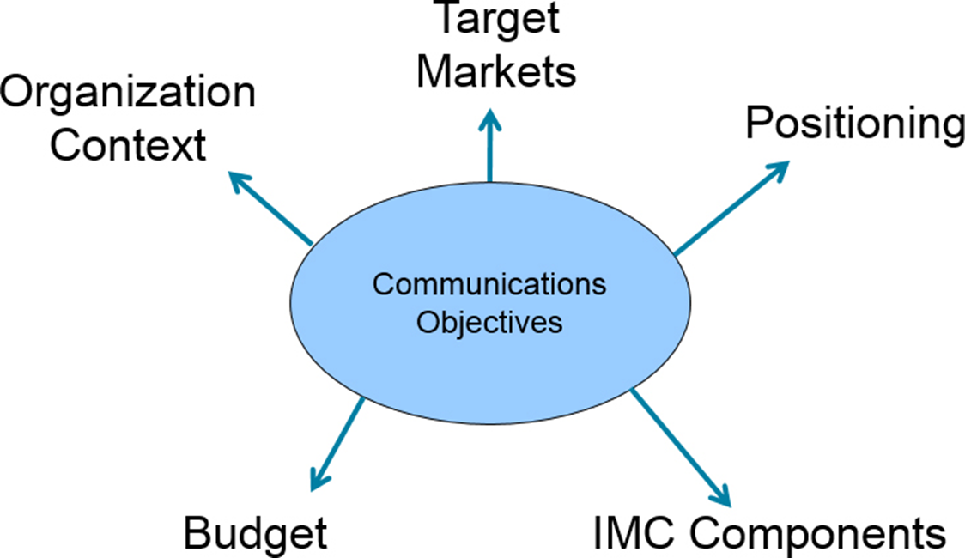
Marketing Communications Objectives
Notes:
An effective IMC planning process requires quality communications objectives. These objectives tie the organization’s context, target markets, and positioning approaches to the selection of budget figures and IMC components. Communication objectives also guide account executives and advertising creatives in designing the actual advertising campaign.
The objectives include the following. Target markets, positioning, I M C components, budget, and organization context. Arrows extend from the communication objectives block at the center to each objective placed around it.

Slide 32
Figure 4.8 Communication Objectives
Develop brand awareness
Increase category demand
Change customer beliefs and attitudes
Enhance purchase actions
Encourage repeat purchases
Build customer traffic
Enhance firm image
Increase market share
Increase sales
Reinforce purchase decisions
Notes:
This is a list of common communication objectives. Most IMC campaigns will emphasize one communication objective, but may accomplish other objectives in the process. There are some logical combinations, such as developing brand awareness and building customer traffic. Increasing market share would fit with increasing sales and encouraging repeat purchase actions. The key is to match the objective to the medium and the message.

Slide 33

Figure 4.9 Methods of Determining Marketing Communication Budgets
Percentage of sales
Meet-the-competition
“What we can afford”
Objective and task
Payout planning
Quantitative models
Notes:
Companies have a number of ways of determining a communications budget. Setting budgets for large companies with multiple brands and products is often more challenging than with a small company that may sell only one brand or a few products.
A photo of the new branch manager is placed in the upper right corner, with text to the left welcoming and describing the manager. Text in the lower portion of the ad reads, it’s nice to rely on my bank.

Slide 34
Types of Budgets (1 of 3)
Percentage of Sales
  Sales of current year, or next year
  Simple
  Tends to work in the opposite direction
  Does not meet special needs
Meet the competition
  Seeks to prevent market share loss
  Highly competitive markets
  Dollars may not be spent efficiently
Notes:
The percentage of sales method sets the communication budget as a certain percent of this year’s sales or next year’s sales forecast. It is simple to use, which makes it a popular choice. However, it works in the opposite direction of what may be needed. When sales increase, so does the budget. When sales decline, the budget is reduced. It should be just the reverse. It also does not allow for special needs that may rise. Meet-the-competition sets a budget approximately equal to competitors. This approach is used in highly competitive markets where you have to spend what the competition does to keep your brand in front of consumers. Spending the same as competitors does not guarantee success.

Slide 35
Figure 4.10 A d Spending and Market Share of Top Credit Card Companies
Rank | Credit Card | Market Share | Ad Spending (millions)
1 | American Express | 25.1% | $336
2 | J P Morgan Chase | 19.4% | $200
3 | Bank of America | 10.7% | $139
4 | Citibank | 8.3% | $214
5 | Capital One | 6.7% | $317
6 | Discover | 4.4% | $132
Source: Based on “U.S. Market Leaders by Category: Credit Cards,?” Ad Age’s Marketing Fact Pack 2016, December 21, 2015, p. 10.
Notes:
This table shows the major credit cards, how much was spent on advertising, and each card’s market share.

Slide 36
Types of Budgets (2 of 3)
What we can afford
  Set after all other items budgeted
  Do not view marketing as important
Objective and task
  Budgets determined by objectives
  Best method of budgeting
  Used by 50% of firms
Notes:
The “what we can afford” approach sets the communications budget after all of the other budges are set. Normally, with this approach, management does not see the importance of communications. The objective and task method sets the budget based on what it will cost to accomplish the communication and marketing objectives that have been established. Most marketers see this as the best method of budgeting. It is now being used by about half of all firms.

Slide 37
Types of Budgets (3 of 3)
Payout planning
  Ratio—advertising to sales or market share
  Larger percent at product launch
  Lower percent when brand established
  Based on threshold effect
Quantitative models
  Computer simulations
  Develop models based on historical data
Notes:
Payout planning involves setting a budget based on a ratio to sales or market share. This method usually results in spending more money early in the process and then reducing the budget after the brand is established. Quantitative models use historical data to determine the relationship between sales and marketing and then budgets are set accordingly.

Slide 38

Communication Schedule
Pulsating schedule
Flighting schedule
Continuous schedule
Notes:
Communication budgets can be scheduled in three different ways. A pulsating schedule involves advertising throughout the entire year with bursts of additional spending at select times, such as holidays. A flighting schedule allocates the budget only during peak times, with no other times during the year. The continuous schedule divides the budget equally throughout the entire year.

Slide 39
I M C Components
Traditional advertising
Trade promotions
Consumer promotions
Media spending
Alternative media spending
Business-to-business media spending
Notes:
The last decision (in conjunction with the budget) is the selection of IMC components. Traditional advertising cannot be ignored in favor of newer, nontraditional methods. Companies have to think about how much is needed for trade promotions and consumer promotions. Then, there is the actual spending on media. Some companies will also have to consider business-to-business spending. It is not an easy task to determine which components will be the most effective. Not only is the budget a factor, but also the objectives.

Slide 40
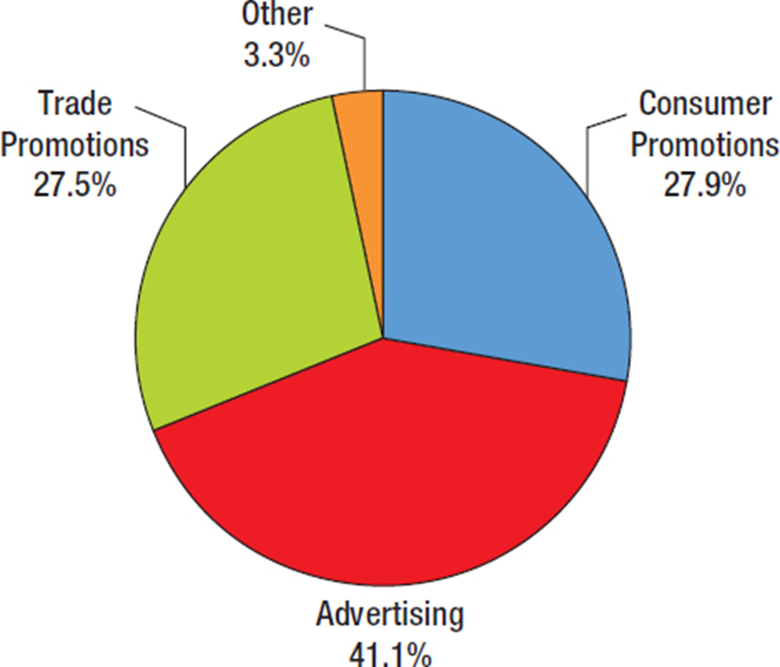
Figure 4.11 Breakdown of Marketing Expenditures
Notes:
In terms of total marketing expenditures, approximately 41.1% is spent on some form of advertising. Consumer promotions account for 27.9% and trade promotions for 27.5%. These percentages will vary from industry to industry. It will also be different for products and services, and for consumer companies and B-to-B firms.

Slide 41
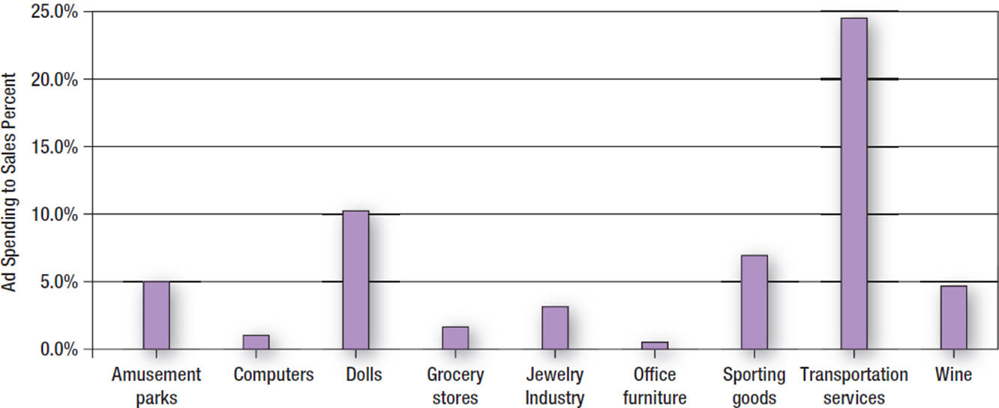
Figure 4.12 Ad Spending as Percent of Sales for Select Industries
Source: Based on “2012 Ad-to-Sales Ratios, Schonfield and Associates, July 2012”.
Notes:
This graph shows the ad spending as a percent of sales for select industries. Transportation services advertising spending is 24% of revenue compared to office furniture which is 0.1%.
The following list provides ad spending to sales percent by industry: amusement parks, 5%; computers, 1%; dolls, 10.5%; grocery stores, 2%; jewelry industry, 3.5%; office furniture, 0.5%; sporting goods, 7%; transportation services, 24%; wine, 4.5%.

Slide 42
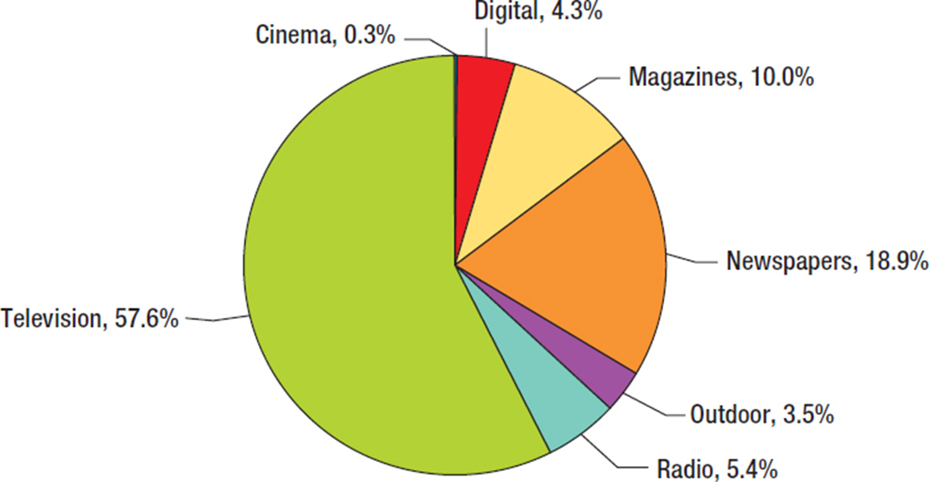
Figure 4.13 Global Ad Spending by Media
Source: Based on Ingrid Lunden, “Nielsen: Old School T V Reigns Supreme at 58% of Ad Spend, Internet Display up 27%
in Q2,”
https://techcrunch.com/
, October 22, 2013
Notes:
When examining global ad spend, television is still where most dollars go with 57.6%. Newspapers are second with 18.9%, followed by magazines at 10%. Although digital is only 4.3%, it is the fastest growing medium.

Slide 43
Figure 4.14 Successful Globally Integrated Marketing Communications Tactics
Understand the international market
A borderless marketing plan
Thinking globally but acting locally
Local partnerships
Communication segmentation strategies
Market communication analysis
Solid communication objectives
Notes:
Successful globally integrated marketing communications require paying attention to a number of factors. The company must understand the international market and cultures where it will be selling products. A borderless marketing plan works best, but in developing this type of plan, firms must allow individual countries to modify the marketing plan. The idea is to think globally, but act locally. Seeking local partnerships can be very advantageous, especially in developing communication segmentation strategies and conducting a market communication analysis. With this information, solid communication objectives can be established.

Slide 44
Blog Exercises
Motel 6
Carnival Cruise Line
Segmentation & Positioning
Notes:
The blog exercises for Chapter 4 include Motel 6, Carnival Cruise Line, and videos about segmentation and positioning. Links are embedded in the text for each.

Slide 45

Copyright
This work is protected by United States copyright laws and is provided solely for the use of instructors in teaching their courses and assessing student learning. Dissemination or sale of any part of this work (including on the World Wide Web) will destroy the integrity of the work and is not permitted. The work and materials from it should never be made available to students except by instructors using the accompanying text in their classes. All recipients of this work are expected to abide by these restrictions and to honor the intended pedagogical purposes and the needs of other instructors who rely on these materials.

