Slide 1
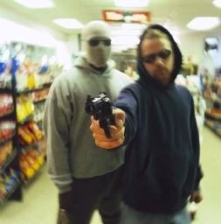
Criminal Law and Procedure
0
5
C
H
A
P
T
E
R
Wherever Law ends,
Tyranny begins.
John Locke

Slide 2
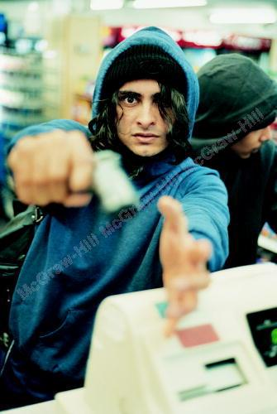
Nature of Crimes
Crimes are public wrongs, classified from most serious to least serious as:
  Felony
  Misdemeanor
  Infraction
Purpose of criminal sanctions: incapacitation, deterrence, rehabilitation, probation, retribution
Notes:
See the Federal Sentencing Guidelines

Slide 3
Elements/Essentionals of Crime
To convict a defendant of a crime, the government must
  Demonstrate that alleged acts violated a criminal statute
  Prove beyond a reasonable doubt that the defendant committed the acts
  Prove the defendant had the capacity of criminal intent
Courts narrowly interpret criminal statutes
Notes:
Example of narrow interpretation of statutes: U.S. v. Sun-Diamond Growers of California

Slide 4
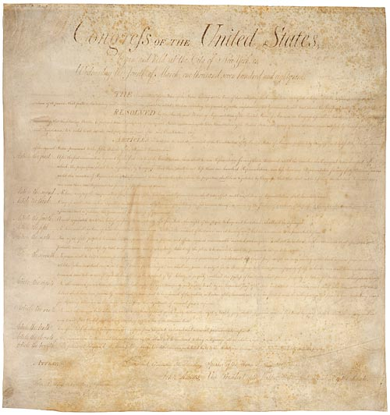
Constitutional Protections
Bill of Rights: first ten amendments to the U.S. Constitution
  Literally binds only the federal government, but applied to states through the due process clause of the Fourteenth Amendment

Slide 5
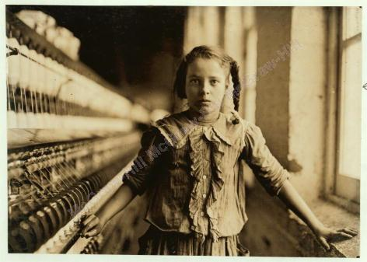
Constitutional Limitations
Government may not enact an ex post facto (after the fact) law
  Thus a person cannot be charged with a crime for an act that was not a crime when the act was committed
Child worker in North Carolina cotton mill, 1908. This type of child labor was not prohibited until 1938, with the enactment of the Fair Labor Standards Act.
Notes:
One recognized exception to the rule about ex post facto laws is the environmental statute entitled Comprehensive Environmental Response, Compensation, and Liability Act CERCLA). CERCLA provides for criminal penalties, including imprisonment, for conduct that occurred before the law was enacted.

Slide 6
Proof and Intent
Defendants are presumed innocent until proven guilty beyond a reasonable doubt
Most serious crimes require proof of the defendant’s mens rea, or criminal intent
  Defendant must have had capacity to form criminal intent
  Three types of incapacity recognized: intoxication, infancy, and insanity

Slide 7
Constitutional Limitations
First Amendment allows government to regulate indecent speech and does not protect obscene expression
  To determine if expression is obscene, courts apply the three-part Miller test
    Example: Supreme Court applied the Miller test to strike down most of the Congressional efforts to criminalize obscenity on the Internet
Notes:
Congress shall make no law respecting an establishment of religion, or prohibiting the free exercise thereof; or abridging the freedom of speech, or of the press; or the right of the people peaceably to assemble, and to petition the Government for a redress of grievances.
— The First Amendment to the U.S. Constitution
Expression is obscene only if the government proves each element of the controlling obscenity test, which the Supreme Court established in Miller v. California (1973): (a) [That] the average person, applying contemporary community standards, would find that the work, taken as a whole, appeals to the prurient interest; (b) [that] the work depicts or describes, in a patently offensive way, [explicit] sexual conduct specifically defined by the applicable state law; and (c) [that] the work, taken as a whole, lacks serious literary, artistic, political, or scientific value. If any of the three elements is not proven, the work is not obscene; instead, it is entitled to First Amendment protection.

Slide 8
Constitutional Limitations
Constitutionally-protected behavior cannot be deemed criminal
Statutes must define prohibited behavior precisely enough to allow law enforcement officers and the public to understand which behavior is illegal
  A statute may not be vague
Notes:
The right of privacy held implicit in the Constitution caused the Supreme Court, in Griswold v. Connecticut (1965), to strike down state statutes that prohibited the use of contraceptive devices and the counseling or assisting of others in the use of such devices. The hyperlink is to the case information and opinion on the Oyez Project website. This decision provided the constitutional basis for the Court’s historic Roe v. Wade (1973) decision, which limited the states’ power to criminalize abortions.

Slide 9
Skilling v. United States
Facts:
  Jeffrey Skilling, former president and chief operating officer of Enron, was found guilty of 19 counts of fraud, including conspiracy to commit honest-services wire fraud
  Appellate court affirmed the conviction and Skilling appealed to the U.S. Supreme Court arguing that honest-services statute was unconstitutionally vague
Notes:
The hyperlink is to the U.S. Supreme Court’s opinion.

Slide 10
Skilling v. United States
Issue before the U.S. Supreme Court:
  Did jury improperly convict Skilling of conspiracy to commit “honest-services” wire fraud?
Statutory Interpretation:
  Congress enacted § 1346 to reinstate honest-services law that McNally decision altered
  Text of § 1346 targets corruption in which offender profits by causing third party, instead of the betrayed party, to suffer deprivation of money or property
Notes:
In 1987, the U.S. Supreme Court ruled in McNally v. United States to cease development of the intangible-rights doctrine (and honest-services theory) because the particular scheme did not qualify as mail fraud. However, Congress quickly enacted § 1346 to reinstate as illegal a “scheme or artifice to deprive another of the intangible right of honest-services.”

Slide 11
Skilling v. United States
Case Law:
  Court reviewed case law, concluding that §1346 criminalizes only bribery and kickback schemes of honest-services law, thus it is not unconstitutionally vague
Held:
  Skilling did not engage in bribery and kickback schemes, so did not commit honest-services fraud; conviction flawed and case remanded for further proceedings

Slide 12
Arthur Andersen v. U.S.
Facts:
  Arthur Andersen audited Enron’s accounting practices
  In response to government investigation of Enron, Andersen began to destroy records related to Enron – allegedly according to the firm’s document retention policy – despite objections by some employees
  Records destruction continued until Andersen was served with subpoenas for records
Notes:
The hyperlink is to the case and opinion on the Oyez Project website.

Slide 13
Arthur Andersen v. U.S.
Facts (cont.):
  Andersen found guilty of “knowingly…and corruptly” persuading employees to destroy documents that would be needed in an official proceeding (i.e., witness tampering)
Issue before the Supreme Court:
  Whether Arthur Andersen’s conviction must be reversed because the jury instructions misinterpreted the elements of the offense
Notes:
The hyperlink is to the Supreme Court opinion.

Slide 14
Arthur Andersen v. U.S.
Statutory interpretation:
  Text establishes the mens rea – knowingly – and then a list of acts
Discussion of trial court’s jury instructions:
  Instructions lowered the level of culpability required to impose criminal liability and expanded the list of acts
    Practical meaning: trial court judge made it too easy to convict Andersen

Slide 15

Arthur Andersen v. U.S.
Held:
  Jury instructions were flawed
  Case remanded for further proceedings
Notes:
The ruling in favor of Andersen did not prevent the collapse of the company. The company lost most of its clients after it was indicted and as of early 2006, there were approximately 100 civil suits still pending against the firm related to audits of Enron and other companies. The company began winding down its American operations after the indictment and from a high of 28,000 employees in the US and 85,000 worldwide, the firm as of early 2006 had only around 200 based primarily in Chicago. There is a website for Andersen alumni to connect, but the Andersen.com website is merely one page as of 2-20-06.

Slide 16
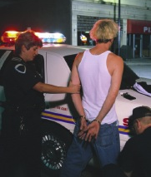
Criminal Procedure
Arrest and booking of defendant
Arrest report filed with prosecutor
If defendant charged, complaint filed
Initial appearance of defendant before judicial officer
Preliminary (probable cause) hearing
Notes:
Booking is an administrative procedure and includes fingerprinting, mugshots, etc. Bail may be available at this stage.
After receiving the arrest report, the prosecutor decides whether to charge the defendant with the alleged offense.
During an initial appearance, the magistrate or judge informs the accused of the charges and outlines the accused’s constitutional rights. If a misdemeanor in which the defendant pleads guilty, the sentence may be imposed without a later hearing. If the accused pleads not guilty to a misdemeanor charge, a trial is set for a later date. The magistrate sets the amount of bail for any crime when a later trial date has been set.
In many states, the preliminary hearing is an additional protection for felony cases. In a preliminary hearing, the prosecutor must introduce enough evidence to show probable cause that the accused committed a felony. If convinced of probable cause, the magistrate binds over the defendant for trial.

Slide 17
Criminal Procedure
If probable cause exists, formal charge – information or indictment – filed with court
Arraignment of defendant in which defendant enters a plea
  Guilty, not guilty, nolo contendere (no contest)
Defendant who pleads not guilty and faces incarceration for more than six months may choose a jury trial
  Bench trial (judge only) also available
Notes:
About ½ the states require a grand jury approve a decision to prosecute a person for a felony and issue an indictment. In the other states, felony defendants may be charged by either an indictment or an information (formal charged signed by prosecutor) at the prosecutor’s discretion. Misdemeanor cases are prosecuted by information in most states.
About ½ the states require a grand jury approve a decision to prosecute a person for a felony and issue an indictment. In the other states, felony defendants may be charged by either an indictment or an information (formal charged signed by prosecutor) at the prosecutor’s discretion. Misdemeanor cases are prosecuted by information in most states.
In an arraignment, the defendant is brought before a judge, informed of all charges, and asked to enter a plea (guilty, not guilty, or nolo contendere).
Evidence of a guilty plea may be admissible in a later civil case against the defendant for the same conduct, but a nolo contendere plea is inadmissible in a later civil action.

Slide 18
Constitutional Protections
Fourth Amendment protects persons against unreasonable and arbitrary searches and seizures
  Interpreted by Supreme Court to protect a reasonable expectation of privacy
  General rule: warrantless searches are unreasonable (unconstitutional)
  See United States v. Hall
Notes:
United States v. Hall:
William T. Parks, a special agent of the U.S. Customs Service, was investigating allegations that Bet-Air, Inc. (a Miami-based seller of spare aviation parts and supplies) had supplied restricted military parts to Iran. Parks entered Bet-Air’s property and removed, from a garbage dumpster, a bag of shredded documents. The dumpster was located near the Bet-Air offices in a parking area reserved for the firm’s employees. To reach the dumpster, Parks had to travel 40 yards on a private paved road. No signs indicated that the road was private. In later judicial proceedings, Parks testified that at the time he traveled on the road, he did not know he was on Bet-Air’s property.
When reconstructed, some of the previously shredded documents contained information seemingly relevant to the investigation. Parks used the shredded documents and the information they revealed as the basis for obtaining a warrant to search the Bel-Air premises. In executing the search warrant, Parks and other law enforcement officers seized numerous documents and Bet-Air records.
A federal grand jury later indicted Bet-Air’s chairman, Terrence Hall, and other defendants on various counts related to
the alleged supplying of restricted military parts to Iran. Contending that the Fourth Amendment had been violated, Hall filed a motion asking the court to suppress (i.e., exclude) all evidence derived from the warrantless search of the dumpster and all evidence seized during the search of the Bet-Air premises (the search pursuant to the warrant). The federal district court denied Hall’s motion. Following a jury trial, Hall was convicted on all counts and sentenced to prison. Hall appealed to the 11th Circuit Court of Appeals.

Slide 19
United States v.
SDI Future Health, Inc.
Facts:
  Internal Revenue Service (IRS) investigators concluded that SDI and corporate officers had engaged in Medicare and tax fraud
  IRS applied for and executed a search warrant for SDI business premises
  Evidence obtained in the search provided basis for indictments of SDI, Kaplan and Brunk
  Defendants filed motion to suppress evidence arguing warrant was vague and overbroad
  Trial court granted motion to suppress
Notes:
The hyperlink is to the case opinion on the Findlaw.com website.

Slide 20
United States v.
SDI Future Health, Inc.
Issue on appeal:
  Government appealed to Ninth Circuit appellate court, which focused on whether corporate executives may challenge a police search of company premises not reserved for the executives’ exclusive use
Legal Analysis:
  Court applied Katz test: whether executives had a reasonable expectation of privacy in the area searched
Notes:
Ask your students what they consider reasonable steps to restrict public access to garbage.

Slide 21
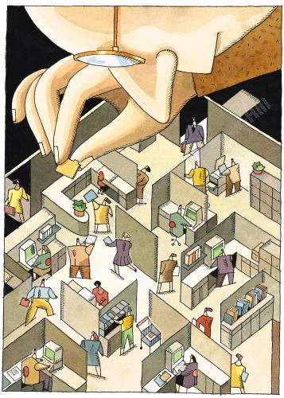
United States v.
SDI Future Health, Inc.
Holding:
  Individual challenging a search of workplace areas beyond his/her own office must show personal connection to the places searched and materials seized in order to establish standing
  Reversed and remanded
Notes:
The Court noted that an exception exists for a small business over which an individual exercises daily management and control over the entire operation. Note that in a cube farm (depicted), there may be little or no expectation of privacy.

Slide 22
What is a Search?
Many Fourth Amendment cases carve out exceptions to the general rule, establishing activities that do not constitute a search:
  Visual observation of things or activities in public view
  Narcotics detection dogs used in a public place to investigate luggage or cars
  Enhanced aerial photography of a facility

Slide 23
Warrantless Searches
Supreme Court has held that constitutional warrantless searches include:
  Area within an arrestee’s immediate control
  Premises police enter in hot pursuit of an armed suspect
  Stop-and-frisk searches for weapons
  Inventory searches of property (e.g., briefcase, automobile) in an arrestee’s possession
  Consensual searches
  Plain view
  Exigent circumstances (Kentucky v. King)
Notes:
In Kentucky v. King, 2011 U.S. LEXIS 3541 (U.S. Sup. Ct. 2011), the Supreme Court held that the exigent circumstances exception to the Fourth Amendment’s warrant requirement justifies police officers’ warrantless entry into and search of residential property if the officers, after knocking on the door and announcing their presence, become concerned that evidence may be destroyed.

Slide 24
Warrantless Searches
Supreme Court has held that constitutional warrantless searches include:
  DNA swabs in the booking process
  Customes searches
  Administrative inspections of closely regulated businesses
Notes:
In Kentucky v. King, 2011 U.S. LEXIS 3541 (U.S. Sup. Ct. 2011), the Supreme Court held that the exigent circumstances exception to the Fourth Amendment’s warrant requirement justifies police officers’ warrantless entry into and search of residential property if the officers, after knocking on the door and announcing their presence, become concerned that evidence may be destroyed.

Slide 25
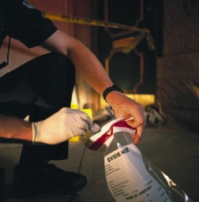
The Exclusionary Rule
Prevents the use of evidence seized in an illegal search in a subsequent trial of the defendant
  Supreme Court has narrowed operation of the rule
  Good Faith Exception
Notes:
The hyperlink is to the case decision on the Oyez.org website. The Supreme Court in Hudson v. Michigan concluded: “In sum, the social costs of applying the exclusionary rule to knock-and-announce violations are considerable; the incentive to such violations is minimal to begin with, and the extant deterrences against them are substantial – incomparably greater than the factors deterring warrantless entries when [Mapp v. Ohio] was decided. Resort to the massive remedy of suppressing evidence of guilt is unjustified.”

Slide 26
USA PATRIOT Act
Within six weeks after the attack on the United States on Sept. 11, 2001, Congress enacted a statute that amended more than a dozen statutes and broadly expanded government’s ability to conduct searches of property and library records, monitor Internet activities, and track electronic communications (Terrorism Prevention)
Notes:
The hyperlink is to the Act. The PATRIOT Act is highly controversial. Some sections have already been declared unconstitutional and challenges to the constitutionality of the law continue.
Included in the USA PATRIOT Act are measures allowing the federal government significantly expanded ability, in terrorism-related investigations, to conduct searches of property, monitor Internet activities, and track electronic communications. Most, though not all, actions of that nature require a warrant from a special court known as the Foreign Intelligence Surveillance Court. The statute contemplates, however, that such warrants may be issued upon less of a showing by the government than would ordinarily be required, and may be more sweeping than usual in terms of geographic application. Moreover, warrants issued by the special court for the search of property can be of the so-called “sneak and peek” variety, under which the FBI need not produce the warrant for the property owner or possessor to see and need not notify an absent property owner or possessor that the search took place (unlike the rules typically applicable to execution of “regular” warrants). The USA PATRIOT Act also calls for banks to report seemingly suspicious monetary deposits, and any deposits exceeding $10,000, not only to the Treasury Department (as required by prior law) but also to the Central Intelligence Agency and other federal intelligence agencies. In addition, the statute enables federal law enforcement authorities to seek a Surveillance Court warrant for the obtaining of individuals’ credit, medical, and student records, regardless of state or federal privacy laws that would otherwise have applied.

Slide 27
The Fifth Amendment
The Fifth Amendment provides a privilege or protection against compelled testimonial self-incrimination
  Practical meaning: a person may remain silent if making a statement would assist the government in prosecuting the person
  Miranda warnings safeguard the right
  Also prohibits prosecutorial comments at trial about the defendant’s failure to testify
Notes:
“No person shall be held to answer for a capital, or otherwise infamous crime, unless on a presentment or indictment of a Grand Jury, except in cases arising in the land or naval forces, or in the Militia, when in actual service in time of War or public danger; nor shall any person be subject for the same offence to be twice put in jeopardy of life or limb; nor shall be compelled in any criminal case to be a witness against himself, nor be deprived of life, liberty, or property, without due process of law; nor shall private property be taken for public use, without just compensation.”
— The Fifth Amendment to the U.S. Constitution
The Miranda v. Arizona decision, to safeguard the Fifth Amendment right, requires police officers to warn a defendant that the defendant has “the right to remain silent.”
In Dickerson v. United States (2000), the Supreme Court classified the Miranda warnings as a constitutional rule, which Congress could not legislatively overrule.

Slide 28
Scope of Fifth Amendment
Self-incrimination privilege applies to
  Testimonial admissions, so police may compel a defendant to provide non-testimonial evidence (fingerprints, body fluids, hair)
  Applies only to humans (not corporations)
  Applies only if a defendant could be charged with a crime (not merely a civil lawsuit)
Double jeopardy clause protects defendants from multiple criminal prosecutions for the same offense

Slide 29
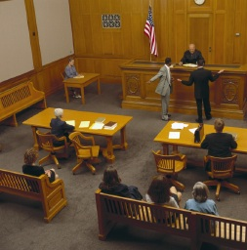
Sixth Amendment
Applies to criminal cases by guarantees of a
  Speedy trial
  Impartial jury
  Right to confront and cross-examine witnesses
  Right to effective assistance of counsel
Notes:
“In all criminal prosecutions, the accused shall enjoy the right to a speedy and public trial, by an impartial jury of the State and district wherein the crime shall have been committed, which district shall have been previously ascertained by law, and to be informed of the nature and cause of the accusation; to be confronted with the witnesses against him; to have compulsory process for obtaining witnesses in his favor, and to have the Assistance of Counsel for his defence.”
— The Sixth Amendment to the U.S. Constitution

Slide 30
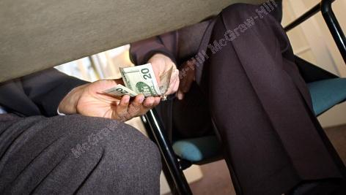
White Collar Crimes
Under modern rule, a company may be liable for criminal offenses committed by employees who acted within the scope of their employment and for the benefit of the corporation
Numerous policy debates about how to deal with corporate crime
Notes:
Policy issues include how to penalize a corporation, are criminal fines enough to deter corporations from illegal conduct, should an individual employee be imprisoned for a corporate culture of misconduct, should a corporation be held liable for employees acting illegally, etc.

Slide 31
Ethics in Action
Does an employee have an ethical duty to his or her employer?
When an employee learns of apparently illegal conduct by his or her employer, does the employee have an ethical duty to become a whistleblower?
What practical consequences might an employee face if he or she blows the whistle on illegal corporate activity?
Notes:
Every employee has a fiduciary duty of loyalty to his or her employer. This duty will conflict with a duty to society if the employer engages in illegal conduct.
Numerous whistleblower protection laws exist. Though an employee probably will be protected by a federal or state whistleblower protection statute, the practical consequences of blowing the whistle on illegal conduct is that the employee will be terminated or, at the very least, ostracized. However, Time magazine selected three whistleblowers as Persons of the Year in 2002: Sherron Watkins of Enron, Coleen Rowley of the FBI, and Cynthia Cooper of WorldCom. See the article available at http://www.time.com/time/personoftheyear/2002/

Slide 32
White Collar Crimes
Regulatory offenses
  Example: violating the Clean Water Act
Fraudulent acts
  Examples: false claims, fraudulent concealment, wire fraud
Sarbanes-Oxley Act violations
  Example: Knowingly altering documents or business records with the intent to impede a government investigation

Slide 33
White Collar Crimes
Bribery and Illegal Gratuities
  Example: violating Foreign Corrupt Practices Act
Racketeer Influenced and Corrupt Organizations Act (RICO) violations
  Example of criminal RICO: using income derived from a “pattern of racketeering activity”
  Examples: extortion, money laundering, loan sharking, obstruction of justice and bribery
Notes:
The hyperlink is to the opinion on the Oyez Project website.
The Racketeer Influenced and Corrupt Organizations Act (RICO) makes it “unlawful for any person employed by or associated with any enterprise engaged in, or the activities of which affect, interstate or foreign commerce, to conduct or participate, directly or indirectly, in the conduct of such enterprise’s affairs through a pattern of racketeering activity or collection of unlawful debt.” 18 U.S.C. § 1962(c). A federal grand jury indicted Edmund Boyle for a violation of RICO § 1962(c) and for conspiracy to commit that offense, in violation of RICO § 1962(d). In addition, the grand jury indicted Boyle for conspiracy to commit bank burglary and nine counts of bank burglary and attempted bank burglary.
Boyle requested a jury instruction that the government was required to prove that the enterprise “had an ongoing organization, a core membership that functioned as a continuing unit, and an ascertainable structural hierarchy distinct from the charged predicate acts.” The court refused to give that instruction.
Boyle was convicted on 11 of the 12 counts against him, including the RICO counts, and was sentenced to prison. He appealed to the U.S. Court of Appeals for the Second Circuit, which affi rmed his conviction. The U.S. Supreme Court then granted certiorari in order to resolve confl icts among the various courts of appeals concerning the meaning of “enterprise” for purposes of a RICO prosecution.
Court: “We are asked in this case to decide whether an association-infact enterprise under RICO must have “an ascertainable structure beyond that inherent in the pattern of racketeering activity in which it engages” (quoting Boyle’s certiorari petition)….The crux of Boyle’s argument is that a RICO enterprise must have structural features in addition to those that we think can be fairly inferred from the language of the statute…. We see no basis in the language of RICO for the structural requirements that Boyle asks us to recognize…. The instructions the district court judge gave to the jury in this case were correct and adequate…. Judgment of Second Circuit Court of Appeals affirmed.”

Slide 34

Computer Crime
In general, existing criminal statutes apply to criminal activity via computers
Computer Fraud and Abuse Act imposes criminal and civil liability on a person who “knowingly, and with intent to defraud, accesses a protected computer without authorization . . . [and] obtains anything of value.”
Notes:
Example of violation of Computer Fraud & Abuse Act: accessing a competitor’s computer to obtain customer lists

Slide 35
Test Your Knowledge
True=A, False = B
  An employee’s sole duty is to his or her employer
  RICO violations are only criminal in nature
  An employee may access a company’s computer to obtain personal information about his or her supervisor and use the information to persuade the supervisor to give the employee a raise
Notes:
False, since the government will contend that a higher duty to society exists.
False, since RICO applies to civil violations as well as criminal violations.
False, since such an act would be in violation of the Computer Fraud and Abuse Act.

Slide 36
Test Your Knowledge
True=A, False = B
  To convict a defendant of a crime, the government must prove beyond a reasonable doubt that the defendant committed the acts
  Obscenity is fully protected speech by the First Amendment to the Constitution
  Only felonies require proof of the defendant’s mens rea, or criminal intent
  A defendant may choose one of three pleas: guilty, not guilty, and nolo contendere
Notes:
True
False. To determine if expression is obscene, courts apply the three-part Miller test.
False. Most serious crimes require proof of the defendant’s criminal intent, including misdemeanors.
True

Slide 37
Test Your Knowledge
True=A, False = B
  The Bill of Rights is the first dozen amendments to the Constitution
  The Fourth Amendment provides a privilege from self-incrimination and double jeopardy
  The Fifth Amendment protects persons against unreasonable and arbitrary searches and seizures
Notes:
False; the first ten amendments
False. The Fifth Amendment provides the privilege from self-incrimination and double jeopardy.
False. The Fourth Amendment protects against unreasonable search and seizure.

Slide 38
Test Your Knowledge
Multiple Choice
  Sixth Amendment to the Constitution guarantees
    Speedy trial
    Right to confront and cross-examine witnesses
    Right to effective assistance of counsel
    Impartial jury
    All of the above
Notes:
The correct answer is (e), All of the above.

Slide 39
Test Your Knowledge
Multiple Choice
  Which of the following would not be a constitutional search?
    Taking bag of shredded documents from a dumpster
    Aerial surveillance of a manufacturing plant
    Thermal imaging device to detect heat in a home
    A stop-and-frisk search for weapons
Notes:
The correct answer is (c), a thermal imaging device to detect heat within a home. See the U.S. v. Hall decision.

