Slide 1
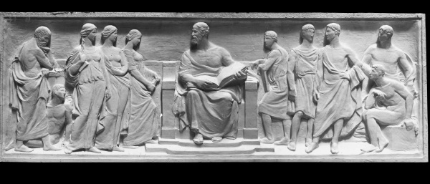
Business Ethics, Corporate Social Responsibility, Corporate Governance, and Critical Thinking
0
4
C
H
A
P
T
E
R
It is not what a lawyer tells me I may do; but what humanity, reason, and justice, tell me I ought to do.
Edmund Burke

Slide 2
Learning Objectives
Appreciate strengths & weaknesses of various ethical theories
Learn to apply guidelines for ethical decision making
Recognize critical thinking errors
Be an ethical leader

Slide 3
Why Study Business Ethics
Ethics is the study of how people should act
Ethics also refers to the values and beliefs related to the nature of human conduct
  Based on ethical standards or moral orientation
Business ethics: business conduct that seeks to balance the values of society with the goal of profitable operation

Slide 4

Corporate Social Responsibility
Do corporations have a duty to society?
This question has engendered ongoing debate for over a century
What role, if any, does morality play?
Notes:
Opportunity for class discussion

Slide 5
Corporate Social Responsibility
Many corporations have adopted a Code of Ethics to foster ethical behavior within a firm
  And/or to enhance their public image
Some laws, such as the Sarbanes-Oxley Act, have forced some firms to adopt codes of ethics for their executives
Notes:
Link to pdf file of the text of the Sarbanes-Oxley Act

Slide 6

Ethical Theories
Teleological ethical theories focus on the consequences of a decision
Deontological ethical theories focus on decisions or actions alone
Recognize that ethical values are as diverse as individual humans
Notes:
See the Internet Encyclopedia of Philosophy

Slide 7
Rights Theory
Basic deontological view: certain rights are fundamental
Kantianism (from Immanuel Kant) applies the categorical imperative: judge an action by applying it universally
Modern Rights Theories soften Kant’s absolute duty approach, yet protect fundamental rights (a strength of the theory)
Notes:
Kant’s categorical imperative may be summarized as “act as you would have all people act”
Rights theory is ethnocentric in that not all cultures view rights similarly. For example, the U.S. treats freedom of speech as a fundamental right, but not all cultures agree with that perspective.

Slide 8

Justice Theory
Basic teleological view: a society’s benefits and burdens should be allocated fairly among its members
John Rawls argued for the:
  Greatest Equal Liberty Principle – each person has an equal right to basic rights and liberties
  Difference Principle – inequalities acceptable only if elimination would harm the poorest class
Notes:
While fairness and impartiality appears ideal, justice theory ignores the costs of producing equality, which may create conflict in a theoretically free market society

Slide 9
Strengths & Criticism
Rights Theory
  Strength: protects fundamental rights unless a greater right takes precedence
  Criticism: near absolute yet relative value of rights protected is difficult to articulate
Justice Theory
  Strength: protects the least advantaged members of society
  Criticism: treats equality as absolute

Slide 10

Utilitarianism
Basic teleological view: maximize utility for society as a whole with cost-benefit analysis
  Jeremy Bentham & Stuart Mill
Strength of theory is in the simplicity of a cost-benefit analysis
Criticism of theory: how does a person measure all the costs and benefits?
Notes:
Many businesses follow utilitarianism because the cost-benefit analysis seems relatively straight-forward
Problem is determining and measuring all the “real” costs and benefits. For example, what are the costs and benefits of clean air and how would these costs and benefits be measured? What are the costs and benefits of outsourcing jobs overseas?

Slide 11
Profit Maximization (Shareholder)
Basic teleological view: maximize the firm’s long-run profits within the limits of law
  From economists Adam Smith, Milton Friedman, and Thomas Sowell
  If legal, then ethical
Strength of the theory is focus on profits as a mechanism for creating social benefit
Criticism of the theory: underlying assumptions may be flawed
Notes:
Many businesses follow profit maximization because the profit-making goal and the “if legal, then ethical” maxim appears attainable
Problem is that corporate profits may not result in benefit to society and ethical conduct may transcend written law (i.e., law is merely a floor).

Slide 12
Virtue Theory
Hightlights the importance of character – both for individuals and an organization
Demands individuals and organizations know their values and how they correlate to identity, habits, and ways of engaging with others.
  Who are you? What values are most important to you? What is your corporate purpose? What are your corporate values? Are your corporate actions and our values integrated?
Notes:
Many businesses follow profit maximization because the profit-making goal and the “if legal, then ethical” maxim appears attainable
Problem is that corporate profits may not result in benefit to society and ethical conduct may transcend written law (i.e., law is merely a floor).

Slide 13
Virtue Theory
Strengths: acting with regard to one’s self interest is a hallmark of the human condition
Criticisms: too subjective, limited in scope, difficult to be useful, especially in a corporate context.
Notes:
Many businesses follow profit maximization because the profit-making goal and the “if legal, then ethical” maxim appears attainable
Problem is that corporate profits may not result in benefit to society and ethical conduct may transcend written law (i.e., law is merely a floor).

Slide 14
Business Stakeholders
Stakeholders are internal and external to the firm and include society as a whole
Stakeholders have their own interests in the particular business actions of a company
  Examining stakeholder interests supports efforts by a company to engage in corporate social responsibility

Slide 15
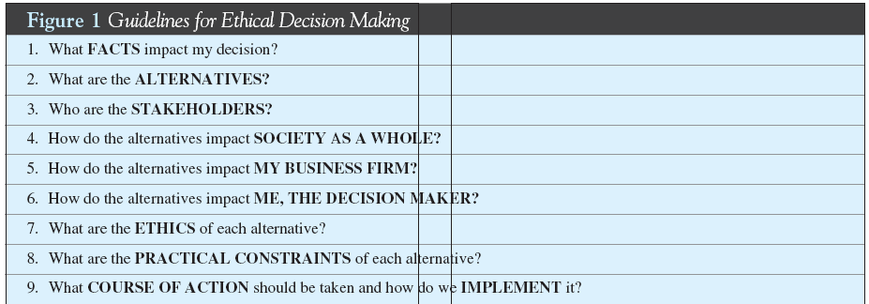
Guidelines for
Ethical Decision Making

Slide 16
Apply the Nine Factors
To a decision whether:
  To lay off employees to cut costs at the plant or incur a significant decrease in profit
  To use a less expensive component with a 15% increased risk of defect or use a more expensive component with decreased profit
  To violate the environmental permit and pay the $25,000 fine or spend $50,000 to comply with the permit
Notes:
Opportunity to go back one slide and go through each factor for each example decision making problem or to approach the decision from the four ethical theories: rights theory, justice theory, utilitarianism, and profit maximization theory.

Slide 17

Question for Discussion
Who and what are the business stakeholders for your college?
What duties – if any – does a college owe to society?
Notes:
Opportunity for class discussion

Slide 18

Thinking Critically
Ethical decision making requires critical thinking, or the ability to evaluate arguments logically, honestly, and objectively
Learn to identify the fallacies in thinking

Slide 19


Non Sequiturs and Appeals to Pity
A non sequitur is a conclusion that does not follow from the facts
  Result: they miss the point
Appeals to pity gains support for an argument by focusing on a victim’s predicament
  Often also a non sequitur!
Notes:
The typical non sequitur is: “I don’t get paid enough, so I’ll take a few supplies. My employer won’t even miss them.”
The typical appeal to pity is contained within anti-smoking ads that depict lung cancer patients and the impact on their families

Slide 20


False Analogies
A false analogy is arguing that since a set of facts are similar to another set of facts, the two are alike in other ways
  Company X and Company Y are both large
  Company X did activity 1, so Company Y should also do activity 1
Both are sandwiches, but not the same
Notes:
An example of an analogy is arguing that since Six Sigma worked for Company X, it should work for Company Y, too. The analogy may indeed be valid, but it also may be a false analogy.

Slide 21
Circular Reasoning and
Argumentum ad Populum
If a person assumes the thing the person is trying to prove, circular reasoning occurs (begging the question)
  Example: we should tell the truth because lying is wrong
Argumentum ad populum is an emotional appeal to popular beliefs
  The bandwagon fallacy is essentially the same flaw in reasoning
Notes:
Circular reasoning is also referred to as “begging the question” because an answer to a query merely restates the question. Example:
Political polls are used in argumentum ad populum quite frequently because the arguer states that a poll shows a majority believe in something so they must be right. However, those polled may be ill-informed or the polling process may have been flawed. Bottom line: simply because many people believe something doesn’t mean it is true. The classic example is that people believed the earth was flat until proven wrong by adventuresome sailors.
The bandwagon fallacy boils down to this: “Everyone else is doing it, so it must be okay.”

Slide 22

Argumentum ad Baculum and Argumentum ad Hominem
Argumentum ad baculum uses threats or fear to support a position
  Often occurs in unequal bargaining situation
Argumentum ad hominem (argument against the man) attacks the person, not his or her reasoning
Notes:
Argumentum ad baculum is often used when a person of authority or in a superior bargaining position pushes his or her views upon others with threats. Examples: threats to boycott a company’s products or file a lawsuit.
Argumentum ad hominem is classic methodology in the political sphere: “Don’t trust him, he’s a member of X political party.” This type of argument attacks a person’s character, a conflict of interest, a person’s consistency, or assessing guilt by association.

Slide 23
Argument from Authority and
False Cause
Argument from authority relies on an opinion because of the speaker’s status as an expert or position of authority rather than the quality of the speaker’s argument
If a speaker observes two events and concludes there is a causal link between them when there is no such link, a false cause fallacy has occurred
Notes:
Argument from authority may be used to belittle the other person when it takes the form of argument to reverence or respect. For example, if someone states, “Who are you to question expert X?”
False cause fallacies are very common, which is why causation is such an important element of tort law..

Slide 24
The Gambler’s Fallacy &
Appeals to Tradition
The gambler’s fallacy results from the mistaken belief that independent prior outcomes affect future outcomes
  Example: the chances of getting heads when flipping a coin do not improve with each flip
If a speaker declares that something should be done a certain way because that is the way it has been done in the past, the speaker has made an appeal to tradition
Notes:
The chances of getting heads are 50% every time a coin is flipped since each coin flip is an independent event.
Appeals to tradition are not necessarily flawed, but simply doing something because it has been done before is flawed reasoning.

Slide 25
Reductio ad absurdum
Reductio ad absurdum carries an argument to its logical end, but does not consider whether it is an inevitable or probable result
  Often called the slippery slope fallacy
  Example: “Eating fast food causes weight gain. If you are overweight you will die of a heart attack. Fast food leads to heart attacks.”
Notes:
The slippery slope argument is very common with those who advocate a position regarding controversial topics such as abortion, health care, crime statistics, tort reform, etc. Recognizing the slippery slope argument is easy: “If we do this, then this will happen, and then this terrible thing will happen.”

Slide 26
Lure of The New and
Sunk Cost Fallacy
The lure of the new argument is the opposite of appeals to tradition because the argument claims since something is new it must be better
The sunk cost fallacy is an attempt to recover investments (time, money, etc.) by spending more
  “Throwing good money after bad” behavior
Notes:
The lure of the new is very common in marketing, but may be seriously flawed if the new product is defective or isn’t evaluated on the basis of substance.
The sunk cost fallacy is an easy pitfall for businesses when pursuing projects that originally seemed important.

Slide 27
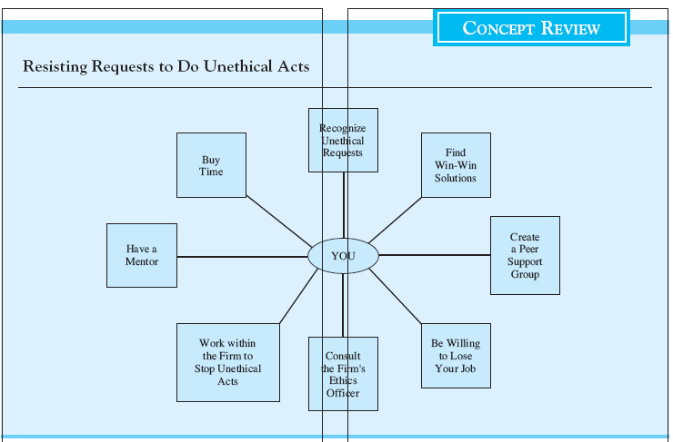
4-27
Notes:
Opportunity for class discussion

Slide 28
Lead Ethically
Be Ethical!!
Communicate the company Core Values
Connect Ethical Behavior with the Company’s and workers’ best interest
Reinforce Ethical Behavior
  Work to create a culture in which employees feel a sense of “ownership” in the organization.
Notes:
Many businesses follow profit maximization because the profit-making goal and the “if legal, then ethical” maxim appears attainable
Problem is that corporate profits may not result in benefit to society and ethical conduct may transcend written law (i.e., law is merely a floor).

Slide 29
Test Your Knowledge
True=A, False = B
  Teleological ethical theories focus on the consequences of a decision
  Kantianism holds that a society’s benefits and burdens should be allocated fairly among its members
  Utilitarianism attempts to maximize utility for society as a whole by a cost-benefit analysis
Notes:
True
False. Kantism applies the categorical imperative in which a person should judge a proposed action by applying it universally. Justice theory holds that a society’s benefits and burdens should be allocated fairly among its members
True.

Slide 30
Test Your Knowledge
Multiple Choice
  The business stakeholder standard of behavior determines whether an act is, or is not, ethical by:
    maximizing a company’s long-run profits within the limits of law
    examining the interests of various interested parties with regard to a particular business action
Notes:
The correct answer is (b)

Slide 31
Test Your Knowledge
Multiple Choice
  If a person assumes the thing the person is trying to prove, the person has made the following error in reasoning:
    A false analogy
    Argumentum ad hominem
    Circular reasoning
Notes:
The answer is (c).

Slide 32
Test Your Knowledge
Multiple Choice
  Jack said Firm X and Firm Y are both large telecommunications firms. Then Jack said Firm X had implemented The Process, so Firm Y should also implement The Process. Jack has made the following error in reasoning:
    the sunk cost fallacy
    the fallacy of utilitarianism
    fallacy based on the lure of the new
    a false analogy
Notes:
The correct answer is (d). A false analogy is arguing that since a set of facts are similar to another set of facts, the two are alike in other ways. For example, stating (1) Company X and Company Y are both large, and (2) Company X did activity 1, so (3) Company Y should also do activity 1, is a false analogy. A fallacy based on the lure of the new may also be an underlying fallacy, but is not the primary error in reasoning. The sunk cost fallacy reduces to “throwing good money after bad.” Utilitarianism is a theory of ethics.

Slide 33

Thought Question
If your boss asked you to shred documents as part of a “routine document retention policy” and you knew the documents were important to a criminal investigation, what would you do?
Notes:
This is the situation Arthur Andersen employees were faced with when told to shred documents related to Enron.

