Slide 1
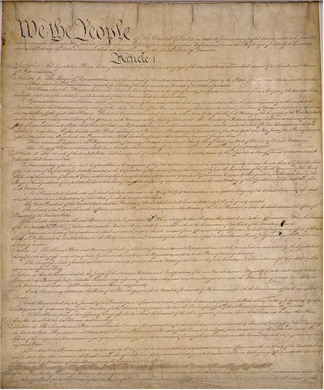
Business and the Constitution
0
3
C
H
A
P
T
E
R
“The very idea of the power and the right of the People to establish government presupposes the duty of every Individual to obey the established Government.
George Washington
Farewell Address
September 19, 1796

Slide 2
Overview of the Constitution
Establishes a tripartite government to ensure a separation of powers:
  Article I sets forth the legislative powers of Senate and Congress
  Article II gives executive power to execute legislation, command armed forces, make treaties
  Article III provides judicial power to the Supreme Court and subsidiary courts

Slide 3
System of Checks & Balances
No single branch may control government
Supreme Court has power of judicial review
States reserve certain powers
Federal powers are limited

Slide 4
The Power to Regulate
Federal government has exclusive power to administer certain national concerns, such as war and currency
Federalism: Some powers are shared with the states
  Example: power to tax, power to spend
States possess exclusive power to enact laws to protect general welfare, health, and safety
https://www.childwelfare.gov/systemwide/laws_policies/statutes/witnessdv.pdf

Slide 5
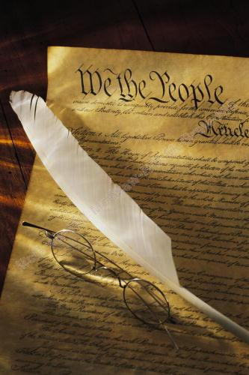
Federal Supremacy
The Constitution and statutes enacted by Congress, including treaties, are supreme law of the land
  Article VI, Clause 2

Slide 6
Federal Preemption
Article I, Section 8 lists issues on which Congress may pass statutes
Thus, if Congress enacts a law on a certain issue, then Congress “preempts” state regulation of that issue
  Example: Congress enacted the Civil Rights Act of 1964, thus a state cannot enact a law allowing discrimination based on race, religion, or gender

Slide 7
Role of the Supreme Court
Judicial Review: courts can declare the actions of other governmental bodies unconstitutional.
Marbury v. Madison (1803) The Supreme Court interpreted the Constitution to grant federal courts the power of judicial review – power to declare statute or governmental action unconstitutional and void.

Slide 8
Testing Constitutionality
Courts apply a means-ends test to review allegedly unconstitutional statute
  Rational basis test (minimal scrutiny)
    If law has rational basis, it will stand
  Intermediate scrutiny
    Law must substantially relate to important governmental objectives to stand
  Strict scrutiny
    Law presumed invalid if, on its face, it is based on race, ethnicity, and religion

Slide 9

The Commerce Power
Commerce clause literally applies to interstate commerce
  Article I, Section 8, Clause 3
Supreme Court has applied the power to intrastate commerce when the activity affects interstate commerce
Gonzales v. Raich emphasizes the far reach of the commerce power
  Is marijuana like wheat?
Notes:
Wickard v. Filburn, used as precedent in Gonzales v. Raich, concerned the production of wheat. Specifically, the Supreme Court upheld the application of regulations promulgated under the Agricultural Adjustment Act of 1938 to control the volume of wheat production and movement in interstate and foreign commerce. Filburn produced more wheat than alloted, but had intended to wholly consume the wheat on his farm. The Court concluded that Congress can regulate purely intrastate activity “even if [Wickard’s] activity be local and though it may not be regarded as commerce, it may still, whatever its nature, be reached by Congress if it exerts a substantial economic effect on interstate commerce.”

Slide 10
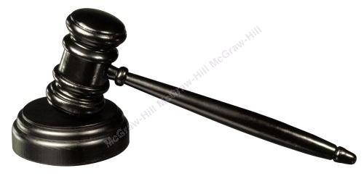
Independent Checks on Government
The Constitution limits federal and state regulation of the economy by three independent checks:
  Freedom of speech
  Due process
  Equal protection
The constitutionality of a particular government action is determined by a means-end tests: rational basis, intermediate scrutiny, and strict scrutiny

Slide 11
The First Amendment
First Amendment guarantees freedoms of religion, speech, press, assembly, and petition to individuals
  And to corporations
Protection has never been afforded to certain classes of speech
  False, lewd, obscene, profane, libelous, and insulting speech is not protected
Notes:
U.S. v. Stevens, 130 S. Ct. 1577 (U.S. Sup. Ct. 2010) concerned the constitutionality of a statute that criminalized the creation, sale, or possession of certain depictions of animal cruelty and a website operated by Stevens that depicted scenes of dog fighting. The Supreme Court held that the statute violated the First Amendment protection of free speech and was therefore unconstitutional. In Brown v. Entertainment Merchants Association, 2011 U.S. LEXIS 4802 (2011), the Court struck down a California law that restricted the sale of violent video games to minors.

Slide 12
Commercial Speech
Speech proposing a commercial transaction
  Neither noncommercial expression nor political, thus commercial speech not fully protected
If First Amendment protects the speech, then a restriction is valid if it: (1) seeks to implement a substantial governmental interest, (2) directly advances the interest, and (3) is the least restrictive method of achieving the interest
Notes:
The First Amendment protects commercial speech if the speech concerns lawful activity and is not misleading.

Slide 13
Government Speech
When the government itself speaks, is free to convey its preferred viewpoints and to reject contrary views.
Whether government speech is present depends largely upon the extent to which the government crafted and communicated the messages.
Notes:
The First Amendment protects commercial speech if the speech concerns lawful activity and is not misleading.

Slide 14
Constitutional Limitations
Fifth Amendment prohibits federal government from depriving “any person of life, liberty, or property without due process of law”
  Known as the due process clause
  Applied to states through Fourteenth Amendment by process of incorporation

Slide 15
Constitutional Limitations
Due process clause interpreted liberally to be guarantee of protection from
  Unreasonable procedures
    Procedural due process
  Unreasonable laws
    Substantive due process
Protection from government action
Notes:
Government nexus shown in Brentwood Academy v. Tennessee Secondary School Athletic Association

Slide 16
Constitutional Limitations
Equal protection clause of Fourteenth Amendment applies to states and federal government when classifying people
  Basic test: rational basis (minimal)
Equal protection clause of Fourteenth Amendment applies to states and federal government when classifying people
  Basic test: rational basis (minimal)
Equal protection clause of Fourteenth Amendment applies to states and federal government when classifying people
  Basic test: rational basis (minimal)
Equal protection clause of Fourteenth Amendment applies to states and federal government when classifying people
  Basic test: rational basis (minimal)
Equal protection clause of Fourteenth Amendment applies to states and federal government when classifying people
  Basic test: rational basis (minimal)
Equal protection clause of Fourteenth Amendment applies to states and federal government when classifying people
  Basic test: rational basis (minimal)
Equal protection clause of Fourteenth Amendment applies to states and federal government when classifying people
  Basic test: rational basis (minimal)
Equal protection clause of Fourteenth Amendment applies to states and federal government when classifying people
  Basic test: rational basis (minimal)
Equal protection clause of Fourteenth Amendment applies to states and federal government when classifying people
  Basic test: rational basis (minimal)
Notes:
Fitzgerald v. Racing Association of Central Iowa. Before 1989, Iowa permitted one form of gambling: parimutuel betting at racetracks. A 1989 statute authorized other forms of gambling, and a 1994 law further expanded gambling activities, but changed the tax structure. A group of racetracks and an association of dog owners brought suit against Iowa arguing that the tax structure violated the Equal Protection Clause. The Iowa Supreme Court concluded that the tax structure failed to meet the rational-basis review because the tax rate differential frustrated the law’s objective to rescue the racetracks from economic distress. The case was appealed to the U.S. Supreme Court, which broadly applied the rational-basis test to conclude that there is “a plausible policy reason for the classification.”
Bush v. Gore An equal protection claim involving the fundamental right to vote was addressed in high-profile fashion by the Supreme Court in Bush v. Gore (2000). A five-justice majority in the historic and controversial decision terminated an ongoing vote recount in Florida because, in the majority’s view, Florida law’s “intent of the voter” test was not a sufficiently clear standard for determining whether a ballot not counted in the initial machine count should be counted as valid during the manual recount. The majority was concerned that in the absence of a more specific standard, vote counters taking part in the recount might apply inconsistent standards in determining what the voter supposedly intended, and might thereby value some votes over others.

Slide 17
Constitutional Limitations
Equal protection clause prohibits government from treating one person differently than another without reasonable grounds for classifying differently
  “Suspect” classifications (race, gender, ethnicity) require higher level of scrutiny
Examples: Gratz v. Bollinger, Grutter v. Bollinger

Slide 18
The Gratz & Grutter Cases
Facts:
  Caucasian, academically-qualified applicants denied admission to University of Michigan’s undergraduate college (Gratz) or law school (Grutter)
  Plaintiffs filed suit alleging discrimination violating the Equal Protection Clause and Title VI of the Civil Rights Act of 1964
  Undergraduate admissions process applied point advantage to minority applicants
  Law school admissions process was “narrowly tailored,” individualized, and not a quota system
Notes:
The hyperlinks are to the opinions and related information provided by the Oyez Project website.

Slide 19
The Gratz & Grutter Cases
U.S. Supreme Court Decision:
  Applicable legal precedents & public policy:
    Student body diversity is a compelling state interest
      Regents University of California v. Bakke
    “All racial classifications reviewable under the Equal Protection Clause must be strictly scrutinized”
      Adarand Constructors, Inc. v. Pena

Slide 20
The Gratz & Grutter Cases
U.S. Supreme Court Decision (cont.):
  Racial classifications are constitutional only if they are narrowly tailored to further compelling governmental interests
    Regents University of California v. Bakke
  Applying law to facts (conclusion):
    Undergraduate admission process not narrowly tailored enough
    Law school admission process is individualized and flexible enough

Slide 21
Obergefell v Hodges
Does the 14th Amendment require a state to issue a marriage license to same sex couples? Same-sex couples seek the same legal treatment as opposite-sex marriage and without this legal right their personhood would be denied
The Court held that same-sex couples have the same the fundamental right to marry in all the states.

Slide 22
The Takings Clause
Phrase “depriving a person … of property” known as the takings clause
Interpreted to require government to pay property owner just compensation in exchange for taking property by eminent domain; public use purpose required
  “Takings” for economic development purpose satisfies public use requirement
    Kelo v. City of New London
Notes:
The hyperlink is to the case provided by the Oyez Project. The Supreme Court’s 2005 decision in Kelo created substantial controversy.
Does the government’s taking of private property for the purpose of economic development satisfy the public use requirement set forth in the Fifth Amendment’s Takings Clause? In Kelo v. City of New London, 2005 U.S. LEXIS 5011 (2005), the U.S. Supreme Court answered “yes.”
The takings clause often has been litigated in the context of environmental statutes, such as those protecting wetlands.

Slide 23
Test Your Knowledge
True=A, False = B
  The Constitution establishes a tripartite government.
  The federal government has exclusive power over matters of war and taxation.
  States possess exclusive power to enact laws to protect welfare, health, and safety.
  The Fifth Amendment prohibits depriving any person of life, liberty or happiness.
  Federal supremacy means that the U.S. Constitution is the supreme law of the land.
Notes:
True; the executive, legislative, and judicial branches.
False. Both federal and state levels of government have the power to tax.
True.
False. First, there is no Constitutional guarantee of “happiness.” Second, the prohibition is against the government from “depriving any person of life, liberty, or property without due process.”
True.

Slide 24
Test Your Knowledge
True=A, False = B
  The Federal government may not interfere with interstate commerce
  The federal government may not restrict individual or commercial speech
  Constitutional limitations on governmental power includes the Fifth Amendment
  The “takings clause” means that the federal government cannot take away an individual’s freedom
Notes:
False, since the Commerce Clause provides that the federal government has the power to regulate interstate commerce.
False, since a restriction on commercial speech is valid if it (1) seeks to implement a substantial gov’t interest, (2) directly advances the interest, and (3) is the least restrictive method of achieving the interest.
True.
False. The “takings clause” refers to the prohibition against the government taking an individual’s property without due process, and due process means (essentially) just compensation. The real issue, however, is almost always what compensation is “just?”

Slide 25
Test Your Knowledge
Multiple Choice
  Courts apply a means-ends test to review an allegedly unconstitutional statute. Which level of scrutiny applies to a statute that gives benefits to people based on their religion?
    Minimal scrutiny
    Intermediate scrutiny
    Strict scrutiny
Notes:
The answer is (c) because the basis is religion, thus the law is presumed invalid.

Slide 26
Test Your Knowledge
Multiple Choice
  Substantive due process refers to a prohibition against:
    Unreasonable procedures
    Unreasonable laws
    Unreasonable (unfair) results
Notes:
The answer is (b), unreasonable laws. Procedural due process protects from unreasonable procedures.

Slide 27
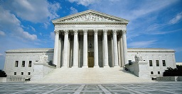
Thought Question
What constitutional issues are important to you?

