Slide 1
Chapter 4
Revising Business Messages

Slide 2
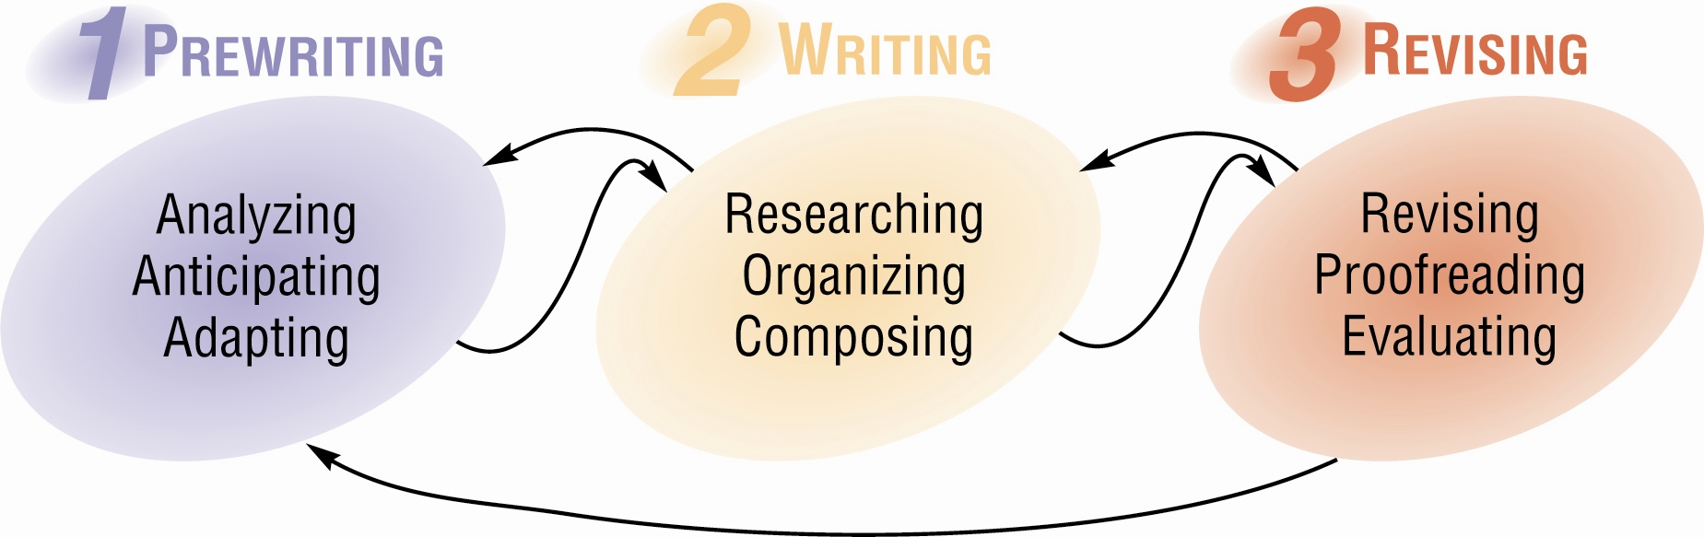
The Writing Process
Mary Ellen Guffey & Dana Loewy, Essentials of Business Communication, 9th Edition
Chapter 4, Slide 2

Slide 3
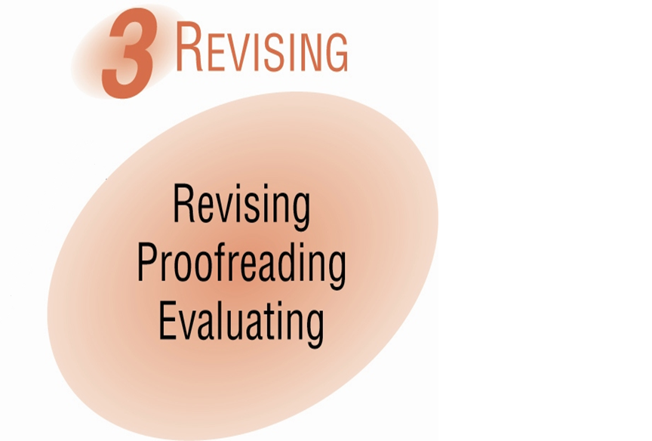
Phase 3 of the Writing Process
Mary Ellen Guffey & Dana Loewy, Essentials of Business Communication, 9th Edition
Chapter 4, Slide 3

Slide 4
Phase 3: Revising
Improving content and
sentence structure
May involve adding,
cutting, and reformatting.
Revising
Correcting grammar,
spelling, punctuation,
format, and mechanics
Proofreading
Mary Ellen Guffey & Dana Loewy, Essentials of Business Communication, 9th Edition
Chapter 4, Slide 4

Slide 5

Phase 3: Revising
The Goals of Business Writing:
  Conciseness
  Clarity
  Vigor and directness
  Readability
Mary Ellen Guffey & Dana Loewy, Essentials of Business Communication, 9th Edition
Chapter 4, Slide 5

Slide 6
Revising for Conciseness
Eliminate flabby expressions.
Poor:
We are of the opinion that
Please feel free to
In addition to the above
At this point in time
Despite the fact that
Improved:
We think
Please
Also
Now
Although
Mary Ellen Guffey & Dana Loewy, Essentials of Business Communication, 9th Edition
Chapter 4, Slide 6

Slide 7
Revising for Conciseness
Limit long lead-ins.
Poor:
This e-mail message is to inform you that we will meet on Friday.
I am writing this letter to say thanks to everyone who voted.
Improved:
We will meet on Friday.
Thanks to everyone who voted.
Mary Ellen Guffey & Dana Loewy, Essentials of Business Communication, 9th Edition
Chapter 4, Slide 7

Slide 8
Revising for Conciseness
Drop unnecessary fillers, such as there is/was and it is/was .
Poor:
There are three items we must discuss today.
It was Lisa and Jeff who were honored.
Improved:
We must discuss three items today.
Lisa and Jeff were honored.
Mary Ellen Guffey & Dana Loewy, Essentials of Business Communication, 9th Edition
Chapter 4, Slide 8

Slide 9
Revising for Conciseness
Reject redundancies.
What words could be omitted in these expressions?
advance warning
close proximity
exactly identical
filled to capacity
final outcome
necessary requisite
new beginning
past history
refer back
serious danger
Mary Ellen Guffey & Dana Loewy, Essentials of Business Communication, 9th Edition
Chapter 4, Slide 9

Slide 10
Revising for Conciseness
Reject redundancies.
What words could be omitted in these expressions?
advance warning
close proximity
exactly identical
filled to capacity
final outcome
necessary requisite
new beginning
past history
refer back
serious danger
Mary Ellen Guffey & Dana Loewy, Essentials of Business Communication, 9th Edition
Chapter 4, Slide 10

Slide 11
Making Sentences Concise
Poor:
Improved:
This e-mail message is to inform you that there is a new health benefit plan available for employees.
A new health benefit plan is available for employees.
I would like to take this opportunity to inform everyone that in all probability we expect to win the contract.
We will probably win the contract.
Mary Ellen Guffey & Dana Loewy, Essentials of Business Communication, 9th Edition
Chapter 4, Slide 11

Slide 12
Making Sentences Concise
Poor:
Improved:
In addition to the above, there are contracts that are attached to this message.
Two contracts are also attached.
Despite the fact that most information is posted on the company intranet, please feel free to call whenever necessary.
Although most information is posted on the company intranet, please call whenever necessary.
Mary Ellen Guffey & Dana Loewy, Essentials of Business Communication, 9th Edition
Chapter 4, Slide 12

Slide 13
Revising for Clarity
Dump trite business expressions.
Trite and Outdated
as per your request
attached hereto enclosed please find pursuant to your request
thank you in advance
under separate cover
Modern
at your request
attached
enclosed is/are
at your request
thank you
separately
Mary Ellen Guffey & Dana Loewy, Essentials of Business Communication, 9th Edition
Chapter 4, Slide 13

Slide 14
Revising for Clarity
Avoid jargon—technical terms and special terminology.
Computer Jargon
queue
export
bandwidth
Alternatives
list of documents waiting to be printed
transfer data from one program to another
Internet capacity
Is jargon ever permissible?
Mary Ellen Guffey & Dana Loewy, Essentials of Business Communication, 9th Edition
Chapter 4, Slide 14

Slide 15
Revising for Clarity
Avoid slang—informal expressions with arbitrary or extravagantly changed meanings.
Slang
sick
clueless
turkey
chill/chill out
Alternatives
great, amazing
unaware, naïve
someone stupid or silly
relax
Mary Ellen Guffey & Dana Loewy, Essentials of Business Communication, 9th Edition
Chapter 4, Slide 15

Slide 16
Revising for Clarity
Drop clichés.
Substitute precise words for overused expressions.
Poor:
Last but not least, you should keep your nose to the grindstone.
We had reached the end of our rope.
Improved:
Finally, you should work diligently.
We could go no further.
Mary Ellen Guffey & Dana Loewy, Essentials of Business Communication, 9th Edition
Chapter 4, Slide 16

Slide 17
Making Sentences Clear and Concise
Poor:
Improved:
Last but not least, the attorney referred back to an exactly identical case.
Finally, the attorney referred to an identical case.
With a little advance warning, we could have sold out before our stocks tanked.
With warning, we could have sold before our stocks declined in value.
Mary Ellen Guffey & Dana Loewy, Essentials of Business Communication, 9th Edition
Chapter 4, Slide 17

Slide 18
Making Sentences Clear and Concise
Poor:
Improved:
Ms. Miller, who shoots straight from the shoulder, demanded final completion by January 1.
Ms. Miller, who is straightforward, demanded completion by January 1.
Pursuant to your request, enclosed please find a check for $150.
As you requested, a check for $150 is enclosed.
Mary Ellen Guffey & Dana Loewy, Essentials of Business Communication, 9th Edition
Chapter 4, Slide 18

Slide 19
Revising for Vigor and Directness
Unbury verbs.
Revise verbs that have been converted to nouns.
Look for words ending in
tion or ment. Could they
be more efficiently and
forcefully converted to verbs?
Tip
Mary Ellen Guffey & Dana Loewy, Essentials of Business Communication, 9th Edition
Chapter 4, Slide 19

Slide 20
Revising for Vigor and Directness
Unbury verbs.
Poor:
The manager came to the realization that social networking made sense.
A job seeker must make application before May 1.
Improved:
The manager realized that social networking made sense.
A job seeker must apply before May 1.
Mary Ellen Guffey & Dana Loewy, Essentials of Business Communication, 9th Edition
Chapter 4, Slide 20

Slide 21
Revising for Vigor and Directness
Unbury verbs.
Poor:
Once we have the establishment of a Web site, our business will grow.
Please give serious consideration to a company vanpool.
Improved:
Once we establish a Web site, our business will grow.
Please seriously consider a company vanpool.
Mary Ellen Guffey & Dana Loewy, Essentials of Business Communication, 9th Edition
Chapter 4, Slide 21

Slide 22
Revising for Vigor and Directness
Control exuberance.
Limit intensifiers very, definitely, quite, really, completely, extremely, actually, and totally.
Excessive
The manager is actually quite pleased with your proposal because the plan is definitely workable.
Professional
The manager is pleased with your proposal because the plan is workable.
Mary Ellen Guffey & Dana Loewy, Essentials of Business Communication, 9th Edition
Chapter 4, Slide 22

Slide 23
Revising for Vigor and Directness
Choose clear, precise words.
Strive for specific verbs, concrete nouns, and vivid adjectives. Beware of unclear pronouns.
Unclear
The man asked for a raise.
An employee presented a proposal.
More precise
Jeff Jones asked for a 10 percent salary increase.
Kelly Keeler, production manager, presented a plan to stagger hours.
Mary Ellen Guffey & Dana Loewy, Essentials of Business Communication, 9th Edition
Chapter 4, Slide 23

Slide 24
Revising for Vigor and Directness
Choose clear, precise words.
Include descriptive, dynamic adjectives instead of overworked, all-purpose ones.
Poor:
They thought her report was good.
She said she would get in touch.
Improved:
The management council thought Erin’s report was factual and well written.
Sheila said she would send you a text message.
Mary Ellen Guffey & Dana Loewy, Essentials of Business Communication, 9th Edition
Chapter 4, Slide 24

Slide 25
Revising for Vigor and Directness
Poor:
Improved:
The seller said he definitely would contact you.
The seller promised to e-mail you.
We must give encouragement to our team.
We must encourage our team.
Mary Ellen Guffey & Dana Loewy, Essentials of Business Communication, 9th Edition
Chapter 4, Slide 25

Slide 26
Revising for Vigor and Directness
Poor:
Improved:
Moviegoers actually show a total preference for buttered popcorn.
Moviegoers prefer buttered popcorn.
Please make an assessment of the home’s value.
Please assess the home’s value.
Ann made a suggestion that we hire Lee.
Ann suggested that we hire Lee.
Mary Ellen Guffey & Dana Loewy, Essentials of Business Communication, 9th Edition
Chapter 4, Slide 26

Slide 27

Revising for Readability
Employ white space.
  Headings
  Short paragraphs
  Ragged-right margins
Mary Ellen Guffey & Dana Loewy, Essentials of Business Communication, 9th Edition
Chapter 4, Slide 27

Slide 28

Revising for Readability
Choose appropriate typefaces.
Serif typefaces have small features at the end of strokes.
      Times New Roman
      Century
      Georgia
      Palatino
Mary Ellen Guffey & Dana Loewy, Essentials of Business Communication, 9th Edition
Chapter 4, Slide 28

Slide 29

Revising for Readability
Choose appropriate typefaces.
Sans serif typefaces are cleaner without features. They are useful for headings, signs, and noncontinuous reading material.
      Arial
      Tahoma
      Verdana
      Calibri
Mary Ellen Guffey & Dana Loewy, Essentials of Business Communication, 9th Edition
Chapter 4, Slide 29

Slide 30
Revising for Readability
Capitalize on type fonts and sizes.
  Font style: a specific style (such as italic, boldface, underline, ALL CAPS) within a typeface family (such as Arial)
  Font size: measured in points
    Most readers are comfortable with 10- to 12-point type for body text.
    Larger font size is appropriate for titles and headings.
Mary Ellen Guffey & Dana Loewy, Essentials of Business Communication, 9th Edition
Chapter 4, Slide 30

Slide 31
Revising for Readability
Use numbered and bulleted lists.
Break up complex information into smaller chunks to ensure rapid comprehension.
Numbered lists: Use for sequences.
Bulleted lists: Use for items that don’t require a certain order.
Capitalize the first word of each item.
Add end punctuation only to items that are complete sentences.
Make each item parallel.
Mary Ellen Guffey & Dana Loewy, Essentials of Business Communication, 9th Edition
Chapter 4, Slide 31

Slide 32
Revising for Readability
Use numbered lists for items that don’t require a certain order.
Poor: We want to hire an accounting assistant who has good communication skills, experience with Excel, and a two-year college degree.
Improved: We want to hire an accounting assistant with these qualifications: Good communication skills Excel experience Two-year college degree.
Mary Ellen Guffey & Dana Loewy, Essentials of Business Communication, 9th Edition
Chapter 4, Slide 32

Slide 33
Revising for Readability
Use bulleted lists for instructions.
Poor: To clean the printer, you should do the following. First, you should disconnect the power cord. Then you open the front cover, and the printer area should be cleaned with a soft cloth.
Improved:
To clean the printer, do the following:
1. Disconnect the power cord.
2. Open the front cover.
3. Clean the printer with a soft cloth.
Mary Ellen Guffey & Dana Loewy, Essentials of Business Communication, 9th Edition
Chapter 4, Slide 33

Slide 34

Revising for Readability
Add headings for visual impact.
Poor: On April 3 we will be in Toledo, and the speaker is Troy Lee. On May 20 we will be in Detroit, and the speaker is Sue Wu.
Improved:
Date City Speaker
April 3 Toledo Troy Lee
May 20 Detroit Sue Wu
Mary Ellen Guffey & Dana Loewy, Essentials of Business Communication, 9th Edition
Chapter 4, Slide 34

Slide 35
Revising for Readability
Use paragraph headings to improve organization and readability.
Poor: The next topic is vacations. A new vacation schedule will be available on May 1. To assist employees, we will begin a flex schedule in the fall.
Improved:
Vacations. A new vacation schedule will be available on May 1.
Flextime. To assist employees, we will begin a flex schedule in the fall.
Mary Ellen Guffey & Dana Loewy, Essentials of Business Communication, 9th Edition
Chapter 4, Slide 35

Slide 36
Improving Readability
Poor:
Improved:
In the next training session, the trainer will demonstrate how to create podcasts, how to share Web programs, and how to build Web directories.
The next training session will demonstrate the following:
Creating podcasts
Sharing programs
Building Web directories
Mary Ellen Guffey & Dana Loewy, Essentials of Business Communication, 9th Edition
Chapter 4, Slide 36

Slide 37
Improving Readability (Practice)
Poor:
Improved:
In preparing for an employment interview, you should begin by studying the job description. Itemizing your most strategic skills and qualifications is also important. Giving responses in a mock interview is another good practice technique.
You can prepare for interviews by doing the following:
Study the job description.
Itemize your most
strategic skills and
qualifications.
Practice giving responses
in a mock interview.
Mary Ellen Guffey & Dana Loewy, Essentials of Business Communication, 9th Edition
Chapter 4, Slide 37

Slide 38

Phase 3: Proofreading
What to watch for in proofreading:
Spelling
Grammar
Punctuation
Names and numbers
Format
Mary Ellen Guffey & Dana Loewy, Essentials of Business Communication, 9th Edition
Chapter 4, Slide 38

Slide 39

Phase 3: Proofreading
How to proofread routine documents:
On your computer screen, focus on one line at a time.
Read carefully for faults such as omitted or double words
Use a spell checker.
Proofread from a hard
copy.
Mary Ellen Guffey & Dana Loewy, Essentials of Business Communication, 9th Edition
Chapter 4, Slide 39

Slide 40

Phase 3: Proofreading
How to proofread complex documents:
Print a copy, preferably double-spaced.
Allow adequate time.
Be prepared to find errors.
Read once for meaning
and once for
grammar/mechanics.
Reduce your reading speed.
Mary Ellen Guffey & Dana Loewy, Essentials of Business Communication, 9th Edition
Chapter 4, Slide 40

Slide 41

Phase 3: Proofreading
For documents that must be perfect:
Have someone read aloud the original while someone else checks the printout.
Spell names.
Spell difficult words.
Note capitalization.
Note punctuation.
Mary Ellen Guffey & Dana Loewy, Essentials of Business Communication, 9th Edition
Chapter 4, Slide 41

Slide 42

Phase 3: Evaluating
Answer these questions about your document:
How successful will this message be?
Does it say what you want it to?
Will it achieve its purpose?
How will you know whether
it succeeds?
Mary Ellen Guffey & Dana Loewy, Essentials of Business Communication, 9th Edition
Chapter 4, Slide 42

Slide 43

“I'm not a very good writer, but I'm an excellent rewriter.”
-- James Michener, American writer
Chapter 4, Slide 43

Slide 44
END

