Slide 1
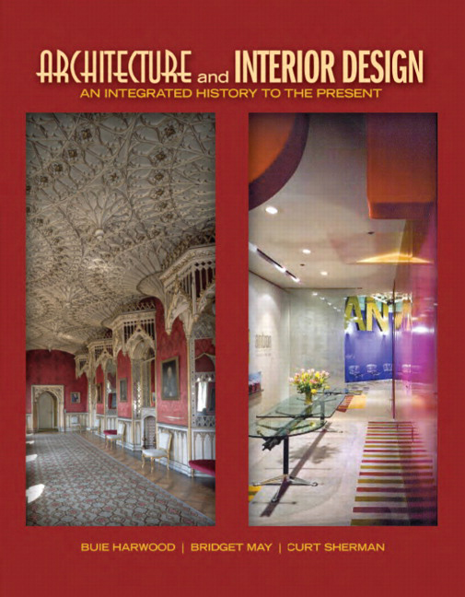

Architecture and Interior Design: An Integrated History to the Present
First Edition
Chapter 60
Neo-Modern
1980s – 2000s
Copyright © 2012 Pearson Education, Inc. All Rights Reserved
Notes:
If this PowerPoint presentation contains mathematical equations, you may need to check that your computer has the following installed:
1) Math Type Plugin
2) Math Player (free versions available)
3) NVDA Reader (free versions available)

Slide 2
Neo-Modern
Designers & architects seek new design language for 21st century
  Challenge concepts & principles of International Style, Late Modern, Post Modern
Innovative, experimental, creative
Characteristic—expressive form, curves, oblique angles, sense of motion, unusual juxtapositions
New ornament—complexity
Usually disregard context & historical precedent; designers make a statement about themselves or challenge traditional ideas
New technology critical to design & production of buildings & objects that become art & individual expressions

Slide 3
Concepts
Reacts to, rebels against, rejects International Style, Late Modern, & Post Modern ideas & images
Worldwide movement seeking greater diversity & new design language for 21st century
Influences: Jacques Derrida, Deconstruction, other 20th century art & design movements
Challenge existing notions of what design should be; deconstruct basic concepts of modern, typology, function, context, formal design language
Do not want to reform society or create a style; “new & diverse forms express diverse functions”
  Humans less important than individual design statement; no attempt to connect with to viewer or user; & symbolism known only to designer

Slide 4
Characteristics and Motifs
Distortion, disruption, deviation characteristic; seeking completely new appearance
  Location, classical & modern traditions, humans ignored
  Devalues structure, grid, form from function
Complex geometry—new ornament; apparent chaos, variety, disorder reflect modern urban environment
Facades, forms, space disconnected, discontinuous
Forms move, unfold, soar, curve, rotate, undulate, interpenetrate, open & close
Most emphasis on form, which does not come from function, context, or human concerns
Motifs—no specific motifs; details often substitute for motifs

Slide 5
Architecture
Complex, expressionistic, dynamic, ambiguous, distorted, disjointed, chaotic, inventive, antihuman, antithesis of previous modern
Reject, deconstruct International Style & Late Modern principles—expression of structure, pure form, truth to materials, form follows function
Discard historic precedent & communication of Post Modern
  Some symbolism but unclear; seem deliberately hostile to public
Very dependent upon computers & software to explore ideas, test performance, construct building
Common building types—less explicit or complex functional requirements & notoriety important—museums, theaters

Slide 6
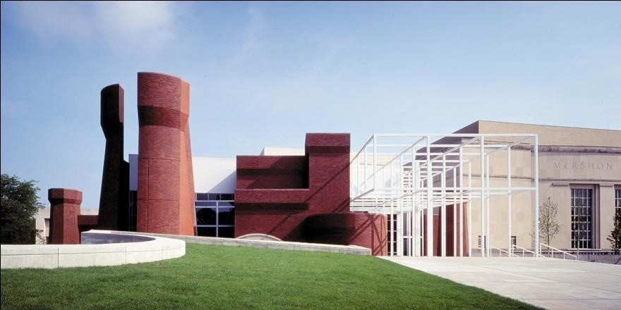
60.1
Wexner Center for the Visual Arts, 1983-1989; Columbus, Ohio; Peter Eisenman. Neo-Modern.
Notes:
Long Description:
The building has an asymmetrical structure. A flat roof rectangle building is on the right. Metal frames are in the middle. The left construction has large irregular-shaped walls and a lawn.

Slide 7
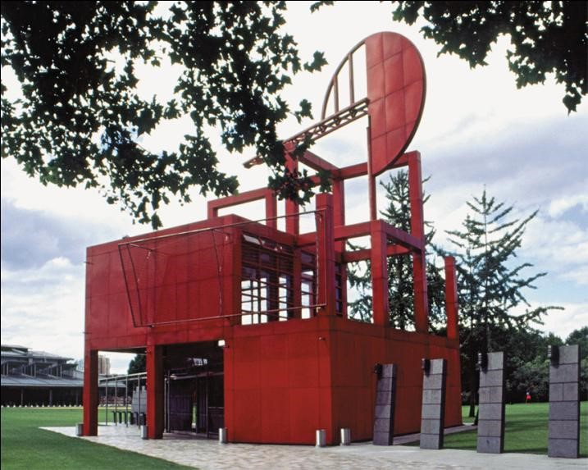
60.2
Follies (Pavilions), Parc de la Villette, 1986-1989; Paris, France; Bernard Tschumi. Neo-Modern.

Slide 8
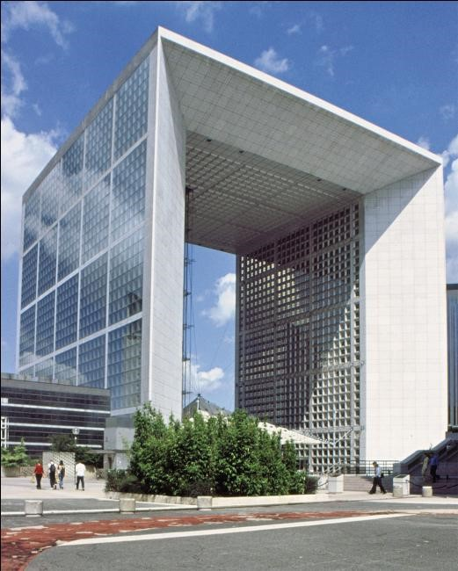
60.3
La Grand Arche, Place de la Defense, 1982-1990; Paris, France; Johann Otto van Spreckelsen. Neo-Modern.

Slide 9
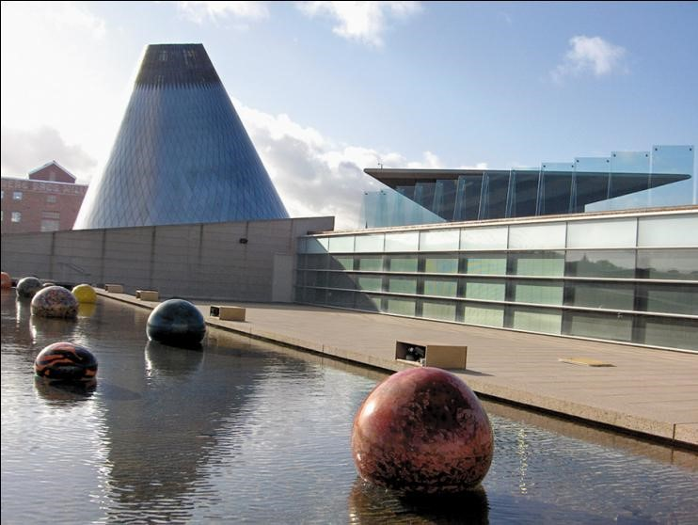
60.4 (1 of 2)
Museum of Glass, 1996; Tacoma, Washington; Arthur Erickson, Nick Milkovich Architects and Thomas Cook Reed Reinvald. Neo-Modern.

Slide 10
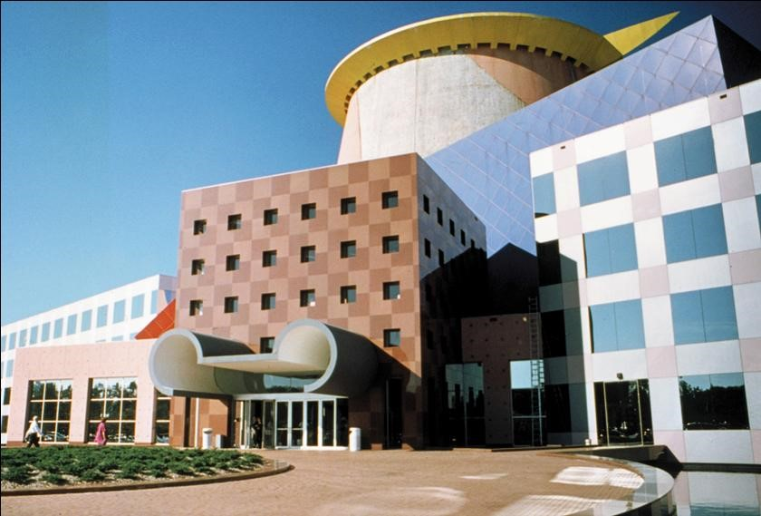
60.4 (2 of 2)
Team Disney Building, 1989-1991; Orlando, Florida; Arata Isozaki. Neo-Modern.
Notes:
Long Description:
The building has an asymmetrical structure. The portico has a roof that has two incomplete circles on the left and the right. The façade has rectangle windows and checkers patterns. The walls have stained glass windows. A circular cupola with a protruded circular roof is on the top.

Slide 11
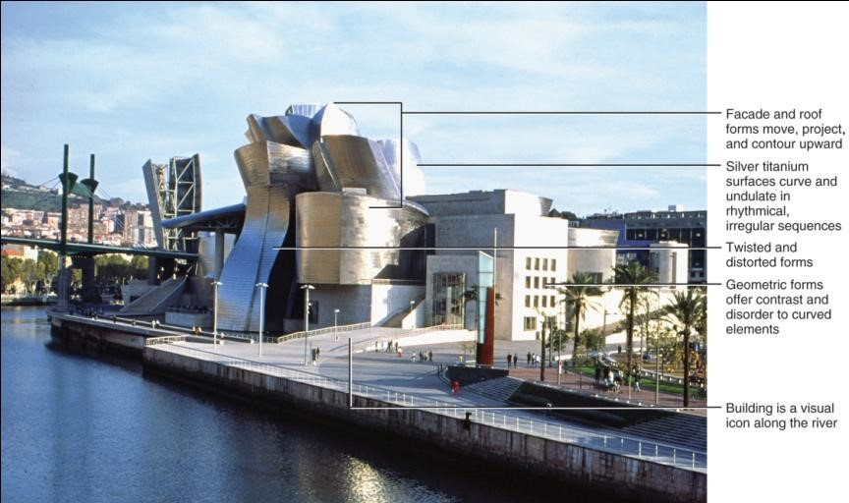
60.6
Guggenheim Museum, 1997; Bilbao, Spain; Frank Gehry and Partners. Neo-Modern.
Notes:
Long Description:
The building has facade and roof forms that move, project, and contour upward. The silver titanium surfaces curve and undulates in rhythmical, irregular sequences. The twisted and distorted forms are on the front. The geometric forms offer contrast and disorder to curved elements. The building is a visual icon along the river.

Slide 12
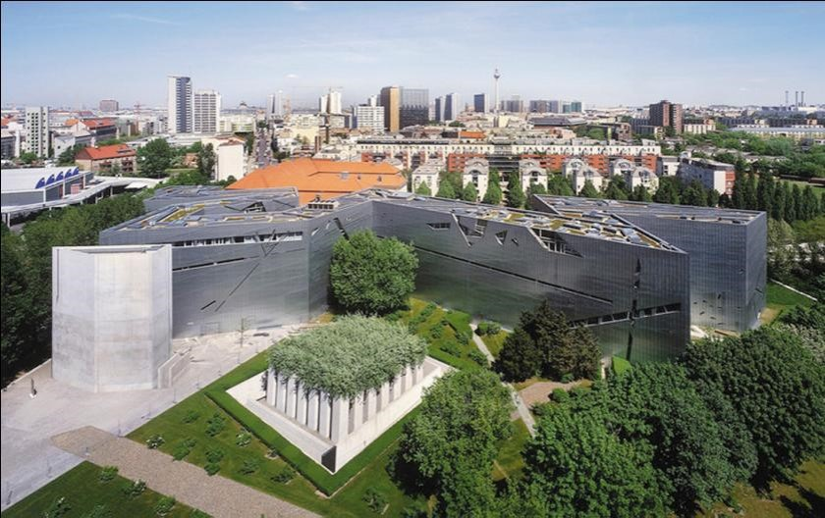
60.7
Jewish Museum, 1989-1999; Berlin, Germany; Daniel Lebeskind. Neo-Modern.
Notes:
Long Description:
It has roof gardens supported by columns. The numerous multiple stories building and towers in the city are visible.

Slide 13
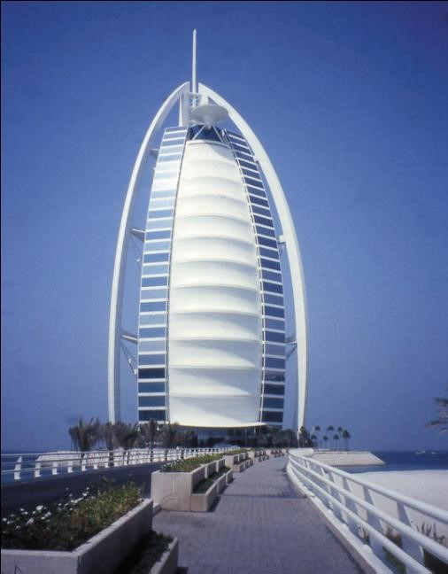
60.8
Burj Al Arab Hotel, 1994-1999; Dubai, United Arab Emirates; Thomas Wright. Neo-Modern.
Notes:
Long Description:
The tall building has its facade covered and decorated with lines. Two large curved columns rise from the floor to the top of the building. The top of the building has a needle and a circular sculpture.

Slide 14
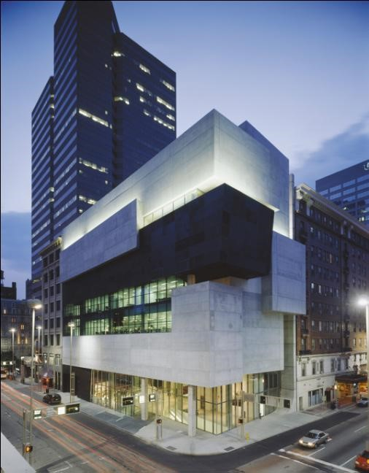
60.9
Rosenthal Center for Contemporary Art, 2003; Cincinnati, Ohio; Zaha Hadid. Neo-Modern.

Slide 15
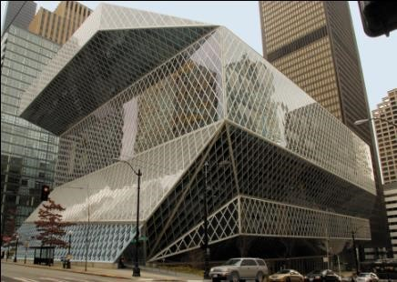
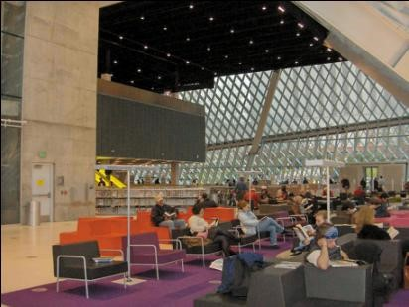
60.10
Seattle Public Library and “Living Room,” 1999-2004; Seattle, Washington; Rem Koolhaas. Neo-Modern.

Slide 16
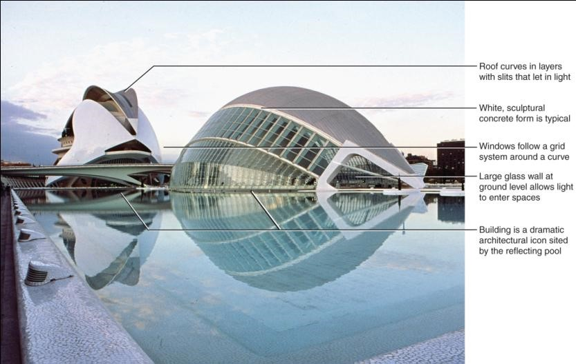
60.11
The City of Arts and Sciences, 1991-2004; Valencia, Spain; Santiago Calatrava. Neo-Modern.
Notes:
Long Description:
The roof curves in layers with slits that let in light. The white sculptural concrete form is typical. The windows follow a grid system around a curve. The large glass wall at ground level allows light to enter spaces. The building is a dramatic architectural icon sited by the reflecting pool.

Slide 17
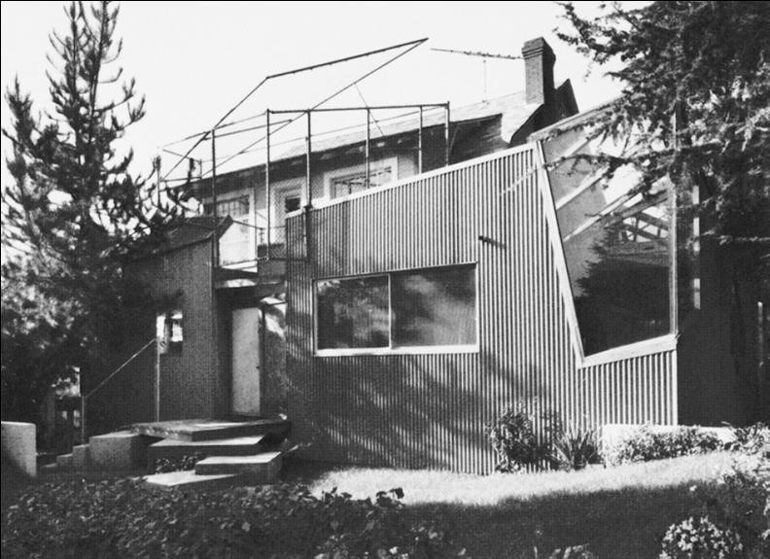
60.12
Gehry House, 1978; Santa Monica, California; Frank Gehry. Neo-Modern.

Slide 18
Interiors
Interiors by architects replicate distinctive exterior form to create integrated whole
  Repeat architectural forms, materials, colors
Seem adverse to intended function and/or user
Discontinuous space; oblique angles; juxtaposition of form, shapes, size, materials
Maybe confusing with inexplicable details
Interior designers work with interior shell but also experiment with form, color, lighting, furnishing
  Energetic, individual, unusual, distinctive
  Creative, original solutions

Slide 19
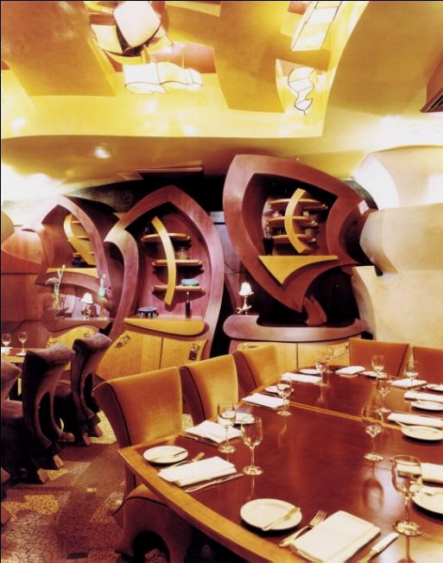
60.13
Iridium Restaurant at Lincoln Center, 1994; New York, New York; Jordan Mozer & Associates. Neo-Modern.

Slide 20
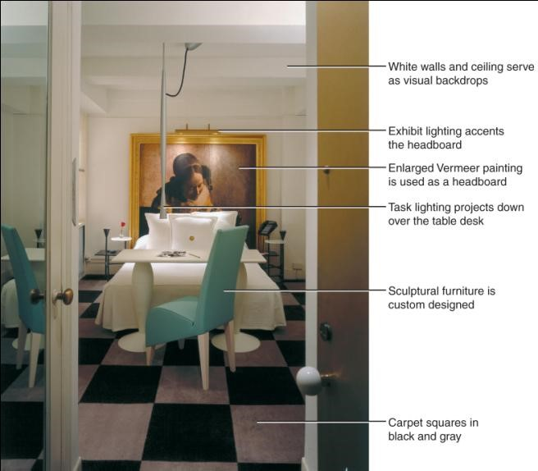
60.14
Guest room, Paramount Hotel, 1990; New York, New York; Philippe Starck. Neo-Modern.
Notes:
Long Description:
It has white walls and a ceiling that serve as visual backdrops. The exhibit lighting accents the headboard. The enlarged Vermeer painting is used as a headboard. The task lighting projects down over the table desk. The sculptural furniture is custom designed. The carpet squares are in black and gray.

Slide 21
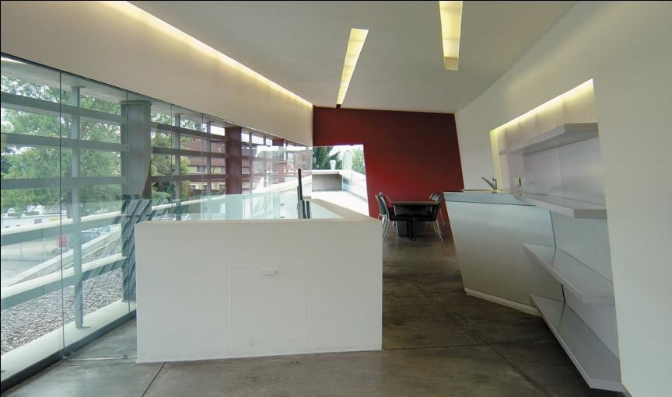
60.15
Interior, Vitra Fire Station, 1994; Weil-am-Rhein, Germany; Zaha Hadid. Neo-Modern.

Slide 22
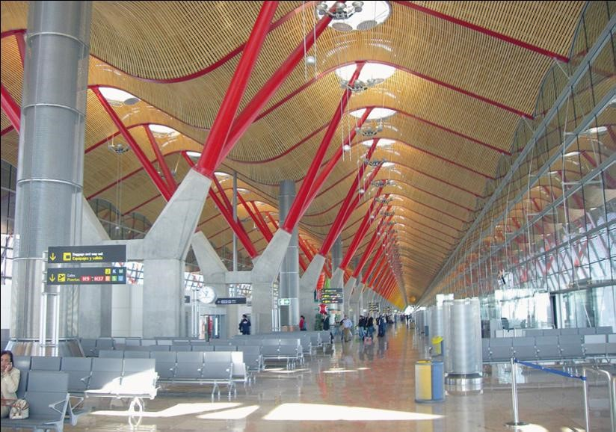
60.16
Interior, Barajas Airport, 1998-2006; Madrid, Spain; Richard Rogers Partnership. Neo-Modern.

Slide 23
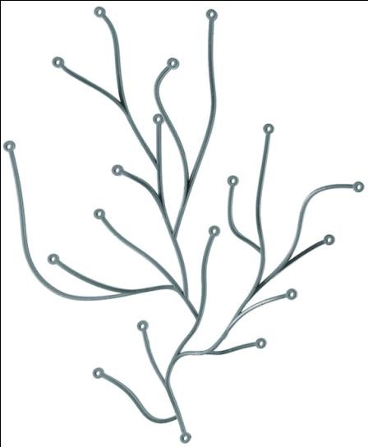
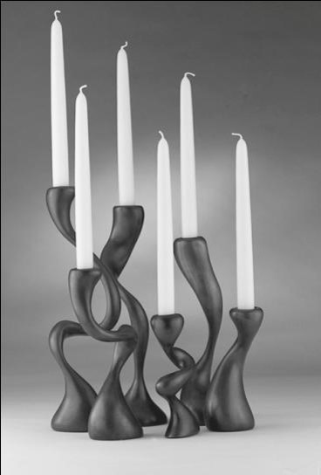
60.17
Lighting: Algue lighting (branching light), 2004, Ronan and Erwan Bouroullec for Vitra; and candelabra, 2005-2006; Jordan Mozer & Associates. Neo-Modern.

Slide 24
Furnishings and Decorative Arts
Expressionistic, artistic, sculptural, individualistic
Less emphasis on function & ergonomics; more on furniture as art
Physical/visual movement, complexity important
Furnishings may be conspicuous or integrated
Challenges traditional ideas of seating, other types
Push envelope, try new or different shapes, materials, forms
Lines, contours, solid/void relationship emphasized
Complexity, fragmentation reflect architecture
Atypical materials
Well-known designers create groups of furniture, textiles, decorative arts

Slide 25
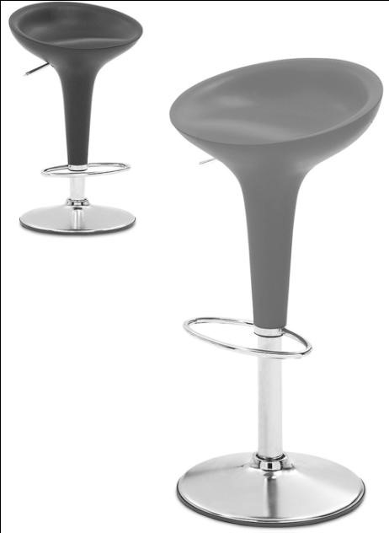
60.18
Bombo bar stool, 1997; Italy; Stefano Giovannoni for Magis. Neo-Modern.

Slide 26
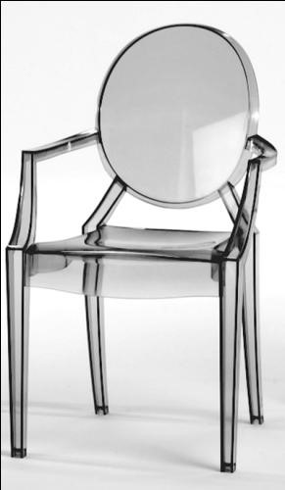
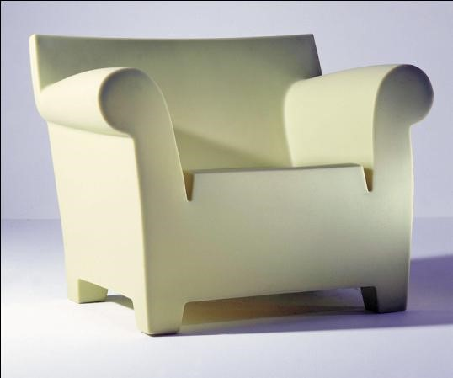
60.19
Louis Ghost armchair and Bubble club chair, 2002; France; Philippe Starck for Kartell. Neo-Modern.

Slide 27
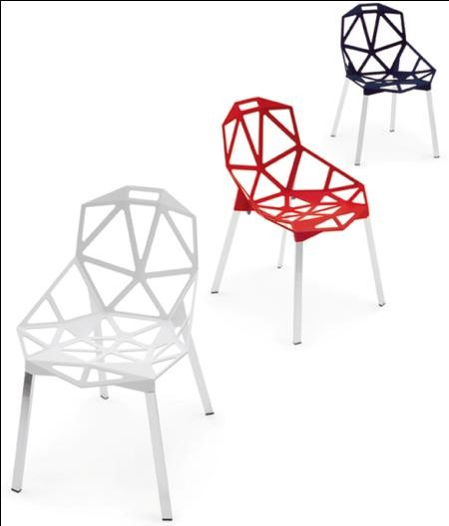
60.20
Chair One, 2003; Italy; Konstantin Grcic for Magis. Neo-Modern.

Slide 28
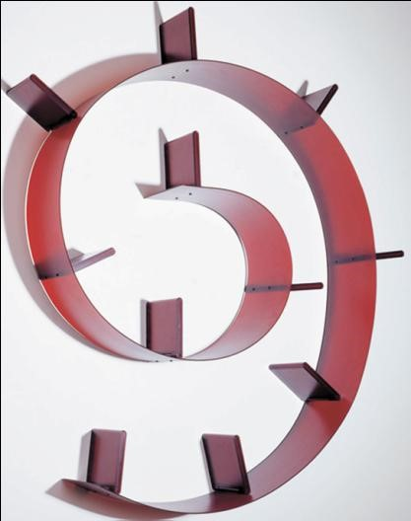
60.21a
Bookworm bookshelf; Italy; Ron Arad Associates for Kartell. Neo-Modern.

Slide 29
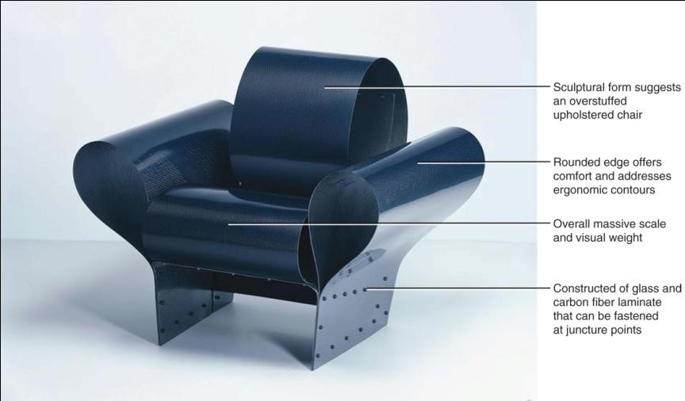
60.21b
Bad Tempered Chair, 2002; England; Ron Arad Associates for Vitra. Neo-Modern.
Notes:
Long Description:
The chair has a sculptural form that suggests an overstuffed upholstered chair. The rounded edge offers comfort and addresses ergonomic contours. The overall massive scale and visual weight. The chair is constructed of glass and carbon fiber laminate that can be fastened at juncture points.

Slide 30
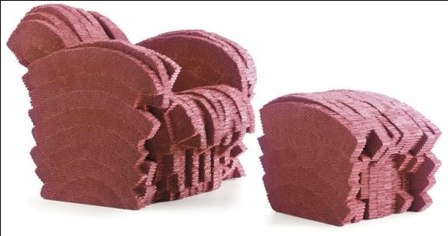
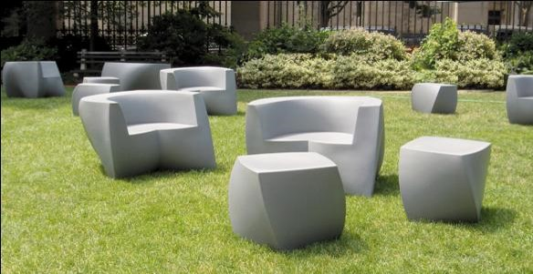
60.22
Red Beaver armchair and stool, 2005; and plastic seating group, 2006-2007; United States and Germany; Frank Gehry for Vitra and Heller. Neo-Modern.

Slide 31
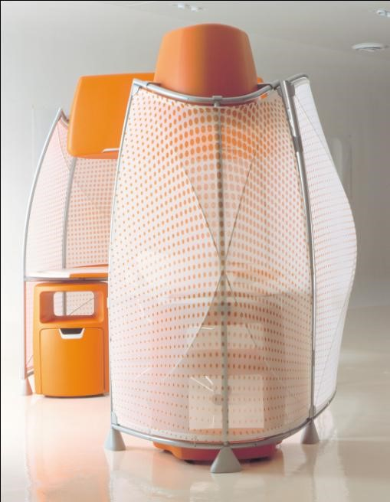
60.23
A3 Systems Furniture, 2002; United States; Hani Rashid at Asymptote for Knoll International. Neo-Modern.

Slide 32

Copyright
This work is protected by United States copyright laws and is provided solely for the use of instructors in teaching their courses and assessing student learning. Dissemination or sale of any part of this work (including on the World Wide Web) will destroy the integrity of the work and is not permitted. The work and materials from it should never be made available to students except by instructors using the accompanying text in their classes. All recipients of this work are expected to abide by these restrictions and to honor the intended pedagogical purposes and the needs of other instructors who rely on these materials.

