Slide 1
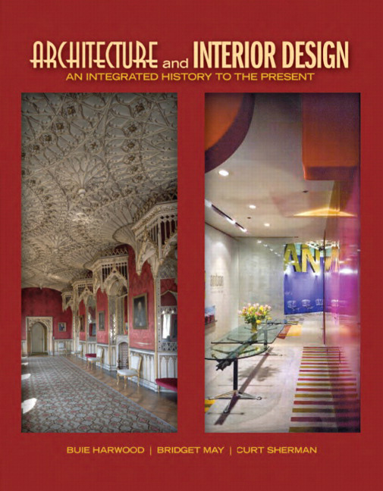

Architecture and Interior Design: An Integrated History to the Present
First Edition
Chapter 59
Environmental Modern
1960s – 2000s
Copyright © 2012 Pearson Education, Inc. All Rights Reserved
Notes:
If this PowerPoint presentation contains mathematical equations, you may need to check that your computer has the following installed:
1) Math Type Plugin
2) Math Player (free versions available)
3) NVDA Reader (free versions available)

Slide 2
Environmental Modern
Responds to macro (building, site) or micro (interior, furniture) environment
Part of larger movement that addresses human needs while safeguarding the earth, its climate, & ecological resources
  Various names—Green Design, Sustainable Design, Eco Design
Concepts expand & evolve to comprehensive design schemes for protecting, conserving, renewing resources
  Include energy conservation, waste management, material conservation, land use & reuse, climate control
Buildings, interiors, furnishings may show evidence of these ideas
Some show strong relationship to nature, site, place

Slide 3
Concepts
Many concepts, theories
  Ideas come from science, ecology, philosophy, psychology
  Reflect comprehensive attitude striving to limit/reverse environmental damage
Actions by individuals, designers, businesses, manufacturers, governments, nations
  Include eliminating waste, reusing or recycling, minimizing energy consumption, improving indoor air quality, using only renewable & durable resources
Environmental concerns affect economic development, urban planning, architecture, construction methods, building materials, interior design, interior finishes, textiles, furniture, decorative arts around the world

Slide 4
Characteristics and Motifs
Appearance varies with designer, client, location, sustainable concepts, new technologies
  Some commonalities: natural materials, earth colors, plants, water features, abundant natural light & air
  Sustainable materials & construction methods often not apparent but positively affect user health & productivity & keeps energy, maintenance costs down
Strongly modern or High Tech examples from those who see technology as means to solve design & environmental problems
Those who see technology as causing problems usually avoid or reject it in favor of cues from location, vernacular types, ancient planning philosophies

Slide 5
Architecture
In late 1960s, some architects new design to surroundings with visible & symbolic links
  Strong sense of place through site, orientation, materials, forms, shapes, colors—Contextualism or Regionalism
From mid 20th century onwards architects increasingly address environmental concerns
  At first, energy conservation & efficiency until more comprehensive schemes develop in 1980s
Principles of green design, sustainable materials, socially responsible use of natural resources for building & site
U S G B C introduces L E E D in 2000
  Benchmark for design, construction, operation of green buildings & later interiors

Slide 6
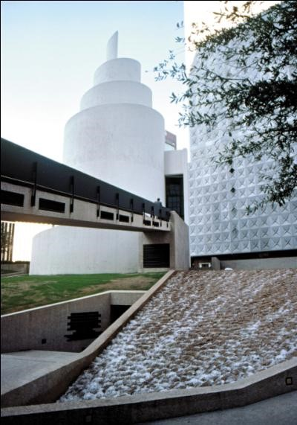
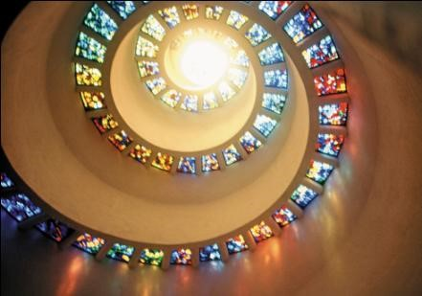
59.1
Thanksgiving Square Chapel and ceiling detail; 1977; Dallas, Texas, Philip Johnson. Environmental Modern.
Notes:
Long Description:
The building has a spiral tower with a sharp needle on the top. A raised passage with a wall railing reaches the spiral tower entrance. The facade wall has numerous square patterns.

Slide 7
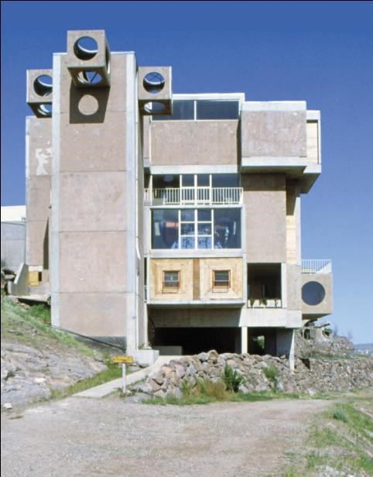
59.2
Arcosanti, 1969 to present; Cordes Lakes Area, Arizona; Paolo Soleri. Environmental Modern.
Notes:
Long Description:
The building has an asymmetrical structure. The facade has a portico and the first story with rectangular glass windows. It has protruded side building has three circular opened walls on its three sides. The side wall has a circle.

Slide 8
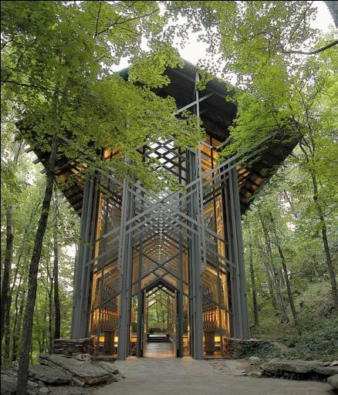
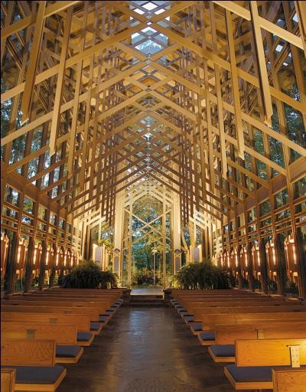
59.3
Thorncrown Chapel and nave, 1978-1980; Eureka Springs, Arkansas; Fay Jones with Maurice Jennings. Environmental Modern.

Slide 9
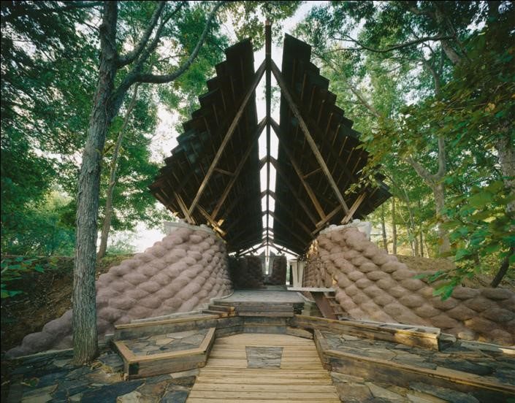
59.4
Yancey Chapel, c. 1990s; Greensboro, Hale County, Alabama; Auburn University’s Rural Studio with Samuel Mockbee. Environmental Modern.

Slide 10
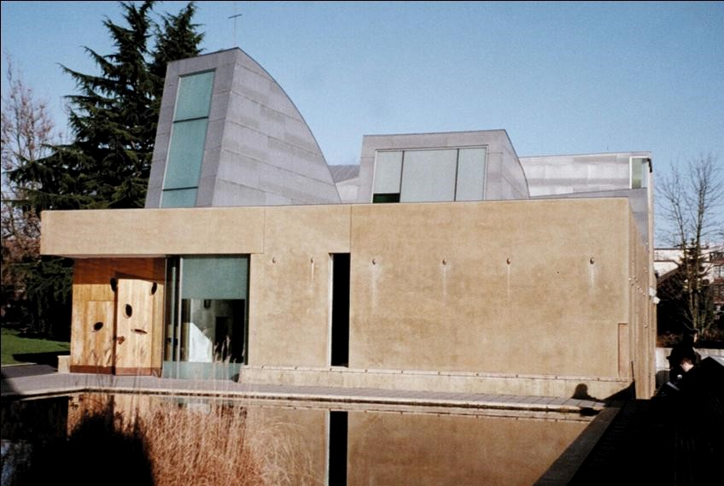
59.5
Chapel of S. Ignatius, Seattle University, 1997; Seattle, Washington; Steven Holl. Environmental Modern.

Slide 11
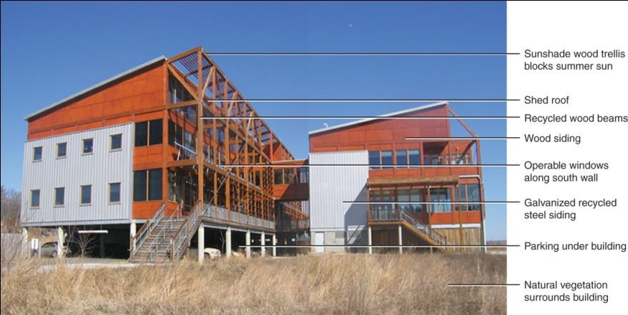
59.6
Chesapeake Bay Foundation Building (Philip Merrill Environmental Center; L E E D Platinum), 2000; Annapolis, Maryland; Smith Group, interiors by Cheryl Brown. Environmental Modern.
Notes:
Long Description:
The top of the building has a sunshade wood trellis that blocks the summer sun. It has a shed roof, recycled wood beams, and wood siding. The facade has operable windows along the south wall. The galvanized recycled steel siding is in the middle. The building has parking underneath. The natural vegetation surrounds the building.

Slide 12
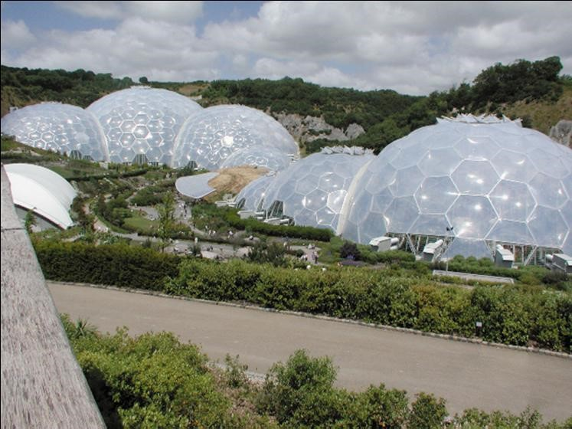
59.7
The Eden Project, 2001; Bodelva, S. Austell, England; Nicholas Grimshaw.

Slide 13
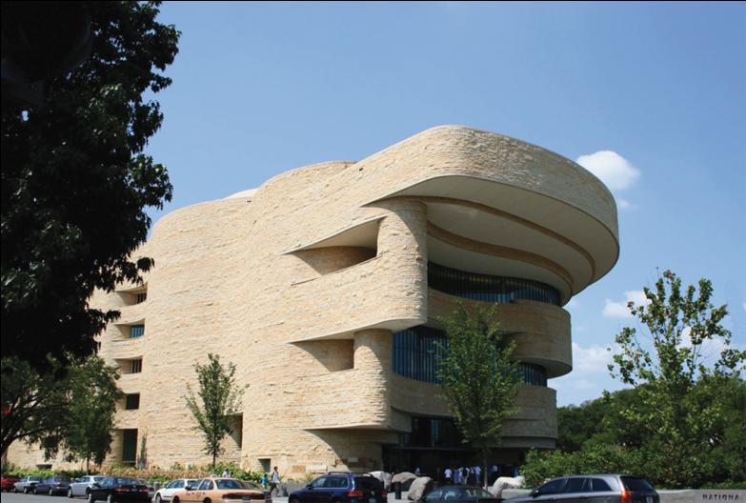
59.8
National Museum of the American Indian, 2004; Washington, D.C.; Douglas Cardinal, G B Q C Architects, Jones & Jones, SmithGroup, Polshek Partnership, and the Native America Design Collaborative. Environmental Modern.
Notes:
Long Description:
The building has multiple stories. It has a portico with a roof on the top story. The story has circular balconies. The roof is supported by columns on the pedestal. The side wall has wall railings for multiple stories.

Slide 14
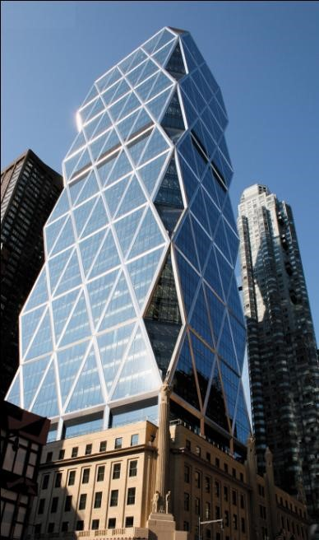
59.9
Hearst Building (L E E D Gold), 2006; New York, New York; Foster and Partners with Adamson Associates. Original lower façade by Joseph Urban, 1920s. Environmental Modern.
Notes:
Long Description:
The building has multiple stories with symmetrical structures and rectangular glass windows. A large tower rises from the top of the building. The tower has glass walls and a geometrical pattern shape.

Slide 15
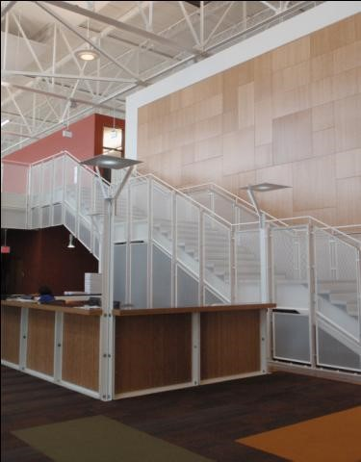
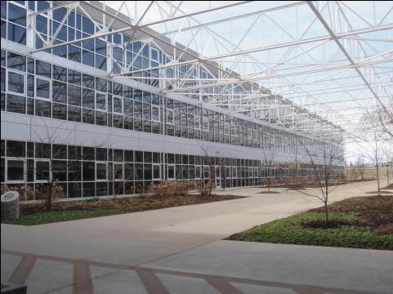
59.10
Alberici Redevelopment Corporation (L E E D Platinum), 2002; St. Louis, Missouri; Mackey Mitchell Associates with Vertegy as integrated design manager. Environmental Modern.

Slide 16
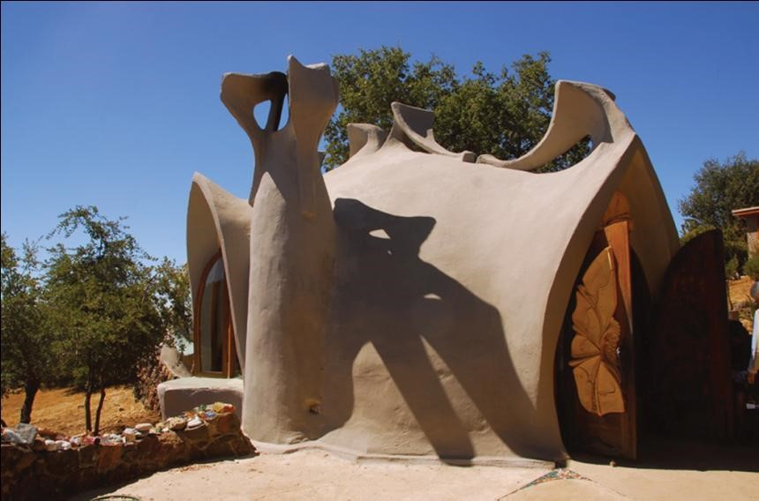
59.11
House, James Hubbell Compound, c. 1990s; Santa Ysabel, California; James Hubbell, Designer. Environmental Modern.

Slide 17
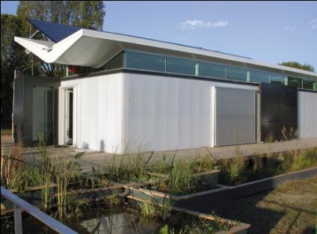
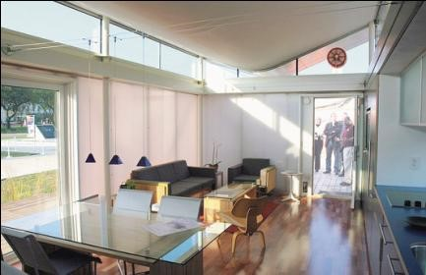
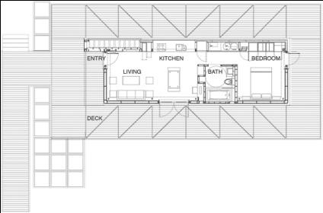
59.12 (1 of 2)
Sustainable House, Solar Decathlon Design Competition, floor plan, and interior, 2005; Washington D.C. Virginia Tech University Design Team and Faculty. Environmental Modern.

Slide 18
Interiors
Aesthetically pleasing interior environments that respond to & support human needs & functions
  Designs vary in response to environmental concerns
  Nonresidential—health, safety, welfare important
  Integrate exterior & interior designs, materials
L E E D certification increasingly important for new & existing interiors
  Interior solutions: nature-based; sense of place; High Tech & Minimal interiors; calming, refuges from daily stress
    Environmentally friendly and/or recycled materials
    Industrial looking forms, little or no applied ornament, rich textures, unique focal points; custom designed furnishings

Slide 19
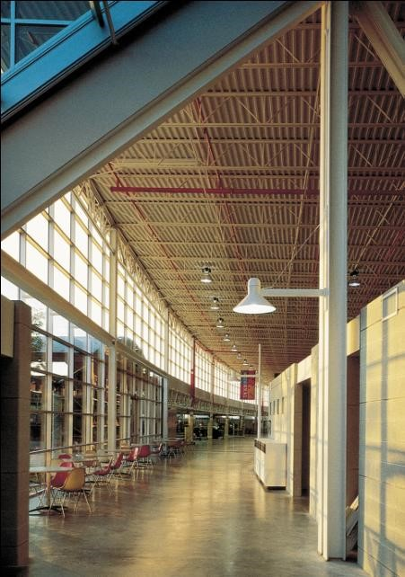
59.12 (2 of 2)
“The Street,” Herman Miller Greenhouse Factory & Offices, 1995; Holland, Michigan;
William McDonough
Partners with VerBurg & Associates. Environmental Modern.

Slide 20
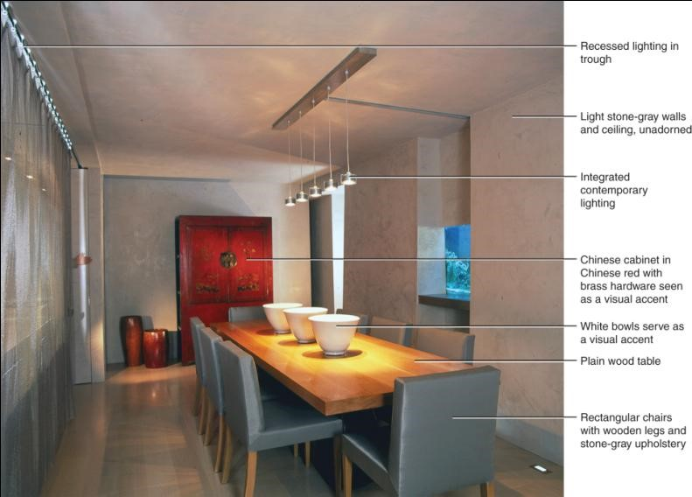
59.14
Dining room, Downtown Duplex, 2002; New York, New York; Clodagh. Environmental Modern.
Notes:
Long Description:
The dining room has recessed lighting in trough, and the light stone gray walls and ceiling, are unadorned. It has integrated contemporary lighting. The Chinese cabinet in Chinese red with brass hardware is seen as a visual accent. The white bows serve as a visual accent. The table is a plain wood table. The chairs are rectangular chairs with wooden legs and stone gray upholstery.

Slide 21
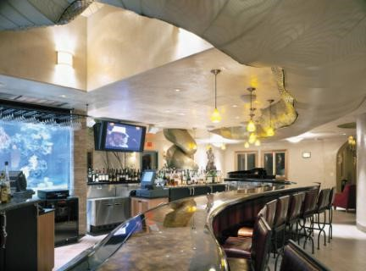
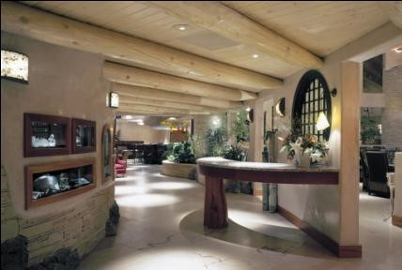
59.15
Hostess area and Anaconda Bar, E l Monte Sagrada Resort, 2005; Taos, New Mexico; David Sargert, Sargert Design Associates. Environmental Modern.

Slide 22
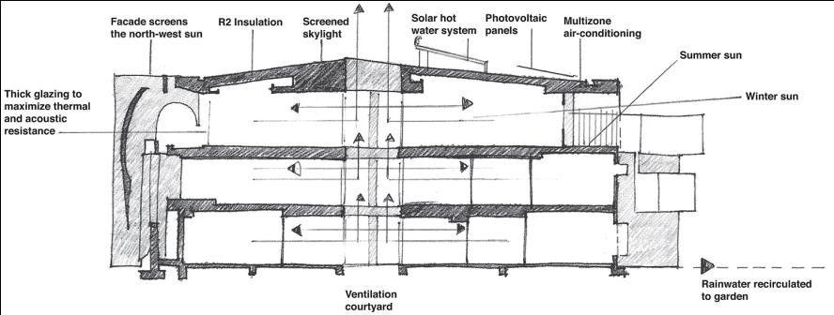
59.16
Section, Swart Residence, 2004; Melbourne, Australia; Peter Carmichael. Environmental Modern.
Notes:
Long Description:
The building has thick glazing to maximize thermal and acoustic resistance. The facade screens the north west sun. It has R 2 insulation and screened skylight. The solar hot water system and the photovoltaic panels are on the top. The multizone air conditioning is installed. The summer sun and winter sun are visible. The rainwater is recirculated into the garden. The ventilation courtyard is visible.

Slide 23
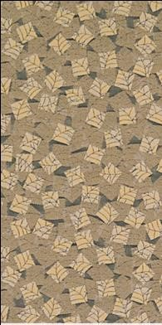
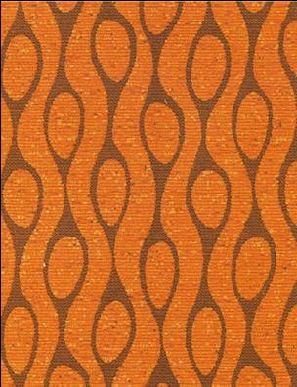
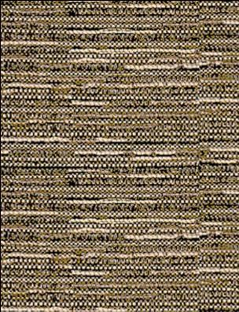
59.17
Textiles: Fabrics from left: Banyon, Finn, and Tibet; 2007; Architex. Environmental Modern.

Slide 24
Furnishings and Decorative Arts
Simplicity; vernacular or Late Modern stylistic characteristics; minimal use of materials; eco-friendly materials & production methods
All or partially sustainable, natural or non-toxic materials, recycled parts
Looks: handcrafted; sleek modern High Tech; inspired by nature
Commercial quickly adopts sustainable principles; residential slower to do so
Manufacturers address sustainability within entire production process, use, end-of-life cycle
  Reduce, reclaim, reuse, recycle; L E E D ratings
  Small, but growing, part of market

Slide 25
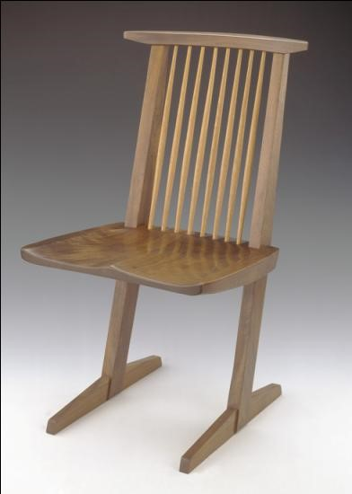
59.18
Conoid chair, c. 1970s; New Hope, Pennsylvania; George Nakashima. Environmental Modern.

Slide 26
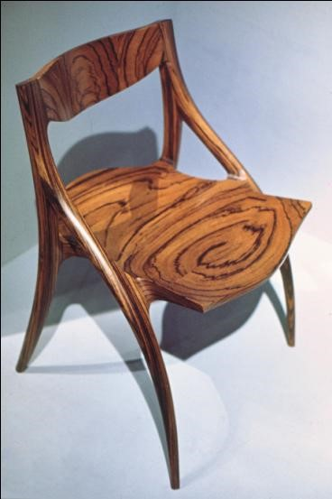
59.19
Armchair, c. 1970s-1990s; New York: Wendell Castle. Environmental Modern.

Slide 27
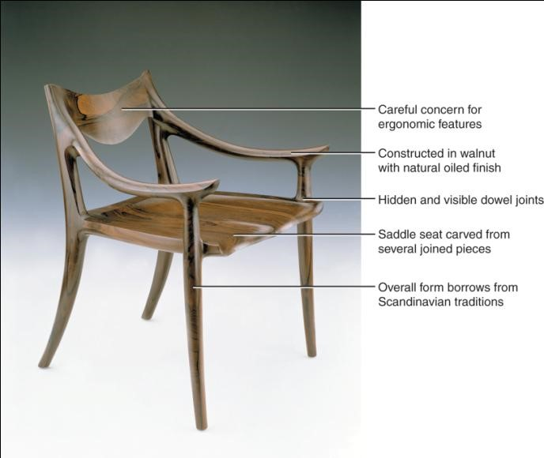
59.20
Low-back chair, c. 1990s; California; Sam Maloof. Environmental Modern.
Notes:
Long Description:
The chair has careful concern for ergonomic features. It is constructed in walnut with a natural oiled finish. It has hidden and visible dowel joints. The saddle seat is carved from several joined pieces. The overall form borrows from Scandinavian traditions.

Slide 28
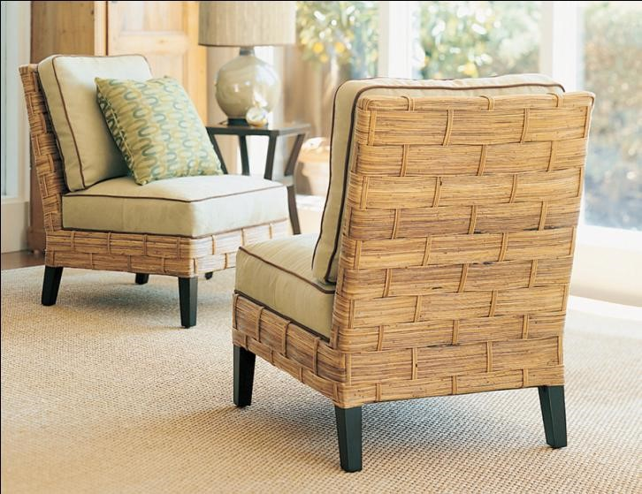
59.21
Bel Air Slipper chair, 2006; Philippines and Indonesia; Palecek. Environmental Modern.

Slide 29
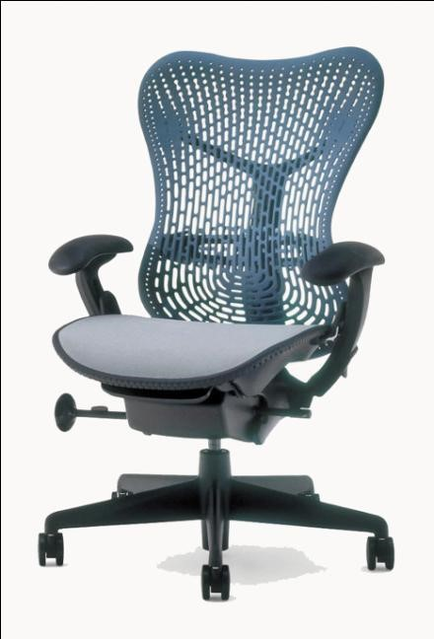
59.22
Mirra chair, 2003; Michigan; Studio 7.5 for Herman Miller. Environmental Modern.

Slide 30
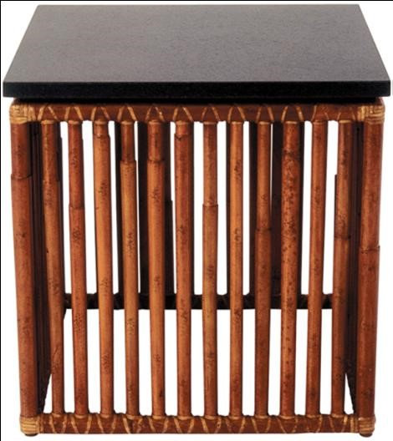
59.23
Moiré square side table with rattan poles, c. 2000s; California; Orlando Diaz-Azcuy for McGuire. Environmental Modern.

Slide 31
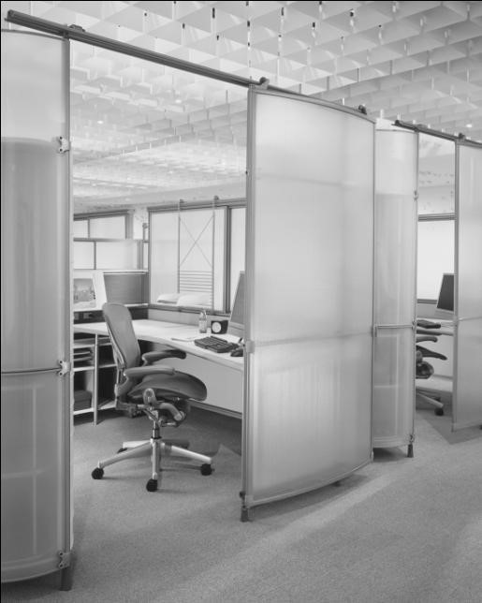
59.24
My Studio Environment, 2006; United States; Herman Miller. Environmental Modern.

Slide 32

Copyright
This work is protected by United States copyright laws and is provided solely for the use of instructors in teaching their courses and assessing student learning. Dissemination or sale of any part of this work (including on the World Wide Web) will destroy the integrity of the work and is not permitted. The work and materials from it should never be made available to students except by instructors using the accompanying text in their classes. All recipients of this work are expected to abide by these restrictions and to honor the intended pedagogical purposes and the needs of other instructors who rely on these materials.

