Slide 1
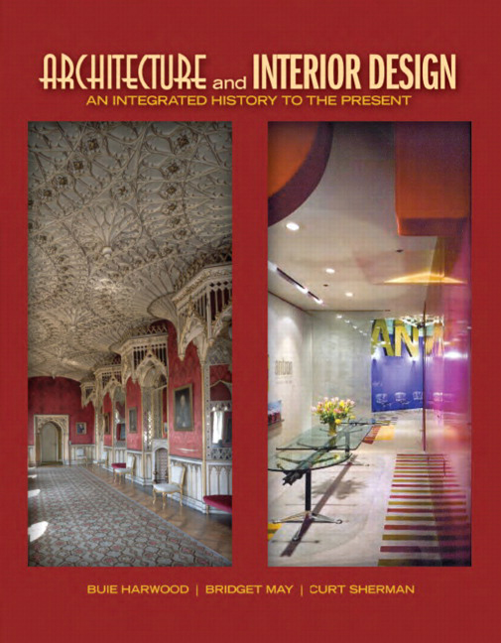

Architecture and Interior Design: An Integrated History to the Present
First Edition
Chapter 52
Scandinavian Modern
1900s – 1960s
Copyright © 2012 Pearson Education, Inc. All Rights Reserved
Notes:
If this PowerPoint presentation contains mathematical equations, you may need to check that your computer has the following installed:
1) Math Type Plugin
2) Math Player (free versions available)
3) NVDA Reader (free versions available)

Slide 2
Scandinavian Modern
Specific early 20th-century architecture, interiors, & furnishings from Denmark, Sweden, Finland, Norway
Adopt some elements of Bauhaus & International Style
Shared aesthetic—nationalism; folk or vernacular & craft traditions; nature; excellent craftsmanship; desire to provide well-designed buildings & objects for all Scandinavian people
Simple, functional, often minimal, concern for individual, natural materials
Scandinavian refers to 4 northwestern European countries, Denmark, Sweden, Finland, Norway
  Share strong historical, cultural and linguistic ties
  Alternative term: Nordic

Slide 3
Concepts
Architects & designers more concerned with practical & humanitarian matters than design theory
Strive for functional designs that reflect humanity in planning, scale, materials
Shared belief—architecture & design not only about aesthetics but economical & function housing for all
Promote good design through education & collaboration among designers, architects, manufacturers
Nordic or Scandinavian identity also important
  Design vocabulary from folk or vernacular traditions; natural environment or landscape; individual characteristics of each country; or collective Scandinavian heritage
  Maintains nationalism within modernist design

Slide 4
Characteristics and Motifs
Simplicity, human scale, modesty, practicality, elegance, excellent craftsmanship
Shared Scandinavian traditions, natural environments or landscapes; respect for materials; natural materials
From landscape—movement, texture, complex compositions, curvilinear forms, eclectic
Designs may rework traditional forms by simplifying or refining to suit modern aesthetics or lifestyles
  Purely functional, modernist, organic
Unity, texture, light important
Motifs—modernist expressions have none; mostly stylized foliage or plants

Slide 5
Architecture
Variety--rugged stone compositions with steep roofs to plain brick, geometric facades to International Style buildings with flat roofs, glass curtain walls, white concrete walls
National Romanticism—folk or vernacular traditions; national identity; wood; handicraft; local building types
Scandinavian Neoclassicism—stripped down classicism; simplified; classical order; some classical elements
Functionalism or Modernism—begins about 1930s; International Style influences
  Some move beyond white boxes by incorporating Scandinavian forms & materials
  Individuality & uniqueness

Slide 6
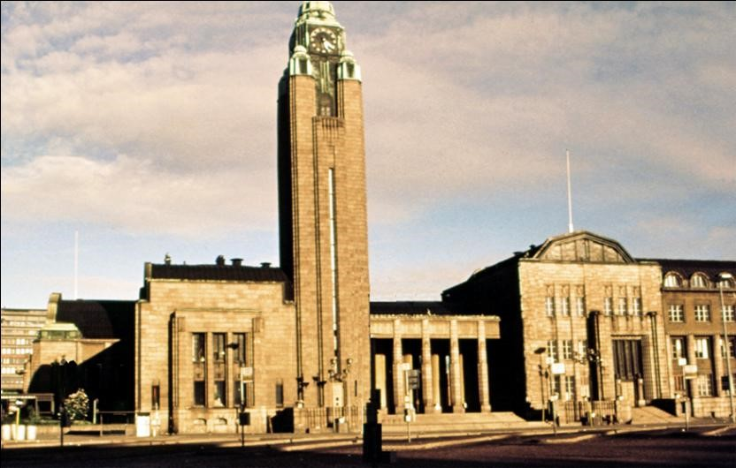
52.1
Main Railway Terminus, 1904-1914; Helsinki, Finland; Eliel Saarinen, Herman Gesellius, and Armas Lindgren. National Romanticism.
Notes:
Long Description:
The main entrance has a rectangle facade with an arched top. The building is an asymmetrical structure. The dependency building has porches supported by columns. A large tower has a clock on its top. The facade has rectangular windows and arched windows. An elongated needle is on the arched top at the central axis.

Slide 7
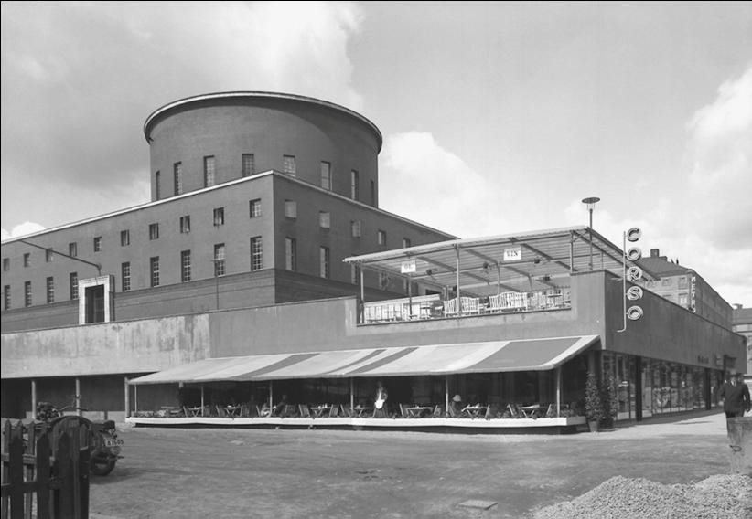
52.2
Stockholm City Library, 1920-1928; Stockholm, Sweden; Gunnar Asplund. Scandinavian Modern.
Notes:
Long Description:
The sidewall has a canopy. The entrance has glass walls below the concrete wall. The first story has a sheet roof supported by iron columns. The top story has a rectangular entrance and rectangular glass windows. The top story has a rounded cupola with a circular roof.

Slide 8
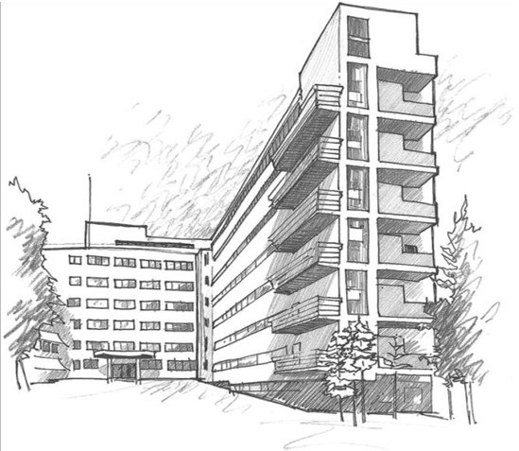
52.3a
Tuberculosis Sanatorium, 1929-1933; Paimio, Finland; Alvar Aalto. Scandinavian Modern.
Notes:
Long Description:
The main entrance has a portico supported by columns. The facade has rectangular glass windows in repetitive series. The building on the right has balconies with balustrades and backspace with walls.

Slide 9
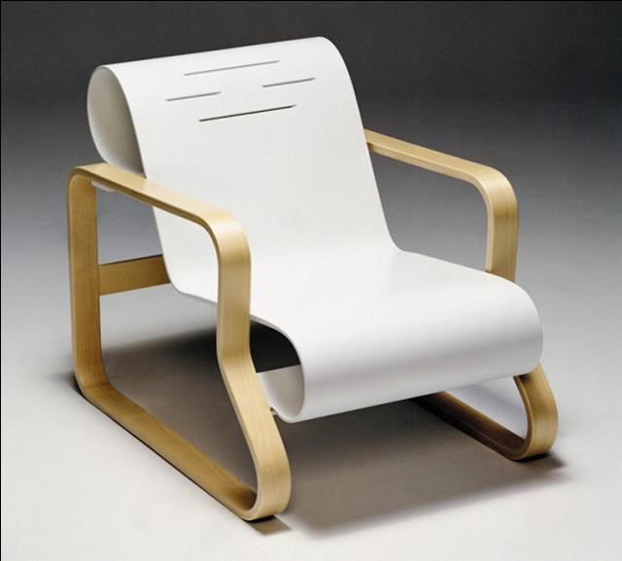
52.3b
Paimio armchair, 1929-1933; Paimio, Finland; Alvar Aalto. Scandinavian Modern.

Slide 10
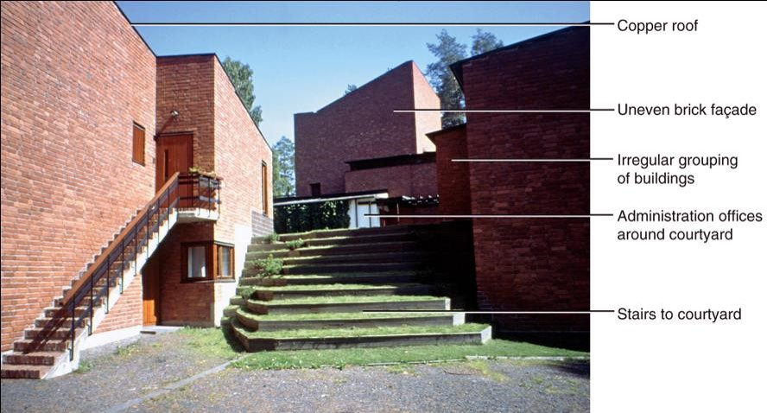
52.4
Säynätsalo Town Hall, Jyväskylä, Finland; Alvar Aalto. Scandinavian Modern.
Notes:
Long Description:
The building has a copper roof and an uneven brick facade. It is an irregular grouping of buildings. It has administration offices around the courtyard. The building has stairs to the courtyard.

Slide 11
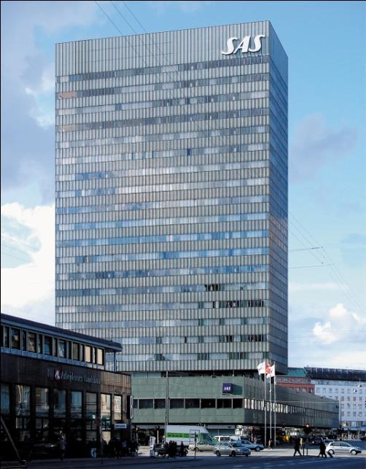
52.5a
S.A.S. Royal Hotel, 1959; Copenhagen, Denmark; Arne Jacobsen. Scandinavian Modern.
Notes:
Long Description:
The building is the tallest and numerous story building. It has glass windows in repetitive series. The horizontal beams have lines. It is a symmetrical structure building. The top story is marked as S A S.

Slide 12
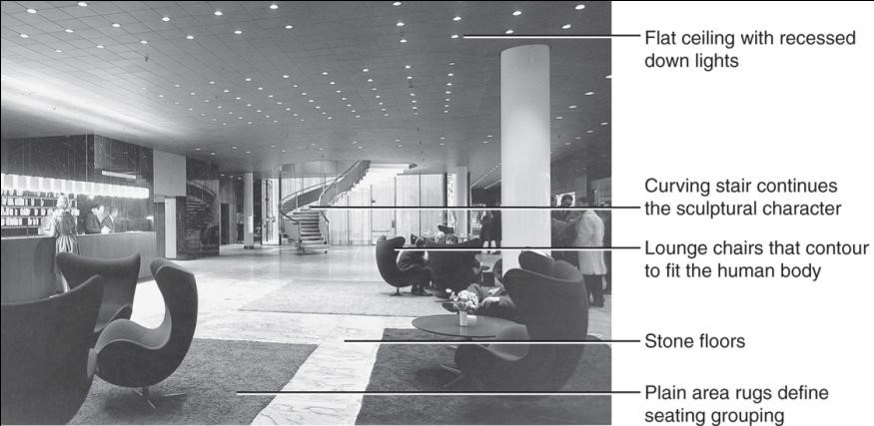
52.5b
S.A.S. Royal Hotel lobby, 1959; Copenhagen, Denmark; Arne Jacobsen. Scandinavian Modern.
Notes:
Long Description:
The ceiling is flat with recessed downlights. The lobby has a curving stair that continues the sculptural character. The floors are arranged with lounge chairs that contour to fit the human body. It has stone floors. The plain area rugs define seating grouping.

Slide 13
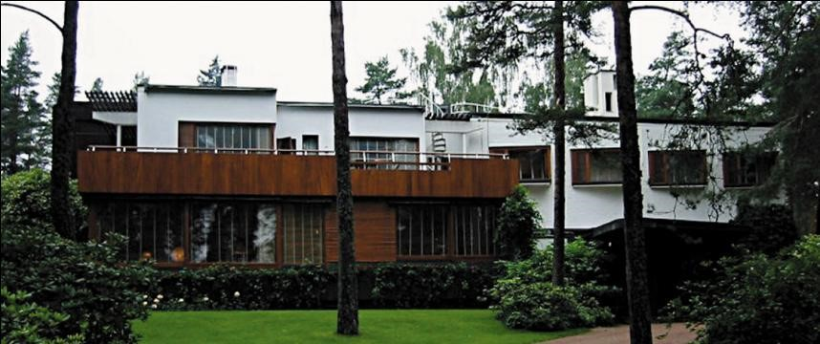
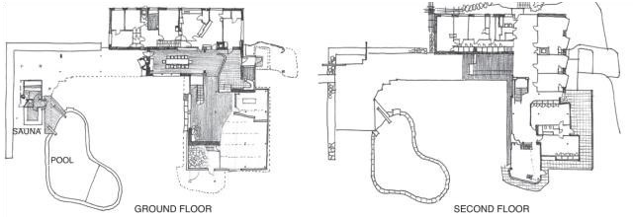
52.6a
Villa Mairea and floor plans; 1937-1938; Noormarku, Finland; Alvar Aalto. Scandinavian Modern.
Notes:
Long Description 1:
The building has a ground floor and one story. The ground floor has glass windows and sculptures. The top of the ground floor has a balustrade. The top story has a flat roof, glass windows, and chimneys. The top roof has a sculpture. The stairs to the top roof are spiral.
Long Description 2:
The ground floor plan shows from the left to the right, a sauna and pool on the left, and a hall, courtyard, and rooms on the right. The second floor has a hall, courtyard, and rooms on the right.

Slide 14
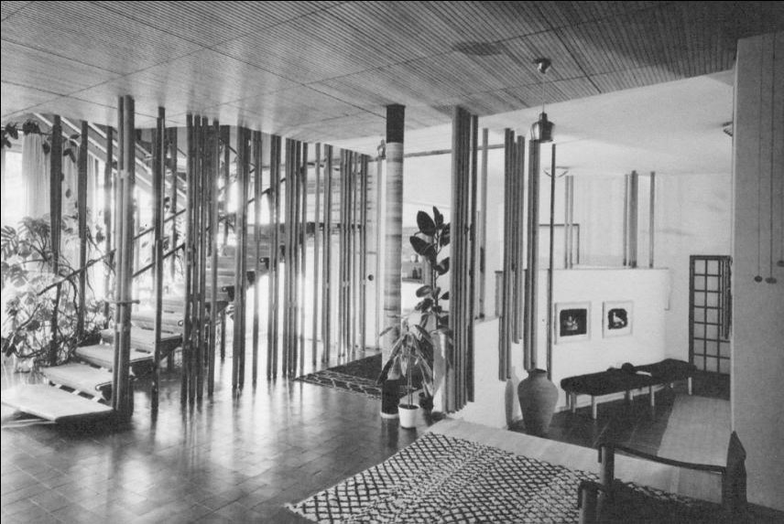
52.6b
Villa Mairea stair hall; 1937-1938; Noormarku, Finland; Alvar Aalto. Scandinavian Modern.
Notes:
Long Description:
The ceiling is decorated with tiles and supported by columns. The stairs are a zig-zag pattern. The sides of the stairs have thin columns. The floor is decorated with tiles and rugs. The chairs are arranged.

Slide 15
Interiors
Simple, modest, minimal furnishings
Important principles—function, lightness, natural light, natural materials & textures
Architect-designed interiors—most variety & pleasant sensory experiences
  Spatial changes, color, light, texture; design furniture & interior for unity
Large windows unite interior with landscape & contrast with more intimate, fireplace- or hearth-centered alcoves
Nationalism—traditional materials & forms; wood construction
Small rooms borrow space from outside; light colors, high ceilings help visually expand space

Slide 16
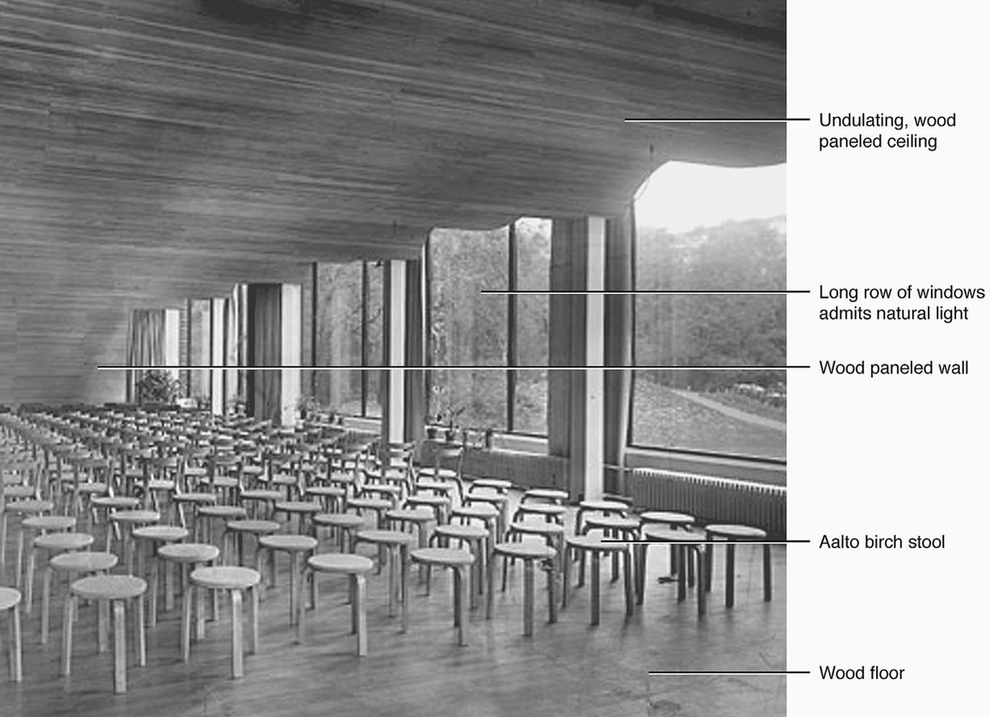
52.7
Discussion and lecture hall, Municipal Library, 1927-1935; Viipuri, Finland. Alvar Aalto. Scandinavian Modern.
Notes:
Long Description:
The hall has an undulating, wood-paneled ceiling. The long row of windows admits natural light. The hall has a wood-paneled wall. The Aalto birch stools are arranged on the wood floor.

Slide 17
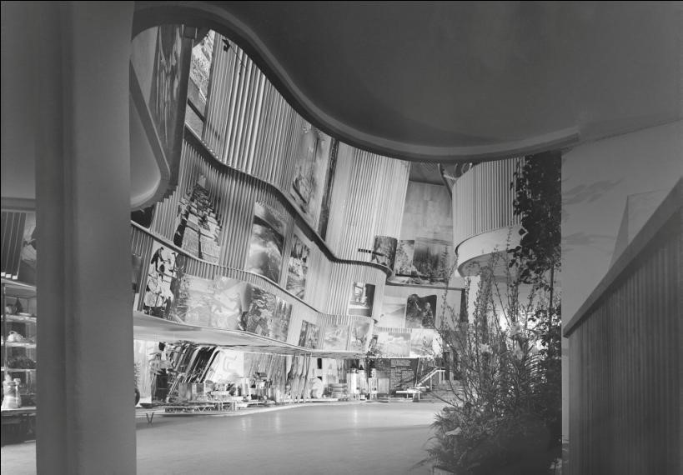
52.8
Interior, Finnish Pavilion, World’s Fair Exhibition, 1939; New York, New York; Alvar Aalto. Scandinavian Modern.

Slide 18
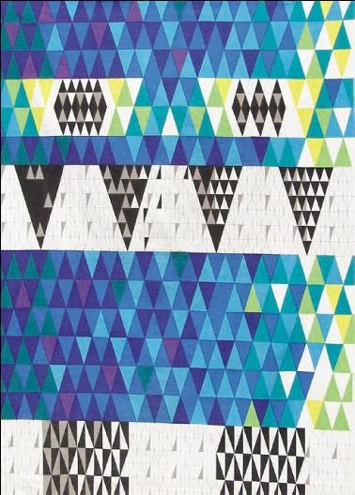
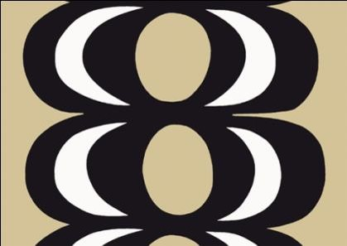
52.9
Textiles: Cotton and linen, c. 1950s-1960s; Sweden and Finland; manufactured by Marimekko and Nordika. Scandinavian Modern.

Slide 19
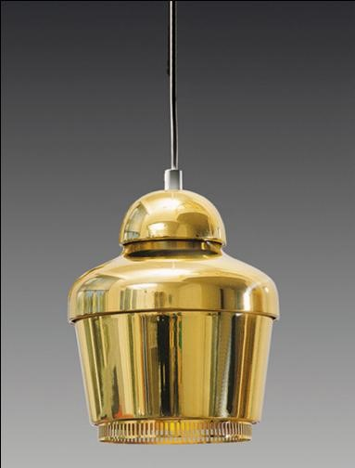
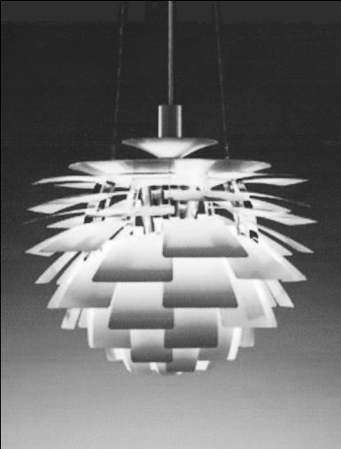
52.10
Lighting: Chandeliers, c. 1950s; Finland and Denmark; Alvar Aalto and Paul Henningsen. Scandinavian Modern.

Slide 20
Furnishings and Decorative Arts
Ranges from handmade to mass-produced
Collaboration among designers, artisans, manufacturers
  Strong craft tradition maintained
Types
  Simplified & mass produced traditional forms
  Designed by architects for particular projects
  Experiments with new materials (plywood) & construction methods (prefabrication)
Simplicity, fits human body, warm, timeless, economical, practical, user-centered, functional
Scandinavian furniture popular post World War
Knocked-down (K D) furniture a Scandinavian contribution

Slide 21
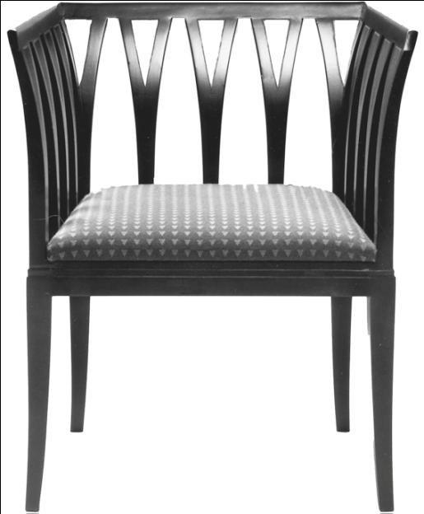
52.11
Blue chair, 1929; Finland; Eliel Saarinen. Scandinavian Modern.

Slide 22
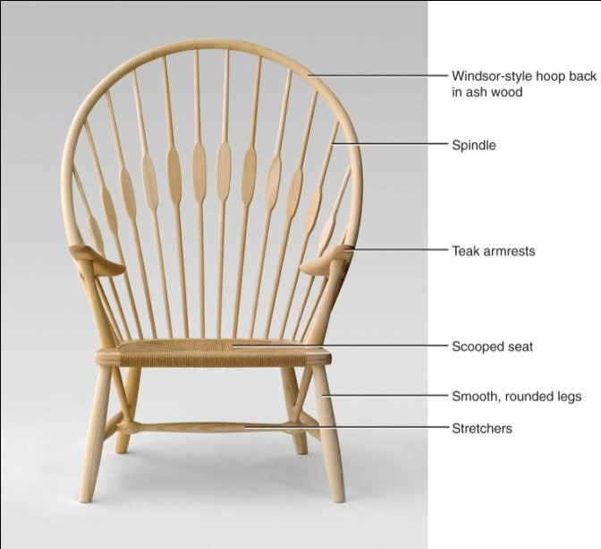
52.12a
Peacock chair, 1947; Denmark; Hans Wegner. Scandinavian Modern.

Slide 23
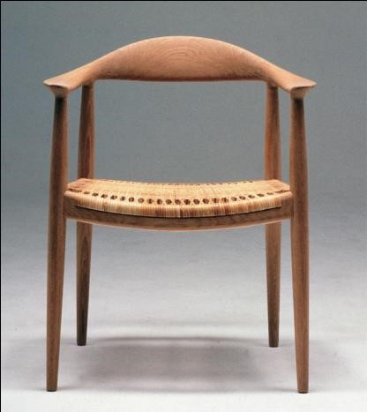
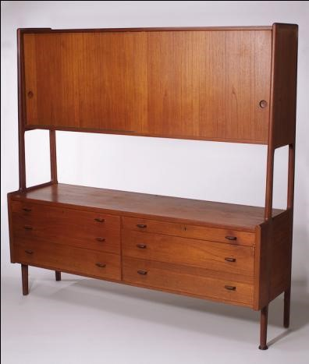
52.12b
Armchair and storage cabinet in teak, 1944-1949; Denmark; Hans Wegner. Scandinavian Modern.

Slide 24
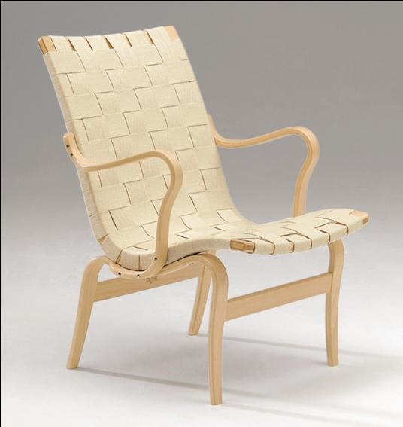
52.13
Eva armchair in laminated beech, 1934; Sweden; Bruno Mathsson. Scandinavian Modern

Slide 25
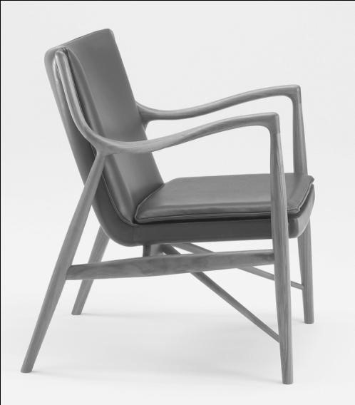
52.14
Armchair, 1945; Finn Juhl. Scandinavian Modern.

Slide 26
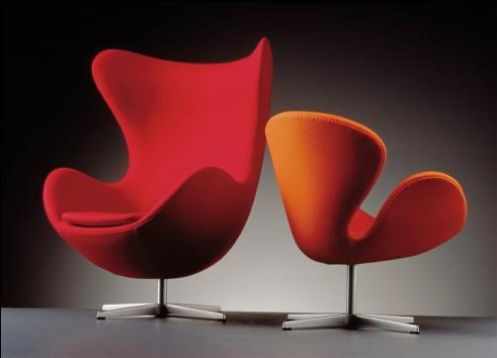
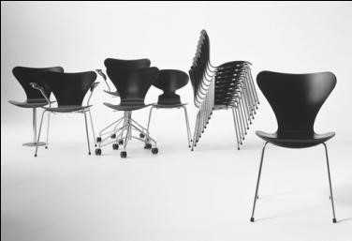
52.15
Top: Ant chair/Model 3107-Series 7 chair, 1955; Left: Egg chair, 1956-1957, and right, Swan chair, 1956-1957; Denmark; Arne Jacobsen.

Slide 27
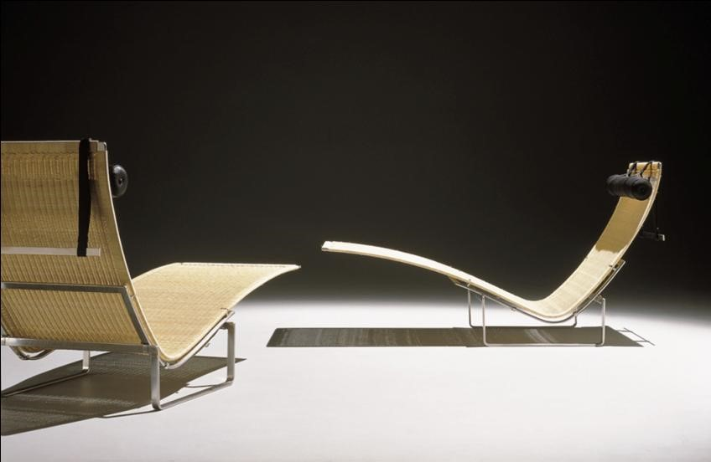
52.16
Chaise, Model P K24, 1965; Denmark Poul Kjaerholm. Scandinavian Modern.

Slide 28
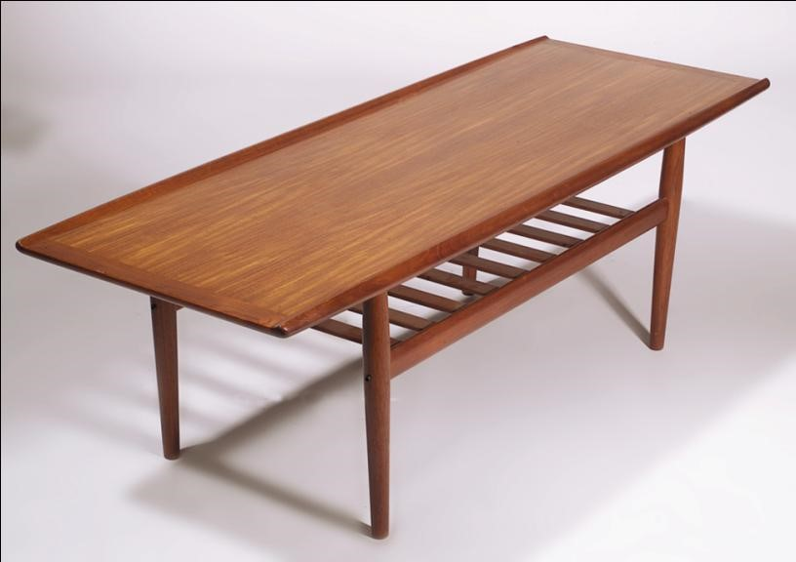
52.17
Coffee table in teak, 1960s; Denmark; Grete Jalk. Scandinavian Modern.

Slide 29
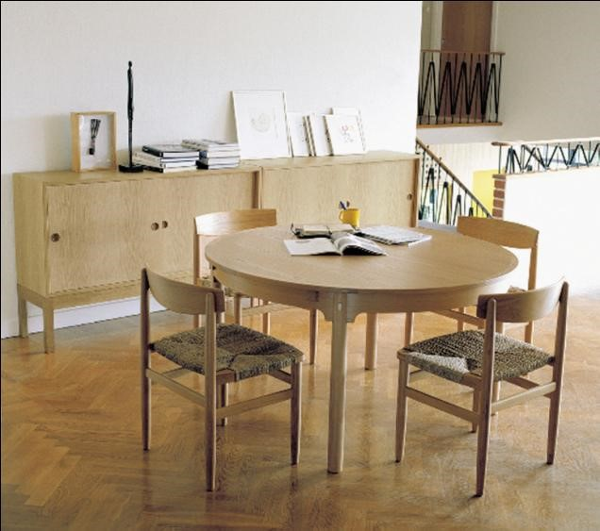
52.18
Dining table and chairs; Ørensend Series, 1955; Denmark; Børge Mogensen. Scandinavian Modern.

Slide 30
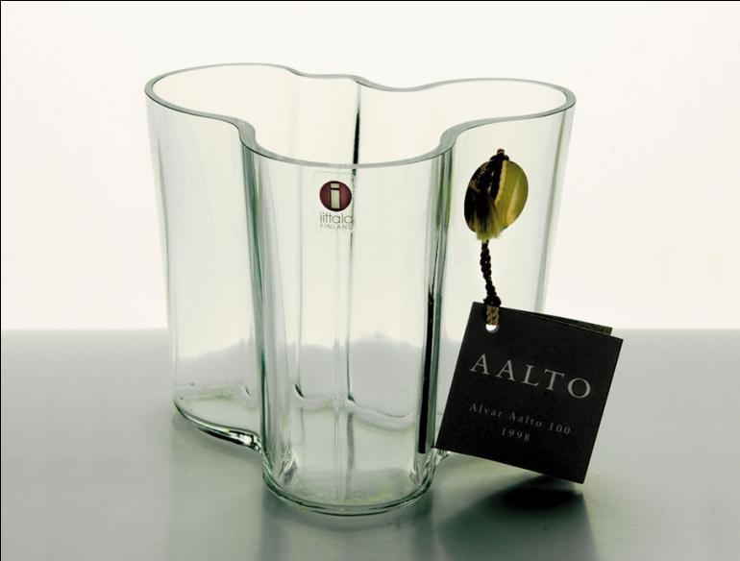
52.19
Decorative Arts: Savoy Vase, c. 1930s; Finland; Alvar Aalto. Scandinavian Modern.

Slide 31

Copyright
This work is protected by United States copyright laws and is provided solely for the use of instructors in teaching their courses and assessing student learning. Dissemination or sale of any part of this work (including on the World Wide Web) will destroy the integrity of the work and is not permitted. The work and materials from it should never be made available to students except by instructors using the accompanying text in their classes. All recipients of this work are expected to abide by these restrictions and to honor the intended pedagogical purposes and the needs of other instructors who rely on these materials.

