Slide 1
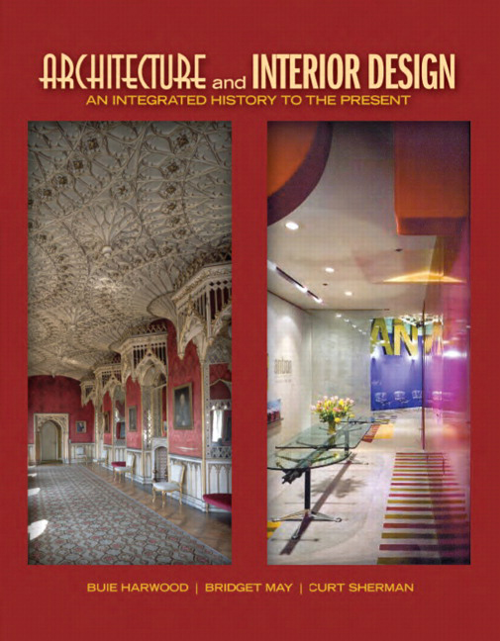

Architecture and Interior Design: An Integrated History to the Present
First Edition
Chapter 51
Art Deco, Art Moderne
1920s – Early 1940s
Copyright © 2012 Pearson Education, Inc. All Rights Reserved
Notes:
If this PowerPoint presentation contains mathematical equations, you may need to check that your computer has the following installed:
1) Math Type Plugin
2) Math Player (free versions available)
3) NVDA Reader (free versions available)

Slide 2
Art Deco, Art Moderne
Art Deco an international style with many expressions in all design arts
  Originates in Paris, 1910s
  Makes strong design statement at Exposition Internationale des Arts Décoratifs in 1925, Paris
  Ranges from highly decorative & lavish to geometric & simple
1930s American designers create Art Moderne or Streamlined Modern
  Simplified geometric style with curvilinear forms & modern materials

Slide 3
Concepts
Art Deco embraces machine, machine aesthetics, craftsmanship
Respects past, draws from national & regional traditions
Strives to create modern style for modern age but lacks modernist’s faith in ability of art to improve lives
  Relies on consumerism & capitalism to disseminate
Recognizes importance of unity among the arts & totality of design
Many expressions from diversity of influences--Western & non-Western sources, avant-garde art
Art Moderne—similar influences as Art Deco
  Main influences—idea of speed, aerodynamic forms of industrial design

Slide 4
Characteristics and Motifs
Art Deco modernizes past through stylization & contemporary colors & materials
  Coordinated & integrated approach for total unity
  Traditional or classical forms or more Modernist simple geometry
  Two-dimensional or shallow ornament drawn from many sources
Art Moderne—simplified, sleek, efficient forms
  Smooth surfaces, rounded corners, horizontality, contour lines, minimal ornament, new materials
Motifs: Stylized flowers, leaves, water fountains, birds, animals, sunrays, star bursts; machine inspired geometrics—circles, chevrons, lightning bolts, diamonds, stripes

Slide 5
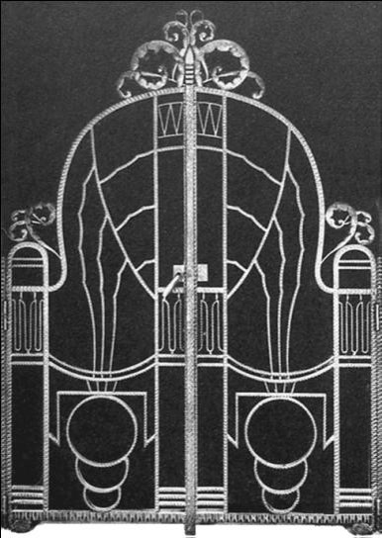
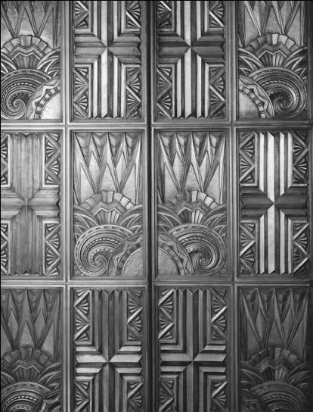
51.1
Architectural Details: Iron entry gate and elevator doors, c. 1920s-1930s; France and the United States; doors designed by Morgan, Walls and Clements. Art Deco.
Notes:
Long Description:
The rows are an alternate repetitive arrangement of two specific patterns. The first pattern has two similar floral motifs on the left and right ends, and two cross signs in the middle. The second row pattern has the cross signs on the left and the right ends, and the two floral motifs in the middle.

Slide 6
Architecture
Art Deco--stylized & geometric floral & figural decoration & brilliant color on classical & modernist forms
  Architectural vocabulary adaptable to any theme, image, or message
  Common on buildings associated with modern life—skyscrapers, movie theaters, airports
  Many characteristics from pavilions at 1925 Paris exposition—straight lines, stepped roofs
  Important legacy—new & creative lighting designs made possible by adoption of electricity
Art Moderne—from late 1920s
  Rounded corners, glass block or porthole windows, bands of windows, repeating lines, minimal ornament

Slide 7
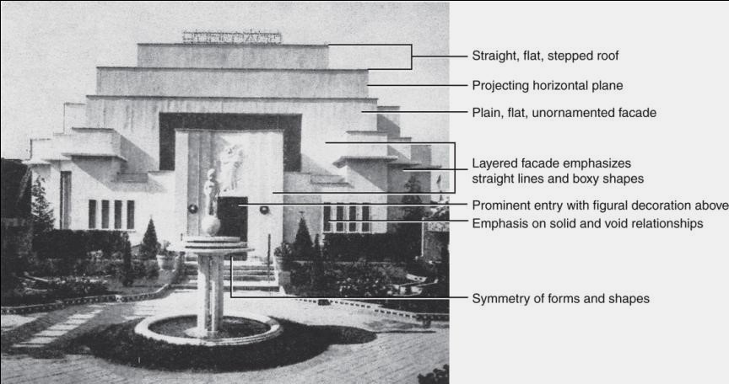
51.2
Pavilion of a Rich Collector, published in Exposition Internationale des Arts Décoratifs et Industriels Modernes, 1925; Paris, France; Emile-Jacques Ruhlmann and Pierre Patout (Ruhlmann Group). Art Deco.
Notes:
Long Description:
Starting from top to the bottom, the facade has a straight, flat, stepped roof, and a projecting horizontal plane. The facade is a plain, flat, unornamented facade. The layered facade emphasizes straight lines and boxy shapes. The doorway has a prominent entry with figural decoration above. The facade has an emphasis on solid and void relationships. The sculpture on the pedestal is at the center and depicts the symmetry of forms and shapes.

Slide 8
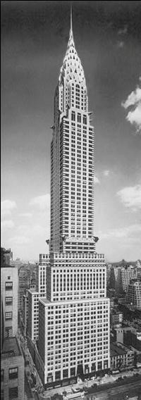
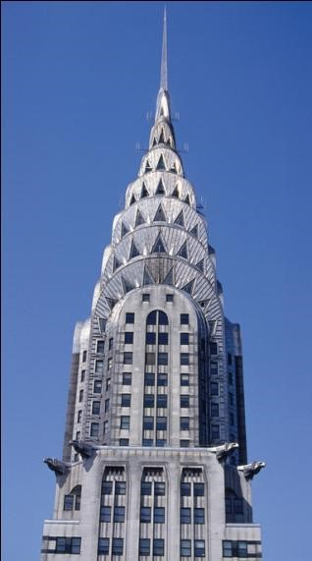
51.4
Chrysler Building and tower detail, 1928-1930; New York, New York; William Van Alen. Art Deco.
Notes:
Long Description:
The Chrysler building is a skyscraper and is the tallest multiple story building. The building is constructed of steel frames and bricks. The building is decorated with metal cladding. The exterior has numerous windows. The exterior building has protruding structures. It has a crown and a needle on the top tower. The building from the bottom to the top, the length of the floors are decreasing with specific numbers of stories.

Slide 9
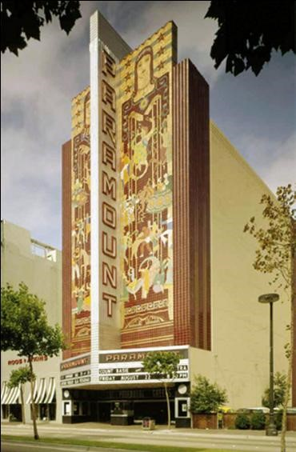
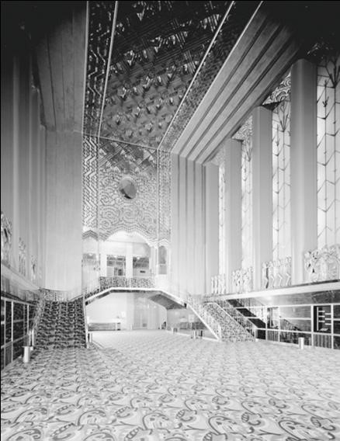
51.5
Paramount Theater and lobby, 1931; Oakland, California; Miller and Pflueger. Art Deco.
Notes:
Long Description 1:
The paramount theater has a large vertical wall in the central axis that divides the facade into two halves. Both halves have similar kinds of decorations. The portico top face of the two halves and the vertical wall surface have the text reads paramount, and a display. The two halves of the facade are decorated with a female painting, stars, various human characters, and lines.
Long Description 2:
The ceiling and rear walls are decorated with geometrical patterns and spirals. The side walls are stained glass supported by columns and glass balustrades. The rear wall has arches supported by columns. The stairs on the left and the right reach the central axis. The left and right stairs are decorated in two different shades. The floor is decorated with tiles.

Slide 10
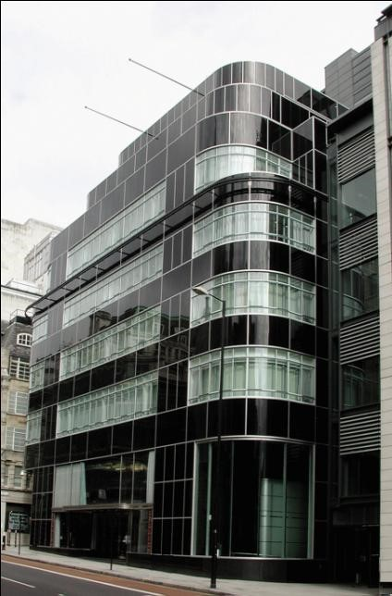
51.6
Daily Express Building, London, England; 1930-1932; Herbert Ellis and W. L. Clarke with Owen Williams. Art Deco.

Slide 11
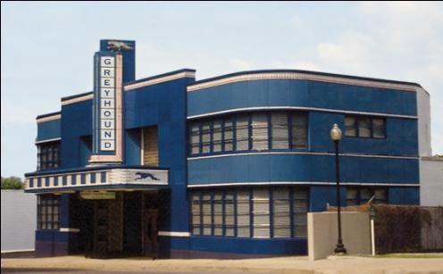
51.7
Greyhound Bus Terminal, 1936-1937; Jackson, Mississippi. Art Moderne.
Notes:
Long Description:
The Greyhound Bus Terminal building has curved corners. A vertical wall on its facade above the portico divides the facade into two halves. The vertical wall has text that reads Greyhound. The portico roof is decorated with squares and a running animal. The facade has glass windows with curtains separated by horizontal beams.

Slide 12
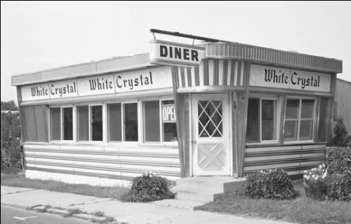
51.8
Diner, c. 1930s; New Jersey. Art Moderne.
Notes:
Long Description:
The entrance of the building lies on the oval corner. The entrance has a rectangle door decorated with geometrical patterns. The roof is flat. The facade has glass windows on the pedestal walls. The walls are decorated with horizontal lines. The surface below the roof has text that reads white crystal.

Slide 13
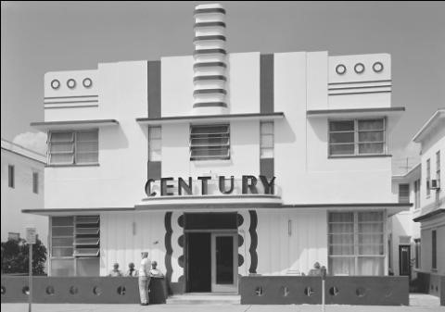
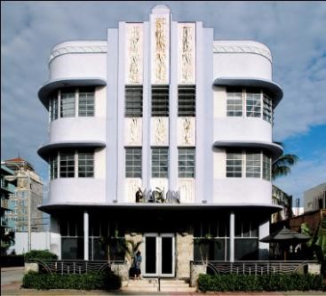
51.9
Century Hotel and Marling Hotel, 1935-1939; Miami Beach, Florida; Century Hotel by Henry Hohauser. Art Moderne.
Notes:
Long Description 1:
The building has a portico and the portico roof has text that reads Century. The entrance has rectangular doors with frames decorated with mirror curves. The corners of the walls have glass windows. The top walls are decorated with circles and horizontal lines. A small tower at the central axis has a line pattern.
Long Description 2:
The building has oval corners with glass windows. The central axis is decorated with floral sculptures and lines. The entrance has a portico supported by columns.

Slide 14
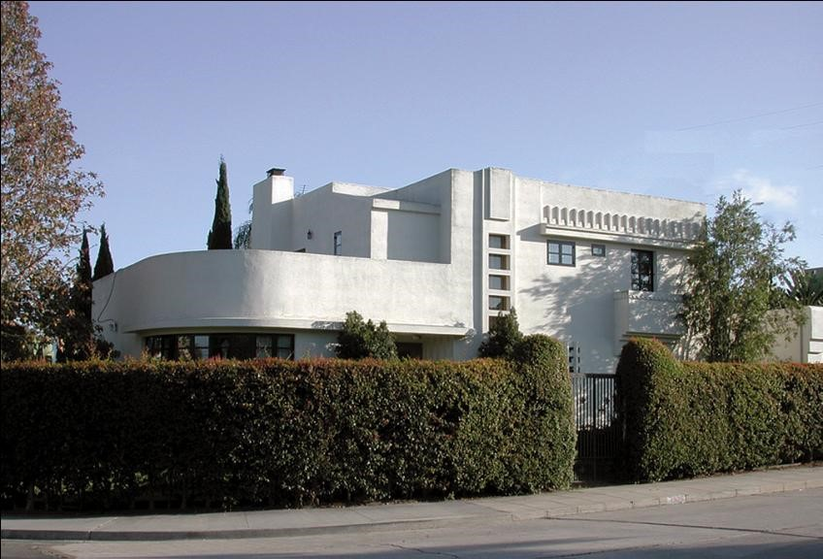
51.10
House, c. 1920s-1930s; San Diego, California. Art Moderne.
Notes:
Long Description:
The entrance has a portico with a curved wall. The side walls have glass windows and geometrical patterns. The roof is slanting and flat. The boundary wall is of plants with a metal gate.

Slide 15
Interiors
Art Deco in 1920s created by French artist/designers, not architects
  Renewed importance of decoration & designer’s individuality
  Interior design, designers, & decorators more important during period; create custom designs; teams common
Underlying classicism in form & organization; superb craftsmanship, expensive materials, lavish decoration
Great variety in style—various design approaches
  Some architectural—more simplicity, starkness, rectilinear
  More decorative—patterns, color, ornament
Kitchens & bathrooms receive more design attention

Slide 16
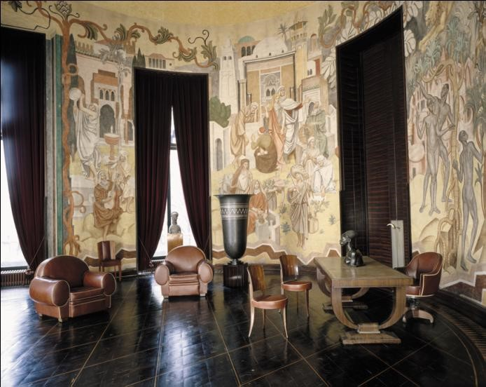
51.11
Office of Paul Reynaud, Minister of Colonies; 1931; Paris, France; furniture by Emile-Jacques Ruhlmann; frescoes by Louis Bouquet. Art Deco.
Notes:
Long Description:
The walls are decorated with paintings that portray the evolution of human civilization in various periods. The walls have glass windows with draperies. The wooden tables and chairs and cushion chairs are arranged randomly in the hall.

Slide 17
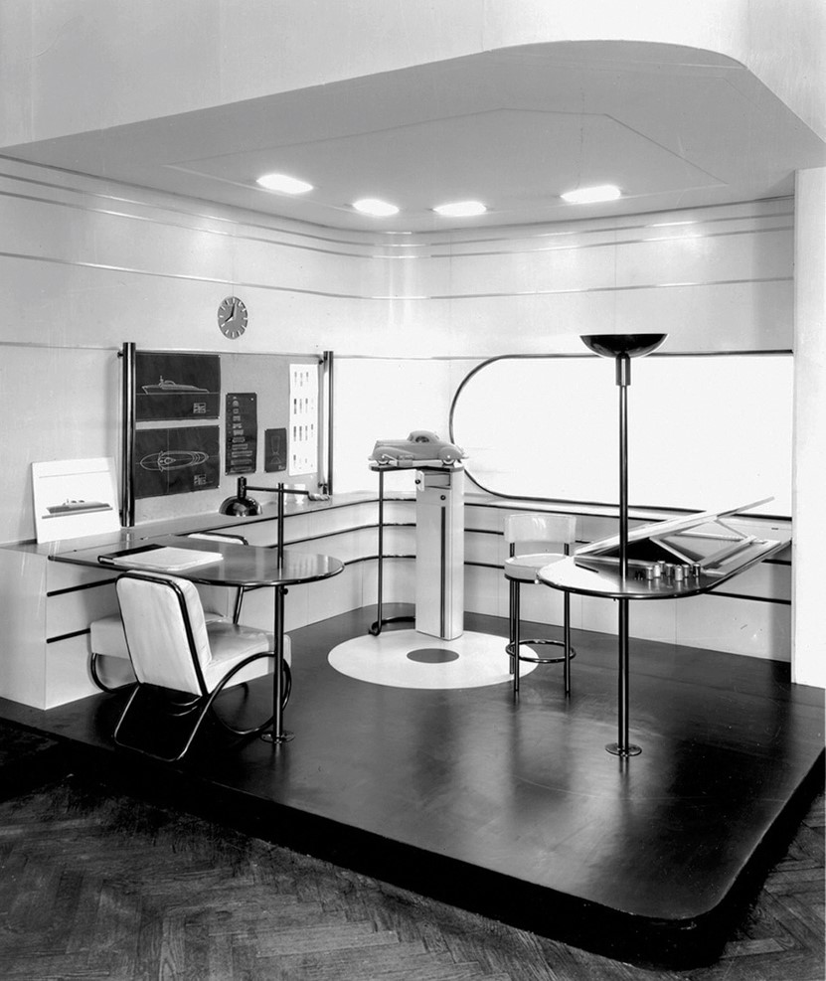
51.12
Office exhibited at the Contemporary American Industrial Art Show at the Metropolitan Museum of Art, 1934; New York, New York; Raymond Loewy and Donald Deskey. Art Moderne.
Notes:
Long Description:
The ceiling is decorated with lamps. The walls are decorated with lines and paintings. The sideboards are attached to the walls. The sidewall has an oval rectangle corner glass window. The floor is arranged with desks, leather chairs with metal frames, and circular tables.

Slide 18
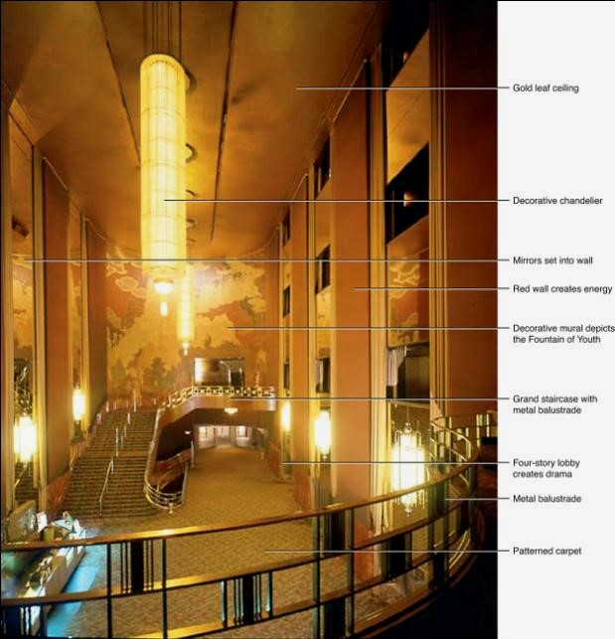
51.13
Grand Foyer, Radio City Music Hall, 1931-1940; New York, New York; interiors by Donald Deskey. Art Deco.
Notes:
Long Description:
The hall has a gold leaf ceiling. A decorative chandelier is hung on the ceiling. The side walls are decorated with mirrors that are set into the wall. The hall has a red wall that creates energy. The walls have a decorative mural that depicts the fountain of youth. The staircase is decorated grand with a metal balustrade. The four-story lobby creates drama. The story has a metal balustrade. The floor is decorated with a patterned carpet.

Slide 19
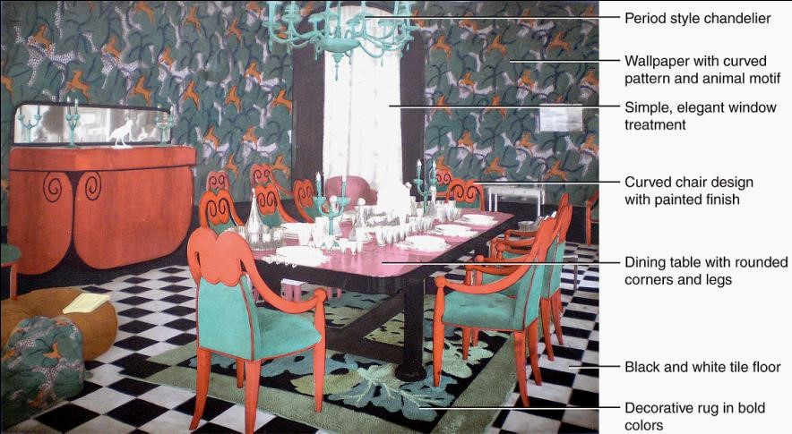
51.14
Dining room, published in Les Art de la Maison, 1926; France; Martine. Art Deco.
Notes:
Long Description:
The dining room has a period-style chandelier. The walls are decorated with wallpapers with curved patterns and animal motifs. The walls have a simple, elegant window treatment. The chairs have a curved chair design with a painted finish. The dining table has rounded corners and legs. The floor is a black and white tile floor. The floor is decorated with decorative rugs in bold colors.

Slide 20
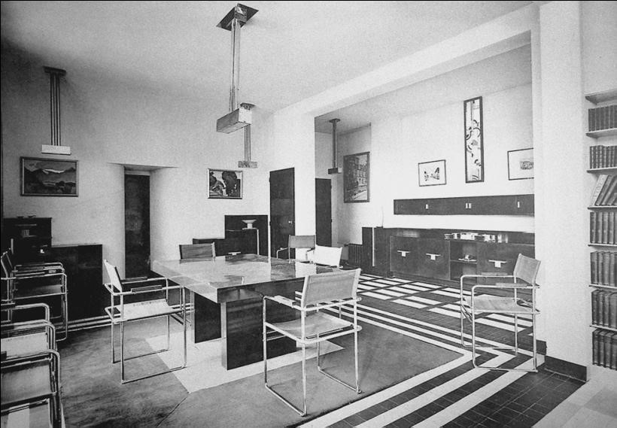
51.15
Dining room, c. 1925-1926; France. Robert Mallet-Stevens. Modernist Art Deco.
Notes:
Long Description:
The dining room has a plain ceiling with a hanging chandelier. The sidewalls are decorated with different types of paintings. The sideboards and bookshelves are attached to the walls. The columns are plain. The rectangle tables and chairs with metal forms are arranged in the room. The floor is decorated with geometrical patterns.

Slide 21
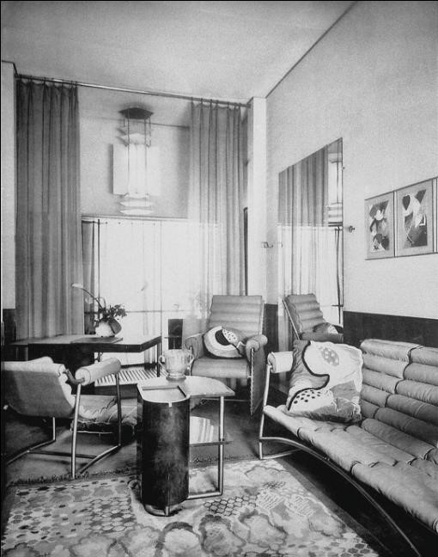
51.16
Interior published in Intérieurs au Salon des Artistes Decorateurs, late 1920s. Modernist Art Deco.
Notes:
Long Description:
The ceiling is plain. The walls are decorated with paintings and glass windows with curtains. The floor is decorated with random geometrical patterns and floral motifs. The sofa and chairs have repetitive cylindrical patterns leather seats and back. A glass table with a metal frame is at the center.

Slide 22
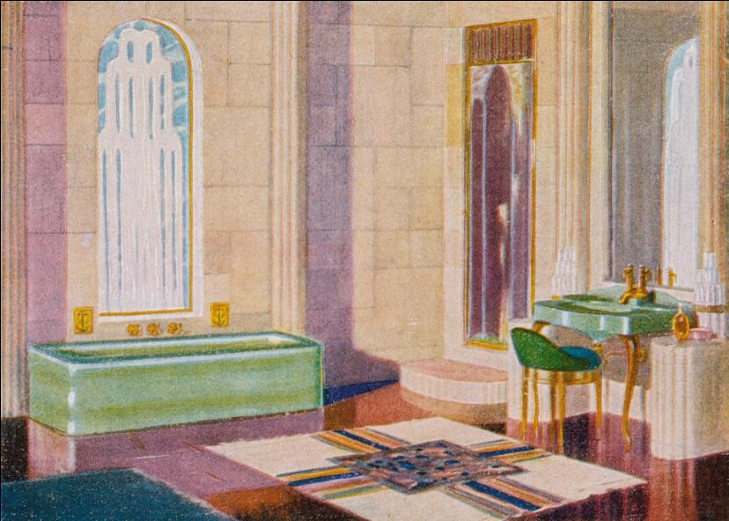
51.17
Advertisement showing a bathroom, c. 1930s. Art Deco.
Notes:
Long Description:
It has a sink with a mirror supported by columns and a chair and a bathtub. The walls are decorated with arches. The doors have rectangle frames and arched steps. The floors are decorated with geometrical patterns.

Slide 23
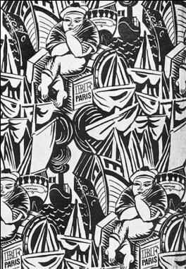
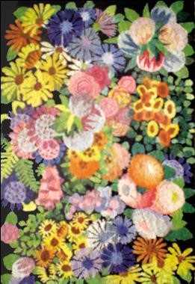
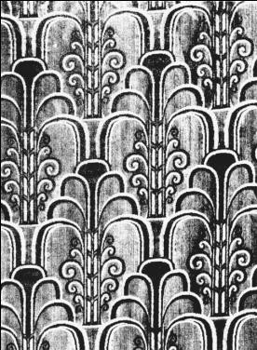
51.18
Textiles: Woven and printed fabrics in various Art Deco designs, c. 1920s; France and United States. Art Deco.

Slide 24
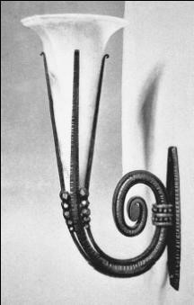
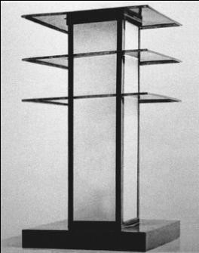
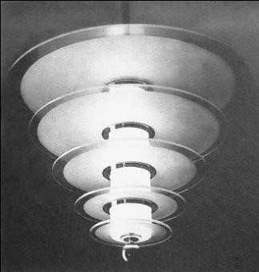
51.19
Lighting: Sconce, table lamp by Robert Mallet-Stevens, and chandelier, c. 1920-1930s. Art Deco.

Slide 25
Furnishings and Decorative Arts
Art Deco & Art Moderne furniture repeats form and motifs of interiors & architecture
Art Deco types
  High-style French custom designed—elegance, excellent craftsmanship, expensive materials; 18th & early 19th century forms
  Bauhaus inspired—custom designed to reflect space; geometric forms, less ornament, modern materials
Art Moderne usually mass-produced; sometimes custom designed
  Streamlined, geometric or biomorphic forms; simple contours; no ornament
  Smaller, less expensive, functional, practical

Slide 26
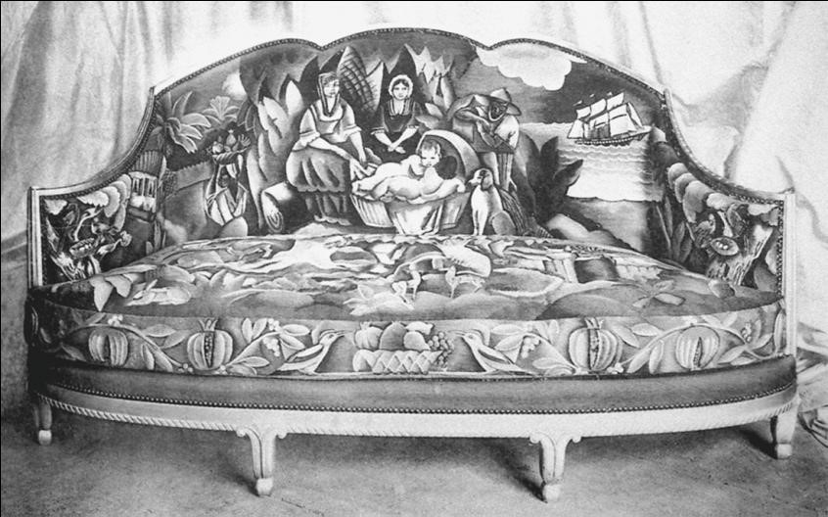
51.20
Canapé, c. 1910-1920s; France; La Compagnie des Arts Français (Süe et Mare.) Art Deco.

Slide 27
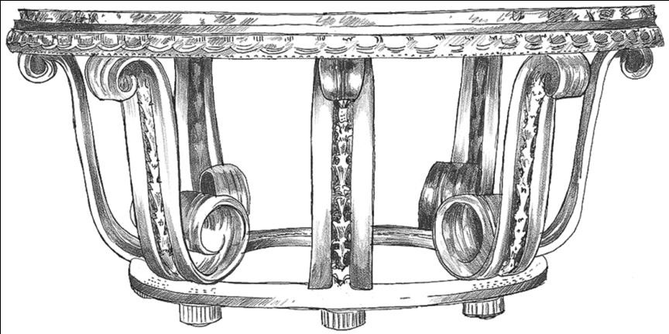
51.21
Console, c. 1920s; France; Edgar Brandt. Art Deco.

Slide 28
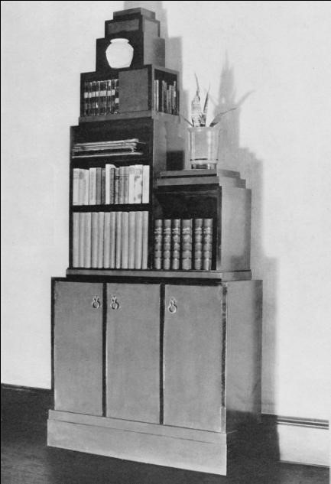
51.22
Skyscraper bookcase, c. 1926-1927; United States; Paul Theodore Fankl. Art Deco.

Slide 29
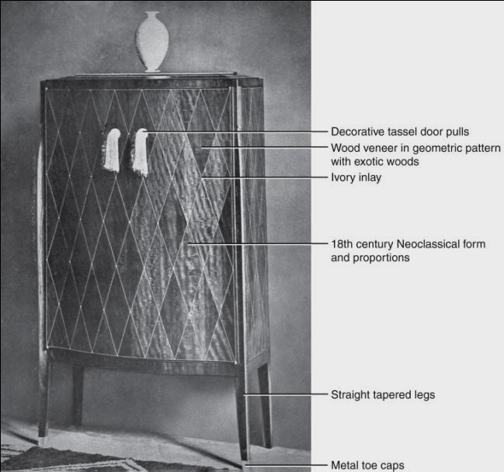
51.23a
Armoire, 1918-1925; France; Emile-Jacques Ruhlmann. Art Deco.
Notes:
Long Description:
The armoire has decorative tassel door pulls. The surface has wood veneer in a geometric pattern with exotic woods and ivory inlay. The surface is decorated with eighteenth-century neoclassical form and proportions. The armoire has straight tapered legs and metal toe caps. A vase is present at the top.

Slide 30
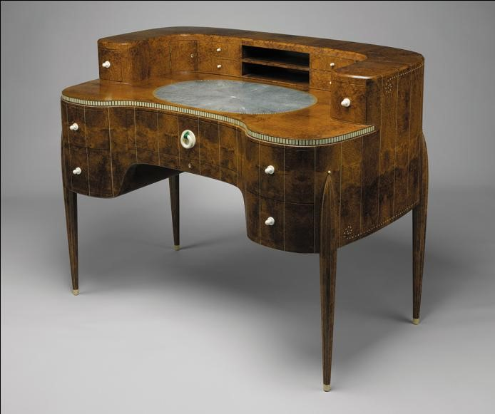
51.23b
Desk, 1918-1925; France; Emile Jacques-Ruhlmann. Art Deco.

Slide 31
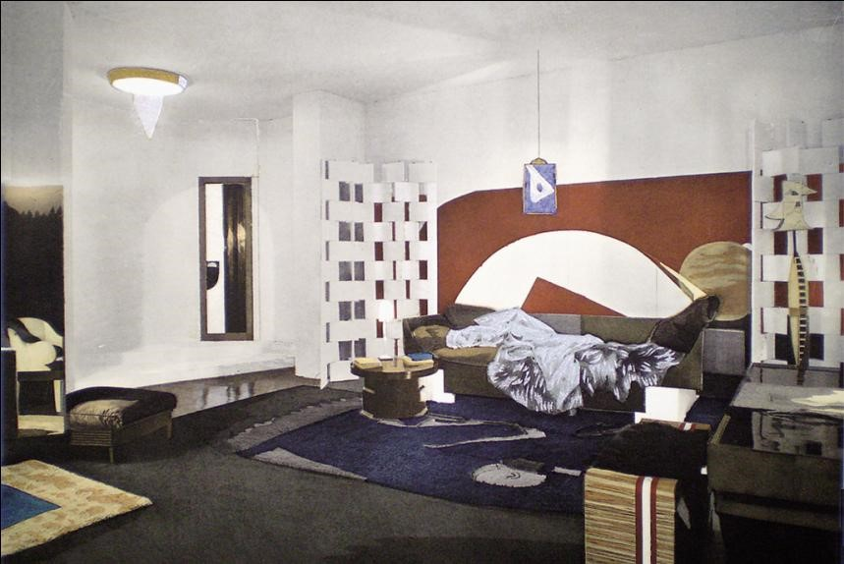
51.24
Interior and furnishings, c. 1922; France. Eileen Gray. Modernist Art Deco.
Notes:
Long Description:
The ceiling is plain and has a sconce. The walls have glass windows and asymmetrical square walls. The wall is decorated with modern art paintings. The furnitures are arranged on the sides of the walls. The floor has rugs with geometrical patterns.

Slide 32

Copyright
This work is protected by United States copyright laws and is provided solely for the use of instructors in teaching their courses and assessing student learning. Dissemination or sale of any part of this work (including on the World Wide Web) will destroy the integrity of the work and is not permitted. The work and materials from it should never be made available to students except by instructors using the accompanying text in their classes. All recipients of this work are expected to abide by these restrictions and to honor the intended pedagogical purposes and the needs of other instructors who rely on these materials.

