Slide 1
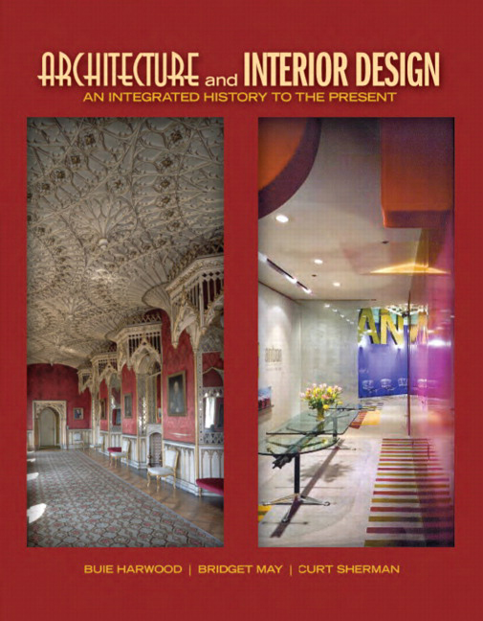

Architecture and Interior Design: An Integrated History to the Present
First Edition
Chapter 27
Directoire, French Empire
1789 – 1815
Copyright © 2012 Pearson Education, Inc. All Rights Reserved
Notes:
If this PowerPoint presentation contains mathematical equations, you may need to check that your computer has the following installed:
1) Math Type Plugin
2) Math Player (free versions available)
3) NVDA Reader (free versions available)

Slide 2
J. Late Neoclassical
Begins in France, c. 1790, simpler image inspired more by ancient Greece than ancient Rome
Result of scholarship & archaeology
Designers strive for archaeological correctness
  Copy or adapt ancient elements in architecture, interiors & furnishings
Neoclassicism aligns with new, more democratic forms of government
  Favored for government buildings
New inventions & mass production bring changes in architecture, interiors, and furnishing during the period

Slide 3
Directoire, French Empire
Neoclassicism dominates period
  Evolves & responds to political & social developments
Interiors & furniture, more than architecture, display styles
Simple, plain Directoire evolves into heavier, more majestic Empire
Architect-designers, Charles Percier & Pierre-François-Léonard Fontaine, create Empire
  Dictated by Napoleon Bonaparte, Emperor of France
Empire glorifies Emperor Napoleon
  Creates heroic vision though grandeur, military images, & Roman Imperial motifs.

Slide 4
Concepts
Neoclassicism dominates architecture
Three styles define interiors & furnishings
  All Neoclassical & reflect climates of their day
Directoire (1789-1799) links Louis
& Empire
  Plainer, more Grecian, & closer imitation of classical antiquity
Consulate (1799-1804) introduces Imperial Roman & Egyptian influences
  Reflects Napoleon’s military conquests & early reign
  More formal, monumental, increased ornament
Empire (1904-1815) glorifies Napoleon
& his empire
  Heroic image for emperor who earned right to rule

Slide 5
Motifs
Classical motifs common through 1815
  Classical figures, acanthus leaf, swag, rinceau, rosette, anthemion, arabesque, vase, lyre
Directoire: lozenges, rosettes, spirals
  Symbols of Revolution: oak leaf, clasped hands
Consulate & Empire:
  Roman motifs: animal legs, swans caryatids, monopodia
  Military symbols: stars, spears, swords, helmets
  Egyptian motifs after 1799: sphinxes, obelisks
  Napoleonic symbols: honeybee, laurel wreath, N

Slide 6
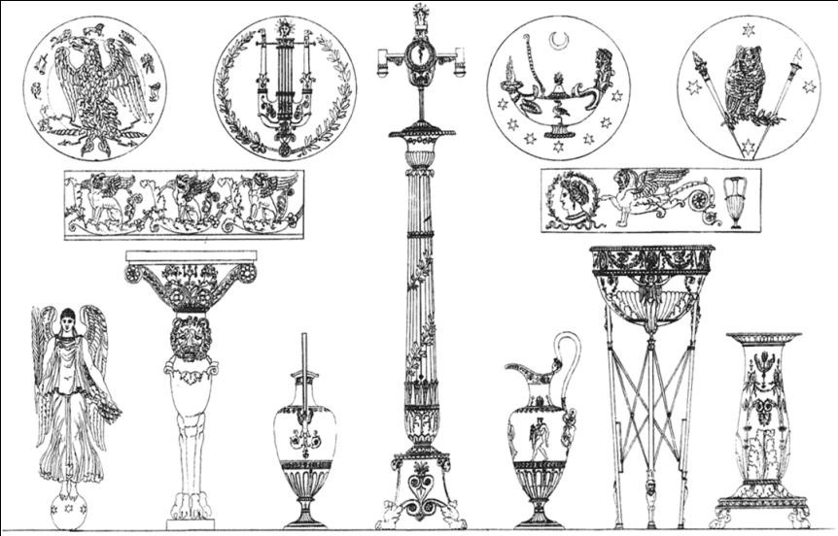
27.1
Détails et adjustements tirès de L’Atélier de Peinture du C. I., c. 1827; Charles Percier and Pierre-François-Léonard Fontaine. French Empire.
Notes:
Long Description:
The designs from the left to the right are as follows. A bird is surrounded by different types of animals. A string is an instrument surrounded by an acanthus leaf design. A bowl with a lid has a human figure carved on one raised arm on the right and a leaf design on the left. An owl is on two swords. A rinceau. A human figure bordered with leaves design. A lion with forelegs, wings, and a volute tail. A vase. An angel is on a sphere. A column has a lion face standing vertically with four legs and volute capital on its head with a horizontal rectangular bar. A vase with a leaf design stick at its center. A column of a Corinthian order has a capital. A vase has a swan handle and protruding mouth. A vas holder has a circular basket with leaves design on its top and three legs. A vase with a flat mouth and leaves design on it body.

Slide 7
Architecture
Most building activity after 1790s
  Mainly renovations of residences & government buildings
Designers & architects study, measure, draw, & publish information about ancient structures
  Subsequently become models for new buildings
Architectural theory emphasizes form and structure over ornament, and education centers on ancient models
Bold, stylistically unadventurous
  Grecian plainness & geometric forms dominate
  Some Roman or Egyptian attributes & motifs
Napoleon’s personal commissions for restorations & enlarging palaces and other residences

Slide 8
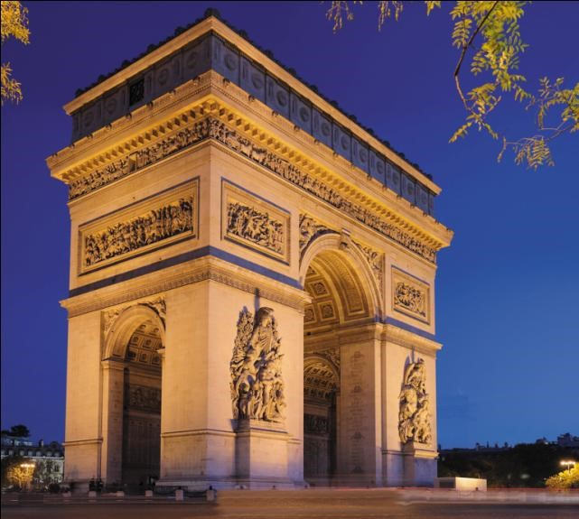
27.2
Arc de Triomphe de l’Etoile, c. 1808–1836; Paris, France; J.-F.-T. Chalgrin. French Empire.

Slide 9
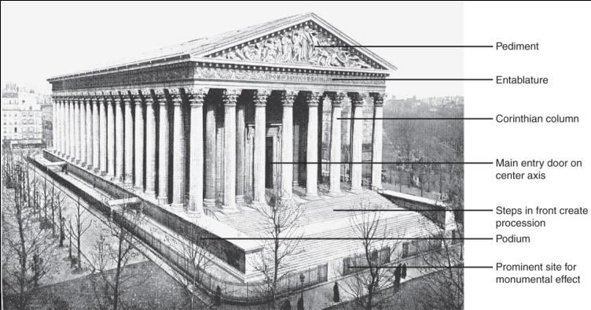
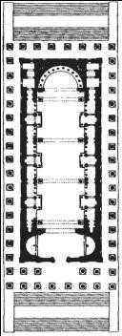
27.3
La Madeleine and floor plan; 1804-1849; Paris, France; Pierre Vignon and interiors by J.-J.-M. Huvé. French Empire.
Notes:
Long Description:
The La Madeleine building has a pediment with human sculptures. The entablature below the pediment has text and animal figures. The building is surrounded by Corinthian columns. The main entry door is on the center axis. The steps in front of the main door entrance create a procession. The podium is on the lateral building. The prominent site for monumental effect is at the bottom.

Slide 10
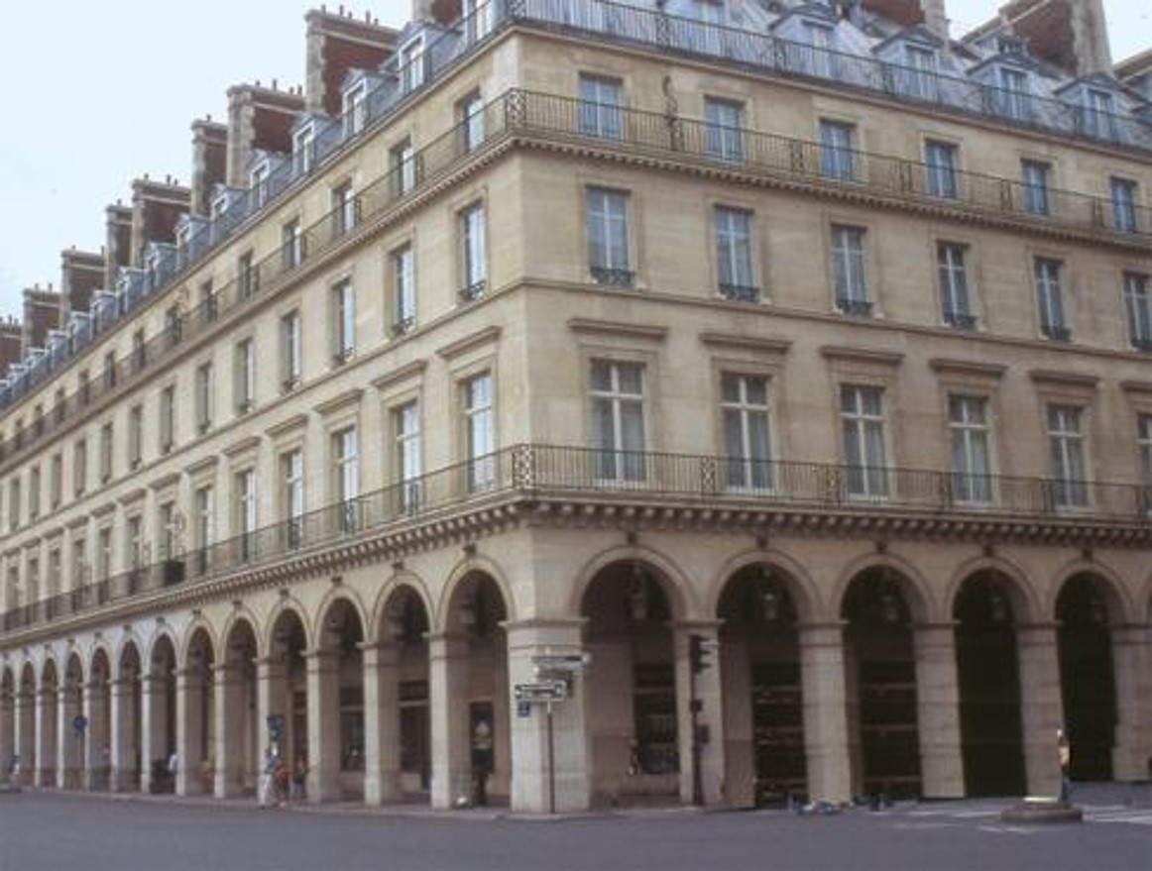
27.4
Rue de Rivoli, 1802–1855; Paris, France; Charles Percier and Pierre-François-Léonard Fontaine. French Empire

Slide 11
Interiors
Classical attributes & motifs from Greece, Rome, & Egypt
Evolve from light & delicate to majestic & pompous
  Pompeiian-style wall decorations common in all
  Directoire: continues scale & treatments of last years of
  Louis
  More simplicity, muted colors, more delicate decoration, & additional antique details.
Empire: masculine, formal, & richly detailed
  Classical decorations, rich colors, & large, formal furniture arranged around the walls
Percier & Fontaine create Empire
  Design all elements in a room for unity

Slide 12
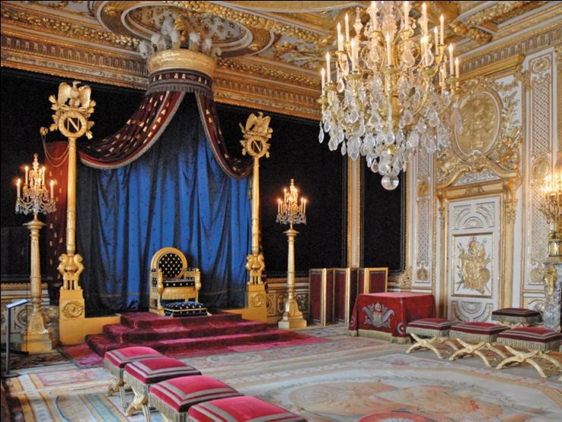
27.5
La Salle du Trone á Napoleon (throne room of Napoleon), Palais de Fontainebleau, c.1800; Fontainebleau, France. French Empire.
Notes:
Long Description:
The ceiling has grand decorations. A textile screen behind the throne rises toward the ceiling. Lamps supported by columns are on the left and the right of the throne. A large hanging lamp is hung on the ceiling. Many small thrones are arranged on the left and the right of the floor.

Slide 13
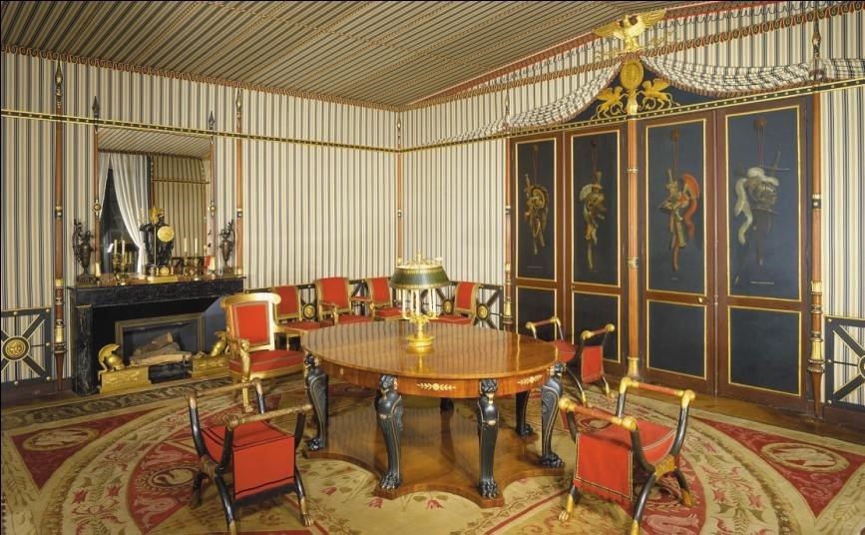
27.6
Salle de Conseil (Council Chamber), Château de la Malmaison, c.1800; near Paris, France; Charles Percier and Pierre-François-Léonard Fontaine. French Empire.

Slide 14
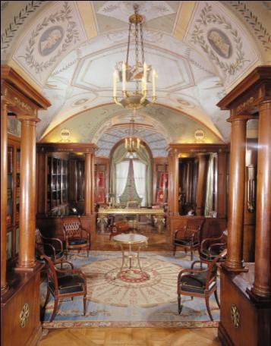
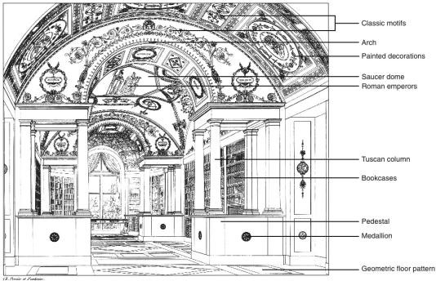
27.7
Cabinet de travail-bibliothéque (library), Château de la Malmaison, near Paris, France. Library published in Recueil de décorations intérieures, 1812, 1827. French Empire.
Notes:
Long Description 1:
The classic motifs, arch, painted decorations, saucer dome, and Roman emperors painting are on the ceiling. The Tuscan column rises from the pedestal. Bookcases are mounted on the walls. The pedestal and Medallion are in the medial region. The floor is decorated with a geometric floor pattern.
Long Description 2:
The library has classic motifs, arches, painted decorations, and a saucer dome on the ceiling. The Tuscan column rises from the pedestal. Bookcases are mounted on the walls. The pedestal and Medallion are in the medial region. The floor is decorated with a geometric floor pattern.

Slide 15
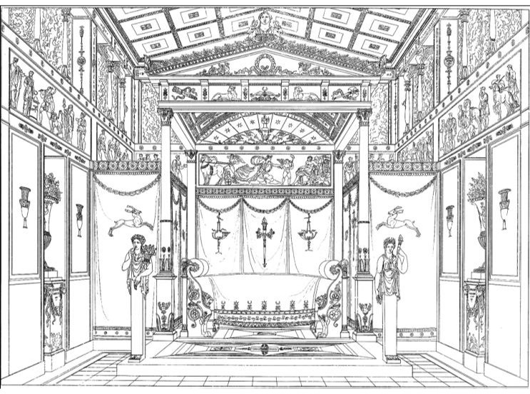
27.8
Lit éxécuté à Paris, c. 1827; Paris, France; Charles Percier and Pierre-François-Leonard Fontaine; published in Recueil de décorations intérieures, 1812, 1827. French Empire.
Notes:
Long Description:
The great throne is under a roof supported by four columns. The roof has a pediment and cornice. The pediment has a human figure sculpture. The top ceiling has geometrical patterns. The upper side walls have a painting of people. Two women sculptures are on the left and the right of the throne.

Slide 16
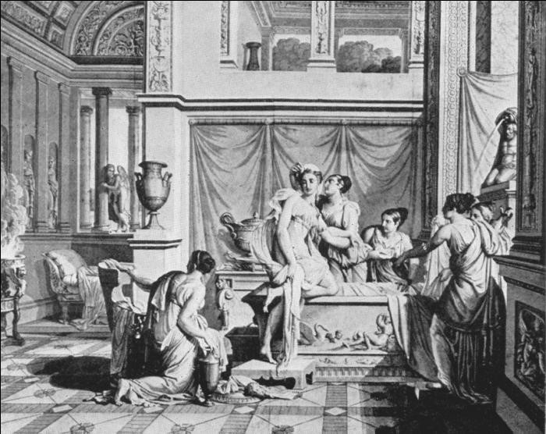
27.9
Wallpaper: Panel from “Psyche and Cupid,” 1814; France; Dufour. French Empire.

Slide 17
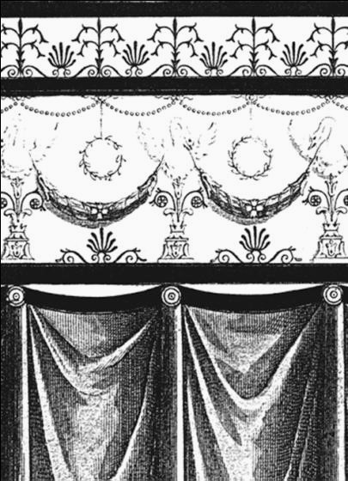
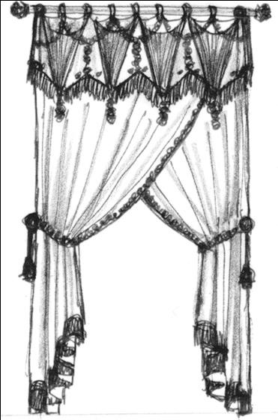
27.10
Window Treatments: Wallpaper showing drapery treatment and actual draperies, c. 1815–1820s. French Empire.

Slide 18
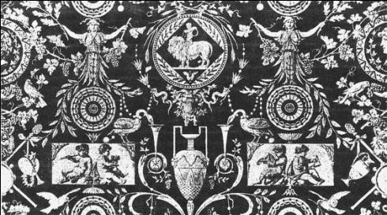
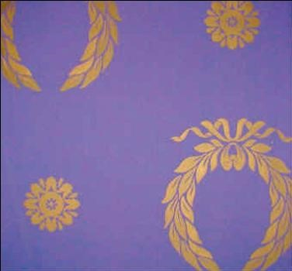
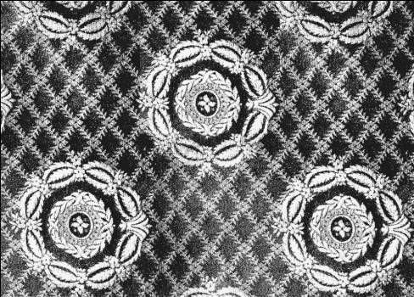
27.11
Textiles: Upholstery with period motifs; France. French Empire.

Slide 19
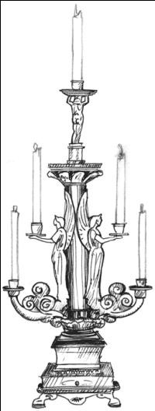
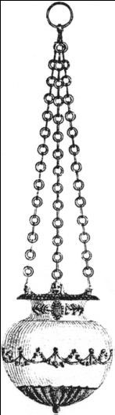
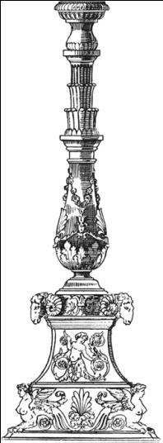
27.12
Lighting: Candelabra, hanging lamp, and guéridon, c. early 1800s. French Empire
Notes:
Long Description:
Two angel sculptures are on the left and the right of a column on the stand. Two arms extend from the feet of the sculptures holding two holders with candles. The arms of the sculptures are two holders with candles. A circular plat above the angel sculptures held a human sculpture that held a holder with a candle on his head.

Slide 20
Furnishings & Decorative Arts
Classical attributes, forms, & motifs
  Inspired by Pompeii, ancient vase paintings, & stucco reliefs
  Copy & adapt ancient Greek & Roman furniture
Directoire: slender proportions, greater severity, angularity
  Rolled-over backs, saber legs
Consulate: heavier in scale, more gilding & ornament
  Egyptian motifs & characteristics of Empire
Empire: classical & architectonic
  Masculine, stiff, & majestic & design supersedes comfort
  Blocky, sharp corners, little applied ornament

Slide 21
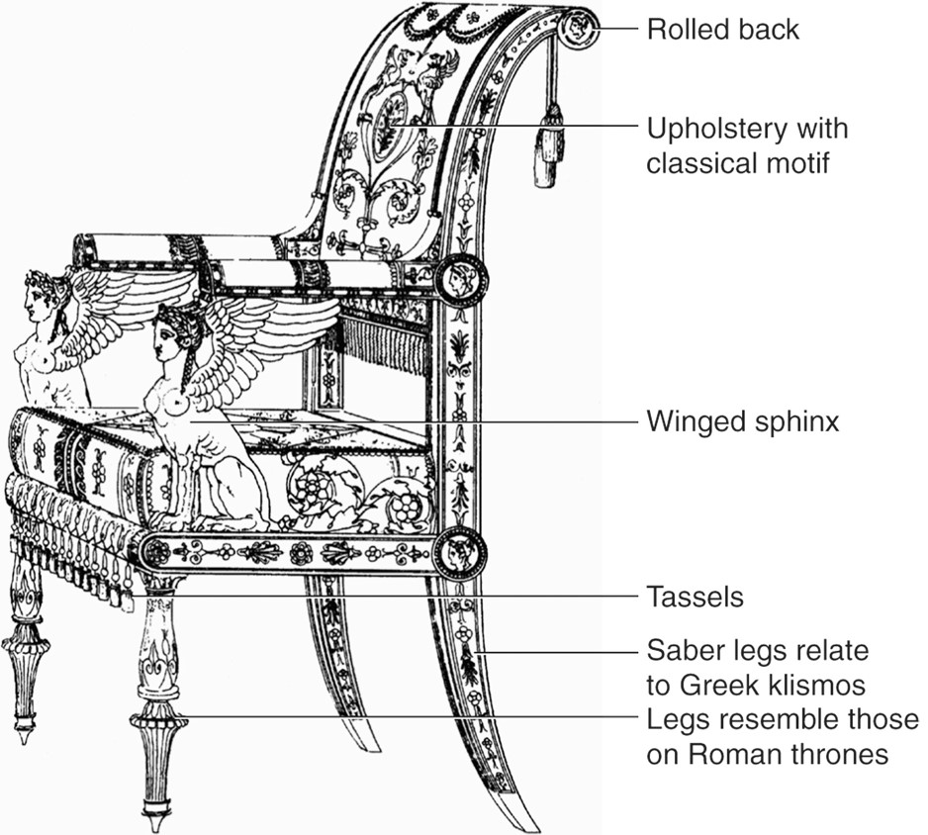
27.13
Fauteuil, c. 1800, Paris, France; Charles Percier and Pierre-François-Leonard Fontaine; published in Recueil de décorations intérieures, 1812, 1827. French Empire.

Slide 22
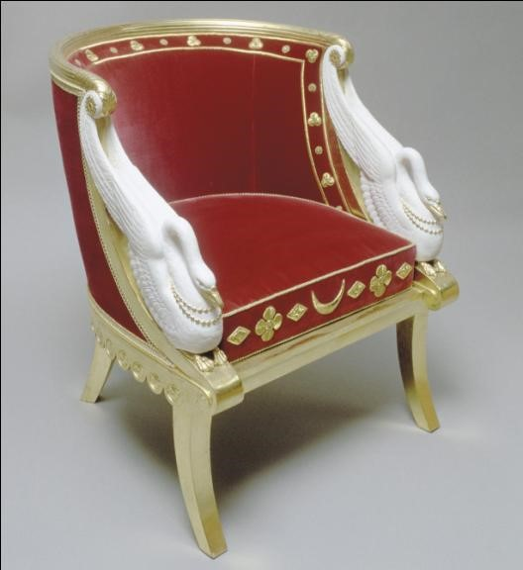
27.14
Bergère with swans, c. early 1800s; France. French Empire

Slide 23
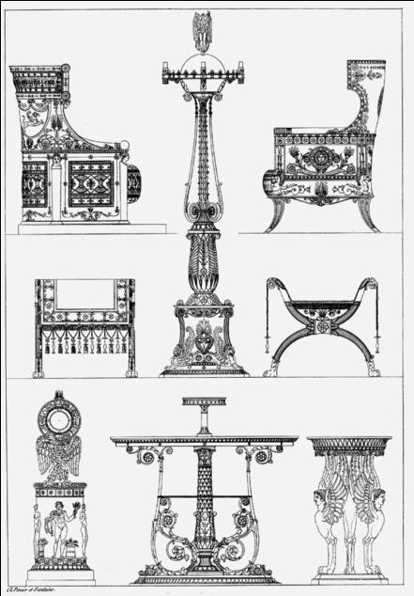
27.15
Fauteuils, tabourets, candelabra, côté du tabouret, petit pendule, and table, c. 1800; Paris area, France; by Charles Percier and Pierre-François-Léonard Fontaine; published in Recueil de décorations intérieures, 1812, 1827. French Empire.
Notes:
Long Description:
The two types of fauteuil have tall backs with semicircular tops. One of the fauteuils has rectangle frames holding the seat. The other fauteuil has an armrest and curved legs. An upholstery has tassels and flower borders. A Candelabra has a rectangle stand at the bottom with a lotus vase and a rising column holds the lamp holder. A bowl has an arch leg with volute arms. A table has a human sculpture at its bottom and a circular plate held by wings. A table has a central column and the legs have flower plant designs. A table has sphinx and cabriole legs.

Slide 24
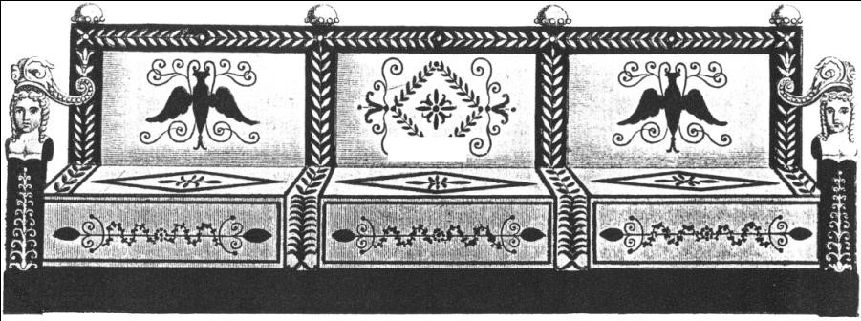
27.16
Canapé, c. 1790s–1810s; France. French Empire.

Slide 25
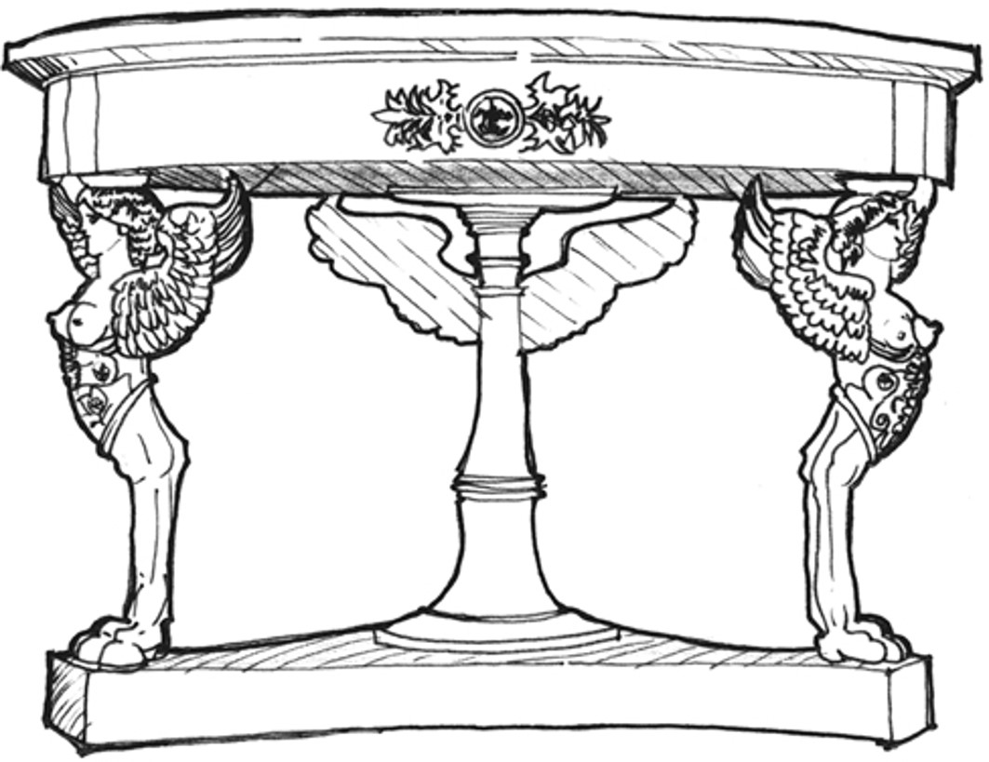
27.17
Round table with pedestal base and animal legs, c. early 1800s; France. French Empire.

Slide 26
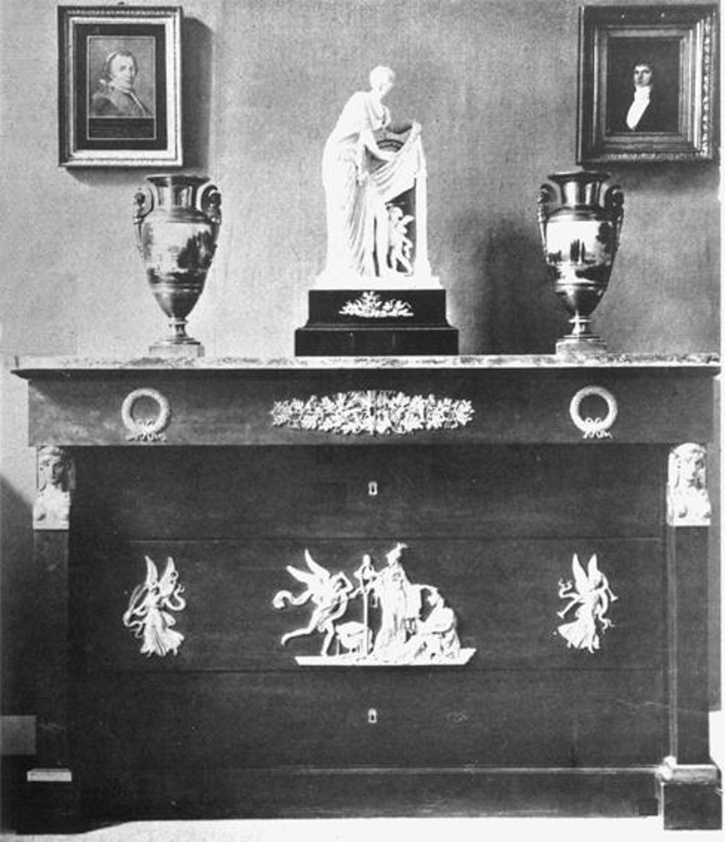
27.19
Commode with ormolu decoration, c. 1800-1820s; France.

Slide 27
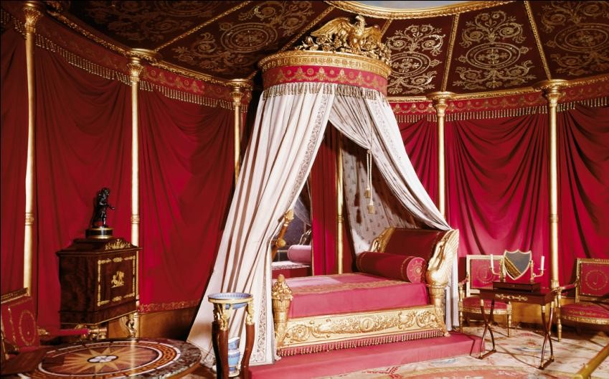
27.20
Lit, Chambre a Coucher de l’Impératrice (Josephine’s bedroom), Château de la Malmaison, c. 1800; Paris, France; Charles Percier and Pierre-François-Léonard Fontaine. French Empire.

Slide 28
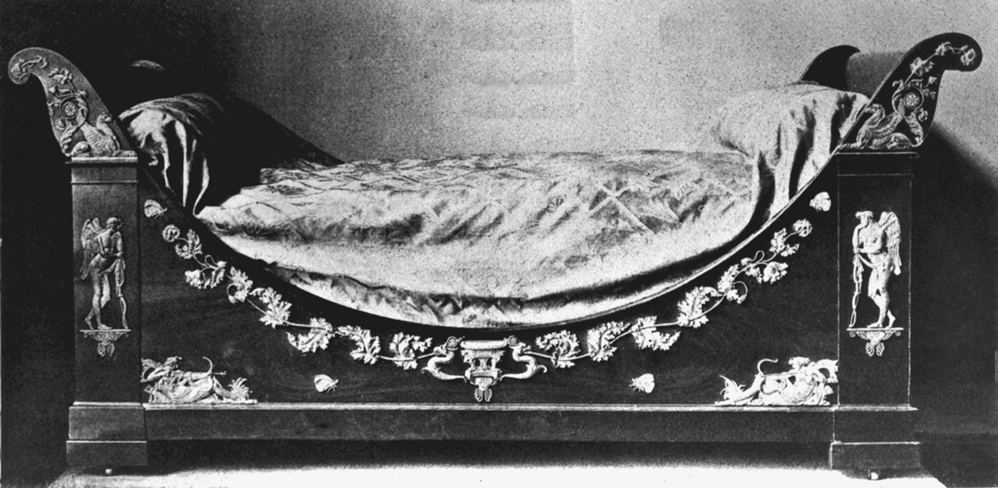
27.21
Lit en acajou garni de cuivres dorés (bed in mahogany with gilded bronze appliqués), c. early 1800s; France. French Empire.

Slide 29

Copyright
This work is protected by United States copyright laws and is provided solely for the use of instructors in teaching their courses and assessing student learning. Dissemination or sale of any part of this work (including on the World Wide Web) will destroy the integrity of the work and is not permitted. The work and materials from it should never be made available to students except by instructors using the accompanying text in their classes. All recipients of this work are expected to abide by these restrictions and to honor the intended pedagogical purposes and the needs of other instructors who rely on these materials.

