Slide 1
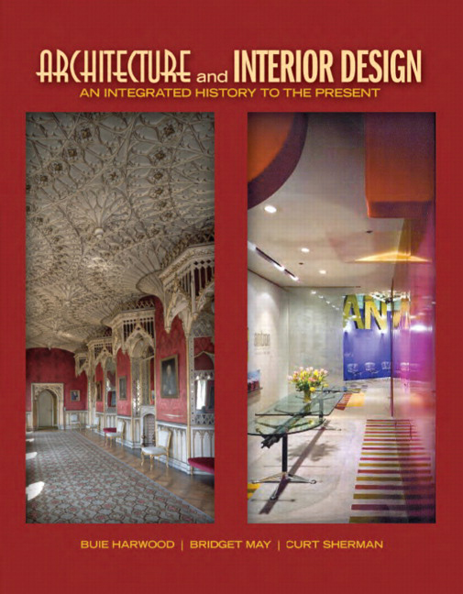

Architecture and Interior Design: An Integrated History to the Present
First Edition
Chapter 18
Louis
1643 – 1715, France
Copyright © 2012 Pearson Education, Inc. All Rights Reserved
Notes:
If this PowerPoint presentation contains mathematical equations, you may need to check that your computer has the following installed:
1) Math Type Plugin
2) Math Player (free versions available)
3) NVDA Reader (free versions available)

Slide 2
Louis Roman numeral fourteen.
France leading world power in 17th century
Replaces Italy as artistic leader of Europe
Versailles—grandest example of French Baroque
  Dazzles all of Europe
  Sets standard for luxury & extravagance in architecture, interiors, furniture
Exemplifies French Baroque planning concepts, design language & intent
French Baroque coincides with the reign of & is created for
Louis
  An absolute monarch who considers himself greatest ruler in Europe

Slide 3
Concepts
French Baroque seeks to awe & inspire
  Absolutism of Sun King, Louis
Projects grandeur, majesty, luxury
Unified compositions integrate landscape, architecture, interiors, furniture, & decorative arts
Elaborate statement of court taste
  Avoids exuberance, emotionalism, & excess of Italian Baroque
  Embraces reason, restraint, order, formality
  Applies Baroque principles more fully to secular interiors
Motifs—classical architectural elements; Versailles—intertwined Ls, sun faces, military symbols, fleur-de-lis, crowns; acanthus leaves, cherubs, cartouches

Slide 4
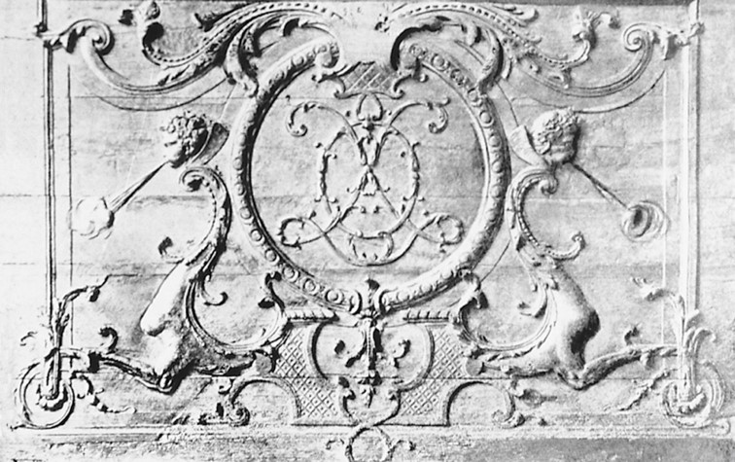
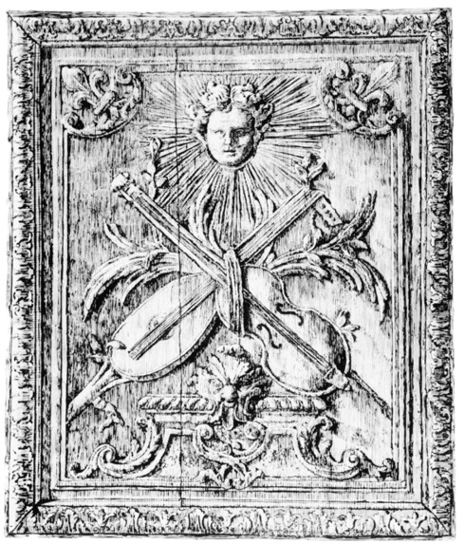
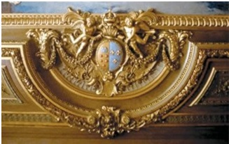
18.1
Motifs: Top from left: intertwining L’s and sun face with musical instruments; bottom: crown and fleur-de-lis. French Baroque/Louis

Slide 5
Architecture
Baroque Classicism
  Symmetry, classical order, monumental scale, center emphasis
  Borrows from conservative Italian Baroque of Bernini
Façades relatively flat with projecting units
Dignity, masculinity, vigorous but restrained ornament
Distinctively French—pavilions, frontispiece with pediment or separate roof & sculptural ornament, tall hipped or mansard roof
Extravagantly planned exteriors & interiors
Great building activity—Versailles, châteaux, hôtels, middle-class housing

Slide 6
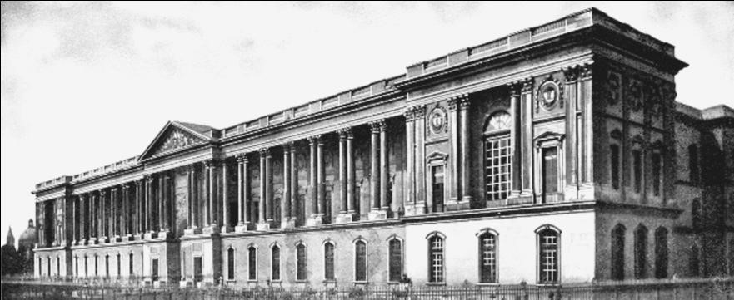
18.2
East Front, Louvre, 1667-1670; Paris, France; Claude Perrault, Louis Le
Vau and Charles Le Brun. French Baroque/Louis

Slide 7
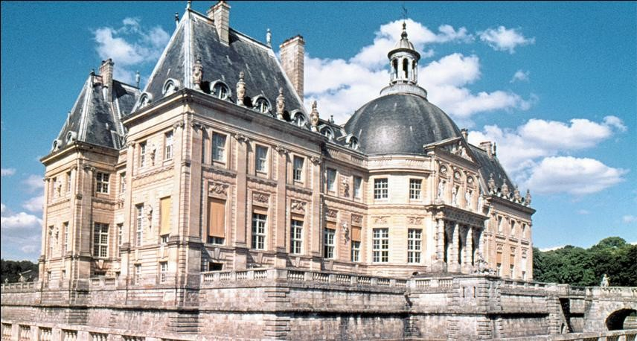
18.3a
Château Vaux-le-Vicomte, 1657-1661, near Paris, France; Louis Le Vau, André Le Nôtre, and Charles Le Brun. French Baroque/Louis

Slide 8
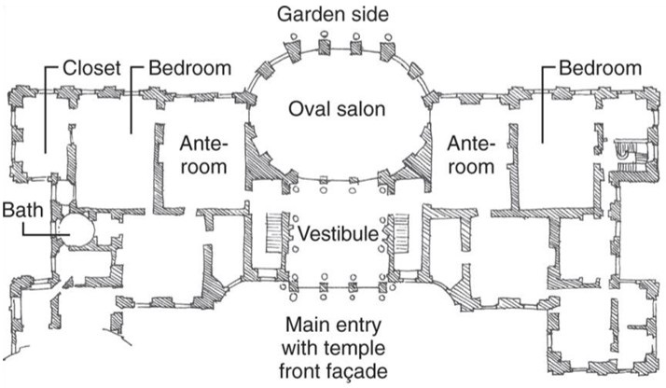
18.3b
Château Vaux-le-Vicomte, floor plan, 1657-1661, near Paris, France; Louis Le Vau, André Le Nôtre, and Charles Le Brun. French Baroque/Louis
Notes:
Long Description:
Chateau Vaux-le-Vicomte has the main entry with a temple front facade, vestibule, an oval salon, one ante-room and bedroom to the left of the oval salon, and another ante-room and bedroom to the right side of it. A closet is next to the bathroom. A bath is near the closet. The garden side is behind the oval salon.

Slide 9
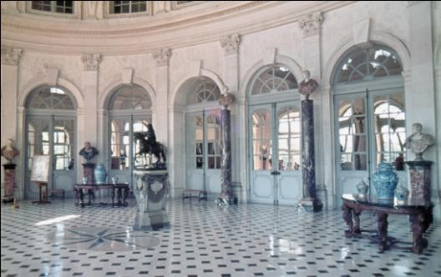
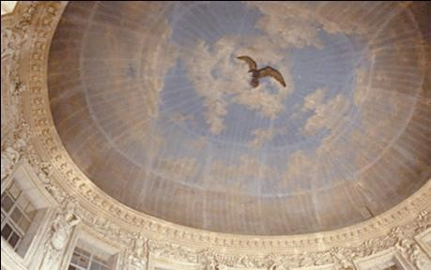
18.3c
Château Vaux-le-Vicomte oval salon ceiling and oval salon, 1657-1661, near Paris, France; Louis Le Vau, André Le Nôtre, and Charles Le Brun. French Baroque/Louis
Notes:
Long Description 1:
The ceiling of the oval salon of Chateau Vaux-le-Vicomte has a bird picture at the center and has many lines from the circumference connecting to the bird picture which is at the center. The circumference has a round-shaped design. Rectangular-shaped windows are present just below the ceiling.
Long Description 2:
The floor of the oval salon of Chateau Vaux-le-Vicomte has diamond-shaped marble. The oval salon is surrounded by doors. Many idols are placed on the table beside doors, in halls and sculptured ornaments are present on top of the door on the wall.

Slide 10
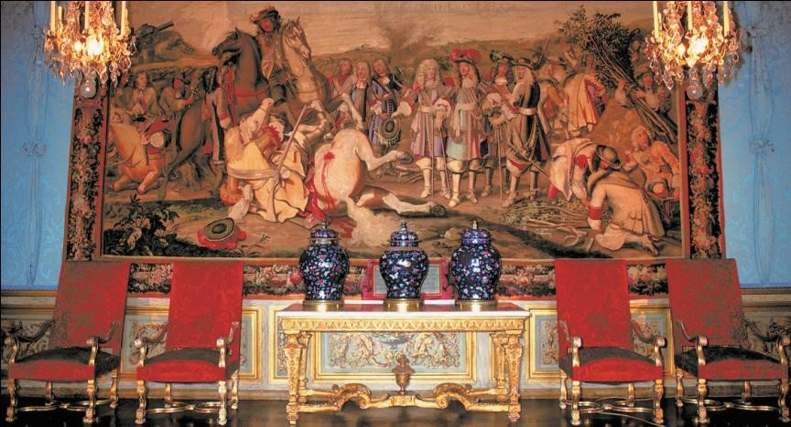
18.3d
Château Vaux-le-Vicomte interior with tapestry, 1657-1661, near Paris, France; Louis Le Vau, André Le Nôtre, and Charles Le Brun. French Baroque/Louis
Notes:
Long Description:
The interior of the Chateau Vaux-le-Vicomte has a big painting on the wall which depicts war, where a warrior on a horse had killed a warrior along with his horse and many soldiers are lying down with blood. Some people are watching the war in the painting. Two hanging lights are hung in front of the painting. A table with three jars is placed on it. Two chairs are placed to the right and left of the table.

Slide 11
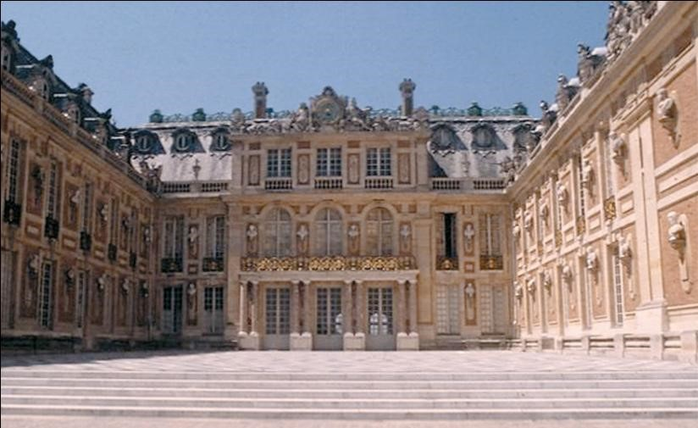
18.4a
Palais de Versailles, La Cour d'honneur or Marble Court, 1664-1672; Versailles, France; Louis Le Vau. French Baroque/Louis

Slide 12
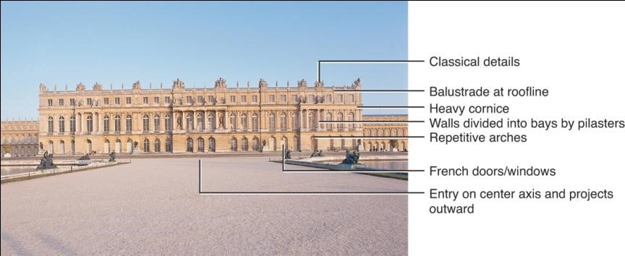
18.4b
Palais de Versailles, Garden Front, 1664-1672; Versailles, France; Louis Le Vau. French Baroque/Louis
Notes:
Long Description:
The view from the garden of Palais de Versailles has a Balustrade at the roofline, a top with classical details, heavy cornice, walls divided into bays by plasters, repetitive arches, French doors, and windows and entry on the center axis and project outward.

Slide 13
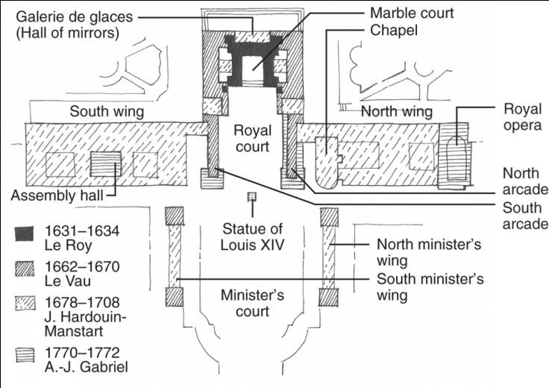
18.4c
Palais de Versailles, floor plan, 1631-1772; Versailles, France. French Baroque/Louis
Notes:
Long Description:
The floor plan of the Palais de Versailles depicts a minister's court, a statue of Louis Roman fourteen, the left side of the minister's court is the north minister's wing and the right side is the south minister's wing, the royal court is at the center, the right side of the royal court is the south wing. Assembly hall is present in the south wing. The left side of the royal court is the north wing. Royal Opera, Chapel, north arcade, and south arcade are present in the north wing. The marble court is at the back of the royal court and the Galerie de glace (Hall of mirrors) is next to the marble court.

Slide 14
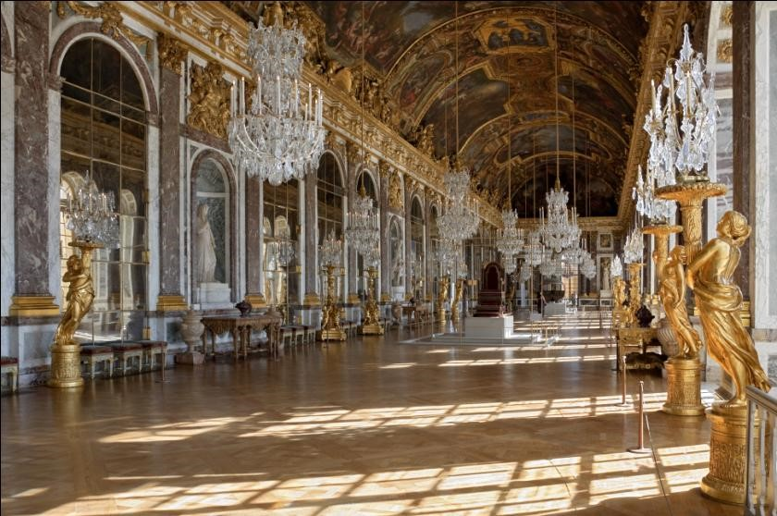
*18.4d
Palais de Versailles, Galerie des Glaces (Hall of Mirrors), 1664-1672; Versailles, France; Louis Le Vau and Charles Le Brun. French Baroque/Louis

Slide 15
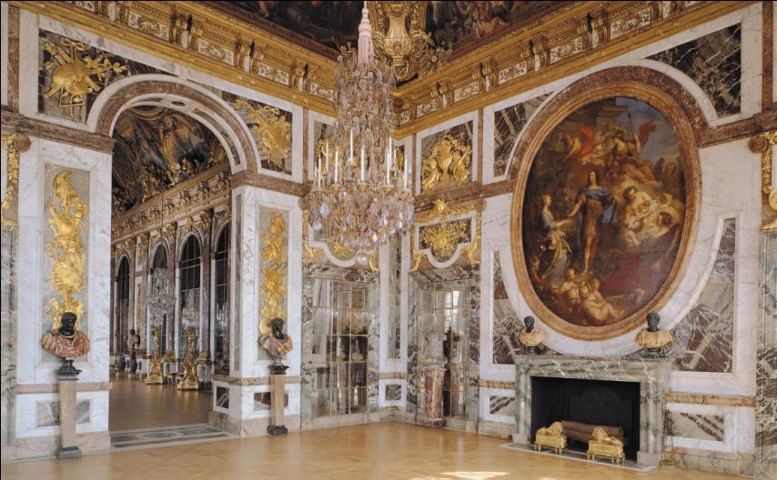
18.4e
Palais de Versailles, Salon de la Paix (Room of Peace), 1664-1672; Versailles, France; Louis Le Vau and Charles Le Brun. French Baroque/Louis
Notes:
Long Description:
Salon de la Paix (Room of Peace) of Palais de Versailles has a large circle-shaped Jesus painting on the wall, hanging light is hung on the ceiling, the entrance is decorated with ornamented sculptures, idols are placed at the sides of the entrance, and the bottom of Jesus painting.

Slide 16
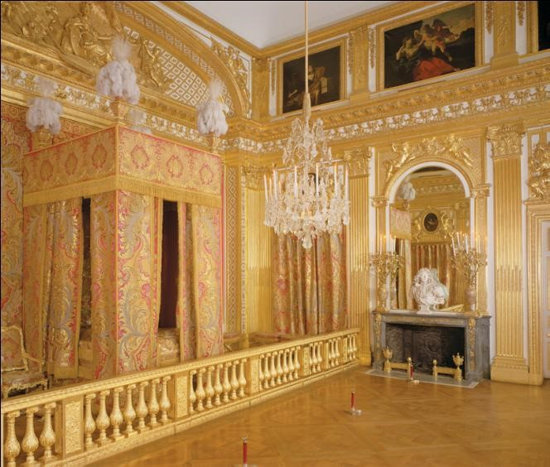
18.4f
Palais de Versailles, Louis XIV’s Bedchamber, 1701; Versailles, France; Jules Hardouin-Mansart and Robert de Cotte. French Baroque/Louis
Notes:
Long Description:
The bedchamber in Palais de Versailles has an antechamber with a bed aclove which is separated by a barrier. The bed is covered with decorated silk cloth. There is an idol placed on a table in the antechamber, hanging light is hung on the ceiling, and paintings on the wall.

Slide 17
Interiors
Compliment exteriors—classical order, language, & motifs but far more sumptuous
Symmetry, formality, grandeur, large scale, rich decoration, vivid color, luxurious materials
Rectilinear space arranged symmetrically new to France
Ceremonial interiors most lavishly appointed
  Balustrades, daises separate to support etiquette & rituals
Charles Le Brun plans & decorates Versailles interiors
  Great power & influence, virtually creates Louis
  style
  Considered 1st all-around interior decorator
French Royal Academy of Painting & Sculpture produces man artists & others who can embellish interiors

Slide 18
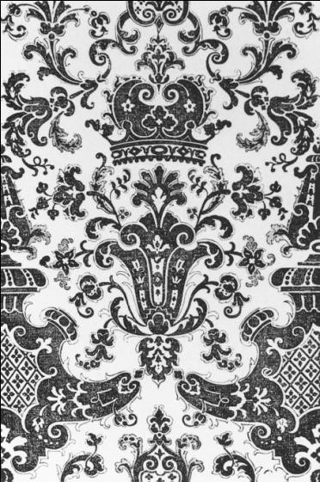
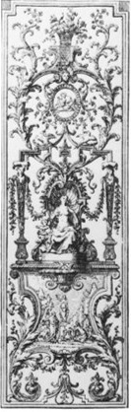
18.5
Textiles: Textiles reflecting designs of Louis XIV; France. French Baroque/Louis

Slide 19
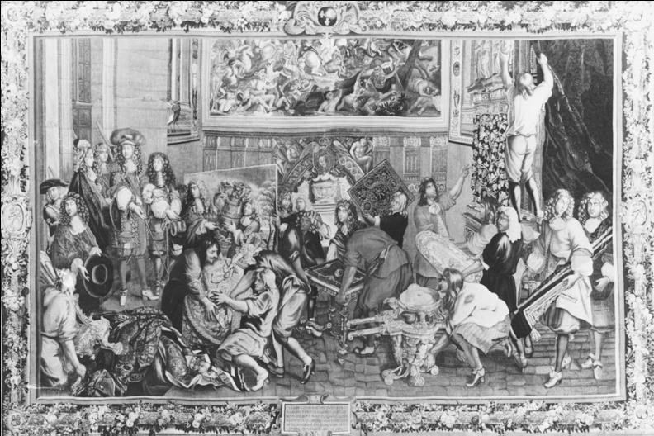
18.6
Textiles: Tapestry commemorating the visit of Louis XIV to the Gobelins factory in 1667. French Baroque/Louis

Slide 20
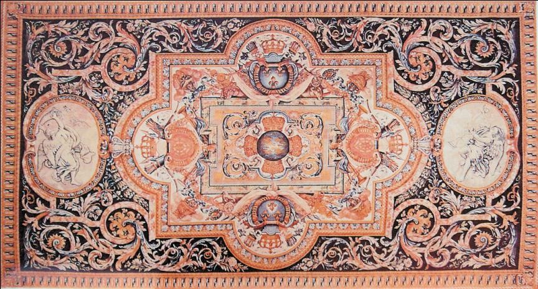
18.7
Rugs: Savonnerie rug, 1680; France. French Baroque/Louis

Slide 21
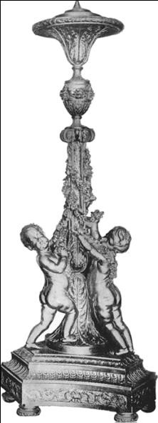
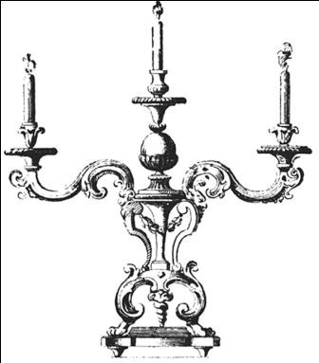
18.8
Lighting: Guéridon and candelabra; France. French Baroque/Louis
Notes:
Long Description:
The candelabra has three arms to hold the candles. The left and right arms are fluted light arms with foliage decoration and bell-shaped nozzles and the central arm has a large bell-shaped nozzle. These arms are supported by a central, two-fluted arm stem.

Slide 22
Furnishings & Decorative Arts
Harmonizes with interiors & influence of Charles Le Brun becomes integral part of room decoration
Supports ceremony, rank, status so appearance more important than comfort
Symmetrical, rectangular, some large curves, massive proportions, lavish decoration
  Carving, marquetry, gilding
Legs—term, console, turned, cabriole
Feet—bun, paw, carved, turned
Stretchers—X or saltire, H
Factories open to produce goods for court, nobility, middle class

Slide 23
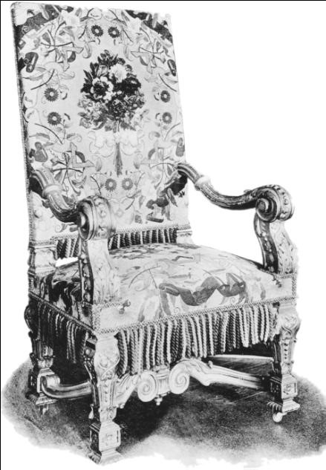
18.10
Gilt fauteuil, late 17th century; France. French Baroque/Louis

Slide 24
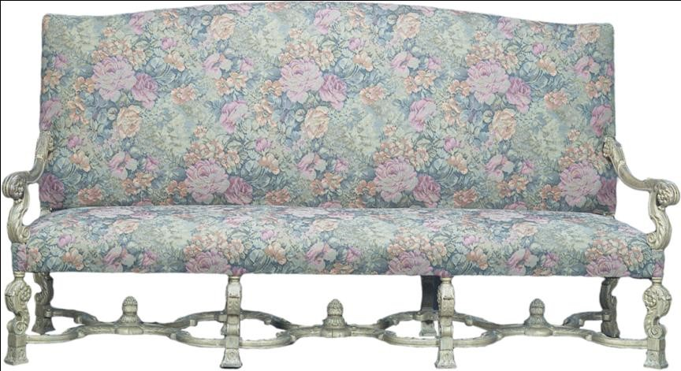
18.11
Carved and gilded canapé, late 17th century; France; French Baroque/Louis

Slide 25
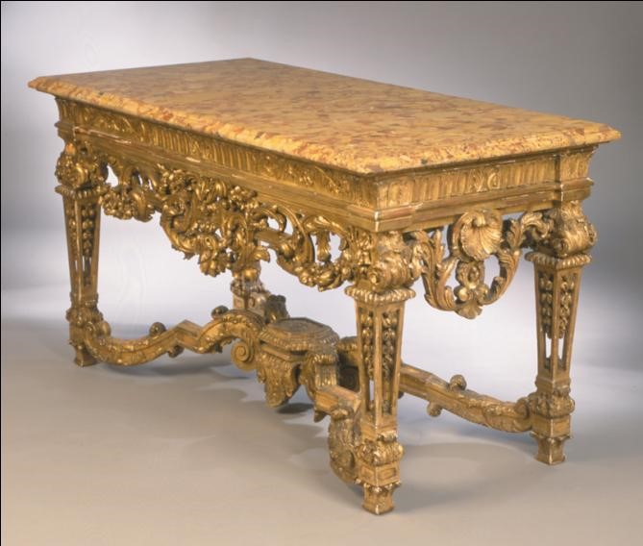
18.12
Table; 17th century; France. French Baroque/Louis

Slide 26
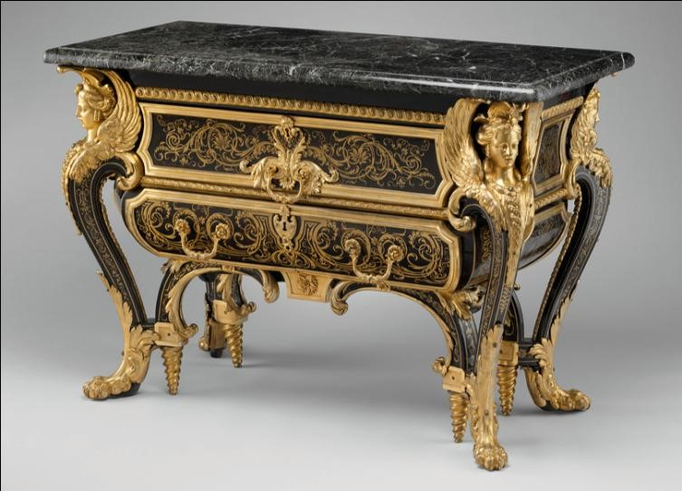
18.13
Commode, early 18th century, France; André-Charles Boulle. French Baroque/Louis
Notes:
Long Description:
The commode has a flat-topped desk, has two levels of drawers. An acanthus-leaf scroll mount is present on the drawers. The drawer's front has a brass-and-tortoiseshell marquetry design on it. The legs of the commode have female figures with paw-and-acanthus feet.

Slide 27
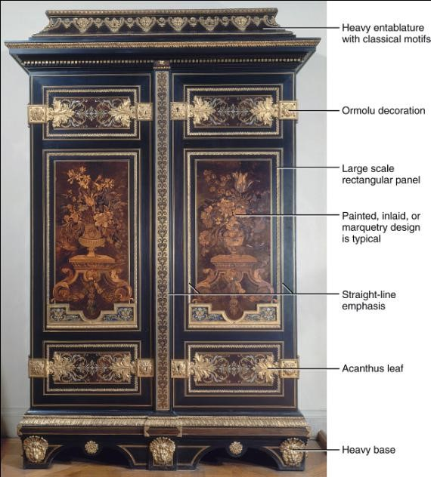
18.14
Armoire, c. 1700; attributed to André-Charles Boulle. France.
Baroque/Louis
Notes:
Long Description:
The armoire has a heavy entablature with classical motifs at the top and ormolu decoration. A large scale rectangular panel is painted, inlaid, or typical marquetry design, a straight-line emphasis that divides into parts, acanthus leaf, and a heavy base.

Slide 28

Copyright
This work is protected by United States copyright laws and is provided solely for the use of instructors in teaching their courses and assessing student learning. Dissemination or sale of any part of this work (including on the World Wide Web) will destroy the integrity of the work and is not permitted. The work and materials from it should never be made available to students except by instructors using the accompanying text in their classes. All recipients of this work are expected to abide by these restrictions and to honor the intended pedagogical purposes and the needs of other instructors who rely on these materials.

