Slide 1
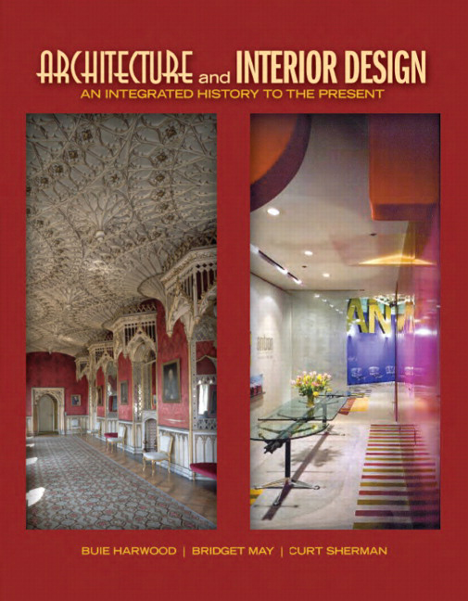

Architecture and Interior Design: An Integrated History to the Present
First Edition
Chapter 16
American Colonial
England, Spain, France, Germany, and Holland 17th – 19th Centuries
Copyright © 2012 Pearson Education, Inc. All Rights Reserved
Notes:
If this PowerPoint presentation contains mathematical equations, you may need to check that your computer has the following installed:
1) Math Type Plugin
2) Math Player (free versions available)
3) NVDA Reader (free versions available)

Slide 2
American Colonial
Beginning late 16th century, European colonists arrive in the New World
  Seeking religious or political freedom, wealth
English, Spanish, French, Germans & Dutch bring social & cultural traditions of homeland
Recreate architecture, interiors, furniture, decorative arts knew at home
  Most unaware of high-style Renaissance
  Medieval & vernacular with exception of Spanish
Settlement patterns originate according to each country’s territorial holdings
  But affected by country’s administration of its colonies

Slide 3
England: Concepts & Architecture
Architecture, interiors, furnishings reflect familiar forms of England
  Vernacular & medieval
Architecture—public & private--like that of home
  Small, functional, little embellishment
Settled times—Tudor, Elizabethan, even classical styles
Plans & materials vary with region
Similar characteristics: steeply pitched gable roof, casement windows, timber-framed construction
Plans—hall, hall & parlor, lean-to within 1,
2 stories
Little thought of symmetry or other classical attributes

Slide 4
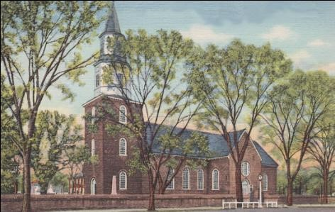
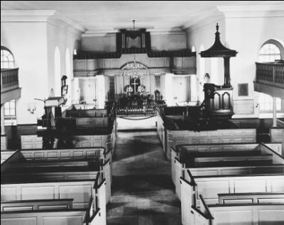
16.2
Bruton Parish Church and interior, 1711-1715; Williamsburg, Virginia; plans by Alexander Spotwood. English Colonial.

Slide 5
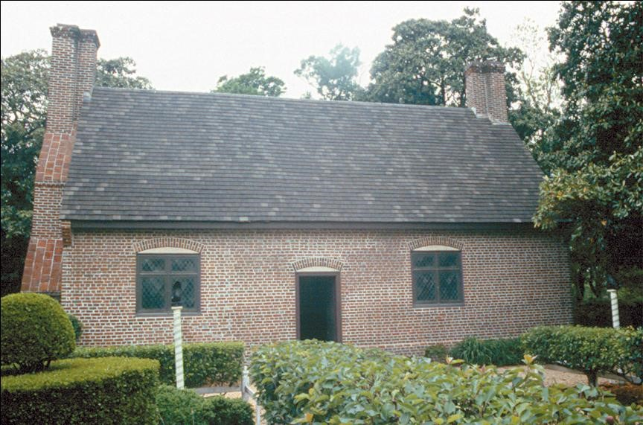
16.3
Adam Thoroughgood House, 1636-1640; Princess Anne County, Virginia. English Colonial.

Slide 6
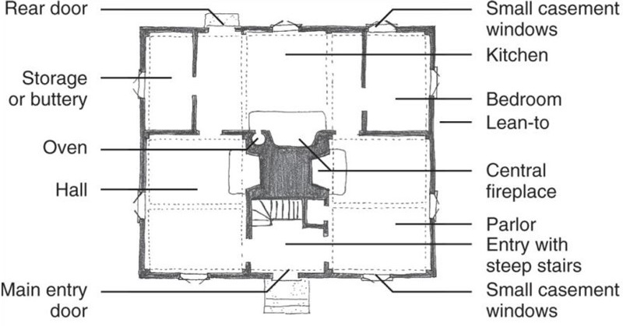
16.4
Floor plan, hall and parlor house with lean-to, 17th century, Connecticut. English Colonial.
Notes:
Long Description:
The floor plan of the hall and parlor house shows the main entry door, then the entry with steep stairs, small casement windows on the right side of the main entry door, a hall, a parlor, an oven, a central fireplace, a bedroom, a lean-to, kitchen, storage or buttery, another small casement windows in the bedroom, and a rear door.

Slide 7
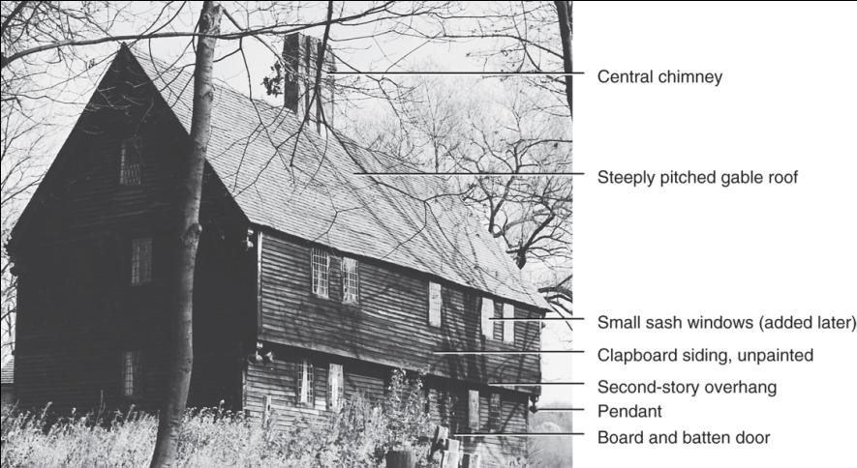
16.5
Parson Capen House, 1683, Topsfield, Massachusetts. English Colonial.

Slide 8
Interiors, Furnishings, Decorative Arts (1 of 5)
Interiors--vernacular & medieval
  Modest scale, functional, visible structure
  Rough textures, low ceilings, large fireplaces
Multi-functional rooms
  Hall—center of family life & used for cooking, eating, socializing, sometimes sleeping
Furniture—early crude and quickly made
Later—closely follows English Elizabethan, Jacobean, William & Mary
Often multifunctional
Some rooms filled with furniture, particularly seating
  Chambers usually have more than one bed

Slide 9
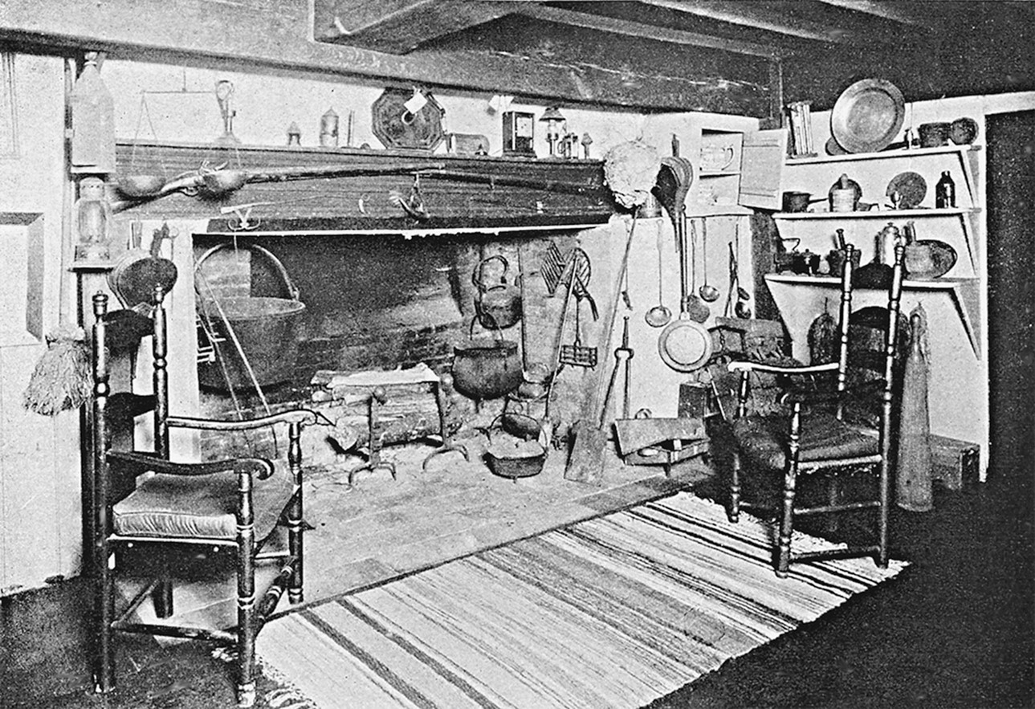
16.7
Recreated interior with 17th-century fireplace and some furnishings; Ipswich, Massachusetts. English Colonial.
Notes:
Long Description:
The interior is a vernacular and medieval architectural style that has a low ceiling and a large fireplace. There are chairs, and mats placed near the fireplace. Many utensils are arranged. The hall is used for multi-functional purposes.

Slide 10
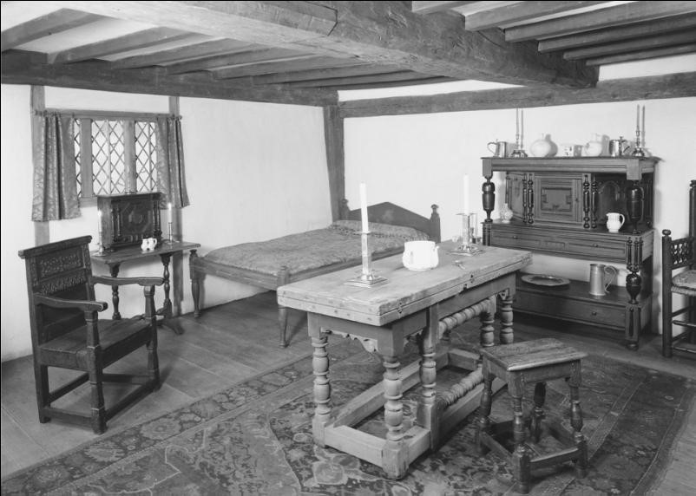
16.8
Hall and chamber (Hart Room), Hart House, before 1674; Ipswich, Massachusetts. English Colonial. [Courtesy, Winterthur Museum]

Slide 11
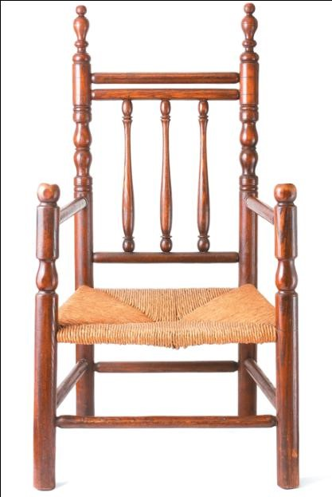
16.12
Carver chair, late 17th century; New Haven County, Connecticut. English Colonial.

Slide 12
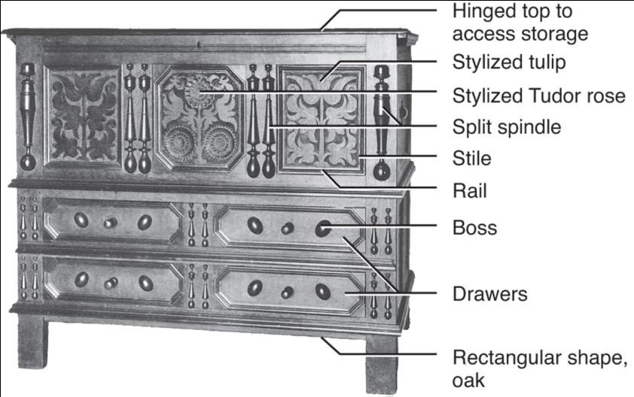
16.13
Connecticut or Wethersfield chest; 17th century; Hartford, Connecticut. English Colonial.
Notes:
Long Description:
Connecticut or Wethersfield chest is made from oak wood and in a rectangular shape. This chest has a hinged top to access storage, a stylized tulip at the center and a stylized Tudor rose at the left and right side of the chest, a split spindle, stile, rail, boss, and four drawers.

Slide 13
Spain: Concepts, Motifs, Architecture
Impressive buildings establish, emphasize authority & power
  More influences from Spanish Renaissance & Baroque
  More provincial, adapted to local conditions, labor forces, materials
Motifs—Spanish Renaissance & Baroque, Native American
Architecture—missions & churches main survivors
  Built to impress new converts
  Unornamented adobe (Southwestern U.S.) to domed & vaulted stone with decorative portals (Texas, Arizona)
Houses for protection from climate & attack instead of style
Materials, construction unlike Spain but similar characteristics

Slide 14
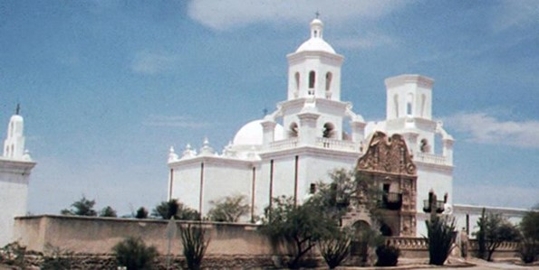
16.16
San Xavier del Bac, 1767-1797; near Tucson, Arizona; Ignacio Gaoma. Spanish Colonial.
*[Substitute image]

Slide 15
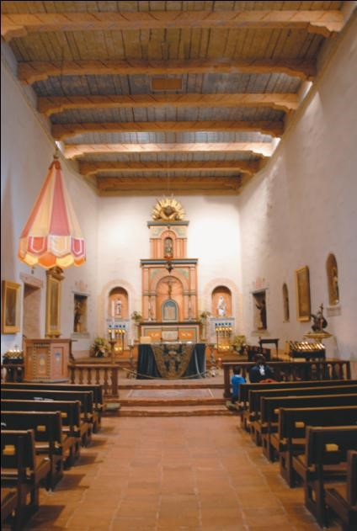
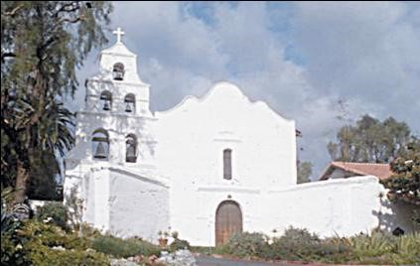
16.17
Sand Diego de Alcala Basilica and nave, 1774, rebuilt in 1803, 1812; Sand Diego, California. This was the first mission to be built in California. Spanish Colonial.

Slide 16
Interiors, Furnishings, Decorative Arts (2 of 5)
Interiors—contrast of colors, shapes, light, dark
Churches—plain exterior, richly decorated interiors
  Baroque devices, light; sculpture; & paintings to impress
Domestic—white-washed walls, dark wood trim & floor
  Sparsely but luxuriously & colorfully furnished
Furniture—Spanish prototypes but cruder, provincial
  Some brought from Spain, some made locally
  Local woods, board construction
  Simple form, rectilinear supports
  Simple painted or carved decoration
  Spindles carved instead of turned

Slide 17
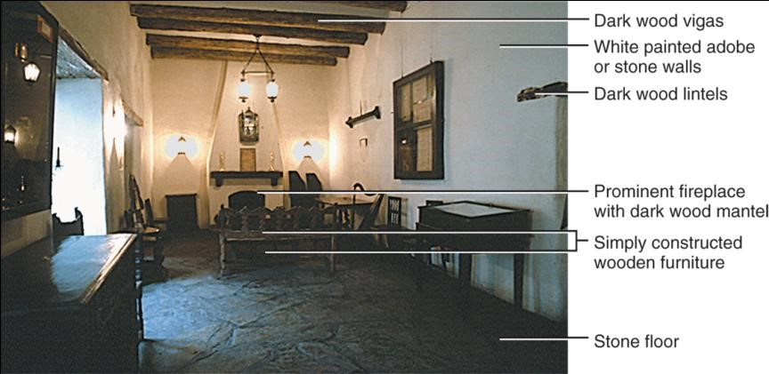
16.20
Sala, Governor’s Palace, 1749; San Antonio, Texas. Spanish Colonial.
Notes:
Long Description:
The Governor's Palace called Sala had dark wood vigas on the roof and walls were made of adobe or stone and white painted. There were dark wood lintels and a prominent fireplace with a dark wood mantel. The Palace had simply constructed wooden furniture and stone floor.

Slide 18
France: Concepts & Architecture
Material culture resembles those in France & settlers’ classes & regions of origin
Architecture—French medieval prototypes adapted to a range of climates
  Wood & stone in Canada
  Log houses Mississippi River valley
  Sophisticated cottages & townhouses in New Orleans
  Louisiana plantation houses
Chief house type—small, hipped roof, with or without a porch in all climates
Early plans 1 or 2 rooms; later 2 or 3 rooms and 1 or 2 rooms deep

Slide 19
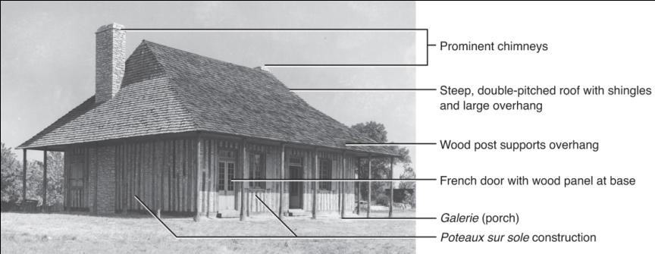
16.22
Cahokia Courtyard, 1737; Cahokia, Illinois. French Colonial.
Notes:
Long Description:
The Cahokia Courtyard has prominent chimneys, steep and double-pitched roof with shingles and a large overhang, and a wood post support overhang. The courtyard has a French door with a wood panel at the base, a galerie. It is an example of Poteaux sur sole construction.

Slide 20
Interiors, Furnishings, Decorative Arts (3 of 5)
Multifunctional rooms follow French prototypes
Simple treatments
  Paneled or plastered walls; low, beamed ceilings; taller ceilings in warmer climates; dirt or wood floors
  Little furniture
Furniture follows French prototypes
  Similar construction methods, lines, forms, details
  Styles—Louis
Louis
Louis
Louis
continue after out of fashion at home
  Simplicity & mixing of styles give provincial appearance
  Some built-in

Slide 21
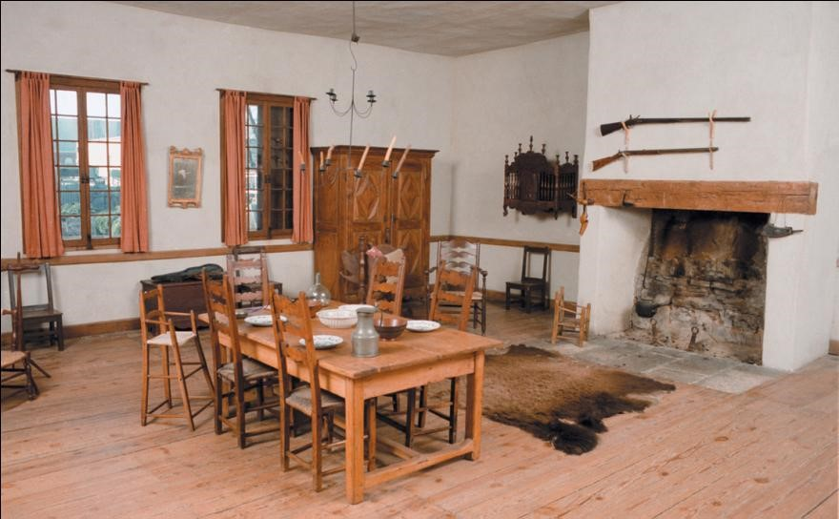
16.24
Keeping Room, Louis Bolduc, 1770-1785; S. Genevieve, Missouri. French Colonial.
Notes:
Long Description:
The keeping room of Louis Bolduc has plastered walls and a wood floor. There is a fireplace and two guns are placed above it. It has a dining table with chairs and plates arranged on the table. Windows are made of wood and have curtains. A wooden cupboard and many other pieces of furniture are present in the room.

Slide 22
Germany: Concepts & Architecture
Traditional German medieval building & furnishing patterns
Architecture—rural settlers maintain medieval building traditions into 19th century
Some have collective European heritage, such as stone & wood
  Swedes bring log cabins to America; Germans spread them westward
Affluent houses—stone or brick with gable, quoins; others of logs
Texas & Wisconsin—fackwerk, half-timbering
Early houses combine barns, stables, service & living areas under roof

Slide 23
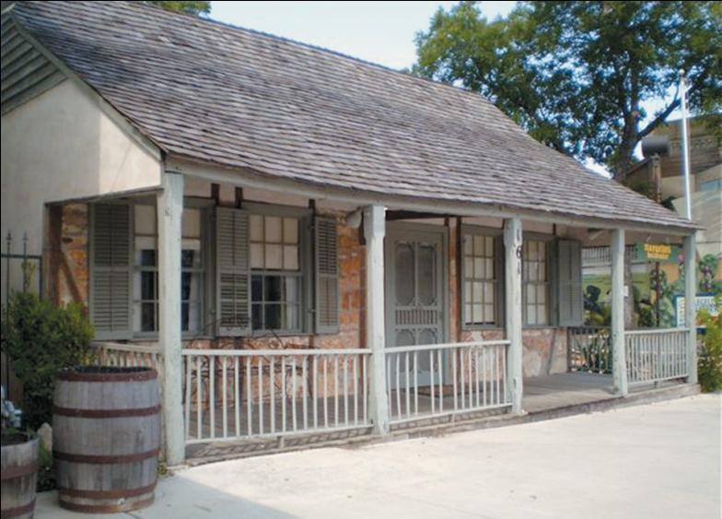
16.25
Klein-Naegelin, 1846; New Braunfels, Texas. Fachwerk construction. German Colonial.
Notes:
Long Description:
Klein-Naegelin's house was constructed using stones or bricks with gable and quoins. Walls are made with cedar timbers, then filled solid with sun-baked adobe brick. The porch across the front of the house has five squared, beveled, wood columns. Windows are double-hung and louvered shutters on the front windows.

Slide 24
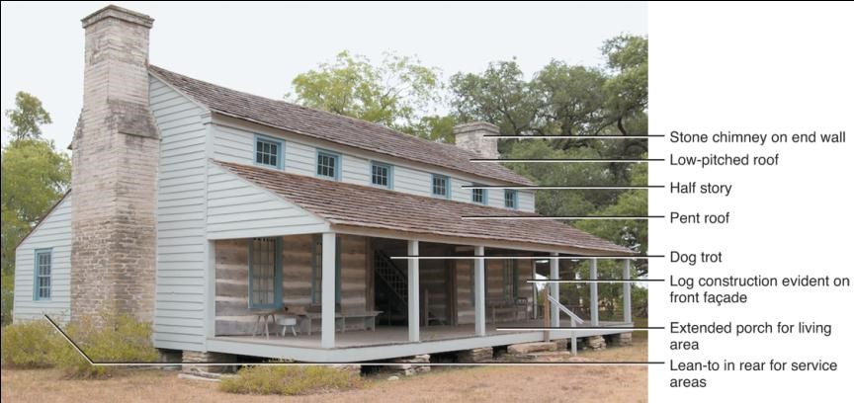
16.26
Muckleroy House, 1840; Round Top (now Henkel Square), Texas. German Colonial.
Notes:
Long Description:
The Muckleroy House has a stone chimney on the end walls. It is a half-story house with low pitched roof. There is a pent roof too. The Muckleroy house is an example of a Dog trot. It is constructed with the log that is evident on the front facade and there is an extended porch for the living area. Lean-to can be seen in the rear for service areas.

Slide 25
Interiors, Furnishings, Decorative Arts (4 of 5)
Interiors—simple, colorful treatments
  Wood floors & colorful rugs
  Whitewashed walls with painted patterns
  Beamed or plastered ceilings
Furniture—rural & urban
  Rural—medieval into 19th century
  Urban—influenced by & influences English
  Ladder-back chairs with rush seats, painted chests
Fraktur—colorful, hand-decorated texts or documents
Ceramics—slipware & sgraffito ware
Glassware—mostly made by Germans in colonial period

Slide 26
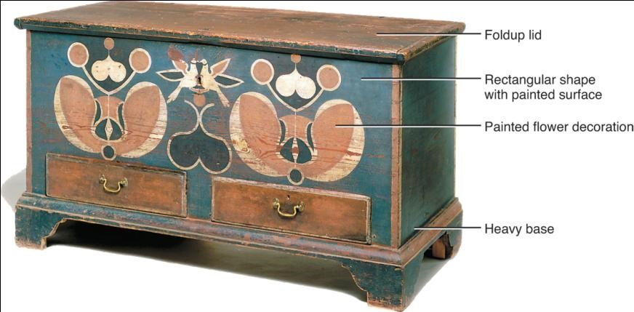
16.27
Painted chest, 1795-1810; Shenandoah Valley County, Virginia: Johannes Spitler. German Colonial.

Slide 27
Holland: Concepts & Architecture
Dutch recreate buildings & furnishings from Holland
  Strong reciprocity between English & Dutch settlers
Architecture—several house types
  Urban row house—gable end faces street with parapet wall in various shapes; shops below living quarters
  Other houses identified by roofs—straight-side gable & flared eave
Wood, brick, or stone
  Mostly brick with patterns of blue, purple, or gray mixed with red
Raised front-door and stoep or platform
Linear floor plans—three adjacent rooms

Slide 28
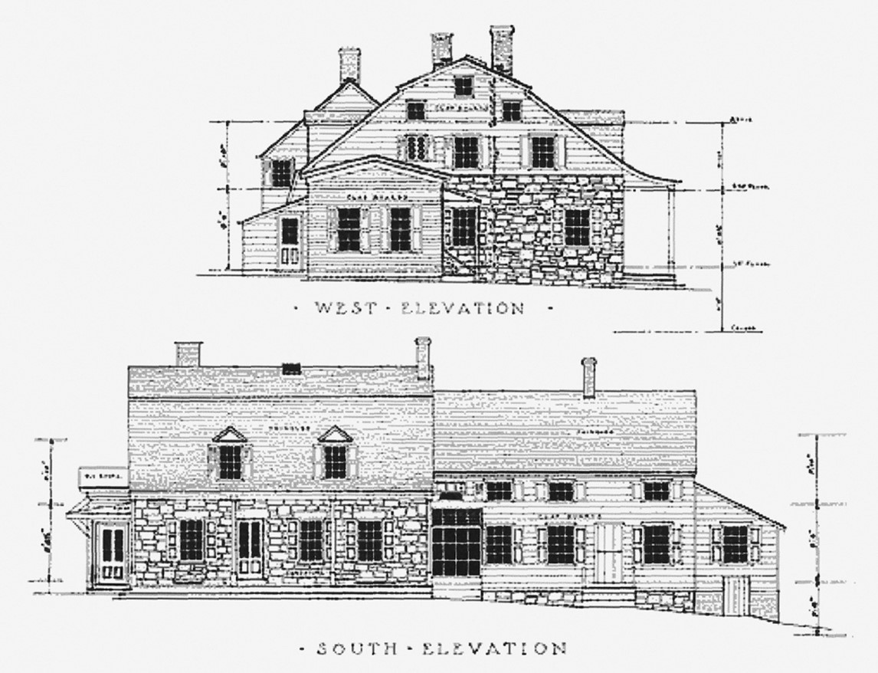
16.28
Terheun House, c. 1670 and later; Hackensack, New Jersey. Flare-eave roof. Dutch Colonial.
Notes:
Long Description:
The west elevation shows a flare-eaved roof and chimneys. It has rectangular-shaped windows. The south elevation shows the slanting and flat roofs with chimneys. The windows with pediment. The glass windows are on the facade.

Slide 29
Interiors, Furnishings, Decorative Arts (5 of 5)
Interiors—more colorful than English
  Tiles, ceramics, textiles, paintings
  Many are merchants so have objects from around the world
White-washed walls, beamed or plastered ceilings
Large fireplace with hood & cast-iron fireback; tiled surround & ruffled valance hanging from hood
Furniture—reproduces Dutch prototypes, brought from home, or imported
  Kas—distinctive Dutch storage piece in Hudson River valley
  Beds sometimes built-in
Tin-glazed earthenware (Delft) tiles & objects in blue & white or polychrome

Slide 30

Copyright
This work is protected by United States copyright laws and is provided solely for the use of instructors in teaching their courses and assessing student learning. Dissemination or sale of any part of this work (including on the World Wide Web) will destroy the integrity of the work and is not permitted. The work and materials from it should never be made available to students except by instructors using the accompanying text in their classes. All recipients of this work are expected to abide by these restrictions and to honor the intended pedagogical purposes and the needs of other instructors who rely on these materials.

