Slide 1
Earth Systems Engineering and Management
CEE 400
Week 3:
Earth Systems Engineering and Management

Slide 2
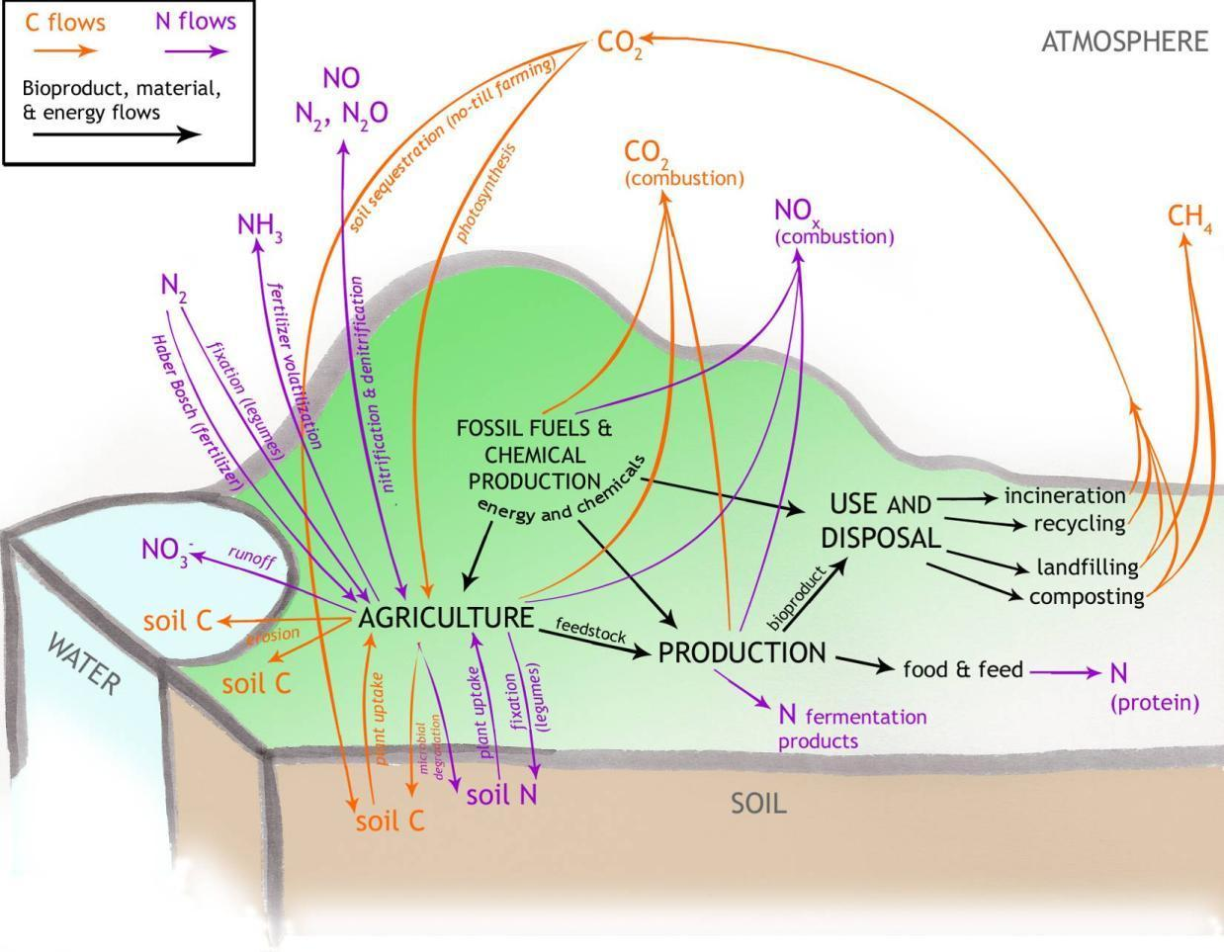
Life cycle carbon and nitrogen fluxes for bio-based products

Slide 3
Learning Model: Carbon Cycle Management
Step 1: Reduce emissions (environmental perspective only; UN process based on this)
Step 2: Capture emissions (carbon sequestration, as original policy fails)
Step 3: Design atmosphere (ambient carbon dioxide management); politics and ethics far more complex
Step 4: Integrated earth systems engineering and management – carbon cycle management as human condition, not “problem” to be “solved”

Slide 5
Carbon Cycle Governance System
CO₂ Emitted
Biomass
Fossil Fuel Energy Production System
Electricity
Fossil Fuel Power Plant
Fixed Uses
Fossil Fuel
Fossil Fuel Power Plant
Buildings
Mobile Uses (e.g., transportation)
Fossil Fuel Power Plant
H₂
Control Functions
Input: B +
MW
Fossil Fuel
Municipal Waste
Output: CO₂ Emitted
CO₂ Sequestered
CO₂ Sequestered
Target CO₂ Concentration Metric: in Atmosphere

Slide 6
Earth Systems Engineering and Management: Climate Change- Carbon Cycle Schematic
Nitrogen, phosphorus, sulfur cycles
Biosphere
Atmosphere and Oceanic Systems
Hydrologic cycle
Engineering/ Management of Earth system relationships
Human systems: economic, cultural, religious, etc
Other cycles
Carbon cycle
Earth System Engineering
Geoengineering options
Other options
Energy system
Ocean fertilization
Biomass agriculture
Genetic engineering and biotechnology
Other Technology systems
Fish farming, etc
Engineering/ Management of carbon cycle
Information technology and services (e.g., telework)
Fossil fuel industry, etc.
Organic chemical industry, etc.
Scope of traditional engineering disciplines
Implementation at firm, facility, technology and process level

Slide 7
Earth Systems Engineering and Management
Earth Systems Engineering and Management is the capability to design, engineer, and manage, through dialog and continual feedback, integrated built/human/natural systems that achieve the multivariate and sometimes mutually exclusive goals and desires of humanity, including at the least personal, social, economic, technological, and environmental dimensions, within the constraints imposed by the states and dynamics of existing complex adaptive systems.

Slide 8
Six Major Phases of Systems Analysis
Determine goals of system (requires dialog with client, stakeholders, and system)
Establish criteria for ranking alternatives
Develop alternative solutions (including technological, functional, social and long-term structural alternatives)
Based on J. E. Gibson, How To Do a Systems Analysis, University of Virginia, 2000.

Slide 9
Six Major Phases of Systems Analysis
Rank alternative solutions. Here, you must include nonperformance considerations such as:
  What are effects on non-users or minor stakeholders?
  What are the effects of piecemeal or incremental implementation?
  Impact on/coupling to existing systems
  Sensitivity to parameter variations (look for robust solutions)
  Ratification procedures (systems solutions almost always require political acceptability in real world)

Slide 10
Six Major Phases of Systems Analysis
Iterate on both implementation and system response (learning process)
Action (should be tied back to goals, and may be continuing process rather than end of analysis)

Slide 11
ADAPTIVE MANAGEMENT
Derived from the experience of natural resource economists, managers, and ecologists, adaptive management attempts to develop “ways for active adaptation and learning in dealing with uncertainty in the management of complex regional ecosystems.” The approach must be “seen as a strategic one of adaptive policy management, of science in the appropriate scales, and of understanding human behavior, not a procedural one of institutional controls.” Specifically, it requires:
Integrated policies, not piecemeal ones.
Flexible, adaptive policies, not rigid, locked-in ones.
Adapted from L.H. Guncerson, C.S. Holling, and S.S. Light, eds. 1995. Barriers and bridges to the renewal of ecosystems and institutions. New York: Columbia University Press.

Slide 12
ADAPTIVE MANAGEMENT
3. Management and planning for learning, not simply for economic or social product.
4. Monitoring designed as a part of active interventions to achieve understanding and to identify remedial response, not monitoring for monitoring’s sake.
5. Investment in eclectic science, not just in controlled science.
6. Citizen involvement and partnership to build “civic science”, not public information programs to inform passively.

Slide 13
Earth Systems Engineering and Management Principles: Theory
Only intervene when required and to the extent required (humility in the face of complexity).
At the level of earth systems engineering and management (ESEM), projects and programs are not just technical and scientific in nature, but unavoidably have powerful cultural, ethical, and religious dimensions.
Unnecessary conflict surrounding ESEM projects and programs can be reduced by separating social engineering from technical engineering dimensions.
ESEM requires a focus on systems as systems, rather than as just constituent artifacts; a dynamic, rather than static, mental model of underlying phenomenon.
Boundaries around ESEM projects and programs should reflect real world couplings and linkages through time, rather than disciplinary or ideological simplicity.
Major shifts in technologies and technological systems should be evaluated before, rather than after, implementation.

Slide 14
Earth Systems Engineering and Management Principles:
Design and Engineering
ESEM initiatives should be characterized by explicit and transparent objectives or desired performance criteria, with quantitative metrics which permit continuous evaluation of system evolution (and signal when problematic system states may be increasingly likely).
Design, engineering, and implementation of ESEM initiatives must not be based on implicit or explicit models of centralized control in the traditional rigid sense. Rather than attempting to completely define or dominate a system, the ESEM professional will have to see themselves as an integral component of the system, coupled with its evolution and subject to many of its dynamics. This will require a completely different psychology of engineering.
ESEM projects should be incremental and reversible to the extent possible.
ESEM should aim for resiliency, not just redundancy, in systems design. A resilient system resists degradation and, when it must, degrades gracefully even under unanticipated assaults; a redundant system may have a backup mechanism for a particular subsystem, but still may be subject to unpredicted catastrophic failures.
ESEM should aim for inherently safe design, so that the system fails, when it must, in a noncatastrophic way.

Slide 15
Earth Systems Engineering and Management Principles: Governance
ESEM projects and programs by definition raise important scientific, technical, economic, political, ethical, theological and cultural issues, so you need a governance model which is democratic, transparent, and accountable.
ESEM governance mechanisms should foster inclusive, multicultural dialog.
ESEM governance models, which deal with complex, unpredictable systems, must accept high levels of unpredictability and uncertainty. Thus, ESEM policy development and implementation is a dialog with the relevant systems, rather than finding a “solution” to a “problem”.
ESEM governance systems should accordingly place a premium on flexibility and the ability to evolve in response to changes in system state.
The earth systems engineers and the policymakers need to understand themselves, and be seen by the public, as part of an evolving ESEM system, rather than as agents outside the system guiding it.
The ESEM environment and the complexity of the systems at issue require explicit mechanisms for assuring continual learning, including ways in which assimilation of the learning by stakeholders can be facilitated.
There must be adequate resources available to support both the immediate ESEM project and the science and technology research and development necessary to ensure that the responses of the relevant systems are understood.

Slide 16
Current status of bioproducts
 | Corn | Soybean | Sugarcane, Sugarbeets | Cellulosic Material trees, grasses, crop residue | Starchy crops | Seeds sunflower, rape, safflower | New Crops Kenaf, cuphea, milkweed, sorghum | Algae | Food wastes | Animal byproducts manure, tallow, cheese whey
Energy
Ethanol | ● |  | ● | ▲ | ▲ |  | ▲ |  | ▲
Biodiesel |  | ● |  |  |  |  |  | ▲ | ▲
Other (gaseous, H₂, direct combustion) | ▲ | ▲ | ▲ | ▲ ● | ▲ |  | ■ | ■ | ■ | ▲ ●
Materials
Aggregates for construction |  |  |  | ▲ |  | ■ | ■
solvents/inks/paints |  | ● |  |  |  | ■
plastics/polymers | ● |  |  |  | ▲ |  |  |  | ▲
lubricants |  | ● |  |  |  | ● |  | ▲ |  | ▲
specialty chemicals |  | ▲ |  | ■ | ▲ |  | ▲ | ■ |  | ▲
● Currently in production ▲ Active research area ■ Potential exists for further development

Slide 17
Generalized LCA Results
Bio-based products have…
  Reduced fossil energy consumption
  Reduced CO₂ emissions
  Significant NO₃⁻ emissions (not found in fossil fuel counterparts)
  Greater disruptions of N cycle
  Highly variable, difficult to measure, highly complex models
  Generally not included

Slide 18
Disruptions in C and N Cycles
CO₂ concentrations increased 31 ± 4% 1750 to 2010
N₂O concentrations increased ~15% over same period
Flux of atmospheric N₂ to reactive nitrogen compounds has increased over 1100%
Notes:
18
~370ppm CO2, ~300ppb

Slide 19
Nitrogen-related Impacts
Excess reactive nitrogen responsible for many environmental problems
NH₃
N₂O
NO_{x}
NO₃⁻
Acidification
Smog Formation
Human Health
Eutrophication/Hypoxia
Global Warming
Ozone Depletion

Slide 20
Disruptions in C and N Cycles
Fossil fuel combustion responsible for majority of carbon cycle disruption
Agricultural activities are responsible for ~75% of nitrogen cycle disruption
  Haber-Bosch process
  Increased cultivation of rice, soybeans (biological nitrogen fixation)
C & N cycles in agriculture are highly linked

Slide 21
Earth Systems Engineering and Management
Dialog, not Problem Solution
Earth Systems
Engineering
and Management
Planning
Designing
Construction
Management
Fundamental systems in temporal or spatial scale, displaying complex, unpredictable and discontinuous behavior and characterized by emergent characteristics.
Two (coupled) categories:
Primarily non-human
Primarily human
What is current state?
Can it be rationally and morally improved, and, if so, how?
Conscious activity
Moral responsibility for outcome
Of all or part of relevant system; itself an activity subject to moral and rational critique
Managing complex systems a poorly understood and nascent art (“The Learning Organization”)
A process and dialog, not a control exercise
“Adaptive Management” of complex resource systems (the Baltic, the Everglades) an example

Slide 22
Hydrologic/agriculture ESEM system model schematic
Large-Scale Data Systems and Models (National Weather Service forecasts, global analysis data, general circulation models)
Temperature
Humidity
Rain
Pressure
  Mesoscale Atmospheric Simulation Models (Regional atmospheric and land-surface information)
Response Evaluations
Rain and Snow
Radiation
Temperature
Humidity
Wind
Pressure
Subsystems
Land Analysis System (Hydrological characteristics of each watershed using digital elevation data)
Agriculture and crop system models
Infrastructure models
Economic models
Population models
Land use models
Water infrastructure modifications
Intra-and interspecific crop modifications
Food storage/delivery infrastructure upgrades
Watershed Hydrology Models (Surface and subsurface hydrology at individual watersheds)
+
Runoff
Soil water
River flow
.
.
.
Local Atmospheric and Hydrological Models (Riverflow, local weather, land-surface information)
Source: Based on Science and Technology Review Industrial Ecology Collection, 1996, p.34, Allenby, in press, C.

