Slide 1
Being a person of purpose!
Rev. Dr. Dean M. Vieselmeyer

Slide 2
GOALS
Goals are important to stay in balance.
To get from here to there you need a destination and you need a plan.

Slide 3
GOALS –
FROM THE BEGINNING
ADAM/EVE – SINNED
SALVATION WAS THE GOAL

Slide 4
GENESIS 3:15
I will put enmity between you and the woman and between your offspring and hers; he will crush your head and you will strike his heel.

Slide 5
JESUS’ GOAL FOR HIMSELF
“I will drive out demons and heal people today and tomorrow, and on the third day I will reach my goal.”
Luke 13:32

Slide 6

JESUS’ GOAL FOR HIS DISCIPLES

Slide 7
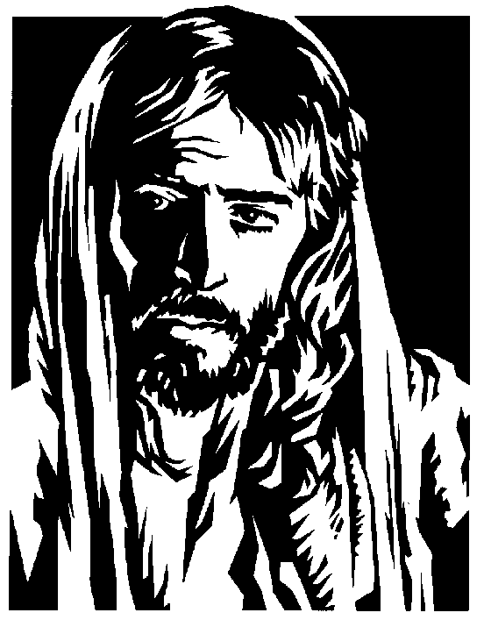
PAUL - II COR. 5:9
“WE MAKE IT OUR GOAL TO PLEASE HIM.”

Slide 8
GOALS
At Yale:
  In 1953, 3% of Yale graduates completed a goals program.
  In 1973, the 3% accomplished more in career and financial earnings than the 97% combined.

Slide 9
GOALS
A study at UCLA discovered:
  Goal-setters with a plan of action average $7,401 per month income
  without goals, $3,397 per month income.

Slide 10
GOALS
“You show me a stock clerk with a goal and I’ll show you a person who will make history. You show me a person without a goal and I will show you a stock clerk!.” -J.C. Penney

Slide 11
GOALS
John Henry Fabre studied processionary caterpillars.
They starved to death because they had confused activity with accomplishment.

Slide 12
GOALS
Imagine Sir Edmund Hillary climbing 29,000 ft. to the top of Mt. Everest saying, “Oh, I was just walking around!”

Slide 13
GOALS
Howard Hill, a famous archer-- “How can I hit a target I can’t see?”

Slide 14
Characteristics of Goals
Some goals must be big (out of reach, not out of sight)
Stretch and grow to your full potential (e.g., 37 pounds in 10 months)

Slide 15
Characteristics of Goals
Keep you on track
Greatly reduce the possibility of short-range frustrations (e.g., buying a house)

Slide 16
Characteristics of Goals
Goals must be broken down
Analyze to determine where you are and what tangible steps will be (e.g., 3.7 pounds a month)

Slide 17
Characteristics of Goals
Have some daily goals to keep you disciplined and in touch with the “nitty gritty” details of daily life (i.e., action steps)

Slide 18
Characteristics of Goals
Goals must be specific so you can pinpoint and envision them more easily, increasing motivation
(e.g., eat sweets only on Sunday)

Slide 19
Characteristics of Goals
Some goals must be ongoing because they are processes, such as:
  “Keeping my space well organized”
  “Maintain fitness and weight loss”

Slide 20
Characteristics of Goals
Length/sharing of go
Time frame:
    Long -range: over two years
    Medium-range: six months - two years
    Short-range: under six months

Slide 21
Characteristics of Goals
Length/sharing of goals
  Give-up goals - tell everyone (e.g., lose weight, quit smoking, quit swearing)
  Go-up goals - tell only those who will support you in this endeavor (e.g., become president of the company)

Slide 22
Two Interviews by Barbara Walters
Jim Carrey of “The Mask”
Liam Neeson of “Schindler’s List”
Jim had 15 yrs. less experience then Liam

Slide 23
Two Interviews by Barbara Walters
Liam Neeson
  made 20 films before reaching his star status with Schindler’s List
  “I didn’t know where I would end up.”
  He had a tendency to drift and meander from project to project.

Slide 24
Two Interviews by Barbara Walters
Jim Carrey
  was a star and reached his financial goal in about 5 years
  He wrote himself a check for $10 million and dated it for 5 years in the future
  5 yrs. later, signed a contract for The Man in the Moon for $10 million on the month he projected.

Slide 25
The Four Steps to Qualifying Goals
WRITE down everything you want to be, do, or have
Ask yourself WHY?
Ask yourself, “Do I really have this in balance?”

Slide 26
The Four Steps to Qualifying Goals
Ask yourself:
  Is it really my goal?
  Is it morally right and fair?

Slide 27
The Four Steps to Qualifying Goals
  Is it consistent with my other goals?
  Can I emotionally commit to it?
  Can I see myself reaching it?
  Does it meet the “Basic 6”?

Slide 28
Basic 6
Will it make me happier?
Will it make me healthier?
Will it make me more prosperous?

Slide 29

Basic 6
Will it help make me more friends?
Will it help me become more secure?
Will it give me more peace of mind?

Slide 30
Zig Ziglar
Trip to Acapulco

Slide 31


Slide 32
A trip to Acapulco
General Goals Procedure Chart

Slide 33

Step One:
Identify your goal –
Go to Acapulco

Slide 34
Step Two:
The benefits of reaching this goal:
  Fishing
  Good food
  Relaxing beach

Slide 35
Step Three:
Major obstacles and mountains to climb to
reach the goal
  Reports
  Interviews
  Luncheon
  Service call
  Letters

Slide 36
Step Four:
Skills or knowledge required to
reach this goal
  Define actual time needed
  Define actual task elements

Slide 37
Step Five:
Individuals, groups, companies and organizations to work with to
reach this goal…
  Service manager
  Office manager

Slide 38
Step Six:
Plan of action to reach this goal
  Plan to write letters later
  Delegate
  List

Slide 39
Step Seven:
Completion date –
  TOMORROW

Slide 40

Record Keeper

Slide 42
The productivity factors that make a difference are:
1. Desire
2. Work

Slide 43
The little things make a difference!

Slide 44
The Little Things:
Call a girl a “kitten” , she will love you.
Call her a “cat” and you’ll have a problem.

Slide 45
The Little Things:
Say she is a “vision”, you’ll score all kinds of points;
Call her a “sight” and you’re in trouble.

Slide 46
The Little Things:
It’s one thing to say to a young lady, “You look like the first day of spring.”
And it’s something else to tell her “You look like the last day of a long hard winter.”

Slide 47
The Little Things:
It’s great to say, “You know, honey, when I look into your eyes, the wheels of time stand still.”
But if you look into her face and say, “You know, honey, you’ve got a face to stop a clock!”, you’re in trouble.

Slide 48
Think About It!!!
211 degrees
  = Hot Water
212 degrees
  = Steam:
    Locomotives
    Steamships

Slide 49
“Desire Changes the Hot Water of Mediocrity into the Steam of SUCCESS!!

Slide 50
Bumble Bees
Cannot fly...aero dynamically it is impossible!
      Body is too heavy!
      Wings are too light!
Bumble Bees can’t read...
      SO They FLY!!

Slide 51
Intelligent Ignorance
Henry Ford’s idea of the
V-8 Engine...

Slide 52
Jacob Schick
Shaving in Alaska became a problem. Water in the pan would freeze before the job of shaving was done...
Schick’s idea of the electric razor was the answer!

Slide 53
Charles Kettering
Starting cars with a crank was a problem for him while his arm was broken...
The idea of a self-starter seemed good!

Slide 54
What is the Wisdom of the Ages?

Slide 55
Work is the foundation of all business, the source of all prosperity, the parent of genius. Work can do more to advance youth than his own parents be they ever so wealthy...

Slide 56
it is represented in the humblest savings, laid in the foundation of every fortune. It is this act that gives life its savor, but it must be loved before it can bestow its greatest blessings...

Slide 57
and achieve its greatest ends. When loved, work makes life sweet, purposeful and fruitful.

Slide 58
Dr. Dale
A productivity expert at the University of Minnesota says:
    “Forty-one percent of all time spent on the job is wasted!”

Slide 59
Wise Balloon Salesman:
“It’s the use of what’s inside that counts!”

Slide 60
Zig Ziglar
“You don’t ever really work for anyone else!”

Slide 61
In the game of life those who follow through will end up the biggest winners of all!!

Slide 62
CHALLENGES…WHEN OVERCOME MAKE LIFE RICH AND MEMORABLE.
IF DAVID HAD KILLED A DWARF INSTEAD OF GOLIATH, WHO WOULD HAVE NOTICED? WHO WOULD HAVE CARED?

Slide 63

I’m not all that I can be;
I’m not all that I will be;
But I’m a lot better than I used to be.

Slide 64
SIR EDMUND HILLARY
“Mt. Everest, you beat me the 1st time, but I’m going to beat you the 2nd time. You have grown all you’re going to grow, but I am still growing.”

Slide 65
WHAT DO WE LEARN...
FROM THE CHINESE
BAMBOO TREE?

Slide 66
When a task is once begun, you leave it not until it’s done. And be a matter great or small, do it well or not at all.

