Slide 1
Chapter 7
The Nature of Industry

Slide 2
Learning Objectives
Calculate alternative measures of industry structure, conduct, and performance, and discuss their limitations.
Describe examples of vertical, horizontal, and conglomerate mergers, and explain the economic basis for each type of merger.
Explain the relevance of Herfindahl-Hirschman index for antitrust policy under the horizontal merger guidelines.
Describe the structure-conduct-performance paradigm, the feedback critique, and their relation to the five forces framework.
Identify whether an industry is best described as perfectly competitive, a monopoly, monopolistically competitive, or an oligopoly.

Slide 3
Market Structure
Market Structure
Market structure factors that impact managerial decisions:
  Number of firms competing in an industry
  Relative size of firms (concentration)
  Technological and cost conditions
  Demand conditions
  Ease of firm exit or entry

Slide 4
Industry Concentration
Market Structure
Measures the size distribution of firms within an industry.
  Are there many small firms?
  Are there only a few large firms?

Slide 5
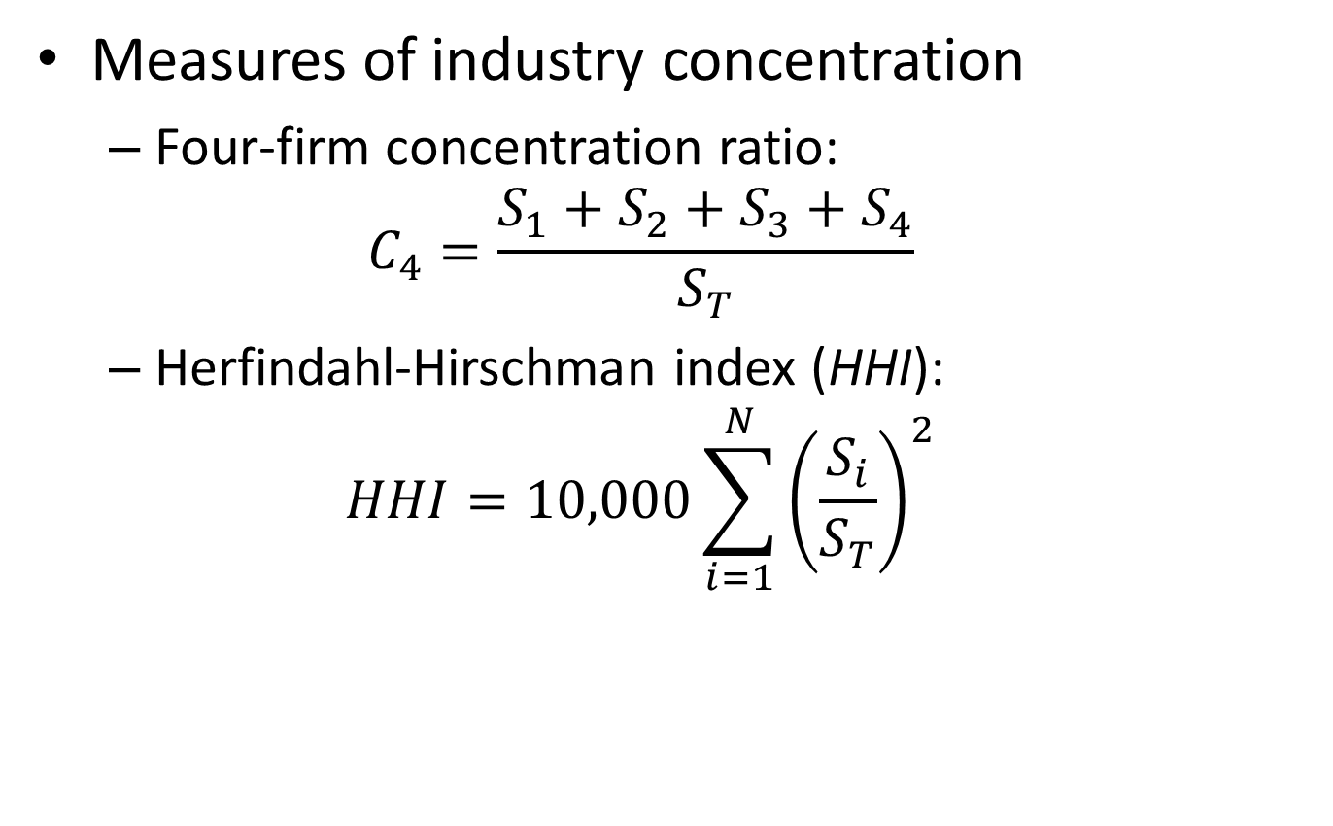
Measuring Industry Concentration
Market Structure
Measures of industry concentration
  Four-firm concentration ratio:
  $$C_{4}=\frac{S_{1}+S_{2}+S_{3}+S_{4}}{S_{T}}$$
  Herfindahl-Hirschman index (HHI):
  $$HHI=10,000\sum_{i=1}^{N}{{\left(\frac{S_{i}}{S_{T}}\right)}^{2}}$$

Slide 6
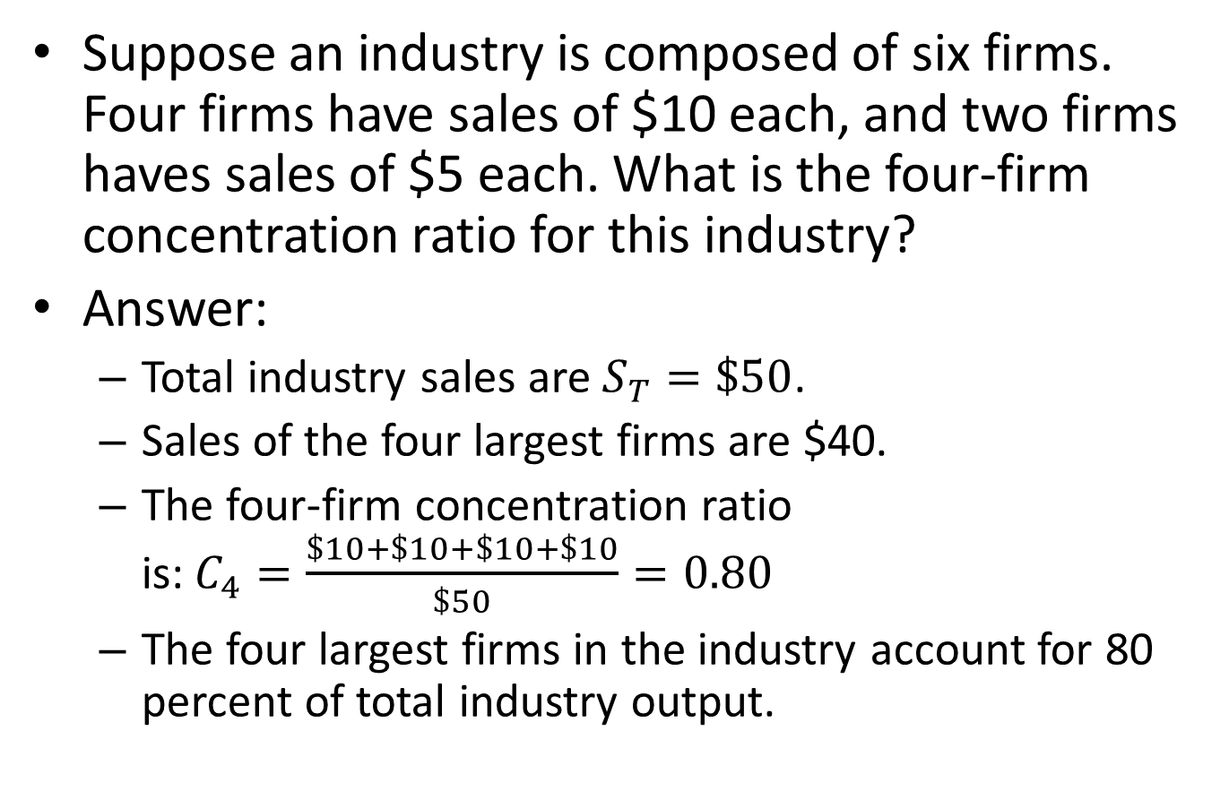
Measuring Industry Concentration in Action
Market Structure
Suppose an industry is composed of six firms. Four firms have sales of $10 each, and two firms haves sales of $5 each. What is the four-firm concentration ratio for this industry?
Answer:
  Total industry sales are $S_{T}=\$50$.
  Sales of the four largest firms are $40.
  The four-firm concentration ratio is:$C_{4}=\frac{\$10+\$10+\$10+\$10}{\$50}=0.80$
  The four largest firms in the industry account for 80 percent of total industry output.

Slide 7
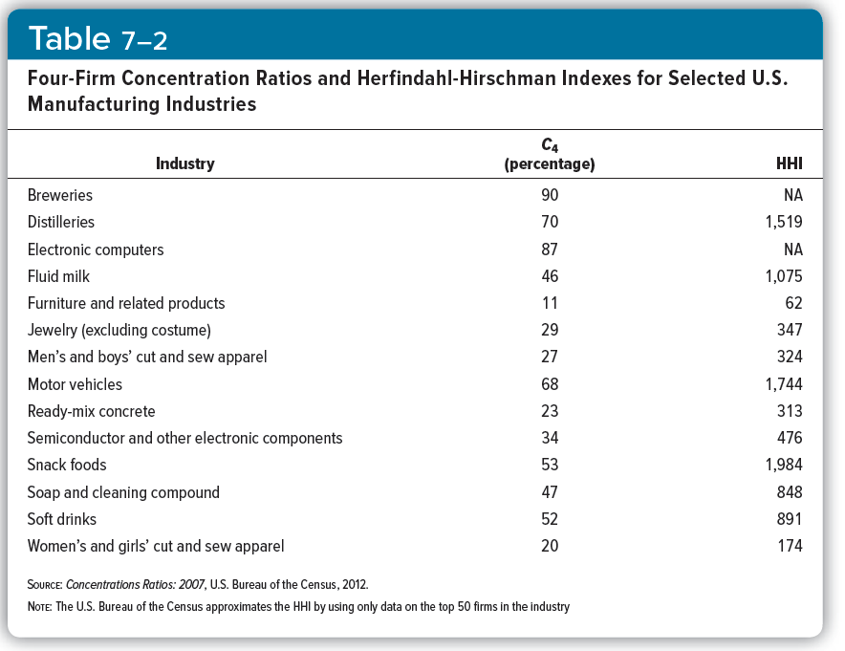
Market Structure

Slide 8
Limitations of Concentration Measures
Market Structure
Factors that impact and limit industry concentration measures include:
  Global markets
  National, regional and local markets
  Industry definitions and product classes

Slide 9
Technology
Market Structure
Industries differ in regard to the technologies used to produce goods and services.
  Labor-intensive industries
  Capital-intensive industries
Within a given industry if the available technology is:
  the same, firms will likely have similar cost structures.
  different, one firm will likely have a cost advantage.

Slide 10
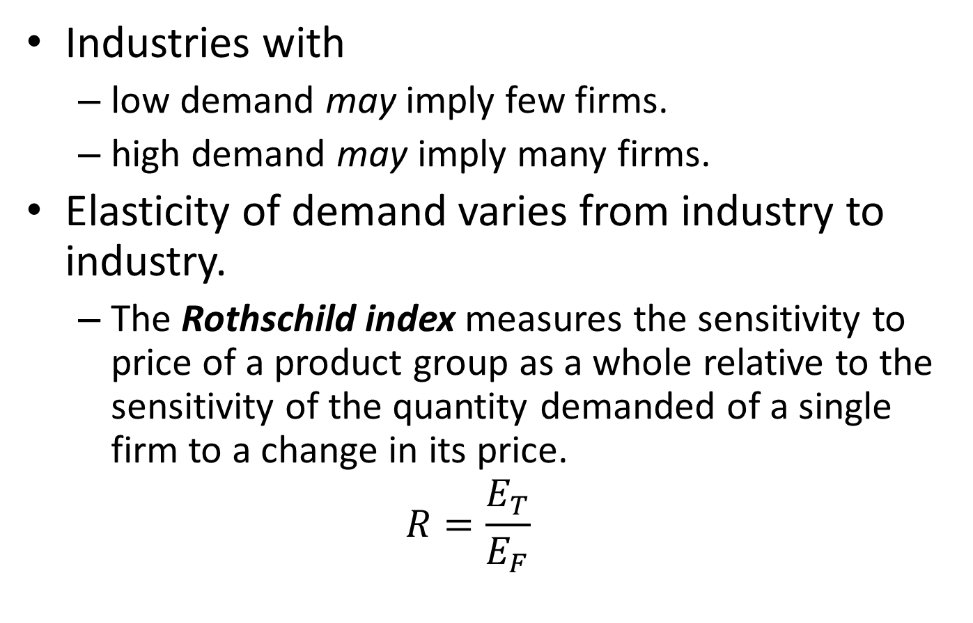
Demand and Market Conditions
Market Structure
Industries with
  low demand may imply few firms.
  high demand may imply many firms.
Elasticity of demand varies from industry to industry.
  The Rothschild index measures the sensitivity to price of a product group as a whole relative to the sensitivity of the quantity demanded of a single firm to a change in its price.
  $$R=\frac{E_{T}}{E_{F}}$$

Slide 11
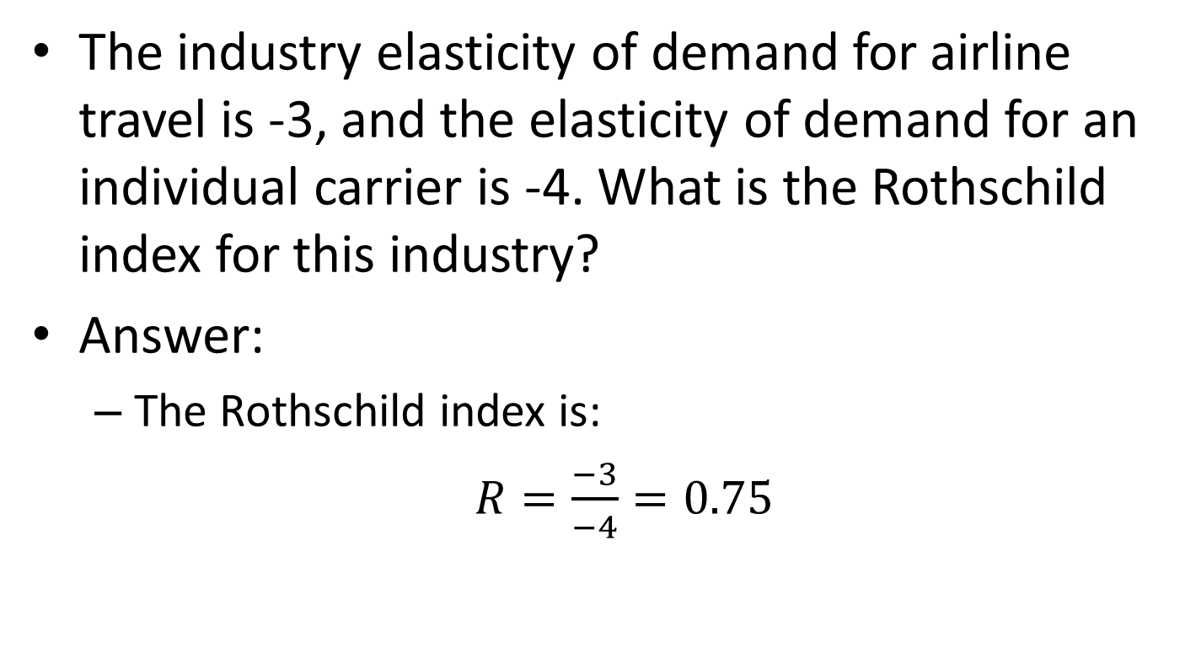
Demand and Market Conditions in Action
Market Structure
The industry elasticity of demand for airline travel is -3, and the elasticity of demand for an individual carrier is -4. What is the Rothschild index for this industry?
Answer:
  The Rothschild index is:
  $R=\frac{−3}{−4}=0.75$

Slide 12
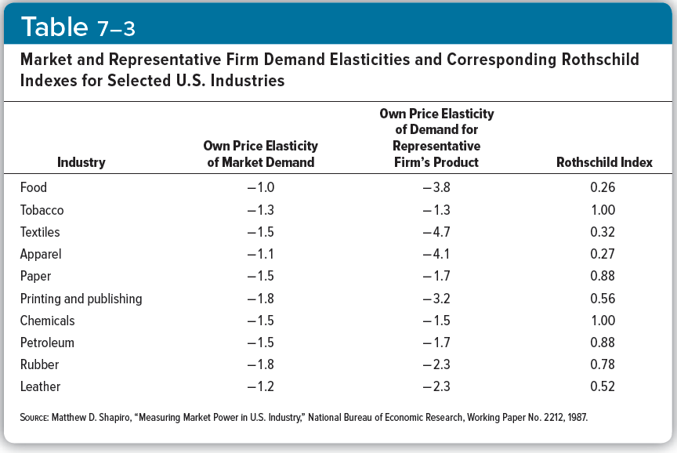
Market Structure

Slide 13
Potential for Entry
Market Structure
Optimal decisions by firms in an industry will depend on the ease with which new firms can enter the market.
Several factors can create barriers to entry (or make entry difficult).
  Capital requirements
  Patents
  Economies of scale

Slide 14
Conduct
Conduct
Behavior of firms:
  Price markup over costs
  Integration and merger
  Advertising expenditures
  Research and development expenditures

Slide 15
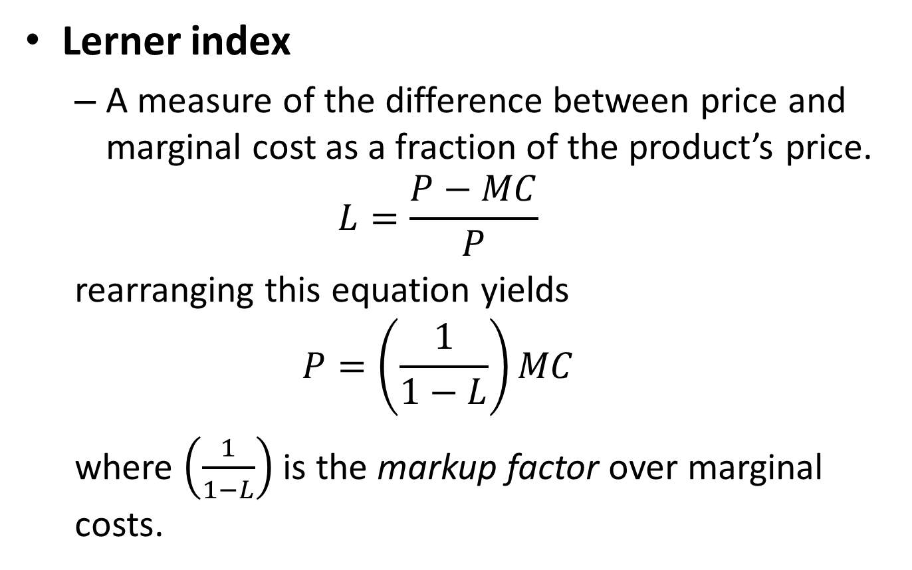
Pricing Behavior
Conduct
Lerner index
  A measure of the difference between price and marginal cost as a fraction of the product’s price.
  $$L=\frac{P−MC}{P}$$
  rearranging this equation yields
  $$P=\left(\frac{1}{1−L}\right)MC$$
  where $\left(\frac{1}{1−L}\right)$ is the markup factor over marginal costs.

Slide 16
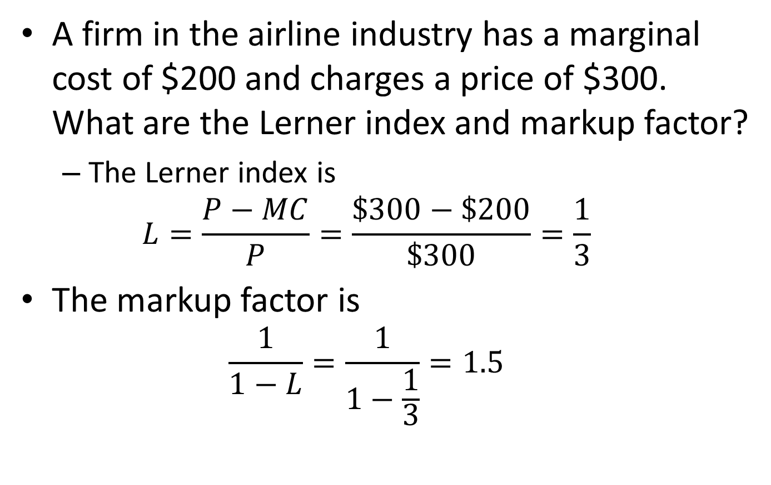
Pricing Behavior in Action
Conduct
A firm in the airline industry has a marginal cost of $200 and charges a price of $300. What are the Lerner index and markup factor?
  The Lerner index is
  $$L=\frac{P−MC}{P}=\frac{\$300−\$200}{\$300}=\frac{1}{3}$$
The markup factor is
  $$\frac{1}{1−L}=\frac{1}{1−\frac{1}{3}}=1.5$$

Slide 17
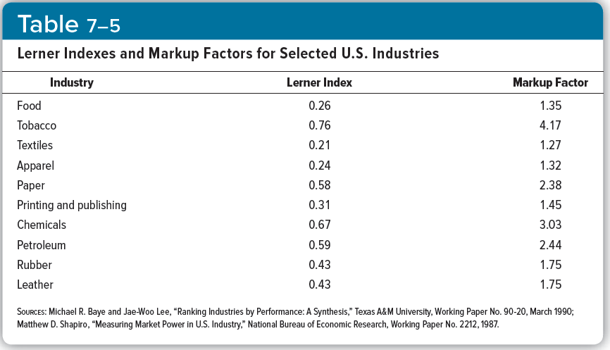
Conduct

Slide 18
Integration and Merger Activity
Conduct
Integration
  Uniting productive resources of firms.
  Can occur during the formation of a firm.
Merger
  Two or more existing firms “unite,” or merge, into a single firm.
Reasons firms merge:
  Reduce transaction costs.
  Reap benefits of economies of scale and scope.
  Increase market power.
  Gain better access to capital markets.

Slide 19
Types of Integration
Conduct
Vertical integration
  Various stages in the production of a single product are carried out in a single firm.
Horizontal integration
  Merging two or more similar final products into a single firm.
Conglomerate mergers
  Integration of two or more different product lines into a single firm.

Slide 20
Research and Development
Conduct
Research and development
  Expenditures made by firms to gain a technological advantage, with the aim of acquiring a patent.
Company | Industry | R&D as Percentage of Sales
Bristol-Meyers Squibb | Pharmaceuticals | 19.7
Ford | Motor vehicle and parts | 4.1
Goodyear Tire and Rubber | Rubber and plastic parts | 2.0
Kellogg | Food | 1.5
Proctor & Gable | Soaps and cosmetics | 2.5

Slide 21
Advertisement
Conduct
Advertisement
  Expenditures made by firms to inform or persuade consumers to purchase their products.
Company | Industry | Advertising as Percentage of Sales
Bristol-Meyers Squibb | Pharmaceuticals | 4.9
Ford | Motor vehicle and parts | 3.2
Goodyear Tire and Rubber | Rubber and plastic parts | 2.5
Kellogg | Food | 9.2
Proctor & Gable | Soaps and cosmetics | 11.7

Slide 22
Performance
Performance
Refers to the profits and social welfare that result in a given industry

Slide 23
Dansby-Willig Performance Index
Performance
Ranks industries according to how much social welfare would improve if the output in an industry were increased by a small amount.
Industry | Dansby-Willig Index
Food | 0.51
Rubber | 0.49
Textiles | 0.38
Apparel | 0.47
Paper | 0.63
Chemicals | 0.67
Petroleum | 0.63

Slide 24
The Structure-Conduct-Performance Paradigm
The Structure- Conduct-Performance Paradigm
Structure:
  Factors like technology, concentration and market conditions.
Conduct:
  Individual firm behavior in the market. Behavior includes pricing decisions, advertising decisions and R&D decisions, among other factors.
Performance:
  Resulting profit and social welfare that arise in the market.
Structure-conduct-performance paradigm
  Model that views these three aspects of industry as being integrally related.

Slide 25
The Casual View
The Structure- Conduct-Performance Paradigm
Market structure “causes” firms to behave in a certain way.
… this behavior, or conduct, “causes” resources to be allocated in certain ways.
… this resource allocation leads to “good” or “bad” performance.

Slide 26
The Feedback Critique
The Structure- Conduct-Performance Paradigm
There is no one-way causal link among structure, conduct and performance.
  Firm conduct can affect market structure;
  Market performance can affect conduct and market structure.

Slide 27
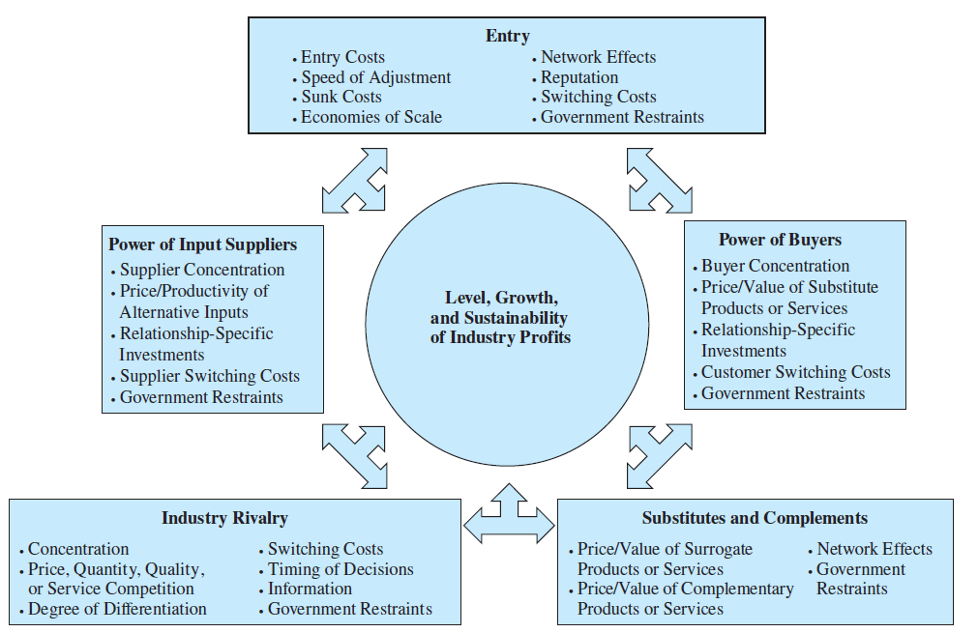
Five Forces Framework
The Structure- Conduct-Performance Paradigm

Slide 28
Looking Ahead
Overview of the Remainder of the Book
Perfect competition
  Many, small firms and consumers relative to market.
  Firms produce very similar products.
  No market power (P = MC).
Monopoly
  Sole producer of good or service.
  Market power (P > MC).
Monopolistic competition
  Many, small firms and consumers relative to market.
  Firms produce slightly different products.
  Limited market power.
Oligopoly
  Few, large firms tend to dominate market.
  Price/marketing strategies are mutually interdependent with other firms in the industry.

