Slide 1




ENGL 101:
Article Review Paper –
Introductory Paragraph
& Thesis Statement
Notes:
Hello everyone, and welcome to your first ENGL 101 class. My name is Heesun Nam, and I will be your instructor for this course. Today, I want to spend some time going through introductions, the course syllabus, as well as the course format.

Slide 2
In Today’s Class
A Sentence-by-Sentence Look at the Introductory Paragraph
Introduction of Author (Credibility) vs. credibility rating
Topic Sentence
Thesis Statement (Overall evaluation using evaluative criteria)

Slide 3
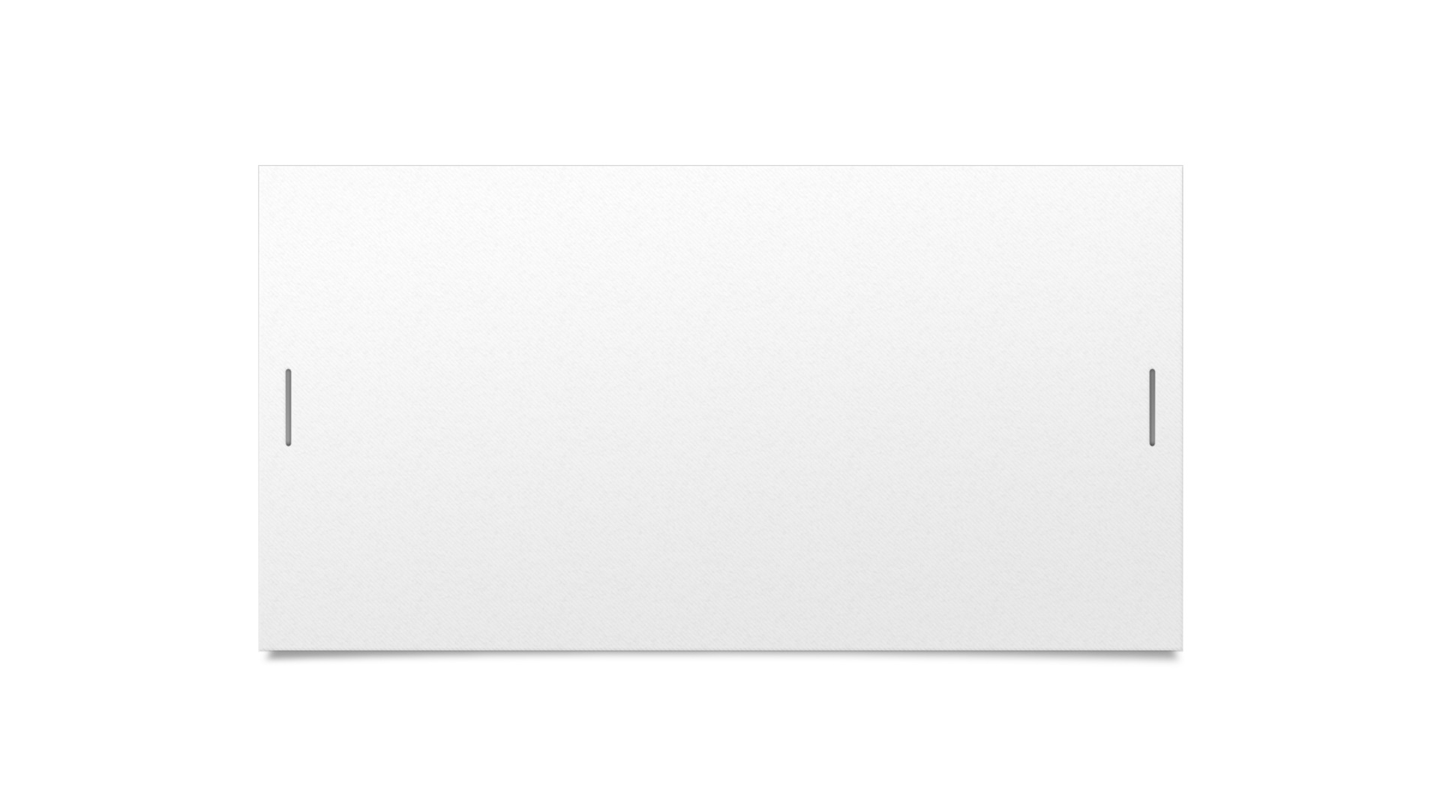



Icebreaker of the Day
Please go to www.menti.com and enter code 8454 4996!

Slide 4

Announcements
Choose your topic soon! Which article you need to read for the Article Review depends on it
Read the article THOROUGHLY – do not just read the abstract!
DISCUSS the article with your learning coach and BRAINSTORM weaknesses and strengths of the article (if you have not done so already)!
Check your “Article Review Draft” wiki page and make sure your file can be clicked. If there are issues, please let me know ASAP

Slide 5
Article Review: an Overview
Begin
Begin with the bibliographic information of the article in proper APA format
Introduce
Introduce the article’s main idea. Include your evaluative thesis here.
Summarize
Summarize the article in a succinct way in one paragraph
Evaluate
Evaluate the strengths and weaknesses of the article in 3 evaluative body paragraphs
Conclude
Conclude your findings by adding a general recommendation

Slide 6
Title
Make sure the title of the assignment is: “A Review of [the title of your article]
e.g. “A Review of A Modest Proposal for Christ-Figure Interpretations”

Slide 7

Introductory Paragraph
Short (3-4 sentences)
Begin with the general topic of the article/book (=NOT a specific thesis of the article)
Then, add the author’s full name and his or her background/credentials (1 – 2 sentences)
End with the thesis statement

Slide 8
Sentence #1: General Topic Sentence
This sentence lets the reader know what the article is ABOUT (but does not reveal the ARGUMENT of the article)
EXAMPLE: In “A Modest Proposal for Christ-Figure Interpretations”, Richard Walsh discusses the implications of analyzing filmic characters from a Christological perspective.

Slide 9
Are these sentences acceptable?
“This article is about privacy issues in the United States”
No – the sentence is too general and the title of the article probably already reveals this
“This article argues that governments need to regulate the internet in their respective countries in order to curb privacy issues in the cyberspace”
No – the sentence contains the thesis of the article, which should be revealed in the SUMMARY section of the paper, not the introduction

Slide 10
Sentence #2: Credential of the Author
Who is the author and why should we trust him/her?

Slide 11

What is a ‘credential’?
Dictionary Definition: “evidence of authority, status, rights, entitlement to privileges, or the like, usually in written form”
In academic writing, we need to demonstrate that the author of the article we are writing about has the authority to discuss the topic in depth

Slide 12
3 Es = 3 Ways to Demonstrate Credibility
Education
Experience
Expertise

Slide 13
Credibility Credibility Rating!
Credibility rating (#1 – 5) of a text depends on the TYPE of text
1. Popular source for self-help or entertainment
2. Personal story, testimonial, or narrative (blogs, magazines, pop culture books)
3. News article, magazine article, article from a professional organization; may include research but reported in journalistic or less formal style
4. Scholarly source but written for average reader; includes references and scholarly research such as studies, statistics, and reports.
5. Scholarly source written for advanced academic work; includes references and scholarly research; written in very formal style, with long sentences and difficult vocabulary. This level is written for experts in the field.

Slide 14
Sample ‘Credibility’ Sentence
Walsh is a Professor of Religion in Methodist University with a Ph.D. in biblical studies from Baylor University, and he has authored several books in the areas of religion and film.

Slide 15
Sentence #3: Thesis Statement
Discusses your OVERALL EVALUATION of the article
Do you think the article is strong or weak?
** Remember that you are critiquing the WRITING of the article, not its IDEAS
Discusses both the strengths and weaknesses of the article
Uses SPECIFIC EVALUATIVE CRITERIA to achieve this purpose

Slide 16

Evaluative Criteria: think ‘MEOW’
M ain argument
E vidence
O rganization
W riting style

Slide 17

Questions to Ask:
What is my opinion about the article? Do I think it is strong or weak?
This establishes your OVERALL EVALUATION of the article
What are some strengths of the article in relation to MEOW?
e.g. The article is organized very well so it is easy for readers to follow the logic of its argument
What are some weaknesses of the article in relation to MEOW?
e.g. The article does not have enough evidence to support its argument

Slide 18



Thesis Statement Formula
Although + less important (SVO), more significant (SVO) + more significant (SVO).
e.g. If your overall evaluation is positive:
Begin with a weakness of the article then add two strengths
e.g. If your overall evaluation is negative:
Begin with a strength then add two negative points

Slide 19
Thesis Statement Samples
1) The overall evaluation is positive (=the article is effective)
“Although the writing style of the article is not suitable for its readers, the article is effective because of its strong main argument and fluid organization”
2) The overall evaluation is negative (=the article is ineffective)
“Although the writing style of the article is captivating for its readers, the article is ineffective because of its insufficient evidence and disjointed organization”

Slide 20
Homework
Begin Task #2 (the first half – the entire task is due next Friday)
Try writing a summary of the article (e.g. main argument -> three sub-arguments -> examples used)
Complete learning pod activity

