Slide 1
Presentation Title
Your Name
Program Name or Degree Name, Walden University
COURSE XXX: Title of Course
Instructor Name
Month XX, 202X

Slide 2
Slide Title
Go to the “Home” tab at the top and click the “New Slide” or “Layout” button to access different formatting for your slides.
Choose formatting that presents your information in the most logical way.
Use consistent, grammatically parallel format for bulleted lists (for example, on this slide, each element begins with an imperative verb).
You can also consult APA’s suggestions on formatting lists.
End bullet points consistently, either with or without a period.

Slide 3
Slide Title
Keep font of text consistent.
Be sure headings are consistent in their spacing, placement, size, etc.
Consider using the slide after the title slide to summarize your presentation’s points (like an abstract for a paper).

Slide 4
Slide Title
Your slides can also contain entire paragraphs, like this one does. In both paragraphs and bulleted lists in your presentation, citation rules apply just as they do in papers: when using or referencing another author’s ideas, you must cite that source. When incorporating a citation in a slide, do so just as you would in a traditional paper: According to Jones (2020), presentations are not very different from papers.
According to Smith and Cat (2020), you should make your presentation great, not just good.

Slide 5
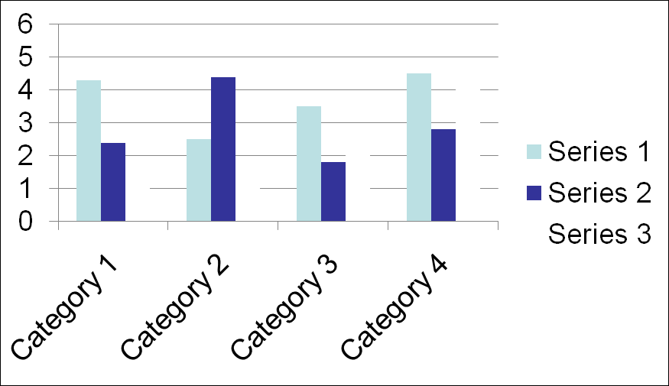
Use APA style rules to format any tables and figures in your presentation:
Figure 1
Title Reflecting Figure Information
Note. Any needed general notes on figure. From “Utilizing Bar Graphs,” by A. Jones, 2020, Journal of Handy Graphs, 76(2), p. 3 (https://doi.org/10.123.45/abc). Reprinted with permission.

Slide 6
Slide Title
Remember to adhere to any assignment guidelines regarding presentation format. This template contains suggestions only.
Keep in mind that there is no such thing as an “APA standard PowerPoint.” Review our presentation tips for more information!
Visit the Academic Skills Center for more tips on how to use PowerPoint or visit Microsoft’s PowerPoint help and learning website.

Slide 7
Slide Title
Always include a reference list at the end of your presentation, just like you would in a paper. Reference list entries take the same format they would in a paper, including a hanging indent. Visit the Common Reference List Examples page for the correct APA format. Here are a few examples:
Jones, P. (2020). This great book. Publisher.
Smith, W., & Cat, D. (2020). How to make a good presentation great. Presentations Quarterly, 45(4), 56-59. https://doi.org/10.123.45/abc

