Slide 1


Department of Defense
Service Members Training
OCONUS Version
Introduction
Notes:
Note to Instructors:
This training briefing is provided by the JCS J3 Deputy Director for Antiterrorism/Force Protection (DD AT/FP), as a resource for unit training managers. For questions or comments related to this training, please send an email message to at.trainingfeedback@anser.org
This Antiterrorism Level I training brief was designed to provide you an interactive approach to meeting the training objectives of Antiterrorism Awareness Training for service members in an OCONUS environment. Due to the comprehensive nature of this brief, a thorough discussion of each teaching point will increase the time needed to conduct this training to well over ninety minutes. Suggestions to keep the training session to within one hour include:
Solicit responses to questions posed in the training by asking for a show of hands regarding the choices – or ask if anyone would offer their response to the question.
Selectively discuss responses to questions that you believe are the most relevant to their situation or where trainees express questions or particular interest.
Do not explain why incorrect choices are wrong unless specifically asked. The reason for many of the incorrect answers will be obvious to your students, and you should not go into detail on them unless a question is raised from one of the students.
Use selected items from the list in the section of the briefing on historical examples of terrorist attacks. You may want to ask your audience if they have a particular interest or questions about any event on the list. You should have time to go through several examples.
It is also highly recommended that you thoroughly familiarize yourself with this briefing, both in regards to content and animation/slide layout. The briefing has a number of slide builds to expose training information in sequence. You will want to anticipate these to assure smooth flow of presentation. Also, if you plan to print a copy of the briefing, it is recommended that you unselect the grayscale option on the print menu.

Slide 2
About This Training
Introduction
Designed by JCS in coordination with OSD and Services
Designed to increase awareness of terrorism and improve ability to apply personal protective measures
Meets the annual requirement for Level I antiterrorism training prescribed by DoDI 2000.16
Complements Web-based and CD-ROM training
Notes:
The purpose of this training is to increase your awareness of terrorism and to improve your ability to apply personal protective measures. Completion of this training meets the annual requirement for Level I antiterrorism training prescribed by DoDI 2000.16. The training program also provides links to resources you can use in the future, such as TADWeb (a database of previous terrorist acts), the State Department Travel Warnings & Consular Information Sheets, and the CIA World Factbook 2001.
If you have questions concerning the training content or your training requirements, please see your unit antiterrorism officer, your supervisor, or sponsor.

Slide 3
Learning Objectives
Introduction
Understand the terrorist threat
Understand how to employ situation-based measures to lower your vulnerability
Recognize proper responses to threat actions
Understand how to support unit security
Notes:
These are the major objectives of Level I Antiterrorism Awareness Training. You should understand how you can lower your personal vulnerability to terrorist attack and understand how your actions can support the security of your unit.

Slide 4
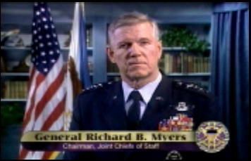

Chairman, JCS
Guidance
Introduction
Terrorists are indiscriminate
  Innocent people are targeted
  Our number one priority …
  win Global War On Terrorism
Your role ... your own safety
  Be alert to the threat
  Be aware of your surroundings
  Report suspicious activity
  Make security your norm
  Avoid predictable routines
  Don’t be a target
Together we will take the fight to the terrorists
Notes:
The Chairman of the Joint Chiefs of Staff has expressed his personal concern about terrorism and the protection of U.S. troops and the personnel that support them.
QUOTE:
“Hello, I’m General Dick Myers. We’ve learned through tragedies such as the horrific attacks of 11 September 2001, that terrorists are indiscriminate in their actions, not only against our great Nation, but also against peaceful and innocent people throughout the world. In my time in uniform, I’ve never seen a more serious threat to our national security and our way of life.
Thus, my number 1 priority is to win the Global War On Terrorism. America is taking the war to the enemy, in Afghanistan and elsewhere around the world, but this war must be fought on many levels. Probably the most important thing that you can do to help in this fight is to ensure your own personal safety. Although the main targets in this war are the international terrorist networks that threaten regional and world security, you must be aware of other threats that may exist in the area where you’re stationed.
Be alert to the threat of terrorism. Be aware of your surroundings. Report unusual or suspicious activity to the authorities. Pay attention to the details of the antiterrorism briefings you receive and make security a part of your routine. Taking the necessary precautions not only increases your own personal security, but also contributes to security of your family, your colleagues, your unit, and your installation or activity.
As President Bush has said, dealing with terrorists will take patience and persistence. The members of these terrorist networks are patient and cunning. They will wait to see if you let your guard down or settle into patterns of predictable behavior. Avoid becoming a tempting target. I need you to do this, so that we may continue to take the fight to the enemy, defending America and our freedoms.”

Slide 5
Lesson Map
Introduction
Introduction
Scenario
Historical
Examples
Notes:
This is the structure of this training. It begins with an introduction to terrorism and a threat briefing. Next, there is an OCONUS-specific scenario in which you can examine the actions you should take to increase your safety in various situations. Finally, several historical incidents illustrate the importance of good antiterrorism safety.

Slide 6
Threat Briefing and DOD Systems
Introduction
Threat Briefing
  Factors to consider about the threat
  How terrorists select targets
  How terrorists identify targets
DOD Systems
  Terrorism threat levels & warnings
  Force protection conditions
Notes:
The training begins with a threat briefing covering these ideas. If you understand how terrorists operate, you can understand ways to protect yourself. Try to anticipate what you can do to avoid becoming a victim to terrorist attack.
Next, the briefing examines systems used by the Department of Defense to monitor threat levels around the world and measures to protect U.S. service members, civilians and dependents.

Slide 7
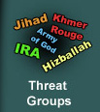
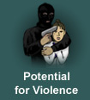

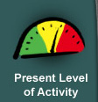
Threat Factors
Introduction
Are there
any terrorist
groups in
my area?
Are they
violent?
Do they
attack
Americans?
How active
are they?
Notes:
Terrorism is the calculated use of violence or the threat of violence to inculcate fear, intended to coerce or to intimidate governments or societies in the pursuit of goals that are generally political, religious, or ideological.
There are eight factors you should consider to understand the threat in your environment. Here are the first four factors.
The first factor to consider is whether there are any known groups in your vicinity. The Department of State publishes an annual report identifying terrorist groups and describing their actions against Americans. You should also ask your antiterrorism officer or your chain of command for information on terrorist groups in your area. What other sources of information could you use? Be alert to news stories in the paper, on radio, or on television. If you hear of violent groups or unexplained violent acts, consider the other factors on this slide. Who were the victims? What is the level of violence? How active is the group?
If you make a point of thinking about these factors, you will be better prepared for the potential risks you face.

Slide 8

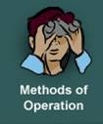

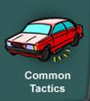
Threat Factors (Continued)
Introduction
How
sophisticated
are they?
How do they
operate–are they
predictable?
What tactics?
What weapons?
What type of
attacks?
Will the local
population warn
Americans?
Notes:
Here are four additional factors to consider: If there are terrorist groups in your area, how sophisticated are they? Do they use highly targeted, carefully planned attacks? Or do they explode bombs randomly in public places? If you know how they operate, you may be able to avoid danger spots and detect evidence of an attack before it occurs. For example, some terrorists study their targets for a month or more to carefully plan an attack. This is called surveillance, or watching secretly to identify patterns they can target. If you know how to look for surveillance, you can take steps to protect yourself and report it to your unit security officer.
If you know the tactics a group uses, you can be on the lookout. For example, a Greek terrorist group, the N-17, uses an overrun tactic in which two terrorists on a motorcycle will overtake their target in traffic. The rider on the rear of the motorcycle then pulls a pistol and shoots their victim, who is trapped in the traffic at a stoplight. If you knew this, you could be on the lookout for suspicious things while you drive. There are things you should do for safety in general, but when you know specific tactics to look for, you can be extra cautious when it can make a difference.
It is important to know whether a terrorist group has local popular support. If they do not have popular support, the local population is more likely to warn Americans about things leading up to an attack. The Defense Department and agencies of the U.S. Government study these factors to increase protection of U.S. forces. Your personal awareness can contribute to these efforts by the U.S. Government.

Slide 9

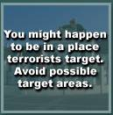
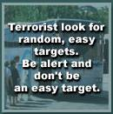
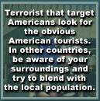
Target Selection
Introduction
Notes:
You should be aware at all times that you may be vulnerable to terrorist attack. Several factors make you a possible target, and you should keep these in mind wherever you go.
You might be a victim merely by being at a place targeted by terrorists. For example, Timothy McVeigh bombed the Murrah Building in Oklahoma City because it was a symbol of the U.S. Government. He did not target a specific individual. There were many innocent victims who suffered because they were at the place he targeted.
You might be the victim of an attack because of your association with the U.S. flag or the Department of Defense. This is why it is important to blend in with your surroundings, or remain anonymous, whenever possible. If the terrorists do not see your association with the United States, they are less likely to see you as a target.
Finally, you could be a victim of opportunity. Terrorists might be looking for an easy target and you could be it. Random, senseless violence is very effective in creating fear and terror. This training will give you some ideas on how you might reduce your exposure to this type of random attack.

Slide 10
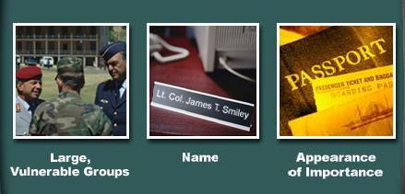
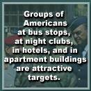
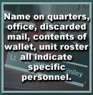
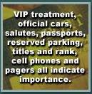
Target Identification
Introduction
Notes:
Try to see yourself as a terrorist might. Do you stand out as an American military person? Do you hang out with large groups of American troops in public? Does your behavior and the behavior of people you are with draw attention to you as Americans? Could a terrorist see you as an important person?
Large groups of Americas can be an inviting target. This is why terrorists bombed a discotheque full of U.S. troops in Berlin in 1986, why they attacked a barracks full of U.S. Marines in Beirut in 1983, and why they attacked an apartment building full of U.S. Air Force troops at Khobar Towers in Saudi Arabia in 1996.
Terrorists also identify and target specific individuals by name. You should protect your personal information to minimize your exposure. Finally, terrorists might target individuals because they appear important. This slide names several things that might attract the attention of terrorists. Terrorists might perceive you to be important even if you do not think you are.
To attack you, terrorists generally must perceive you, your associates, or your location as a target. Do not be an easy target.

Slide 11
DOD Terrorism
Threat Levels
Introduction
Consider a
terrorist group’s
And the operating environment
High
Significant
Operational capability
Activities
Intentions
Increasing
Threat
Moderate
Low
Notes:
The Defense Intelligence Agency assesses a Terrorist Threat Level for each country by considering these factors. Other U.S. agencies are also involved in collecting and analyzing terrorist threat information and intelligence in an effort to ensure the best possible warning of terrorist dangers. If there is indication that a terrorist group is operationally active and targeting U.S. forces, the Defense Intelligence Agency will issue a Terrorism Warning Report. Regional and local U.S. commanders can assign a different Terrorist Threat Level for specific personnel, family members, units, and installations. These Threat Levels inform DoD personnel of the need to take appropriate precautions.

Slide 12
Force Protection Conditions
Introduction
Sample
protective measures
Delta
Gate guards
Barriers
ID checks
Vehicle inspections
Patrols
Plan rehearsals
Charlie
Increasing
Protection
Bravo
Alpha
Normal
Notes:
U.S. military organizations use a system of protective measures to reduce vulnerability to terrorist attack. These measures change as the threat of attack changes. The measures are called “Force Protection Conditions.” Regional commanders announce the Force Protection Condition for units under their command. Local commanders may increase the Force Protection Condition based on local factors and may apply additional protection measures to reduce the risk of attack.
These Force Protection Conditions should not be confused with the Defense Intelligence Agency Terrorist Threat Levels. They are not the same thing. Force Protection Conditions are increased to provide added safety and security when Threat Levels increase.

Slide 13
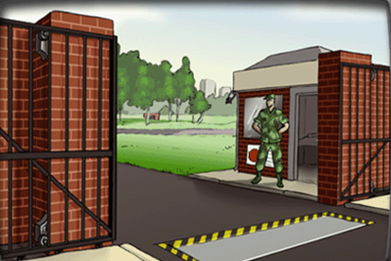
FPCON Normal
Introduction
When there is a general global threat of possible terrorist activity, but it warrants only a routine security posture
  A terrorist attack is always possible
  Best information available offers no indication of probable attack
Expect to see a routine
security posture
Notes:
Take a look at this picture. What security measures can you see? Under what conditions would you expect these measure to be used?
Force Protection Condition Normal applies when there is a general global threat of possible terrorist activity but it warrants only a routine security posture. A terrorist attack is always possible, but the best information available offers no indication of probable attack.
Force Protection Condition Normal provides the protection and security that are appropriate when there is no reason to anticipate an attack.

Slide 14
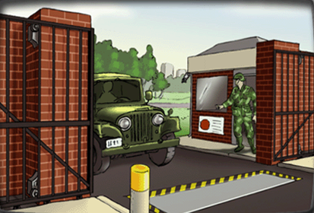
FPCON Alpha
Introduction
When there is a general threat of possible terrorist activity, the nature and extent of which are unpredictable, against personnel and facilities
  General conditions suggest possible violence
  Nothing indicates that this installation is targeted
  Must be capable of being maintained indefinitely
Expect random vehicle checks and
increased crime prevention efforts
Notes:
What about this picture? What is different? Under what conditions would you expect these measures to be used?
Force Protection Condition Alpha applies when there is a general threat of possible terrorist activity, the nature and extent of which are unpredictable, against personnel and facilities. General conditions suggest possible violence, but nothing indicates that this installation is targeted. Force Protection Condition ALPHA must the capable of being maintained indefinitely.
You can expect random vehicle checks and increased crime prevention efforts.

Slide 15
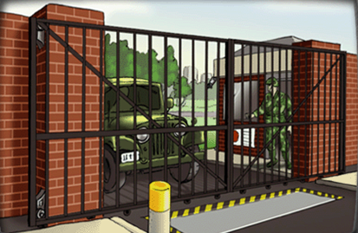
FPCON Bravo
Introduction
When an increased and more predictable terrorist threat activity exists
  Specific information suggests probable violence
  Nothing indicates that this installation is targeted
  Extra precaution is appropriate to deter terrorist planning
  Must be capable of being maintained for weeks without hardship
Expect to see closer inspection of
vehicles and deliveries, ID checks,
and a greater presence of guards
on your installation
Notes:
Now look at this picture. What additional precautions do you see? Under what conditions would you expect these measure to be used?
Force Protection Condition Bravo applies when an increased and more predictable terrorist threat activity exists. Specific information suggests probable violence, but nothing indicates that this installation is targeted. Extra precaution is appropriate to deter terrorist planning. Force Protection Condition Bravo must be capable of being maintained for weeks without hardship. Additional measure may affect operational capability and relations with local authorities
You can expect to see closer inspection of vehicles and deliveries, ID checks, and a greater presence of guards on your installation.

Slide 16
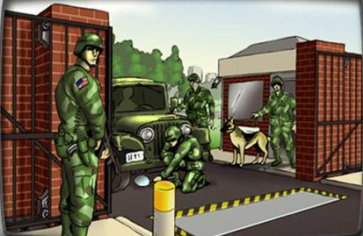
FPCON Charlie
Introduction
When an incident occurs or when intelligence indicates that some form of terrorist targeting against personnel and facilities is imminent
  Evidence of terrorist attack planning, such as terrorist surveillance or reports from local sources
  Strong protective measures are required, but the unit must continue its regular mission activities
  Implemented for only a short period of time
Expect rigorous efforts to inspect
vehicles and facilities, and you may
be required to participate in special
guard duties
Notes:
How about this picture? What security measures can you see? Under what conditions would you expect these measures to be used?
Force Protection Condition Charlie applies when an incident occurs or intelligence is received indicating that some form of terrorist action against personnel and installations is imminent. Evidence of terrorist attack planning may exist, such as terrorist surveillance or reports from local sources. Strong protective measures are required, but the installation must continue its regular mission activities. Implementation for longer than a short period of time will probably create hardship and affect activities of a unit and its personnel.
You can expect even more rigorous efforts to inspect vehicles and facilities, and you may be required to participate in special guard duties.

Slide 17
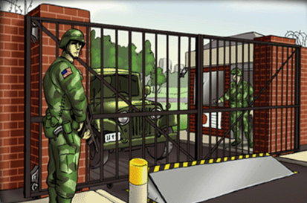
FPCON Delta
Introduction
When a terrorist attack has occurred or when intelligence indicates imminent terrorist action against a specific location
  Normally, Force Protection Condition Delta is declared as a localized warning
  The installation moves to a high state of alert, and commander implements mandatory security measures
  Commanders encouraged to supplement mandatory security measures
Additional security measures
delay and interrupt normal routines
Notes:
Finally, take a look at this picture. What security measures can you see? Under what conditions would you expect these measure to be used?
Force Protection Condition Delta applies when a terrorist attack has occurred or when intelligence indicates imminent terrorist action against a specific location. Normally, Force Protection Condition Delta is declared as a localized warning. The installation moves to a high state of alert, and mandatory security measures are implemented. Commanders are also authorized and encouraged to supplement mandatory security measures. At Force Protection Condition Delta some mission activities may be delayed or canceled.
You can expect the additional security measures to delay and interrupt your normal routines.

Slide 18
Random Antiterrorism Measures
Introduction
Force Protection Condition Normal plus random antiterrorism measures
day
Monday
Tuesday
Wednesday
Thursday
Friday
Saturday
Sun
Roll out
quick-reaction
force
Random
vehicle
inspections
Close gate,
place
barriers
Random
vehicle
inspections
ID
checks
ID
checks
Notes:
Random antiterrorism measures, or RAMs, are defined as the random use of different force protection measures at a specific installation. For example, at Force Protection Condition Normal an installation might have guards monitoring traffic at gates. A random measure might be to conduct random vehicle inspections at a gate over a period of several hours. Emergency response units or a rapid-reaction force may rehearse deployment to a perimeter fence line, or a gate might be temporarily closed. Random antiterrorism measures are used to rehearse protective measures for different Force Protection Conditions. Additionally, mixing up the security measures randomly increases the threat awareness of U.S. troops and confuses terrorists who might be watching the U.S. installation. These random measures serve as a deterrent against terrorist attack, since the terrorist has a harder time predicting unit routines and vulnerabilities.

Slide 19
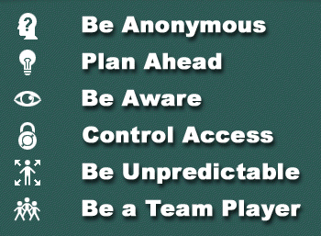
AT Themes
Introduction
Blend in, don’t be an
easily identified target
Think ahead and
choose safer options
Look for suspicious
persons/activities
Prevent crime,
maintain security
Change routines, routes,
times, and speeds
Cooperate with unit
security measures
Notes:
These six themes are found throughout this terrorism awareness training.
If you will think about these themes as you conduct your normal activities from day to day, you can make it a habit to reduce your vulnerability to terrorist attack.

Slide 20
Discussion
Introduction
To help combat terrorism, General Myers asks you to do which of these?
Be alert to the threat of terrorism, be aware of your surroundings, report suspicious behavior
Be a team player, plan ahead, and keep a low profile
Actively represent DOD
Notes:
The correct choice is answer a).
a) Be alert to the threat of terrorism, be aware of your surroundings, report suspicious behavior.
This is correct. Taking these precautions can increase the security of yourself, family, unit and installation.
b) Be a team player, plan ahead, and keep a low profile.
This is incorrect. While all of these measures are important, They are not the measures that General Myers recommends to combat terrorism.
c) Actively represent DoD.
This is incorrect. Allowing yourself to be easily identified with DoD increases your vulnerability to a terrorist attack.

Slide 21
Discussion
Introduction
Which topic will not be presented in this AT awareness training?
Threat briefing
CONUS/OCONUS scenarios
DoD counterterrorism capabilities
Historical overview of recent terrorist incidents
Notes:
The correct answer is choice c).
While this training does include a threat briefing scenario and a historical overview, it does not provide a review of DoD’s counterterrorism capabilities.

Slide 22
Discussion
Introduction
Which is not one of the eight factors you should consider when evaluating the threat in your environment?
Level of sophistication
Victim nationalities
Method of operation
International notoriety
Notes:
The correct answer is choice d).
The eight factors include threat groups, victim nationalities, potential for violence, present level of activity, level of sophistication, level of popular support, methods of operations, and common tactics.
While a group that has international notoriety most likely achieved that recognition by pulling off successful attacks, this in itself is not sufficient to help you determine a possible threat.

Slide 23
Discussion
Introduction
Which will do the most to reduce vulnerability?
Avoid locations terrorists might target, stay in large groups, be anonymous
Be alert, avoid the appearance of importance, blend in with the local population
Use a cell phone, avoid locations terrorists might target, and display your identification
Notes:
The correct answer is choice b).
a) Avoid locations terrorists might target; stay in large groups; be anonymous.
This is incorrect. Avoiding locations terrorists might target and remaining anonymous may help to reduce your vulnerability. Large groups, however, could present terrorists with a lucrative target.
b) Be alert, avoid the appearance of importance, blend in with the local population.
This is correct. Each of these measures will help reduce your vulnerability to a terrorist attack.
c) Use a cell phone, avoid locations terrorists might target, and display your identification. This choice is incorrect. Avoiding locations that terrorists might target can help reduce your vulnerability. Using a cell phone, however, draws attention to you and may cause a terrorist to believe that you are a highly important person. Likewise, displaying your identification could provide personal information to a watching terrorist.

Slide 24
Discussion
Introduction
What measures can you expect to encounter at FPCON Alpha?
Inspection of vehicles and deliveries, ID checks, and more guards
Random vehicle checks and increased crime prevention efforts
Rigorous inspection of vehicles and facilities, participation in special guard duties
Notes:
The correct answer is choice b).
Inspection of vehicles and deliveries, ID checks, and a greater presence of guards.
This is incorrect. You can expect these measures at FPCON Bravo.
b) Random vehicle checks and increased crime prevention efforts.
This is correct. These measures are associated with FPCON Alpha.
c) Rigorous efforts to inspect vehicles and facilities, participation in special guard duties.
This is incorrect. These actions will be seen at FPCON Charlie.

Slide 25
Discussion
Introduction
Which FPCON is used when a terrorist incident occurs or intelligence indicates that terrorist action or targeting against personnel and facilities is imminent?
a) Alpha
b) Bravo
c) Charlie
d) Delta
Notes:
The correct answer is choice c).
Alpha is implemented when there is a general threat of possible terrorist activity, the nature and extent of which are unpredictable, against personnel and facilities.
Bravo applies when an increased and more predictable terrorist threat activity exists. Specific information suggests probable violence, but nothing indicates that this installation is targeted.
FPCON Charlie is used when a terrorist incident occurs or intelligence indicates that terrorist action against personnel and facilities is imminent.
Delta applies when a terrorist attack has occurred or when intelligence has been received that terrorist action against a specific location is imminent.

Slide 26
Discussion
Introduction
Which FPCON is used where a terrorist attack has occurred or when intelligence has been received that terrorist action against a specific location is imminent?
a) Alpha
b) Bravo
c) Charlie
d) Delta
Notes:
The correct answer is choice d).
Alpha is implemented when there is a general threat of possible terrorist activity, the nature and extent of which are unpredictable, against personnel and facilities.
Bravo applies when an increased and more predictable terrorist threat activity exists. Specific information suggests probable violence, but nothing indicates that this installation is targeted.
FPCON Charlie is used when a terrorist incident occurs or intelligence indicates that terrorist action against personnel and facilities is imminent.
Delta applies when a terrorist attack has occurred or when intelligence has been received that terrorist action against a specific location is imminent.

Slide 27
Discussion
Introduction
Which is not one of the six AT themes?
Plan ahead
Be unpredictable
Control access
Identify potential terrorists
Notes:
The correct choice is answer d).
The six themes of this AT training are (1) be anonymous, (2) plan ahead, (3) be aware, (4) control access, (5) be unpredictable, and (6) be a team player. This training does not teach you to identify potential terrorists.

Slide 28
Department of Defense
Service Members Training
OCONUS Scenario
Notes:
Module B contains the antiterrorism awareness training situations for overseas locations.

Slide 29
Lesson Map
OCONUS Scenario
Introduction
Scenario
Historical
Examples
Notes:
We are in Module B, the scenario for overseas locations.

Slide 30
AT Themes
OCONUS Scenario
Blend in, don’t be an
easily identified target
Think ahead and
choose safer options
Look for suspicious
persons/activities
Prevent crime,
maintain security
Change routines, routes,
times, and speeds
Cooperate with unit
security measures
Notes:
These six themes are found throughout this terrorism awareness training.
If you will think about these themes as you conduct your normal activities from day to day, you can make it a habit to reduce your vulnerability to terrorist attack.

Slide 31
Introduction
OCONUS Scenario
This module presents a series of situations with multiple courses of action
Situations were selected to reinforce the course learning objectives
Each situation is designed to highlight one or more of the AT themes
  Applicable AT theme(s) will be highlighted
Notes:
Instructor notes:
Throughout this briefing, the six themes will appear on the left side of each situation. Those themes that are illustrated by the particular situation will be highlighted. Try to understand how the theme applies in each situation.

Slide 32
Scenario
OCONUS Scenario
You have been told you are to go TDY to an operating base in Riyadh, Saudi Arabia.
Air travel
Government facility
Hotel security
Ground travel
Hostage survival
Returning home
You will encounter situations pertaining to all of these
Notes:
Imagine that you are a temporary-duty traveler to Riyadh, Saudi Arabia. You need to keep yourself safe and support the security of the U.S. forces command you are visiting.

Slide 33
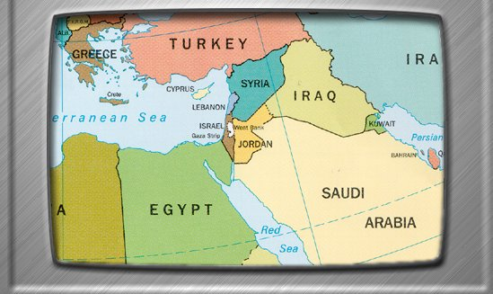
Situation Brief
OCONUS Scenario
There is a history of violence in the Middle East. You must understand a few basic trends to lower your personal vulnerability to terrorist attack.
Notes:
Do you remember the eight local security factors? Apply them to the Middle East in anticipation of your TDY trip.
When you are traveling or are stationed in the Middle East, you should be aware of the following trends:
1. Threat groups? The Middle East is home to several established terrorist organizations.
2. Target American? American assets have been targeted many times.
3. Violence? There is a high likelihood of violent terrorist action in the Middle East.
4. Level of activity? You should review CIA and Department of State announcements concerning current terrorist activities in the Middle East.
5. Sophistication? Terrorist organizations in the Middle East have used highly planned attacks that are precisely targeted with extremely high explosive force.
6. Popular support? There is significant popular support for the political objectives and religious motivations behind anti-American terrorist attacks.
7. Predictable? Terrorists in the Middle East favor highly concentrated, large groups of U.S. service members but have targeted smaller targets as well.
8. Preferred tactics? Almost any tactic is plausible in the Middle East, although false alarm threats, personal attacks with firearms, and small-scale bombings are the most plausible.

Slide 34
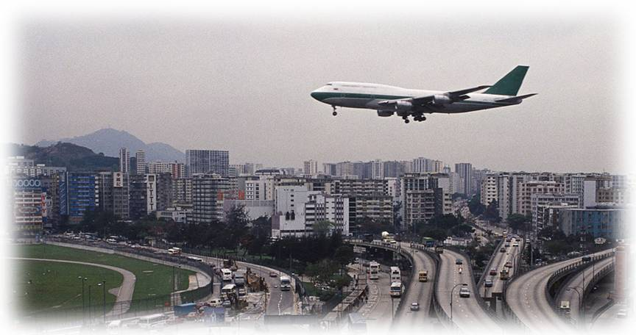
Air Travel
OCONUS Scenario
Notes:
The first situation we will examine is air travel.

Slide 35
Air Travel
OCONUS Scenario
Planning for your trip
Selecting your route
Choosing a seat
Packing for your trip
Moving through the airport
Encountering danger
Notes:
These are the specific situations and decisions we will examine.

Slide 36
Preparing for Your Trip
OCONUS Scenario
What is your first step?
Ask your unit intelligence officer for current threat information for Saudi Arabia and the Middle East, read the current State Department Travel Advisory and Country Fact Sheet on the Internet
Call the Saudi Embassy in Washington, DC to ask for information on their country
Call the State Department to try to learn more about Saudi history and customs, read the current State Department Travel Advisory and Country Fact Sheet on the Internet
You are going TDY
to the Middle East
Notes:
Instructor narrative
You will travel to an operating base in Riyadh, Saudi Arabia for a brief temporary duty. Be careful since there is a history of violence in the Middle East. What is a good first step to take in preparation?
Questions and answers: Option 1) is the correct answer.
1. Ask your unit intelligence officer for current threat information for Saudi Arabia and the Middle East. Also, read the current State Department Travel Advisory and Country Fact Sheet on the Internet.
The correct choice is to visit your unit intelligence officer to get current threat information for Saudi Arabia and the Middle East. Specifically, ask about the presence of threat groups, and their tactics, level of activity, and attitude toward Americans. You can also read official information about the area from the State Department and CIA. These efforts will help focus your protective measures when you get there.
2. Call the Saudi Embassy in Washington, DC to ask for information on their country.
Any effort to learn more about the general environment in Saudi Arabia is good, but you should rely primarily on official US Government sources of information.
3. Call the State Department to try to learn more about Saudi history and customs. Also, read the current State Department Travel Advisory and Country Fact Sheet on the Internet.
Any effort to learn more about the general situation is good, but you need to seek information specifically about threat groups and their intentions.
This situation illustrates the importance of the antiterrorism themes of planning and awareness. You should plan your travel and anticipate the situations you will face. If you wait until you are there, it will be too late to make preparations.

Slide 37
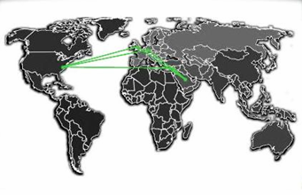
Selecting Your Route
OCONUS Scenario
What city should you book your flight through?
Connect with a two-hour layover in Frankfurt, Germany
Connect with a one-hour layover in Amman, Jordan
Connect with a four-hour layover in Frankfurt, Germany
You are booking
your flight
Notes:
Instructor narrative
The travel agent offers you three routes from New York to Riyadh and you know you want to avoid high threat areas. Which of the following itineraries do you select?
Questions and answers: Option 1) is the correct answer.
Connect with a two-hour layover in Frankfurt, Germany.
The best choice is a two-hour layover in Frankfurt, Germany. You should choose an itinerary on US carriers, when possible, and select foreign carriers and connecting airports known for superior security. Also consider the airports from which your connecting flights originate. Shorter layover times reduce your window of vulnerability in foreign locations. DoD travelers may have limited choices in official travel, but you should consider these security issues in your personal travel and raise security concerns when someone else is planning your official itinerary.
2. Connect with a one-hour layover in Amman, Jordan.
You chose to connect through Amman, Jordan with a one-hour layover. This is not the best choice even though the connection is shorter, because the connecting airport is in the Middle East and may expose you to unnecessary risk.
3. Connect with a four-hour layover in Frankfurt, Germany.
You chose to connect with a four-hour layover in Frankfurt, Germany. This is not best because a shorter layover was available.
This situation illustrates the themes of being anonymous, planning and access control. By choosing more secure airport locations for layovers, you minimize your exposure to dangerous situations. In other words, good airport security provides access controls that protect you from potential violence. The idea of anonymity, or blending in, is illustrated by purchasing tickets in advance. In this way, you would spend less time in a waiting line, possibly revealing your military association.

Slide 38
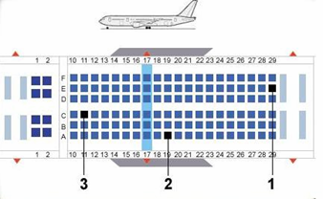
Choosing a Seat
OCONUS Scenario
What should you pick?
Middle seat, rear of the aircraft
Window seat, middle of the aircraft
Aisle seat, front of the aircraft
You must choose a
seat for your trip
Notes:
Instructor narrative
You are wisely pre-purchasing your ticket to avoid lines at the airport. You remember your commander’s instructions when the travel agent asks for your seat preference. Choose your seat.
Questions and answers: Option 2 is the correct answer.
Middle seat, rear of the aircraft.
A middle seat in the rear of the aircraft is not the best choice. A terrorist skyjacker is likely to stand at the very rear or very front of the passenger compartment to control the passengers. By sitting in the rear or on the aisle you are more accessible to the skyjackers and might be singled out.
2) Window seat, middle of the aircraft.
This is the correct choice because you are in a location that is not easily accessible, and it will allow you to blend in with the rest of the passengers.
3) Aisle seat, front of the aircraft.
An aisle seat in the front of the aircraft is not the best choice. A terrorist skyjacker is likely to stand at the very front or very rear of the passenger compartment to control the passengers. By sitting up front or on the aisle you are more accessible to the skyjackers and might be singled out.
This situation demonstrates the principles of being anonymous, planning ahead and controlling access. Choosing a seat that is not on the aisle allows you to better blend in with other passengers. Whenever possible, one should plan ahead and try to pre-purchase airline tickets and make seat reservations that reduce their exposure in a terrorist incident.

Slide 39
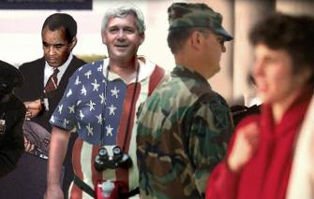
Packing for the Trip
OCONUS Scenario
What should you pack?
Pack a military duffel bag and wear your uniform
Use a standard civilian suitcase and wear plain clothing
Use an oversized suitcase with a “U.S. Government” label and wear your uniform
You are packing
Notes:
Instructor narrative
You have many choices to make as you prepare for the trip. You start to pack necessary items. Which do you choose?
Questions and answers: Option 2 is the correct answer.
1) Pack a military duffel bag and wear your uniform.
This is the wrong choice. You chose to bring military gear, and even though this might act as a deterrent against personal attacks, you have increased the likelihood of your being a target by association with the U.S. military.
2) Use a standard civilian suitcase and wear plain clothing.
The correct choice is to wear civilian clothing and bring civilian baggage that looks unremarkable so that you do not stand out among other travelers. Remember to a plan ahead and be anonymous.
3) Use an oversized suitcase with a “U.S. Government” label and wear your uniform to the airport.
Wearing clothes and carrying baggage that clearly identify you as American enhances the likelihood of your being a target by association with the United States.
This situation demonstrates the principals of being anonymous and planning ahead. Whenever possible, while traveling, one should wear casual clothing that will blend in with the clothing of those around you, not wearing anything that identifies you as an DoD Service Member. Always plan ahead and decide what clothing you should take while traveling that reduces your vulnerability.

Slide 40
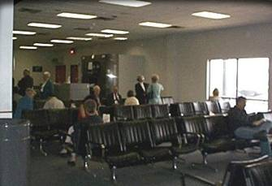
Moving Through the Airport
OCONUS Scenario
What should you do?
Phone ahead to headquarters in Riyadh to let them know when you will be arriving
Go straight to the gate where your transfer plane will be leaving and stay at the gate
Find a remote area of the airport terminal with few people to avoid areas that would likely be targeted
In between legs of
your trip, you have
a two-hour layover –
you know that you
remain in the secured
section of the airport
Notes:
Instructor narrative
During your 2-hour layover you think about avoiding dangerous situations and wisely decide to remain inside the security checkpoint. What do you do?
Questions and answers: Option 2) is the correct answer.
1. Phone ahead to headquarters in Riyadh to let them know when you will be arriving.
This is incorrect. While this call is a courtesy to those who may meet you at your destination, you might unnecessarily reveal something about your identity and plans to people around you in the terminal.
2. Go straight to the gate where your transfer plane will be leaving and stay at the gate.
The correct answer is to go directly to your departure gate and sit quietly. Remain alert for suspicious activity by other passengers and look for places to take cover in case of an attack. Avoid disclosing your military affiliation in conversation or when making phone calls.
3. Find a remote area of the airport terminal with few people to avoid areas that would likely be targeted.
This is not best because you should avoid remote areas where security forces could not respond as quickly in the event of an incident.
This situation illustrates the themes of being anonymous, being aware, and controlling access. Getting inside the security gate and going to your gate is a form of access control. Try to anticipate locations with some form of restrictive access and remain inside the protected areas. You should also remain vigilant, blend in, and avoid drawing attention to yourself.

Slide 41
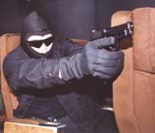
Airplane Hijacking
OCONUS Scenario
Ideas for immediate response
Be alert, remain calm
Hide your military ID
Encourage others to remain calm
Try to understand the developing situation
The plane has been
skyjacked
Notes:
Instructor narrative
Despite your precautions, it seems there was a terrorist aboard the plane. He is issuing his demands, brandishing a gun. Consider your immediate response.
Discussion
DoD personnel do not have special authority or jurisdiction on commercial airliners. You have the same status and options as other passengers. Avoid making things worse while you try to understand the situation. You may be at greater risk if the terrorists see you as a threat. Remain calm and do not draw attention to yourself; be alert to the actions of the skyjacker. If the situation demands your immediate action, as a passenger and a US citizen you may choose to act.
An effort to identify passengers by nationality or affiliation could indicate the objectives of the skyjackers. Conceal your affiliation with the US Department of Defense if possible.

Slide 42
Airplane Hijackings
Things to Consider
OCONUS Scenario
Is a Federal Air Marshall on the aircraft?
How heavily
armed are the hijackers?
Do hijackers closely monitor activities of passengers?
Are pilots left in control of the plane?
What is the hijackers’ destination?
Do hijackers demand ID from passengers?
Is someone
in a position
to resist the hijackers?
Are passengers able to place calls to people on the ground?
Are passengers singled out based on nationality or affiliation?
Remain Calm,
Comply with Demands
Continuously Evaluate the Situation
Notes:
Instructor narrative
Until recently, the primary motivation for airplane skyjackings was to acquire hostages. Once in control, terrorists could attempt to exchange the lives of passengers for the release of fellow terrorists in prison or political concessions from a government. However, the events of 11 September 2001 identified a new motivation for skyjacking airplanes – suicidal attack on high-value targets. Passengers need to remain extremely alert and rational to try to understand the intentions of the skyjackers.
Some possible considerations include:
Is there a Federal Air Marshall on the aircraft? If so, he or she is best suited to take action.
Are the pilots left in control of the aircraft? If so, they might be allowed to land the plane safely.
How heavily armed are the skyjackers? This could determine the passengers’ options for resistance.
What is the skyjacker’s destination? This might indicate their goal.
Do the skyjackers closely monitor the activities of the passengers? If not, there may be an opportunity to call 911 to alert authorities on the ground.
Do the skyjackers demand identification from the passengers? This might indicate their intent to single out specific hostages by nationality or affiliation with government.
Are passengers able to place calls to people on the ground? This might suggest the hijackers’ intentions.
Are passengers singled out based on nationality or affiliation? This is a good reason to conceal your military affiliation, if possible.
Is someone in a position to resist the skyjackers? Active resistance is a difficult decision.
Determining the best response in a hostage situation is a critical judgment call.
It is not likely that you will ever experience any form of aircraft skyjacking. US authorities are working diligently to increase airport security. Additionally, your flight may have an Air Marshall on board and you should not try to intervene in a situation where someone else is better trained and equipped to respond. It is also likely that the situation would be very confused and you may not have a clear understanding of what is happening. The intent of this discussion is for you to reflect on the possible choices you might have to make in extraordinary circumstances. Sitting quietly may be prudent in most circumstances, but it is conceivable the situation may require something different. In all situations, it is important for you to remain alert to unexpected events, think clearly, and act responsibly.

Slide 43
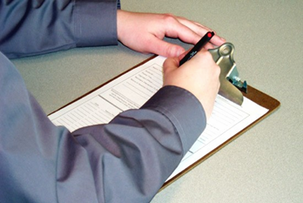
Interacting With Local Authorities
OCONUS Scenario
What should you do?
Provide information only if they ask you questions
Cooperate, describe the hijackers. Ask to speak with a US Embassy or US military representative as soon as possible since follow-up contact should be through them
Tell them to contact the US Government
The skyjacking situation has been resolved -
you are being
debriefed
Notes:
Instructor narrative
Fortunately, the incident was resolved without violence. The local authorities are interviewing you and are asking a lot of questions. You know you should help them. How should you respond?
Questions and answers: Option 2 is the correct answer.
Answer if they ask questions, but do not draw unneeded attention to yourself since you will not be available for the local trial in any event.
This is not best because you should seek to help the local police.
2) Cooperate and give a detailed description of the hijackers. Ask to speak with a US Embassy or US military representative as soon as possible since follow-up contact should be made through them.
The best answer is to cooperate with police and provide details. Also, you should ask to talk to a US Embassy or US military official as soon as possible since they know the international agreements that govern your presence in that country. Follow-up contact with the host nation police should be made through them. As a representative of the United States, you should be supportive of the local police. The US military cooperates with local authorities to promote mutual safety. By informing your commander, you help protect others from new threats.
3) Tell them to contact the U.S. Government.
This is not best since your silence will not help their investigation.
This situation illustrates the themes of of team work and being aware. Teamwork is an important principle in the fight against terrorism and violence; the local police are key team members. Because you were carefully noting the hijackers’ actions, your input is crucial to the report.

Slide 44
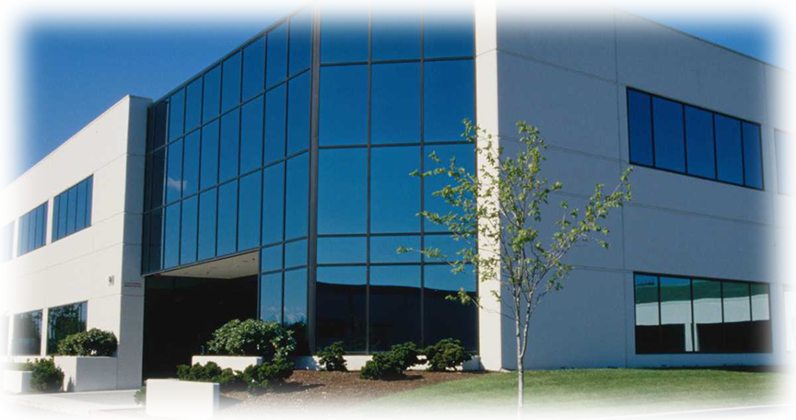
Government Facility
OCONUS Scenario
Notes:
We will now examine the situations for security at a Government facility.

Slide 45
In a Government Facility
OCONUS Scenario
Meeting your escort
Approaching the gate
Detecting surveillance
Understanding countermeasures
Observing a janitor
Finding a suspicious package
Noticing changes in local conditions
Encountering a security guard
Notes:
We will examine these specific situations.

Slide 46
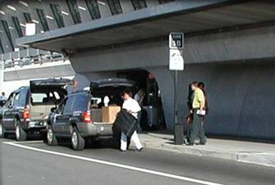
Contacting Your Base
OCONUS Scenario
For your safety, what does your escort urge you to have with you while in the city?
Maps of the local area, location of the US Embassy, list of emergency phone numbers, and your tourist passport
Maps of the local area, list of contact emergency phone numbers, and plenty of money
Maps of the local area, list of contact phone numbers for emergency situations, and a 2-way, military radio
Your escort is giving
you advice about
safety.
Notes:
Instructor Narrative:
After gathering your luggage, you and your escort leave the airport. You inform your escort of the incident on the plane and ask him questions about the local situation. He gives you some tips on staying safe in the Middle East: Always inspect your vehicle for tampering before getting in, try not to draw attention to yourself in public, make sure a responsible person knows where you are, and always travel with a buddy. What other precautions should you take when you are off base?
Questions and answers: Option 1 is the correct answer.
Make sure you have maps of the local area, the location of the US Embassy, a list of emergency phone numbers, and your tourist passport.
The correct answer is to have a local map, the location of the US Embassy, a list of emergency contact phone numbers, and proper identification (a tourist passport if possible). Other good ideas are to inspect your car for tampering, keep a low profile in public, and avoid political demonstrations. You could also ask for sources of information on the local situation. In this way, you increase awareness and prepare for emergencies.
2) Make sure you have maps of the local area, a list of contact phone numbers for emergency situations, and plenty of money.
This is incorrect because money does not reduce your vulnerability but might make you a target for theft.
3) Make sure you have maps of the local area, a list of contact phone numbers for emergency situations, and a 2-way, military radio..
This is not best because, though radio contact is an asset, it probably will draw attention to you as an important person or a DoD member.
This situation illustrates the themes of being anonymous, planning ahead, being aware, and being a team player. By not choosing to carry large amounts of money or a military device such as a two-way radio you more easily blend in with other people and therefore lower your profile. You demonstrate planning ahead by ensuring that you have the necessary maps to navigate through a city that is not familiar to you. By discussing safety with your escort and requesting information on the local area you are raising your awareness and knowledge of your surroundings. And also by informing your escort of the incident on the plane, you are keeping them aware of information which could effect their perceptions of the local threat.

Slide 47
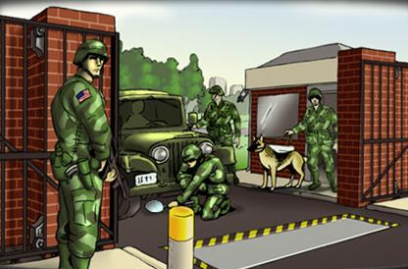
Approaching the Gate
OCONUS Scenario
What should you do?
Stock up on emergency supplies and inspect packages closely
Review security measures for various Force Protection Conditions and ask your leaders if you should take special precautions
Get a bulletproof vest from the supply center and obtain antibiotics to increase resistance to biological attacks
As you approach
your installation,
security appears
tight
Notes:
Instructor narrative
As you approach the gate, the radio in your vehicle has a news story about increased political tensions in your city. Knowing this, and seeing the security measures at the front gate, you know you should do something to enhance your security. What should you do?
Questions and answers: Option 2) is the correct answer.
1. Stock up on emergency supplies and inspect packages closely.
This is incorrect because you did not reduce your exposure to the most likely dangers.
2. Review security measures for various Force Protection Conditions and ask your leaders if you should take special precautions.
The correct answer is to review security measures for various Force Protection Conditions and ask your leaders for security guidance. Also, to increase your personal safety, you should monitor the radio for more information, vary routes and departure times to and from work, avoid crowds, be alert for surveillance, and inspect packages closely.
3. Get a bulletproof vest from the supply center and obtain antibiotics to increase resistance to biological attacks.
This is incorrect because your unit will issue body armor if appropriate and medical personnel should distribute antibiotics in response to exposure.
This illustrates being aware of your local environment. Radio news of unrest or public disturbances can be an important indicator of dangerous situations.

Slide 48
Approaching the Gate
OCONUS Scenario
What do you do?
Though you do not say anything, you show your irritation at being delayed
Get out of your car to get a better view of the procedures at the gate
Stay in your car, provide ID for all occupants, and cooperate with guard instructions. Remain alert for suspicious activities outside the gate area
As you approach,
security appears tight
Notes:
Instructor narrative
Security appears to be very tight at the front gate. Guards are performing 100% ID checks and inspecting vehicles with the aid of dogs and with mirrors to see undercarriages. A security camera is aimed at the vehicle inspection area. You remember that the base is at Force Protection Condition ALPHA, and conclude that this might be a Random Antiterrorism Measure (RAM) since 100% vehicle inspections are normally done at higher FORCE PROTECTION CONDITIONs. You wisely decide not to say anything to hassle the guards. While waiting in line for a vehicle inspection at the gate, what do you do?
Questions and answers: Option 3 is the correct answer.
1) Though you do not say anything, you show your irritation at being delayed. It seems obvious that you are not a threat.
This is incorrect because you are making the work of security guards more difficult.
2) Get out of your car to get a better view of the procedures at the gate.
This is incorrect because you might distract the guards from their duties or even be perceived as a threat.
3) Stay in your car, provide identification for all occupants, and cooperate with guard instructions. Remain alert for suspicious activities outside the gate area.
The correct choice is to stay in your car and get out photo ID. While waiting, remain alert for suspicious things outside the gate area, and cooperate with instructions when motioned forward for inspection. You are more protected by remaining in your car. Be patient since guards are following very specific instructions. Avoid making sudden movements that might be misinterpreted by guards and stand by while the guard performs the vehicle inspection. Unit security requires teamwork.
This situation illustrates the themes of being aware, controlling access and being a team player. By remaining vigilant while in your care you are practicing being aware of your environment. By staying in you car you are better protecting yourself than if you got out and are therefore controlling access. In addition, by waiting for and cooperating with the instructions of security personnel you are being a team player.

Slide 49
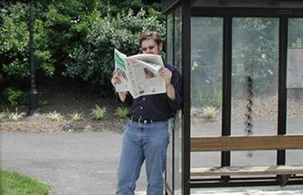
Detecting Surveillance
OCONUS Scenario
What do you do?
Carefully get out of line and drive away from the base, passing the stranger and getting a thorough description for the security forces
Tell the security guard what you have seen and provide a description of the individual
Do nothing; he is probably waiting for another bus
The man at the
bus stop seems to be
watching the base
Notes:
Instructor narrative
While waiting at the gate, you notice a man across the street at a bus stop reading a newspaper. He seems to be watching the activities at the gate over the top of his newspaper. A bus arrives and leaves but the man is still standing there. You wisely decide not to approach him. What should you do?
Questions and answers: Option 2 is the correct answer.
1) Carefully get out of line and drive away from the base, passing the stranger and getting a thorough description for the security forces.
This is incorrect because it is better to let security personnel evaluate and respond to the situation.
2) Tell the security guard what you have seen and provide a description of the individual.
The correct choice is to report and describe the person to the gate security. They are responsible for security on the base and will make the decision on how to deal with potential surveillance. In this way you are being a good team player. Suspicious activity should be reported immediately, and no action should be taken on your part that might put you at personal risk or cause the individual to believe he may have been spotted.
3) Do nothing; he is probably waiting for another bus.
This is incorrect because you did not report a suspicious activity to appropriate security personnel.
This situation illustrates the themes of being aware and being a team player. By studying the individual carefully, you can remember enough details to give the guards a good description of the individual. By providing information to the guards and letting them handle the situation you are being a team player.

Slide 50
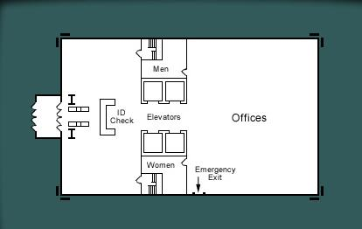



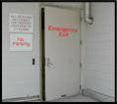
Understanding Countermeasures
Family Member Scenario
Notes:
Instructor narrative
When you arrive at the installation in-processing center, you take a few moments to pass through a security check similar to airport security. Your uniformed family member gets a No Escort Required badge and other family members get Escort Required badges. As you wait, you take a few moments to look at several antiterrorism and security measures being used. These include access control measures:
-Access Control Measures
ID checks
Metal detectors
Badge/visitor control systems
Bag inspections
Bomb sniffing guard dogs
Locked secondary building entrances
You also notice several blast mitigation measures including:
Barriers to keep vehicles away from buildings
Fragmentation resistant film on windows to reduce glass fragmentation
Also present are observation/monitoring measures such as:
Random security patrols
Security cameras
These are some of the measures used to protect individuals working at the installation by deterring terrorist planning, reducing terrorist access, and reducing the potential effects of terrorist bombs.

Slide 51
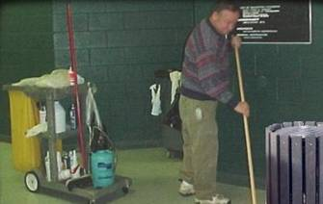
Suspicious Activity at Work
OCONUS Scenario
What should you do?
Ask him why he is searching through the trash
Have him escorted from the facility immediately
Make a thorough list of his activities and report him to your supervisor immediately
While at work you
notice a janitor
displaying suspicious
activity
Notes:
Instructor narrative
While working in your office, you notice one of the local janitorial workers takes the time to search through the contents of a trashcan while cleaning up. You know you must do something, but what should you do?
Questions and answers: Option 3 is the correct answer.
1) Ask him why he is searching through the trash.
This is incorrect because you should let security personnel handle this for safety and maximum intelligence value in the investigation.
2) Have him escorted from the facility immediately.
This is incorrect because you should let security personnel decide how to handle the investigation for maximum intelligence value.
3) Make a thorough list of his activities and report him to your supervisor immediately.
The best answer is to make a thorough list of the his activities and report the suspicious worker to your supervisor immediately. Knowing all the activities of suspicious individuals is important to security investigators. You should not try to handle this personally since security personnel are trained to respond to terrorist surveillance. The insider threat is very important. You should be alert for suspicious activities by people who have routine access to your facilities.
This situation illustrates the themes of being aware and being a team player. By looking for suspicious activity in your work place you are raising you level of knowledge concerning what is appropriate behavior and therefore in a better position to recognize anything unusual. By informing your supervise or security personnel you give the trained professionals an opportunity to do their job and are therefore a team player.

Slide 52
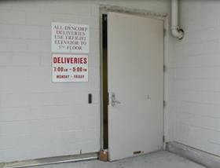
Noticing a Violation
OCONUS Scenario
What do you do?
Close the door and then point out the security violation to one of the facility managers
Point out the security violation to one of the facility managers
Keep an eye on the door yourself
You are walking through the facility and notice a door propped open
Notes:
Instructor narrative
You also notice other security measures on the base. Temporary barriers have been erected in the parking lot so no one can park closer than 100 feet to any buildings, and there are guards at several locations. At the facility where you work, there is a 100% ID check at the front door. As you walk about, you notice that a rear door to the building has been propped open with a box. No one is guarding the door. You know you should do something, but what?
Questions and answers: Option 2 is the correct answer.
1) Close the door and then point out the security violation to one of the facility managers.
This is incorrect because you do not know the reason the door was propped open and by closing it yourself you might be interfering with something.
2) Point out the security violation to one of the facility managers.
The correct choice was to point out the security violation to one of the facility managers. You are being a team player when you remind others of the importance of security.
3) Keep an eye on the door yourself.
You chose to keep an eye on the door yourself. This is incorrect because it is not your job to guard the door, and you do not know who should and should not use it.
This situation illustrates the importance of the principles of planning, awareness, access control and being a team player. The best security at the front desk can be defeated by an unsecured rear door. A security plan needs to consider all possible entry points. This also illustrates the need to be aware of security violations and understand their importance for access control. Finally, you are a team player when you remind fellow Service members to observe proper security measures.

Slide 53
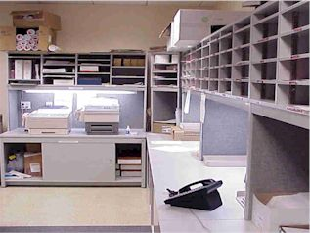
Suspicious Package at Work
OCONUS Scenario
You know you should not open it, but what do you do?
Without opening the package, thoroughly examine it looking for oily spots on the outside and protruding wires
Destroy the package by immersing it in water
Leave the package alone, isolate the room, and notify security personnel
You find a package
in the mailroom
marked “Personel for
the Comendar”
Notes:
Instructor Narrative:
You find a package in the mailroom with no return address and a handwritten address to your facility that was full of errors. You notice that it is marked “Persone” for Comendar”. You wisely decide not to open the package, but what do you do?
Questions and answers: Option 3 is the correct answer.
Without opening the package, thoroughly examine it looking for oily spots on the outside and protruding wires.
This is incorrect because unnecessary handling of the package exposes you to added danger.
2) Destroy the package immediately by immersing it in water.
This is wrong because this action might trigger an explosion.
3) Leave the package alone, isolate the room, and notify security personnel.
The correct answer is to leave the package alone, isolate the room, and notify security personnel. Indicators may include oily stains, uneven balance or shape, no return address, return address that does not match the postmark, misspellings in the address or return address, unusual odor, excess postage, marking as “Personal For” a specific individual, or a foreign style of handwriting.
This situation illustrates the themes of being aware, controlling access, and being a team player. You are demonstrating awareness of your environment by noticing the package and the suspicious handwriting, By isolating the room, you are controlling access and preventing other people from entering a potentially dangerous space. By notifying security you are allowing those that are professionally trained to handle such situations do their job.

Slide 54
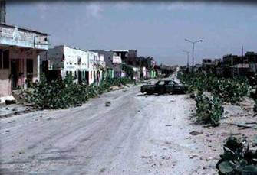
Noticing Changes in Local Conditions
OCONUS Scenario
What should you do?
Monitor the situation closely and if the change in environment persists alert security officials
Bring it to the attention of your supervisor
Go down to the street and investigate
You notice that a
normally busy street
is practically deserted
Notes:
Instructor narrative
From an upstairs window you can look down on a busy market and street below. Every day you take a few minutes to look at the confusion in the street outside the fence, but today you notice the street is practically deserted. You know you must do something, but what?
Questions and answers: Option 2) is the correct answer.
1. Monitor the situation closely and if the change in environment persists alert security officials.
This is incorrect because you may waste valuable time that could be used to raise defenses.
2. Bring it to the attention of your supervisor.
The correct choice is to bring it to the attention of your supervisor and security. This is correct since your leaders can work with security personnel and local officials to evaluate the situation.
3. Go down to the street and investigate.
This is incorrect because you are probably not qualified to do this task. Get it to the right officials for action.
This situation illustrates the importance of awareness and being a team player. If normal activities suddenly change, someone might know something you don’t. If the local population hears rumor of a violent attack, they might close a local market or close stores at unusual times. Local employees might not show up for work or might keep their kids home from a nearby school or daycare facility. As a good team player you should bring these changes to your supervisor for immediate investigation.

Slide 55
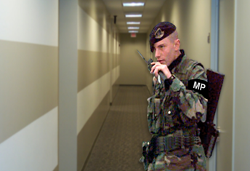
Complying with Evacuation Instructions
OCONUS Scenario
What do you do?
Quickly secure classified information, and then exit down the rear staircase
Ask the security guard for identification and an explanation before complying
Wait to see what other workers in your office do since it might be a false alarm or just a drill
A security guard
enters your workspace
and tells you to
evacuate the building
Notes:
Instructor Narrative:
A security guard enters your workspace and loudly instructs workers to evacuate immediately through the rear staircase. You do not see or hear any alarms, nor have you ever seen this particular guard before. What do you do?
Questions and answers: Option 1 is the correct answer.
1) Quickly secure classified information, and then exit down the rear staircase.
The best decision is to quickly secure classified information, and precisely follow the guard’s instructions, in this case to use the rear staircase, helping coworkers along the way. Proceed to the rally point designated in your unit emergency plan and account for all personnel. Then, be alert for opportunities to assist emergency personnel if appropriate. Immediate response and evacuation procedures saved many lives during the Khobar Towers attack, so it is important to act quickly. While being suspicious can be good for security, it can also be counterproductive in an emergency.
2) Ask the security guard for identification and an explanation before complying.
You chose to ask the guard for ID and an explanation before complying. This is incorrect because immediate compliance may save lives.
3) Wait to see what other workers in your office do since it might be a false alarm or just a drill.
This is incorrect because you should encourage coworkers to comply with instructions immediately.
This situation illustrates the themes of planning ahead and being a team player. You should always familiarize yourself with the emergency plans of the building you are working in in the event of an emergency. By following the evacuation instructions of security personnel you are being a team player.

Slide 56
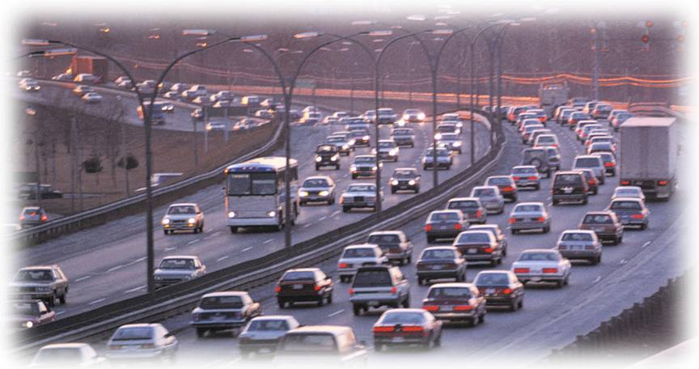
Ground Travel
OCONUS Scenario
Notes:
We will now examine situations concerning ground travel security.

Slide 57
Ground Travel
OCONUS Scenario
Renting a car
Familiarizing yourself with your car
Getting Directions
Driving under surveillance
Notes:
We will examine these four situations.

Slide 58
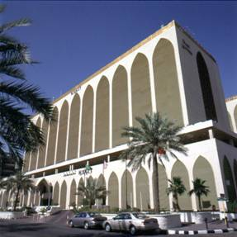
Choosing Your Hotel
OCONUS Scenario
What should you pick?
4-star hotel recommended by fellow service member with an excellent gym
Hotel recommended by US Embassy with low cost
Hotel recommended by US Embassy with easy access to US base
You have to select a
hotel off the
installation
Notes:
Instructor narrative
After spending several days in temporary quarters in the operating base, your supervisor informs you that you have been selected to move to a local hotel because there is a new group of troops arriving and there is not enough room for everyone at the base. You wisely choose not to take the advice of a local taxi driver since he cannot be trusted as a reliable source. Which hotel do you choose?
Questions and answers: Option 3) is the correct answer.
1) 4-star hotel recommended by fellow service member with an excellent gym.
You chose the 4-star hotel on the advice of a fellow service member. You have no way of knowing how secure this location is. The fellow service member may not have the best information and is not responsible for this decision.
2) Hotel recommended by US Embassy with low cost.
You chose the hotel recommended by the US Embassy with low cost. While you should follow the advice of the embassy, you should also be sure to consider the security aspects of this decision as well.
3) Hotel recommended by US Embassy with easy access to US base.
The correct choice is the hotel recommended by your unit security officer or the US Embassy. Preferred facilities may have modern security systems like electronic keys that are hard to duplicate and are re-keyed for each new guest. A well-run hotel is more likely to have a security conscious staff. Also desirable are features to minimize your exposure like proximity to the US base and a hotel restaurant.
Remember that it is always preferable to stay in temporary quarters on a U.S. installation. If you have to stay in a hotel overseas, take the advice of the local U.S. command or the U.S. embassy. Hotels should be selected based on their security systems to control and monitor access and on their location. This illustrates good planning and access control.

Slide 59
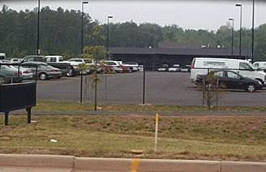
Renting a Car
OCONUS Scenario
Which car should you choose?
An older model car with non-distinctive markings
A new, oversized SUV which will provide you with added protection if in an accident
A recent model, medium-size, sedan
You are deciding which
car to rent - you wisely decided not to rent a sports car
Notes:
Instructor narrative
You need a rental car to get to your hotel. You go to a rental car company to rent your car. You are selecting a rental car. You want to choose one that is smart from a security perspective. You wisely decide not to rent an exotic-looking sports car since you might be a more likely target of theft. What specifically should you look for?
Questions and answers: Option 3 is the correct answer.
1) An older model car, avoiding distinctive markings that identify you as a tourist.
This is not best because it might be less reliable.
2) A new, oversized SUV. You will be better protected if you get into an accident. Ensure all safety equipment is working (lights, horn, wipers, brakes), and tires are properly inflated.
This is not best because it could be a more likely target of theft, is more readily identifiable, and may not effectively conceal cargo.
3) A recent model, medium-size, sedan that is commonly used in the local area. Avoid distinctive markings that identify you as a tourist and keep gas tank at least half full.
The best choice is a car that blends into the local area that is unlikely to attract a thief. So, avoid oversized SUVs or expensive-looking sports cars and distinctive markings that identify you as a tourist such as a rental company bumper sticker. Look for evidence of good maintenance and working safety equipment (lights, horn, wipers, brakes). The enclosed trunk of a sedan more effectively conceals cargo than a station wagon, SUV, or minivan.
This situation illustrates the themes of being anonymous, planning ahead and being aware. You are increasing your anonymity by selecting a non-descript vehicle which is common in most cities. By understanding what kind of car is appropriate to the environment you are in and making an effort to rent such a car, you are demonstrating good planning and an awareness of your environment.

Slide 60
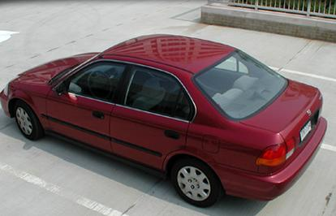
Inspecting Your Vehicle
OCONUS Scenario
When do you inspect your rental car?
Prior to leaving the rental car parking lot and every time the vehicle is left in an unsecured location
After the car is parked in an unsecured location
At the earliest convenient time
You know you should
inspect and
familiarize yourself
with your rental car
Notes:
Instructor narrative
While still at the rental car company you remember that it is important to familiarize yourself with your vehicle, but when should you inspect your car?
Questions and answers: Option 1 is the correct answer
Prior to leaving the rental car parking lot and every time you return to your car after it has been left in an unsecured location.
The correct choice is to familiarize yourself with the car prior to leaving the rental office, and then inspect the car each time you use it when it has been parked in an unsecured location. Thoroughly examine the car working from the outside in. Start with a visual inspection of the exterior without touching it, to include the undercarriage and wheel wells, for any evidence of tampering. Before opening the doors, look into the interior and then open every compartment of the car to look for anything that does not belong.
2) After the car has been parked in an unsecured location such as the hotel garage.
This is incorrect because you failed to become familiar with the car before leaving it in an unsecured location. You might not be able to recognize tampering because you are unfamiliar with the normal appearance of the car.
3) At the earliest convenient time.
This is incorrect because what you consider to be convenient might be too late.
This situation illustrates the the theme of being aware. By familiarizing yourself with your rental car, you are increasing your knowledge of the vehicle so you can better recognize tampering at a later time.

Slide 61
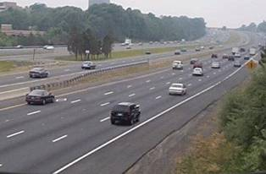
Getting Directions
OCONUS Scenario
What should you do?
Ask the clerk at the rental car counter
Use your hotel’s courtesy phone to call and ask for directions
Call the hotel from a pay phone and ask for directions to their location using major highways
You need directions
to drive to the hotel
Notes:
Instructor narrative
Before leaving the rental car counter you realize you need driving directions to the hotel. You wisely decide not to ask a local stranger or taxi driver. How do you get help?
Questions and answers: Option 3 is the correct answer.
1) Ask a clerk at the busy car rental counter.
This is incorrect because you are revealing your destination and getting information from someone who is not a trusted source.
2) Use the courtesy phone of the hotel you are staying at to call for directions.
This is not best because you are inadvertently revealing your destination by using the hotel courtesy phone.
3) Call the hotel on a pay phone and ask for directions to their location using major highways.
The correct choice was to call the hotel on a pay phone and ask for directions using major roads. By limiting what you say publicly, you can protect your anonymity and your destination while getting help from a trusted source. You should consider what you are revealing about yourself and who is listening when you are seeking information in public places.
This situation illustrates the themes of being anonymous and planning ahead. By using a pay phone instead of the hotel courtesy phone or asking for directions at the counter, you have limited the possibility of accidentally disclosing the location of your hotel. By asking for directions to the hotel using main roads prior to leaving the rental car lot you are planning ahead by driving in what are probably safer areas and reducing the chance that you will become lost while driving to the hotel.

Slide 62
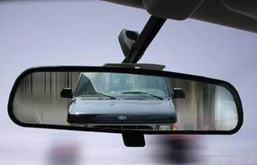
Driving Under Surveillance
OCONUS Scenario
What should you do?
Drive at normal speed to a public location or the front of your hotel, avoiding chokepoints and getting boxed in
Slow down and let the truck pass, make eye contact with driver, get a description of the driver
Turn off onto a side street and park in an ally to lose the persuer
You suspect that you
are being tailed –
you know that you should not try to outrun the other vehicle
Notes:
Instructor narrative
On the road to the hotel, you stay on main highways and through streets since you do not know the area well. You are still thinking about the aircraft incident and the emphatic warnings of your Commander. As you keep an eye on the surrounding traffic, you try to remember if the truck behind you was the same one that followed you from the car rental office and you nervously lock the doors and close the windows. You wisely decide not to try to outrun the truck. What else should you do?
Questions and answers: Option 1 is the correct answer.
1) Drive at normal speed to a safe, familiar public location such as a police station or the hotel. Try to avoid choke points or being boxed-in by traffic.
The correct choice is to drive to a safe, familiar public location. If you are familiar with the city you should drive to a police station, but in unfamiliar surroundings stick with the places and routes you know such as your hotel. Stay a car length behind other vehicles when stopped to avoid being boxed-in and avoid streets or alleys where you might become trapped. Drive defensively to avoid an accident, and provide a vehicle description to your unit security officer.
2) Slow down to see if the truck will pass you; make eye contact so the driver knows you are aware. Try to get a detailed description of the vehicle and driver.
This is incorrect because you may precipitate a confrontation or cause an accident.
3) Turn off onto a side street and park in an alley to try to lose the suspicious truck or to verify he is following you.
This is wrong because you would probably put yourself in a more dangerous situation in unfamiliar surroundings.
This situation illustrates the theme of being aware. It is important to always be aware of your surrounding in order to recognize odd behavior or or things that are out of place.

Slide 63
Hotel Security
OCONUS Scenario
Notes:
We will now examine several situations you might face in a hotel.

Slide 64
Hotel Security
OCONUS Scenario
Choosing your hotel
Choosing a room
Leaving the room
Dining out
Returning to your room
Notes:
These are the situations we will discuss concerning safety in a hotel.

Slide 65
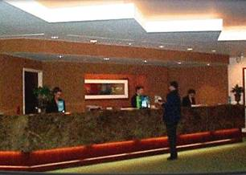
Choosing a Room
OCONUS Scenario
What should you do?
Keep first floor room
Trade for one on the 4th floor, near a fire exit, that opens to the hotel interior
Trade for one on the 4th floor, near the elevators, that opens to the exterior of hotel
Trade for one on the 12th floor, near the elevators, that opens to interior of the hotel
You are check into
the hotel –
your room is on the first floor but you have the option to change
Notes:
Instructor narrative
The room reserved for you when you made the reservation over the phone is on the first floor and opens directly onto the parking lot. Do you want to keep this room or change the reservation to a different room?
Questions and answers: Option 2 is the correct answer.
1) Keep this room.
You chose to keep your current room, which is very easy for a stranger to access since it is on the ground level and opens onto the exterior. By not changing rooms, you are a predictable target.
2) Trade this room for one on the 4th floor, near a fire exit, that opens to the hotel interior.
The correct choice is to change rooms, thus being an unpredictable target. A room above the 3rd floor with no balcony that opens onto the interior of the hotel is better because outside intruders are less likely to have unsupervised access. A room away from the street may be less exposed to a street-level bomb blast. Also, a fire truck ladder can reach up to the 10th floor or you may escape through a nearby fire exit in the event of an emergency.
3) Trade this room for one on the 4th floor, near the elevators, that opens to the exterior of hotel.
This is not the best choice because the exterior entrance is a security risk since it might be accessed without being monitored. Also, you should not use elevators in the event of a fire.
4) Trade this room for one on the 12th floor, near the elevators, that opens to interior of the hotel.
This is not the best choice because you may have a more difficult time evacuating the building in an emergency. You should not use the elevators in the event of a fire.
This situation illustrates the themes of controlling access and unpredictability. By changing rooms, you might frustrate efforts by terrorists or other criminals to size you up as a potential target. Additionally, you are enhancing your personal safety by selecting a room that is not easily accessible to intruders but could still be reached in an emergency.

Slide 66
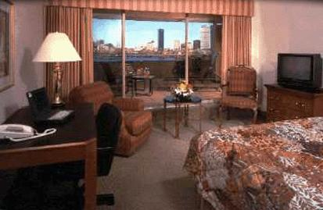
Inspecting Your Room
OCONUS Scenario
What should you check?
Operational locks on doors, balcony, and windows. Ensure phone works and that you know how to place emergency calls
Operational locks on doors and windows. Ensure TV and telephone work
Operational locks on the door. Ensure the TV works. Look for a lock box and mini-bar in the room. Also, ensure phone works
You are in your
hotel room
Notes:
Instructor narrative
You are thinking about the incident on the airplane and the truck following you in traffic. You decide to exercise extra precautions in your hotel room. Which items should be checked in the room?
Questions and answers: Option 1 is the correct answer.
1) Inspect for good operational locks on doors, balcony, and windows. Also, ensure the phone works and that you know how to place emergency calls.
The right choice was to inspect for good operational locks on doors, balcony, and windows. Ensure the radio or television works for emergency news. Look for a lock box in the room or use the hotel safe to secure personal valuables. Also, make sure you know how to place a call on the hotel phone system to police and fire rescue, and to the security office at the local US installation.
2) Inspect for good operational locks on doors and windows. Ensure the cable television and telephone work.
You neglected the balcony door.
3) Inspect for good operational locks on the door. Ensure the television works. Look for a lock box and mini-bar in the room. Also, ensure the phone works.
You neglected window and balcony locks.
This situation illustrates the principles of awareness and controlling access. You help control access when you check the locks and communications available in the room.

Slide 67
Leaving the Room
OCONUS Scenario
How should you leave?
Turn the TV off and leave the hotel through the front door
Turn the TV off and leave the hotel through the side door
Leave the TV on and leave the hotel through the front door
Leave the TV on and leave the hotel through the side door
You are in your hotel
room and you decide
to go out for dinner
Notes:
Instructor narrative
After watching some television, you are going out for dinner. On two previous occasions when you used the side entrance to the hotel, you saw the same person standing around. You remember that terrorists secretly observe potential targets to choose targets and plan attacks. How do you leave the hotel?
Questions and answers: Option 3) is the correct answer.
1) Turn the TV off and leave the hotel through the front door.
While varying your movement in the hotel is a good security measure, you should maintain the appearance that your room is still occupied by leaving the television on.
2) Turn the TV off and leave the hotel through the side door.
This is incorrect. This reveals that no one is in the room and establishes a pattern that you tend to use the side door. Someone observing you could take advantage of your patterns.
3) Leave the TV on and leave the hotel through the front door.
The correct answer is to leave the TV on and leave through the front door. This foils possible surveillance by maintaining the appearance that someone is still in your room; by varying the way you move around in the hotel you are more unpredictable.
4) Leave the TV on and leave the hotel through the side door.
This is incorrect. While it is a good idea to maintain the appearance that someone is still in your room, you established a pattern of leaving through the side door. Someone observing you could take advantage of this pattern.
This illustrates the principles of anonymity and unpredictability. By varying your routines, you are less predictable and tend to blend into the activities of the hotel.

Slide 68
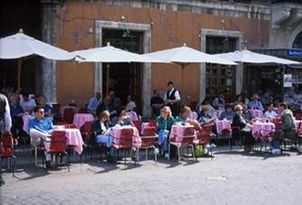
Dining Out
OCONUS Scenario
How should you respond?
Don’t say anything! Just eat your food and ignore the stranger
Engage in some conversation, but nothing personal or about your purpose here
Relax and enjoy the dinner conversation
A stranger starts
asking you questions
about your work
Notes:
Instructor narrative
After making sure everything is in order, you decide to head down to a nearby restaurant, since you are hungry. You ask for a table inside because the street-side tables are more exposed to possible dangers. The restaurant is busy, and there are several people sitting near you. One friendly stranger starts asking you where you’re from and what you do. What should you do?
Questions and answers: Option 2) is the correct answer.
1) Don’t say anything! Just eat your food and ignore the stranger.
It is not best to say nothing and the stranger. This will just appear rude and will only call attention to you more as you try to ignore the stranger.
2) Engage in some conversation, but nothing personal or about your purpose here.
The correct choice is to engage in some conversation, but nothing personal. This will maintain your anonymity without calling more attention to yourself. By being alert and cautious, you may be seen by your acquaintance as a person with high security awareness. While you should not overreact, you should notice when someone is unusually engaging or interested in you. Keep in mind the incident involving Specialist Edward Pimental, who left a German night club with a young woman he had met inside. The woman turned out to be a terrorist, and after leaving the night club, led Pimental to an isolated area where he was killed to acquire his military ID. The next day, a group of terrorists used Pimental’s ID card to access Rheim Main Air Base and detonate a car bomb.
3) Relax and enjoy the dinner conversation.
It is not best to just relax and enjoy the dinner conversation. This is incorrect because you are not being alert to the possibility that his interest might signal either criminal or terrorist intent.
This situation illustrates the principle of remaining anonymous and aware. Avoid identifying yourself as a U.S. Service member and always remain alert to unusual developments in your surroundings. Providing unnecessary details about yourself could increase your vulnerability to a terrorist act. Even if the man in the restaurant is merely a friendly diner, you never know who else might be monitoring your conversation.

Slide 69
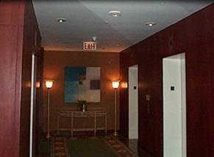
Returning to Your Room
OCONUS Scenario
How should you proceed?
Approach stranger to ask the time, get description, and let the stranger know that you are alert to his or her behavior
Stop at public area of the hotel for a few minutes; if the individual is still there, report stranger to front desk, take an indirect route to your room, inform your unit security officer and provide description
Avoid the individual in the lobby, take the elevator directly to your floor. Inform your unit security officer and provide a description
You are heading
back to your room and
you notice the stranger
from dinner in the lobby
Notes:
Instructor narrative
You finish dinner and head back to your room. Thinking about the individual in the restaurant, you decide to eat in the hotel restaurant or use room service next time. In the lobby, you think you recognize the same individual from the restaurant who seemed overly interested in your purpose in Los Angeles. You notice that lights in the elevator lobby indicate on which floors the elevator stops. You know you should take some precaution. How do you proceed?
Questions and answers: Option 2 is the correct answer.
1) Approach the stranger to ask the time. This will allow you to get an accurate physical description, and will let the stranger know that you are alert to his or her behavior.
This is incorrect because if the individual has hostile intentions, it will put you at greater risk.
2) Stop at a secure, public area of the hotel (gift shop, restaurant) for a few minutes. If the individual is still there, go to the front desk and report the stranger; then, take an indirect route to your room. Inform your unit security officer of the possible surveillance and provide a description of the individual.
The correct choice is to report it to hotel management. You are less vulnerable with an escort. Take an indirect route to your room by riding an elevator to a wrong floor, then take another elevator or stairs to the correct floor. This conceals your floor to an observer in the lobby. If you believe the person is a threat, do not ignore your instincts. By reporting the suspicious person, you may deter a crime. Informing your unit security officer is good teamwork.
3) Avoid the individual in the lobby, and take the elevator directly to your floor. Inform your unit security officer of the possible surveillance and provide a description of the individual.
This is incorrect because you assume this individual has no hostile intent. By not acting you open yourself and others to greater risk.
This illustrates the themes of being aware, being unpredictable and being a team player. You should vary your pattern of movements in the hotel and be aware that someone could be watching you to find out what room you are in. By letting the front desk know of the developing situation you are providing hotel security the opportunity to assist you.

Slide 70
Vehicle Improvised
Explosive Device
OCONUS Scenario
Inspecting the vehicle
Finding a suspicious package
Changing Plans
Notes:
We will examine these specific situations.

Slide 71
Inspecting the Vehicle
OCONUS Scenario
What should you do first?
Carefully inspect the exterior, but since the car was locked don’t examine the interior, trunk, engine, or fuel door
Open and inspect the engine compartment and trunk. Alert the hotel manager if evidence of tampering
Without touching the car, inspect the exterior to include wheel wells and undercarriage. Alert the hotel manager or police if any sign of tampering
You are in a hurry,
but you remember
to inspect your car
Notes:
Instructor narrative
After having breakfast in your room the next morning, you go to the parking garage to get your vehicle. You remember that the parking garage is not secure; anyone can have access to it. Looking at your watch, you see you are running a few minutes late, but you wisely decide to inspect your car. What do you do first?
Questions and answers: Option 3 is the correct answer.
1) Carefully inspect the exterior, but since the car was locked it is not necessary to examine the interior, trunk, engine, or fuel door.
Your inspection did not include the interior, trunk, engine and fuel door because the car had been locked. This is incorrect because the car locks can be defeated.
2) Open the engine compartment and trunk to inspect hidden spaces thoroughly. Alert the hotel manager if any evidence of tampering is found.
This is incorrect because you might disturb an explosive device you could detect with an exterior, visual inspection.
3) Without touching the car, inspect the exterior to include wheel wells and undercarriage. Alert the hotel manager or police immediately if you find any sign of tampering.
The correct procedure is to inspect the exterior first without touching it (including undercarriage and wheel wells) to avoid disturbing a bomb you might detect visually. Then, open and inspect the interior, engine compartment, fuel door, and trunk. Look for any evidence of tampering such as unusual wires, boxes, metal pipes, cut wire insulation, or wire clippings. Alert the hotel manager or police immediately if you find any evidence of tampering.
Taking the time to inspect your car for tampering illustrates the theme of being aware. A terrorist who sees that you routinely perform good vehicle inspections may see you as a harder target. This could save your life. Involving hotel management and local authorities at the first sign of tampering identifies you as a team player.

Slide 72
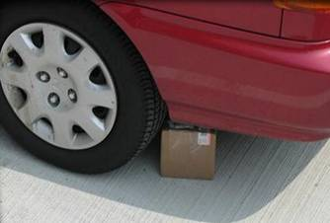

Slide 73
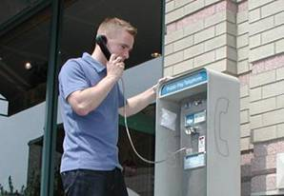
Changing Plans
OCONUS Scenario
What precautions should you take?
Request the bomb squad inspect your car, inform base security of the incident, change to a different hotel, trade in your rental car for a different one
Stay at the hotel until an armored car can be sent to pick you up
Drive immediately to the base using a different route than the day before
The bomb squad
removed a smoke
grenade. You are
continuing on.
Notes:
Instructor narrative
The police bomb squad removed the shoebox under your car and found a smoke grenade with the pin pulled so it would discharge when you moved the car. Though it might not have caused any harm, it was clearly a malicious act and suggests that you are being targeted. What precautions do you take to protect yourself?
Questions and answers: Option 1 is the correct answer.
1) Request the bomb squad inspect your car, then inform base security of the incident, change to a different hotel, and trade in your rental car for a different one.
The correct action was to ask the bomb squad to inspect your car, then grab your belongings and drive to the base using a different route. The base is your safest environment. There you can inform base security of the incident, change to a different hotel, and trade in your rental car for a different one. This provides maximum immediate security, and by changing hotels and cars you may foil someone performing surveillance against you.
2) Stay at the hotel until an armored car can be sent from the base to pick you up.
This is not best because you are remaining at an insecure location where you have been targeted.
3) Drive immediately to the base using a different route than the day before.
Although the base is a more secure environment, this is not the best decision because you can do more to reduce your visibility to the terrorists.
This decision illustrates the themes of being anonymous, of being unpredictable and being a team player. By changing hotels and getting a different rental car, you are making it harder for terrorist to observe your routine patterns and activities, as well as reestablishing your anonymity. Getting the installation security office involved not only aids in protecting you, but also ensures that you are being a good team player by informing your chain of command.

Slide 74
Hostage Survival
OCONUS Scenario
Notes:
We will now examine situations concerning hostage survival.

Slide 75
Hostage Situation
OCONUS Scenario
Receiving an unexpected delivery
Responding to the threat
Dealing with the terrorists
Being rescued
Notes:
We will examine these specific situations.

Slide 76

Receiving an
Unexpected Delivery at Your Hotel
OCONUS Scenario
How should you respond?
Tell him to leave it outside your door and you will get it in a while
Tell the person to wait, call the front desk to confirm the identity of the employee at your door before receiving the delivery
Tell him to leave it at the front desk and you will get it later. Then call the front desk to confirm the package sender and addressee. If not urgent, get it in the morning
There is a knock
at your hotel room door from someone who says he is from room service
Notes:
Instructor narrative
At your new hotel, you decide to stay in your room to avoid exposure. But at 9:00 pm, you hear a knock at the door and through the peephole see a person in a hotel staff uniform. When you ask who it is, a man says he is room service and he has a delivery for you. You remember you are expecting a fax from your home base, but you wisely decide not to open your door to a stranger. What do you do?
Questions and answers: Option 3 is the correct answer.
1) Tell him to leave it outside your door and you will get it in a while.
This is incorrect because it leaves the delivery exposed to theft or tampering. Also, an intruder could simply wait for you to open the door.
2) Tell the person to wait, and then call the hotel front desk to confirm the identity of the hotel employee at your door before receiving the delivery.
You chose to call the front desk to confirm the identity of the employee before opening the door. This is prudent, but it is incorrect because you are still giving a stranger needless access to your room.
3) Tell them to leave it at the front desk and you will get it at your convenience. Then call the front desk to confirm the package sender and addressee. If not urgent, get it in the morning.
The correct choice was to tell the person to return it to the front desk. Then you can call to confirm the delivery addressee and sender, and if not urgent, get it in the morning. This way you are controlling access to your room and your person. To preserve your anonymity, do not ask who it is for.
This situation illustrates the themes of anonymity, awareness, and access control. Think hard before giving access to your room to a stranger and confirm the identity of the visitor. Try to keep your identity and your association with the U.S. military private. Control access to your room by not opening the door if you do not have to. In this case, if you receive a package that you do not need immediately, ask them through the door to drop it at the front desk so you can pick it up later.

Slide 77

Responding to a Threat
OCONUS Scenario
How should you respond?
Since you are faced with deadly force, do not resist as the intruder comes in to search your room and belongings
Try to slam the door as quickly and as hard as you can, then duck to the floor
Grapple with the intruder for control of his weapon
A man bursts
through the door
pointing a gun
Notes:
Instructor narrative
After a few seconds, you hear the clicking of a key turning in your lock, and before you can respond, the door bursts open. A man steps into the room, pointing a very large handgun at you. What do you do? How should you respond?
Questions and answers: Option 1 is the correct answer.
1) Since you are faced with deadly force, do not resist as the intruder comes in to search your room and belongings.
The correct choice is to not resist. The best way to stay alive and unhurt at this point is to cooperate with the intruder. Don’t be a dead hero!
2) Try to slam the door as quickly and as hard as you can, then duck to the floor.
Trying to slam the door on the intruder and ducking is not a good decision, because your opponent has greater firepower and may use deadly force. The handgun should tell you that you cannot immediately struggle against this situation.
3) Grapple with the intruder for control of his weapon.
Grappling with the intruder for control of the gun is not a good choice. This is highly risky since your opponent has greater firepower. The handgun should tell you immediately that you cannot struggle against this situation.
This situation illustrates the themes of prior planning and being aware when facing deadly force. You should rehearse in your mind what you will do if a dangerous situation occurs.

Slide 78

Dealing With the Terrorists
OCONUS Scenario
How should you respond?
Use your imagination to invent stories to confuse them and resist their interrogations. Respond to questions but do not engage in conversation
Answer their questions calmly, but do not agree to their accusations. Lie only to protect classified information, and stick with a simple credible story
Tell them they are wrong about DoD - explain why you are proud to be an American
Your captors are
ranting and asking
you questions
Notes:
Instructor narrative
The intruders bind you and the hotel employee, and search your room. They become excited when they find papers with DoD markings in your briefcase and your military ID in your wallet. They curse at you, call you an imperialist, and accuse the US of crimes against the developing world. They see everything as being related to their political viewpoint. The political diatribe is irritating and you are tired of being tied up. You wisely control your temper and stay calm. They ask lots of questions about your duty position, your unit mission, and your training. How do you respond?
Questions and answers: Option 2 is the correct answer.
1) Use your imagination to invent stories to confuse them and resist their interrogations. Respond to questions but do not engage in conversation.
This is incorrect because if you are caught in a lie they are more likely to become angry and treat you badly.
2) Answer their questions calmly, but do not agree to their accusations. Lie only to protect classified information, and stick with a simple credible story.
The correct choice was to respond to their questions in a calm, respectful, and nonpolitical manner. You should not agree with outrageous accusations, but behave so they will see you as an innocent person. Tell them you do not understand the question or do not know the answer on topics that are beyond your responsibility and do not inflate your personal importance. Lie only to protect classified information. You should think about what you would do, and plan ahead, in order to control your emotions and fears in this type of dangerous situation.
3) Tell them they are wrong about DoD and try to win them over with your political debating skills. Explain why you are proud to be an American.
This is incorrect because you will likely make them angry with you personally.
This situation illustrates the importance of the principles of being anonymous and of planning. You need to be aware of what information your captors are trying to get from you. Information you give them might be used against you. Being anonymous in this context is limiting the amount of information you provide. Don’t reveal classified or sensitive information, but try to be truthful on a generic level. If you must fabricate a story to protect classified information, make it simple and plausible and stick with it. You are better off if you plan your actions before this situation arises.

Slide 79

Being Rescued
OCONUS Scenario
What should you do?
Roll off the bed, remain quiet, and stay on the floor until you are told to do otherwise
Shout instructions to the rescue team and try to get to your feet
Remain still, seated on the bed, and shout warnings to the rescue team
The door flies open;
a rescue is in
progress
Notes:
Instructor narrative
During the night, you try to reassure the hotel employee and remain calm, patient, and cooperative, so as not to make the terrorists angry. At 9:00 the next morning, there is a knock on the door. A voice asks: “Are you all right in there?” The captors hiss, “Keep quiet”, and they look panicky. Moments later, a key rattles in the lock, and one of the captors shouts, “Go away!” The door falls silent. Suddenly, with a crashing sound the door flies open. You wisely choose not to attack your captors. What do you do?
Questions and answers: Option 1 is the correct answer.
1) Roll off the bed, remain quiet, and stay on the floor until you are told to do otherwise.
The correct choice was to roll to the floor and stay down and quiet. In this way you reduce your profile as a target and the likelihood the rescuers might mistake your actions as threatening. By remaining quiet you do not draw the attention of the rescue team from the armed terrorists.
2) Shout instructions to the rescue team and try to get to your feet.
This is incorrect because you only add confusion to a dangerous situation and are more likely to be hit by gunfire.
3) Remain still, seated on the bed, and shout warnings to the rescue team.
This is incorrect because you remain exposed to gunfire and your shouts only add confusion to the situation.
This situation illustrates the importance of planning, being aware and of teamwork. In a hostage rescue situation, the best thing you can do is to plan to get out of the way of your rescuers. Hit the ground and stay down until a rescuer gives you instructions. Always be alert to the developing situation so you can anticipate actions you might be required to make. Be a team player and don’t interfere with the hostage rescue team – they are professionals and highly trained in these types of operations.

Slide 80

Returning Home
OCONUS Scenario
Notes:
We will now examine some situations back at your home base and at your residence.

Slide 81
Returning Home
OCONUS Scenario
Suggesting base security measures
Choosing housing
Inspecting your home
Planning for home security
Notes:
We will examine these situations.

Slide 82

Suggesting Base Security Measures
OCONUS Scenario
What should you suggest?
Alter the measures that are employed at the base’s current FPCON
Raise the local FPCON
to a higher level
Use some higher-level FPCON measures randomly at your current FPCON
Once you are home,
your commander asks
you what measures
could be used to
improve security on
your home base
Notes:
Instructor narrative
You finished your mission to the Middle East. Once home, you go to see your commander and brief him about your eventful trip. You mention that the security measures at the base you were visiting seemed very effective, including the security hotline they were using, the identification checks at the front gate, and barriers to prevent parking next to buildings. Your commander is interested in your observations, and asks how you think these new measures could be used on your home base. You suggest that he:
Questions and answers: Option 3 is the correct answer.
1) Alter the measures employed at the base’s current Force Protection Condition.
Altering the measures employed at the base’s current Force Protection Condition is not the best answer. While this is in the local commander’s authority, the local threat environment may not justify it.
2) Raise the local FPCON to a higher level.
Proposing that your commander raise the local Force Protection Condition to a higher level is not the best answer. While this also is in the local commander’s authority, the local threat environment may not justify it.
3) Use some higher-level FPCON measures randomly at your current FPCON.
The correct choice is to recommend that he use some higher-level Force Protection Condition measures randomly at your current Force Protection Condition. It is a good idea to employ higher measures as random antiterrorism measures to vary unit routines and frustrate terrorist planning, to raise antiterrorism awareness of your unit, and to train U.S. forces by rehearsing antiterrorism plans and procedures.
This situation illustrates the principles of Planning and Unpredictability. While it is impractical to implement a higher FPCON without substantial intelligence that an attack could be carried out against your installation, Random Antiterrorism Measures can be used to make your installation less predictable to possible attackers.

Slide 83

Choosing Housing
OCONUS Scenario
What should you choose?
An apartment building full of Americans, with a street-level entrance
A single-family home off the beaten path where no one would expect a foreigner to live
A townhouse in a building with one American family and three German families, 1 mile from a police station and near a 24-hour grocery
Your new orders
are for Germany.
You have to choose
housing on the
economy.
Notes:
Instructor narrative
Your commander tells you, “By the way, your orders for Germany arrived and, good news, you have concurrent travel for your family.” You learn from your new unit in Germany that you will be “living on the economy,” so you are concerned about security. Upon arriving in Germany, you ask the housing office for advice on secure locations. You are given several options. Which do you choose?
Questions and answers: Option 3) is correct.
1) An apartment building full of Americans with a street-level entrance.
This is incorrect because a high concentration of Americans may present a convenient target. Also, “convenient street-level access” probably means that the facility has poor physical security characteristics.
2) A single-family home off the beaten path where no one would expect a foreigner to live.
This is incorrect because your isolation might make you an easy target for terrorist planning and kidnapping. A single-family home is hard to make very secure, and a cul-de-sac will not provide you with alternative routes of access.
3) A townhouse in a building with one American family and three German families, 1 mile from a police station and near a 24-hour grocery.
The correct choice is a townhouse in a building with one other American family and three German families, about a mile from a police station and near a 24-hour grocery store. This is correct because you have good proximity to public safety resources for quick emergency response. Also, commercial facilities can provide a safe haven in a public environment. You will want to get to know and develop good relations with your neighbors. You should weigh many security factors in choosing a location.
This decision illustrates the importance of several antiterrorism themes. By choosing a location with a mixture of local citizens as well as a few Americans, you can blend in and you might be a less inviting target. Apartment buildings known to be popular with Americans might present a big target. Selecting a residence with multiple routes to choose from permits you to be more unpredictable in your travels to and from your residence. A multi-family dwelling might offer better security measures for controlled access. Single-family homes are very difficult to secure. Finally, the decisions you make in planning and selecting a residence will determine many aspects of security at your residence.

Slide 84
Inspecting Your Home
OCONUS Scenario
Which action does not make sense?
Ask the landlord to replace the locks and add a deadbolt
Cut back the shrubbery
Place a key under a flower pot on the front porch
Put up additional exterior lighting and a peephole in outside doors
Display “guard dog” or “alarm service” signs
You are inspecting
your new home
for security
Notes:
Instructor narrative
You check the doors for locks and find several things to work on. Which does not make sense for security at home?
Questions and answers: Option 3) does not make sense from a security perspective.
1) Ask the landlord to replace the locks and add a deadbolt.
Putting good locks on all doors and windows is smart. Deadbolt locks and sliding locks make it harder to break in. Use a double-key lock (requiring a key inside and outside) near glass door panels and windows so that an intruder can’t break the glass and gain entry. This is consistent with the theme of controlling access.
2) Cut back the shrubbery.
Cutting back the shrubbery reduces the places a prowler can hide while trying to break in. This is consistent with the theme of controlling access.
3) Place a door key under a flowerpot on the front porch.
The incorrect action is to hide a key outside your house. This is a common practice, and thieves and intruders know it. If they find it, you have given them easy access to your home. The other responses were all good ideas for residential security.
4) Put up additional exterior lighting and a peephole.
Additional lighting outdoors makes it harder for an intruder to work in secret, and a peephole in outside doors makes it easier to identify visitors before opening doors. This is consistent with the theme of controlling access.
5) Display “guard dog” or “security” or “alarm service” warning signs.
Warning signs for a guard dog or a security or alarm service may cause an intruder to choose a target that appears less secure. This is consistent with the theme of controlling access.
This illustrates the importance of planning and access control. These physical security measures serve to discourage prowlers or others who might case your residence for break-in.

Slide 85
Planning for Home Security
OCONUS Scenario
You are discussing security with your family
Which action does not make sense?
Post emergency telephone numbers near the phone and ensure that young children know how to use them
Establish household rules that only a responsible adult may open a door to a visitor
Ensure that adults know to call the utility company to verify utility workers’ identities
Plan for a location in a well-lit public place for family members to gather in case of emergency
Prominently display your name and rank on your house or mailbox
Notes:
Instructor narrative
After your experiences in Saudi Arabia, you are anxious to ensure your family’s safety. You decide to make a plan for your family. Which does not make sense for security at home?
Questions and answers: Option 5) does not make sense from a security perspective.
Post emergency telephone numbers and ensure that the children know how to use them
Putting emergency phone numbers near your phone is a wise precaution. Every household member needs to be able to call for help. This is consistent with the theme of planning.
2) Establish household rules that only a responsible adult may open an outside door to a visitor.
Requiring small children to wait for an adult to open outside doors to visitors is smart so that adults can determine whether a door should be opened to a stranger. This is a useful way to control access.
3) Ensure that adults know to call the utility company to verify utility workers’ identities before permitting entry.
Ensuring that adults confirm the identity of utility workers and repairmen reduces the possibility that a criminal or terrorist might gain access to your home through deception. Confirming identification with appropriate authorities is a valuable means to control access.
4) Plan for an emergency location in a well-lit public place for family members to gather in an emergency.
Planning for an emergency “rally point” in a public, well-lit location like a grocery store is smart. You and your family will likely be safer there until authorities can respond to an emergency. This is consistent with theme of planning.
5) Prominently display your name and rank on your house or mailbox.
The incorrect action is to prominently display your name and rank on your house or mailbox. This may be a common practice in some communities, but it is generally best not to identify yourself needlessly. This is consistent with the antiterrorism theme of being anonymous.
This situation illustrates the importance of planning for access control. Your family members need to be aware of the household rules for safety. These routines will help control unauthorized access to your residence and prepare your family for emergencies.

Slide 86

Historical Incidents
Historical Applications
Khobar Towers
TWA 847
CAPT Nordeen
Berlin Discotheque
Oklahoma City Bombing
Beirut Bombing
GEN Dozier (Residential)
GEN Dozier (Hostage)
CAPT Tsantes/MSG Judd
USS Cole
GEN Haig/GEN Kroesen
WTC and Pentagon
Exit to End
Notes:
We will choose from this list of high-profile terrorist incidents to learn more about particular events. Try to apply your AT awareness to identify ways the incident could have been prevented. Please note, that while in slide show mode you can go directly to a specific historical example by clicking on the button in front of the title. Also, each historical example screen includes a “return” button which will take you back to this screen.

Slide 87

Khobar Towers
Historical Applications
Dhahran, Saudi Arabia
20,000-lb. truck bomb
3 sentries alerted sleeping Airmen — evacuation was in progress
Event resulted in increased force protection awareness
Date: 25 June 1996
Killed: 19
Wounded: Hundreds
Sentries alert to change in local environment saved lives!
Return
Notes:
On 25 June 1996, terrorists exploded a massive truck bomb outside the Khobar Towers housing complex in Dhahran, Saudi Arabia. That terrorist act killed 19 American Service members, and hundreds of other Service members and Saudis were injured. The bomb was huge, estimated at nearly 20,000 lbs. After this tragedy, the Department of Defense thoroughly investigated the attack and implemented new programs to promote the safety of U.S. forces worldwide.
Determined terrorists can mount devastating attacks anywhere. Consequently, unit security demands teamwork and vigilance. Unit security measures did little to prevent injury from this huge truck bomb. But alert guards could see that the normally busy public square near Khobar Towers was being vacated. Alert procedures could have enabled troops to seek a protected position.
Seven months before the attack on Khobar Towers, a car bomb exploded at the Office of the Program Manager, Saudi Arabia National Guard in Riyadh. The 250-pound bomb exploded in a parking lot next to a building where American military forces trained Saudi military personnel. It killed seven people, including five Americans, and injured 35 others. Following the bombing, intelligence indicated that terrorists continued to target U.S. forces in Saudi Arabia, particularly in the Eastern Province. As a result, the Commander in Chief of U.S. Central Command declared a “high” threat level in the entire country.
The U.S. troops stationed at Khobar Towers operated the King Abdul Aziz Air Base, one kilometer to the west, from which coalition aircraft enforced the no-fly zone in Southern Iraq in Operation Southern Watch. Khobar Towers was a high-rise building complex in a densely populated urban area. A vulnerability assessment of Khobar Towers after the Riyadh bombing concluded that a vehicle bomb detonated at the perimeter could pose a serious threat to Khobar. In view of the increased threat level and the vulnerability assessment, Brigadier General Terryl Schwalier, commander of the 4404th Wing (Provisional), which included the U.S. forces at Khobar, instituted significant improvements in force protection designed to tighten security and counter the anticipated terrorist threat.
Shortly before 10:00 p.m. on 25 June 1996, three sentries posted on the roof of building 131 at Khobar Towers saw two men park a fuel truck at the edge of a nearby parking lot, about eighty feet from the base of their building, then speed away in a car. Recognizing the possibility of a truck bomb, the sentries reported the threat to the Central Security Control and then initiated an evacuation of the building, knocking on doors and orally alerting personnel to the danger. In about four minutes, the sentries were able to alert only the top three floors of the eight-story dormitory. Meanwhile, the CSC attempted to contact the Wing Operations Center to activate “Giant Voice,” a base-wide loudspeaker and siren system, to sound an alert. Before Giant Voice could be activated, however, the truck bomb exploded, causing a partial collapse of building 131 and lesser damage to nearby buildings. Nineteen American Service members were killed in the blast.
This historical example illustrates the importance of being anonymous, being aware, and being a team player. Whenever possible, one should avoid living or congregating with large numbers of American servicemen and creating an inviting target for potential terrorist attacks. Individuals should also be alert to changes in the local area such as reduced public traffic, closed shops, and the absence of vendors. In addition one should always cooperate with the instruction of unit security personnel and report any suspicious activity.

Slide 88

TWA 847
Historical Applications
Two terrorists hijacked a plane in midair
A terrorist killed a Navy Diver because of his military affiliation
The terrorists kept the plane for 17 days
Date: 14 June–3 July 1985
Killed: 1 Navy diver
Many passengers beaten
Do not expose your military affiliation!
Return
Notes:
On 14 June 1985, two well-dressed terrorists smuggled two hand grenades and a 9-mm pistol on board TWA flight 847. Once on the plane, they took seats in the rear of the aircraft. TWA 847 departed Athens, Greece, en route to Leonardo Da Vinci Airport in Rome, Italy, with 153 passengers and crew on board, including 120 Americans. Approximately 20 minutes into the flight, the two skyjackers ran down the aisle shouting, screaming, and waiving their weapons and ordered the pilot to fly the plane to Beirut. They then moved male passengers to the window seats and beat upon and threatened all the passengers. Passengers were ordered to put their heads down, with their hands covering their faces. The head stewardess, an ex-German national, was ordered to collect passports from the passengers as one of the skyjackers followed close behind. Among the passengers were four U.S. Navy divers who were carrying no passports and were traveling only on their military ID cards. When the stewardess translated the English word “sailor” into the German word “kriegsmarina,” the terrorists, who did not understand English, mistook the divers for U.S. Marines. Beirut Airport twice denied permission to land, so the terrorists brought a 24-year old diver, Robert Stetham, to the first-class section and began to beat him with an armrest taken from a cockpit chair.
The authorities on the ground finally gave in to the pleas of the captain and allowed the plane to land. In exchange for refueling, the terrorists released 17 women and 2 children. The plane then made several flights back and forth from Beirut to Algiers, with selected passengers being let off at each stop. The purpose of this almost continuous movement was to allow the skyjackers to distance themselves from the rapidly building U.S. military presence in the region. Robert Stetham was killed during or shortly after TWA 847 landed in Beirut the second time. Finally, on 30 June, day 17 of the ordeal, the hostages were loaded into cars and vans and driven to Damascus, Syria, for their eventual trip back to the United States on 2 July 1985. In exchange for release of the passengers, the terrorists demanded the release of Lebanese Shi’ites being held by Israel, immediate withdrawal of Israeli forces from southern Lebanon, and international condemnation of the actions of the U.S. and Israeli governments in the Middle East.
This historical example demonstrates the principles of being anonymous and planning ahead. Terrorists attack U.S. troops of all ranks and Services. Your best defense is to blend in and not be an obvious target. While acting courageously by not identifying his fellow service members while under extreme duress, Robert Stetham might have been safer if he had concealed his military ID and traveled on a tourist passport. Try to avoid the most exposed locations in an aircraft, the aisle seats at the front and rear.

Slide 89

CAPT Nordeen
Historical Applications
Greek terrorists killed CAPT Nordeen with car bomb
CAPT Nordeen was killed while riding in an armored car
The bombing followed weeks of careful surveillance and planning
Date: 28 June 1988
Killed: 1
Wounded: Several bystanders
Being unpredictable can save your life!
Return
Notes:
On 28 June 1988, Greek terrorists attacked and killed a U.S. naval attache, CAPT William Nordeen, in Athens. Nordeen was killed four days after Greek and American negotiators concluded an unproductive seventh round of talks on a new agreement about the future of U.S. military bases in Greece. The N-17 opposed U.S. bases in Greece and attacked Nordeen as a symbol of U.S. policy.
Nordeen used an armored car due to the persistent threat of small arms attack (see CAPT Tsantes, 1983). Terrorists adapt their tactics to their targets. In Greece, the N-17 used pistol attacks on soft, unarmored cars in traffic. To attack a U.S. officer in an armored car, they command-detonated a car bomb on his normal route to work. The attack followed many weeks of careful surveillance around Nordeen's residence. The terrorists placed 50 pounds of high explosives in a stolen Toyota and lined the interior of the vehicle nearest to the curb with bags of cement to direct the blast toward the roadway. They then parked the car along the route that Nordeen traveled to work every day and command-detonated it from a nearby residence as he passed.
Nordeen was killed 100 yards from his residence when the bomb blew his armor-plated car across a small, tree-lined street and lodged it in a steel fence. Trees, fences, gates, and walls in the area of the explosion were blackened by smoke as fire engulfed both cars. Neighbors were injured when the blast hurled pieces of Nordeen's car into adjacent houses. The explosion occurred at 8:06 a.m. in the northern Athens suburb of Kifissia, where many American and other foreign diplomats live. A witness said that shortly after the blast he saw two men on a motorcycle drive off. Although there was no immediate claim of responsibility, Greek authorities concluded that it was the work of the N-17.
This historical example illustrates the principles of being aware and being unpredictable. Be vigilant, look for signs of surveillance, and report them to your unit security officer. Changes in routines such as departure times from your residence and routes of travel make terrorist planning more difficult. Also, alertness to surveillance activities may discourage attackers from their plans. Do not assume that you are safe just because you have a protective shield such as armored Plexiglas in an official car.

Slide 90

Berlin Discotheque
Historical Applications
Libyan terrorists placed a suitcase bomb in a nightclub
Although the alert state was high in Europe, local threat conditions in Berlin gave little indication of attack
Two US sergeants and one Turkish woman were killed
Date: 5 April 1986
Killed: 3
Wounded: 230
Avoid vulnerable areas with large groups of Americans!
Return
Notes:
On 5 April 1986, a Libyan terrorist bomb killed two U.S. sergeants and a Turkish woman and injured 230 others in a West Berlin nightclub. Libyan leader Colonel Qadhafi praised the attack as a “revolutionary act.” This was one in a series of Libyan terrorist attacks and U.S. counterattacks in the 1980s. Libyan terrorists targeted U.S. troops because of ongoing disputes with the United States far away in the Mediterranean. Local threat conditions in Berlin gave little warning of the attack.
U.S. forces in Europe were on a high state of alert because of warnings of anti-U.S. terrorism. Three days earlier, on 2 April, the Abu Nidal Palestinian terrorist group bombed TWA Flight 840, which was flying from Rome to Athens. As it approached Athens, an explosion shook the aircraft, taking four lives. U.S. intelligence concluded that Abu Nidal acted on orders of Colonel Qadhafi to avenge U.S. missile attacks on Libyan torpedo boats the previous month. Earlier on the night of 5 April, British intelligence intercepted a message to Tripoli from the Libyan embassy in East Berlin predicting “a joyous event.” The intercepted message was routed to the U.S. Army brigade stationed in West Berlin.
The brigade commander, BG Thomas Griffin, mobilized U.S. military police patrols to check bars in Berlin, looking for suspicious individuals or activities. American soldiers in West Berlin frequented many local bars, but there were not enough MPs to clear them all out on a Saturday night. A team of MPs was only 300 yards from the La Belle discotheque when the bomb went off. The suitcase bomb consisted of three kilograms of plastic explosives mixed with nails and was left in a bathroom. Evidently, no one in the nightclub noticed the abandoned suitcase. The explosion killed two American sergeants and a young Turkish woman; 230 others were wounded, including several dozen American troops.
Two weeks later British authorities captured one of the Arab terrorists involved in the operation, Ahmad Hazi Hindawi. When questioned in a routine security check, Hindawi’s pregnant girlfriend told security guards at London’s Heathrow Airport that Hindawi had given her a package before she boarded a 747 headed to Israel. Upon further inspection, they discovered that Hindawi had placed a bomb in her luggage. When confronted, Hindawi confessed that Syrian diplomats in East Berlin had given him the suitcase bomb for the Berlin discotheque attack. He also had in his possession the phone numbers and sketches of other nightclubs in Berlin frequented by American Servicemen. Broadcasts from Tripoli to the Libyan embassy in East Berlin had ordered the bombing.
This historical example illustrates the the principles of being anonymous and being aware. Public places with large groups of U.S. troops are appealing targets. Your best defense is to stick to places with good security. Be alert even when local conditions are not threatening. An alert observer might have noticed the suspicious suitcase in the bathroom.

Slide 91

Oklahoma City Bombing
Historical Applications
The weapon was a large truck bomb parked in front of the building
The targets were tenant Federal agencies
Tim McVeigh and Terry Nichols were apprehended and convicted of the bombing
Date: 19 April 1995
Killed: 168
Wounded: Hundreds
Be vigilant -- consider the unexpected threat!
Return
Notes:
On 19 April 1995, around 9:03 a.m., just after parents dropped their children off at day care at the Murrah Federal Building in downtown Oklahoma City, a massive bomb inside a rental truck exploded, blowing half of the nine-story building into oblivion.
A stunned nation watched as the bodies of men, women, and children were pulled from the rubble for nearly two weeks. When the smoke cleared and the exhausted rescue workers packed up and left, 168 people were dead in the worst terrorist attack on U.S. soil.
This historical example illustrates the principle of being aware. An aware observer might have noticed Timothy McVeigh parking a large vehicle in front of the Murrah Federal Building and then walking away from the scene. There were a few minutes of time between the time he truck was parked in front of the bui9lding and the time of the explosion. Some action might have been taken, at least to evacuate the first floor day care facility.

Slide 92

Beirut Bombing
Historical Applications
The Islamic Jihad Organization perpetrated a suicide truck bombing
Multiple sentries witnessed the attack but were unable to stop it
Many and frequent threats preceded the attack
Date: 23 October 1983
Killed: 244
Wounded: Hundreds
Large Groups of Americans can be targets!
Return
Notes:
On 23 October 1983, a large truck laden with explosives equivalent to 12,000 pounds of TNT crashed through the barricade of the U.S. compound at the Beirut International Airport, penetrated the front entrance to the Marine Battalion Landing Team Headquarters building and exploded. The force of the explosion destroyed the building, killing 244 U.S. military personnel. The Islamic Jihad Organization carried out this act under the direction of the Iranians, and there was sponsorship and authorization by the Syrians.
U.S. military forces had entered Lebanon in September 1982 as part of a multinational force. The mission of the U.S. contingent of the multinational force was to establish conditions for the withdrawal of foreign military forces from Lebanon and to assist the Lebanese government and the Lebanese Armed Forces in gaining control over the Beirut area. Initially the local populace warmly welcomed the U.S. force. However, the politico-military situation deteriorated, and in April 1983 a terrorist bomb destroyed the U.S. embassy. From August to October the U.S. force was flooded with terrorist attack warnings.
On 23 October 1983, witnesses reported seeing a large yellow Mercedes-Benz truck traveling at a speed reportedly in excess of 35 miles per hour moving from the parking lot south of the headquarters building through the barbed wire and concertina fencing, into the main entrance of the building, where it blew up at approximately 6:22 a.m. The truck penetrated the perimeter barbed wire and concertina obstacle, passed between guard positions six and seven without being engaged, entered an open gate, passed around one sewer pipe obstacle and between two others, flattened the sergeant-of-the guard booth, entered the interior of the lobby by passing through the main entrance, and exploded. The sentry at post seven heard the truck as it ran over the wire, then observed it and recognized that it was probably a vehicle bomb. He inserted a magazine into his M16, chambered a round, and took aim. He did not fire since by that time the truck had already penetrated the building. Both sentries realized that the truck carried a bomb and sought cover within their bunkers. One sentry reported seeing the top of the building explode vertically in a V shape. He then took cover inside his bunker for protection from the falling debris. The sergeant of the guard was at his position at the main entrance (south) of the building. He was alone at his post and was facing inward (north) toward the lobby when he heard noises to his rear, including a rapidly revving engine. He turned and realized the driver’s intentions and ran from his post toward the rear entrance (north) yelling repeatedly, "Hit the deck." He glanced over his shoulder as the truck continued toward the front entrance. He saw the truck breach the entrance and run over his post and come to a halt in the center of the lobby. There was an interval of one or two seconds between the truck’s halt and the detonation.
The explosion created a crater measuring 39 feet by 29 feet 6 inches and 8 feet in depth, and analysis suggested that major damage to the headquarters and significant casualties would have resulted even if the terrorists had detonated the device on the roadway, some 330 feet from the building itself.
This historical example demonstrates the principle of controlling access, being aware, and maintaining responsive rules of engagement and readiness posture. The concentration of U.S. troops in a building presented a lucrative target. When this in a necessity, control of access and effective security measures are key when facing a terrorist threat. Long-term high threat and high security posture can lead to laxness. That is when discipline and alertness are needed the most. Each individual plays an important role in maintaining unit security. Following this attack, DoD has placed greater emphasis on the use of vehicle barriers, improved chain of command, and rules of engagement.

Slide 93

GEN Dozier (Residential)
Historical Applications
Italian Red Brigades kidnapped US Army
BG James Dozier
Terrorists entered Dozier’s residence posing as plumbers
Terrorists performed extensive surveillance
Dozier was rescued by Italian police
Date: 17 December 1981
Killed: None
Access control is a key line of defense!
Return
Notes:
On 17 December 1981, terrorists of the Italian Red Brigades kidnapped U.S. Army Brigadier General James Dozier from his residence in Verona, Italy. They opposed Italian membership in NATO, so they targeted senior U.S. military officers in order to embarrass Italian law authorities and lead to an overthrow of the Italian government. At the time of the incident, Brigadier General Dozier was the Deputy Chief of Staff for Logistics and Administration for NATO’s Southern Command in Verona, Italy.
BG Dozier’s residence was located in a multistory apartment building in Verona that had been used for seven years to house senior U.S. officers. The building had undergone a security inspection, but none of the recommendations had been put into effect. The only viable security system in the building, other than door locks on individual apartments, was a buzzer-and-intercom system at the main entrance. An armed Italian policeman served as BG Dozier’s driver, but there were no other security personnel assigned.
The terrorists observed the residence for at least 30 days from various locations. They observed the apartment with binoculars from a position across the street. They also posed as young picnicking couples, with no children, in a small park located on the riverbank below the apartment. They also posed as young people standing at the bus stop, often looking up at the apartment and letting buses go by or taking a bus and returning to the same stop a short time later. The terrorists also penetrated the Doziers’ home to gather information about them and the layout of their apartment. A pair posing as utility meter readers made two visits to the residence. This was unusual, since meter readers normally worked alone in that area. On another occasion, a female believed to have been a terrorist visited the Dozier apartment under the guise of taking an opinion poll. Mrs. Dozier allowed the woman into the apartment.
On the day of the kidnapping, four terrorists (three men and a woman) parked behind the building in a rented blue van. Two men wearing white coveralls and carrying tool bags entered the building and rang the buzzer on the Dozier apartment. The terrorists told Dozier that they were plumbers, and that hey wanted to check his apartment for leaks. Dozier ignored two warning signs. Normally, visitors ring the downstairs doorbell for entry before ringing at the apartment door. Also, the landlord had not informed Dozier about the plumbers; however, Dozier knew that leaks were commonplace, so he let the two men in and led them to a utility room. At one point the General turned his back on the terrorists and the men forcefully spun Dozier around and thrust the barrel of a weapon with a silencer into his face. At the same time, the other assailant grabbed Mrs. Dozier and held a pistol to her head. Dozier struggled with his attacker until he saw the gun held at his wife’s head; he then ceased struggling. The terrorists then handcuffed him, bound his feet, applied a gag and a blindfold, and placed him in a padded trunk brought up by a third terrorist. Dozier was taken to the van and transported to an apartment in Padua, Italy.
This historical example demonstrates the principles of being anonymous, being aware, controlling access and being unpredictable. Terrorists decided BG Dozier was a desirable target because he was a senior U.S. officer. Dozier lived in a building commonly known for housing high-ranking military officials. General Dozier also had routines that made it easier to plan an attack. The terrorists considered three other U.S. generals but chose Dozier because his personal security was less rigorous. After studying his routines for a month, they were confident they could successfully kidnap him. On the day of attack, Dozier gave terrorists access to his apartment. You should be alert for unusual activities and individuals in your surroundings. You should also have planned rules for controlling access to your residence by strangers.

Slide 94

GEN Dozier (Hostage)
Historical Applications
Dozier was chained to a cot inside a 6-foot tent
Captives used loud music and lights to disorient him
Terrorists interrogated Dozier repeatedly
Dozier maintained discipline and dignity
Date: 17 December 1981
Killed: None
Plan and act to be a survivor!
Return
Notes:
Terrorists of the Italian Red Brigades held U.S. Brigadier General James Dozier hostage in Padua, Italy. After seizing Dozier at his residence in Verona, the terrorists placed him in a padded trunk, put the trunk into a cardboard refrigerator box, and drove into Verona. They transferred the general to another vehicle and then traveled approximately 70 kilometers to Padua, east of Verona, where they took General Dozier to a multistory apartment building over a supermarket. Upon arriving there, the terrorists took Dozier up and down in an elevator to disorient him and placed him in a second-floor apartment in a 6-foot-square tent. An armed guard was posted on the other side of a partition in the tent with an alarm button in case the general tried to escape. Dozier was chained to a cot in the tent by his left hand and right leg with just enough slack to use a chemical toilet. To further isolate him, the terrorists forced him to listen to loud, hard rock music with headphones. He endured this for about a week until he was able to convince them to play some classical music at a lower volume. They also illuminated his tent with a 40-watt bulb 24 hours a day so that Dozier would become disoriented as to the date and time.
The terrorists did not realize exactly who he was until they read a biographical sketch in the press. “Then,” the general said, “they became very excited.” While he was not beaten during his captivity, the general was interrogated no fewer than seven times. Dozier maintained a dignified, professional demeanor and did not discuss political topics for fear he might antagonize his captors.
Shortly before noon on the day of the assault, Italian police surrounded the area, and plainclothes officers quietly asked shoppers and others to leave the danger zone. When Dozier’s captors looked out on the supermarket parking lot, they observed several individuals getting out of vans carrying weapons. They assumed that these gunmen were other terrorists carrying out a robbery of the store below. Seconds later the door flew open and 10 policemen raided the apartment in an action that took only 90 seconds. Five terrorists were apprehended, and the general was released.
During his 42 days in captivity, Dozier established a disciplined routine. "This was so they could anticipate what I'd do next,” Dozier noted, “and eventually they stopped watching me so closely. Also, I made a conscious attempt to get them to see me as a human being. I asked about Judy (Mrs. Dozier) and established a dialogue. Later, the Red Brigade captors were asked their impression of events to see if what I did worked. It had. They said that they saw me as a very disciplined person. They certainly saw me as a human being, not a piece of meat.” This fact may have saved his life. General Dozier states that the individual tasked to provide the majority of his security was under orders to kill Dozier if he tried to escape or in the event a rescue. This same individual was on guard when the general was rescued. During the struggle, he pointed his weapon at Dozier, with the apparent intent to carry out his orders. At the last moment he changed his mind and was detained by the police.
This historical example illustrates the principle of planning. If you are taken hostage, it is important to remain calm and plan ahead concerning what you are going to discuss with your captors and how you are going to act. Red Brigade terrorists seized Brigadier General Dozier as a political symbol. By acting in a disciplined manner, Dozier was able to win their trust, and they came to treat him more humanely. He talked about his family, avoided political topics, and tried to adhere to a consistent routine. As a result, his captors respected him as a disciplined individual. If you are taken hostage, try to remain oriented and sustain your morale. Do not give your captors reason to harm you. Be patient and maintain hope in your eventual rescue.

Slide 95

CAPT Tsantes
Historical Applications
N-17 terrorists riding a motorcycle shot and killed CAPT Tsantes
MSG Judd was briefed on N-17 tactics
MSG Judd survived attack by being alert to motorcyclist approaching in traffic
Date: 15 November 1983
Killed: 2
Know the local threat and be alert!
Return
Notes:
On 15 November 1983, terrorists riding a motorcycle overtook CAPT George Tsantes’ sedan and shot and killed him. The terrorist organization N-17 took credit for the attack. MSG James Judd was briefed on the attack, so when he saw the rear rider on a motorcycle pull a pistol in traffic, Judd drove across a median to escape. He was seriously injured, but his alertness and quick action probably saved his life.
In early November 1983, left-wing newspapers stated that Tsantes was a CIA agent and further speculated that he may have been the agency’s Athens station chief. The U.S. embassy denied the report, but the damage had already been done. Every weekday at 7:00 a.m., Tsantes stepped into the rear seat of a black, U.S. embassy Plymouth sedan outside his home in Kifissia, Greece, a northern suburb of Athens, for a 30-minute ride to his office. On 15 November 1983, two men on a light-blue Vespa motor scooter shadowed Tsantes’ sedan in traffic. When Tsantes stopped for a traffic light, the scooter pulled up alongside and a gunman riding on the rear of the scooter fired seven shots from a .45-caliber pistol. Tsantes was killed instantly and his driver, 62-year-old Nikos Veloustsos, died later in the hospital. Several hours after the murder of Tsantes, a man called a local Greek newspaper and claimed responsibility for the act on behalf of the November 17th Organization (N-17).
U.S. Army MSG James James Judd was a postal officer for the JUSMAGG in Athens and was well aware of the attack on Tsantes five months earlier. On 3 April 1984, Judd was transporting mail from the advisory group’s office in Athens to the U.S. Air Force base in Hellenikon. MSG Judd was stopped at a traffic light on Vouliagmeni Avenue in Athens at 4:30 p.m. when a red Honda motorcycle with two passengers approached his jeep from the left rear. Judd noticed that they stopped at the rear of his vehicle rather than continue on to the front of the line of traffic as he expected. He then saw the rear passenger on the motorcycle draw a pistol from his jacket. Recognizing the danger, he turned left across the median and swerved into the oncoming traffic. The gunman fired five shots through the rear window of his jeep; two rounds hit and seriously wounded Judd. Despite his wounds, he drove two miles to the Air Force base gate before collapsing. The N-17 claimed responsibility for the shooting, even though it was not successful, to protest the U.S. presence on four military bases in Greece.
This historical example illustrates the principles of being aware and being unpredictable. Terrorists using “overrun” tactics shot CAPT Tsantes. MSG Judd learned from the loss of CAPT Tsantes and was alert to the threatening actions of a motorcyclist in Athens. Alertness can save lives. Routines such as departures times from a residence and routes of travel make terrorist planning easier. Try to learn from the experience and loss of other Service members.

Slide 96

USS Cole
Historical Applications
Two men maneuvered a 35-foot craft alongside the USS Cole in Yemen
The explosive-laden craft ripped a 36-ft. hole
Crew members had no indication the craft was hostile
Date: 12 October 2000
Killed: 17
Wounded: 42
Anticipate the unexpected attack!
Return
Notes:
On 12 October 2000, terrorists attacked the Arleigh Burke–class destroyer USS Cole (DDG 67) during refueling in Aden Harbor, Yemen. Two individuals maneuvered a 35-foot craft laden with explosives along the Cole’s port side, amidships, and detonated them. The blast ripped a 32- by 36-foot hole, killing 17 and injuring 42 crew members. The attackers showed no sign of hostile intent before the explosion, and crew members believed that the craft was involved in routine harbor activities. In fact, as the attackers maneuvered their craft alongside the USS Cole, they smiled and waved in a friendly manner.
U.S. intelligence assessed Aden’s threat as “significant,” and the Cole’s crew implemented many measures to protect their ship. However, these measures were not sufficient. Better planning and coordination with host nation and U.S. authorities was needed.
The terrorists attacked the USS Cole as a symbol of U.S. policy in the Middle East. In response, DoD has intensified efforts to enhance safety for ships in port activities.
This historical example illustrates the principles of anticipating the unexpected attack, planning ahead, being aware and being a team player. USS COLE crew responded to this attack with teamwork and saved the ship. One should always plan ahead and understand what protective measures to take in response to the local threat. Also, it is vital to understand and fully support unit security procedures and remain vigilant. Be alert to activities that could become a threat.

Slide 97

GEN Haig/GEN Kroesen
Historical Applications
Red Army Faction launched attacks on two senior military commanders in 1979 and 1981
Red Army Faction bombed the motorcade of Haig and used a rocket-propelled grenade against Kroesen
Attacks were preceded by extensive surveillance and planning
Alert response and vehicle armor prevented casualties
General Alexander Haig
Unpredictability can save your life!
Return
Notes:
At the height of the Cold War, West German terrorists of the Red Army Faction attempted to kill General Alexander Haig in an explosive ambush. The Red Army Faction had observed the general for about 30 days prior to the attack. Through this surveillance they learned that General Haig traveled in a three-car motorcade and varied among three possible routes to and from his office. On the morning of the explosion, one of the three routes was closed due to construction, which increased the probability that the terrorists would select the correct route for the ambush. The route used that morning was the one most often used. It was less congested and was also General Haig’s preferred route. One terrorist on a motorcycle waited at a major intersection to determine which route the motorcade would use and radioed advance warning to the ambush team. Another terrorist waited on a knoll 150 meters from the ambush site, a small, 50-foot bridge wired with explosives, ready to command detonate the charge.
On the day of the attack, the motorcade consisted of a lead car carrying U.S. Army Criminal Investigation Division personnel, the general’s armored Mercedes, and an unarmored chase car with more security personnel. The lead car was about 200 meters in front of the general’s car, maintaining a speed of 30 miles per hour. Just as the general’s car passed over the bridge, the bomb exploded, inflicting only minor damage on the rear portion of Haig’s car. The momentum of the chase car, however, carried it into the blast, which lifted it up and blew it laterally. It came to rest 50 feet away. Haig’s driver accelerated to clear the area, but Haig instructed him to stop so that he could look after the welfare of the security personnel in the chase car. He started to exit his car but was persuaded by his aide to get back into the car and leave as fast as possible, since the aide correctly assessed that Haig was the primary target.
The attack failed for several reasons. The terrorist setting off the charge had an obstructed view of the ambush area and misjudged the vehicle position. Also, Haig’s car was moving at a higher rate of speed than normal, changing a timing factor for the attack. Finally, the terrorists did not cover the ambush site with small arms fire. Had they done so, General Haig might have become a casualty when he left his car.
Terrorist groups learn from their mistakes, as demonstrated in their attack on General Frederick Kroesen, Commander of U.S. Army–Europe on 15 December 1981. The Gudrun Ensslin Commando of the Red Army Faction monitored the General’s routine for several days and developed a plan using ambush tactic similar to the attack on Haig but covered the target area with small arms fire in the event the general attempted to exit his vehicle.
On the day of the, at 7:22 a.m, General Kroesen’s Mercedes and an unarmored chase car with security personnel arrived at a traffic light and stopped. As the cars stopped, the terrorists fired two rounds from a Soviet RPG-7 and four rounds from a .223 caliber rifle. The first RPG-7 missed and detonated on the far side of the vehicle. The second round penetrated the trunk and detonated upon exit. The general sustained minor cuts on his neck. The driver froze with fear, and the aide struck the man to get him to start the car and leave the scene. The general later said his first impulse was to get out of the car..
This historical example also demonstrates the principles of being unpredictable and being aware. Vary your routines in many ways. Change the time of departure, the routes of travel, and even the rate of travel in your daily routines. Be alert for suspicious surveillance activities and report them to your unit security officer. Think through your best response in the event of an attack. The attacks demonstrated the importance of recognizing and properly responding to an attack.

Slide 98

Historical Applications
WTC and Pentagon
Terrorists hijacked four loaded passenger airliners and used them as guided missiles
Collapsed both World Trade Center Towers and caused major damage to the Pentagon
Attack required extensive planning, preparation and rehearsal
Deadliest terrorist attack in history
Date: 11 September 2001
Killed: Over 3000
Wounded: Thousands
Be vigilant and think under pressure!
Return
Notes:
At 8:45am on Tuesday, September 11, 2001, a hijacked passenger jet, American Airlines Flight 11 out of Boston, crashed into the north tower of the World Trade Center, tearing a gaping hole and setting it afire. At 9:03am a second hijacked airliner, United Airlines Flight 175 from Boston, crashed into the World Trade Center's south tower. At 9:43am American Airlines Flight 77 crashed into the Pentagon. Subsequently, both towers of the World Trade Center collapsed as burning jet fuel melted the buildings' steel girders. At 10:10am, United Airlines Flight 93, also hijacked, crashed in Somerset County, PA, after passengers struggled with the hijackers.
The September 11 attacks reflected meticulous planning by a global network of terror. They also showed that all Americans must be on guard against terrorism, not just the military.
Until now it was assumed that all hijackings would end in a landing and hostage standoff with negotiators. Previously, U.S. Service Members identified by terrorist hijackers were likely to be singled out for abuse or death. In that situation, it was smart to remain anonymous and passive.
However, suicidal tactics now force all victims to make a critical decision. When faced with certain death, active resistance against suicidal terrorists may be the victims' best hope of survival and only chance to prevent devastating consequences of a successful terror attack. The courageous resistance of the passengers on Flight 93 probably prevented even more horrific consequences. However, active resistance should only be taken after careful consideration of the events unfolding. It is possible that there is a Federal Air Marshal on board in a better position to take control of events, and one should always try to determine what the plan of the terrorist is. If it is a suicide hijacking, immediate action is not necessarily required – the hijackers will still require time to to re-route and fly the plane to its target, giving one time to analyze the situation.
This historical example demonstrates the principles of being aware, planning and being a team player. As said above it is always best to monitor the situation to determine what the terrorists’ intent. Only after that is done, should one plan on a coarse of action that includes active resistance. By waiting to see if there is a Federal Air Marshall on board you are also being a team player.

Slide 99

Chairman, JCS
Guidance
Stay vigilant
We will win the Global War on Terrorism
But, not without your efforts
Notes:
AT is everyone’s responsibility. Right now, somewhere in the world, be assured that someone is plotting to do us great harm. Alert and trained individuals are key elements of AT, so take the time to develop a security-conscious attitude. Your safety and the safety of your loved ones may depend on it. Thank you.

Slide 100
For More Information
http://at-awareness.org
  DoD use only
  Access code word: aware

