Slide 1
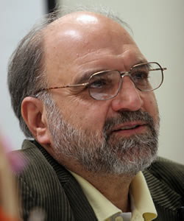
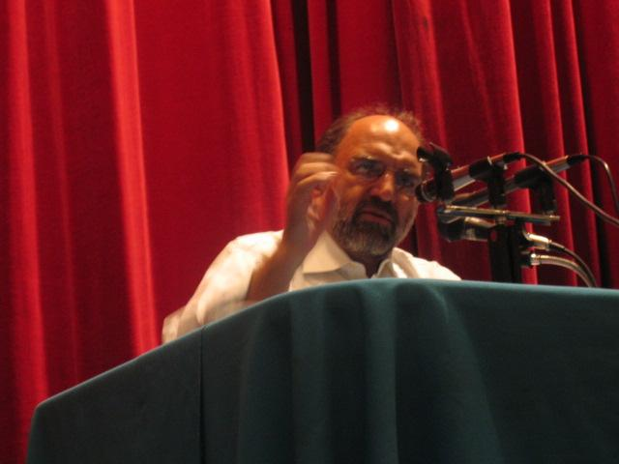
Abdolkarim Soroush
1945-

Slide 2
Studied pharmacy in Iran before moving to the United Kingdom
Returned to Iran after the fall of the Shah in 1979.
A member of Iran’s Cultural Revolution Committee.
In 2005, the Time magazine listed him as one of the world’s 100 most influential individuals

Slide 3
Souroush: all religions have their historical lives
Religion is always changing.

Slide 4
Pure Islam does not exist
There is no single interpretation of texts that one associates with Islam (and that constitute Shari’a).

Slide 5
There is no single interpretation for any text
There are always competing interpretations (perspectives).

Slide 6
Since there is no legitimate interpretation of sacred texts
You can always have new interpretations as society moves forward.
The seeds of Islam were sown back in the 7th century CE; Islam has since branched out.
Islam is nothing but the series of interpretations of Islam.

Slide 7
Interpretation of Quran is an ongoing historical activity
The meaning is in flux.
This generation’s questions about the text are different from the questions of another generation.

Slide 8
Rumi: “religion is like a rope”;
You could use is to get to the bottom of the well or to climb your way out of the well.
We humans give direction to religion.
Like we do to science or technology.

Slide 9
How meanings of the text change over time?

Slide 10
Example: Jihad (an offensive warfare) was not meant to be for eternity
Only for the duration of tribes (because the best defense of tribes is offense).
The Prophet never recommended jihad to urban lifestyle. This is what majority of scholars are saying. Offensive war according to Shiites is haram (it is a sin).

Slide 11
Another example: Caliphate

Slide 12
Does Islam have an issue of compatibility with modern world?
Some people believe that there is the need for Reformation in Islam.
Souroush: Muslims don’t need Reformation because there is no one standing between Muslims and God (There is no religious authority in Islam like there is in Christianity).

Slide 13
Reform in Islam could be carried out by reinterpretation
Understanding of Islam (its interpretations) could change.
Human understanding of Islam could change to accommodate new demands in society.

Slide 14
How should interpretations of Islam change?
By understanding modernity (the present) and relating it to Islam.
Modernity not simply as a cultural import from the West but as a fact of development of human kind.

Slide 15
Modern politics is based on two ideas:
The idea of rights;
The idea of nation-states;

Slide 16
Pre-modern era was one of responsibilities
All religions belong to the era of responsibilities and obligations.
No Holy book in any religion emphasizes individual rights.

Slide 17
The caliphate was the state of obligations; there was no balance of rights and duties.
Earlier age was the age of obligations and duties only.
The emphasis was on the idea of responsibility.

Slide 18
The idea of rights is a modern issue (post-Enlightenment)
It is no longer the politics of obligations and duties (like in the language of religions).

Slide 19
Democracy
is politics based on human rights and not on human obligations.
That’s what is being prioritized.

Slide 20
A modern notion of being religious as a right rather than as a duty (or responsibility)
The language of religion should be turned into the language of rights.

Slide 21
Another novelty: nation-states
The idea of nation-states (a little over 200 years old)
When you have a conflict of religious and national identity which one is more important?
Should all Iranians fight the enemy or only Muslims?

Slide 22
This has no precedent in any religion
In a nation state you are a citizen and not a member of a religious community (now you have conflicting national interests).

Slide 23
Nowadays it as about the turf, the soil (nationalism)
It used to be in defense of God.

Slide 24
Muslims are not an integrated umma any more
Each Muslim society has its national interest.
This concept did not exist in the past.
Now there are conflicting national interests.
There can be no Muslim khilafa (caliphate) any more.

Slide 25
An Islamic state did exist, but in the era of a nation-state it has lost its meaning completely
In Islam the concept of nation-state was not predicted (foreseen).

Slide 26
For Souroush, among Muslim scholars and intellectuals there are:
Puritans, and
Reformers

Slide 27
Puritans deny historicity of religion
Apply letters without historicality (historical actuality).
They take an ahistorical perspective and place an emphasis on law.
They treat Islam as a set of legal norms.

Slide 28
Puritans feel that we need to have a radical change
But they are still not certain about where should change come from.
Who is the right person to tell them what is the right reform?
Some go back to earlier traditions.

Slide 29
Puritans are very vocal
so people think they are representative of Muslims.

Slide 30
The majority of Muslims are not vocal
What is the nature of that majority?
Most of the Muslim-majority countries are ruled by oppressive rulers.
Most Muslims don’t even get a chance to voice their opinion.

Slide 31
Soroush on Reformists in Islam

Slide 32
Soroush: Islam is an ethical religion, it is not a religion of law
The Prophet was there to fulfill morality.
He never said I legislate for Muslims.
He defined himself as a moralist not as a legislator.

Slide 33
Mutazilites (al Farabi, Ibn Sina):
In order to be a religious person you first need to be moral, able to judge.

Slide 34
MORALITY IS INDEPPENDENT FROM RELIGION:
Good and Bad are objective qualities.
In order to know good and bad you need no religion; you only need your reason.
Independence of reason from religion;
independence of morality from religion.

Slide 35
al Farabi and Ibn Sina (Mutazilites): had very important ideas
They were not literalist.
They didn’t think there was a fixed meaning for the text.
They were the people of interpretation; they gave new life to the text and encouraged others to do the same.

Slide 36
Mu’tazilites were defeated by conservatives (asherites)
Asherites: if it were up to humans to determine what is good and what is not that would be chaos.

Slide 37
But now in the modern reformist movement there is going back to this tradition
Ethics is not part of religion.
That is true from a philosophical and theological point of view.

Slide 38
Some reformists argue that sharia is rational
Muhammad Abduh, Nasr Abu Zayad (Egypt)
Muhamma Arkum (Algeria)
Muhammad Jabri (Morocco)

Slide 39
There is a wisdom behind sharia and that wisdom can be uncovered
That would allow us to see why a law that apostate should be killed is there.
If there is such a thing, do we still have an obligation to apply it now.

Slide 40
We live in an era where life is more important than belief
When belief was more important than life
capital punishment for apostasy made sense.

Slide 41
There must be a rationale behind the obligation to wear a veil
This is not a divine command.

Slide 42
The movement of religious reform in Islam is more than 100 years old (in Iran, in Arab lands)
It is religious, scholarly.
Most of the reformist scholars are persecuted, outlawed.
If you say something unorthodox about religion you will be banned, and sometimes maybe even lose your head.

Slide 43
Rational analysis is a kind of demystificaiton of Islamic law
All religions, including Islam, are prone to mystification.
It is a kind of secularization of Islamic law.

Slide 44
Political obstacles to democratization of Muslim communities
Resilience of
  authoritarianism and
  patriarchy.
  Failed transitions.

Slide 45
Intellectual obstacles
The concept of rights is not very widespread (or important) in the Muslim world.
Souroush believes that the importance of rights should be more visible to Muslims and Muslim countries.

Slide 46
Islamic modernists thought that democracy was to be derived from Islam
Some have tried doing that without success.
None of the modern concepts can be derived from ANY of the major religions (including Islam).

Slide 47
Islam is not unique in that regard: democracy cannot be derived from any religion
The language of religions is the language of obligations and with no reference to rights.
This is why democracy cannot be found in any religious texts.

Slide 48
But all religions talk about justice (sometimes in legal terms, and sometimes in ethical terms)
No religion can void the idea of justice.

Slide 49
Aims of modern justice is to:
fulfill needs,
attain rights, and
eliminate discrimination and inequity.

Slide 50
Democracy and Islam

Slide 51
Democracy: is a modern way of implementing and applying justice
Justice for the people who are rights-oriented (and not obligation oriented).
A method of accomplishing justice by the people who are rights oriented.

Slide 52
Human understanding of Islam must be able to adjust itself to democracy
Democracy cannot somehow adjust itself to Islam.

Slide 53
Justice and Human Rights are connected
In order to restrain and restrict political power, there must be an establishment of justice and human rights.
Rights concerning government, power, and the just relationship of the ruler and the ruled are the most significant elements of these rights.

Slide 54
In a democratic state
neither Muslims nor non-Muslims derive their human rights from their faith.
These rights are a product of their membership within the larger group of humanity.

Slide 55
Since for Soroush faith is not the basis of rights
A non-Muslim is not required to renounce his/her faith in order to enjoy equal human rights in a Muslim society.
Nor are Muslims required to renounce their faith in Islam as the one, true religion, in order to accept equal rights for non-Muslims.

Slide 56
Why Muslim communities may be prone to democracy:

Slide 57
Muslims are legally minded
That is prone to democracy because democracy implies the rule of law.
Law-mindedness goes well with duty-mindedness.

Slide 58
There is a long tradition of independence of judiciary in Islam (the judges independent from the khalif)
The most difficult task of democracy-building is independent judiciary
You cannot have open society without the rule of law and no rule of law without an independent judiciary.

Slide 59
Democracy is not only important for the defense of human rights
but also for providing the conditions necessary for the growth of religious knowledge.

Slide 60
An Islamic Democracy is possible and essential
  But this depends on the society;

Slide 61
Justice is a method
It is BROADER than democracy.
Justice cannot be reduced to democracy but democracy can (wrongly) be reduced to justice.
The methods of applying justice vary.

Slide 62
It is up to Islamic thinkers to come up with the method of justice for Muslim countries
It could be the “Western” idea of democracy,
or it could a different “version” of justice.
democracy is not a god-given thing, it is a man-made thing, and you have to think where to apply it best.

Slide 63
Religious reformers have an obligation:
  to make religion compatible with a modern way of life,
  to eradicate corruptions infiltrated into religion.
  need to introduce rights into Sharia in order to make it more modern and democratic.

Slide 64
There is a need to introduce rights into Sharia in order to make it more modern and democratic
  It is the task of Muslim scholars to find a way to apply justice to Muslim countries
  Whether if it is the “Western” idea of democracy, or a different “version”

Slide 65
Democracies and justice: responsibilities and obligations are forgotten
Obligations/responsibilities are not as important.

Slide 66
The idea of rights: we are on the verge of selfishness
Nowadays we need religion to bring us back a balance of rights and duties.

