Slide 1
INTERNATIONAL SALES

Slide 2






Module Overview
9. International
1. Introduction
8. Market Entry
Sales (Producrts v
Strategies
Services ) B2C &
B2B
2. The Global
7. Delivering Value
10. Marketing and
Marketplace
(Channelnomics)
the impact of
Digital
3. Segmentation,
11. The New
Targeting,
6.Pricing Value
Customer Path
Positioning
(Connected consumers )
4. Developing
5.Communicating
12. Summary & Planning
Value
Value
Application
londonmet.ac.uk

Slide 3

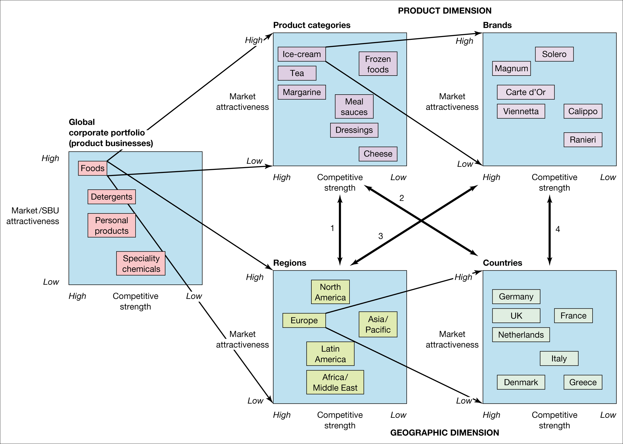
UNILEVER’S PORTFOLIO

Slide 4
INTERNATIONAL SALES
Looking at Unilever’s global presence, the role of a robust sales organisation can’t be overstated
People buy from people
Selling is part of the process both B2B and B2C, locally and internationally alike
It helps represent the product and the company to potential buyers …and their buyers !
•

Slide 5
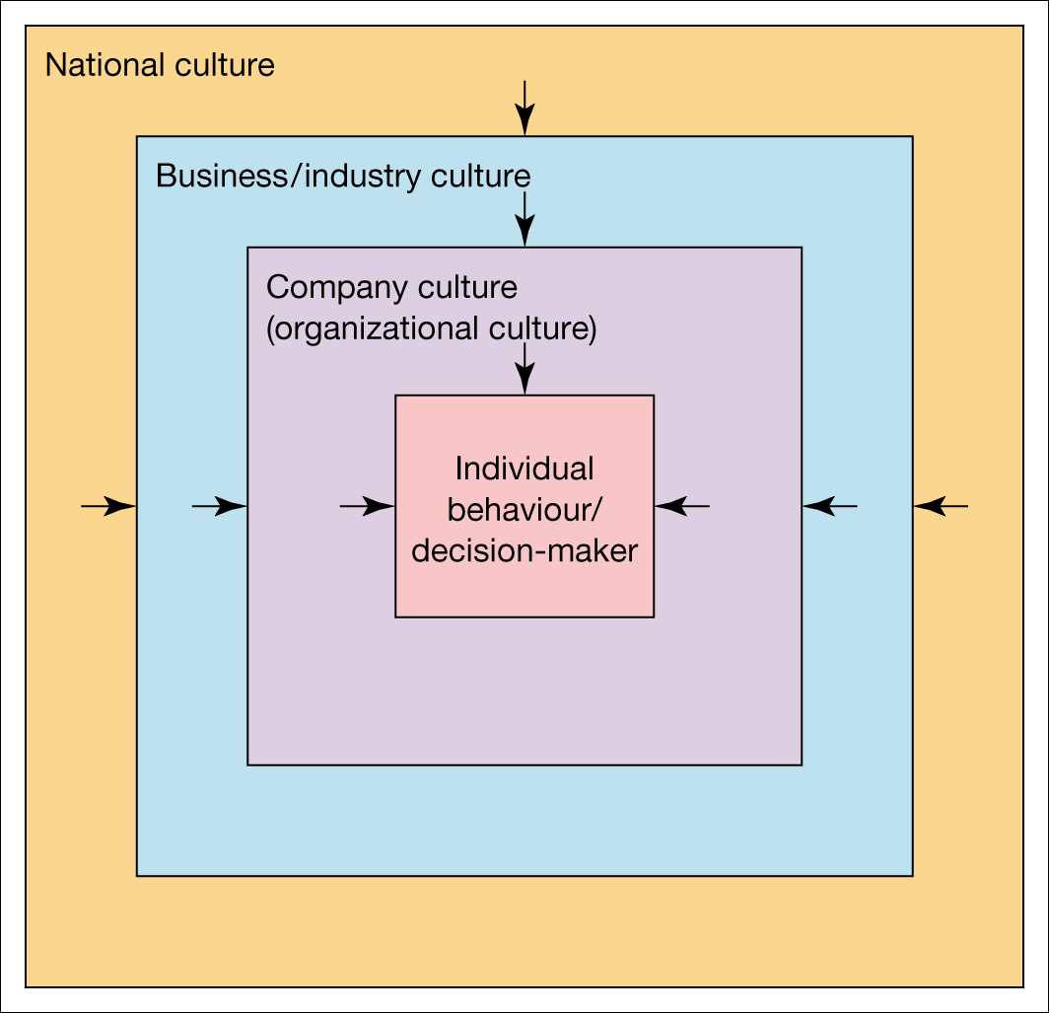
THE DIFFERENT LAYERS OF
CULTURE

Slide 6

INTERNATIONAL SALES
Requires both broad and in-depth knowledge and experience
Success depends on empathy and understanding of markets
Require religious / gender / cultural sensitivities
Political influence: nationalism
Mazda renamed the Laputa after protest from Spanish dealers

Slide 7
Why is ‘Creating Client
Value’ so important today?
Products are increasingly difficult to differentiate, and time to copy has fallen drastically
Direct sales losing ground to other channels – internet, telesales, CRM systems, Amazon, Alibaba (!) etc.
Customers are pushing back against salespeople who just communicate, push and carry brochures
So, consultative sales professionals need to create even
more value than ever before……

Slide 8
INTERNATIONAL SALES
Reasons for doing international sales:
Exploit unavailability of product in overseas markets
Arbitrage difference in selling prices
Opportunities for product differentiation
Larger market size / more growth opportunities in overseas markets

Slide 9
HOW TO INCREASE INTERNATIONAL SALES VIA DIGITAL MARKETING
Optimize your site based on SEO
Define who your target audience is
Know where your audience concentrates
Automate and track your email marketing campaigns
Start a Content Marketing strategy
Define remarketing campaigns
Measure each one of your actions

Slide 10
INTERNATIONAL SALES
Requires knowledge and experience
Success depends on empathy and understanding of markets
Various avenues: joint ventures, subsidiaries, partnerships
Importing and exporting

Slide 11
INTERNATIONAL SALES
Understand trade structure e.g. wholesalers and retailers, brokers and agents
Identify buying points
Buying procedures? Preferred terms and practices
Currency of invoicing
Translation needed?
Competitors?

Slide 12
INTERNATIONAL SALES
How to sell into this market?
  Consider regional testing
  Establish sales target
  Decide on your total sales and promotion budget
  Decide on your selling procedure
What sales literature is necessary?
  Redesign to appeal to new customers
  Arrange translation where necessary

Slide 13
INTERNATIONAL SALES
Advertising revenue?
  Decide on the advertising budget
  Assess differences in media availability and costs
After sales service?
  Direct provision or subcontractor?

Slide 14

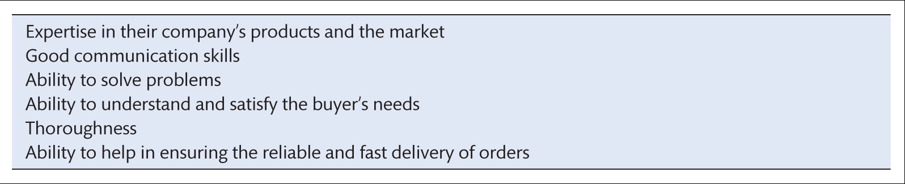
WHAT DO BUYERS EXPECT FROM SALESPEOPLE
Good sales people never, ever put down a good competitor. It is all about match !
Source: Based on Garver, M.S. and Mentzer, J.T. (2000) Salesperson logistics expertise: a proposed contingency framework, Journal of Business Logistics, 21(2):113–32; and Williams,
A.J. and Seminerio, J. (1985) What buyers like from salesmen, Industrial Marketing Management, 14(2):75–8.

Slide 15
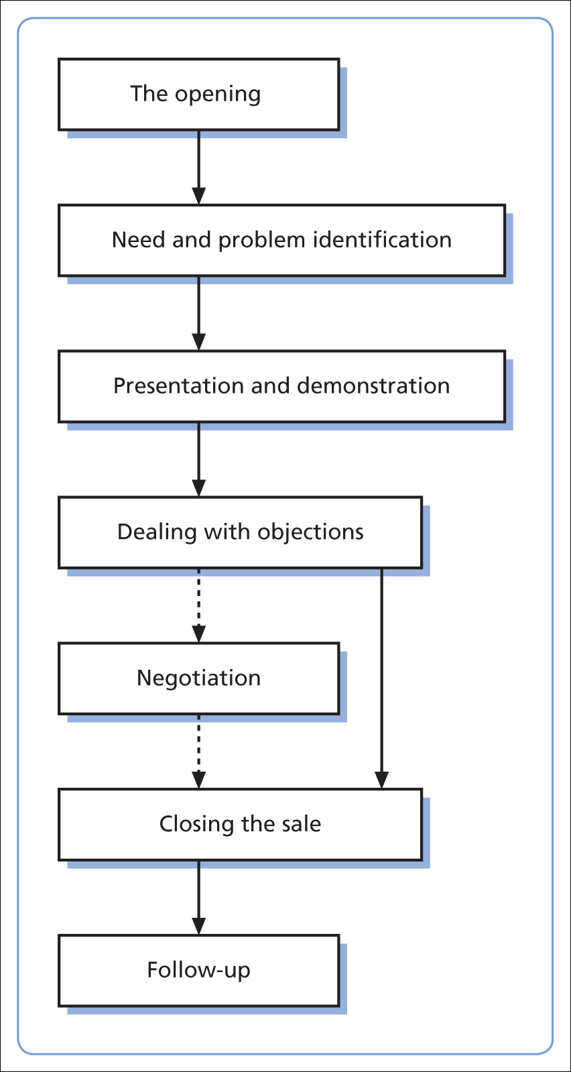
The personal selling process
All about creating value

Slide 16
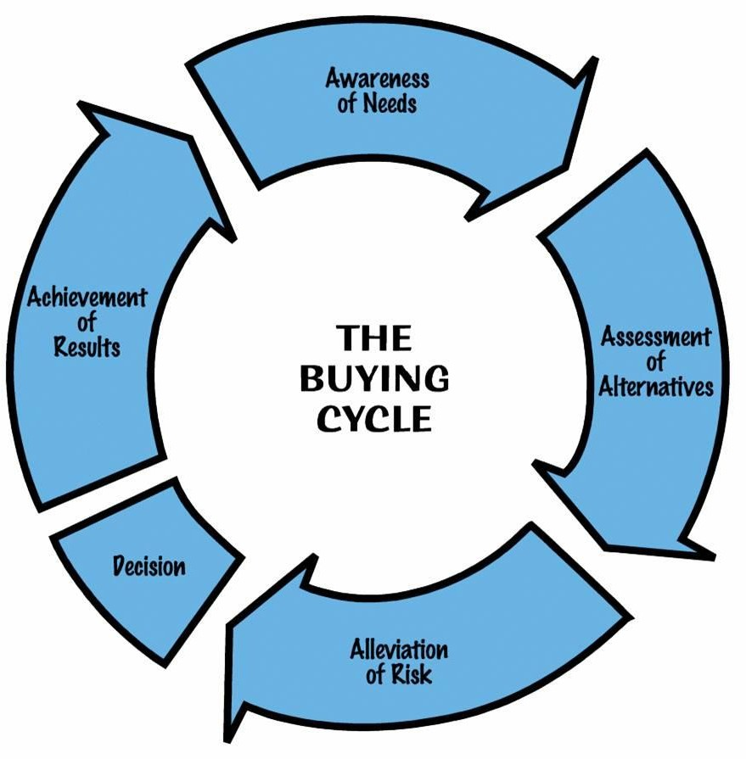
Working the Buying Cycle
The Buying Cycle is remarkably similar for most organisations, although the speed and complexity of the process inevitably changes with scale
Good salespeople move in tandem with buyers around the cycle – sometimes leading, sometimes following

Slide 17
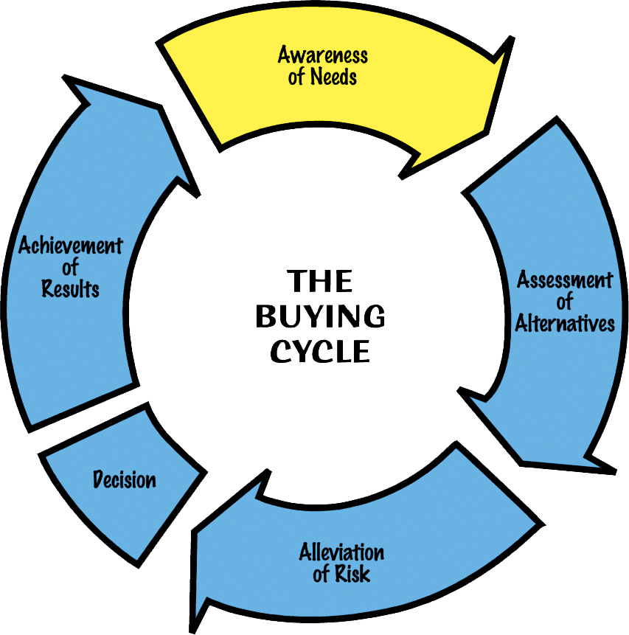
THE AWARENESS
OF NEEDS

Slide 18
THE AWARENESS
OF NEEDS
Where the customer assesses their problems (or opportunities) and evaluates their likely scale and urgency
Where the customer defines their needs and starts to outline initial specifications
Where the customer decides to make a decision to resolve their problems (or take advantage of their opportunities)

Slide 19
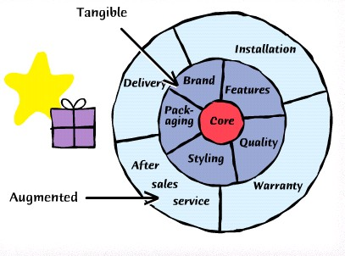
WHAT ARE WE SELLING

Slide 20
AWARENESS OF NEEDS: VALUE SWEET SPOT
An early indication of the areas where the buyer’s various needs overlap with the supplier’s capabilities
Used as a hypothesis to help further develop areas of mutual gain – especially where the customer has yet to fully explore all of their explicit, implicit and latent needs

Slide 21
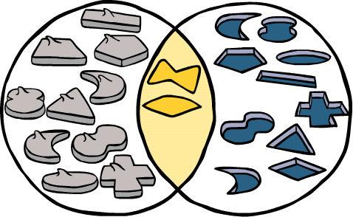
Finding the Value
Sweet Spot
Our Capabilities
Buyer Needs

Slide 22
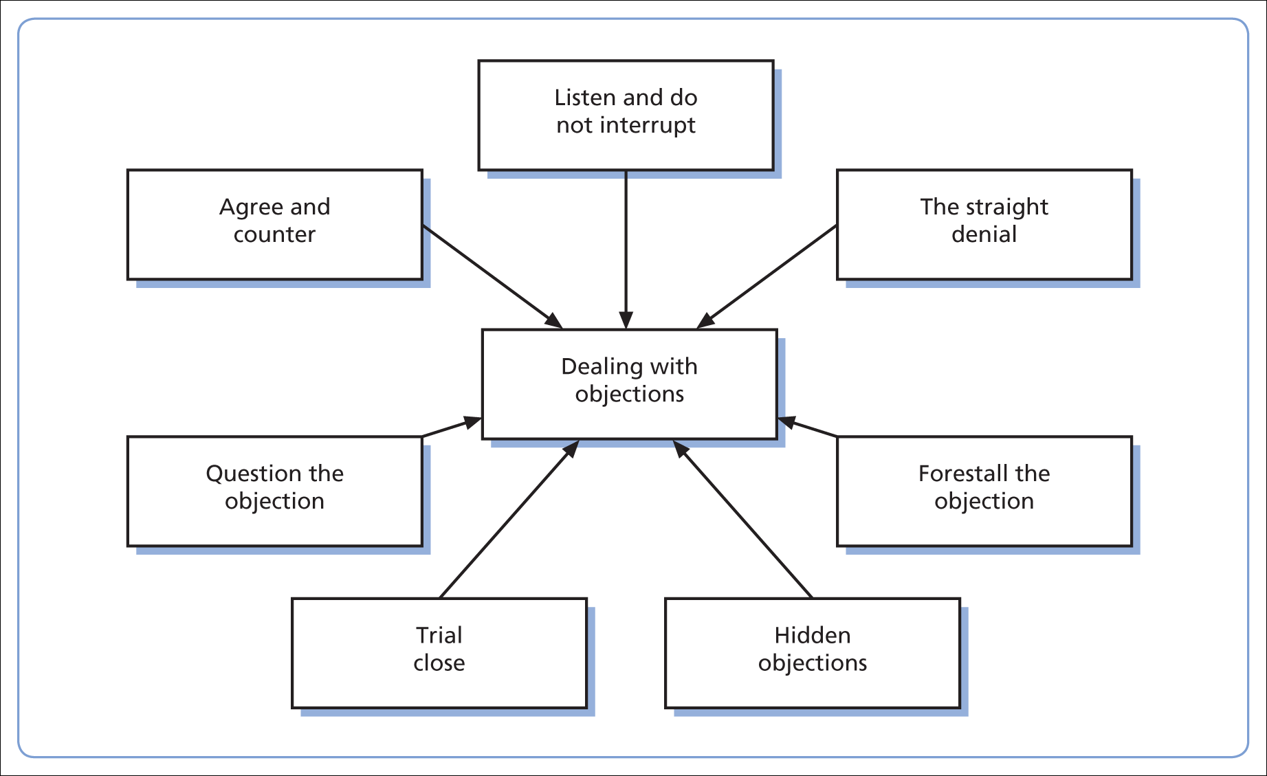
DEALING WITH HESITATION

Slide 23
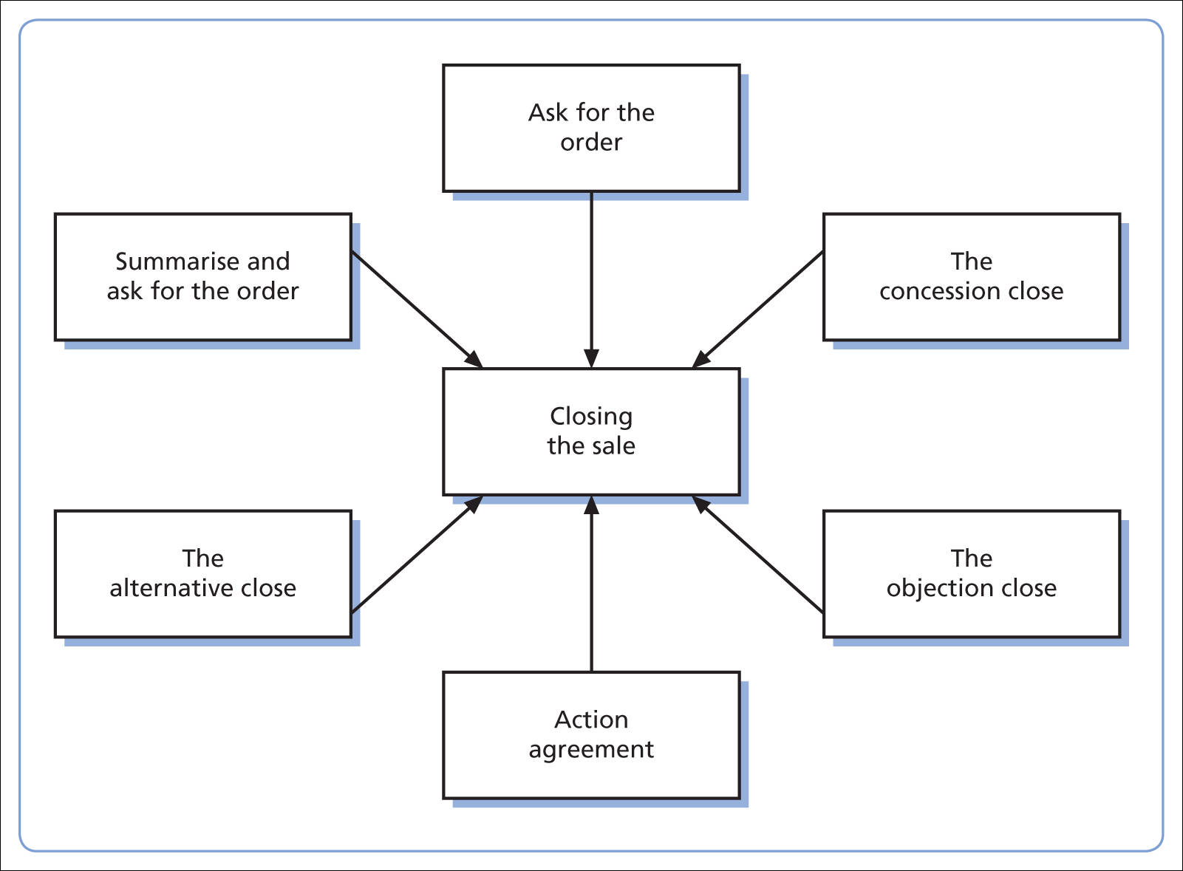
CLOSING THE SALE

Slide 24
Key account management

Slide 25
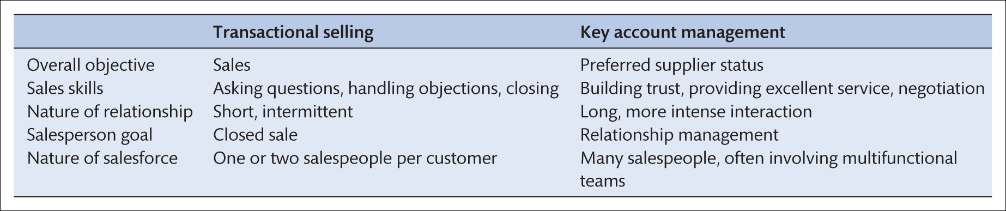
Transactional selling OR Key Account Management ?

Slide 26
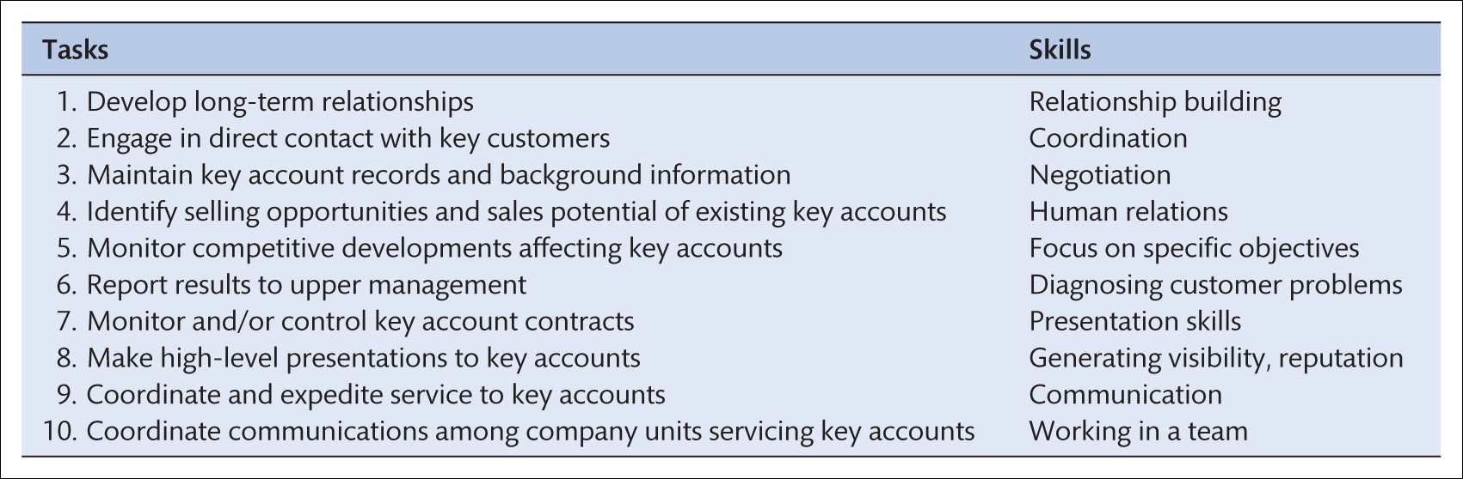
Tasks & skills in KAM

Slide 27
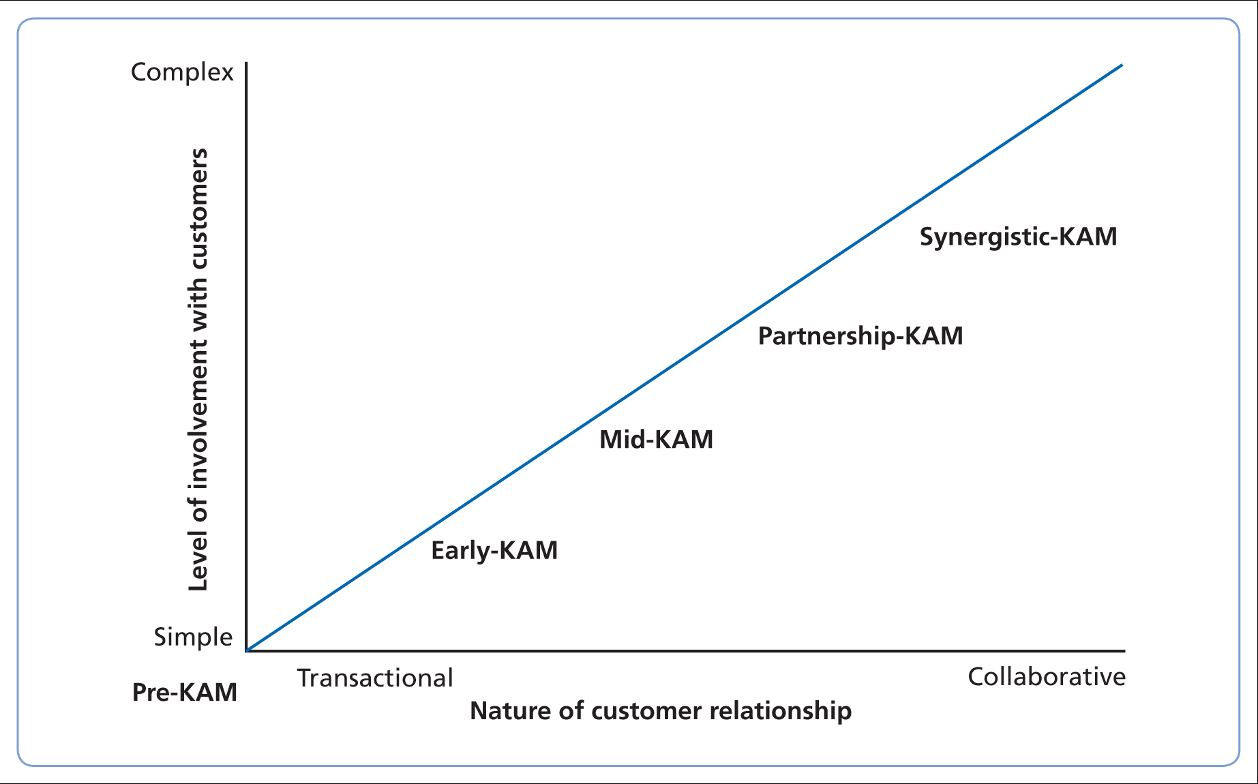
KEY ACCOUNT RELATIONAL DEVELOPMENT MODEL

Slide 28
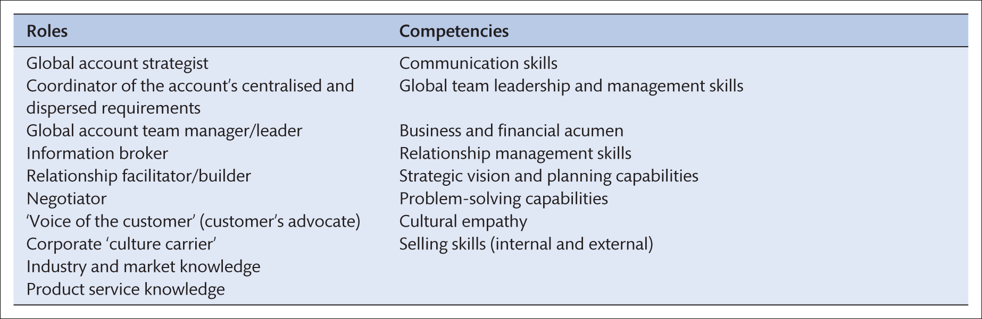
Roles and competencies required of a global account
manager
Sources: Based on Millman, T. (1999) From national account management to global account management in business-to-business markets, Fachzeitschrift für Marketing THEXIS, 16(4):2–9; Millman, T. and Wilson, K. (1999) Developing global account management competencies, Proceedings of the 15th Annual IMP Conference, University College Dublin, September.

Slide 29
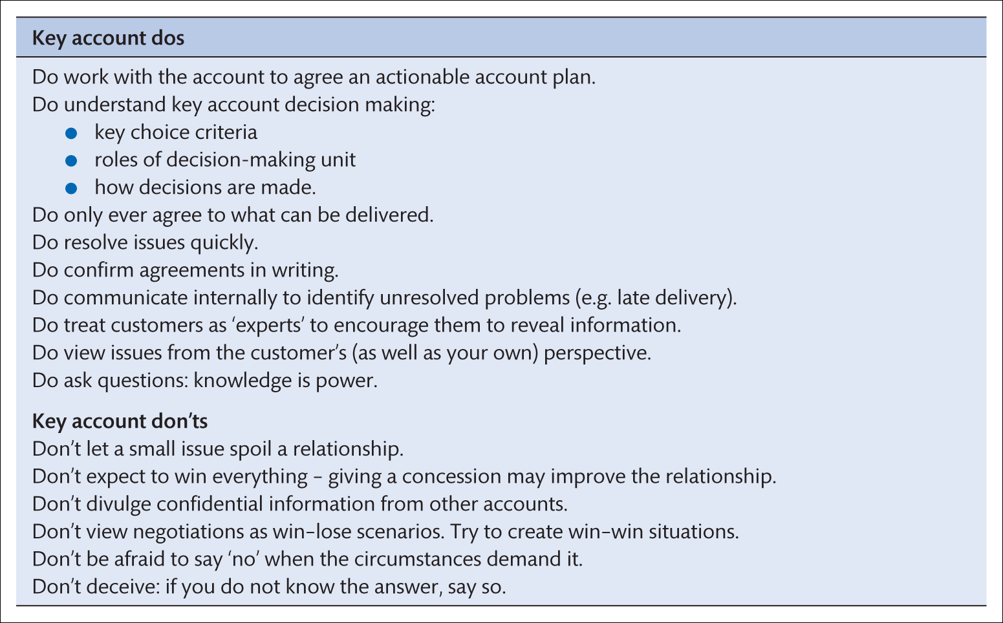
HANDLING RELATIONSHIPS WITH KEY ACCOUNTS

Slide 30
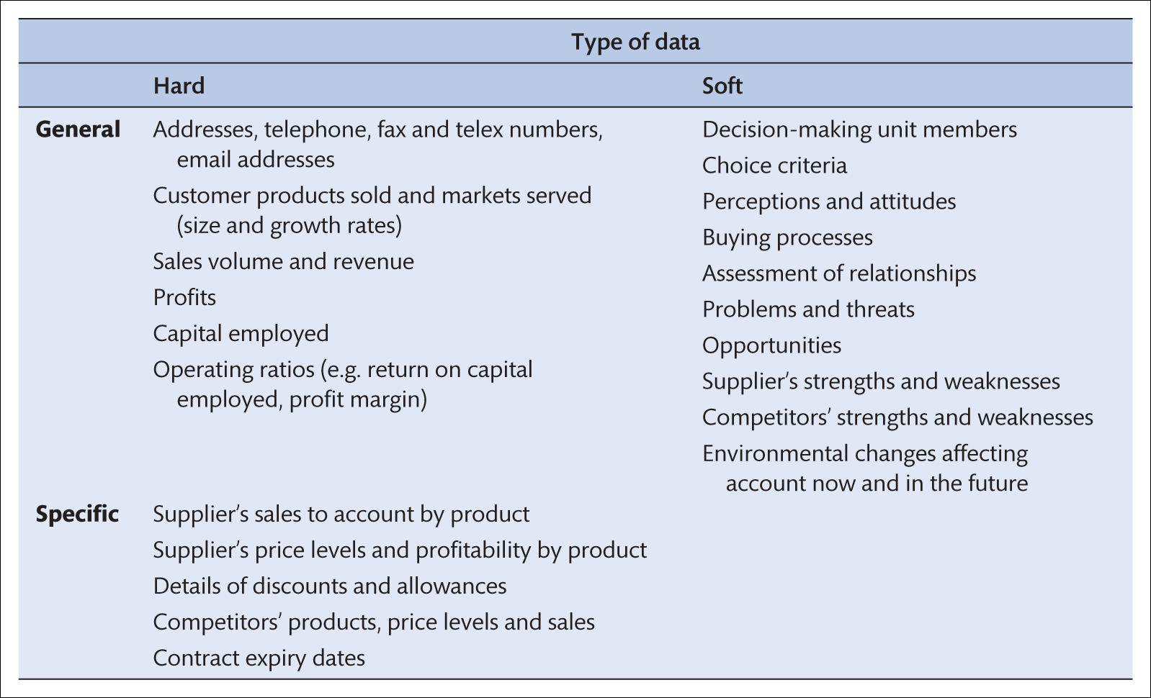
A key account information
system

Slide 31
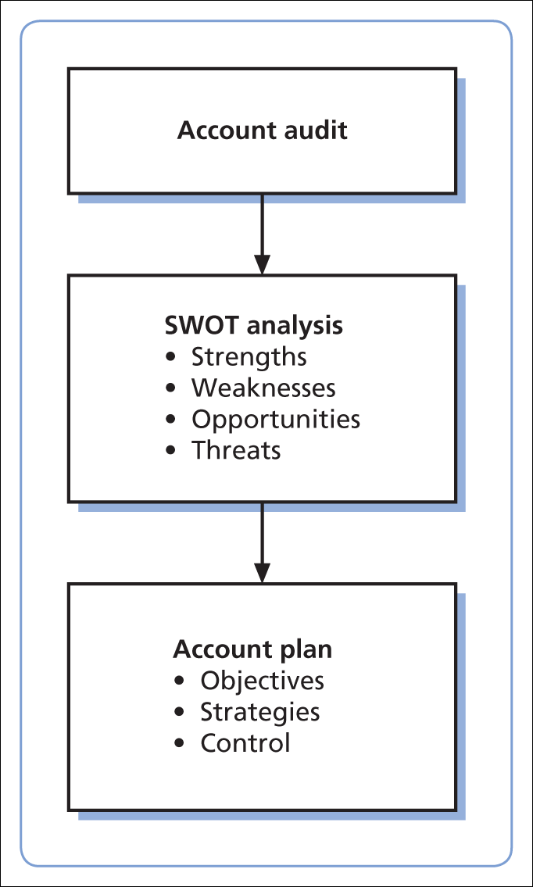
KEY ACCOUNT PLANNING SYSTEM

Slide 32
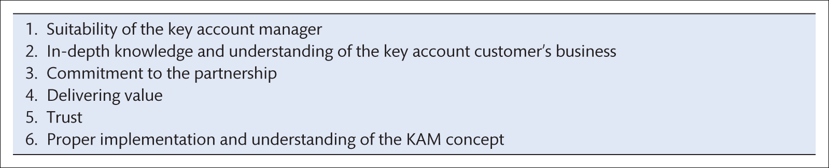
KAM KEY SUCCESS FACTORS
Source: Reprinted from Abratt, R. and Kelly, P.M. (2002) Customer–supplier partnerships: perceptions of a successful key account management program, Industrial Marketing Management, 31:467–76. Copyright © 2002 with permission from Elsevier.

Slide 33
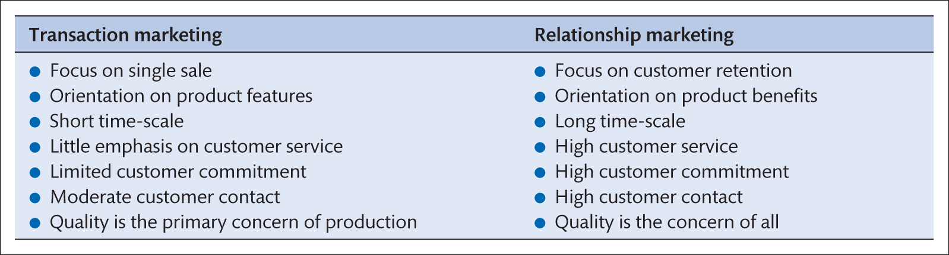
Contrasting transaction marketing and relationship marketing

Slide 34
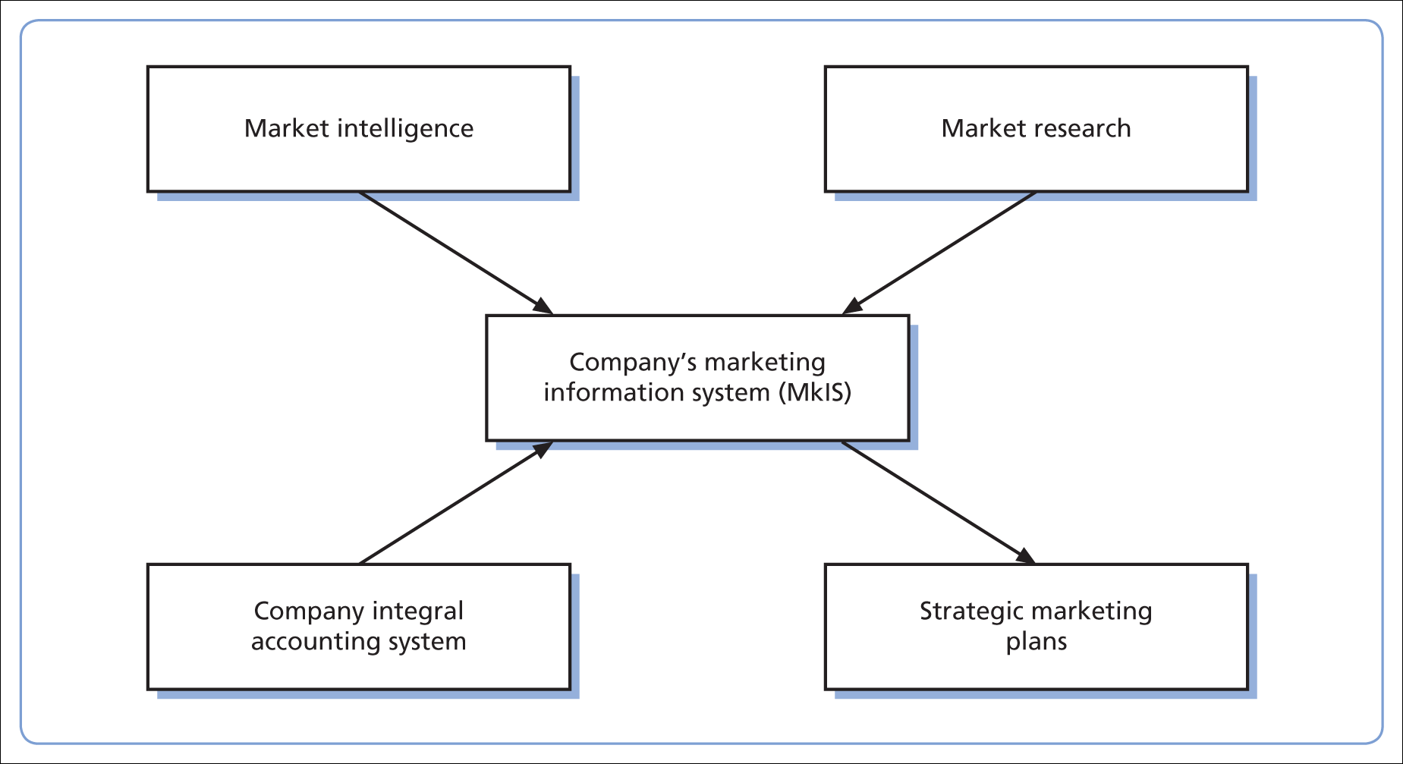
Marketing information system

Slide 35
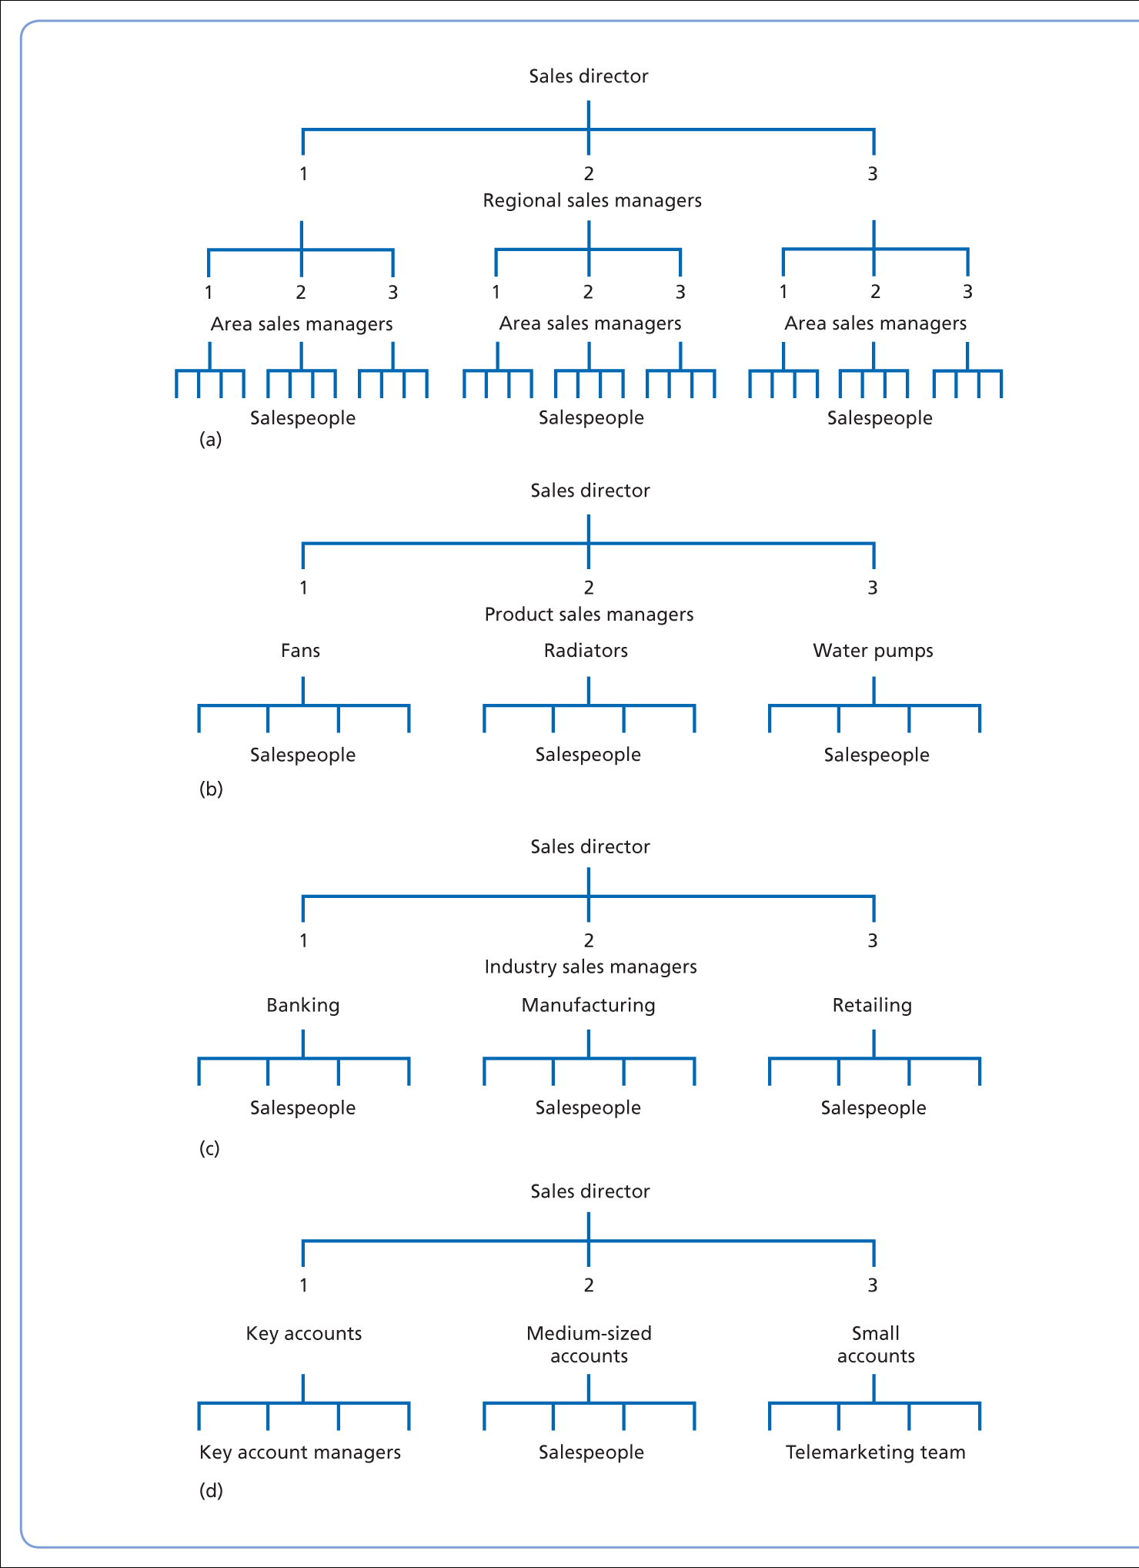
GEOGRAPHICAL STRUCTURE
Sales Organisation structures:
the area sales manager level is optional: where the number of salespeople (span of control) under each regional manager exceeds eight, serious consideration may be given to appointing area managers;
product specialisation structure;
industry-based structure;
account-size structure

Slide 36
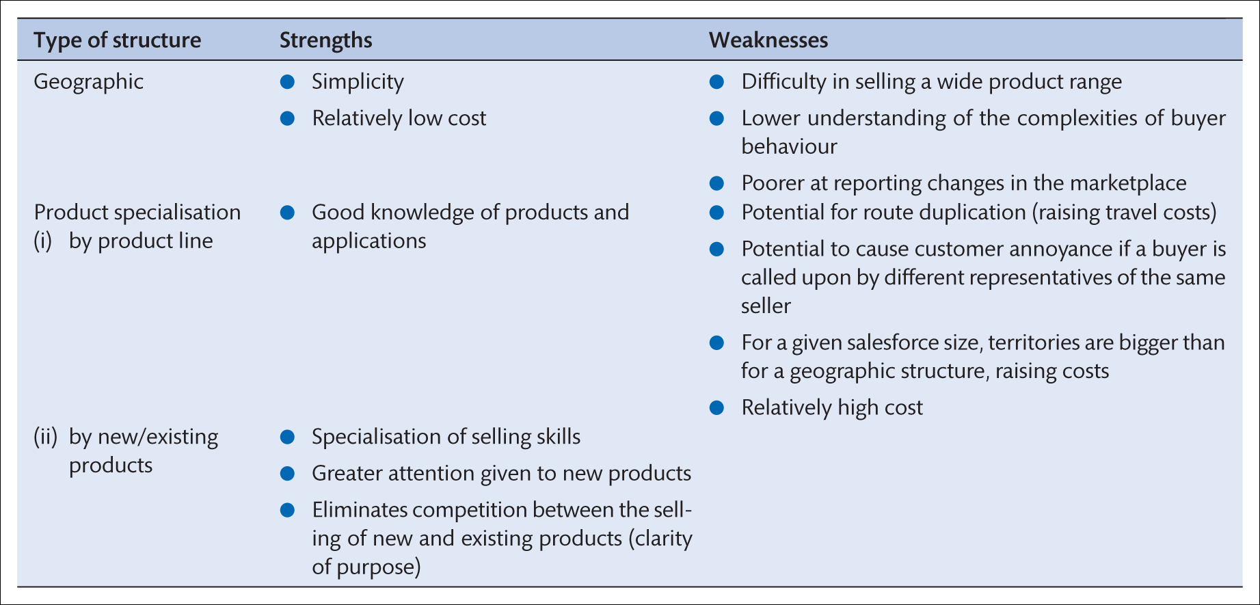
Strengths and weaknesses of geographic and product specialisation in organisational structures

Slide 37
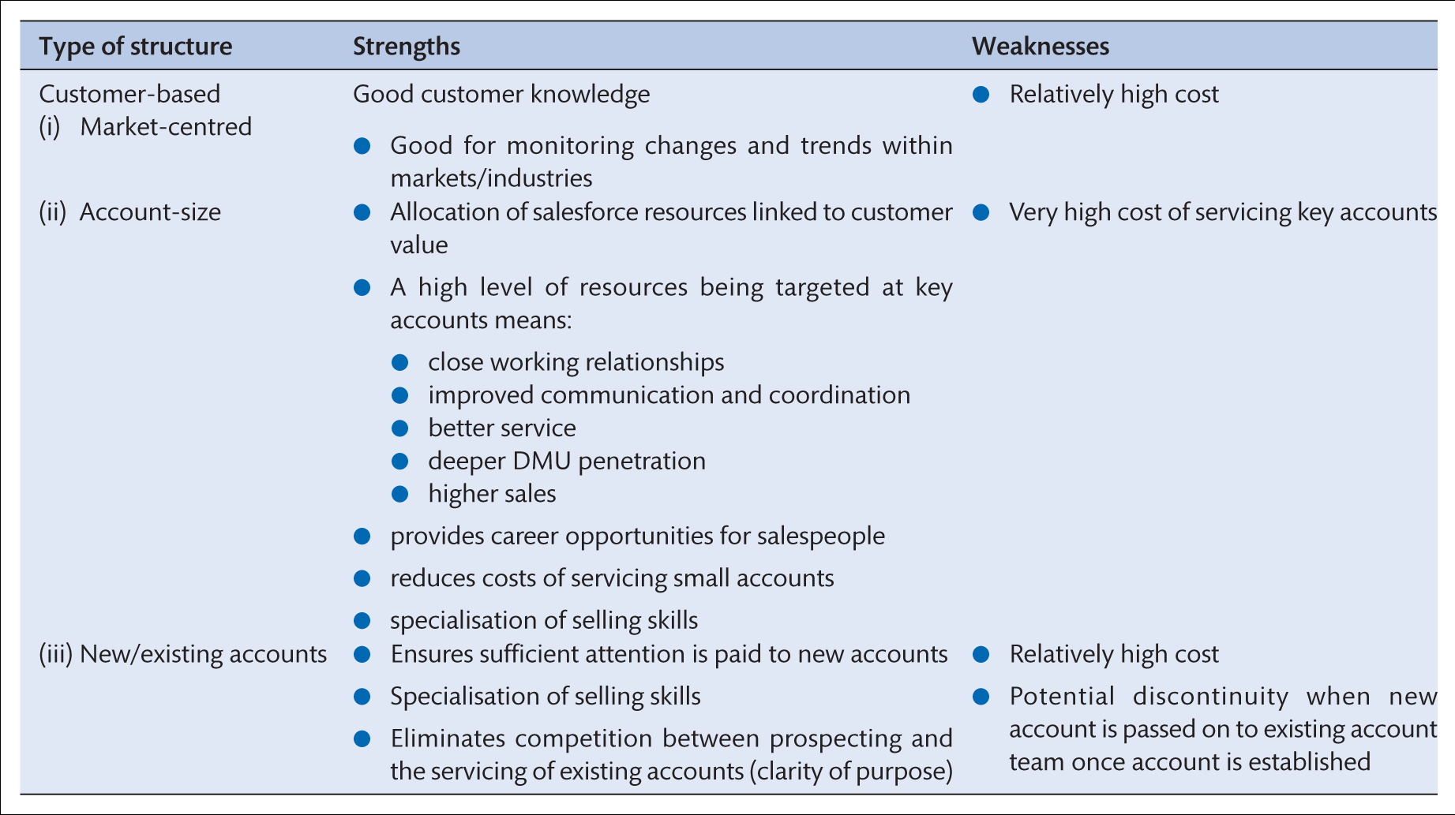
STRENGTHS AND WEAKNESSES OF CUSTOMER-
BASED ORGANISATIONAL STRUCTURES

Slide 38
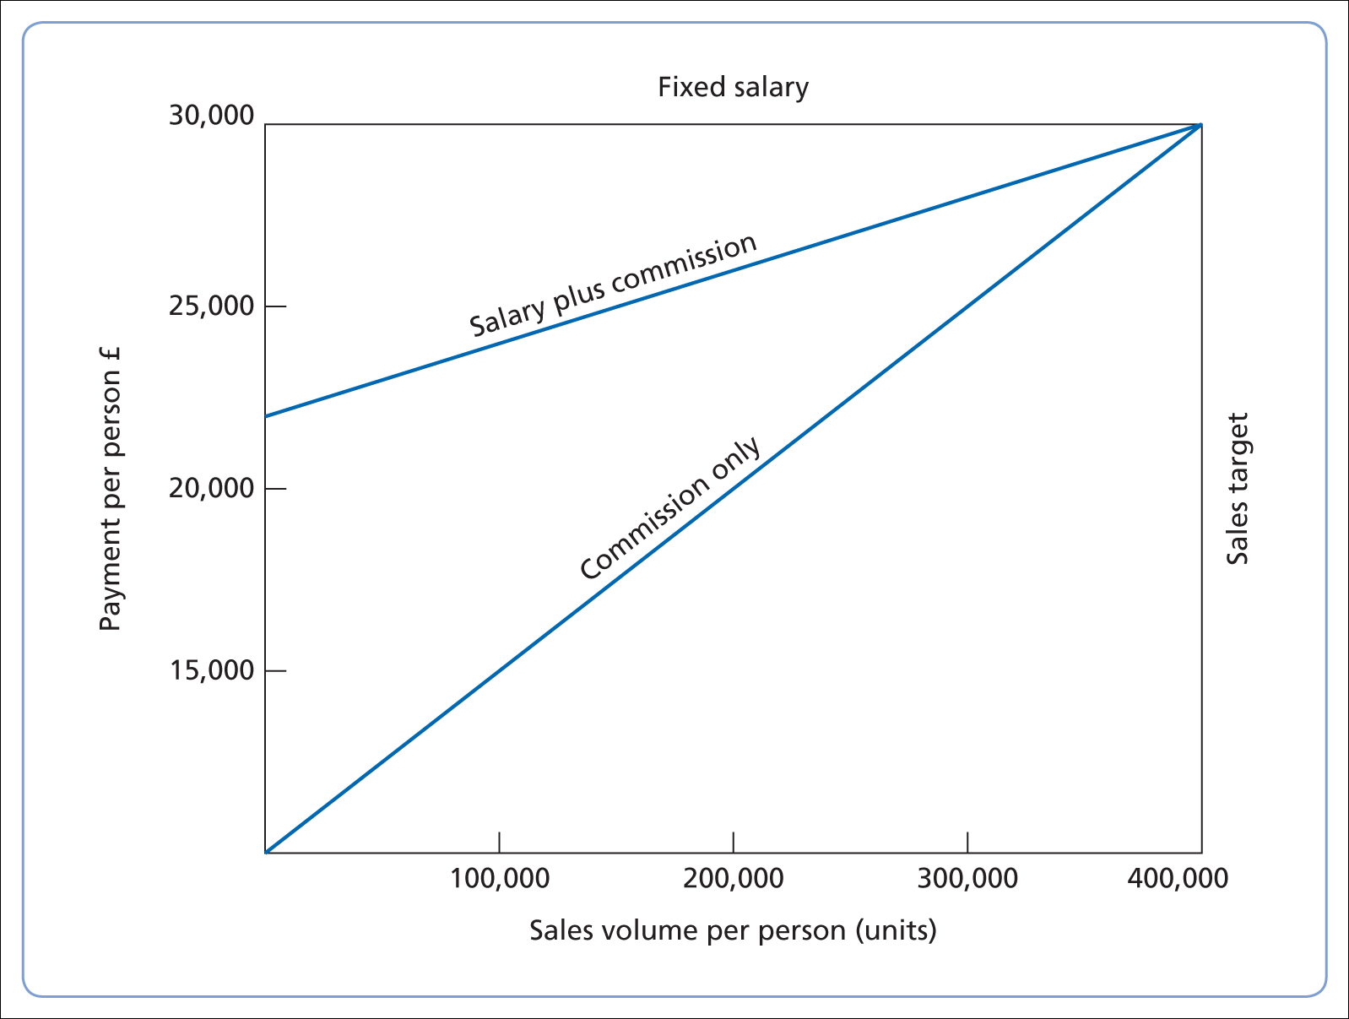
COMPENSATION AND
SALES VOLUME

Slide 39
B2B AND B2C
WHAT IS THE DIFFERENCE BETWEEN B2B AND B2C?
B2B utilises online platforms to sell products or services to other businesses.
B2C ecommerce targets personal consumers.
Differences in marketing strategies include branding, order fulfillment and shipping procedures, after sales service,volume and size of transactions

Slide 40
B2C MARKETING STRATEGIES FOR GLOBAL MARKETS
Define Your Target Audience.
Create a Timeline. ...
Determine What Types of Content You Want to Create. ...
Hire Content Creators. ...
Research Topics. ...
Execute a Plan for Content Creation. ...
Publish and Promote Your Content.

Slide 41
B2B MARKETING STRATEGIES FOR GLOBAL MARKETS
Target the right audience.
Establish methods and team members
Be mindful of translations
Consider cultural differences
Set expectations

Slide 42
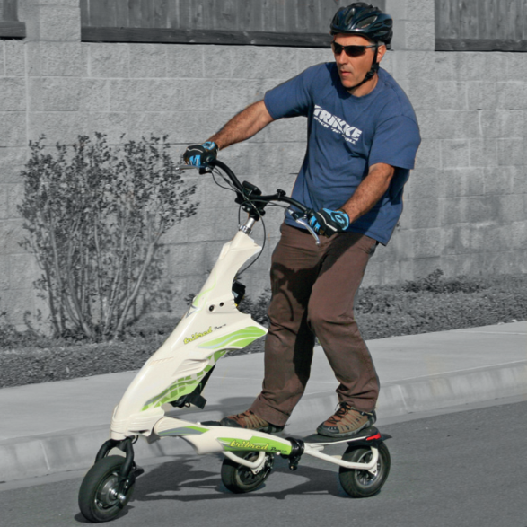
ANSOFF Matrix
 | Present Products | New Products
Present markets | Market penetration | Product development
New markets | Market development | Diversification
Source : Adapted from Ansoff (1957).
A market development strategy involves increasing sales by selling existing products in new markets, either by gaining new customers domestically or entering new markets internationally
Main decisions is ‘do we pursue new audiences in our domestic market or enter new international markets?’

Slide 43
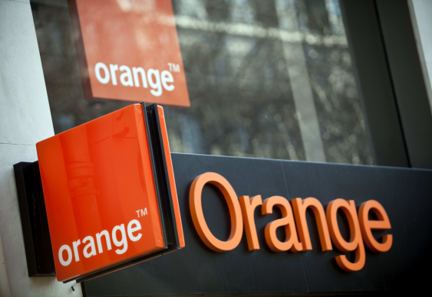
Case Insight – Orange
France Telecom, one of the world's leading telecommunications operators owns the Orange brand.
The Group's strategy aims to establish Orange as an integrated operator and benchmark for new telecommunications services in Europe.
A major problem concerns finding ways to reduce customer churn given the different market conditions in European markets.
Notes:
Why customer retention matters?
What is the main issue on the video?
According to Sue Wilmot, Head of Customer Strategy Deliver, when should a company start to focus on retention strategies?
The company uses both globalisation and adaptation, but it depends on prioritization.
A payday loan (also called a payday advance, salary loan, payroll loan, small dollar loan, short term, or cash advance loan) is a short-term unsecured loan, often characterized by high interest rates.
The term "payday" in payday loan refers to when a borrower writes a postdated check to the lender for the payday salary, but receives part of that payday sum in immediate cash from the lender.

Slide 44
Global Marketing
Single Country Marketing Strategy
Target Market Strategy
Marketing Mix
  Product
  Price
  Promotion
  Place
Global Marketing Strategy
Global Market Participation
Marketing Mix Development
  4 P’s: Adapt or Standardize?
Concentration of Marketing Activities
Coordination of Marketing Activities
Notes:
Global marketing is defined as the process of adjusting the marketing strategies of your company to adapt to the conditions of other countries.
Before you go global, please ask few questions: WHAT- WHY- HOW
“What I am trying to achieve in an international market?” “What are my company’s strengths and weaknesses for that market?” “How can I counter challenges in the market?” “What potential will I have in this market?”
Concentration of Marketing Activities
The extent to which marketing mix activities are performed in one or a few country location.
Coordination of Marketing Activities
The extent to which marketing mix activities are planned and executed interdependently around the globe.

Slide 45
Different types of international organisation
National organisation
Transnational
organisation
International organisation
Global
organisation
Multinational organisation

Slide 46
Countries and People are Different !
Customer preferences, competitors, channels of distribution, and communication
Marketing plans and programmes may need to be extended or changed.
“Standardization” versus “adaptation” – which?

Slide 47

The Beatles- Global Marketing Strategy
U.K albums had different names , number and order of tracks
U.S. singles had Side B songs not available in the U.K.
Songs remixed for U.S. market with different studio effects (reverb and compression)
The British Invasion of the music world was led by the Beatles who first toured the U.S. in 1964.

Slide 48
Standardization V Adaptation
Globalization (Standardization)
  Developing standardized products marketed worldwide with a standardized marketing mix
  Essence of mass marketing
Global localization (Adaptation)
  Mixing standardization and customization in a way that minimizes costs while maximizing satisfaction
  Essence of segmentation
  Think globally, act locally (Theodore Levitt, 1983)

Slide 49
Standardization Vs. Adaptation
The Faces of Coca-Cola Around the World
Arabic
Read right to left
Chinese
“delicious/happiness”

Slide 50
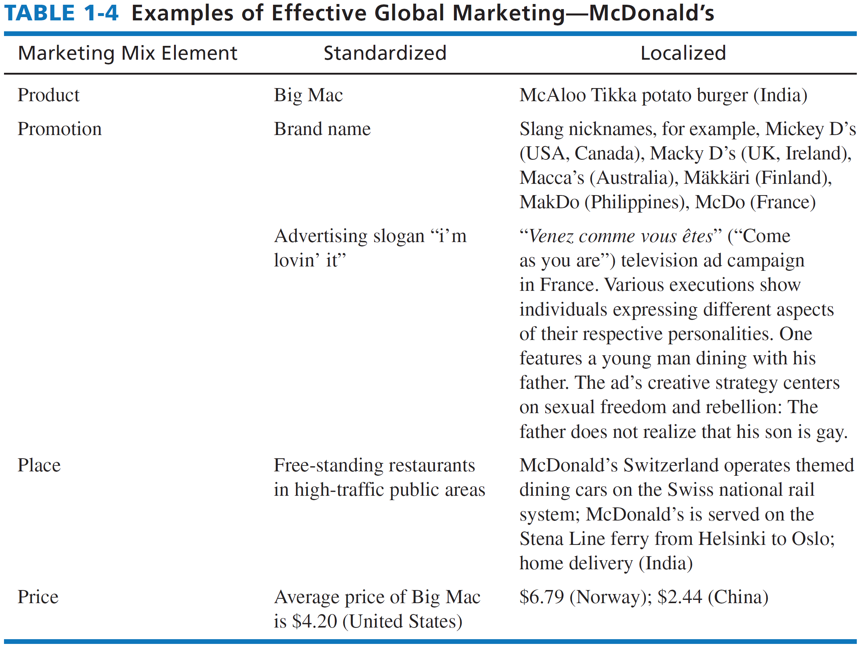

Slide 51
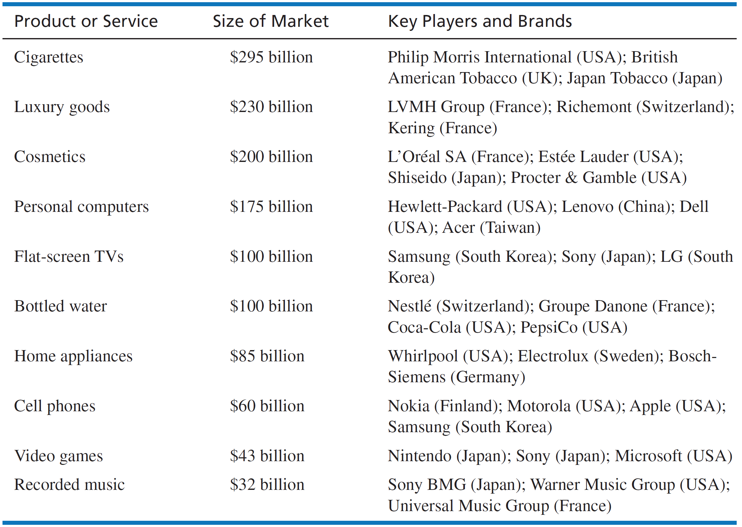
How Big Is The Global Market?

Slide 52
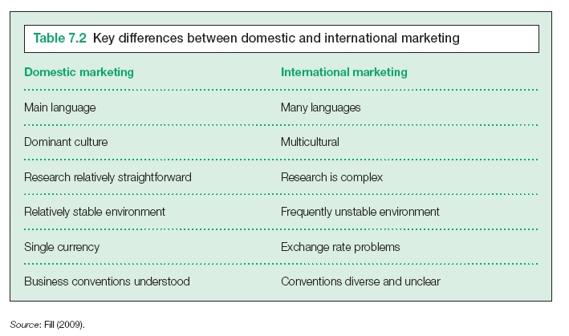
Key Differences between Domestic and International Marketing
Notes:
Global market is very attractive. But you need to focus, a key decision is whether to pursue new audiences in the domestic market, or enter new international markets.
International markets seen as more unstable than domestic market, why?

Slide 53
International Market Development
Requires a strong environmental analysis;
Makes more search demands on a company’s planning and control systems;
Requires extensive repertoire of marketing and business skills (languages, law, etc.);
Presents a great diversity of manufacturing decisions (e.g. location of factories);
Demands high risks in terms of investments and market entry;
Creates particular problems for debt collection and payment methods;
There are various approaches to international market development.
Notes:
Some firms take an ad hoc approach to international marketing- only responding to customer export requests or reactive basis.
International marketing strategy- proactive. View domestic as secondary

Slide 54

Class activity
Background:
Operates in over 190 countries
International streaming revenues > domestic revenues
In your point of view, what are the challenges faced by this company in international market?
Notes:
Background: The company's primary business is a subscription-based streaming service offering online streaming from a library of films and television series, including those produced in-house.
As of October 2020, Netflix had over 195 million paid subscriptions worldwide, including 73 million in the United States.
------------------------------------
Globalisation strategy:
Challenges:
Netflix must secure content deals region by region, and sometimes country by country.
It also must face a diverse set of national regulatory restrictions, such as those that limit what content can be made available in local markets.
International subscribers, many of whom are not fluent in English, often prefer local-language programming.
many potential subscribers, accustomed to free content, remain hesitant to pay for streaming services at all.
----------------------------------------
Success:
Netflix did not try to enter all markets at once.
it carefully selected its initial adjacent markets in terms of geography and psychic distance, or perceived differences between markets. For example, its earliest international expansion, in 2010, was to Canada, which is geographically close to and shares many similarities with the United States.
In doing so, the company learned how to expand and enhance its core capabilities beyond its home market.
First phase and second phase
the first phase of its globalization process was consistent with the traditional model of expansion.
from the experience and learning it gained in that process, Netflix developed the capabilities to expand into a diverse set of markets within a few years — the second phase of the process.
Second phase:
This second phase, involving a faster and more-extensive international expansion, saw Netflix extend its footprint to some 50 countries, drawing on the lessons it learned in the first phase in order to operate in a wider variety of markets. The choice of those markets was influenced by their degree of attractiveness, such as from shared similarities, the presence of affluent consumers, and the availability of broadband internet.
- learning about internationalization and partnering with local stakeholders while also growing its revenue.

Slide 55
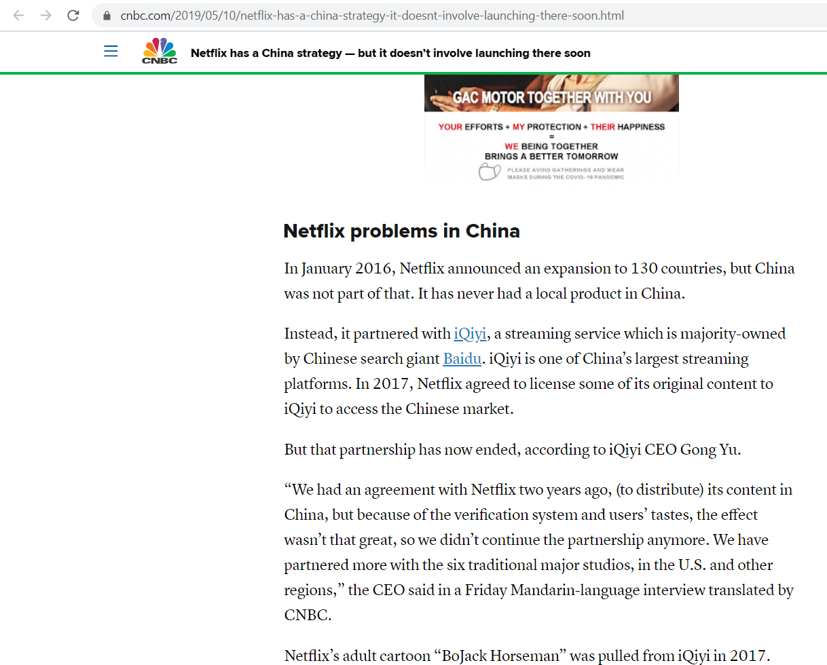
Notes:
Globalisation strategy:
Challenges:
Netflix must secure content deals region by region, and sometimes country by country.
It also must face a diverse set of national regulatory restrictions, such as those that limit what content can be made available in local markets.
International subscribers, many of whom are not fluent in English, often prefer local-language programming.
many potential subscribers, accustomed to free content, remain hesitant to pay for streaming services at all.
----------------------------------------
Success:
Netflix did not try to enter all markets at once.
it carefully selected its initial adjacent markets in terms of geography and psychic distance, or perceived differences between markets. For example, its earliest international expansion, in 2010, was to Canada, which is geographically close to and shares many similarities with the United States.
In doing so, the company learned how to expand and enhance its core capabilities beyond its home market.
First phase and second phase
the first phase of its globalization process was consistent with the traditional model of expansion.
from the experience and learning it gained in that process, Netflix developed the capabilities to expand into a diverse set of markets within a few years — the second phase of the process.
Second phase:
This second phase, involving a faster and more-extensive international expansion, saw Netflix extend its footprint to some 50 countries, drawing on the lessons it learned in the first phase in order to operate in a wider variety of markets. The choice of those markets was influenced by their degree of attractiveness, such as from shared similarities, the presence of affluent consumers, and the availability of broadband internet.
learning about internationalization and partnering with local stakeholders while also growing its revenue.
Third phase:
Netflix focused on adding more languages (including for subtitles), optimizing its personalization algorithms for a global library of content, and expanding its support for a range of device, operation, and payment partnerships.
Mobile experience:
Netflix also began placing a greater emphasis on improving its mobile experience, including sign-ups, credentials and authentication, the user interface, and streaming efficiency for cellular networks. It has been developing relationships with device makers, mobile and TV operators, and internet service providers as well.
The company is also applying its deep customer insight to international markets, using that knowledge to create content that appeals to a wide range of customer segments.
Netflix has demonstrated that developing country-specific knowledge is critical for success in local markets. This knowledge needs to be both broad and deep, extending across political, institutional, regulatory, technical, cultural, customer, and competitor domains. Understanding local cultures ensured that Netflix could be sensitive to and respond to their differences. This enhanced its credibility and helped it forge smooth relationships with key stakeholders.
Future:
Global players- Amazon Prime, Apple TV, Youtube Originals, Disney+, new entrants, regional or local players.

Slide 56
Reflection
Single Country Marketing Strategy vs
Global Marketing Strategy
What is the difference between globalisation vs global localisation?

Slide 57
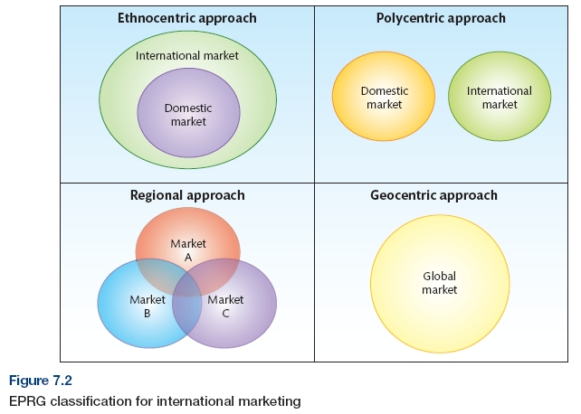


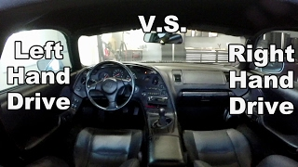


EPRG classification to International Marketing

Slide 58
Review:
Drachal, 2014

Slide 59
Approaches to International Marketing in Europe
Lynch, (1994) proposed five broad categories of European organizations that differ in their approach towards international marketing.
Local scale | Operate within national and local boundaries with little opportunity or desire to trade internationally or there might be little to gain from transferring skills For example, the local convenience store, the car repair garage.
National Scale | Focus mainly on their domestic market, but might find a number of opportunities emerging from a more integrated Europe Responding to more ad hoc customer enquiries. (E.g., Goodys)
Regional Scale | Focus on specific regions within Europe as opposed to operating throughout Europe (e.g., Eastern or Western Europe, Scandinavian countries) Gain experience of operating abroad on a smaller scale (i.e., less risk).
European Scale | Changes to the European Union in both trade relations and regulations, many companies have turned their attentions to marketing throughout Europe. Sees Europe as one geographic market with a number of segments that transcend national boundaries.
World Scale Organisations | These organizations have a strong European base, but now operate in a range of different world markets, either through direct investment, joint venture or exporting basis. E.g., H&M

Slide 60
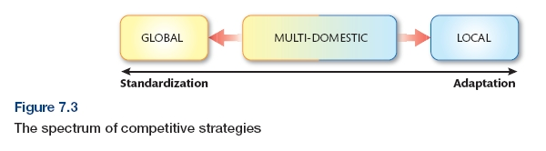
International Competitive Strategy
Notes:
When entering international markets, to what extent should the firm standardize or adapt its marketing strategy.
Different degrees of adaptation to markets based on a local/ global, multi-domestic or a global competitive approach to their international marketing strategy.

Slide 61
Class Activity
Identify factors that motivate international market development
Notes:
Pg14-16

Slide 62
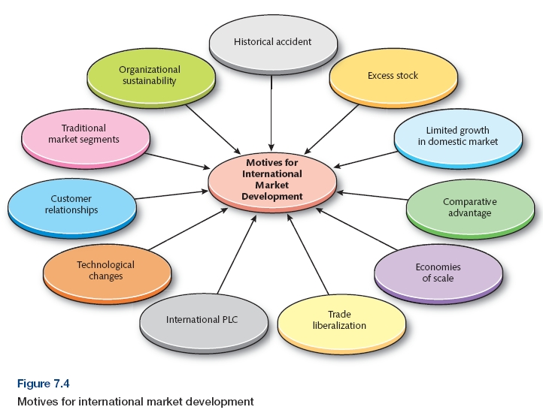
Drivers of International Market Development

Slide 63

INTERNATIONAL MARKET SELECTION
Market accessibility
Market size
Geographic proximity
Psychological proximity
Level and quality of competition
Cost of entering the market
Market’s profit potential
The iconic original VW Beetle
Source: istock.
Notes:
Pg 16

Slide 64
International Market Environment
Need to consider these in each market to assess success of market entry:
  Socio-cultural
  Consumption Attitudes
  Technological
  Political - Legal
  Economic factors

Slide 65
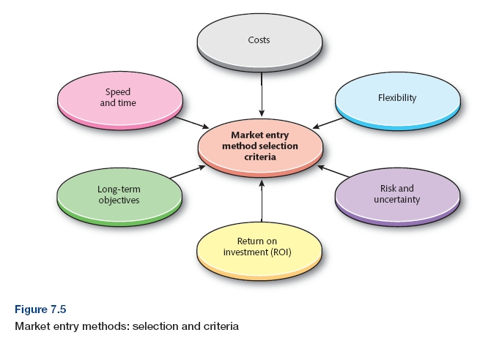
International Market Entry Method Selection Criteria
Notes:
Pg 27

Slide 66
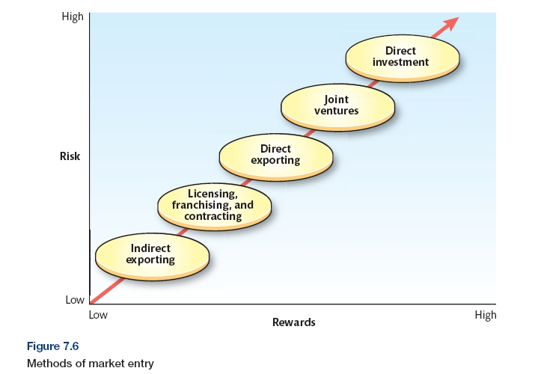
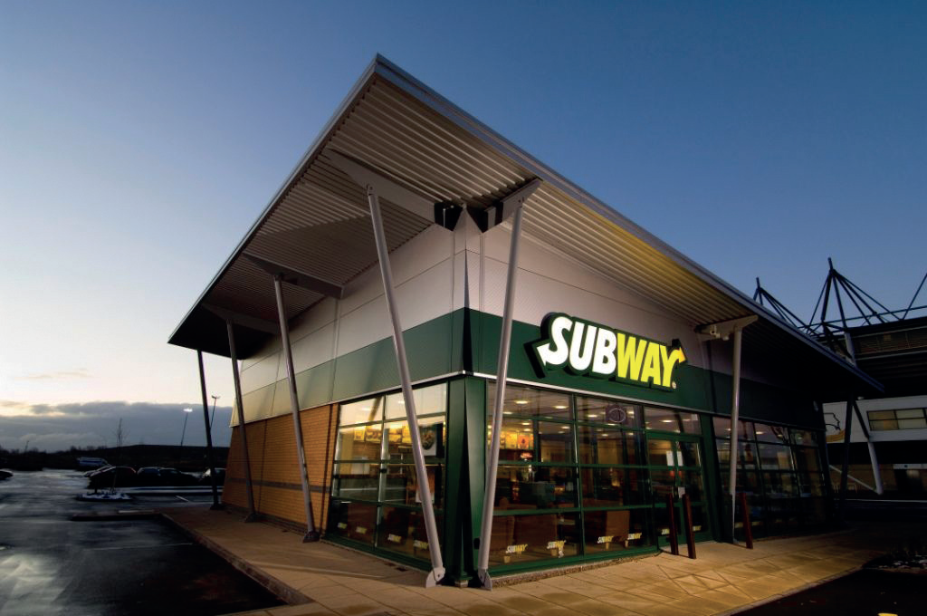
Types of Market Entry Methods
Source : Photo courtesy of the SUBWAY ® chain.
Notes:
Pg 29

Slide 67




Example: Joint Venture
Notes:
Ericsson is a Swedish-based company whereas Sony Ericsson is a subsidiary company of Ericsson. 2. Ericsson is a publicly traded company whereas Sony Ericsson is a joint venture company. ... Ericsson has its headquarters in Kista, Stockholm municipality whereas Sony Ericsson has its headquarters in Hammersmith, London, UK.
On October 27, 2011, Sony announced that it would acquire Ericsson's stake in Sony Ericsson for €1.05 billion ($1.47 billion), making the mobile handset business a wholly owned subsidiary of Sony.

Slide 68
McDonald’s Global and local strategy
Reason for local strategy:
R1: Local tastes and customs
R2: Local competition
R3: Local government laws
R4: Local franchise operations
R5: Local service quality

Slide 69
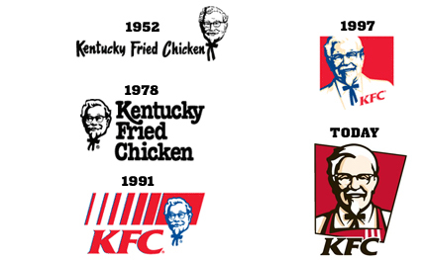
Case study + Review: KFC radical approach

Slide 70
Timeline
1987- first store in China (US’s icon)
1992- greater access to foreign markets, 5 radical approaches
1997-building warehouses and own trucks.
1999- opening dozens of restaurants a year
2005- “new fast food”
2008- annual opening rate- 500 restaurants

Slide 71
Summary
Defined international market development as a key growth strategy.
Explained the different forms of international marketing strategy.
Identified the key drivers for international market development.
Described the criteria used to identify and select international markets.
Examined the environmental factors that could influence the choice of international marketing strategy .
Explored the various methods used for international market entry.

