Slide 1

  – Delivering Value
  (Channelnomics)

Slide 2






Module Overview
9. International
1. Introduction
8. Market Entry
Sales (Producrts v
Strategies
Services ) B2C &
B2B
2. The Global
7. Delivering Value
10. Marketing and
Marketplace
(Channelnomics)
the impact of
Digital
3. Segmentation,
11. The New
Targeting,
6.Pricing Value
Customer Path
Positioning
(Connected consumers )
4. Developing
5.Communicating
12. Summary & Planning
Value
Value
Application
londonmet.ac.uk

Slide 3
Delivering Value (Channelnomics)
Getting to the customer …
Any time, any place, any where !
londonmet.ac.uk

Slide 4
CHANNELS
Marketing channels exist to create utility for customers.
The major categories of channel utility:
  place utility (the availability of a product or service in a location that is convenient to a potential
customer),
  time utility (the availability of a product or service when desired by a customer),
  form utility (the availability of the product processed, prepared, in proper condition, and/or ready to use),
  information utility (the availability of answers to questions and general communication
Because these utilities can be a basic source of competitive advantage and represent an important element of a firm’s overall value proposition,
choosing a channel strategy is one of the key policy decisions that management must make

Slide 5
CHANNELS
A distributor is a wholesale intermediary that typically carries product lines or brands on a selective basis.
An agent is an intermediary who negotiates exchange transactions between two or more parties but does not take title to the goods being purchased or sold
The Internet and related forms of new media are dramatically altering the distribution landscape. For example, eBay pioneered the peer-to-peer marketing (p-to-p) model, whereby individual consumers market products to other individuals.
Low-cost mass-market products and certain services can be sold on a door-to-door basis via a direct sales force. Door-to-door and house-party selling is considered a mature channel in the United States. For example, Tupperware has a sales force of 200,000 in Indonesia.

Slide 6
CHANNELS
2 types of channel management:
If Management chooses direct involvement, the company establishes its own sales force or operates its own retail stores.
2nd option is indirect involvement, which entails utilizing independent agents, distributors, and retailers.
Channel decisions typically involve long-term legal commitments and obligations to various intermediaries. Such commitments are often extremely expensive to terminate or change, so it is imperative for companies to document the nature of the relationship with the foreign partner.

Slide 7
DISTRIBUTION CHANNELS: TERMINOLOGY AND STRUCTURE
Physical distribution is the physical flow of goods through channels.
A channel of distribution is “an organised network of agencies and institutions that, in combination, perform all the activities required to link producers with users to accomplish the marketing task.”
Distributor - wholesale intermediary that typically carries
product lines or brands on a selective basis
Agent - an intermediary who negotiates transactions between two or more parties but does not take title to the goods being purchased or sold

Slide 8
Marketing Channels
and Value Networks
Marketing channels
  Sets of interdependent organizations participating in the process of making a product or service available for use or consumption
  Intermediaries: merchants, agents, and facilitators

Slide 9
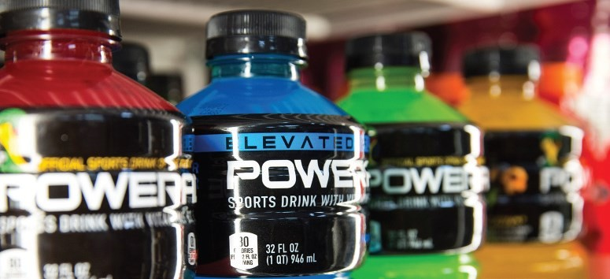
Marketing Channels
and Value Networks
A marketing channel system
  The particular set of marketing channels a firm employs
  Push vs. pull strategy

Slide 10

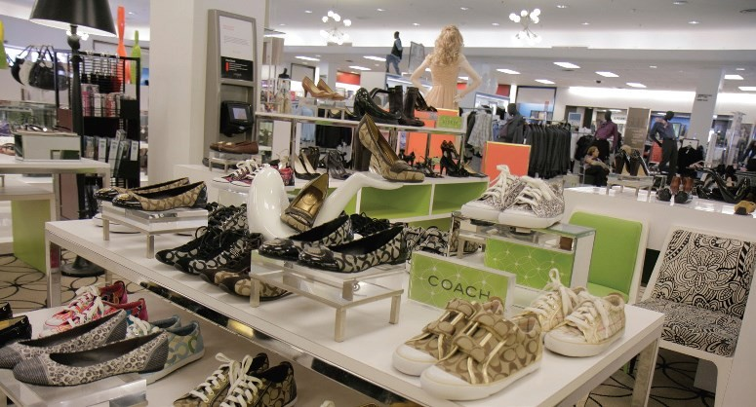
Marketing Channels
and Value Networks
Multichannel marketing
  Using two or more marketing channels to reach customer segments in one market area
  Omnichannel marketing
  Integrated marketing channel system
Notes:
Multichannel marketing uses several channels to promote a product or service, but these channels may not be seamlessly integrated
In contrast, omnichannel marketing is a holistic approach where the channels are interconnected and work synergistically to deliver a seamless customer experience.

Slide 11
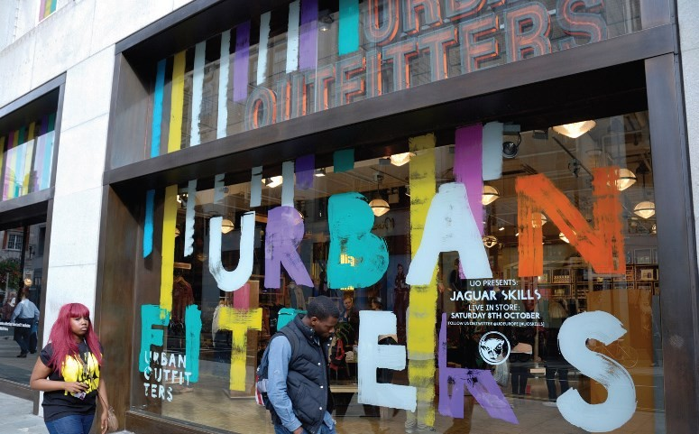
Marketing Channels
and Value Networks
Value network
  A system of partnerships and alliances that a firm
creates to source, augment, and deliver its offerings
  Demand chain planning

Slide 12
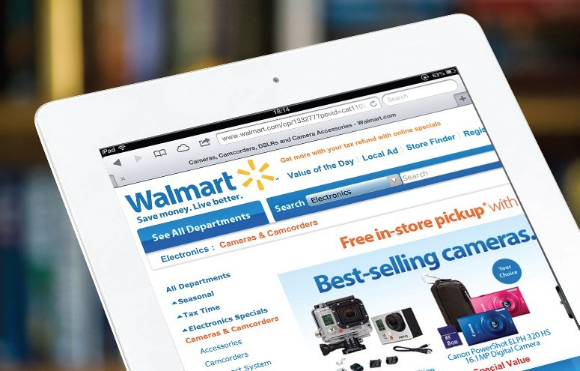
Marketing Channels
and Value Networks
The digital channels revolution
  Customer support in store/online/phone
  Check online for product availability at local stores
  Order product online to pick up at store
  Return a product purchased online to a nearby store
  Advocacy

Slide 13
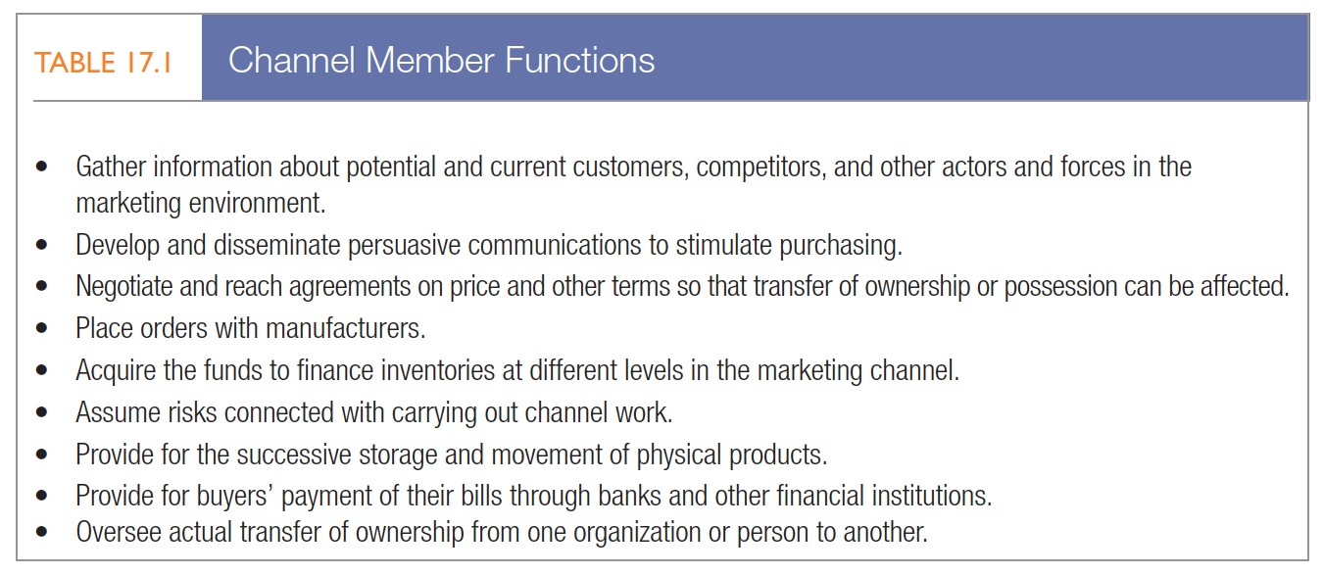

The Role of
Marketing Channels
Channel functions and flows

Slide 14

THE ROLE OF
MARKETING CHANNELS
Channel levels
  Zero-level channel (direct)
  One/two/three-level channels (intermediaries)
  Reverse-flow channels (laundry, recycle)
Service sector channels

Slide 15
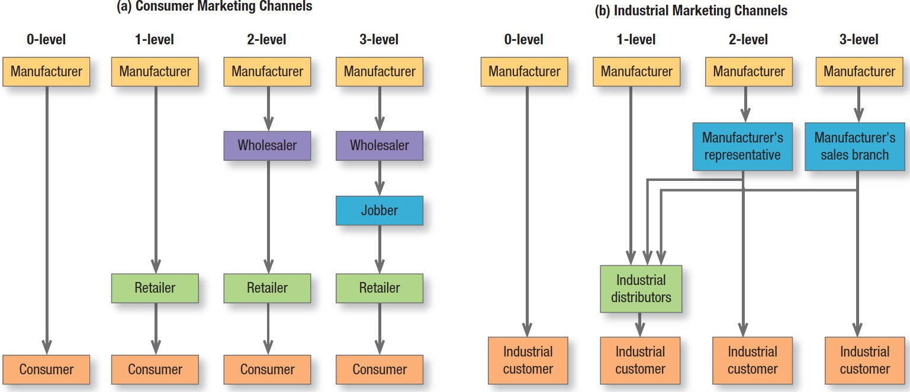
Consumer/Industrial
Marketing Channels

Slide 16
Channel-Design Decisions
Analysing customer needs and wants
  Desired lot size
  Waiting and delivery time
  Spatial convenience
  Product variety
  Service backup

Slide 17
Consumer Channels
Manufacturer-owned stores
  Nike,
  Levi Strauss,
  Apple,
  Sony,
  Many fashion design houses have flagship stores
Independent franchises
Independent retailers
  Tesco, Aldi, Lidl
Flagship retail stores for Apple, Sony, well-known fashion houses, Nike to build brand loyalty, showcase products, and help gather marketing intelligence

Slide 18
Channel-Design Decisions
Establishing objectives and constraints

Slide 19
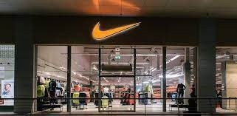
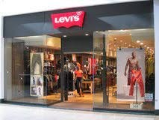
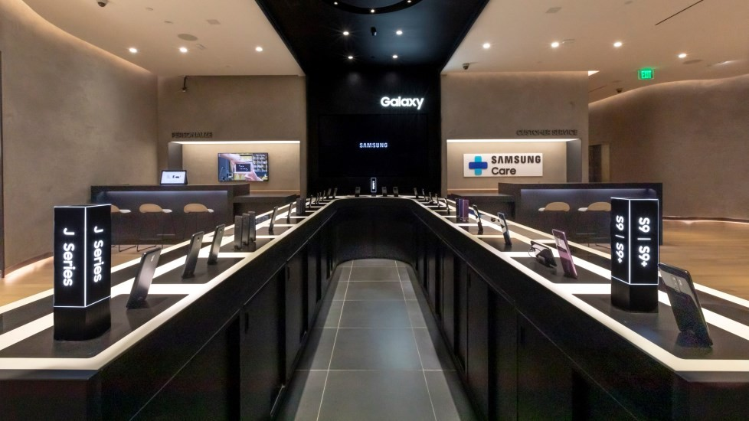
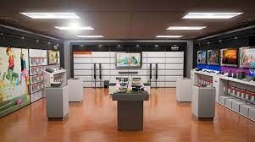

Slide 20
Channel-Design
Decisions
Identifying major channel alternatives
Types of intermediaries
Number of intermediaries
Terms/responsibilities of channel members

Slide 21
Establishing Channels
Direct involvement - the company establishes its own sales force or operates its own retail stores
Indirect involvement - the company utilises independent agents, distributors, and/or wholesalers
Channel strategy must fit the company’s competitive position
and marketing objectives within each market it operates
Examples : Microsoft dominance /

Slide 22
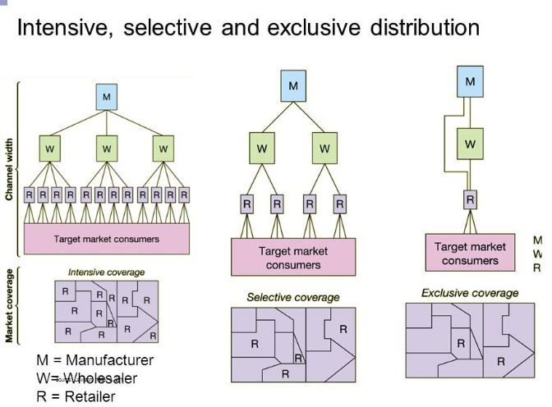
Identifying major channel alternatives
Number of intermediaries
  Exclusive distribution
  Selective distribution
  Intensive distribution

Slide 23
Identifying major Channel Alternatives
Terms and responsibilities of channel members
Price policy
Conditions of sale
Distributors’ territorial rights
Mutual services and responsibilities

Slide 24
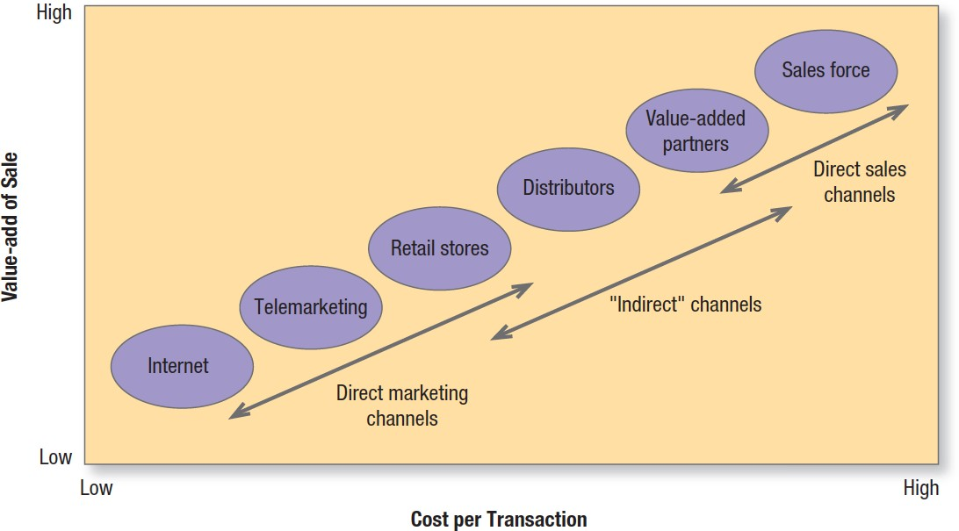
Channel-Design
Decisions
Evaluating major channel alternatives
  Economic criteria
  Control and adaptive criteria

Slide 25
Channel-Management
Decisions
Selecting channel members
Training channel members
Evaluating channel members
Global channel considerations
Channel modification decisions
Modifying channel design

Slide 26
Channel Objectives & Utility
Marketing channels exist to create utility for customers
  Place utility - availability of a product or service in a location that is convenient to a potential customer
  Time utility - availability of a product or service when desired by a customer
  Form utility - availability of the product processed,
prepared, in proper condition and/or ready to use
  Information utility - availability of answers to questions and general communication about useful product features and benefits

Slide 27
Training and Motivating
Channel Members
Manufacturer & Channel power
Coercive Reward Legitimate
Expert
Referent / Respect

Slide 28
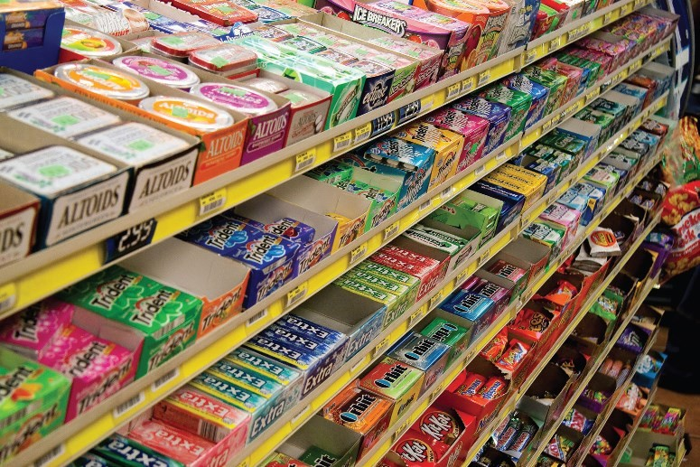
Training and Motivating
Channel Members
Channel partnerships and practices
  Demand-side management
  Supply-side management
  Enablers and integrators

Slide 29
Peer-to-Peer Marketing
The Internet and other related media are dramatically altering distribution
Interactive TV is becoming a viable direct marketing
channel
eBay pioneered P2P
  Helped Disney and IBM set up auction sites for B2C auctions
Interactive TV is coming when homes are wired for 2-way

Slide 30

Door-to-Door Selling
Mature form in the U.S.
Tupperware has a sales force of 200,000 in Indonesia, its biggest market
Growing popularity in China-
Avon, Mary Kay
½ of cars are sold door-to-door in Japan with 100,000 salespeople
Herbal Life ??
The U.S. marklet accounts for only 10% of Tupperware sales. Tricia Stitzel is CEO of the company.

Slide 31
Retailing in Emerging Markets
Consumers purchase food, soft drinks, and other items at “Mom & Pop” stores, kiosks, and market stalls in single-use packages. 70% of Mexicans shop at these stores
P&G aids stores that carry at least 40 P&G products with displays, promo materials through a golden store programme
Nestlé has a floating supermarket that sails the Amazon River to reach remote areas
Microsoft B2B – Gold and Platinum Partnerships

Slide 32
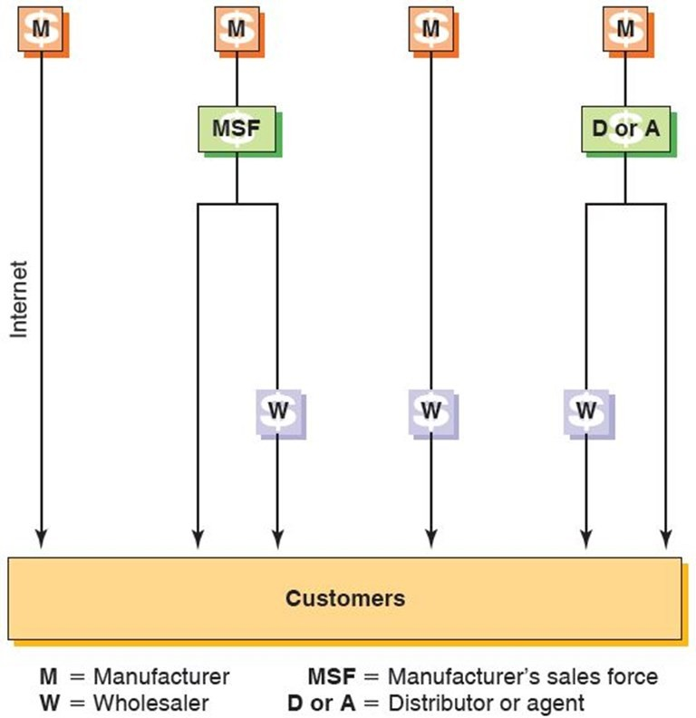
Industrial Products Channels
Marketing Channel Alternatives: Industrial Products

Slide 33
Working with Channel Intermediaries
Select distributors - don’t let them select you !
Look for distributors capable of developing markets, rather than those with a few good customer contacts
Treat local distributors as long-term partners, not temporary market-entry vehicles
Support market entry by committing resources and proven marketing ideas
From the start, maintain control over marketing strategy
Make sure distributors provide detailed market and financial performance data as frequently as possible
Build links among national distributors at the earliest opportunity

Slide 34
Intermediaries
Be realistic about the intermediary’s motives
May maximise its own profit margins rather than the
manufacturer’s
May engage in cherry picking-only taking products with known demand
Manufacturer may need to establish its own distribution
channel although it will have high costs
Or the manufacturer can supplement the cost of the sales force of the distributor
Examples : King of Cooks’ knives

Slide 35
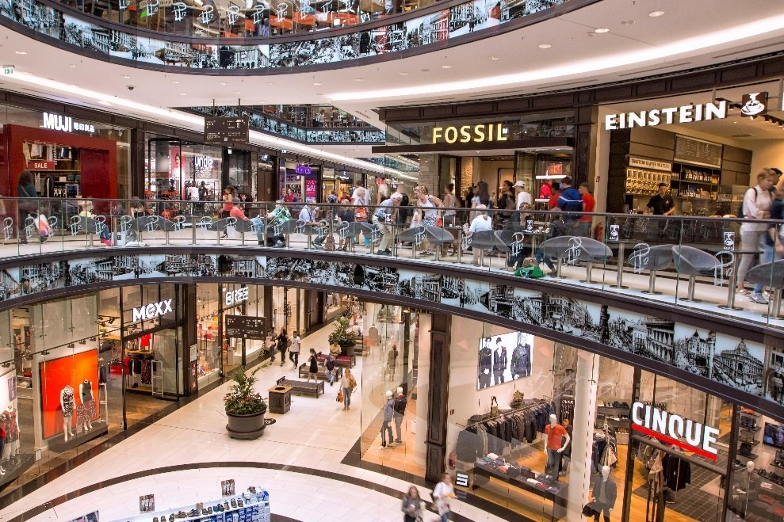
Global Retailing
Department stores
Specialty retailers
Supermarkets
Convenience stores
Discount stores and warehouse clubs
Hypermarkets
Category killers
Outlet stores / Villages
The LP12 Mall of Berlin opened in 2014 with 270 stores as well as apartments.

Slide 36
Global Retailing
Major European retailers spread to colonies in the 19th,
early 20th centuries
Global retailers serve developing nations with more products & better prices
Organised retail refers to modern, branded chain stores
  Only 8% of India’s total market !
  Sector is predicted to have double-digit growth

Slide 37
Top Global Retailers 2017
Rank | Company | Country | Formats | Sales ($ millions)
1 | Walmart Stores | United States | Discount store, wholesale club | $485,873
2 | Carrefour | France | Hypermarket | 82,996 (2016 data)
3 | Tesco PLC | United Kingdom | Supermarket/hypermarket | 69,501
4 | Metro AG | Germany | Diversified | 43,828
5 | Aldi | Germany | Discount store | NA

Slide 38
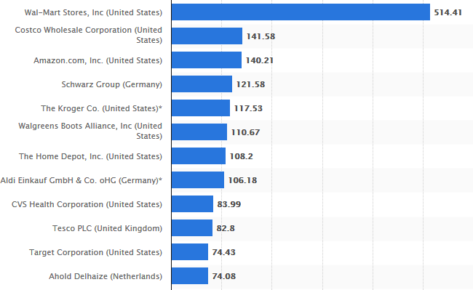
Top Global Retailers 2019

Slide 39
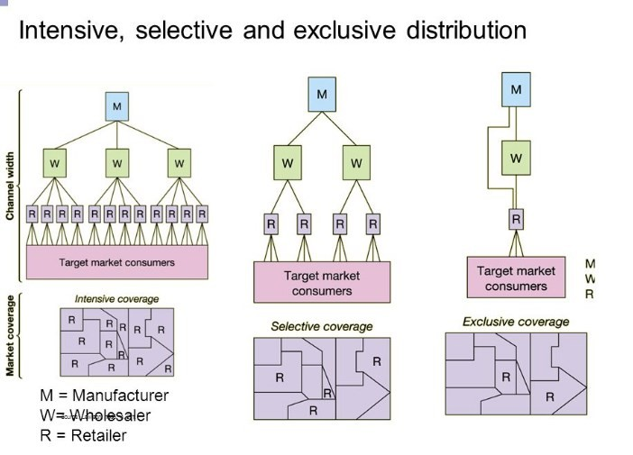
Products /Services
?
?
?

Slide 40
Thank you

Slide 41
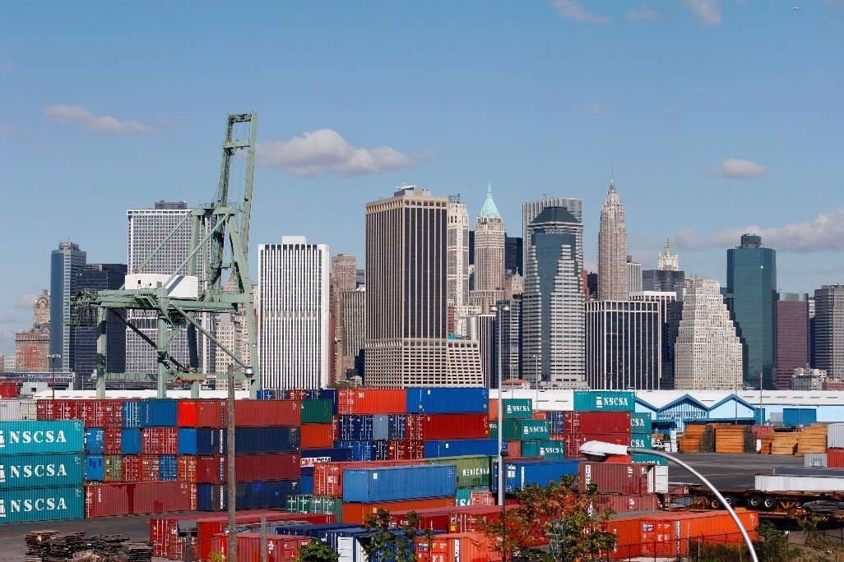
Supply Chain Definitions
Supply Chain
  Includes all the firms that perform support activities by generating raw materials, converting them into components or finished products, and making them available to customers
Logistics
  The management process that integrates the activities of all companies to ensure an efficient flow of goods through the supply chain

Slide 42
Physical Distribution, Supply Chains, and Logistics Management
Order Processing
  includes order entry in which the order is actually entered into a company’s information system; order handling, which involves locating, assembling, and moving products into distribution; and order delivery.
Warehousing
  Warehouses are used to store goods until they are sold
  Distribution centers are designed to efficiently receive goods from suppliers and then fill orders for individual stores or customers.

Slide 43
Physical Distribution, Supply Chains, and Logistics Management
Inventory Management
  Ensures that a company neither runs out of manufacturing components or finished goods nor incurs the expense and risk of carrying excessive stock of these items
  Social media can play an important role by connecting social media followers with the brand
Transportation
  Method or mode a company should utilise when moving products through domestic and global channels; the most common modes of transportation are rail, truck, air, and water

Slide 44
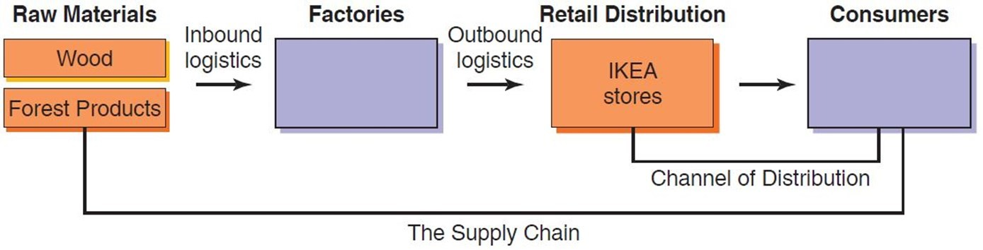
Supply Chain, Value Chain, and Logistics

Slide 45
Transportation
Comparison of Major International Transportation Modes
Mode | Reliability | Cost | Speed | Accessibility | Capability | Ease of Tracing
Rail | Average | Average | Average | High | High | Low
Water | Low | Low | Slow | Low | High | Low
Truck | High | Varies | Fast | High | High | High
Air | High | High | Fast | Low | Moderate | High
Pipeline | High | Low | Slow | Low | Low | Moderate
Internet | High | Low | Moderate to fast | Moderate; increasing | Low | High
Channel Strategy - analysing each shipping mode to determine which mode, or combination of modes, will be both effective and efficient in a given situation

Slide 46
CHANNELS
Companies entering emerging markets for the first time must exercise particular care in choosing a channel intermediary.
1. Select distributors. Don’t let them select you.
2. Look for distributors capable of developing markets, rather than those with a few good customer contacts.
3. Treat local distributors as long-term partners, not as temporary market-entry vehicles.
4. Support market entry by committing money, managers, and proven marketing ideas.

Slide 47
MARKETING CHANNELS

Slide 48
DELIVERING VALUE
channel of distribution as “an organized network of agencies and institutions that, in combination, perform all the activities required to link producers with users to accomplish the marketing task.”
Physical distribution is the movement of goods through channels; channels, in turn, are made up of a coordinated group of individuals or firms that perform functions that add utility to a product or service.
Distribution channels are one of the most highly differentiated aspects of national marketing systems. Channels and physical distribution are crucial aspects of the total marketing program; without them, a great product at the right price and effective communications mean very little

Slide 49
WHAT IS CUSTOMER VALUE PROPOSITION?
A customer value proposition is a business or marketing statement that describes why a customer should buy a product or use a service.
It is specifically targeted towards potential customers rather than employees, partners or suppliers.
Similar to the Unique Selling Proposition, it is a clearly defined statement that is designed to convince customers that one particular product or service will add more value or better solve a problem than others in its competitive set

Slide 50
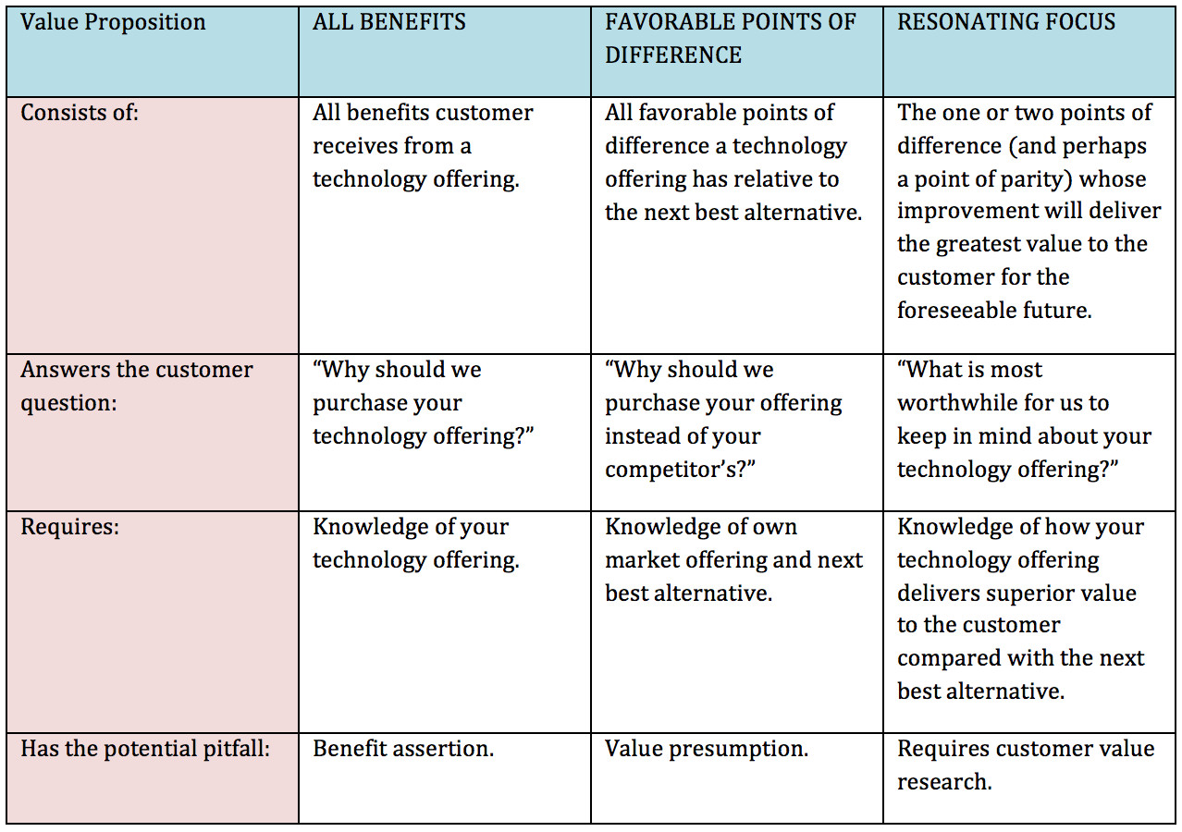
TYPES OF CUSTOMER VALUE PROPOSITION
Value proposition recognizes that customer has alternatives and focuses on how to differentiate one product from competitor.
List all the benefits
employees believe
that their offering
might deliver to
target customers
Suppliers provide customer value proposition by making their offerings superior on the few attributes that are most important to target customers and demonstrate the value of this superior performance, communicate it in a way that conveys a sophisticated understanding of the customer's business priorities.
Anderson, James C., Narus, James A., Rossum, Wouter, “Customer Value Propositions in Business Markets,” – Harvard Business Review, March 2006.

Slide 51
PHYSICAL DISTRIBUTION
Physical distribution consists of activities involved in moving finished goods from manufacturers to customers.
The most important distribution activities are order processing, warehousing, inventory management, and transportation

Slide 52
Supply chain planning and control
Supply chain planning
and control
Operations strategy
The market requires …
specified time, quantity and quality of products and services
Operations management
Design
Improvement
The operation supplies …
the coordinated delivery of products and services from the supply chain
Planning and control

Slide 53
WHAT IS SUPPLY CHAIN MANAGEMENT?
‘Supply chain management is the management of the interconnection of organizations that relate to each other through upstream and downstream linkages between the processes that produce value to the ultimate consumer in the form of products and services.’

Slide 54
SUPPLY CHAIN MANAGEMENT IS CONCERNED WITH MANAGING THE FLOW OF MATERIALS AND INFORMATION BETWEEN A STRING OF OPERATIONS
THAT FORM THE STRANDS OR ‘CHAINS’ OF A SUPPLY NETWORK
Flow between processes
Flow between processes
Supply network management concerns flow between operations
Flow between processes
Flow between processes
Flow between processes
Flow between processes
Flow between processes
Supply chain management concerns flow between a string of operations

Slide 55
Supply chain management is concerned with the flow of information as well as the flow of products and services
‘Upstream’ flow
of customer
requirements
Long-term plans and requirements
Market research information
Individual orders
Payment
Potential new products and services
Flow between processes
Flow between processes
Flow between processes
Consumer
Products and services
New products and services
Delivery information
Payment request / Credit
‘Downstream’ flow
of products and services
for customer
fulfilment

Slide 56
Second-tier supplier
First-tier supplier
First-tier customer
Second-tier customer
End customer
Supply side
Demand side
Purchasing and supply management
Physical distribution management
Information flow
Logistics
Physical flow
Materials management
Supply chain management

Slide 57
TAKING A CUSTOMER PERSPECTIVE OF SUPPLY PERFORMANCE
CAN LEAD TO VERY DIFFERENT CONCLUSIONS
Customer requirements
Customer satisfaction
From the customer’s perspective – 8% satisfaction
100
N
8
20
From the operations perspective – 90% satisfaction
Product/ service appropriate?
Y
N
80
10
N
40
N
Product/ service available?
Y
N
Y
70
50
10
1
N
Y
Y
9
1
Meets price and delivery requirements?
N
Y
20
8
10
Customer orders?
N
10
Y
1
Produced as promised?
Y
N
9
1
Received as promised?
Y
8

Slide 58
THE PURCHASING FUNCTION BRINGS TOGETHER
THE OPERATION AND ITS SUPPLIERS
Suppliers
Purchasing function
The operation
Request for quotations
Prepare
quotation for
specification,
price, delivery,
etc.
Requests
Request for products and services
Demand from customers
Liaison between purchasing and the operation
Select supplier(s)
Quotations
Produce products and services
Prepare purchase order
Receive products and services
Supply to customers
Order
Deliver

Slide 59
FACTORS FOR RATING ALTERNATIVE SUPPLIERS
Short-term ability to supply | Longer-term ability to supply
Range of products or services provided | Potential for innovation
Quality of products or services | Ease of doing business
Responsiveness | Willingness to share risk
Dependability of supply | Long-term commitment to supply
Delivery and volume flexibility | Ability to transfer knowledge as well as products and services
Total cost of being supplied | Technical capability
Ability to supply in the required quantity | Operations capability
 | Financial capability
 | Managerial capability

Slide 60
WEIGHTED SUPPLIER SELECTION CRITERIA FOR THE HOTEL CHAIN
Factor | Weight | Supplier A score | Supplier B score
Cost performance | 10 | 8 (8 x 10 = 80) | 5 (5 x 10 = 50)
Quality record | 10 | 7 (7 x 10 = 70) | 9 (9 x 10 = 90)
Delivery speed promised | 7 | 5 (5 x 7 = 35) | 5 (5 x 7 = 35)
Delivery speed achieved | 7 | 4 (4 x 7 = 28) | 8 (8 x 7 = 56)
Dependability record | 8 | 6 (6 x 8 = 48) | 8 (8 x 8 = 64)
Range provided | 5 | 8 (8 x 5 = 40) | 5 (5 x 5 = 25)
Innovation capability | 4 | 6 (6 x 4 = 24) | 9 (9 x 4 = 36)
Total weighted score |  | 325 | 356

Slide 61
Supply chain relationships
Business
Consumer
B2B
B2C
Relationship:
Most common, all but the last link in the supply chain
E-commerce examples:
EDI networks
Tesco information exchange
Relationship:
Retail operations
Catalogue operations, etc.
E-commerce examples:
Internet retailers
Amazon.com, etc.
Business
C2B
C2C
Relationship:
Consumer ‘offers’, business responds
E-commerce examples:
Some airline ticket operators
Priceline.com, etc.
Relationship:
Trading ‘swap’ and auction transactions
E-commerce examples:
Specialist ‘collector’ sites
eBay.com, etc.
Consumer

Slide 62
Types of supply relationship
Do everything
Vertically integrated operation
Traditional supply management
Do everything important
Character of internal operations activity
‘Partnership’ supply management
Virtual spot trading
Long-term virtual operation
Do nothing
Transactional – many suppliers
Type of inter-firm contact
Close –
few suppliers

Slide 63
Elements of process partnership relationships
Attitudes
Trust
Long-term expectations
Sharing success
Joint learning
Multiple points of contact
Closeness of relationship
Joint co-ordination of activities
Few relationships
Joint problem solving
Information transparency
Dedicated assets
Actions

Slide 64
The effects of supply chain compression
Supply chain time compression
Schedule changes impact market faster
Forecasts made closer to demand time
Defects are detected faster
New products and service faster to market
so can
respond to market changes better
so fewer lost sales from delayed launch
so reduced risk of obsolescence
so improved forecasts
so easier to improve quality
so less need for safety stocks
so revenues are maximized
so reduced stockholding costs
so reduced wastage costs
so revenues are maximized
so less discounted sales
Improved profitability

Slide 65
Supply chain dynamics
Supply chains with different end objectives need to be managed in different ways

Slide 66
Matching the supply chain with market requirements
Nature of demand
Functional products
Innovative products
Predictable
Few changes
Low variety
Price stable
Long lead-times
Low margin
Unpredictable
Many changes
High variety
Price markdowns
Short lead-times
High margin
Efficient
Low throughput times
High utilization
Deployed inventory
Flexible suppliers
Lean supply chain management
Mismatch
Supply chain objectives
Mismatch
Agile supply chain management
Low cost
High utilization
Minimum inventory
Low-cost suppliers
Responsive

Slide 67
Depot
Information
Products
Supplier
Manufacturer
Customer-responsive supply
Depot
Outlets
Depot
Products
Information
Supplier
Manufacturer
Efficient fast-throughput supply
Depot
Outlets

Slide 68
Matching supply chain characteristics to the nature of demand
Nature of demand
Functional products Innovative products
Predictable Unpredictable
Few changes Many changes
Low variety High variety
Price stable Price markdowns
Long lead-time Short lead-time
Low margin High margin
Match
Mismatch
Fast response Low cost
Low throughput time High utilization
Deployed inventory Minimum inventory
Flexible suppliers Low-cost suppliers
Supply chain objectives
Responsive Efficient
Mismatch
Match

Slide 70
Additional Reading

Slide 71
TYPES OF RETAILERS
Department stores have a product mix under one roof
Expansion outside of the home market is usually limited to a few countries
Two views:
“It’s quite difficult to transfer a department store brand abroad. You have to find a city with the right demographic for your offer. If you adapt your offer to the locality, you dilute your brand name.”
Maureen Hinton, London Retail Analyst
“Conceptually, department stores are global brands already because we live in a world with an enormous amount of travel between cities and continents.”
Marvin Traub, former CEO, Bloomingdales

Slide 72
TYPES OF RETAILERS
Specialty Retailers
Less variety than department stores
Offer merchandise depth & high levels of service
  The Body Shop,
  Victoria’s Secret,
  Starbucks
  Shell
Supermarkets
Between 50,000 & 60,000 sq. ft.
5,000 to 50,000 lines
UK Tesco is global (less than it was !)
Focused discounters
increasing market share

Slide 73


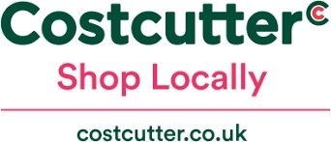

TYPES OF RETAILERS
Convenience Stores
High-turnover convenience & impulse goods
Prices 15-20% higher than grocery stores
7-11 is the world’s largest (64,000 locations)
Spar, Nisa, CostCutter…
Trend towards locating in malls, airports, office buildings, and college & universities
What about M&S Food ?

Slide 74
Types of Retailers
Shopping Centres
Groups of stores in one place
Enclosed or outdoor
Leisure destinations offer entertainment & convenience
Trend towards outdoor “lifestyle centres” with food courts & entertainment
Outlet Stores
Shops that offer excess inventory, out-of-date merchandise or factory seconds
Popular in the US since the 70’s, fast expanding into Europe & Asia

Slide 75
RETAILING TRENDS
Environmental Factors that cause retailers to look outside
the home country
  Saturation in the home country market
  Recession or other economic factors
  Search for scale related economies
  Strict regulation on store development
  High operating costs
Critical Question
  What advantages do they have relative to the local competition?

Slide 76
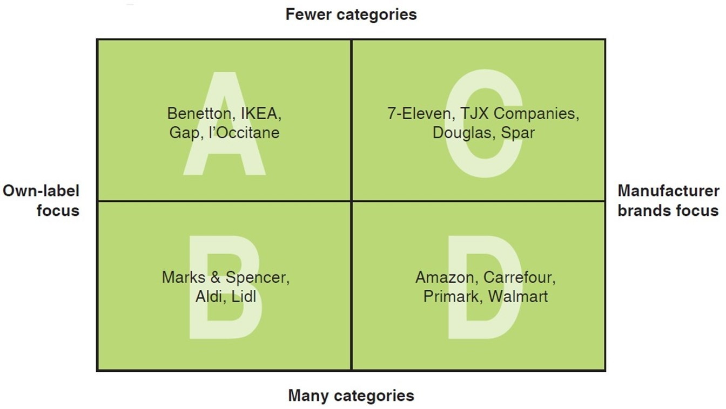
Global Retailing Categories

Slide 77
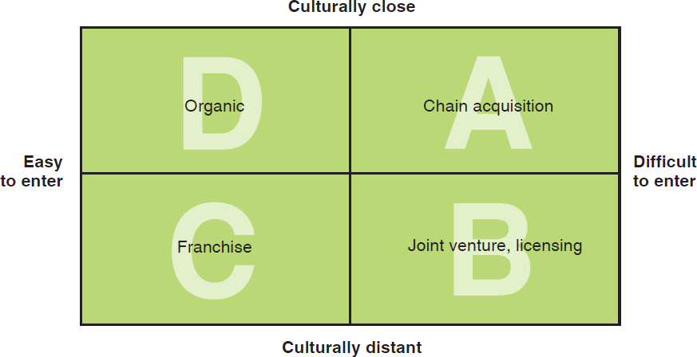
GLOBAL RETAILING MARKET ENTRY STRATEGY FRAMEWORK

Slide 78
Global Retailing Strategies
Organic Growth
  Company uses its own resources to open a store on a greenfield site or acquire one or more existing retail facilities
Franchise
  Appropriate strategy when barriers to entry are low yet the market is culturally distant in terms of consumer behavior or retailing structures
Chain Acquisition
  A market entry strategy that entails purchasing a company with multiple existing outlets in a foreign country
Joint Venture
  This strategy is advisable when culturally distant, difficult- to-enter markets are targeted

