Slide 1
MN7032SR
Communicating Value

Slide 2






Module Overview
9. International
1. Introduction
8. Market Entry
Sales (Producrts v
Strategies
Services ) B2C &
B2B
2. The Global
7. Delivering Value
10. Marketing and
Marketplace
(Channelnomics)
the impact of
Digital
3. Segmentation,
11. The New
Targeting,
6.Pricing Value
Customer Path
Positioning
(Connected consumers )
4. Developing
5.Communicating
12. Summary & Planning
Value
Value
Application
londonmet.ac.uk

Slide 3
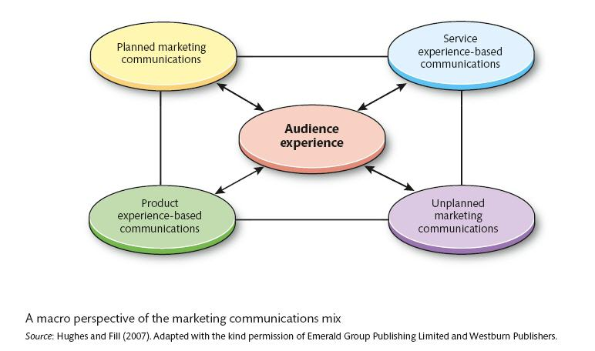
A Macro Perspective of Marketing Communications
Hughes and Fill (2007)
Notes:
Definition: Marketing communications, or promotion as it was originally called, is one element of the marketing mix. It is used to communicate elements of an organization’s offering to a target audience.
----------------
There are communications arising from unplanned or unintended experiences (empty stock shelves or accidents) and there are planned marketing communications (Duncan and Moriarty, 1997),
Communication: 1) Either planned or unplanned 2) Either about service or a product
Planned marketing communications incorporates three key elements: tools, media and messages. The main communication tools are advertising, sales promotion, public relations, direct marketing, personal selling and added-value approaches such as sponsorship.
Messages can be primarily informative or emotional but are usually a subtle blend of both dimensions reflecting the preferences and needs of the target audience.
To help get these messages through to their audiences, organisations use two main types of media. One refers to traditional media such as print and broadcast, cinema and outdoor. The other refers to the increasing use of digital media, and the Internet in particular, in order to listen to and converse with their audiences.
Unplanned marketing communications involve communications that have not been anticipated. These may be both positive and negative but here the emphasis is more on how the organisation reacts to and manages the meaning attributed by audiences. So, comments by third-party experts, changes in legislation or regulations by government, the actions of competitors, failures in the production or distribution processes or perhaps the most potent of all communications, word-of-mouth comments between customers, all impact on the way in which organisations and brands are perceived and the images and reputations that are developed
-------------------------------------

Slide 4

Communication is
“Always On”
Marketing messages can assume many forms with a variety of objectives.
  From quirky TV commercials and viral videos to blimps with blinking messages
  Savvy marketers know each element of the marketing mix is a form of communication!
All marketing communications aim to either inform, remind, persuade, or build relationships.

Slide 5
Integrated Marketing Communications (IMC)
Integrated marketing communication (IMC) involves the planning, execution, and evaluation of coordinated, brand communication programs over time to targeted audiences.
  Aim is to deliver consistent messaging across platforms.
  Must use a multichannel promotion strategy which combines traditional marketing communication with social media and other online activities.

Slide 6
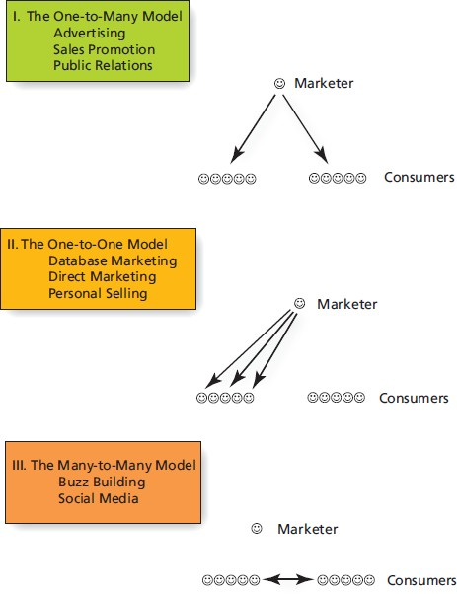
Three Models of Marketing
Communication

Slide 7
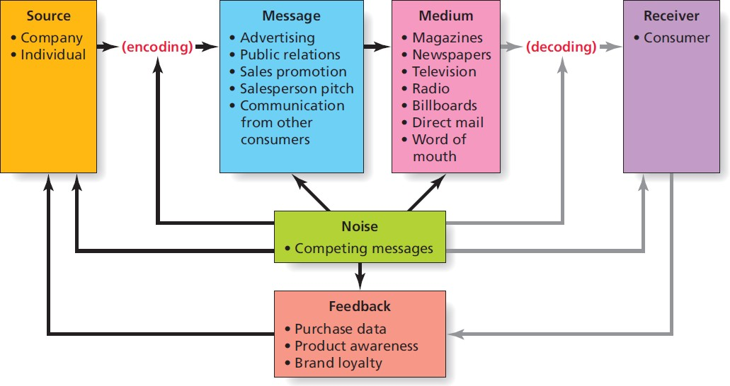
COMMUNICATION MODEL

Slide 8
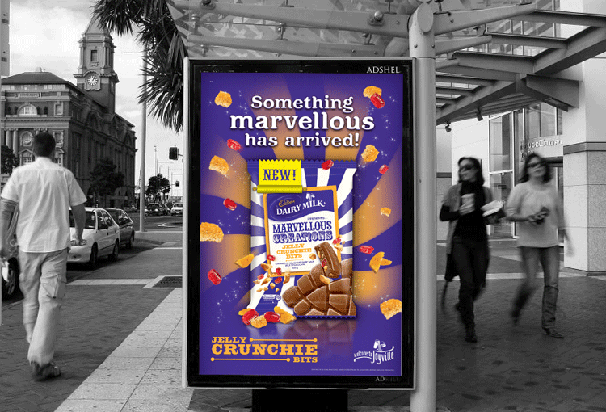
COMMUNICATIONS THEORY
It is the process by which individuals share meaning.
  Linear model of communication
  Two-step model of communication
Notes:
Let’s start with communication theory. This is important because it helps to
explain how and why certain marketing communication activities take place. Communication is the process by which individuals share meaning.
People in a communication are able to interpret the meanings embedded in the messages that they receive and then, as far as the sender is concerned, are able to respond coherently.
The act of responding is important because it completes an episode in the communication process.
Communication that travels only from the sender to the receiver is essentially a one-way process and the full communication process remains incomplete.
---------------------------------------------------------------
For example: When Cadbury presents its Dairy Milk chocolate bar, the person standing on the platform can read it, understand it, and may even enjoy being
entertained by it. He or she does not, however, have any immediate opportunity to respond to the ad in such a way that Cadbury can hear, understand, and act on the person’s comments and feelings.
What if– the same ad presented by a sales promotion representative when he/she is shopping in a supermarket, there are opportunities to hear, record, and even respond to the comments that person makes. This form of communication travels from a sender (Cadbury) to a receiver
(the person in the supermarket) and back again to Cadbury, and is referred to as a two-way communication and represents a complete communication episode.
---------------------------------------------------------------------
Through knowledge and understanding of the communications process, marketing managers are more likely to achieve their objective of sharing meaning with each member of their target audiences. This not only helps to create opportunities to interact with their audiences, but also encourages some people to develop a dialogue—the richest and most meaningful form of communication.
---------------------------
There are three models of communication: the linear model; the two-way model; and the interactive model of communication.

Slide 9

THE SOURCE ENCODES
Process begins with a source with an idea that they want to communicate to a receiver.
Encoding is the process by which the idea is translated into a physically perceivable form that conveys meaning.
  Words, music, and imagery
  Spokespeople
  Animated characters

Slide 10

Encoding…
londonmet.ac.uk

Slide 11
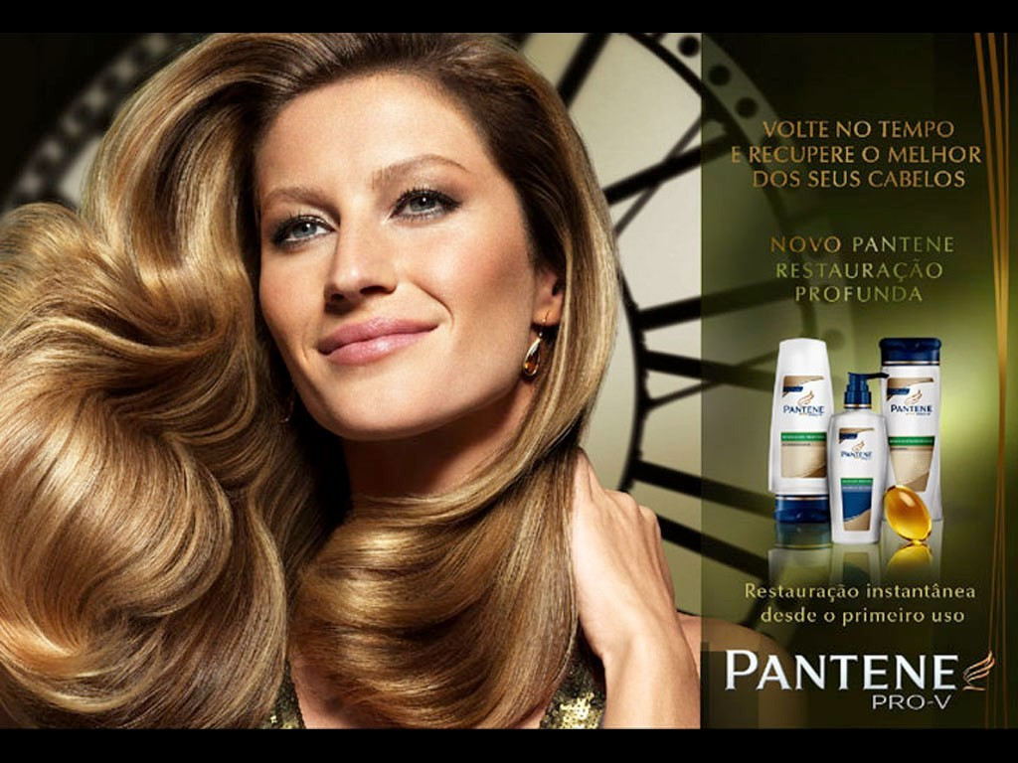
Encoding …
londonmet.ac.uk

Slide 12

The Message
The message is the actual content of communication that goes from the source to a receiver.
May be in the form of:
  Advertising
  Sales promotion
  A salesperson’s pitch
  Infomercial
  Websites, social media, blogs, search engines
  Word of mouth / Advocacy

Slide 13
The Medium
The medium is the communication vehicle that reaches members of the target audience.
Marketers face two major challenges :
  Target market exposure to medium
  Product characteristics are not in conflict with the medium.

Slide 14

The Receiver Decodes
For effective decoding to occur, the source and the receiver must share a frame of reference.
In this ad, the receiver needs to understand the meaning of the “white flag” in order for the message to make sense.

Slide 15
NOISE AND FEEDBACK
The communication model also acknowledges that noise—anything that interferes with effective communication—can block messages.
To complete the communication loop, the source gets feedback from receivers.

Slide 16
THE TRADITIONAL PROMOTIONAL MIX
Promotion mix refers to communication elements that the marketer controls.
  Mass (one-to-many) communication: includes
advertising, sales promotion, and public relations.
  Personal (one-to-one) communication: includes personal selling and direct marketing.

Slide 17
Marketing Communications
Marketing communications inform, remind, persuade, and build relationships with consumers.
  IMC involves coordination of messaging to target customers across platforms over time.
The communication model explains how organisations create and transmit messages.
Marketers are spending less and less each year on mass-media advertising in favour of digital and mobile outlets. What in your view is the trend ?

Slide 18
Step 1: Identify the Target Audience(s)
Must communicate with more than just members of the target market
Other stakeholders influence the target market
Consumers learn about products from
  News media
  Friends and family
  Producers of competitive products

Slide 19
Step 2: Establish the
Communication Objectives
Creating a new customer occurs as a result of a series of messages.
Messages are designed to move the consumer closer to purchase, and hopefully, loyalty through a series of steps known as the hierarchy of effects.

Slide 20
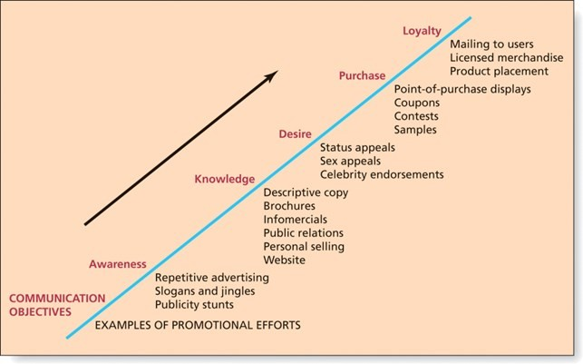

Slide 21
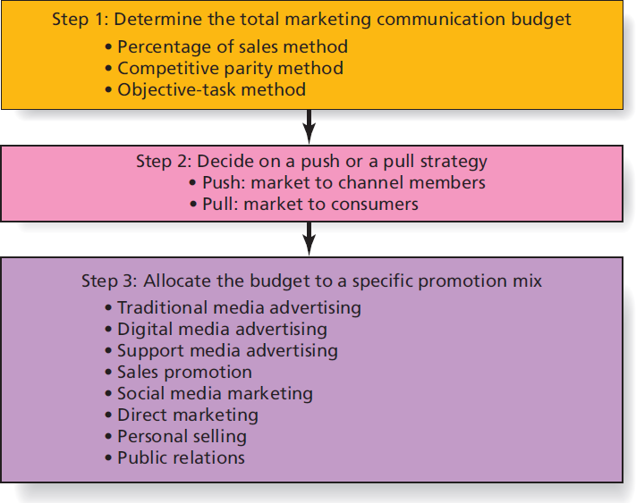
Step 3: Determine the Marketing Communication Budget

Slide 22

DETERMINE THE TOTAL MARKETING COMMUNICATION BUDGET
Top-down budgeting techniques
  Percentage-of-Sales method
  Competitive-parity method
Bottom-up budgeting techniques
  Objective-task method

Slide 23
Step 4: Design the Comms Mix
Designing the comms mix involves:
  Determining communication tools to be used
  Specifying message to be communicated
  Determining the communication channels to be used.

Slide 24
Step 5: Evaluate the Effectiveness of
the Communication Programme
Marketers use a variety of ways to monitor and
evaluate the company’s communication efforts.
Various types of sales promotion are the easiest to evaluate as they often occur over a fixed, short period.
Advertising has lagged or delayed effects, more difficult to clearly link to sales… until the advent of digital media .
  Measure brand awareness, recall of product benefits communicated, and image of the brand before and after any campaign.

Slide 25
MULTICHANNEL PROMOTION STRATEGIES
Combination of traditional advertising, sales promotion, public relations, and direct marketing activities with social media activities
Boost effectiveness of either online or offline strategies used alone
Allow marketers to repeat their messages across various channels.

Slide 26
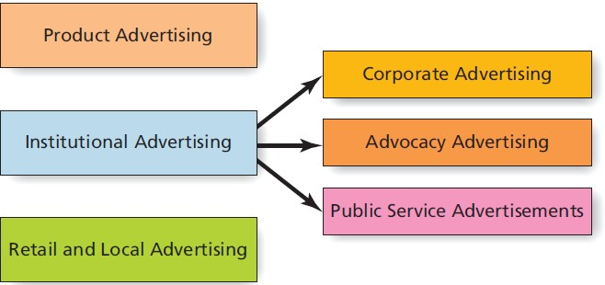
Types of Advertising

Slide 27
Ethical Issues in Advertising
Advertising, more than any other aspect of marketing, has been criticised ;
  Advertising is manipulative,
  is deceptive and untruthful,
  is offensive and in bad taste, and
  causes people to buy things they don’t really need.

Slide 28
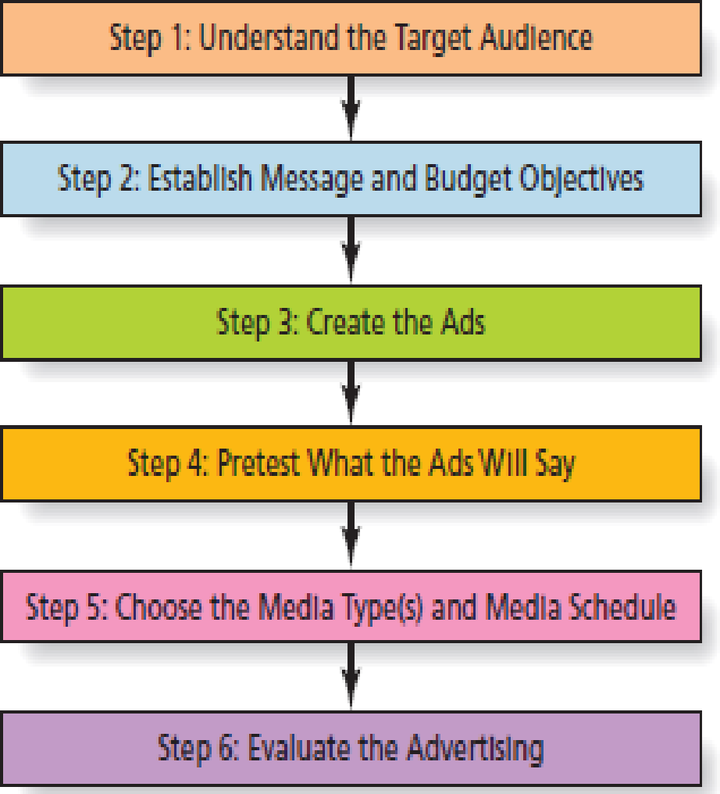
Steps to Develop an Advertising Campaign

Slide 29
ADVERTISING APPEALS
Informational Appeals satisfies consumers’
practical need for information
Emotional Appeals try to influence emotions
A Unique Selling Proposition focuses on clear reason why a product is superior
Reminder Advertising keeps the name of a brand
in people’s minds
Teaser or Mystery Ads generate curiosity

Slide 30
Where to Say It: Traditional Mass Media
Where your market is !
•
TV is often the medium of choice, but is still expensive
Radio is flexible but is declining in use
Newspapers are excellent for local ads
Magazines are varied in scope and can target local markets with selective binding

Slide 31
Where to Say It: Support Media
Directory advertising is information-focused advertising such as the Yellow Pages
Out-of-home media reaches people in public places
Place-based media transmits messages in public places where certain people congregate (airports, doctors’ offices, etc.)

Slide 32
Where to Say It: Digital Media
Owned media may include websites, blogs,Meta, Instagram and X accounts.
  Controlled by company, effective for relationship building
Paid media includes display ads, sponsorships, and paid key word searches.
  Most similar to traditional advertising, less trusted by consumers
Earned media refers to word of mouth or buzz on social media.
  Most credible to consumers, no company control

Slide 33
Website Advertising
Online advertising
  Adults now spend more time on mobile devices than TV.
Target customers via:
Website advertising
  Banners, buttons, and pop-up ads
Permission e-mail marketing
Search engines
Mobile advertising
Video sharing

Slide 34

Social Media Marketing
Marketers no longer are the only ones who talk about their products.
  Millions of consumers have the ability and desire to spread good (or bad) news about products.
  The many-to-many communication model is based on consumers talking to one another about goods, services, and organizations.
  Consumer advocacy / Reviews / MtM

Slide 35
Social Media
Internet-based platforms that allow users to create their own content and share it with others who access these sites.
Examples of social media include Facebook, Twitter, Pinterest, Instagram, YouTube, Yelp, Wikipedia, and Second Life.

Slide 36

Social Networks
Social networks, like Facebook and Twitter, are sites that connect people with other people.
  Marketers monitor social networks to learn what consumers are thinking about the brand and the competition..
  Marketers reach influential opinion leaders by
participating in social media conversations.
  Social networks provide an opportunity to create a
brand community.

Slide 37
Product Review Sites
Product review sites: Social media sites that enable people to post stories about their experiences with goods and services.
  Popular review sites include TripAdvisor, Which, Yelp
  Also most commercial sites include customer review sections

Slide 38
Mobile Apps and Location-Based Social Networks
Location-based social networks integrate sophisticated GPS technology that enables users to alert friends of their exact whereabouts via their mobile phone.
Augmented reality (AR) views a physical real world enhanced or altered by computer-generated sounds, videos, graphics or GPS data. (IKEA)

Slide 39
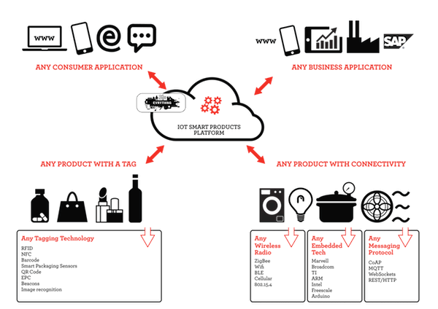
THE INTERNET OF THINGS
The Internet of Things refers to network of physical things, vehicles, buildings, devices which have embedded sensors, electronics, and network connectivity that can collect data and communicate it to each other—the many-to-many of things.

Slide 40
DIRECT MARKETING
Any direct communication to a consumer or business designed to generate a response in the form of an order, a request for further information or a visit to a place of business for purchase of a product.
Includes mail order, telemarketing, direct response advertising, social media, and M-commerce

Slide 41
When and How Often to Say It
A media schedule is a plan that specifies exact media to use and when to use it.
Reach is the percentage of the target market that will be exposed to the media vehicle.
Frequency is the average number of times a person in the target group will be exposed to a message.
Gross rating points compare effectiveness of different media vehicles. (GRPs)
Cost per thousand is the cost to deliver a message to 1,000 people or homes.

Slide 42
Personal Influencers
Opinion Leaders belong to the same peer group as the people they influence, they are more gregarious and more self-confident than non-leaders and are more confident of their role. Their influence is based on informal expertise.
Opinion Formers do not (necessarily) belong to the same peer group as the people they influence. They exert personal influence because of their profession, authority, education or status associated with the object of the communication process. Their influence is based on formal expertise.
Word of Mouth has become one of the most significant and most powerful forms of marketing communications
Notes:
-----------------------
Opinion leaders:
they belong to the same peer group as the people whom they influence;
Studies by Katz and Lazarsfeld (1955) into American voting and purchase behaviour led them to conclude that some individuals were more predisposed to receiving information and then reprocessing it to influence others.
They found that these individuals had the capacity to be
more persuasive than information received directly from the mass media
-----------------------
Opinion formers:
These people are not part of the same peer group as the people whom they influence. Their defining characteristic is that they exert personal influence because of their profession, authority, education, or status associated with the object of the communication process. They provide information and advice as part of the formal expertise that they are perceived to hold.
For example, shop assistants in music equipment shops are often experienced musicians in their own right.
------------------------
Organizations target their marketing communications at opinion leaders and formers in order to penetrate the market more quickly than relying on communicating directly with the target audience. in addition to these forms of influence, reference needs to be made to spokespersons.
There are some potential problems of which advertisers need to be aware when considering the use of celebrities: first, does the celebrity fit the
image of the brand and will the celebrity be an acceptable ‘face’ of the brand, to the target audience, now and in the long run?
Next slide
---------------------------------------
Word-of-mouth communication is ‘interpersonal communication regarding products or services where the receiver regards the communicator as impartial’ (Stokes and Lomax, 2002). This is because
customers perceive word-of-mouth recommendations to be objective and unbiased. In comparison to advertising messages, word-of-mouth communications are more robust (Berkman and Gilson, 1986). Word-of-mouth messages are used either as information inputs prior to purchase, or as a support and reinforcement of their own purchasing decisions.
For example, websites such as TripAdvisor feature reviews and advice from those who have first-hand experience of hotels, resorts, flights, holiday rentals, and holidays.

Slide 43
Where do marcoms objectives come from?
Corporate Mission
Corporate Objectives
Marketing Objectives
Marketing Strategy
Marketing Communications Objectives

Slide 44
A Definition of Marketing Communications
“Marketing communications is a management process through which an organisation attempts to engage with its various audiences. By understanding an audience’s communications environment, organisations seek to develop and present messages for its identified stakeholder groups, before evaluating and acting upon any responses.
By conveying messages that are of significant value, audiences are encouraged to produce attitudinal and behavioural responses”
Fill (2005)
Notes:
ROMI

Slide 45

Three Elements of Marketing Communications
Audiences to target – which specific audience(s) do we need to communicate with and what are their various behaviour and information processing needs? (Who?)
How to Engage them? – what are the audiences’ communications needs and is it possible to engage with them on their terms using one-way, two-way or dialogic communications? (How: Com Need?)
What Responses to aim for? – what are the desired outcomes of the communication process? Are they based on changes in perception, values and beliefs or are changes in behaviour required? (consider Drip – see next slide)
Notes:
This means that everything anybody ever says always exists in response to things that have been said before and in anticipation of things that will be said in response.
In a dialogic process, various approaches coexist and are comparatively existential and relativistic in their interaction. Here, each ideology can hold more salience in particular circumstances. Changes can be made within these ideologies if a strategy does not have the desired effect.

Slide 46
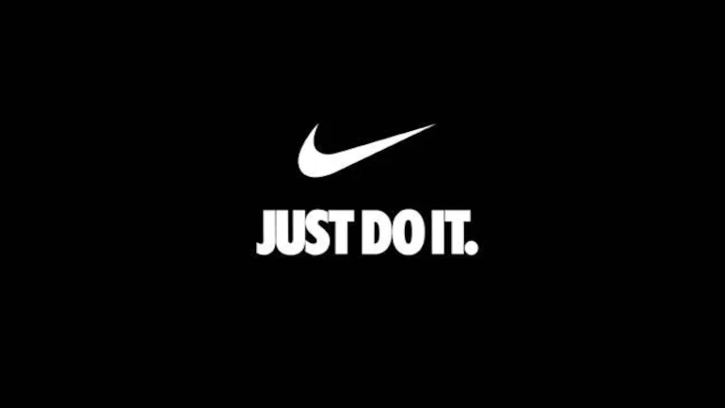

DRIP – Purposes of Communications
Differentiate- to position a brand so that it is perceived to be different to its competitors
Reinforce- to remind or reassure customers about a brand
Inform - to make customers aware of a brand’s existence or attributes
Persuade- to encourage customers to behave in particular ways
Notes:
Nike & Adidas- to differentiate
In many markets, there is little to separate brands (e.g. mineral water, coffee, printers). In these cases, it is the images created by marketing communications that help to differentiate one brand from another and to position them, so that consumers develop positive attitudes and can make purchasing decisions.
------------------------------
To reinforce
Communications may be used to remind people of a need that they might have or of the benefits of past transactions, with a view to convincing them that they should enter into a similar exchange.
Target- existing customer. provide reassurance or comfort either immediately prior to an exchange or, more commonly, post-purchase. This is important because it helps to retain current customers and improve profitability.
------------------------------
To inform
McDonald- next slide
Disney + next slide

Slide 47

McDonald’s Samurai Beef Burger
Notes:
To inform
https://www.youtube.com/watch?v=j7sXpbi11AU

Slide 48
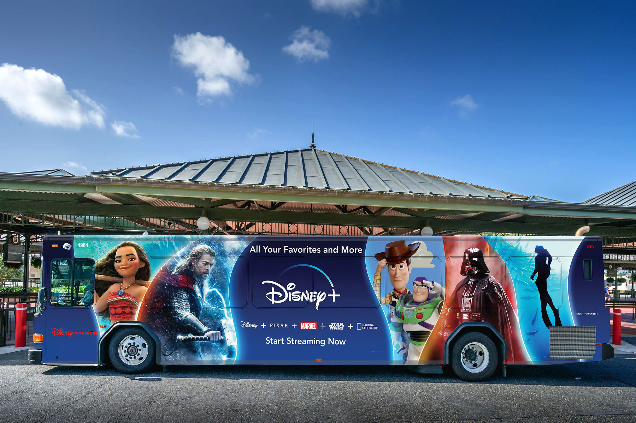
DISNEY’S BUS ADVERTISING
Notes:
To inform

Slide 49
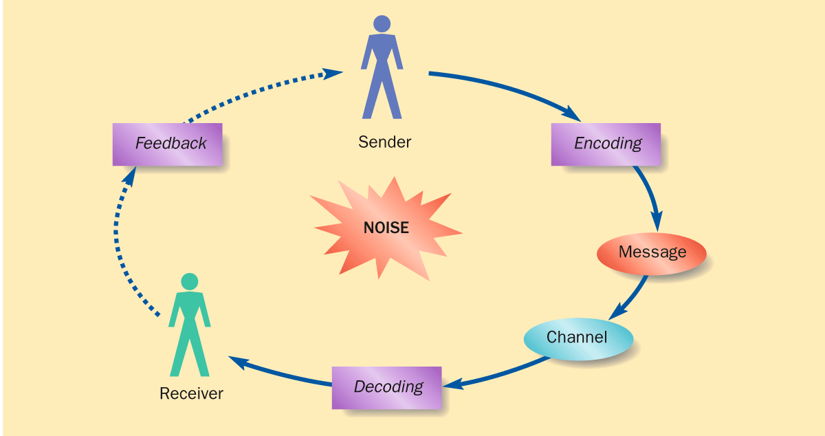
SIMPLE COMMUNICATION MODEL

Slide 50
THE MARKETING COMMUNICATIONS MIX
Tools
Target Audience
Media
Content
Notes:
Tool: Advertising, Sales promotion, personal selling, public relations, direct marketing
Next slide:
Media: Social media, traditional media (radio, TV, newspapers), website, mobile, third-party websites, word-of-mouth

Slide 51
Promotional Tools
Personal Selling
Advertising
Branding
Sales
Promotion
Sponsorship
Public relations
The
Customer
Packaging
Merchandising
Corporate Image
Direct/Digital Marketing
Internal Marketing
Exhibitions
Word of Mouth

Slide 52
FIVE CORE TOOLS
Advertising
Sales Promotion
Public Relations
Direct Marketing
Personal Selling

Slide 53
ADVERTISING
Advertising is a non-personal form of communication, where a clearly identifiable sponsor pays for a message to be transmitted through media. One of the distinctive qualities that advertising brings to the mix is that it reaches large, often mass audiences in an impersonal way.
  Advertising can be used to influence demand for products (and services).
  Advertising can be used to manage perceptions and understanding about the organization as a whole.
The role of advertising is to engage audiences and this engagement is dependent upon the context in which the communication occurs.

Slide 54
SALES PROMOTION
Sales promotions work by offering customers an incentive to buy now rather than in the future, they ‘accelerate’ sales. They provide additional value, in order to induce an immediate sale.
Sales promotions are used extensively in consumer markets.
Need to be used integrated with other communication tools, such as advertising, personal selling and direct marketing.
Sampling, coupons, price deals, premiums and bonus packs are the more common consumer sales promotion techniques.

Slide 55
Public Relations (1)
………… is a management activity that attempts to shape the attitudes and opinions held by an organisation’s stakeholders. It attempts to identify its own policies with the interests of its stakeholders and formulates and executes a programme of action to develop mutual goodwill and understanding. Through this process relationships are developed which are in the long-run interests of all parties.

Slide 56
Public Relations Methods (2)
Public relations does not require the purchase of airtime or space in media vehicles, such as television or magazines. The outcome is that these messages usually carry greater perceived credibility than those messages transmitted through paid media, such as advertising.
There is a low level of control over PR messages.
As no media time has to be purchased the costs of public relations are very low compared to the other tools of the mix.
The main methods are: Media Relations, Publicity and Events, Lobbying, Sponsorship, Crisis Management, Public Affairs, Industry Relations, Issues Management.

Slide 57
Direct Marketing
Direct marketing refers to all media based activities that generate a series of communications and responses directly with an existing or potential customer.
The key role of direct marketing is to reach target audiences with personalized and customized messages that aim to provoke a change in the audience’s behaviour.
A secondary role of direct marketing is to collect customer information, in order to feed future strategies and campaigns.
In order to reach audiences with call-to-action messages, direct marketing uses a variety of media. These include the telephone, Internet, direct mail, email, press and posters.

Slide 58
Personal Selling
Personal selling concerns interpersonal communication and the role is largely one of representation.
Personal selling is a highly potent form of communication simply because messages can be adapted to meet the requirements of both parties, who meet face-to-face, as the communication develops.
Objections can be overcome, information provided in the context of the buyer’s environment and the conviction and power of demonstration can be brought to the buyer when requested.

Slide 59
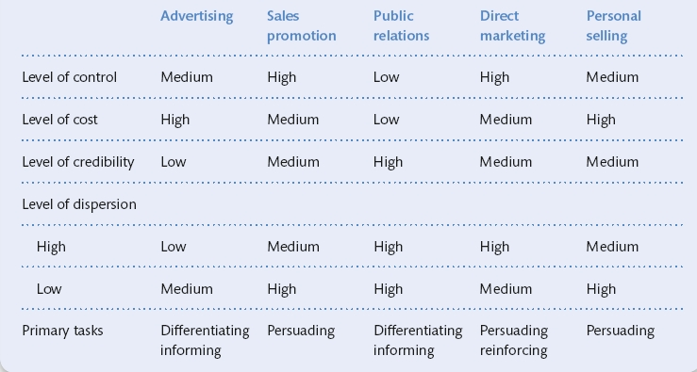
SELECTING THE RIGHT TOOLS
Table 11.2
A consumer audience, often national, can be reached effectively only if tools
of mass communication such as advertising and sales promotion are used (Fill, 2006).

Slide 60
SOME OTHER PROMOTIONAL METHODS
Sponsorship
Product Placement
Field Marketing
Exhibitions
Viral Marketing
Notes:
Field marketing involves working on site to connect with markets. As such, it comprises all marketing activities that involve face-to-face contact with the consumer. For some companies, it includes coordinating large sales teams who meet with customers face to face, while others run street promotions and hand out flyers

Slide 61
The Six Classes of Media
Print Media - newspapers and magazines are the two main media,
others include custom magazines and directories.
Broadcast - television and radio can reach mass audiences with at a
relatively low cost per target reached.
Outdoor - street furniture (such as bus shelters); billboards and Transit
(which includes buses, taxis and the underground).
In-Store - point-of-purchase displays and packaging. Retailers control
the former and manufacturers the latter.
Digital - includes Internet and online marketing, wireless, mobile and
interactive tv.
Other - includes two main media; cinema and ambient (e.g. back of
tickets).

Slide 62
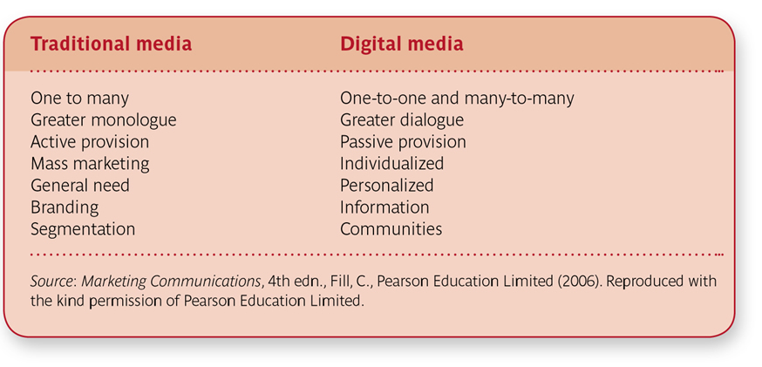
A Comparison of Traditional and Digital Media

Slide 63
Two Key Types of Messages
Information based messages use factual, rational content, often featuring a product’s key attributes. This style is often used where the audience experiences high involvement.
Emotional based messages use sensory, lifestyle and values based content in order to provoke an emotional response. This style is often used where an audience experiences low-involvement.

Slide 64
3 Ps of communications (Pull, Push and Profile)
Pull – aims to encourage customers to ‘pull’ products through the channel
Push – aims to communicate with members of the channel to encourage them to ‘push’ products through the channel
Profile – aims to develop corporate reputation and image

Slide 65
The Marketing Communications Planning Framework (issues to consider)
Who should receive the messages?
What the messages should say?
What image of the organisation/brand receivers are expected
to retain?
How much budget is to be spent establishing this new image?
How the messages are to be delivered?
What actions the receivers should take?
How to control the whole process once implemented?
What was achieved?
© Chris Fill

Slide 66
The communications plan
Situation Analysis (Here & Now!)
Goal (Why?)
Target Groups (Who?)
Specific Communications Objectives (What?) (When?)
Tools, Techniques, Channels and Media
  (How? & Where?) (When?)
Budgets (How much?)
Measurements of results (How effective?)
Source: De Pelsmaker
3

Slide 67
The Marketing Communications Planning Framework
Context Analysis
Communication
Goals &
Positioning
Corporate Goals
Market Research
Marketing Goals
3Ps of Communication
Strategy
Communication Goals
Agencies
Pull
Coordinated
Communication
Mix
Push
Profile
Scheduling
Resources
Tools
Media
Implementation, Control
& Evaluation
Messages
Fill (2002)

Slide 68

Reflection – Disneyland

Slide 69
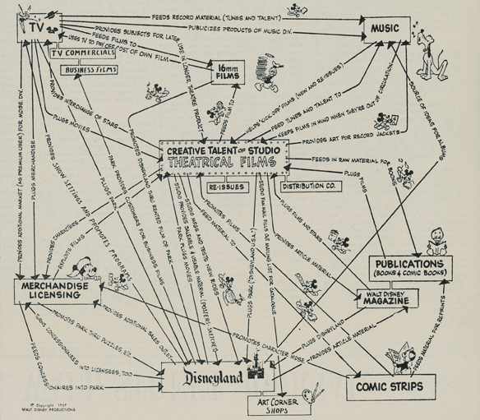
In 1957,
Notes:
This 1957 map of Walt Disney’s vision defined his company’s key assets, including a valuable and unique core, and identified patterns of complementarity among them. It implicitly revealed the industry’s future evolution and provided guidance concerning adjacent competitive terrain that Disney might explore.
This is an entertainment-related assets- books, comic books, music, TV, magazine, themepark, merchandise licensing.
comic strips promote films, films “feed material to” comic strips.
The theme park, Disneyland, plugs movies, and movies plug the park
After 64 years, we are still working out with this.
------------------------------------
Walt’s theory in words might read: “Disney sustains value-creating growth by developing an unrivaled capability in family-friendly animated (and live-action) films and then assembling other entertainment assets that both support and draw value from the characters and images in those films.”
---------------------
Within 15 years leadership at Disney seemed to lose sight of his vision. As the company’s films markedly shifted away from the core capability of animation, Film revenues declined.
Eisner followed the strategy, and Disney’s box office share jumped from 4% to 19%. Character licensing grew by a factor of eight.
The company failed to keep up with technology trends and the best-in-the-world animators migrated from Disney to Pixar. Disney gained access to their skills through a contract, but the relationship between Disney and Pixar grew contentious and was finally severed just before Eisner stepped down, in October 2005.
Robert Iger, quickly moved not merely to repair the Pixar relationship but to acquire the company, for more than $7 billion.
https://hbr.org/2013/06/what-is-the-theory-of-your-firm

Slide 70

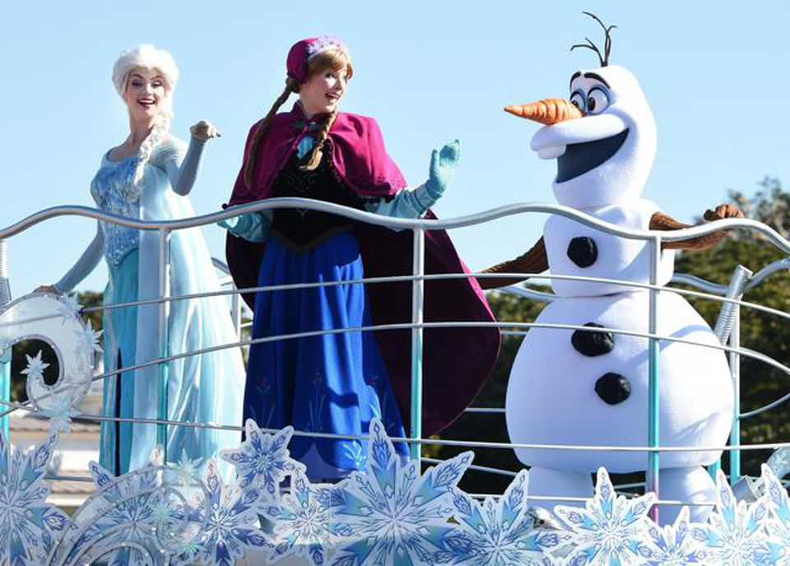
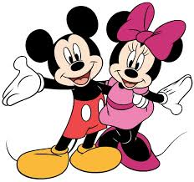
The Walt Disney Company Announces Strategic Reorganization (2018)
What can we learn from Walt Disney Company?
Notes:
https://thewaltdisneycompany.com/walt-disney-company-announces-strategic-reorganization/
https://www.forbes.com/sites/willburns/2015/06/09/disney-proves-that-profitable-marketing-is-about-brand-stories/?sh=1f197ebe227b
Content marketing🡪 Stories first, products later.
Disney has refocused on its core movie franchises under the leadership of CEO Robert Iger.

Slide 71
SOCIAL NETWORKS
DEFINITION:
Use of internet to connect with people and share information, photos,
messages etc

Slide 72
SOCIAL NETWORKS
Wasserman, S. and Faust, K., 1994. Social network analysis: Methods and applications.

Slide 73
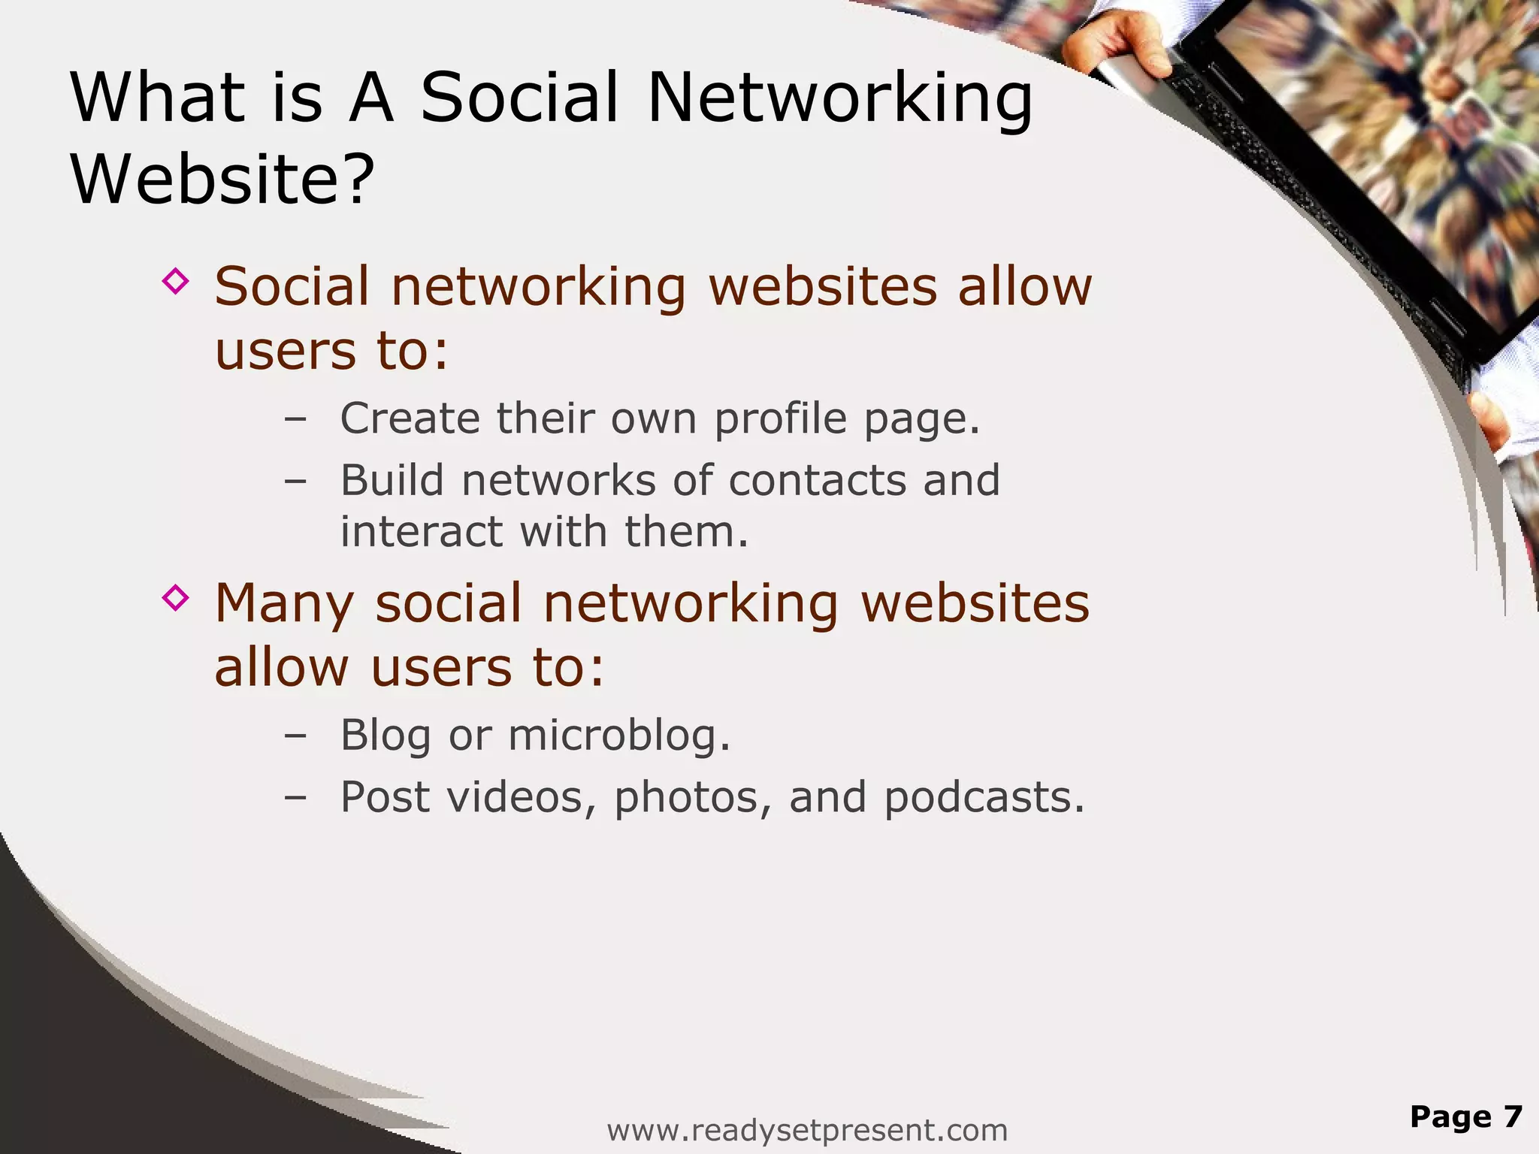
SOCIAL NETWORKS
Wasserman, S. and Faust, K., 1994. Social network analysis: Methods and applications.

Slide 74
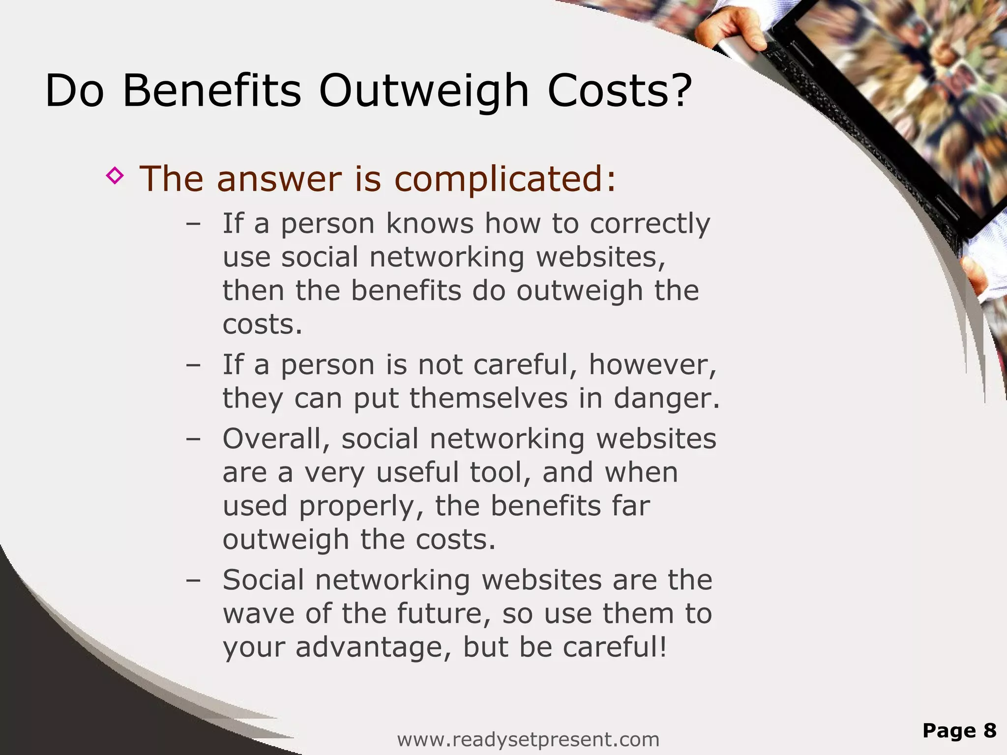
SOCIAL NETWORKS
Wasserman, S. and Faust, K., 1994. Social network analysis: Methods and applications.

Slide 75
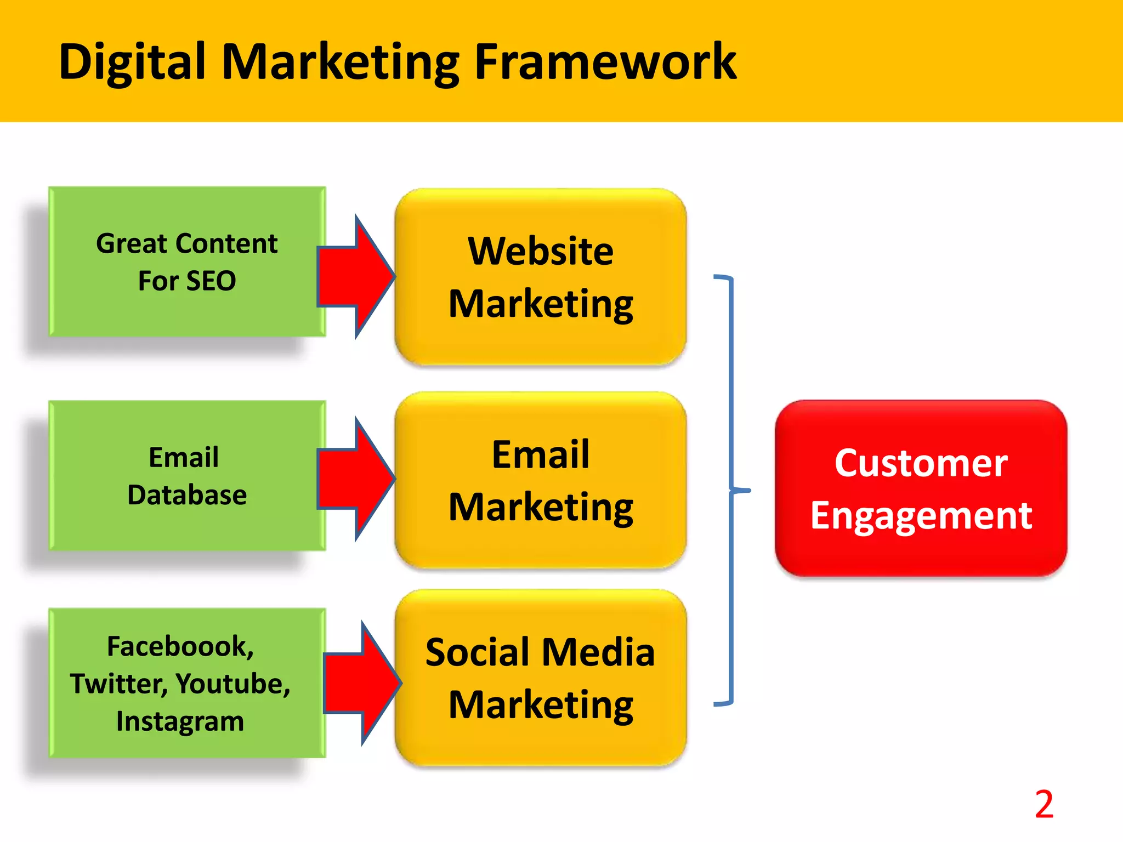
SOCIAL NETWORKS
Wasserman, S. and Faust, K., 1994. Social network analysis: Methods and applications.

Slide 76
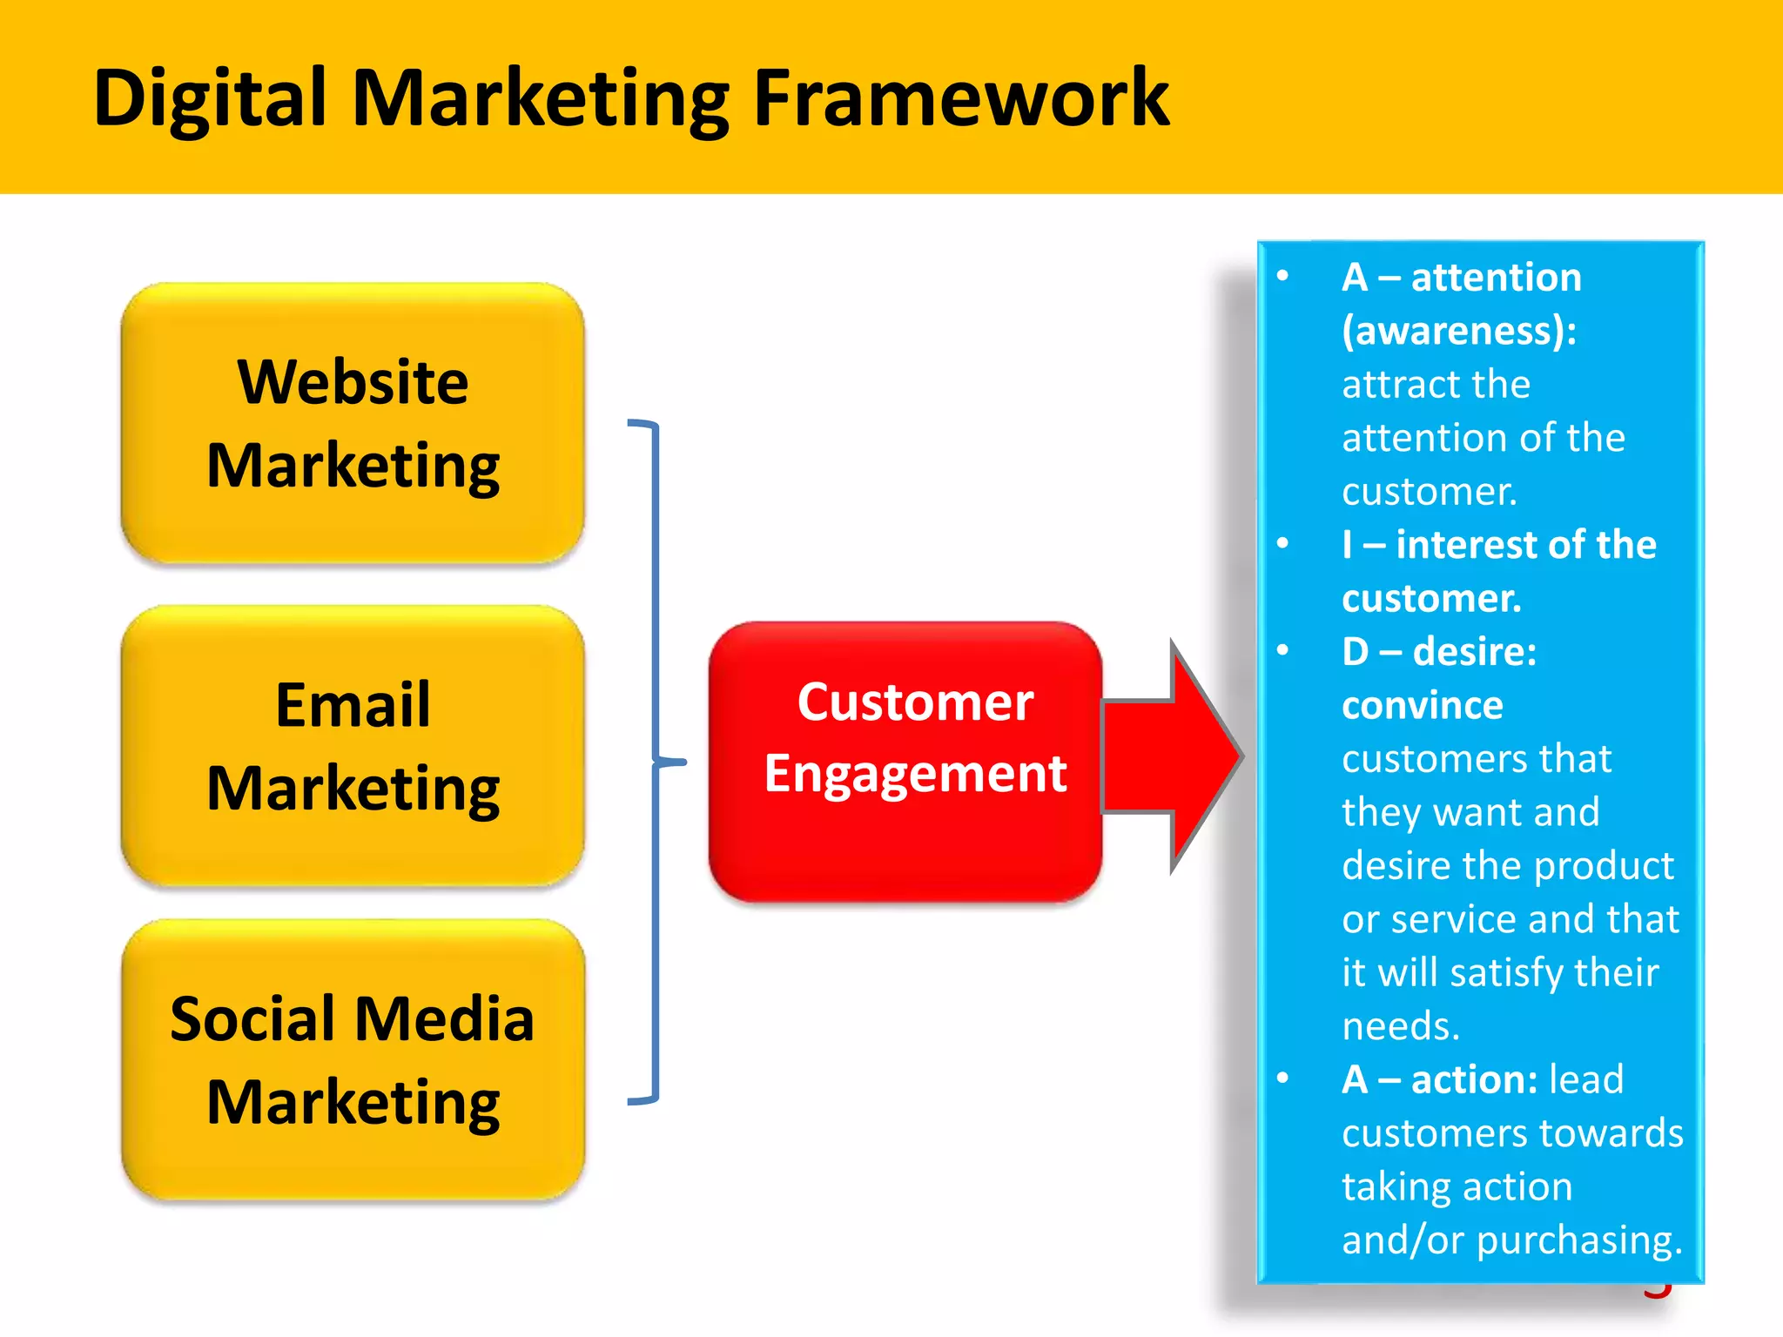
SOCIAL NETWORKS
Wasserman, S. and Faust, K., 1994. Social network analysis: Methods and applications.

Slide 77
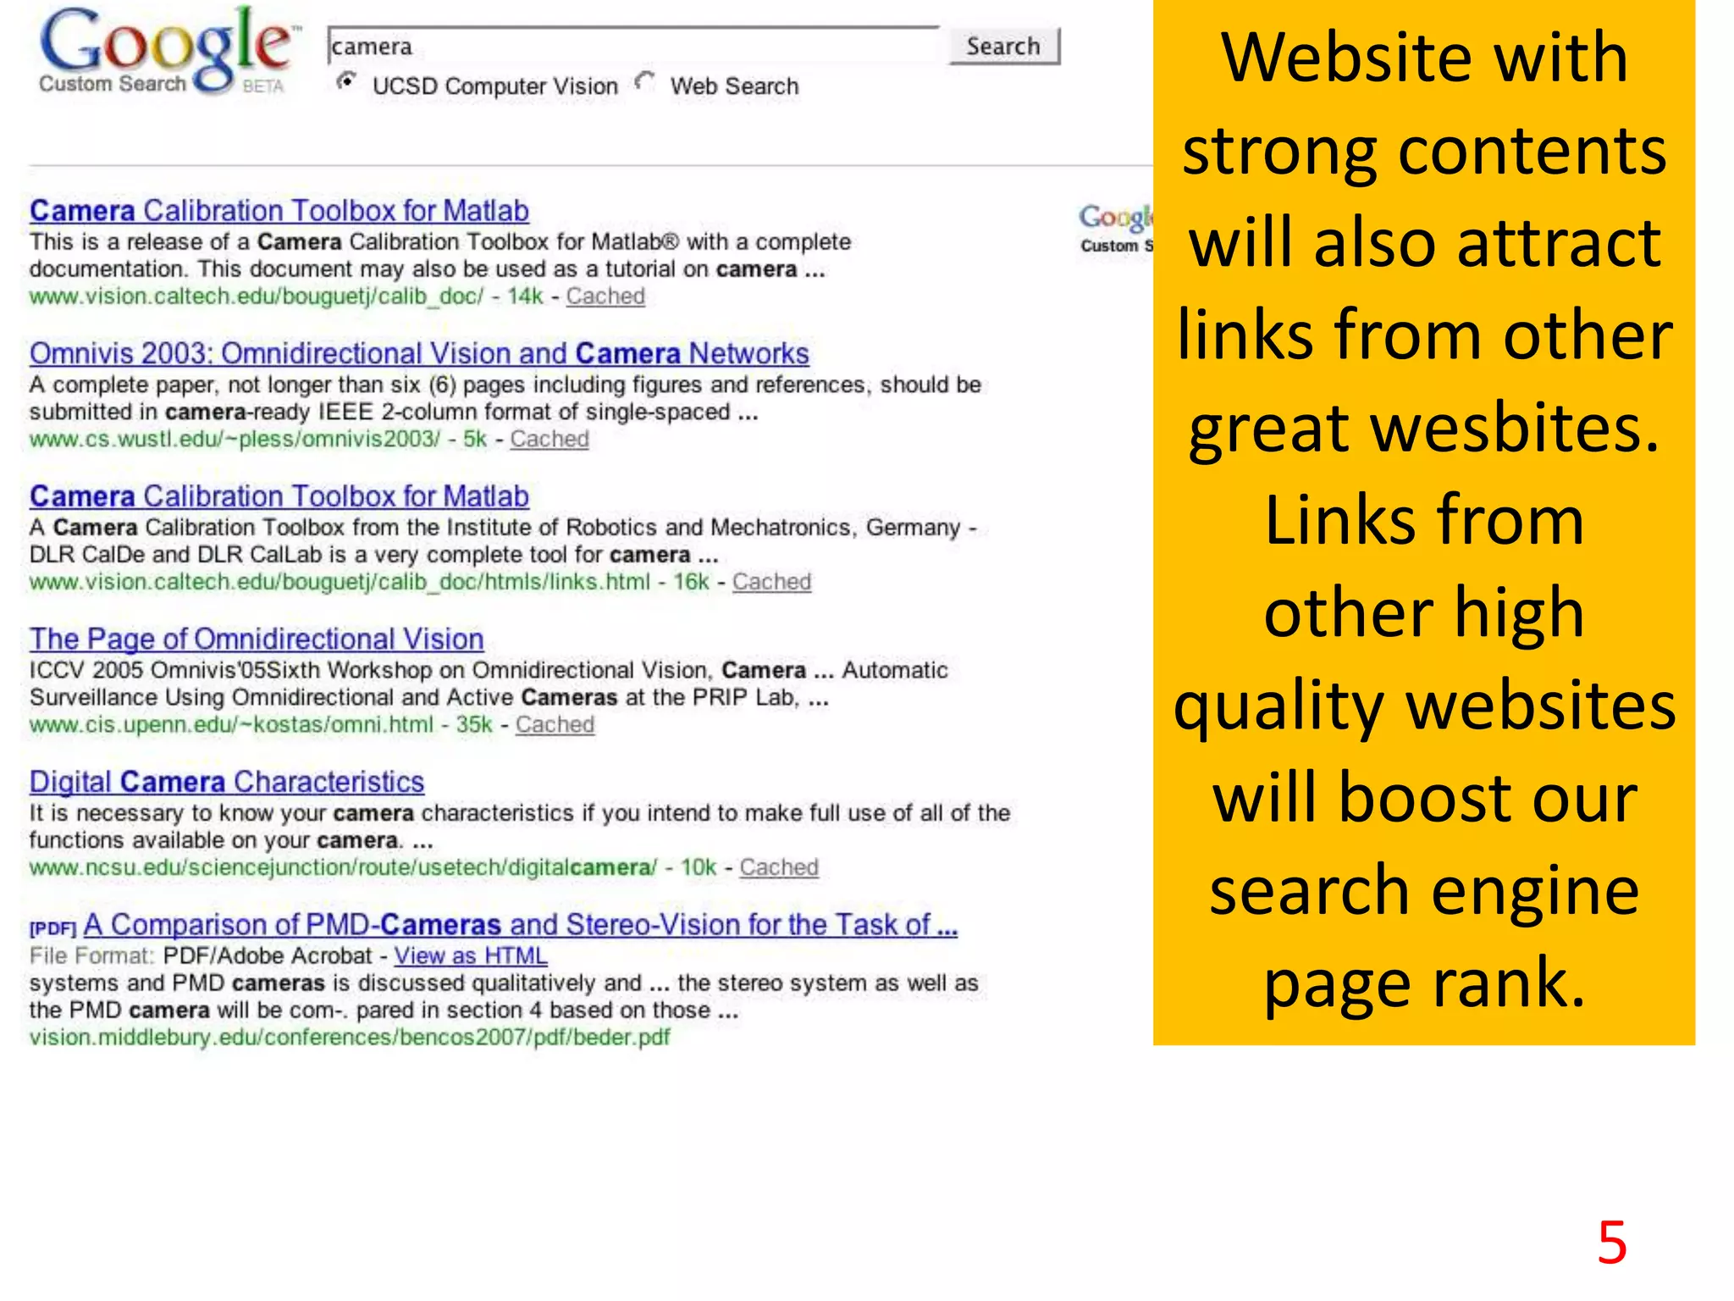
SOCIAL NETWORKS
Wasserman, S. and Faust, K., 1994. Social network analysis: Methods and applications.

Slide 78
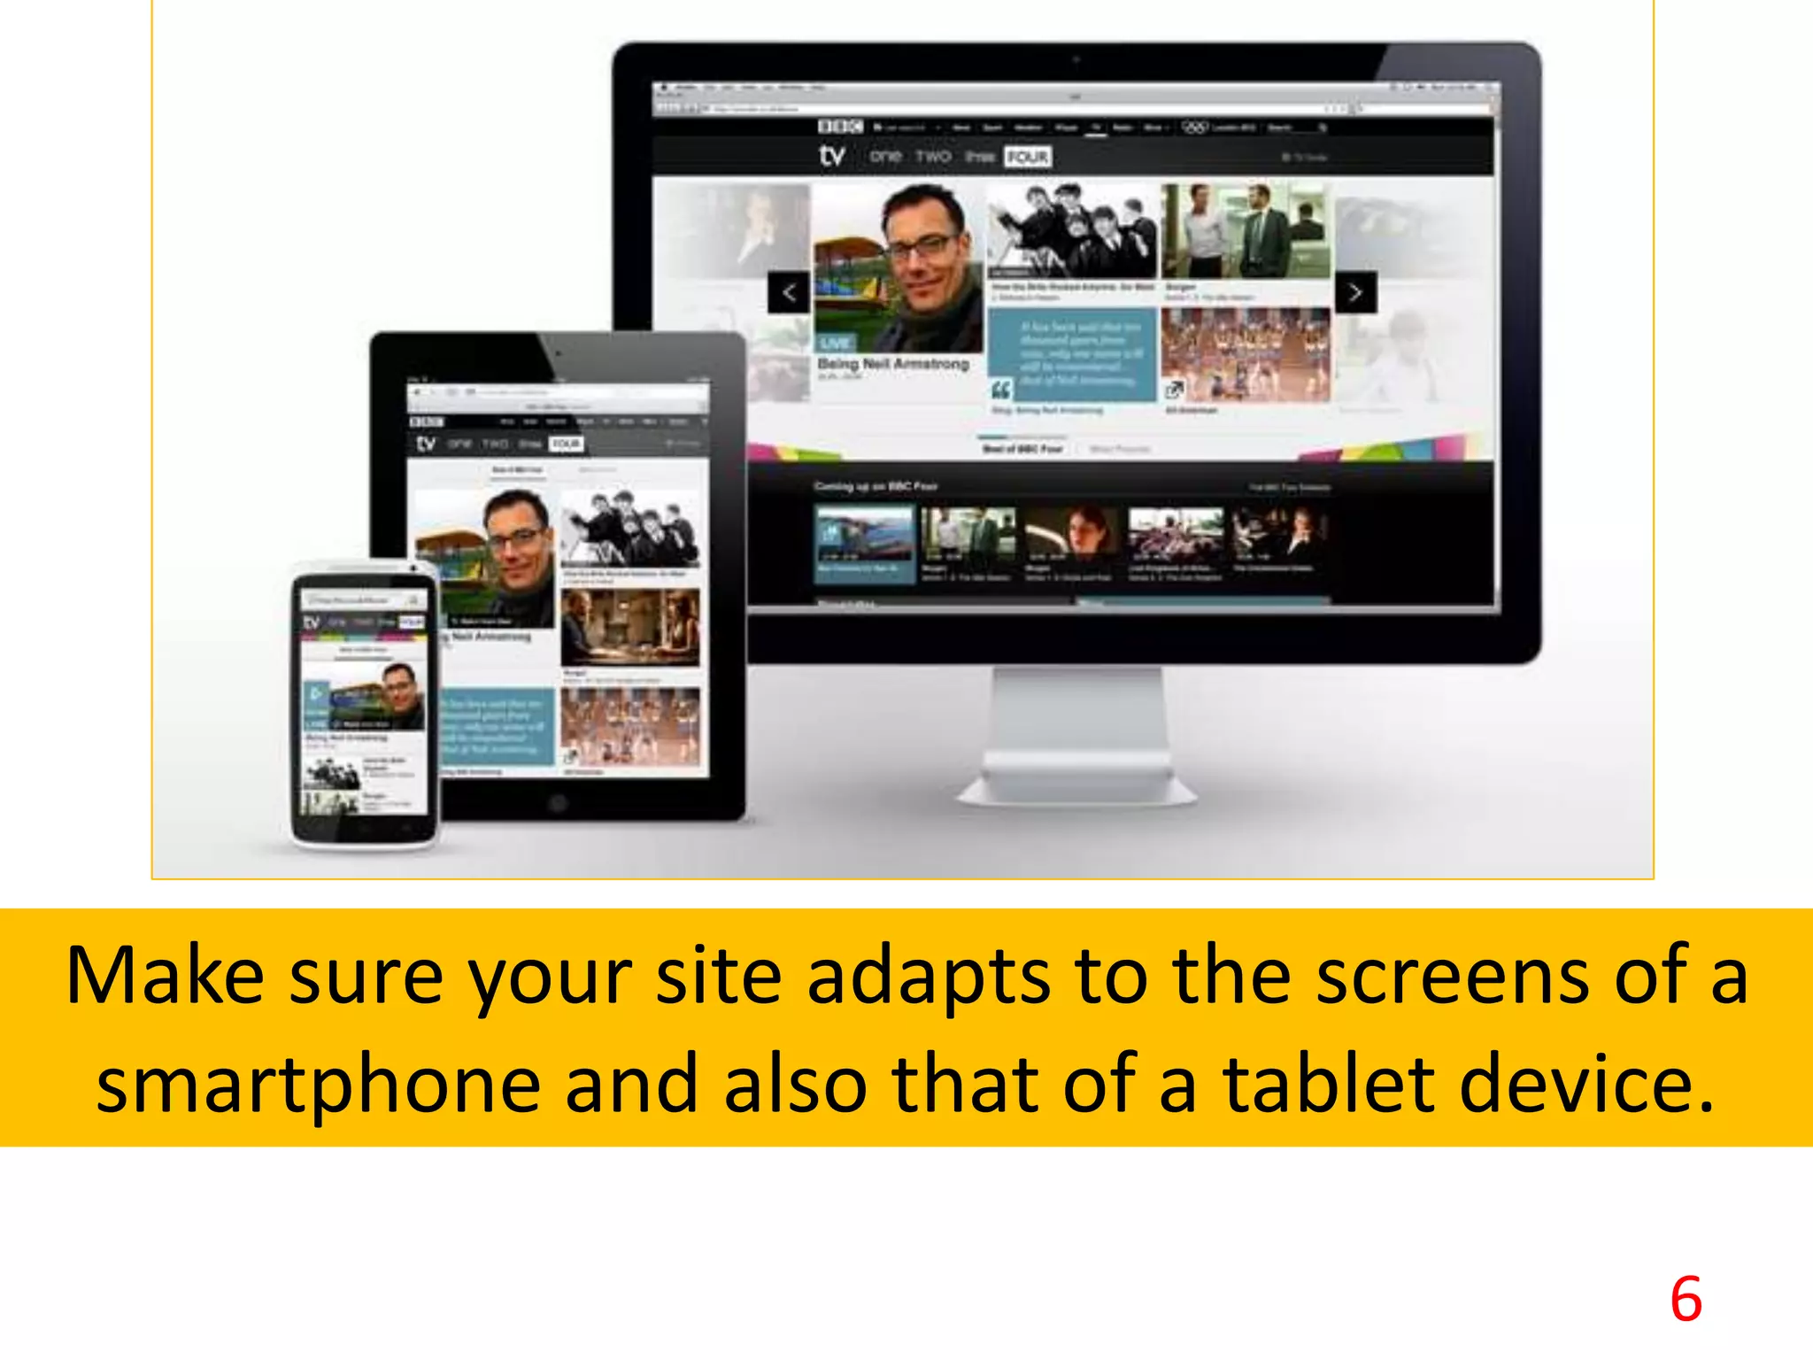
SOCIAL NETWORKS
Wasserman, S. and Faust, K., 1994. Social network analysis: Methods and applications.

Slide 79
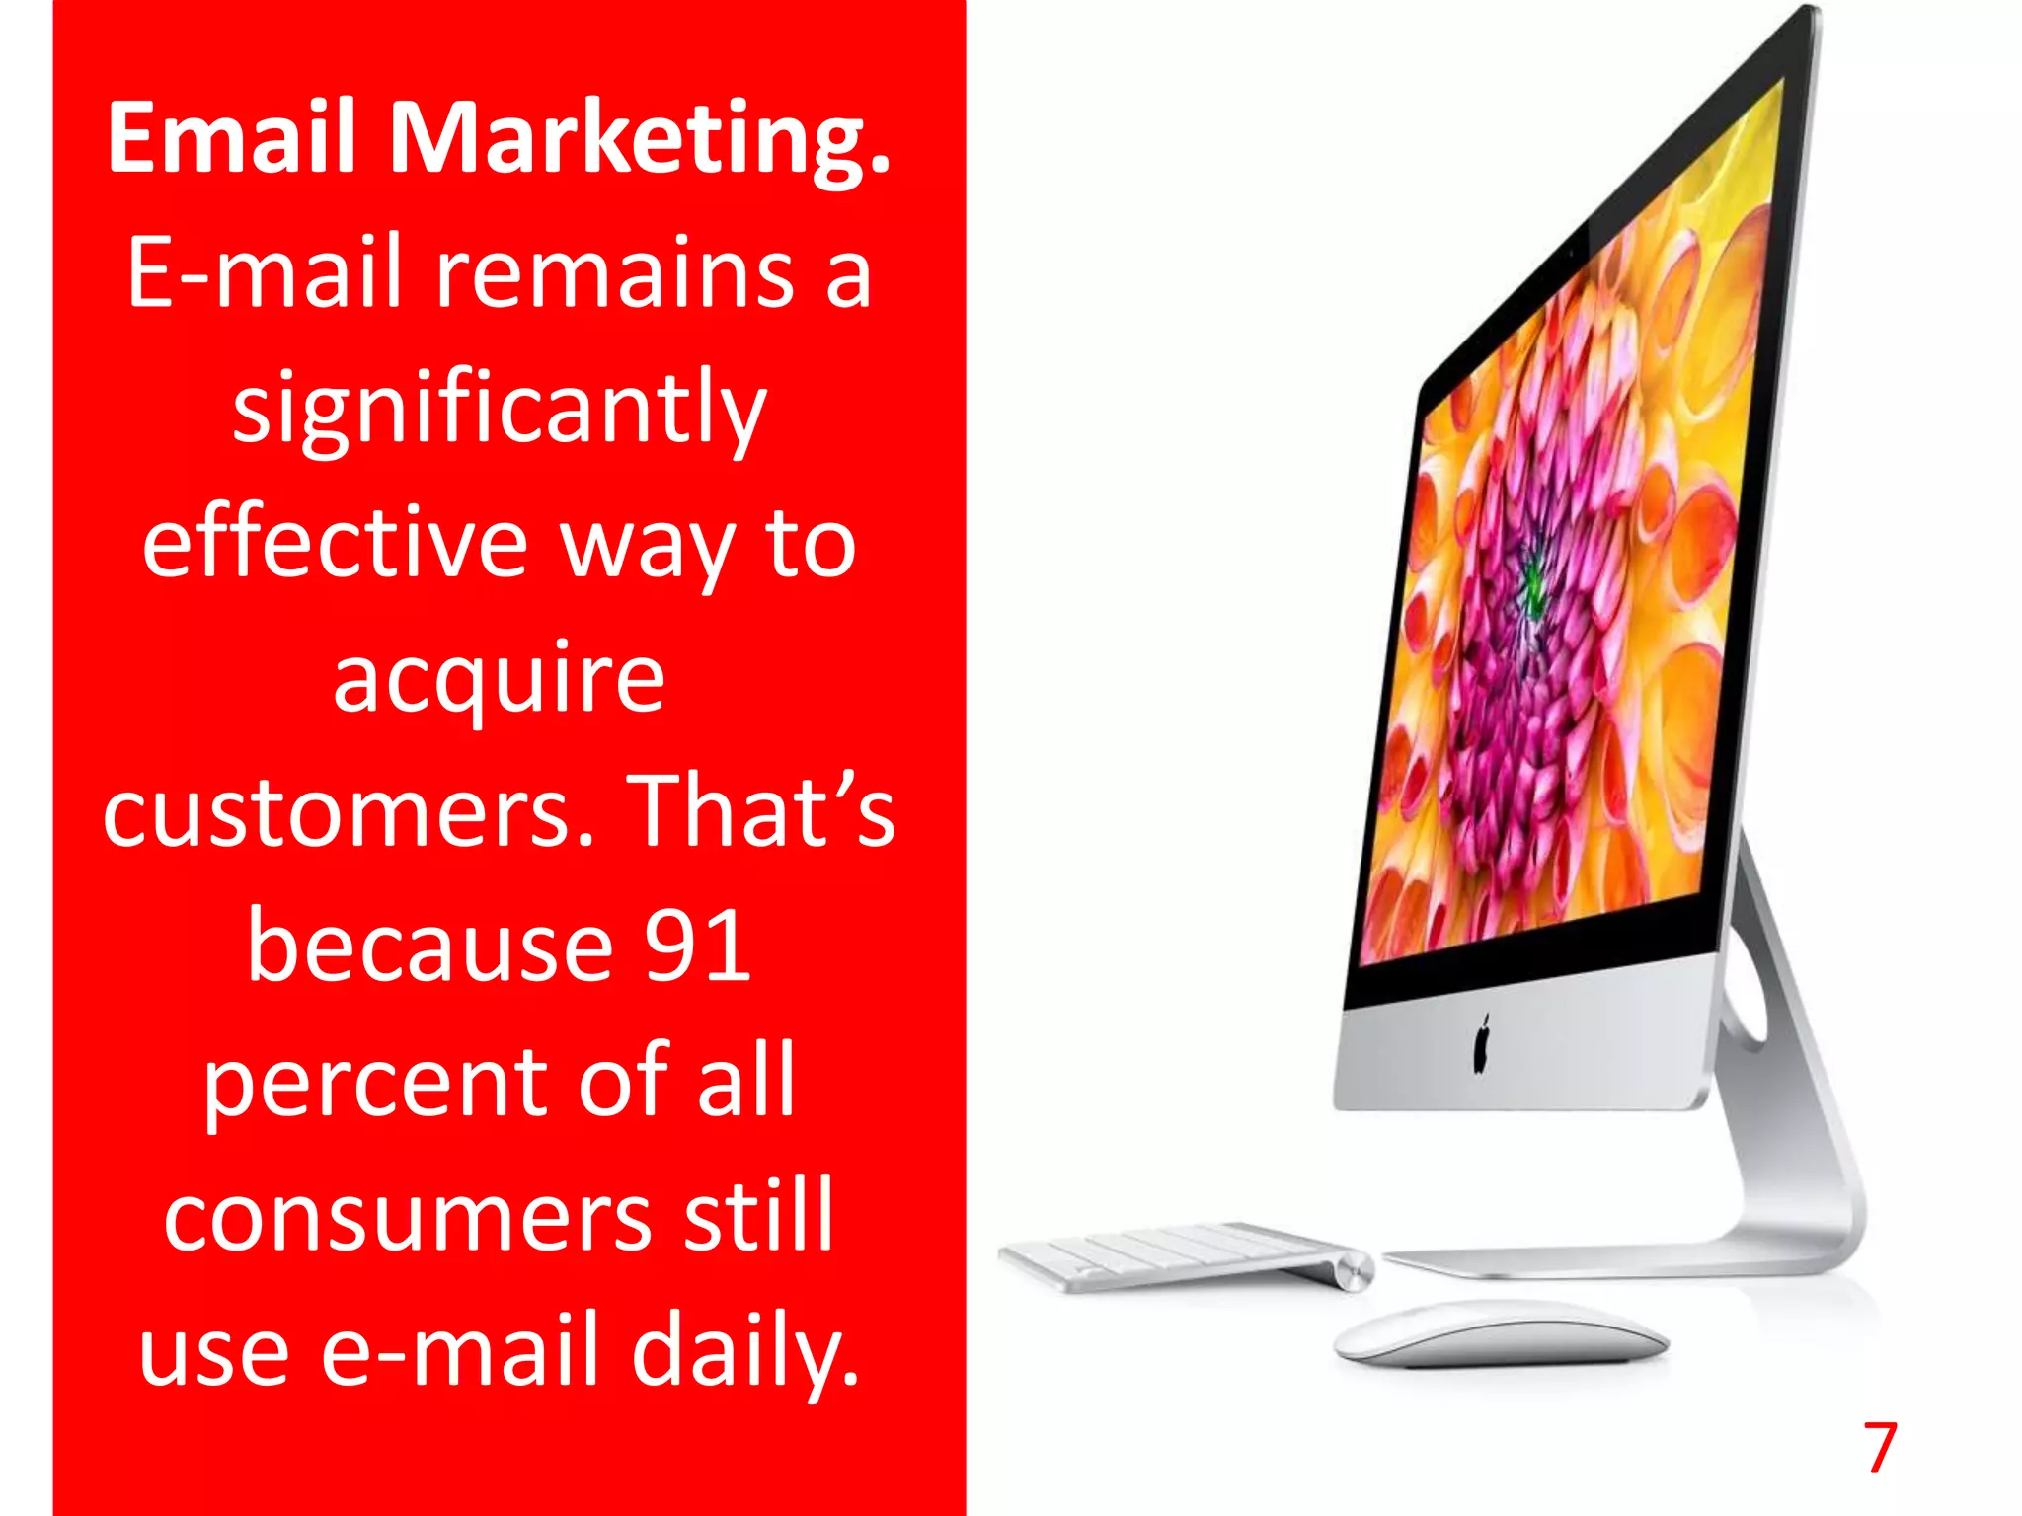
SOCIAL NETWORKS
Wasserman, S. and Faust, K., 1994. Social network analysis: Methods and applications.

Slide 80
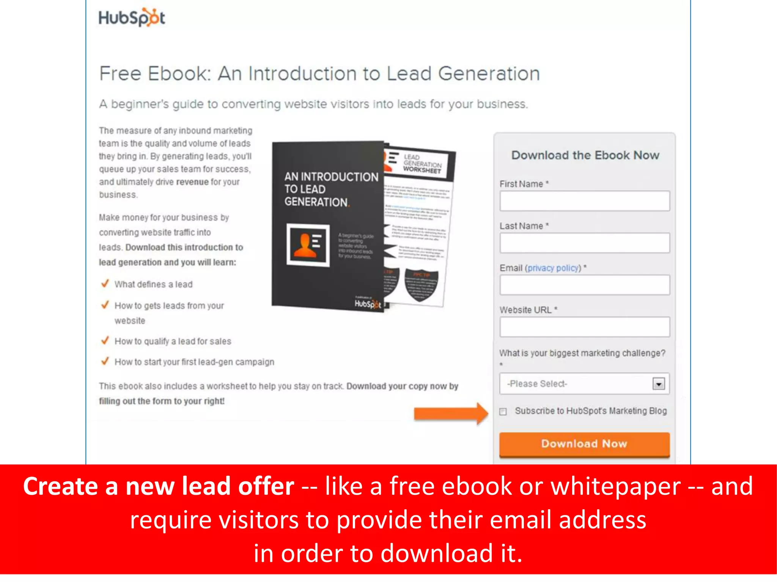
SOCIAL NETWORKS
Wasserman, S. and Faust, K., 1994. Social network analysis: Methods and applications.

Slide 81
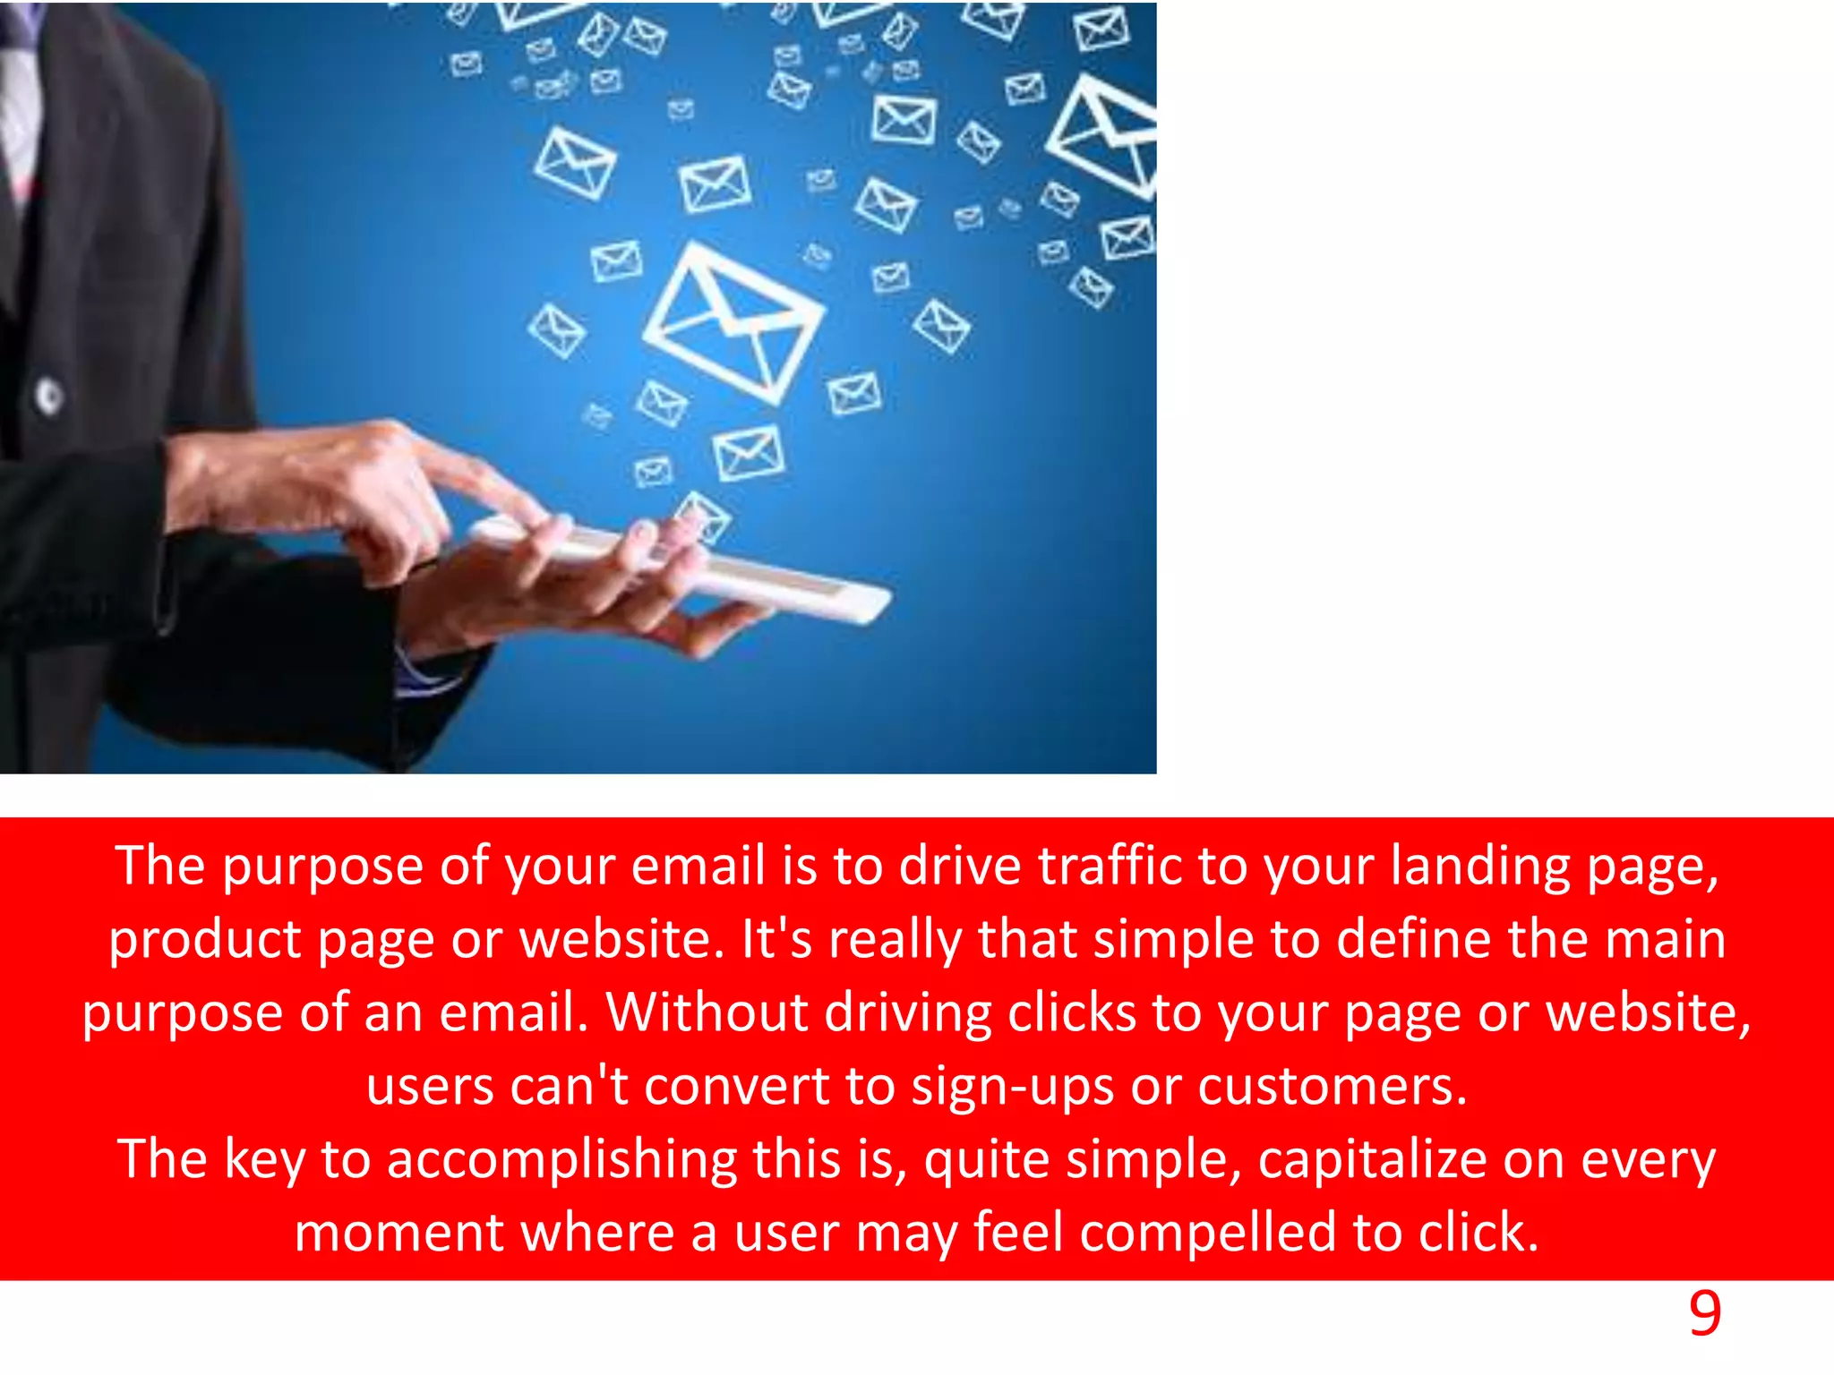
SOCIAL NETWORKS
Wasserman, S. and Faust, K., 1994. Social network analysis: Methods and applications.

Slide 82
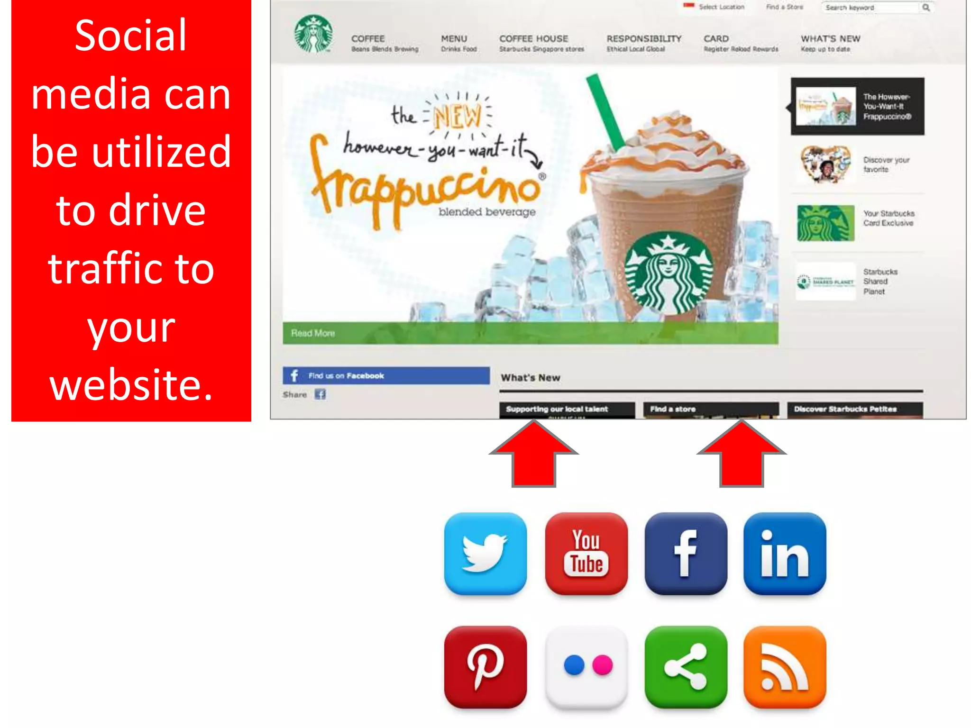
SOCIAL NETWORKS
Wasserman, S. and Faust, K., 1994. Social network analysis: Methods and applications.

Slide 83
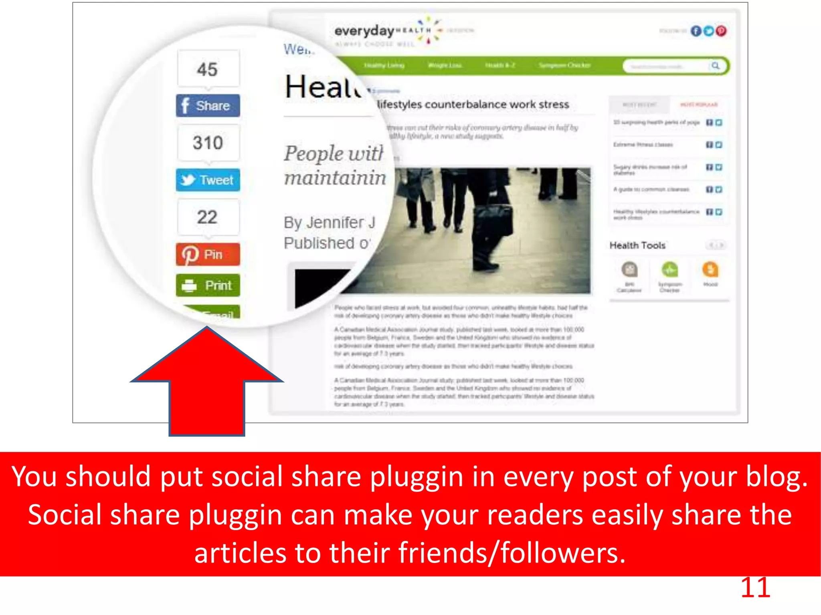
SOCIAL NETWORKS
Wasserman, S. and Faust, K., 1994. Social network analysis: Methods and applications.

Slide 84
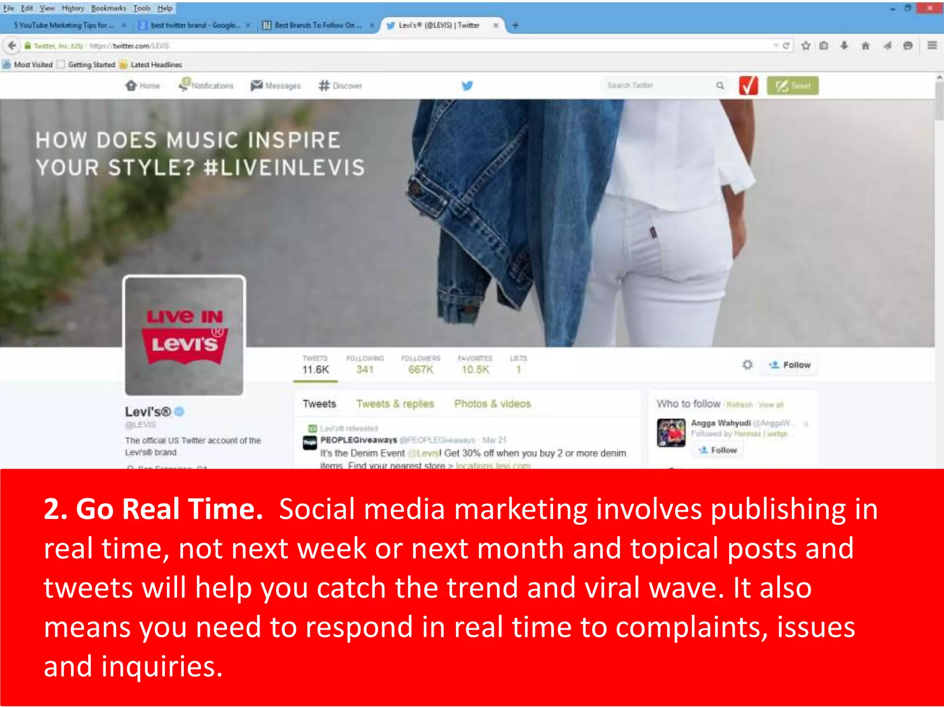
SOCIAL NETWORKS
Wasserman, S. and Faust, K., 1994. Social network analysis: Methods and applications.

Slide 85
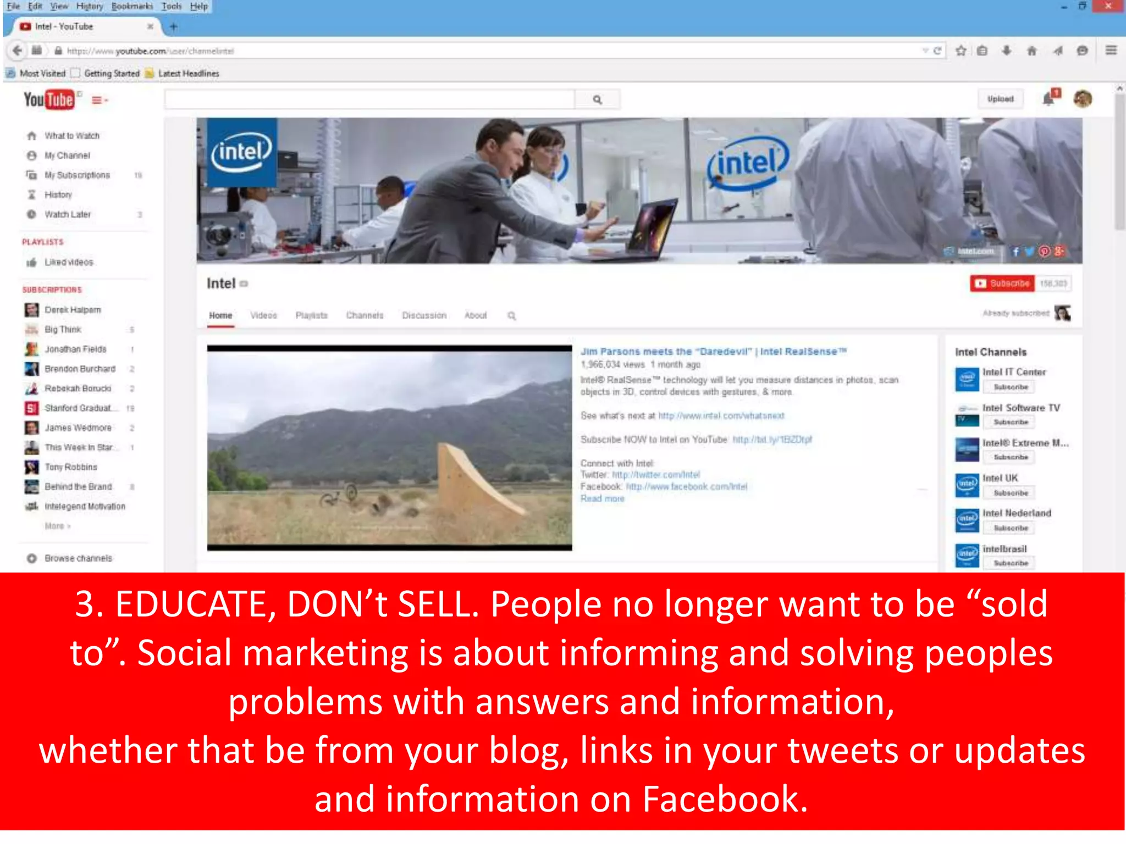
SOCIAL NETWORKS
Wasserman, S. and Faust, K., 1994. Social network analysis: Methods and applications.

Slide 86
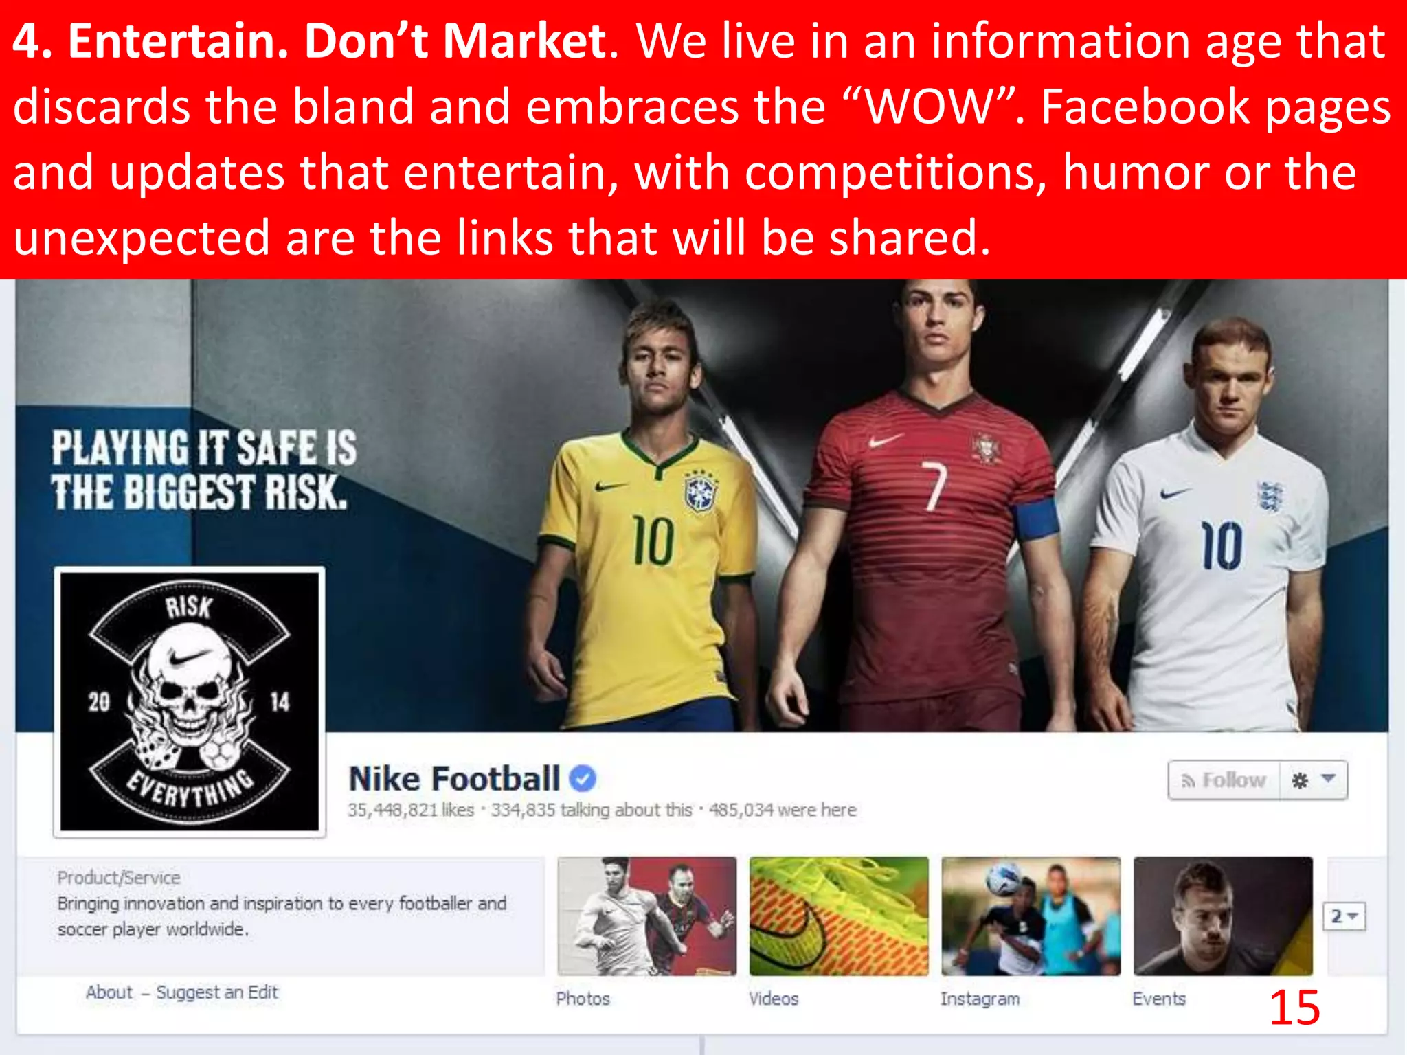
SOCIAL NETWORKS
Wasserman, S. and Faust, K., 1994. Social network analysis: Methods and applications.

Slide 87
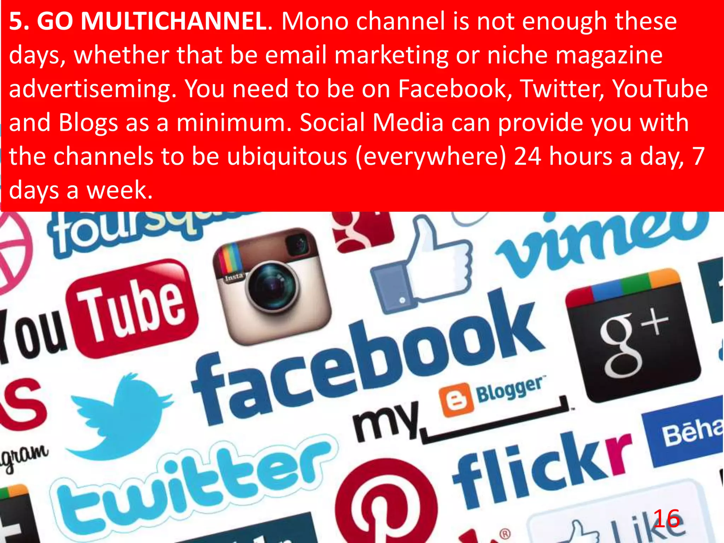
SOCIAL NETWORKS
Wasserman, S. and Faust, K., 1994. Social network analysis: Methods and applications.

Slide 88
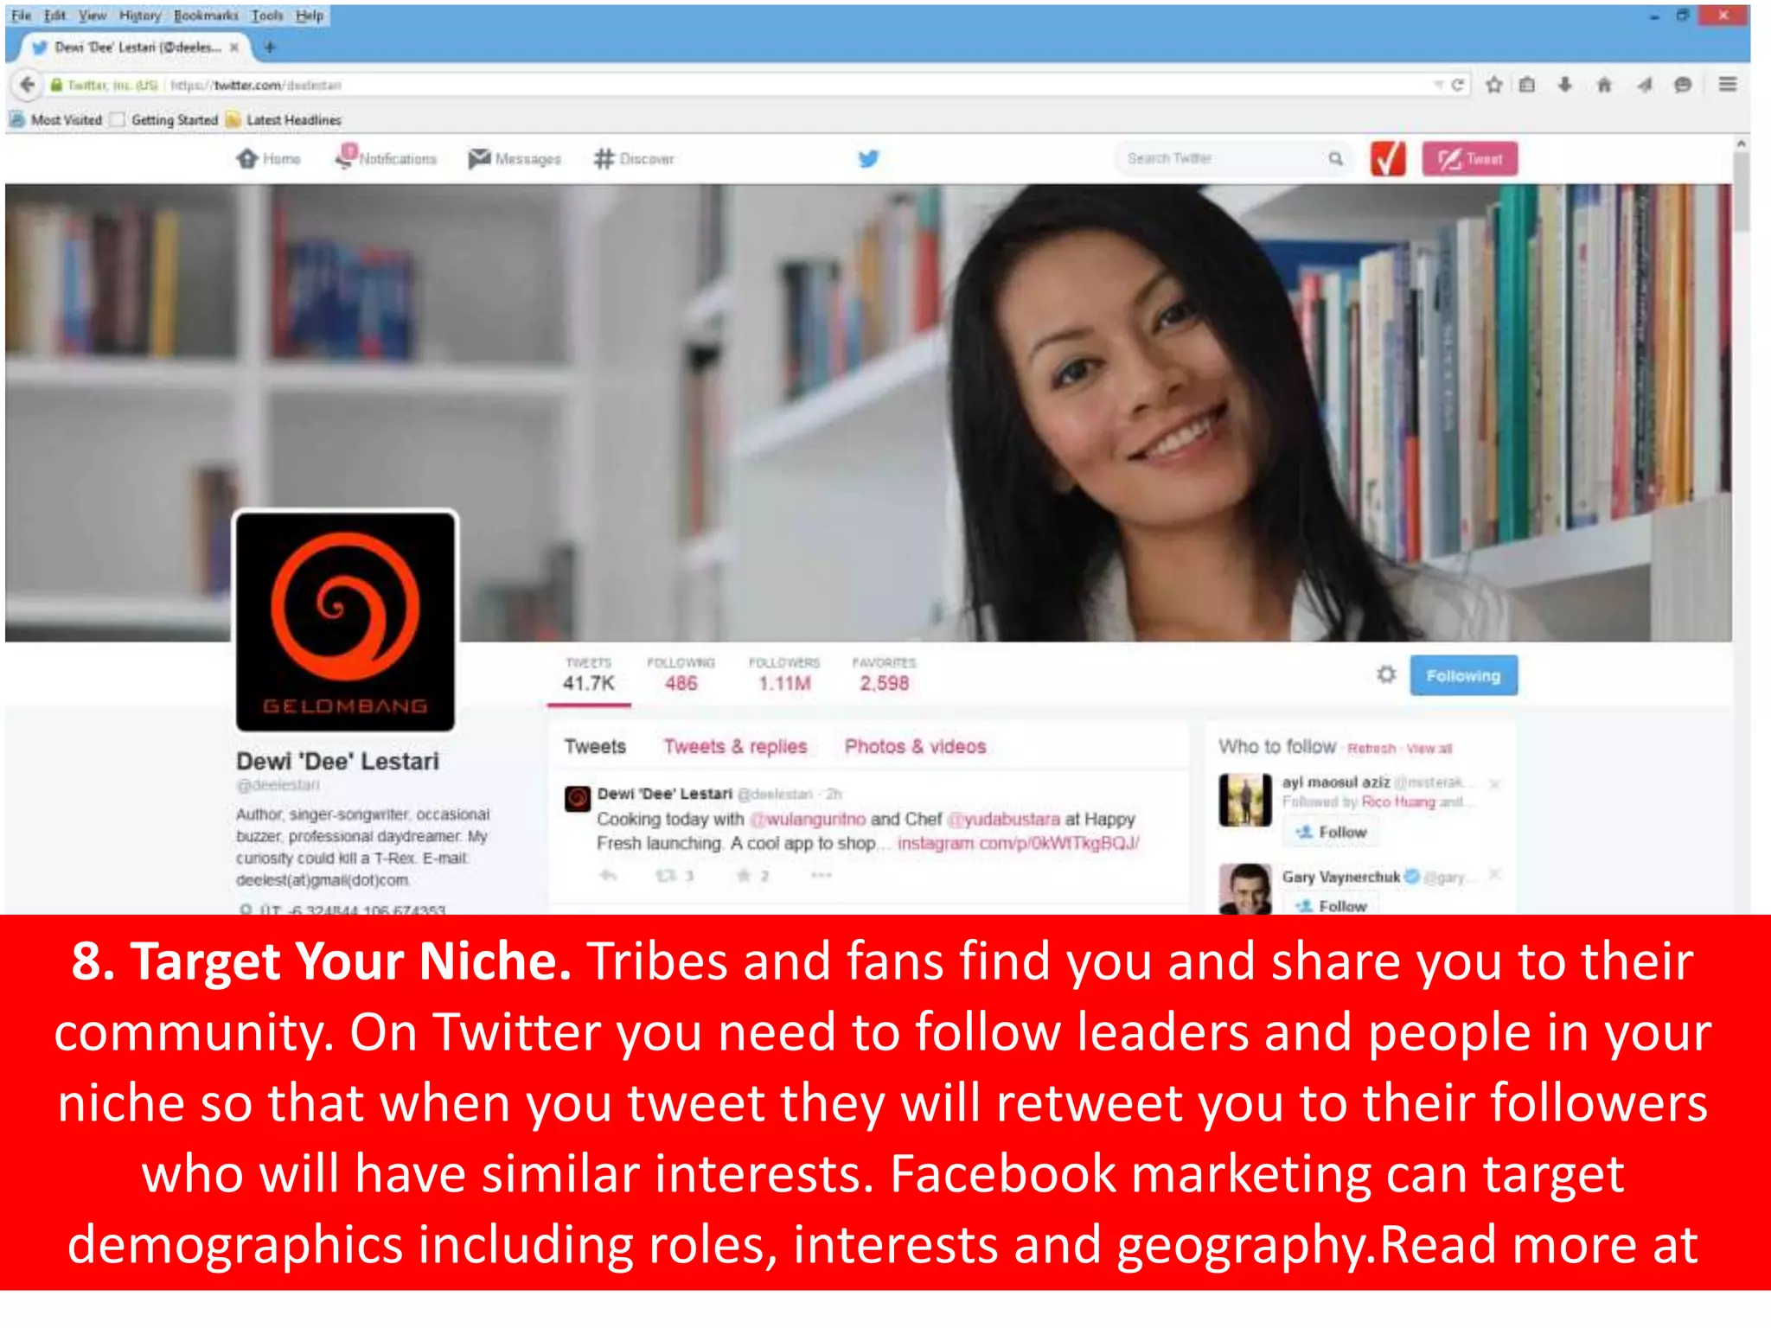
SOCIAL NETWORKS
Wasserman, S. and Faust, K., 1994. Social network analysis: Methods and applications.

