Slide 1


Slide 2
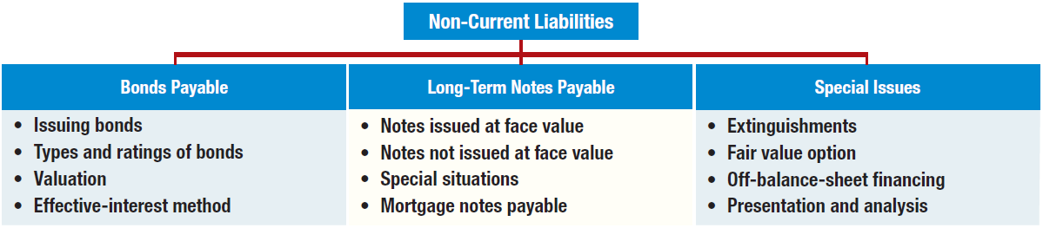
PREVIEW OF CHAPTER
14
Intermediate Accounting
IFRS 2nd Edition
Kieso, Weygandt, and Warfield

Slide 3


14
Non-Current Liabilities
LEARNING OBJECTIVES
After studying this chapter, you should be able to:
Describe the formal procedures associated with issuing long-term debt.
Identify various types of bond issues.
Describe the accounting valuation for bonds at date of issuance.
Apply the methods of bond discount and premium amortization.
Explain the accounting for long-term notes payable.
Describe the accounting for the extinguishment of non-current liabilities.
Describe the accounting for the fair value option.
Explain the reporting of off-balance-sheet financing arrangements.
Indicate how to present and analyze non-current liabilities.

Slide 4
BONDS PAYABLE
Non-current liabilities (long-term debt) consist of an expected outflow of resources arising from present obligations that are not payable within a year or the operating cycle of the company, whichever is longer.
Examples:
Bonds payable
Long-term notes payable
Mortgages payable
Pension liabilities
Lease liabilities
Long-term debt has various covenants or restrictions.
LO 1

Slide 5
Issuing Bonds
Bond contract known as a bond indenture.
Represents a promise to pay:
  sum of money at designated maturity date, plus
  periodic interest at a specified rate on the maturity amount (face value).
Paper certificate, typically a €1,000 face value.
Interest payments usually made semiannually.
Used when the amount of capital needed is too large for one lender to supply.
LO 1

Slide 6
14
Non-Current Liabilities
LEARNING OBJECTIVES
After studying this chapter, you should be able to:
Describe the formal procedures associated with issuing long-term debt.
Identify various types of bond issues.
Describe the accounting valuation for bonds at date of issuance.
Apply the methods of bond discount and premium amortization.
Explain the accounting for long-term notes payable.
Describe the accounting for the extinguishment of non-current liabilities.
Describe the accounting for the fair value option.
Explain the reporting of off-balance-sheet financing arrangements.
Indicate how to present and analyze non-current liabilities.

Slide 7
Types and Ratings of Bonds
Common types found in practice:
  Secured and Unsecured (debenture) bonds.
  Term, Serial, and Callable bonds.
  Convertible, Commodity-Backed, Deep-Discount bonds.
  Registered and Bearer (Coupon) bonds.
  Income and Revenue bonds.
LO 2

Slide 8

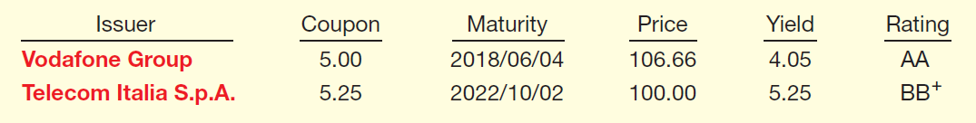
Types and Ratings of Bonds
Corporate bond listing.
Company Name
Price as a % of par
Interest rate based on price
Interest rate paid as a % of par value
Creditworthiness
LO 2

Slide 9
14
Non-Current Liabilities
LEARNING OBJECTIVES
After studying this chapter, you should be able to:
Describe the formal procedures associated with issuing long-term debt.
Identify various types of bond issues.
Describe the accounting valuation for bonds at date of issuance.
Apply the methods of bond discount and premium amortization.
Explain the accounting for long-term notes payable.
Describe the accounting for the extinguishment of non-current liabilities.
Describe the accounting for the fair value option.
Explain the reporting of off-balance-sheet financing arrangements.
Indicate how to present and analyze non-current liabilities.

Slide 10
Valuation of Bonds Payable
Issuance and marketing of bonds to the public:
  Usually takes weeks or months.
  Issuing company must
    Arrange for underwriters.
    Obtain regulatory approval of the bond issue, undergo audits, and issue a prospectus.
    Have bond certificates printed.
LO 3

Slide 11
Valuation of Bonds Payable
Selling price of a bond issue is set by the
  supply and demand of buyers and sellers,
  relative risk,
  market conditions, and
  state of the economy.
Investment community values a bond at the present value of its expected future cash flows, which consist of (1) interest and (2) principal.
LO 3

Slide 12
Valuation of Bonds Payable
Interest Rate
  Stated, coupon, or nominal rate = Rate written in the terms of the bond indenture.
    Bond issuer sets this rate.
    Stated as a percentage of bond face value (par).
  Market rate or effective yield = Rate that provides an acceptable return commensurate with the issuer’s risk.
    Rate of interest actually earned by the bondholders.
LO 3

Slide 13
Valuation of Bonds Payable
How do you calculate the amount of interest that is actually paid to the bondholder each period?
How do you calculate the amount of interest that is actually recorded as interest expense by the issuer of the bonds?
(Stated rate x Face Value of the bond)
(Market rate x Carrying Value of the bond)
LO 3

Slide 14
Valuation of Bonds Payable
Assume Stated Rate of 8%
Market Interest
Bonds Sold At
6%
Premium
8%
Par Value
10%
Discount
LO 3

Slide 15
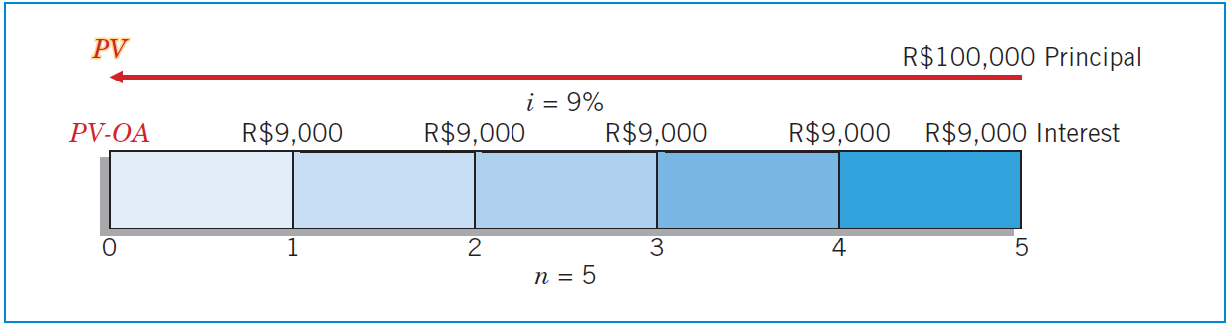
Bonds Issued at Par
Illustration: Santos Company issues R$100,000 in bonds dated January 1, 2015, due in five years with 9 percent interest payable annually on January 1. At the time of issue, the market rate for such bonds is 9 percent.
ILLUSTRATION 14-1
Time Diagram for Bonds
Issued at Par
LO 3

Slide 16
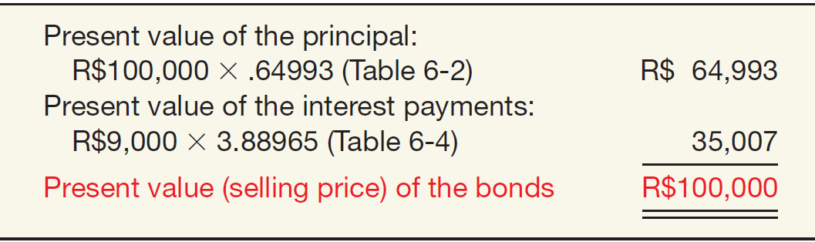
Bonds Issued at Par
ILLUSTRATION 14-1
Time Diagram for Bonds
Issued at Par
ILLUSTRATION 14-2
Present Value
Computation of
Bond Selling at Par
LO 3

Slide 17
Bonds Issued at Par
Journal entry on date of issue, Jan. 1, 2015.
Cash 100,000
Bonds payable 100,000
Journal entry to record accrued interest at Dec. 31, 2015.
Interest expense 9,000
Interest payable 9,000
Journal entry to record first payment on Jan. 1, 2016.
Interest payable 9,000
Cash 9,000
LO 3

Slide 18

Bonds Issued at a Discount
Illustration: Assuming now that Santos issues R$100,000 in bonds, due in five years with 9 percent interest payable annually at year-end. At the time of issue, the market rate for such bonds is 11 percent.
ILLUSTRATION 14-3
Time Diagram for Bonds
Issued at a Discount
LO 3

Slide 19
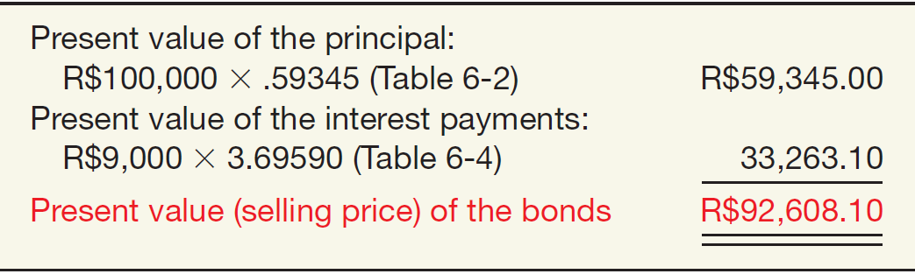
Bonds Issued at a Discount
ILLUSTRATION 14-3
Time Diagram for Bonds
Issued at a Discount
ILLUSTRATION 14-4
Present Value
Computation of
Bond Selling at Discount
LO 3

Slide 20
Bonds Issued at a Discount
Journal entry on date of issue, Jan. 1, 2015.
Cash 92,608
Bonds payable 92,608
Journal entry to record accrued interest at Dec. 31, 2015.
Interest expense ($92,608 x 11%) 10,187
Interest payable 9,000
Bonds payable 1,187
Journal entry to record first payment on Jan. 1, 2016.
Interest payable 9,000
Cash 9,000
LO 3

Slide 21
Bonds Issued at a Discount
When bonds sell at less than face value:
  Investors demand a rate of interest higher than stated rate.
  Usually occurs because investors can earn a higher rate on alternative investments of equal risk.
  Cannot change stated rate so investors refuse to pay face value for the bonds.
  Investors receive interest at the stated rate computed on the face value, but they actually earn at an effective rate because they paid less than face value for the bonds.
LO 3

Slide 22
14
Non-Current Liabilities
LEARNING OBJECTIVES
After studying this chapter, you should be able to:
Describe the formal procedures associated with issuing long-term debt.
Identify various types of bond issues.
Describe the accounting valuation for bonds at date of issuance.
Apply the methods of bond discount and premium amortization.
Explain the accounting for long-term notes payable.
Describe the accounting for the extinguishment of non-current liabilities.
Describe the accounting for the fair value option.
Explain the reporting of off-balance-sheet financing arrangements.
Indicate how to present and analyze non-current liabilities.

Slide 23
Effective-Interest Method
Bond issued at a discount - amount paid at maturity is more than the issue amount.
Bonds issued at a premium - company pays less at maturity relative to the issue price.
Adjustment to the cost is recorded as bond interest expense over the life of the bonds through a process called amortization.
Required procedure for amortization is the effective-interest method (also called present value amortization).
LO 4

Slide 24
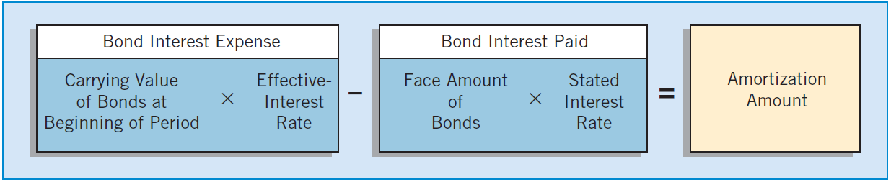
Effective-Interest Method
Effective-interest method produces a periodic interest expense equal to a constant percentage of the carrying value of the bonds.
ILLUSTRATION 14-5
Bond Discount and Premium Amortization Computation
LO 4

Slide 25
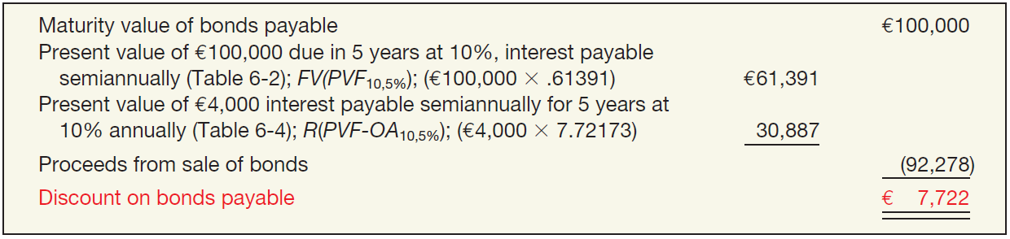
Effective-Interest Method
Bonds Issued at a Discount
Illustration: Evermaster Corporation issued €100,000 of 8% term bonds on January 1, 2015, due on January 1, 2020, with interest payable each July 1 and January 1. Investors require an effective-interest rate of 10%. Calculate the bond proceeds.
ILLUSTRATION 14-6
Computation of Discount on Bonds Payable
LO 4

Slide 26
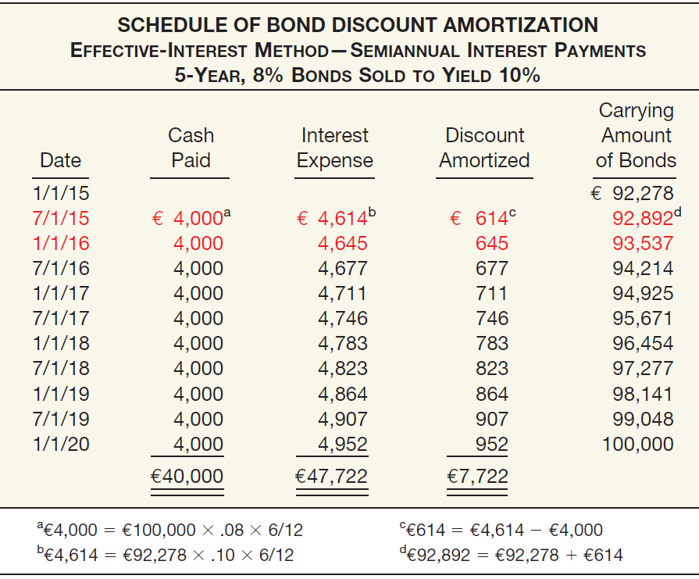
ILLUSTRATION 14-7
Bond Discount
Amortization Schedule

Slide 27
Effective-Interest Method
ILLUSTRATION 14-7
Bond Discount
Amortization Schedule
Journal entry on date of issue, Jan. 1, 2015.
Cash 92,278
Bonds Payable 92,278
LO 4

Slide 28
Effective-Interest Method
ILLUSTRATION 14-7
Bond Discount
Amortization Schedule
Journal entry to record first payment and amortization of the discount on July 1, 2015.
Interest expense 4,614
Bonds payable 614
Cash 4,000
LO 4

Slide 29
Effective-Interest Method
ILLUSTRATION 14-7
Bond Discount
Amortization Schedule
Journal entry to record accrued interest and amortization of the discount on Dec. 31, 2015.
Interest expense 4,645
Interest payable 4,000
Bonds payable 645
LO 4

Slide 30
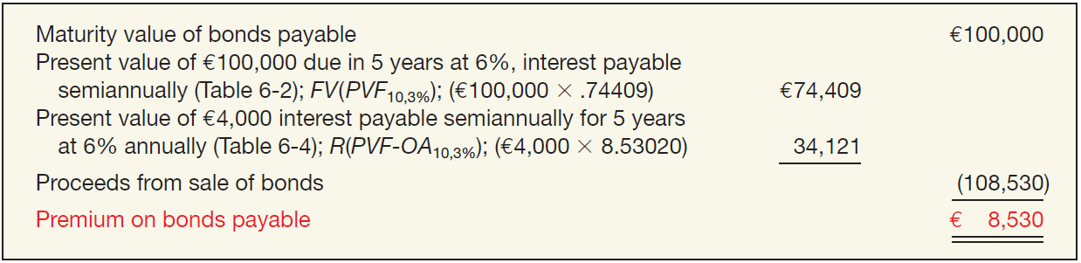
Effective-Interest Method
Bonds Issued at a Premium
Illustration: Evermaster Corporation issued €100,000 of 8% term bonds on January 1, 2015, due on January 1, 2016, with interest payable each July 1 and January 1. Investors require an effective-interest rate of 6%. Calculate the bond proceeds.
ILLUSTRATION 14-8
Computation of Premium on Bonds Payable
LO 4

Slide 31
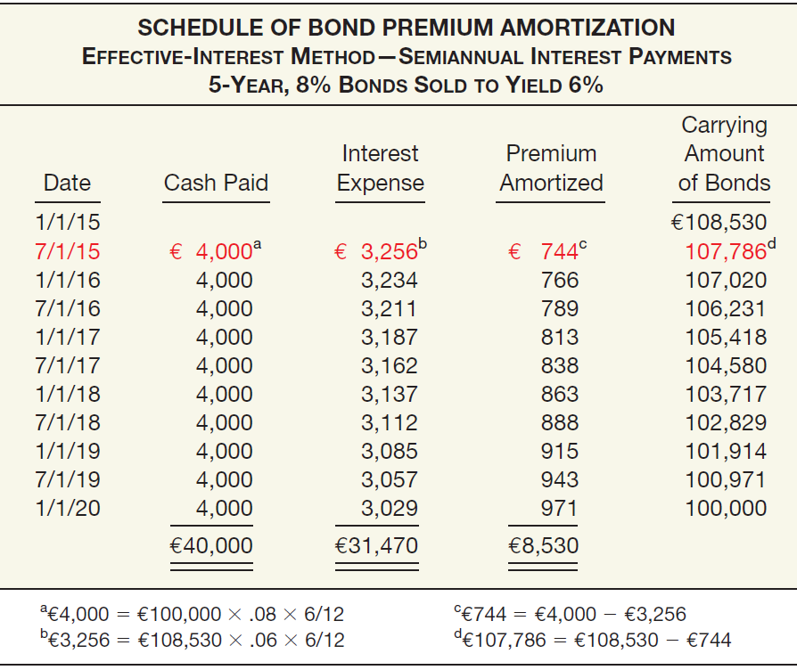
ILLUSTRATION 14-9
Bond Premium
Amortization Schedule

Slide 32
Effective-Interest Method
ILLUSTRATION 14-9
Bond Premium
Amortization Schedule
Journal entry on date of issue, Jan. 1, 2015.
Cash 108,530
Bonds payable 108,530
LO 4

Slide 33
Effective-Interest Method
ILLUSTRATION 14-9
Bond Premium
Amortization Schedule
Journal entry to record first payment and amortization of the premium on July 1, 2015.
Interest expense 3,256
Bonds payable 744
Cash 4,000
LO 4

Slide 34
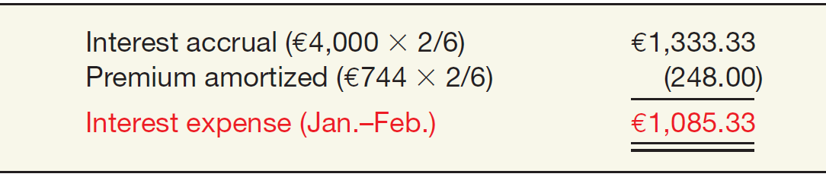
Effective-Interest Method
Accrued Interest
What happens if Evermaster prepares financial statements at the end of February 2015? In this case, the company prorates the premium by the appropriate number of months to arrive at the proper interest expense, as follows.
ILLUSTRATION 14-10
Computation of Interest
Expense
LO 4

Slide 35
Effective-Interest Method
Accrued Interest
ILLUSTRATION 14-10
Computation of Interest
Expense
Evermaster records this accrual as follows.
Interest expense 1,085.33
Bonds payable 248.00
Interest payable 1,333.33
LO 4

Slide 36
Effective-Interest Method
Bonds Issued between Interest Dates
Bond investors will pay the seller the interest accrued from the last interest payment date to the date of issue.
On the next semiannual interest payment date, bond investors will receive the full six months’ interest payment.
LO 4

Slide 37
Effective-Interest Method
Bonds Issued at Par
Illustration: Assume Evermaster issued its five-year bonds, dated January 1, 2015, on May 1, 2015, at par (€100,000). Evermaster records the issuance of the bonds between interest dates as follows.
(€100,000 x .08 x 4/12) = €2,667
Cash 100,000
Bonds payable 100,000
Cash 2,667
Interest expense 2,667
LO 4

Slide 38
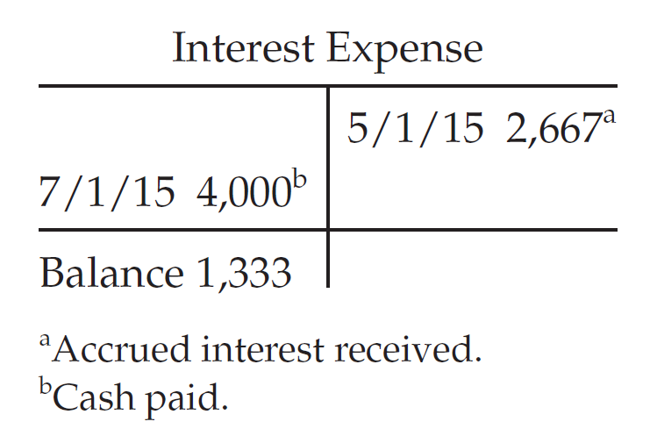
Effective-Interest Method
Bonds Issued at Par
On July 1, 2015, two months after the date of purchase, Evermaster pays the investors six months’ interest, by making the following entry.
($100,000 x .08 x 1/2) = $4,000
Interest expense 4,000
Cash 4,000
LO 4

Slide 39
Effective-Interest Method
Bonds Issued at Discount or Premium
Illustration: Assume that the Evermaster 8% bonds were issued on May 1, 2015, to yield 6%. Thus, the bonds are issued at a premium price of €108,039. Evermaster records the issuance of the bonds between interest dates as follows.
Cash 108,039
Bonds payable 108,039
Cash 2,667
Interest expense 2,667
LO 4

Slide 40
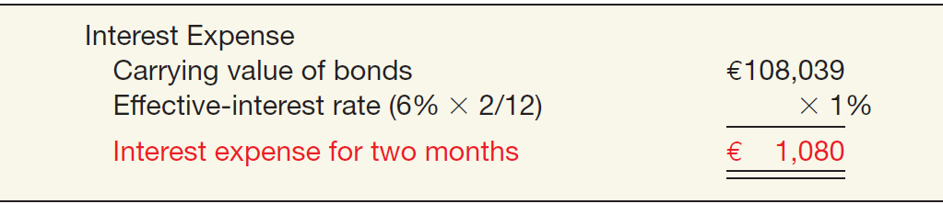
Effective-Interest Method
Bonds Issued at Discount or Premium
Evermaster then determines interest expense from the date of sale (May 1, 2015), not from the date of the bonds (January 1, 2015).
ILLUSTRATION 14-12
Partial Period Interest
Amortization
LO 4

Slide 41
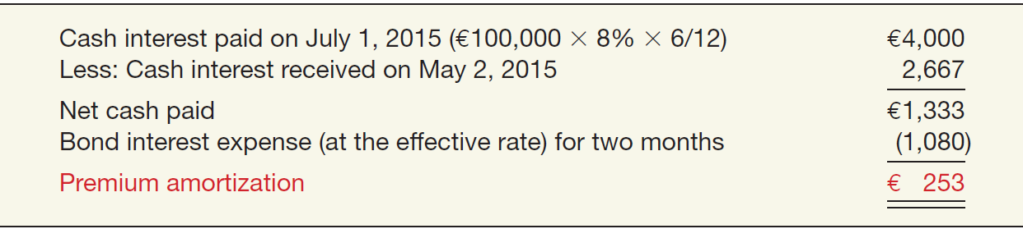
Effective-Interest Method
Bonds Issued at Discount or Premium
The premium amortization of the bonds is also for only two months.
ILLUSTRATION 14-13
Partial Period Interest
Amortization
LO 4

Slide 42
Effective-Interest Method
Bonds Issued at Discount or Premium
Evermaster therefore makes the following entries on July 1, 2015, to record the interest payment and the premium amortization.
Interest expense 4,000
Cash 4,000
Bonds payable 253
Interest expense 253
LO 4

Slide 43
14
Non-Current Liabilities
LEARNING OBJECTIVES
After studying this chapter, you should be able to:
Describe the formal procedures associated with issuing long-term debt.
Identify various types of bond issues.
Describe the accounting valuation for bonds at date of issuance.
Apply the methods of bond discount and premium amortization.
Explain the accounting for long-term notes payable.
Describe the accounting for the extinguishment of non-current liabilities.
Describe the accounting for the fair value option.
Explain the reporting of off-balance-sheet financing arrangements.
Indicate how to present and analyze non-current liabilities.

Slide 44
LONG-TERM NOTES PAYABLE
Accounting is Similar to Bonds
  A note is valued at the present value of its future interest and principal cash flows.
  Company amortizes any discount or premium over the life of the note.
LO 5

Slide 45
Notes Issued at Face Value
BE14-9: Coldwell, Inc. issued a €100,000, 4-year, 10% note at face value to Flint Hills Bank on January 1, 2015, and received €100,000 cash. The note requires annual interest payments each December 31. Prepare Coldwell’s journal entries to record (a) the issuance of the note and (b) the December 31 interest payment.
(a) Cash 100,000
Notes payable 100,000
(b) Interest expense 10,000
Cash 10,000
(€100,000 x 10% = €10,000)
LO 5

Slide 46
Notes Not Issued at Face Value
Zero-Interest-Bearing Notes
  Issuing company records the difference between the face amount and the present value (cash received) as
  a discount and
  amortizes that amount to interest expense over the life of the note.
LO 5

Slide 47
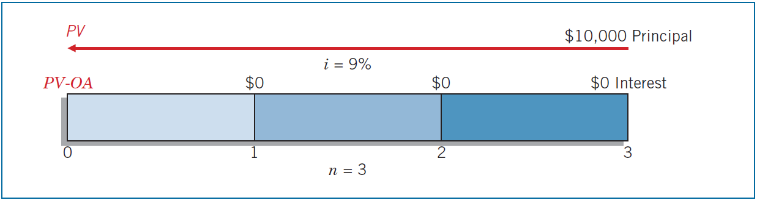
Zero-Interest-Bearing Notes
Illustration: Turtle Cove Company issued the three-year, $10,000, zero-interest-bearing note to Jeremiah Company. The implicit rate that equated the total cash to be paid ($10,000 at maturity) to the present value of the future cash flows ($7,721.80 cash proceeds at date of issuance) was 9 percent.
ILLUSTRATION 14-14
Time Diagram for Zero-Interest Note
LO 5

Slide 48
Zero-Interest-Bearing Notes
Illustration: Turtle Cove Company issued the three-year, $10,000, zero-interest-bearing note to Jeremiah Company. The implicit rate that equated the total cash to be paid ($10,000 at maturity) to the present value of the future cash flows ($7,721.80 cash proceeds at date of issuance) was 9 percent.
Turtle Cove records issuance of the note as follows.
Cash 7,721.80
Notes Payable 7,721.80
LO 5

Slide 49
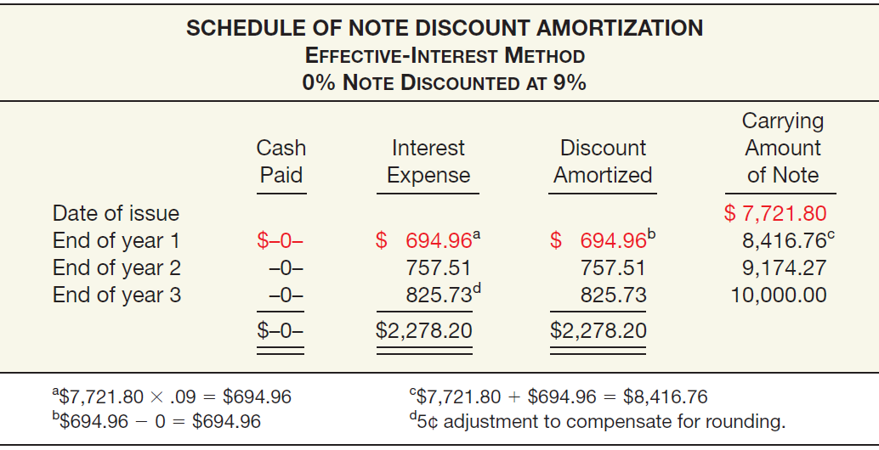
Zero-Interest-Bearing Notes
ILLUSTRATION 14-15
Schedule of Note
Discount Amortization
LO 5

Slide 50
Zero-Interest-Bearing Notes
ILLUSTRATION 14-15
Schedule of Note
Discount Amortization
Turtle Cove records interest expense for year 1 as follows.
Interest Expense ($7,721.80 x 9%) 694.96
Notes Payable 694.96
LO 5

Slide 51
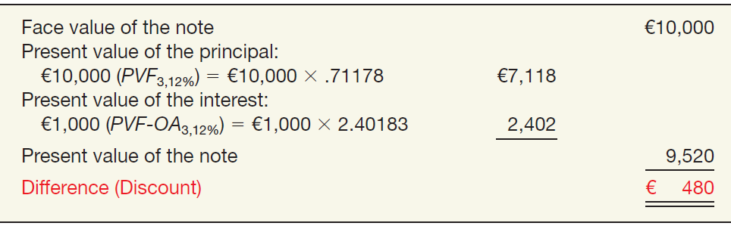
Interest-Bearing Notes
Illustration: Marie Co. issued for cash a €10,000, three-year note bearing interest at 10 percent to Morgan Corp. The market rate of interest for a note of similar risk is 12 percent. In this case, because the effective rate of interest (12%) is greater than the stated rate (10%), the present value of the note is less than the face value. That is, the note is exchanged at a discount.
ILLUSTRATION 7-16
Computation of Present Value—
Effective Rate
Different from
Stated Rate
LO 5

Slide 52
Interest-Bearing Notes
Illustration: Marie Co. issued for cash a €10,000, three-year note bearing interest at 10 percent to Morgan Corp. The market rate of interest for a note of similar risk is 12 percent. In this case, because the effective rate of interest (12%) is greater than the stated rate (10%), the present value of the note is less than the face value. That is, the note is exchanged at a discount.
Marie Co. records the issuance of the note as follows.
Cash 9,520
Notes Payable 9,520
LO 5

Slide 53
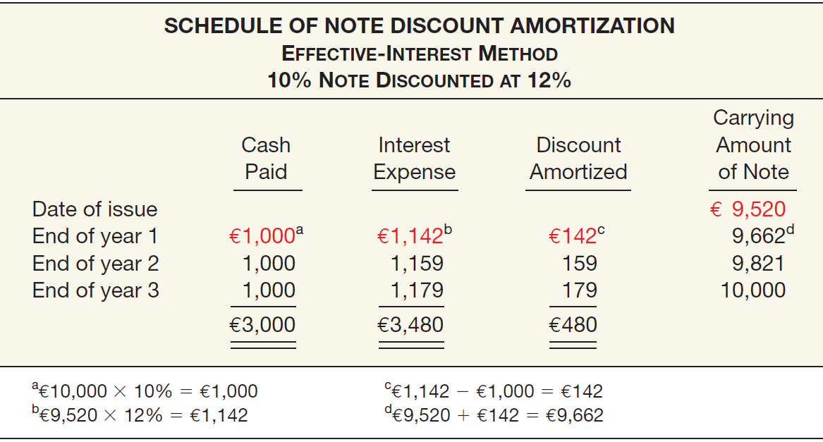
Interest-Bearing Notes
ILLUSTRATION 14-16
Schedule of Note
Discount Amortization
LO 5

Slide 54
Interest-Bearing Notes
ILLUSTRATION 14-16
Schedule of Note
Discount Amortization
Marie Co. records the following entry at the end of year 1.
Interest Expense 1,142
Notes Payable 142
Cash 1,000
LO 5

Slide 55
Special Notes Payable Situations
Notes Issued for Property, Goods, or Services
When exchanging the debt instrument for property, goods, or services in a bargained transaction, the stated interest rate is presumed to be fair unless:
No interest rate is stated, or
The stated interest rate is unreasonable, or
The stated face amount is materially different from the current cash price for the same or similar items or from the current fair value of the debt instrument.
LO 5

Slide 56
Special Notes Payable Situations
Choice of Interest Rates
If a company cannot determine the fair value of the property, goods, services, or other rights, and if the note has no ready market, the present value of the note must be determined by the company to approximate an applicable interest rate (imputation).
Choice of rate is affected by:
  Prevailing rates for similar instruments.
  Factors such as restrictive covenants, collateral, payment schedule, and the existing prime interest rate.
LO 5

Slide 57
Special Notes Payable Situations
Illustration: On December 31, 2015, Wunderlich Company issued a promissory note to Brown Interiors Company for architectural services. The note has a face value of £550,000, a due date of December 31, 2020, and bears a stated interest rate of 2 percent, payable at the end of each year. Wunderlich cannot readily determine the fair value of the architectural services, nor is the note readily marketable. On the basis of Wunderlich’s credit rating, the absence of collateral, the prime interest rate at that date, and the prevailing interest on Wunderlich’s other outstanding debt, the company imputes an 8 percent interest rate as appropriate in this circumstance.
LO 5

Slide 58
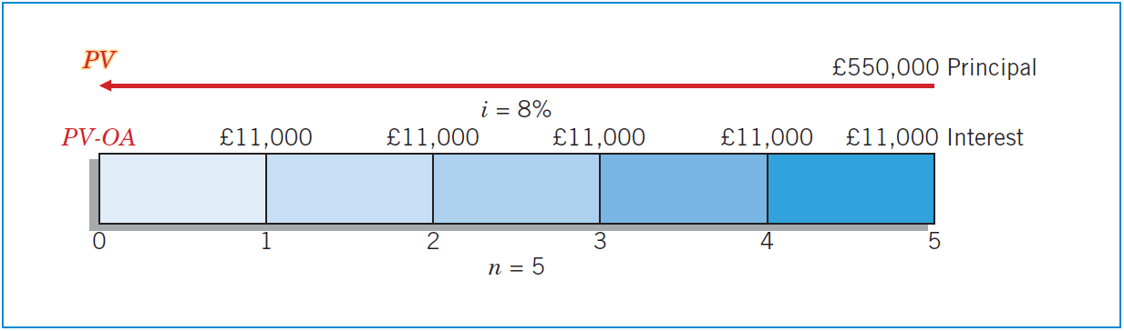
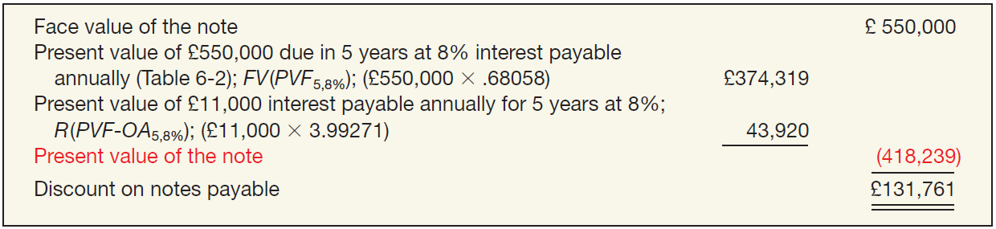
Special Notes Payable Situations
ILLUSTRATION 14-18
Time Diagram for Interest-Bearing Note
ILLUSTRATION 14-19
Computation of Imputed Fair Value and Note Discount
LO 5

Slide 59
Special Notes Payable Situations
ILLUSTRATION 14-19
Computation of Imputed Fair Value and Note Discount
On December 31, 2015, Wunderlich records issuance of the note in payment for the architectural services as follows.
Building (or Construction in Process) 418,239
Notes Payable 418,239
LO 5

Slide 60
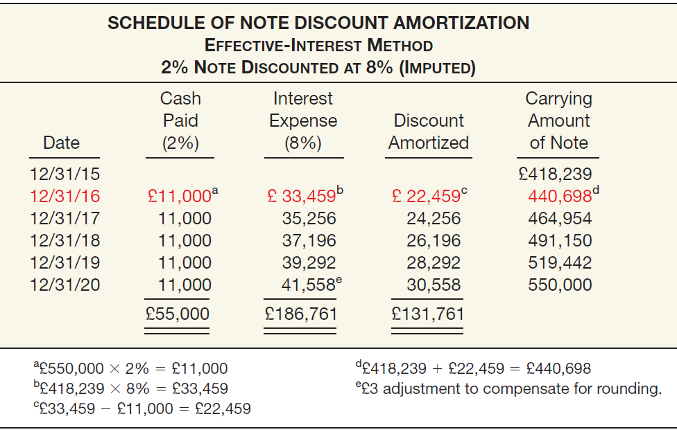
Special Notes Payable Situations
ILLUSTRATION 14-20
Schedule of Discount Amortization Using Imputed Interest Rate
LO 5

Slide 61
Special Notes Payable Situations
ILLUSTRATION 14-20
Schedule of Discount Amortization Using Imputed Interest Rate
Payment of first year’s interest and amortization of the discount.
Interest Expense 33,459
Notes Payable 22,459
Cash 11,000
LO 5

Slide 62
Mortgage Notes Payable
  A promissory note secured by a document called a mortgage that pledges title to property as security for the loan.
  Common form of long-term notes payable.
  Payable in full at maturity or in installments.
  Fixed-rate mortgage.
  Variable-rate mortgages.
LO 5

Slide 63
14
Non-Current Liabilities
LEARNING OBJECTIVES
After studying this chapter, you should be able to:
Describe the formal procedures associated with issuing long-term debt.
Identify various types of bond issues.
Describe the accounting valuation for bonds at date of issuance.
Apply the methods of bond discount and premium amortization.
Explain the accounting for long-term notes payable.
Describe the accounting for the extinguishment of non-current liabilities.
Describe the accounting for the fair value option.
Explain the reporting of off-balance-sheet financing arrangements.
Indicate how to present and analyze non-current liabilities.

Slide 64
SPECIAL ISSUES RELATED TO NON-CURRENT LIABILITIES
Extinguishment of Non-Current Liabilities
  Extinguishment with cash before maturity,
  Extinguishment by transferring assets or securities, and
  Extinguishment with modification of terms.
LO 6

Slide 65
Extinguishment of Non-Current Liabilities
Extinguishment with Cash before Maturity
  Net carrying amount > Reacquisition price = Gain
  Reacquisition price > Net carrying amount = Loss
  At time of reacquisition, unamortized premium or discount must be amortized up to the reacquisition date.
LO 6

Slide 66
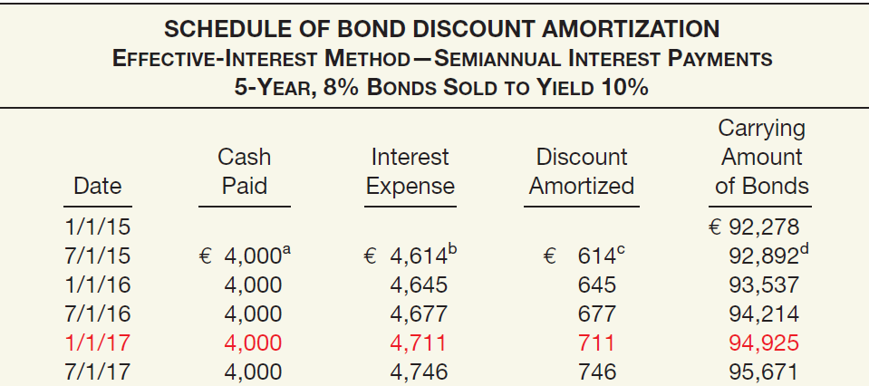
Extinguishment with Cash before Maturity
Illustration: Evermaster bonds issued at a discount on January 1, 2015. These bonds are due in five years. The bonds have a par value of €100,000, a coupon rate of 8% paid semiannually, and were sold to yield 10%.
ILLUSTRATION 14-21
Bond Premium Amortization Schedule, Bond Extinguishment
LO 6

Slide 67
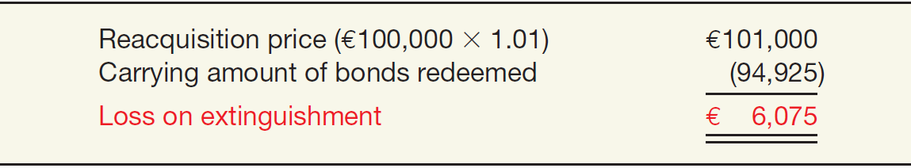
Extinguishment with Cash before Maturity
Two years after the issue date on January 1, 2017, Evermaster calls the entire issue at 101 and cancels it.
ILLUSTRATION 14-22
Computation of Loss on
Redemption of Bonds
Evermaster records the reacquisition and cancellation of the bonds as follows.
Bonds Payable 94,925
Loss on Extinguishment of Bonds 6,075
Cash 101,000
LO 6

Slide 68
Extinguishment of Non-Current Liabilities
Extinguishment by Exchanging Assets or Securities
  Creditor should account for the non-cash assets or equity interest received at their fair value.
  Debtor recognizes a gain equal to the excess of the carrying amount of the payable over the fair value of the assets or equity transferred (gain).
LO 6

Slide 69
Exchanging Assets
  Illustration: Hamburg Bank loaned €20,000,000 to Bonn Mortgage Company. Bonn, in turn, invested these monies in residential apartment buildings. However, because of low occupancy rates, it cannot meet its loan obligations. Hamburg Bank agrees to accept from Bonn Mortgage real estate with a fair value of €16,000,000 in full settlement of the €20,000,000 loan obligation. The real estate has a carrying value of €21,000,000 on the books of Bonn Mortgage. Bonn (debtor) records this transaction as follows.
Note Payable (to Hamburg Bank) 20,000,000
Loss on Disposal of Real Estate 5,000,000
Real Estate 21,000,000
Gain on Extinguishment of Debt 4,000,000
LO 6

Slide 70
Exchanging Securities
  Illustration: Now assume that Hamburg Bank agrees to accept from Bonn Mortgage 320,000 ordinary shares (€10 par) that have a fair value of €16,000,000, in full settlement of the €20,000,000 loan obligation. Bonn Mortgage (debtor) records this transaction as follows.
Notes Payable (to Hamburg Bank) 20,000,000
Share Capital—Ordinary 3,200,000
Share Premium—Ordinary 12,800,000
Gain on Extinguishment of Debt 4,000,000
LO 6

Slide 71
Extinguishment with Modification of Terms
Creditor may offer one or a combination of the following modifications:
  Reduction of the stated interest rate.
  Extension of the maturity date of the face amount of the debt.
  Reduction of the face amount of the debt.
  Reduction or deferral of any accrued interest.
LO 6

Slide 72
Modification of Terms
Illustration: On December 31, 2015, Morgan National Bank enters into a debt modification agreement with Resorts Development Company. The bank restructures a ¥10,500,000 loan receivable issued at par (interest paid to date) by:
  Reducing the principal obligation from ¥10,500,000 to ¥9,000,000;
  Extending the maturity date from December 31, 2015, to December 31, 2019; and
  Reducing the interest rate from the historical effective rate of 12 percent to 8 percent. Given Resorts Development’s financial distress, its market-based borrowing rate is 15 percent.
LO 6

Slide 73
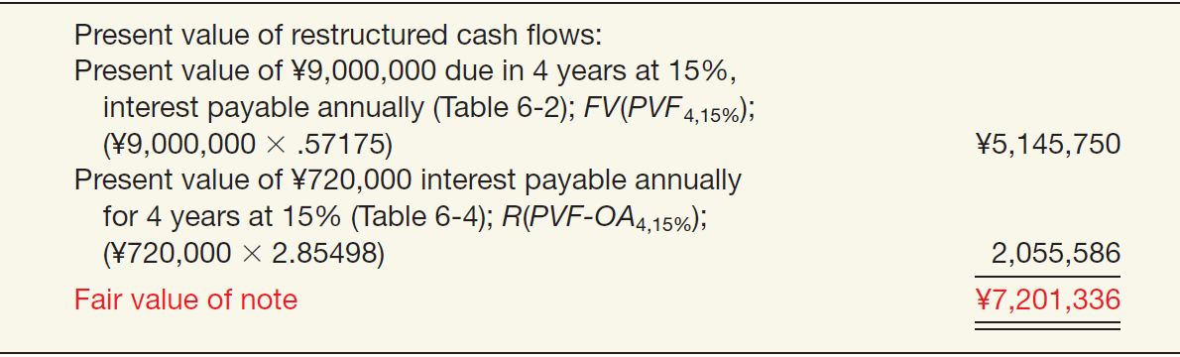
Modification of Terms
IFRS requires the modification to be accounted for as an extinguishment of the old note and issuance of the new note, measured at fair value.
ILLUSTRATION 14-23
Fair Value of Restructured Note
LO 6

Slide 74
Modification of Terms
The gain on the modification is ¥3,298,664, which is the difference between the prior carrying value (¥10,500,000) and the fair value of the restructured note, as computed in Illustration 14-23 (¥7,201,336). Given this information, Resorts Development makes the following entry to record the modification.
Note Payable (old) 10,500,000
Gain on Extinguishment of Debt 3,298,664
Note Payable (new) 7,201,336
LO 6

Slide 75
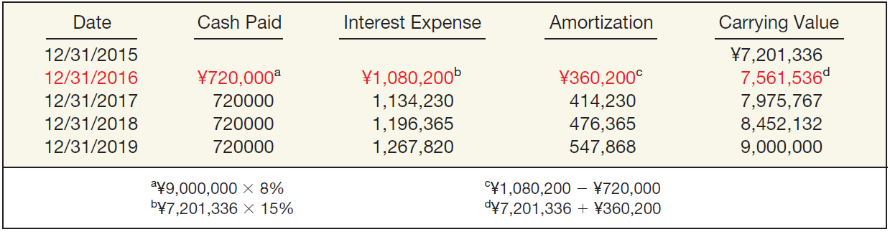
Modification of Terms
Amortization schedule for the new note.
ILLUSTRATION 14-24
Schedule of Interest and Amortization
after Debt Modification
LO 6

Slide 76
14
Non-Current Liabilities
LEARNING OBJECTIVES
After studying this chapter, you should be able to:
Describe the formal procedures associated with issuing long-term debt.
Identify various types of bond issues.
Describe the accounting valuation for bonds at date of issuance.
Apply the methods of bond discount and premium amortization.
Explain the accounting for long-term notes payable.
Describe the accounting for the extinguishment of non-current liabilities.
Describe the accounting for the fair value option.
Explain the reporting of off-balance-sheet financing arrangements.
Indicate how to present and analyze non-current liabilities.

Slide 77
Fair Value Option
Companies have the option to record fair value in their accounts for most financial assets and liabilities, including bonds and notes payable.
The IASB believes that fair value measurement for financial instruments, including financial liabilities, provides more relevant and understandable information than amortized cost.
LO 7

Slide 78
Fair Value Option
Fair Value Measurement
Non-current liabilities are recorded at fair value, with unrealized holding gains or losses reported as part of net income.
Illustrations: Edmonds Company has issued €500,000 of 6 percent bonds at face value on May 1, 2015. Edmonds chooses the fair value option for these bonds. At December 31, 2015, the value of the bonds is now €480,000 because interest rates in the market have increased to 8 percent.
Bonds Payable (€500,000 - €480,000) 20,000
Unrealized Holding Gain or Loss—Income 20,000
LO 7

Slide 79
14
Non-Current Liabilities
LEARNING OBJECTIVES
After studying this chapter, you should be able to:
Describe the formal procedures associated with issuing long-term debt.
Identify various types of bond issues.
Describe the accounting valuation for bonds at date of issuance.
Apply the methods of bond discount and premium amortization.
Explain the accounting for long-term notes payable.
Describe the accounting for the extinguishment of non-current liabilities.
Describe the accounting for the fair value option.
Explain the reporting of off-balance-sheet financing arrangements.
Indicate how to present and analyze non-current liabilities.

Slide 80
Off-Balance-Sheet Financing
Off-balance-sheet financing is an attempt to borrow monies in such a way to prevent recording the obligations.
Different Forms:
  Non-Consolidated Subsidiary
  Special Purpose Entity (SPE)
  Operating Leases
LO 8

Slide 81
14
Non-Current Liabilities
LEARNING OBJECTIVES
After studying this chapter, you should be able to:
Describe the formal procedures associated with issuing long-term debt.
Identify various types of bond issues.
Describe the accounting valuation for bonds at date of issuance.
Apply the methods of bond discount and premium amortization.
Explain the accounting for long-term notes payable.
Describe the accounting for the extinguishment of non-current liabilities.
Describe the accounting for the fair value option.
Explain the reporting of off-balance-sheet financing arrangements.
Indicate how to present and analyze non-current liabilities.

Slide 82
Presentation and Analysis
Presentation of Non-Current Liabilities
Note disclosures generally indicate the nature of the liabilities, maturity dates, interest rates, call provisions, conversion privileges, restrictions imposed by the creditors, and assets designated or pledged as security.
Fair value of the debt should be disclosed.
Must disclose future payments for sinking fund requirements and maturity amounts of long-term debt during each of the next five years.
LO 9

Slide 83
Presentation and Analysis
Analysis of Non-Current Liabilities
One ratio that provides information about debt-paying ability and long-run solvency is:
Total Liabilities
Debt to Assets
=
Total Assets
The higher the percentage of total liabilities to total assets, the greater the risk that the company may be unable to meet its maturing obligations.
LO 9

Slide 84
Presentation and Analysis
Analysis of Non-Current Liabilities
A second ratio that provids information about debt-paying ability and long-run solvency is:
Income before Income Taxes and Interest Expense
Times Interest Earned
=
Interest Expense
Indicates the company’s ability to meet interest payments as they come due.
LO 9

Slide 85
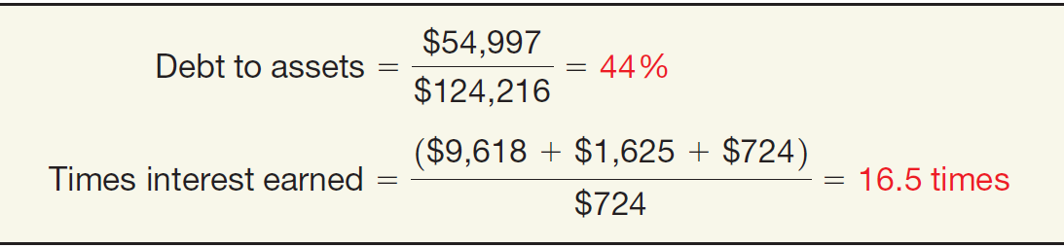
Presentation and Analysis
Illustration: Novartis has total liabilities of $54,997 million, total assets of $124,216 million, interest expense of $724 million, income taxes of $1,625 million, and net income of $9,618 million. We compute Novartis’s debt to assets and times interest earned ratios as shown
ILLUSTRATION 14-28
Computation of Long-Term Debt Ratios for Novartis
LO 9

Slide 86


GLOBAL ACCOUNTING INSIGHTS
LIABILITIES
U.S. GAAP and IFRS have similar definitions for liabilities. In addition, the accounting for current liabilities is essentially the same under both IFRS and U.S. GAAP. However, there are substantial differences in terminology related to noncurrent liabilities as well as some differences in the accounting for various types of long-term debt transactions.

Slide 87
GLOBAL ACCOUNTING INSIGHTS
Relevant Facts
Similarities
U.S. GAAP and IFRS have similar liability definitions. Both also classify liabilities as current and non-current.
Much of the accounting for bonds and long-term notes is the same under U.S. GAAP and IFRS.
Both U.S. GAAP and IFRS require the best estimate of a probable loss. In U.S. GAAP, the minimum amount in a range is used. Under IFRS, if a range of estimates is predicted and no amount in the range is more likely than any other amount in the range, the midpoint of the range is used to measure the liability.
Both U.S. GAAP and IFRS prohibit the recognition of liabilities for future losses.

Slide 88
GLOBAL ACCOUNTING INSIGHTS
Relevant Facts
Differences
Under U.S. GAAP, companies must classify a refinancing as current only if it is completed before the financial statements are issued. IFRS requires that the current portion of long-term debt be classified as current unless an agreement to refinance on a long-term basis is completed before the reporting date.
U.S. GAAP uses the term contingency in a different way than IFRS. A contingency under U.S. GAAP may be reported as a liability under certain situations. IFRS does not permit a contingency to be recorded as a liability.
U.S. GAAP uses the term estimated liabilities to discuss various liability items that have some uncertainty related to timing or amount. IFRS generally uses the term provisions.

Slide 89
GLOBAL ACCOUNTING INSIGHTS
Relevant Facts
Differences
U.S. GAAP and IFRS are similar in the treatment of environmental liabilities. However, the recognition criteria for environmental liabilities are more stringent under U.S. GAAP: Environmental liabilities are not recognized unless there is a present legal obligation and the fair value of the obligation can be reasonably estimated.
U.S. GAAP uses the term troubled debt restructurings and develops recognition rules related to this category. IFRS generally assumes that all restructurings should be considered extinguishments of debt.

Slide 90
GLOBAL ACCOUNTING INSIGHTS
Relevant Facts
Differences
Under U.S. GAAP, companies are permitted to use the straight-line method of amortization for bond discount or premium, provided that the amount recorded is not materially different than that resulting from effective-interest amortization. However, the effective-interest method is preferred and is generally used. Under IFRS, companies must use the effective-interest method.
Under U.S. GAAP, companies record discounts and premiums in separate accounts (see the About the Numbers section). Under IFRS, companies do not use premium or discount accounts but instead show the bond at its net amount.

Slide 91
GLOBAL ACCOUNTING INSIGHTS
Relevant Facts
Differences
Under U.S. GAAP, bond issue costs are recorded as an asset. Under IFRS, bond issue costs are netted against the carrying amount of the bonds.
Under U.S. GAAP, losses on onerous contract are generally not recognized unless addressed by industry- or transaction-specific requirements. IFRS requires a liability and related expense or cost be recognized when a contract is onerous.

Slide 92
GLOBAL ACCOUNTING INSIGHTS
About The Numbers
Under IFRS, premiums and discounts are netted against the face value of the bonds for recording purposes. Under U.S. GAAP, discounts and premiums are recorded in separate accounts.

Slide 93
GLOBAL ACCOUNTING INSIGHTS
On the Horizon
As indicated in Chapter 2, the IASB and FASB are working on a conceptual framework project, part of which will examine the definition of a liability. In addition, the two Boards are attempting to clarify the accounting related to provisions and related contingencies.

Slide 94
COPYRIGHT
Copyright © 2014 John Wiley & Sons, Inc. All rights reserved. Reproduction or translation of this work beyond that permitted in Section 117 of the 1976 United States Copyright Act without the express written permission of the copyright owner is unlawful. Request for further information should be addressed to the Permissions Department, John Wiley & Sons, Inc. The purchaser may make back-up copies for his/her own use only and not for distribution or resale. The Publisher assumes no responsibility for errors, omissions, or damages, caused by the use of these programs or from the use of the information contained herein.

