Slide 1
MN7032SA
Marketing, Marketing Communications and Operations
Lesson 3: Segmentation, Targeting and Positioning

Slide 2
Learning outcomes:
Describe the principles of market segmentation and the STP process
Explain the characteristics and differences between market segmentation and product differentiation
Describe different targeting strategies
Explain the concept of positioning and illustrate how the use of perceptual maps can assist the positioning process

Slide 3
Objectives
Business/Corporate
Objectives
Marketing
Objectives
Product Price Place Promotion
Objectives Objectives Objectives Objectives

Slide 4
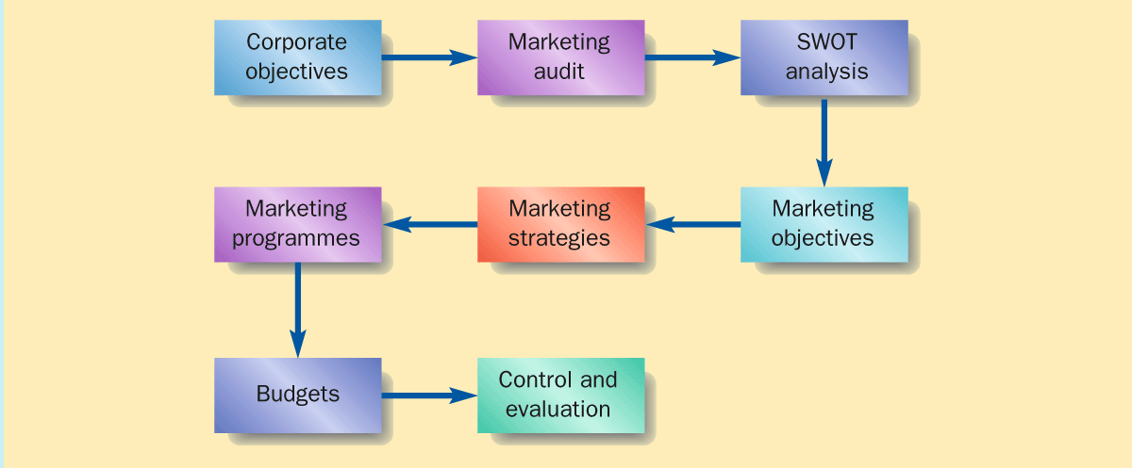
The Marketing Planning
Process
Brassington 2006

Slide 5
The Marketing Planning Process
Where are we now?
Marketing audit
Ratio analysis
Competitor analysis
Customer analysis
Where do we want to be?
Missions & objectives
Segmentation (STP)
Marketing strategies
Which way is best?
Choice criteria &
screening
Modelling
How might we get there?
Marketing mix
How can we ensure arrival?
Problems to overcome
Management controls

Slide 6
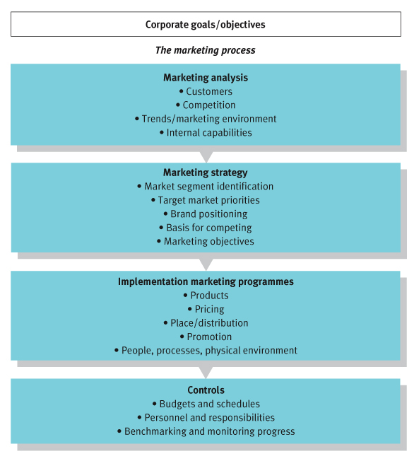
The Marketing Process
STP
Source: Dibb Simpkin et al

Slide 7
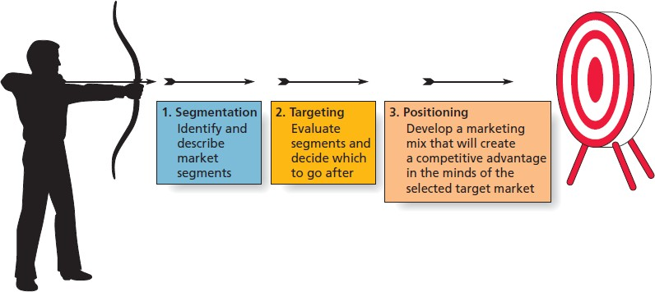
Steps in the Target Marketing Process

Slide 8
SEGMENT, TARGETING AND POSITIONING (STP)
Global market segmentation is the process of identifying and categorizing groups of customers and countries according to common characteristics.
Targeting involves evaluating the segments and focusing marketing efforts on a country, region, or group of people that has significant potential to respond. Such targeting reflects the reality that a company should identify those consumers it can reach most effectively, efficiently, and profitably.
Proper positioning is required to differentiate the product or brand in the minds of target
customers

Slide 9
Segmenting Markets, Targeting and Positioning
Segmentation
Consider variables for segmenting market
Look at profile of emerging segments
Validate segments emerging
Targeting
Decide on targeting strategy
Decide which and how many segments should be targeted
Positioning
Understand consumer perceptions
Position products through communication
Design appropriate marketing mix
Its about what's created in the minds of the target customers

Slide 10
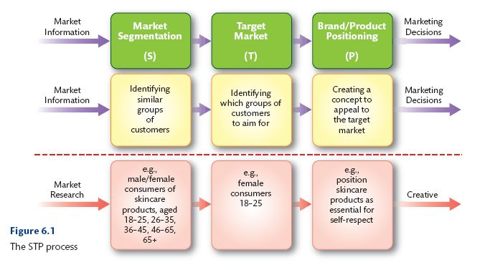
STP Process

Slide 11
Market Segmentation
Identifying the most productive bases for dividing a market, identifying the customers in different segments and developing a segment description (adapted from Hooley, Saunders and Piercy, 1998)

Slide 12
Segmentation – STP Process
Method by which whole markets are subdivided into different segments
Three activities that should be undertaken, usually sequentially, if segmentation is to be successful:
  Segmentation
  Targeting
  Positioning

Slide 13
STEP 1: SEGMENTATION
Segmentation is the process of dividing a larger market into smaller pieces based on meaningful, shared (homogeneous) characteristics
  Useful in both consumer and B2B contexts
  Many different dimensions, or segmentation variables, that marketers can utilise

Slide 14
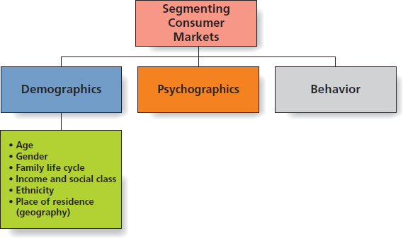
Segmenting Consumer Markets

Slide 15

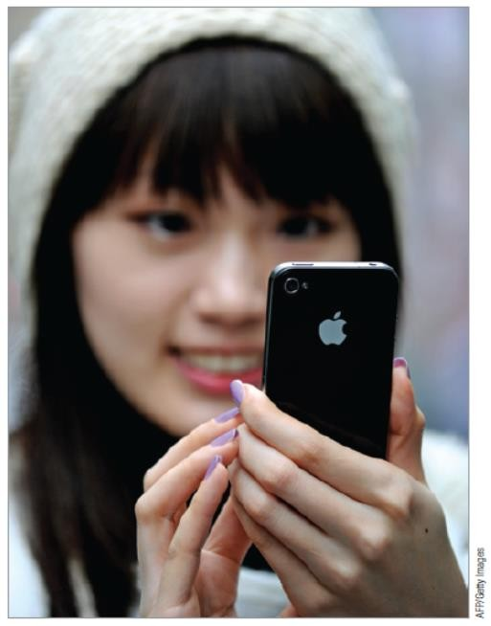
Segmenting by Demographics: Age and Generational Marketing
Children
Teens and Tweens
Generation Y
  aka Millennials or Echo Boomers
  Born between 1978 and 1994

Slide 16
AGE AND GENERATIONAL MARKETING
Generation X (Born between 1965 and 1976)
  Has entrepreneurial reputation, views home as an expression of individuality
Baby-boomers (Born between 1946 and 1964)
- Key segment due to their size and earnings, willing to invest money, time, and energy to maintain youthful image
Mature consumers
  Focus on lifestyle factors, such as mobility

Slide 17
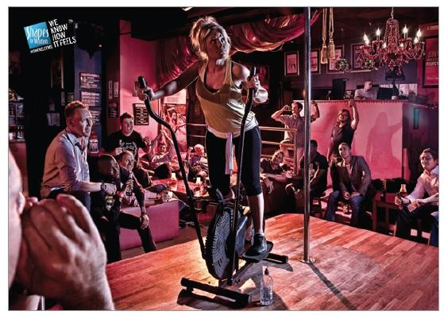
Segmenting by Demographics: Gender
Many products appeal to one sex or the other
  Metrosexual: a straight, urban male who is keenly interested in fashion, home design, gourmet cooking, and personal care

Slide 18
SEGMENTING BY DEMOGRAPHICS: FAMILY LIFE CYCLE
Family needs and expenditures change over time
  As families move through stages, different product
categories ascend or descent in importance
  Even if importance is constant, needs within category may change (e.g., furniture)
What purchase categories would be of rising importance for young newlywed couples?
Expectant parents? Empty nesters?

Slide 19
Segmenting by Demographics:
Income and Social Class
Income
  Strongly connected to buying power
Social Class
  Many consumers buy according to an image they’d like to portray, not their actual level
  For instance, “easy credit” may lead consumers to buy clothes, cars and homes they can’t truly afford
7-10
Copyright © 2016 Pearson Education Ltd

Slide 20
Segmenting by
Demographics: Ethnicity
Ethnic and cultural diversity is increasing…
Perspectives ?

Slide 21
SEGMENTING BY DEMOGRAPHICS: PLACE OF RESIDENCE
Geodemography
  Combines demographics with geography
  Detailed segment profiles by post code based
on geodemography and lifestyle
Geocoding
  Geographically customised web advertising that
feeds local ads to users
  Underscores much paid search advertising on Google and other search engines

Slide 22

Psychographics
Uses psychological, sociological, and anthropological factors to categorise customers
  Shared Interests
Based on three primary consumer motivations:
  Ideals
  Achievements
  Self-expression

Slide 23

Segmenting by Behaviour
Categorises consumers based upon how they act toward, feel about, or use a product
  User status
  80/20 rule
  Long tail concept
  Usage occasions

Slide 24
Segmenting B2B Markets
Segmentation useful for B2B firms!
  Helps B2B companies understand needs and characteristics of potential customers
Firms can be categorised based on:
  Organisational demographics
  Production technologies used
  User status

Slide 25
Segmentation,
Not Stereotyping
The idea of segmenting is to identify groups of customers with similar (homogeneous) needs
Allows marketing to be more efficient and effective
There are many ways by which marketers may segment consumer and business markets
Imagine you have been hired by an off-campus college bookstore as a marketing consultant. What do you think would be the best approach for segmenting their market?

Slide 26
Step 2: Targeting
The next step is targeting, in which marketers evaluate each potential segment and decide upon which groups of customers they will invest marketing resources
  Selected groups are known as target markets

Slide 27
Market Targeting and Market Positioning
Market targeting is the process of evaluating each market segment’s attractiveness and selecting one or more segments to enter.
Market positioning is the arranging for a product to occupy a clear, distinctive and desirable place relative to competing products in the minds of target consumers (adapted from Kotler and Armstrong 2001).

Slide 28
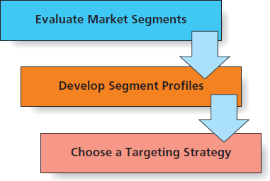
Phases of Targeting

Slide 29

Evaluation of Market Segments
A viable market segment should:
  Have members with similar wants and needs that are different from those in other segments
  Be measureable in size and purchasing power
  Be large enough to be profitable
  Be reachable by marketing communications
  Have needs the marketer can address

Slide 30
Developing Segment
Profiles
After segments are identified, marketers should develop profiles or descriptions of the typical customers within a segment
  Segment profiles might include demographic, location, lifestyle and product-usage characteristics

Slide 31
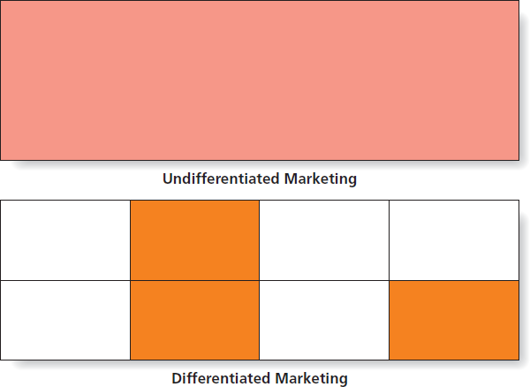
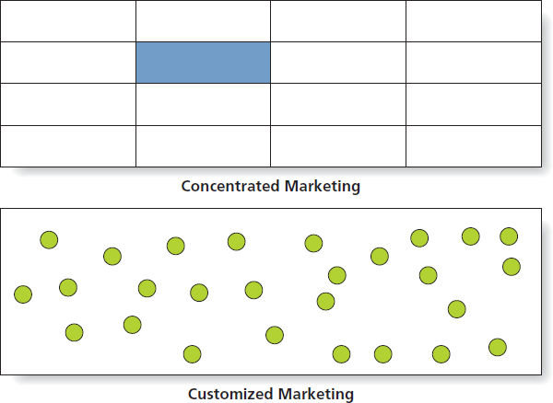
Choosing a
Targeting Strategy

Slide 32
Customised Targeting Strategy
Customised marketing strategy
  Tailoring specific products to individual customers
  Common in personal and professional services, and in industrial marketing
  Mass customisation is the extreme case, which involves modifying a product to meet the needs and tastes of an individual consumer

Slide 33
ETHICAL/SUSTAINABLE DECISIONS IN THE REAL WORLD
Fast food restaurants have long been criticised for targeting children and teens
Critics argue that fast food advertising contributes to childhood obesity
  With rise of social media, fast food has more communication avenues than ever
  Youth obesity trends growing worldwide
  Increased healthcare costs
Should fast food marketing to children be regulated by the government?

Slide 34
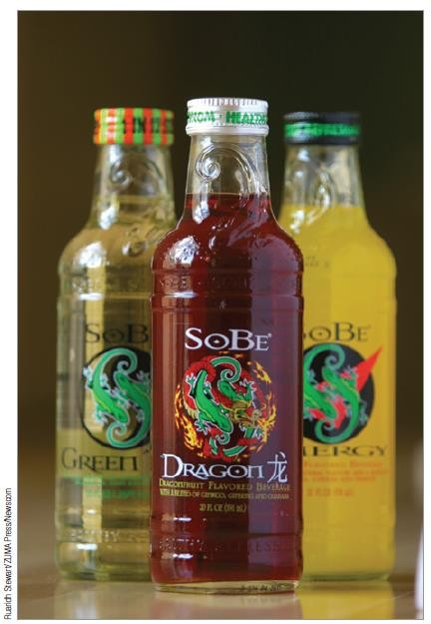
Step 3: Positioning
Positioning is the process by which marketers seek to influence how a particular product is perceived in the minds of customers relative to competing offerings

Slide 35

Stages in a Positioning Decision
Analyse Competitor Positions
Define our Competitive Advantage
Finalise the Marketing Mix
Evaluate and FineTune

Slide 36
MODIFYING POSITIONING STRATEGIES
Repositioning establishes a new position in response to market changes
  Commonly used to change the brand image
  Repositioning can breathe life into “retro” brands

Slide 37
BRINGING A PRODUCT TO LIFE: BRAND PERSONALITY
Positioning strategies often try to create a brand personality
  A distinctive image that captures a brand’s character and benefits
Research has identified several brand personality dimensions:
Sincerity:
Excitement
Competence
Authenticity
Sophistication
Ruggedness
Example? Example? Example? Example? Example? Example?

Slide 38
POSITIONED FOR SUCCESS
Successful brand positioning should align clearly with the company’s competitive advantage(s)
  In turn, marketing mix elements should support a distinctive brand image and value proposition for the target market
Think of your favourite restaurant chain. How would you describe its brand personality? Why?

Slide 39
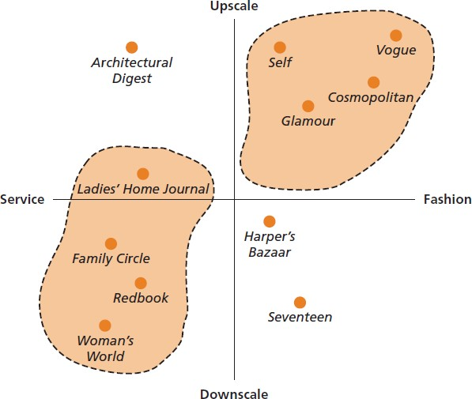
PERCEPTUAL MAP

Slide 40
Why do we need segmentation?
Notes:
Ever wondered why we don’t target everyone with our marketing activities or how market segments are identified? Think about education: how they do segment?
(early childhood, primary school, secondary school, tertiary school, workshop, lifelong learning, skills based learning)
universities: how do you think they identify with which students to communicate about degree programmes? (What criteria do they use? What about
international and domestic student groups: is this difference important for the marketing of higher education services to prospective students?

Slide 41
Definition - Segmentation
Segmentation-The act of dividing the market into specific groups of consumers or buyers who share common needs and who might require separate products and or marketing mixes
(adapted from Kotler et al 1998)
Notes:
In general, whom to focus and why

Slide 42
Market Segmentation
Market segmentation is the division of a market into different groups of customers with distinctly similar needs and product/service requirements.
Purpose of market segmentation:
  Leverage scarce resources.
  To ensure that the elements of the marketing mix are designed to meet particular needs of different customer groups.
  Allows organisations to focus on specific customers needs, in the most efficient and effective way.
Notes:
Pioneer generation- born on or before 31 Dec 1949
Merdeka generation- 1 Jan 1950- 31 Dec 1959
When government want to deliver the message to them, in the past only four languages- Malay, Chinese, English, Tamil.
Today, ministries used TV and promote using dialects: Cantonese, Hakka, Hokkien

Slide 43

Example:
Elderly
Older cabinet ministers
Healthcare workers
Front-line personnel
Vulnerable people
Then…. The rest of the population
Notes:
He said he and some older Cabinet ministers will be vaccinated early as a demonstration that the vaccines are safe.
pregnant women, immuno-compromised persons and those under the age of 16 until more data are available.

Slide 44
Benefits of STP Process
“80% of profits usually derived by 20% of customers” Pareto’s Principle
Enhancing a company’s competitive position by providing direction & focus for marketing strategies.
Examining and identifying growth opportunities in the market through the identification of new customers, growth segments or new product uses.
More effective and efficient matching of company resources to targeted market segments promising the greatest ROMI.
Notes:
ROMI- return on marketing investment
“Pe’rei-tow”

Slide 45
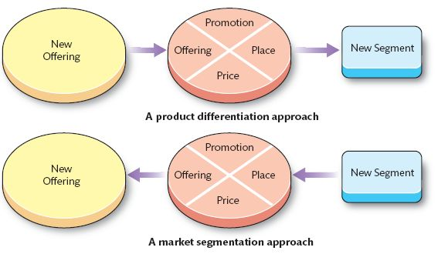
Market Segmentation Vs Product Differentiation
Notes:
Market segmentation is related to product differentiation.
If you aim at different market segments,
you might adapt different variations of your offering to satisfy those segments.
Market segmentation focuses on market segments
Product differentiation focuses on product offering.
With increasing proliferation of tastes in modern society, many consumers have an increased disposable income. As a result, marketers often seek to design product offerings around consumer demand (market segments) rather than around their own production needs (product differentiation).

Slide 46
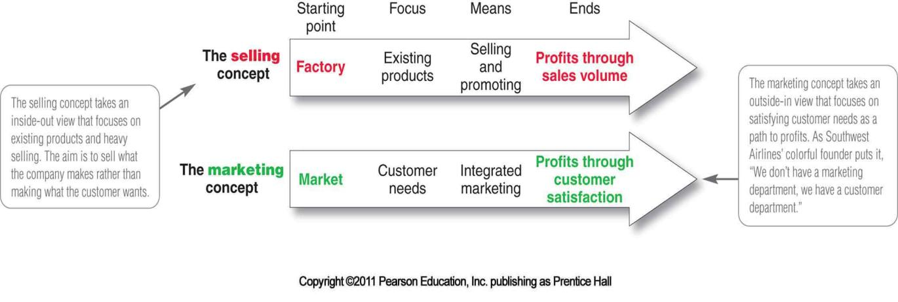
Pause for a while.. Let’s recall
Selling vs marketing concept
Source: Marketing, An Introduction, 11th Edition, Armstrong/ Kotler

Slide 47
Process of Market Segmentation
There are two main approaches to segmenting markets:
Breakdown Method: Adopts the view that the market is considered to consist of customers which are essentially the same, so the task is to identify groups which share particular differences.
Build-Up Method: Considers a market to consist of customers that are all different, so here the task is to find similarities.
Let’s take a look at our example: Education sector.
https://www.ntuclearninghub.com/ntuc-training-fund-seps/
Notes:
The first adopts the view that the market consists of customers that are essentially the same, so the task is to identify groups that share particular differences. This is the breakdown method.
The breakdown approach is the most established and is the main method used for segmenting consumer markets. The build-up approach seeks to move from the individual level at which all customers are different to a more general level of analysis based on the identification of similarities (Freytag and Clarke, 2001). The build-up method is customer-oriented, seeking to determine common customer needs. The aim of both methods is to identify market segments in which identifiable differences exist between segments (segment heterogeneity) and similarities exist between members within each segment (member homogeneity).

Slide 48
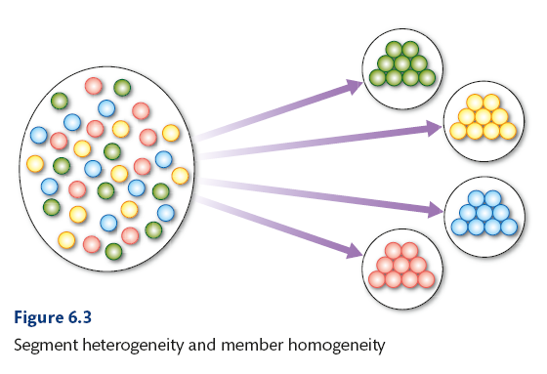
Process of Market Segmentation
Aim is to identify segments where:
  identifiable differences exist between segments (segment heterogeneity).
  similarities exist between members within each segment (members homogeneity).

Slide 49
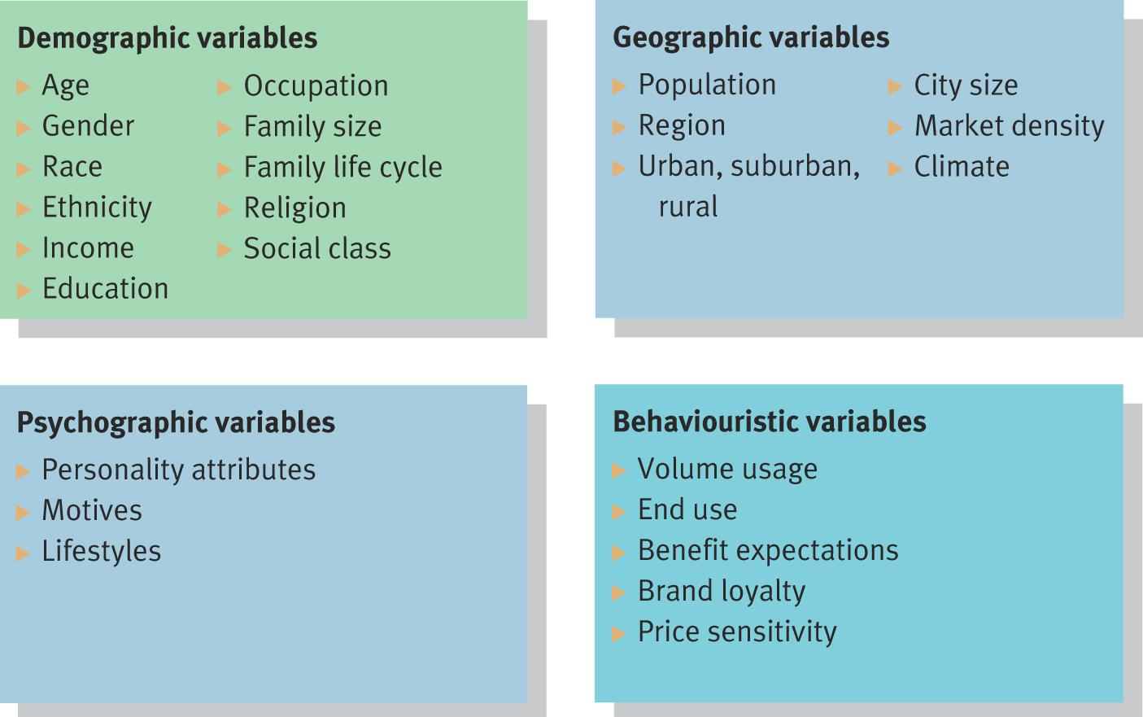
Segmentation variables for consumer markets

Slide 50
Segmenting Consumer Markets
Segmentation Bases/Criteria
  Profile Criteria - Who my market are and where are they? (Demographic + geographic according to previous table)
  Behavioural Criteria - Where, when, and how does my market behave?
  Psychological Criteria - Why does my market behave that way?

Slide 51
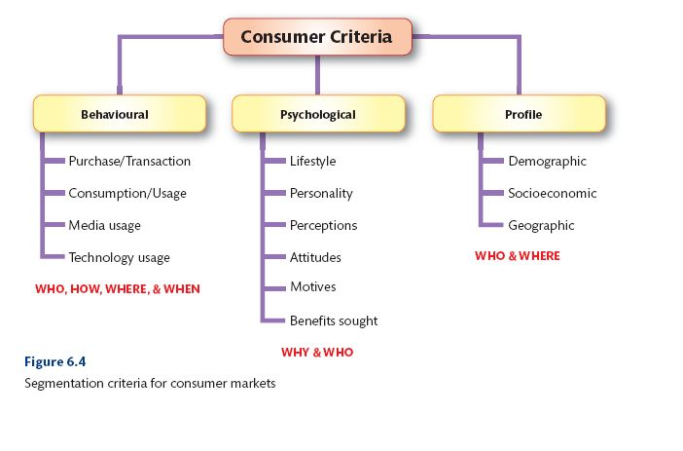
Segmenting Consumer Markets
Notes:
Pg 172
Profile- To do this, we use demographic methods (age, gender, race), socio-economics (determined by social class or income levels), and geographic location (by postal code systems). Example: Insurance and financial investment fund: risk profile. age, employment, income, and asset net worth to identify attractive market segments for a new investment portfolio.

Slide 52
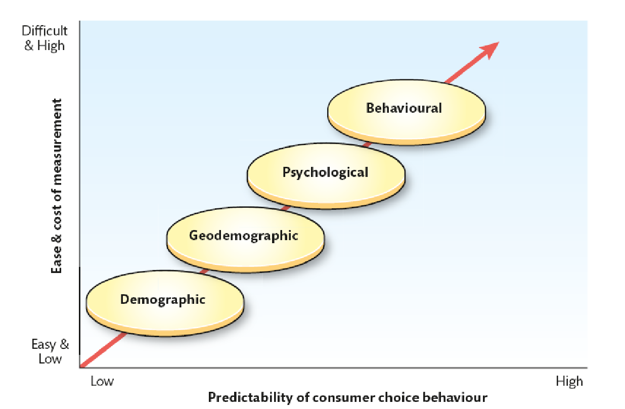
Predictability vs Cost of segments
Source: Integrated Marketing Communications in Advertising and Promotion (AISE, 7th edn. by Shimp (2007). Reprinted with permission of South-Western, a division of Thomson Learning
Notes:
Demographic is always the easy and low cost to kickstart.
Demographic- age, gender, family size, life cycle, generation, income, occupation, education, ethnicity.

Slide 53
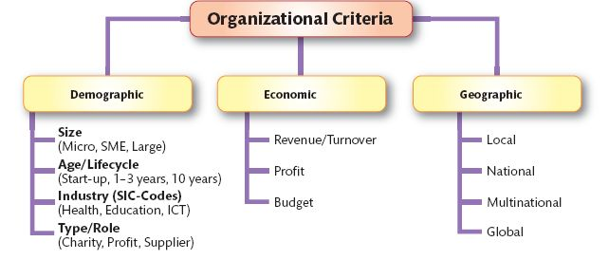
Organizational Characteristics

Slide 54
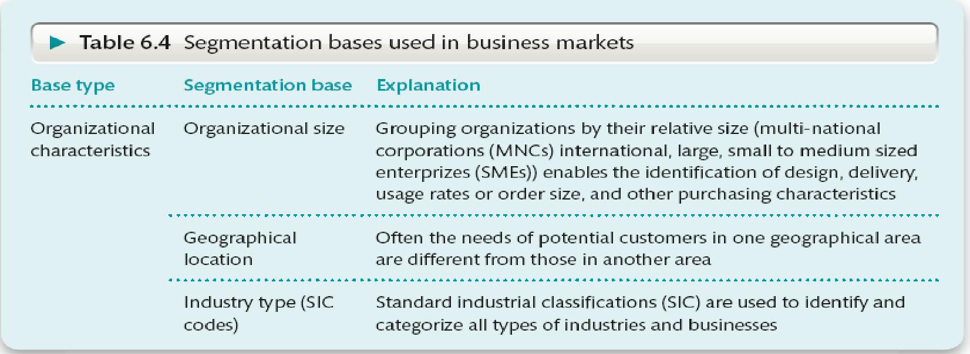
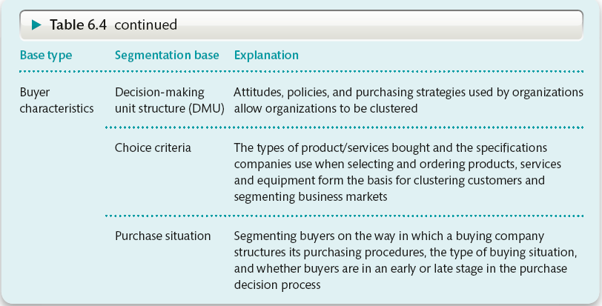
Segmenting Business Markets

Slide 55
Segmentation - Dangers
Risk of poor definition and implementation of psychographic segmentation.
Knowing where to stop.
Fragmentation of the market.
Customer confusion.
Notes:
Market fragmentation- a situation in which there are many different types of customer for a particular product or service or many different companies providing a particular product or service:

Slide 56
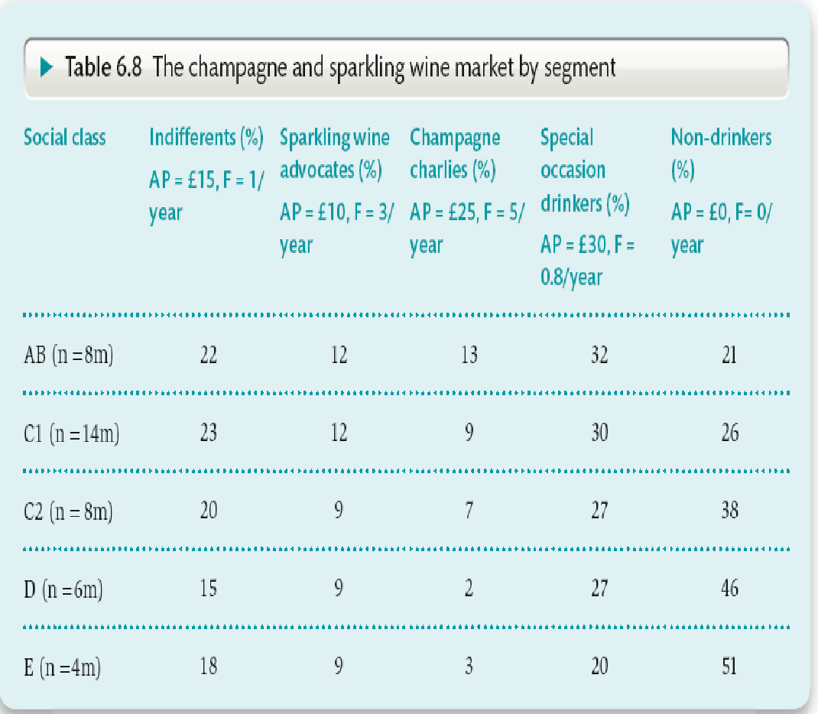
Exercise: Market Segmentation
In a group with other colleagues from your seminar/tutor group, discuss answers to the following questions:
Using the information in the Table 6.8 on the Champagne market, and a suitable calculator (?), determine what are the most potentially profitable segments in the marketplace.
What other data do we need to determine the size of the market (market potential)?

Slide 57
Targeting Criteria
Criteria for targeting - DAMP
  Distinct – is each segment clearly different from other segments?
  Accessible – can buyers be reached through appropriate promotional programmes and distribution channels?
  Measurable – is the segment easy to identify and measure?
  Profitable – (defendable?) is the segment sufficiently large to provide a stream of constant future revenues and profits?
Notes:
Pg 187
The second important part of the STP process is to determine which, if any, of the segments
uncovered should be targeted and made the focus of a comprehensive marketing programme.
Kotler (1984) suggested that, for market segmentation to be
effective, all segments must be: (DAMP)

Slide 58
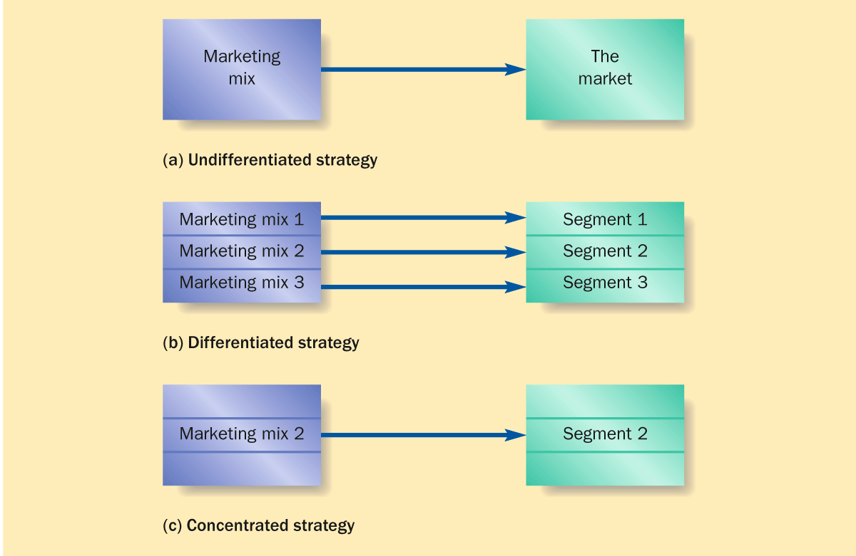
Targeting Strategies
Notes:
The undifferentiated approach—There is no delineation between market segments and instead the market is viewed as one mass market with one marketing strategy for the entire market. Although very expensive, this approach is selected in markets in which there is limited segment differentiation. The 2012 Olympics, for example, marketed at a world market or certain government services.
The differentiated targeting strategy—There are several market segments to target, each being attractive to the marketing organization. To exploit market segments, a marketing strategy is developed for each segment. For example, Hewlett Packard has developed its product range and marketing strategy to target the following user segments of computing equipment: home office users; small and medium-sized businesses; large businesses; and health, education, and government departments. A disadvantage of this approach is the loss of economies of scale resulting from the resources required to meet the needs of many market segments. For example: Netflix- international users and domestic users.
A concentrated marketing strategy—Where there are only a few market segments, this approach (also known as a niche marketing strategy) is often adopted by firms that either have limited resources to fund their marketing strategy or wish to adopt a very exclusive strategy in the market. Next slide: Aston martin
Aston Martin, the iconic British manufacturer of sports cars, uses this approach to target high net worth individuals interested in stylish, expensive, high performance cars. This approach is also used by SMEs and micro-sized organizations, mainly as a result of their limited resources. For example, a local plumber may focus on the local residential market.

Slide 59
Undifferentiated Targeting Strategy
Least demanding targeting strategy.
Assumes that the market is one homogenous unit with no significant differences.
One single marketing mix serving all needs.
Relatively inexpensive.

Slide 60
Differentiated Targeting Strategy
Involves the development of a number of different marketing mixes for different segments.
Allows a business to tailor its offerings to suit different segments.
Spreads risk across market segments.
Requires a detailed overview of the market and its development potential.
Can dilute a company’s efforts.

Slide 61

Concentrated Targeting Strategy
The concentrated approach is the most focused and involves specialising on serving one specific segment.
Can lead to very detailed knowledge of the target segment’s needs and wants.
This strategy can help keep costs down as there is only one marketing mix to manage.
Helps to develop a niche market.

Slide 62
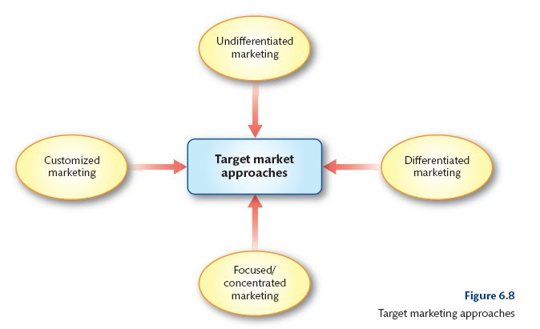
Targeting Approaches (customised/micro-marketing)
Notes:
e.g. Undifferentiated – same message to all; Differentiated: different messages to different people; focused: focusing on one group only; customised – highly differentiated

Slide 63
Example of Differentiated Strategy
Marketing Mix 1
Utilitarian
Customer
Marketing
Mix 2
Trendy-
Casual
LEVI’s
Marketing
Mix 3
Price
shopper
Marketing
Mix 4
Mainstream
Marketing
Mix 5
Tradition-
alist

Slide 64
Positioning
Definition: The act of designing the company’s offering and image so that they occupy a meaningful and distinct competitive position in the target customers’ minds.
Two fundamental elements:
  Physical attributes - the functionality and capability that a brand offers.
  Communication - the way in which a brand is communicated and how consumers perceive the brand relative to other competing brands in the market place.
Notes:
Positioning is the means by which goods and services can
be differentiated from one another and so give consumers a reason to buy

Slide 65
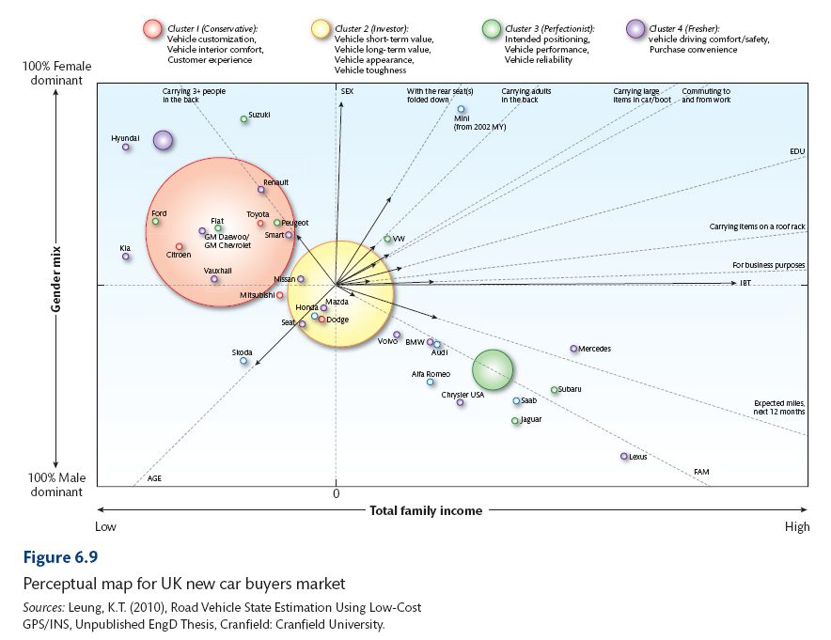
Example of a Perceptual Map
Notes:
the closer products/brands are clustered together on a perceptual
map, the greater the competition. For example, Samsung & Apple & Huawei.
The further apart the positions, the greater the opportunity for new brands to enter the market, simply because the competition is less intense.
For example, in the UK new car market, there are numerous brands in the marketplace all competing with each other across differing core attributes, such as whether or not the car is needed for business purposes, is needed for carrying more than three people, is needed for carrying large items on a roof rack, or needs a large boot and so on. To show how the differing brands are positioned relative to each other using scores on the above attributes for each car brand, we can measure and map the brand positioning.
Figure 6.8 shows the positioning of each of the main car brands in relation to the main product attributes, but also indicates four clusters of car buyers in the UK new car buyers market.
Conservatives buy based on perceptions of vehicle customization, interior comfort, and experience.
● Investors buy based on the value and appearance of the car.
● Perfectionists buy on the basis of perceptions of vehicle performance, reliability, and the company’s advertising.
● Freshers buy based on their perceptions of vehicle driving comfort and safety, and purchase convenience.

Slide 66
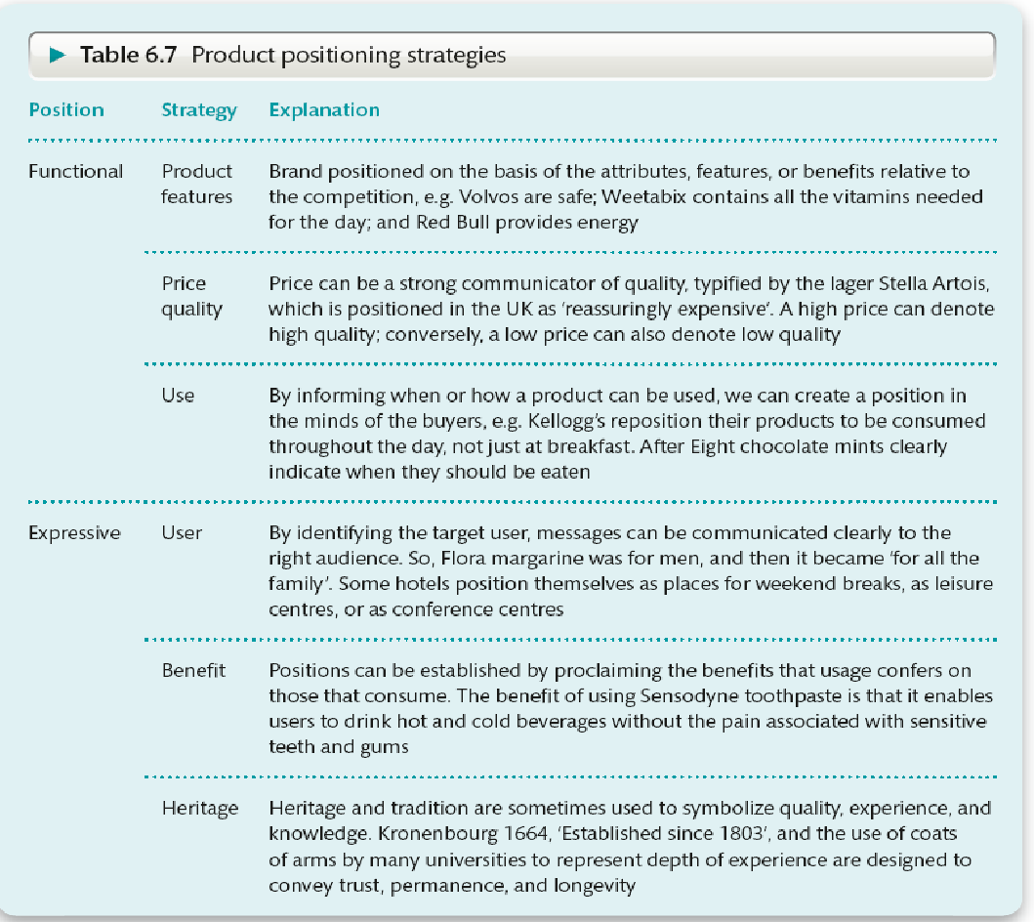
Positioning Strategies
Product attributes
How customers express
themselves

Slide 67
Repositioning Strategies
The following provides four ways of repositioning a product, depending on the individual situation facing a brand. In some cases, a brand might need to be adapted before relaunch.
1. Change the tangible attributes and then communicate the new proposition to the same market.
2. Change the way a product is communicated to the original market.
3. Change the target market and deliver the same product.
4. Change both the product (attributes) and the target market.
Notes:
(1) Regent Inns repositioned in 2007, ahead of the UK public smoking restrictions,
by moving the focus of bar and restaurant brands such as Walkabout, Jongleurs, and Old Orleans to food rather than drinks, and changing lighting and seating to alter the atmosphere and ambience. The brands’ logos were also refreshed (Godsell, 2007).
(2) Vodafone have changed its global positioning in an attempt to throw off its ‘stuffy’ image. This has involved changing its strap line from ‘Power to you’ to ‘Instant connections’, communicating more relational values.
(3) On some occasions, repositioning can be achieved through marketing communications alone, but targeted at a new market. For example, Lucozade was repositioned from a drink for sickly children, a niche market with limited volume sales growth, to an energy drink for busy, active, and sports-oriented people, achieved through heavyweight advertising campaigns
(4) For example, the Indian company
Dabur needed to develop, but had to reposition itself as an FMCG company, rather than retain its earlier position as an Ayurvedic medicine manufacturer. To do this, it had to develop new product offerings and new packaging; it dropped the umbrella branding strategy and adopted an individual branding approach. This was then communicated, using leading Bollywood actors and sports stars, to reach various new markets.

Slide 68

Coach- Affordable luxury
Notes:
Affordable Luxury' is the brand position of Coach before 2014, this is a cost-effective strategy. Very vulnerable to the marketing environment.
Competition: Michael Kors expanded its product line from ready-to-wear to accessories andrapidly opened the shop worldwide which significantly increased sale. Kate Spade's target customeris young girls and it is more popular than Coach among millennial people because it uses love bright colors,delicate heart-shaped, dot pattern, pink puff sleeve and lace in its products design
Brand image: is Coach had always discount image among their customer. Launched discount store. Affordable Luxury'is not equal toalways discount. In consequence，American customers lost interest in their C logo products
Affordable luxury🡪 modern luxury (brand is inclusive, more approachable and is not just based on exterior symbols of status )
The majority of Coach's target customer is millennials, as well as those people, love to use social media to catch upwith the trend and to flow the celebrities who they love. Selena Gomez as the US pop singer was chosen to represent the brand from 2016.
After four years of effort, Coach finally re-establish itself as a high end-brand in 2017.

Slide 69
Exercise: Your Task
(Consider your company)
Segmentation
What variables do you use?
What are the emerging segments?
Targeting
What is your targeting strategy
Decide which and how many segments should be targeted
Positioning
What do your customers think of you?
How do you position your products

Slide 70
INTERNATIONAL PRODUCT AND
BRAND POSITIONING
International products and international brands are offered in several markets in a particular region.
A global product meets the wants and needs of a global market.
A true global product is offered in all world regions of the World
A global brand has the same name and, in some instances, a similar image and positioning throughout the world

Slide 71
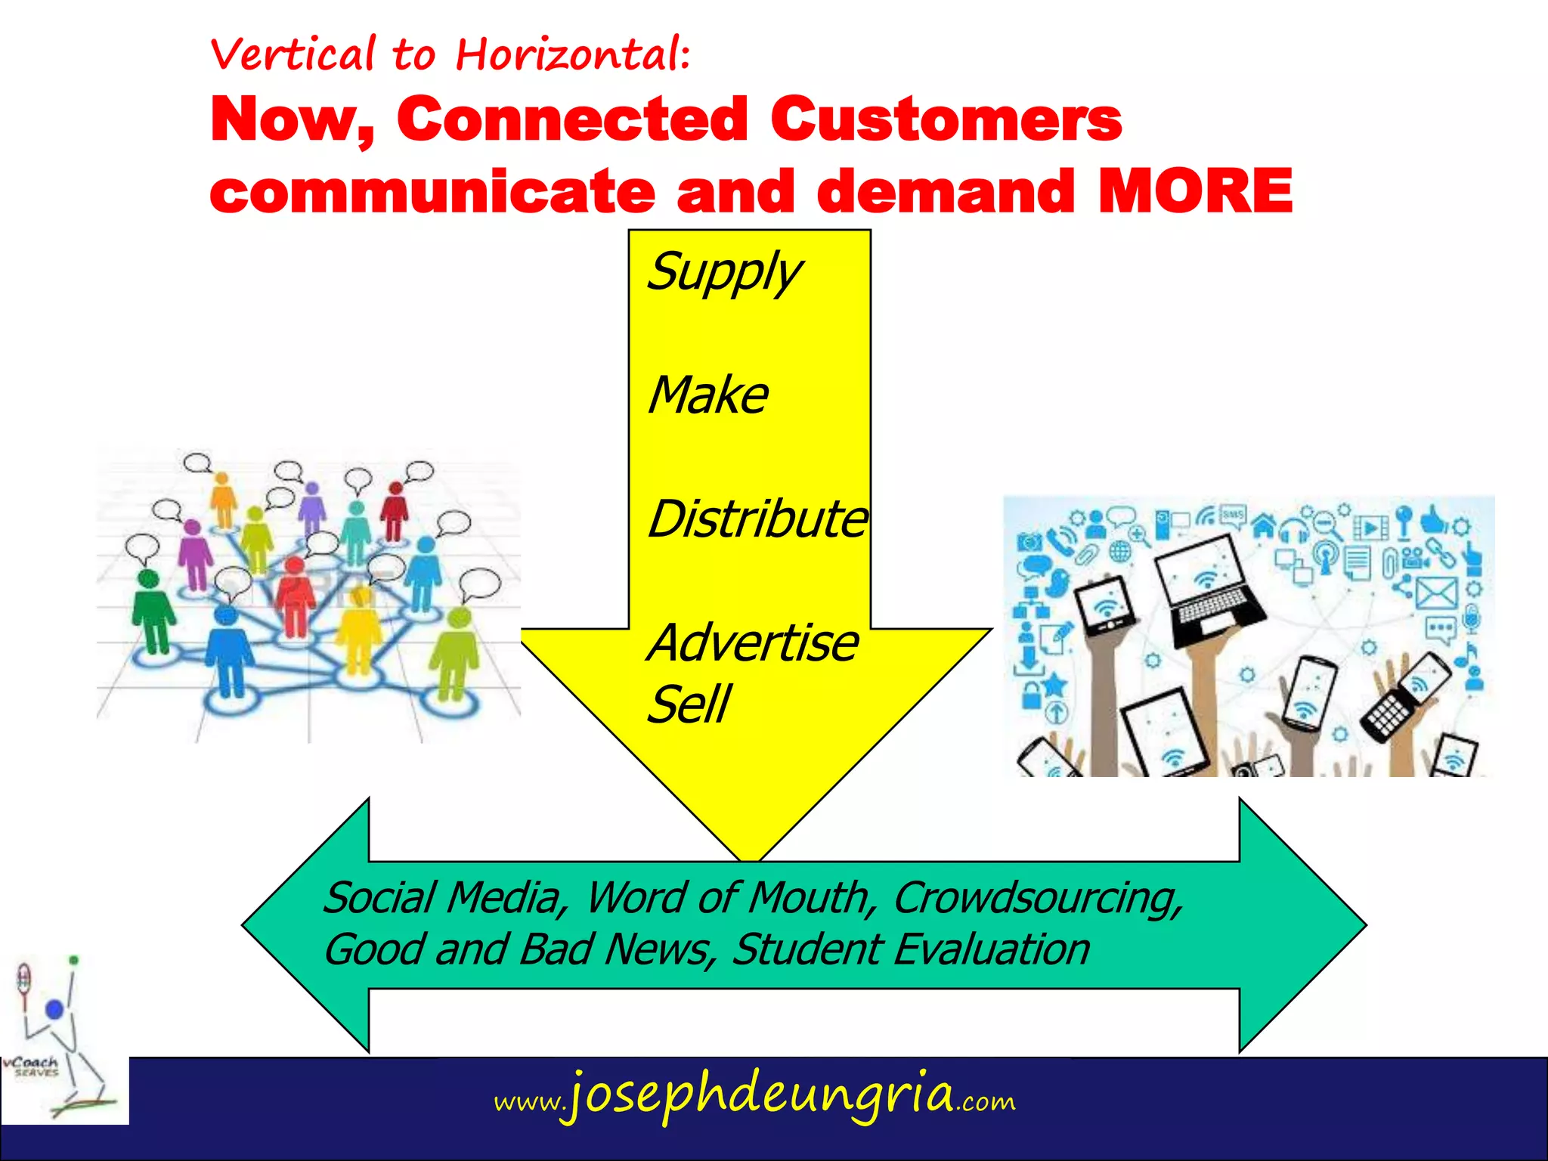
POWER SHIFTS TO THE CONNECTED CUSTOMERS

Slide 72
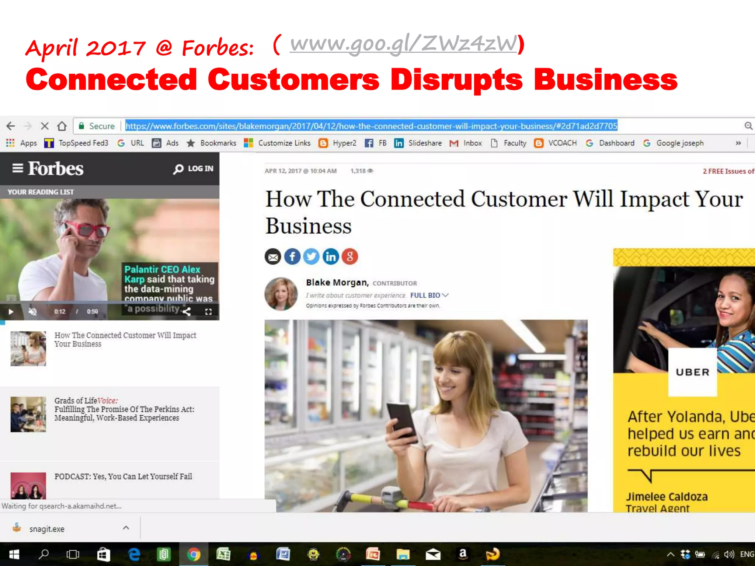
POWER SHIFTS TO THE CONNECTED CUSTOMERS

Slide 73
FROM INDIVIDUAL TO SOCIAL
When making purchase decisions, customers have typically been driven by individual preference as well as by a desire for social conformity.
Given the connectivity we live in today, the weight of social conformity is increasing across the board.
Customers care more and more about the opinions of others.
They also share their opinions and compile massive pools of reviews.
Together, customers paint their own picture of companies and brands, which is often very different from the image that companies and brands intend to project.
The internet, especially social media, has facilitated this major shift by providing the platform and tools.
most personal purchase decisions will essentially be social decisions.

Slide 74
POWER SHIFTS FROM
EXCLUSIVE TO INCLUSIVE
Gone are the days when being exclusive was the goal.
Inclusivity has become the new name of the game.
At the macro level, the world is moving from a hegemony to a multilateral power structure.
Superpowers, mainly the European Union and the US realize that some economic powers are shifting to Asia, which has experienced steady growth in recent years.
Emerging market populations: younger, more productive, and growing in terms of income level.
The political influence of the Western world is also declining
Businesses are moving toward inclusivity.
Technology enables both automation and miniaturization, which bring down product costs
Companies are able to serve the new emerging markets.
Disruptive innovations across business sectors have brought cheaper and simpler
products to the poor, formerly considered a “non-market.”
https://catalogimages.wiley.com/images/db/pdf/9781119341208.excerpt.pdf

Slide 75
POWER SHIFTS FROM
EXCLUSIVE TO INCLUSIVE
Products and services once considered exclusive are now available to mass markets all over the world. Examples include Tata Nano’s $2,000 car
Transparency brought on by the internet also enables entrepreneurs from emerging countries to draw inspiration from their counterparts in developed countries. They are building clone businesses marked by local twists in the execution. E.g. Amazon-inspired Flipkart.com from India, Groupon-inspired Disdus from Indonesia and Uber-inspired Grab in Malaysia.
The walls between industries are also blurring. The convergence and integration of two or more industries are trending e.g. medical treatment + tourism = medical tourism, financial services integrate with telco
In the online world, social media has redefined the way people interact with one
another, enabling people to build relationships without geographic and demographic
barriers.

