Slide 1
MN7182SR
GLOBAL MARKETPLACE

Slide 2
THE GLOBAL MARKETPLACE - ENVIRONMENT
What is global marketing? How does it differ from “regular” marketing
Global marketing: an organization that engages in global marketing focuses its resources and competencies on global market opportunities and threats.
A fundamental difference between “regular” marketing and global marketing is the scope of activities.
A company that engages in global marketing conducts important business activities outside the home-country market

Slide 3
THE GLOBAL MARKETPLACE - ENVIRONMENT
We live in a global marketplace. Apple iPhones, Burberry trench coats, Caterpillar earthmoving equipment, Facebook, LEGO toys, McDonald’s restaurants, Samsung HDTVs, and Swatch watches are found practically everywhere on the planet.
Global companies are fierce rivals in key markets. E.g. American auto industry giants General Motors and Ford are locked in a competitive struggle with Toyota, Hyundai, and other global Asian rivals as well as European companies such as Volkswagen. U.S.-based Intel, the world’s largest chip maker, competes with South Korea’s Samsung.
In the global smartphone market, Apple (United States), Motorola (China), and Samsung are dominant players. The globalization of the appliance industry means that Bosch, Electrolux, Haier Group, LG, and Whirlpool all compete for precious retail floor space and consumer awareness and preference.
We live in a world in which markets are local. In China, for example, Yum! Brands’ KFC fast-food chain competes with local restaurants such as Haidi Lao.

Slide 4
THE GLOBAL MARKETPLACE - ENVIRONMENT
Four decades ago, the phrase global marketing did not exist. Today, businesspeople use global marketing to realize their companies’ full commercial potential.
No matter whether you live in Asia, Europe, North America, or South America, you will be familiar with global brands such as KFC, McDonalds

Slide 5
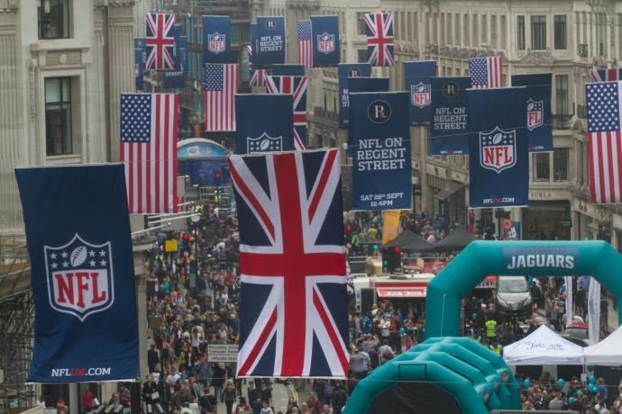
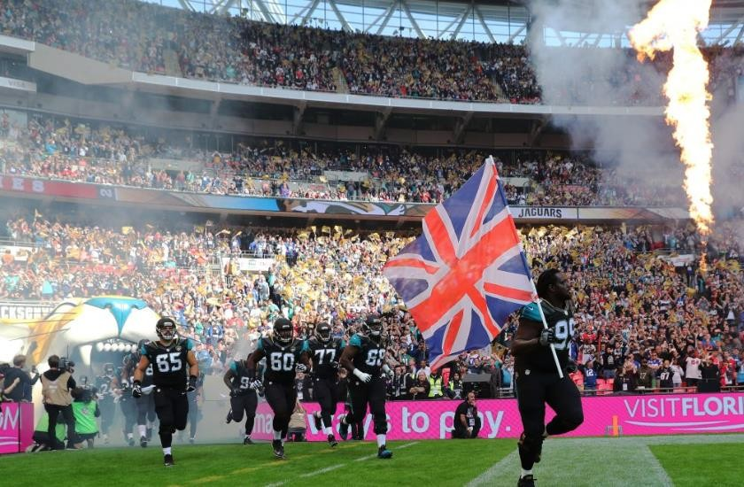
GLOBALISATION OF PRO SPORTS
Major league sports like the NBA, NFL, and MLS are finding new fans abroad.
Soccer is a global
sport.
The National Football League is focusing on Canada, UK, China, Germany, Japan, and Mexico.
The NFL promoted games in London

Slide 6
COMPETITIVE ADVANTAGE, GLOBALISATION & GLOBAL INDUSTRIES
Focus
Concentration and attention on core business and competence
“Nestle is focused: We are food and beverages. We are not running bicycle shops. Even in food we are not in all fields. There are certain areas we do not touch…We have no soft drinks because I have said we will either buy Coca-Cola or we leave it alone. This is focus”
Helmut Maucher, former CEO and Chairman of Nestlé SA
credited for transforming Nestlé into the world’s largest food company
https://www.nestle.com/brands/brandssearchlist

Slide 7
GLOBAL MARKETING: What It Is & What It Isn’t
Single Country Marketing Strategy
Target Market Strategy
Marketing Mix
  Product
  Price
  Promotion
  Place
Global Marketing Strategy
Global Market Participation
Marketing Mix Development
  Adapt or Standardise?
Concentration of Marketing Activities
Coordination of Marketing
Activities
Integration of Competitive Moves

Slide 8
STANDARDISATION VS. ADAPTATION
Globalisation (Standardisation)
  Developing standardised products marketed worldwide with a standardised marketing mix
  Essence of mass marketing
GloCalisation (Adaptation)
  Mixing standardisation and customisation in a way
that minimises costs while maximising satisfaction
  Essence of segmentation
  Think globally, act locally

Slide 9

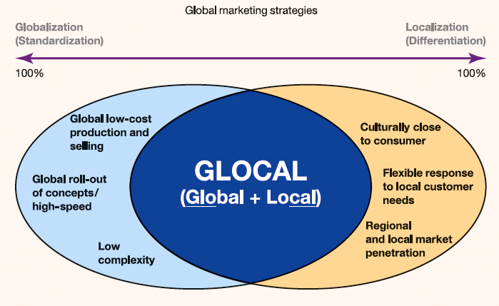
The GlocaLisation framework

Slide 10
WHY IS GLOBAL
MARKETING DIFFERENT?
Consumer Culture : Diverse / Unique
Markets : Fragmented, different
Data : Difficult to get
Politics : Stability
Governments : Attitudes / politics
Competitors : Local / International /
Established
Economies : Varying levels and systems
Finance : Different systems
Currencies : Fluctuating
Businesses : The local way…
Control : Remote & Difficult

Slide 11
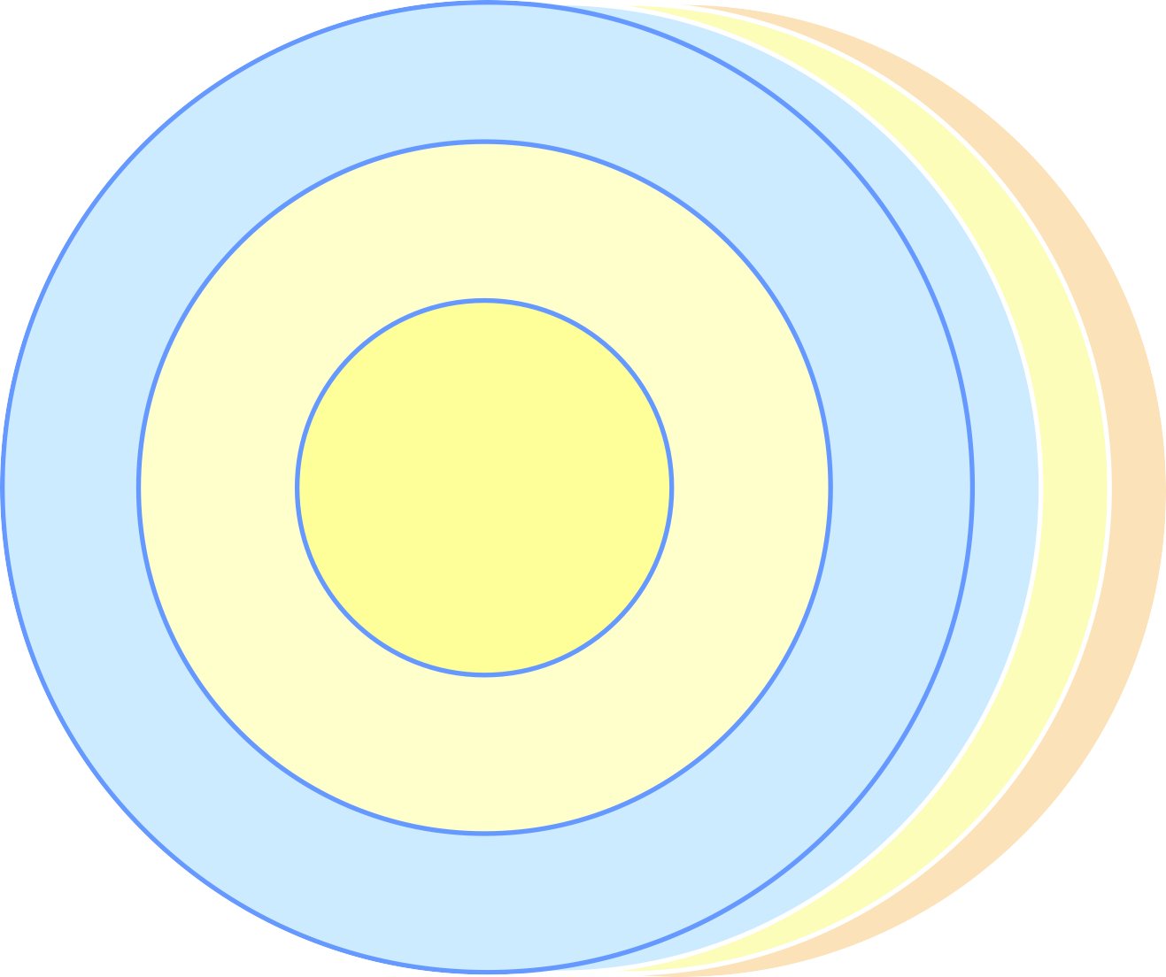

THE INTERNATIONAL MARKETING TASK
Foreign environment (uncontrollable)
Political/legal forces
Economic forces
Domestic environment (uncontrollable)
Political/ legal forces
Marketing
(controllable)
Price Product
Competitive structure
Cultural forces
Competitive Forces
Promotion
Channels of distribution
Environmental uncontrollables country market A
Geography and Infrastructure
Economic climate
Environmental uncontrollables country market B
Level of Technology
Structure of distribution
Environmental uncontrollables country market C

Slide 12
THE IMPORTANCE OF GOING GLOBAL
Only 5% of Nestle’s income is generated in its home country
For U.S. companies, 75% of total world market for goods and services is outside the country
Coca-Cola earns 75% of operating income and 2/3 of profit
outside of North America
For Japanese companies, 90% of world market is outside the
country
94% of market potential is outside of Germany for its companies even though it is the largest EU market

Slide 13
Forces Affecting Global Integration & Global Marketing
Multilateral trade agreements
Converging market needs and wants and the information revolution
Transportation and communication improvements
Product development costs

Slide 14
Driving Forces Affecting Global Integration and Global Marketing
Leverage
–Experience transfers
–Scale economies
–Resource utilisation
–Global strategy

Slide 15
Restraining Forces Affecting Global Integration and Global Marketing
Management myopia
Organisational culture
National controls
Opposition to globalisation

Slide 16



https://youtu.be/b9nDPWaOK4g
londonmet.ac.uk

Slide 17
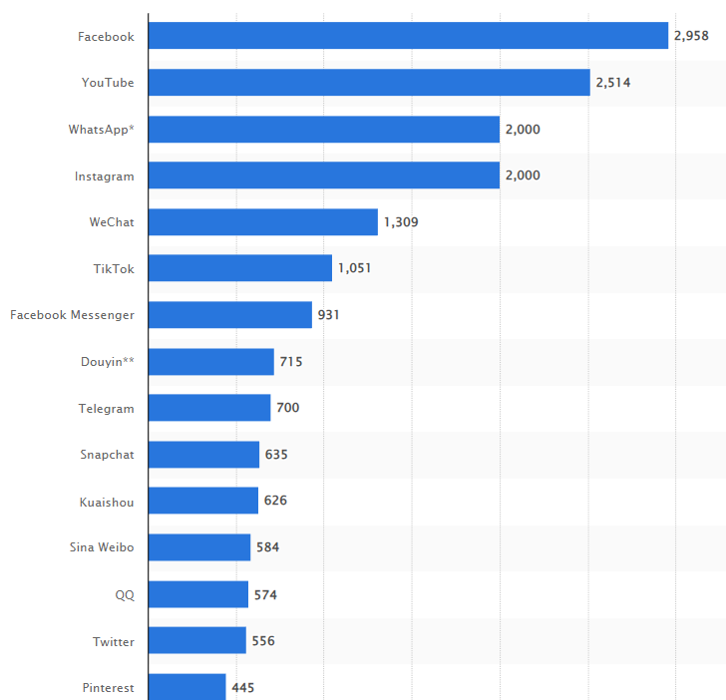
Most popular social networks : January 2023
by number of monthly active users
In millions
londonmet.ac.uk

Slide 18

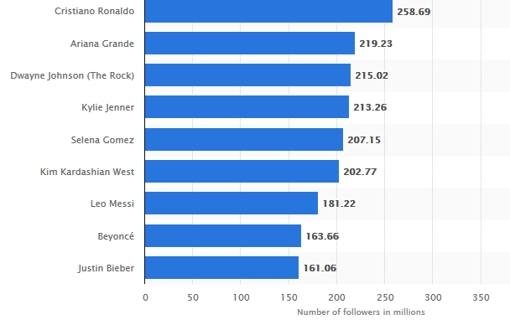
Instagram accounts with the most followers : Jan 2021
With the rise of influencers, people
1bn monthly active users /
can even make a living there
popular all over the world.
londonmet.ac.uk

Slide 19
INFORMATION SYSTEMS AND MARKETING RESEARCH
Information technology (IT): an organization’s processes for creating, storing, exchanging, using, and managing information.
A management information system (MIS) provides managers and other decision makers with a continuous flow of information about company operations. MIS is a broad term that can be used to refer to a system of hardware and software that a company uses to manage information. An MIS should provide a means for gathering, analyzing, classifying, storing, retrieving, and reporting relevant data.
big data: extremely large data sets that can be subjected to computational analysis to reveal patterns and trends

Slide 20
INFORMATION SYSTEMS AND MARKETING RESEARCH
An electronic data interchange (EDI) system allows a company’s business units to submit orders, issue invoices, and conduct business electronically with other company units as well as with outside companies.
One of the key features of EDI is that its transaction formats are universal, which enables computer systems at different companies to “speak the same language.”
Customer relationship management (CRM) is an important business tool that helps companies leverage the data they collect through systems.

Slide 21
SOURCES OF MARKET INFO
Research has shown that executives HQ f global companies obtain as much as two-thirds of the information they need from personal sources.
A great deal of external information comes from executives based abroad in company subsidiaries, affiliates, and branches.
Headquarters-based executives generally acknowledge that company executives overseas are the people who know best what is going on in their areas.
Similarly, a company with limited geographical operations may be at risk because internal sources abroad tend to scan only the information about their own countries or regions.

Slide 22
NEW PRODUCTS AND SERVICES
The digital revolution has spurred innovations in many different industries. Companies in all parts of the world are developing a new generation of products, services, and technologies.
These include broadband networks, mobile commerce, wireless connectivity, and smartphones.
A broadband communication system is one that has sufficient capacity to carry multiple voice, data, or video channels simultaneously.
Broadband offers multiple marketing opportunities to companies in a variety of industries. It also allows Internet users to access streaming media such as streaming audio and streaming video.
Streaming media are also having a profound impact on the television industry, with Amazon.com, iTunes, Netflix, YouTube and other services offering movie and TV show downloads

Slide 23
CLOUD COMPUTING
Cloud computing means that instead of installing software such as iTunes or Microsoft Office on a computer hard drive, such applications are delivered through a Web browser.
Cloud computing means that archives—including music and movie files, photos, and documents—are stored on massive remote servers and data centers rather than on individual users’ computers.
Computer files can be accessed remotely, via the Internet, from any location and from any computer

Slide 24
SMARTPHONES
Cell phones have been one of the biggest new-product success stories of the digital revolution.
Worldwide, 1.5 billion smartphones were shipped in 2017.
Smartphones have much greater functionality than feature phones, incorporating many of the capabilities of computers

Slide 25
DEVELOPING VALUE THROUGH
DISTRIBUTION CHANNELS
In business-to-consumer marketing (also known as b-to-c or B2C marketing), consumer channels are designed to put products in the hands of people for their own use.
Business-to-business marketing (also known as b-to-b or B2B marketing) involves industrial channels that deliver products to manufacturers or other organizations that then use them as inputs in the production process or in day-to-day operations.

Slide 26
ADVERTISING
Advertising is a sponsored, paid message that is communicated through non-personal channels.
Global advertising relies on the same advertising appeals, messages, artwork, and copy in campaigns around the world.
Global advertising may be defined as messages whose art, copy, headlines, photographs, taglines, and other elements have been developed expressly for their worldwide suitability
The effort required to create a global campaign forces a company to determine whether a global market exists for its product or brand.

Slide 27
GLOBAL ADVERTISING CONTENT
Communication experts generally agree that the overall requirements of effective communication and persuasion are fixed and do not vary from country to country.
The same is true of the components of the communication process

Slide 28
PUBLIC RELATIONS
Public Relations (PR) is a “strategic communication process that builds mutually beneficial relationships between organizations and their publics.
Public relations personnel are responsible for fostering goodwill, understanding, and acceptance among a company’s various constituents and stakeholders.
Along with advertising,PR is one of four variables in the promotion mix.
One of the key tasks of the PR practitioner is to generate favorable publicity.
Publicity is communication about a company or product for which the company does not pay.
Publicity is sometimes referred to as earned media, and advertising and promotions are known as unearned media.)

Slide 29
SALES PROMOTION
Sales promotion refers to any paid consumer or trade communication program of limited duration that adds tangible value to a product or brand.
In a price promotion, tangible value may take the form of a price reduction, coupon, or mail-in refund.
Non-price promotions may take the form of free samples, premiums, “buy one, get one free” offers, sweepstakes, and contests.
Consumer sales promotions may be designed to make consumers aware of a new product, to stimulate nonusers to sample an existing product, or to increase overall consumer demand.
Trade sales promotions are designed to increase product availability within distribution channnels.
At many companies, expenditures for sales promotion activities have surpassed expendiitures for media advertising.
Sales promotion is just one of several marketing communication tools available to enterprises. In turn, sales promotion plans and programs should be integrated and coordinated with those for advertising, public relations (pr), and personal selling.

Slide 30
SALES PROMOTION
Sampling is a sales promotion technique that provides potential customers with the opportunity to try a product or service at no cost.
Cost of goods is one of the major disadvantages associated with sampling; another problem is that it is sometimes difficult for marketing managers to assess the contribution that a sampling program makes to return on investment.

Slide 31
COUPONING
A coupon is a printed certificate that entitles the bearer to a price reduction or some other special consideration for purchasing a particular product or service.
Coupons can also be handed out in stores, offered on a self-service basis from on-shelf dispensers, delivered to homes by mail, or distributed electronically at the checkout counter. In addition, the number of coupons distributed via the Internet is growing.
Social couponing is one of hottest online sales promotion trends today. Industry leader Groupon offers its followers deal-of-the-day coupons that are sponsored by local businesses. Followers then share their experiences via social networks. The local business gets customers, and Groupon takes a share of the coupon proceeds.

Slide 32
PERSON TO PERSON SELLING
Personal selling is person-to-person communication between a company representative and a prospective buyer.
The seller’s communication effort is focused on informing and persuading the prospect, with the short-term goal of making a sale and the longer-term goal of building a relationship with that buyer.
The salesperson’s job is to correctly understand the buyer’s needs, match those needs to the company’s product(s), and then persuade the customer to buy. Because selling provides a two-way communication channel, it is especially important in marketing industrial products that may be expensive and technologically complex.
Sales personnel can often provide headquarters with important customer feedback that can be used in design and engineering decisions.
Effective personal selling in a salesperson’s home country requires building a relationship with the customer;

Slide 33
SOCIAL NETWORKS
Social media marketing is a technique that leverages on social networks and applications to spread brand awareness and promote particular products. Usually centres around establishing major presence on social media platform.
Types of social media:
  Social networking: Facebook / linkedin
  News
  Microblogging: 小红书 / 微博
  Forums eg cars and other special interest

Slide 34
SOCIAL NETWORKS

Slide 35
PRICING OBJECTIVES AND STRATEGIES
Whether dealing with a single home-country market or multiple country markets, marketing managers must develop pricing objectives as well as strategies for achieving those objectives.
Price is always an independent variable; as a marketing tactic, managers can raise, lower, or maintain prices as part of the overall marketing strategy.
Nevertheless, a number of pricing issues are unique to global marketing
The pricing strategy for a particular product may vary from country to country; a product may be positioned as a low-priced, mass-market product in some countries and as a premium-priced, niche product in others

Slide 36
PRICING OBJECTIVES AND STRATEGIES
The market skimming pricing strategy is often part of a deliberate attempt to reach a market segment that is willing to pay a premium price for a particular brand or for a specialized or unique product
Companies that seek competitive advantage by pursuing differentiation strategies or positioning their products in the premium segment frequently use market skimming. For example, LVMH and other luxury goods marketers that target the global elite market segment use skimming strategies

Slide 37
PRICING OBJECTIVES AND STRATEGIES
A market penetration pricing strategy calls for setting price levels that are low enough to quickly build market share.
Scale-efficient plants and low-cost labor allowed these companies to flood the market.
A first-time exporter is unlikely to use penetration pricing, for a simple reason: Penetration pricing often means that the product may be sold at a loss for a certain length of time.

Slide 38
PRICING OBJECTIVES AND STRATEGIES
Target costing ensures that development teams will bring profitable products to market not only with the right level of quality and functionality but also with appropriate prices for the target customer segments.
It is a discipline that harmonizes the labor of disparate participants in the development effort, from designers and manufacturing engineers to market researchers and suppliers. . .

Slide 39
PRICING OBJECTIVES AND STRATEGIES
In target costing, the marketing team must do the following:
Determine the segment(s) to be targeted, as well as the prices that customers in the segment
Customers be willing to pay.
Using market research techniques such as focus groups and conjoint analysis, the team seeks to better understand how customers will perceive product features and functionalities.
Compute overall target costs with the aim of ensuring the company’s future profitability.
Allocate target costs to the product’s various functions.
Calculate the gap between the target cost and the estimated actual production cost.
Obey the cardinal rule: If the design team can’t meet the targets, the product should not be
launched

Slide 40
ENVIRONMENTAL INFLUENCES THAT IMPACT PRICES.
CURRENCY FLUCTUTATIONS
INFLATION
GOVERNMENT CONTROLS, SUBSIDIES AND REGULATIONS
COMPETITIVE BEHAVIOUR
GREY MARKETS (PARALLEL IMPORTS)
DUMPING
PRICE FIXING
TRANSFER PRICING E.G. SUBSIDIARIES BUY FROM EACH OTHER
BARTER TRADE
COUNTRADE (BUY BACK)

Slide 41
ENVIRONMENT
In a global marketing environment, a business is competing with many brands from around the world.
Why is it important to understand the global business environment?
  It helps businesses easily adapt to the business environment in host countries
  It helps enhance the ability to expand market share in new countries
  It helps optimize profits by country, market share
  It helps diversify markets, less dependent on a single market
  It helps limit risks due to differences in culture and awareness in each country
  It shows how to optimize resources and supply capacity

Slide 42
MARKET RESEARCH
Market research is the project-specific, systematic gathering of data.
American Marketing Association defines marketing research as “the activity that links the consumer, customer, and public to the marketer through information.”
In global market research, this activity is carried out on a global scale. The challenge of global market research is to recognize and respond to the important national differences that influence the way information can be obtained. These include cultural, linguistic, economic, political, religious, historical, and market differences.

Slide 43
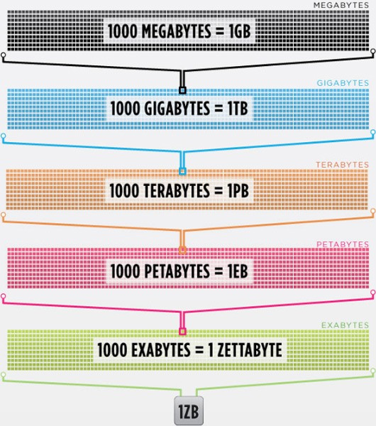
What is big data?
Every day, we create 2.5 quintillion bytes of data — so much that 90% of the data in the world today has been created in the last two years alone. This data comes from everywhere: sensors used to gather climate information, posts to social media sites, digital pictures and videos, purchase transaction records, and cell phone GPS signals to name a few.
  This data is “big data.

Slide 44
Huge amount of data
There are huge volumes of data in the world:
  From the beginning of recorded time until 2003, we created 5 billion gigabytes of data.
  In 2011, the same amount was created every two days
  In 2013, the same amount of data is created every 10 minutes.

Slide 45
Why is data important
Segmentation of audience
Tailoring products/services to individuals
Understanding buyer behaviour
Customer Engagement

Slide 46
ERA OF BIG DATA
Big data refers to extremely large data sets that can be subjected to computational analysis to reveal patterns and trends
Big data and big data analytics have long been the province of astronomers, meteorologists, and other members of the scientific community.
Only recently have big data collection and analysis been applied to business situations. In particular, the exploding popularity of Facebook and other social media platforms has resulted in a wealth of big data.
The cost of data collection has dropped so dramatically that a company can amass scads of data irrespective of a particular question, problem, or purpose that its marketers might have.

Slide 47
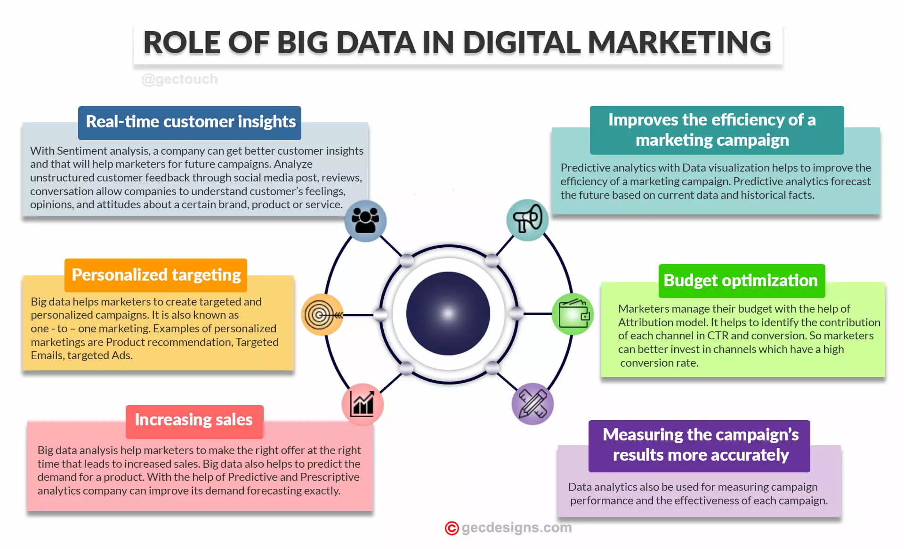
https://marketinginsidergroup.com/content-marketing/big-data-for-marketing-its-all-about-the-questions/

Slide 48
ERA OF BIG DATA
TYPES OF BIG DATA:
In marketing, big data encompasses diverse sets of information that can be categorized into various types. The three types of big data that hold significance in the marketing are:
Customer data: demographics, behaviors, preferences, interactions, and purchase history
Operational data: sales, inventory, supply chain, logistics, customer service, etc.
Financial data: revenue, expenses, profitability, budgets, and financial performance
Consumer data enables the development of effective strategies
operational aids in optimization
financial can be leveraged to understand financial impacts of marketing decisions.
Brenner, M. (2023, July 14). Big Data For Marketing? It’s All About The Questions. Marketing Insider Group. https://marketinginsidergroup.com/content-marketing/big-data-for-marketing-its-all-about-the-questions/

Slide 49
ERA OF BIG DATA
POTENTIAL CHALLENGES
Leveraging on big data in marketing offers immense potential for driving business growth and enhancing customer experiences. However, there are several challenges that marketers face when dealing with big data. Here are some issues :
Time Disparities in Data Systems: A delay in incoming data can create a disconnect in the information they are receiving and actual customer preferences.
Streaming Data Sources: Data can be vast and arrive at high velocities, making it difficult to process and extract insights promptly.
Cross Department Cooperation: Lack of cross-functional collaboration within a company can hinder the seamless integration and sharing of data.
What data to Gather: It’s important to prioritize quality over quantity and focus on collecting relevant and meaningful data that aligns with marketing objectives.
Which Analytics to Use: From descriptive analytics to predictive modeling and machine learning algorithms
Brenner, M. (2023, July 14). Big Data For Marketing? It’s All About The Questions. Marketing Insider Group. https://marketinginsidergroup.com/content-marketing/big-data-for-marketing-its-all-about-the-questions/

Slide 50
ROLE OF ANALYTICS IN MARKETING
Marketing data analytics is the process of analyzing marketing data to extract actionable insights.
Includes identifying key marketing metrics, collecting reliable data, tracking the metrics over time, and using the results to improve future strategies.
Pricing analytics are the metrics and associated tools used to understand how pricing activities affect the overall business, analyze the profitability of specific price points, and optimize a business’s pricing strategy for maximum revenue.
Pricing tends to become a bigger challenge as companies grow.
Companies with lots of products sold at different price points, different customer tiers, or complex product bundles tend to see the greatest benefits from analysis.
Brenner, M. (2023, July 14). Big Data For Marketing? It’s All About The Questions. Marketing Insider Group. https://marketinginsidergroup.com/content-marketing/big-data-for-marketing-its-all-about-the-questions/

Slide 51
ROLE OF ANALYTICS IN MARKETING
Data analytics help companies understand the factors that drive subscription and churn rates by letting them know more than just knowing which factors drive one-time sales.
Going after the wrong customer segment can mean significant lost revenue. Pricing analytics show which customer segments are the most (and least) profitable and which respond best to specific pricing strategies.
Brenner, M. (2023, July 14). Big Data For Marketing? It’s All About The Questions. Marketing Insider Group. https://marketinginsidergroup.com/content-marketing/big-data-for-marketing-its-all-about-the-questions/

Slide 52
IMPORTANCE OF ANALYTICS
IN MARKETING
Product Intelligence
Analytics can help track how customers interact with products. This information can be used to improve the products, from pricing to features, to better align with customer needs.
Customer Trends and Preferences
By understanding customer trends and preferences, you can adjust your marketing mix to better appeal to the target audience. Information can also be used segment customers and create targeted marketing campaigns.
Customer Support
Analytics can be used to improve customer support by identifying areas where customers are having difficulty or need assistance. This information can be used to develop training materials or improve self-service options.
Messaging and Media
Data analytics can help you understand which messages and media are most effective in reaching and converting customers.
Competition
You can use marketing data analytics to track your competition and also understand strengths and weaknesses. Businesses
that use data analytics can gain a competitive edge over those that do not.
Predict Future Results
With predictive analytics, you can build a forecasting model to analyze current and past data to project future results.
Seto, F. (2023, August 2). Marketing Data Analytics for Business Decisions | Coupler.io Blog. Coupler.io Blog.

Slide 53
ROLE OF ANALYTICS IN MARKETING
HOW TO LEVERAGE ON ANALYTICS TO GAIN MARKETING INSIGHTS:
Define your customers’ top keywords and topics through search analysis. Star by looking at Google Trends.
Scan social analytics to show what % of social conversations include mentions of your brand.
Insights from website analytics will help you understand which keywords drive conversions.
Brenner, M. (2023, July 14). Big Data For Marketing? It’s All About The Questions. Marketing Insider Group. https://marketinginsidergroup.com/content-marketing/big-data-for-marketing-its-all-about-the-questions/

Slide 54
STRATEGIC PLANNING
TOOLS AND FRAMEWORKS

Slide 55
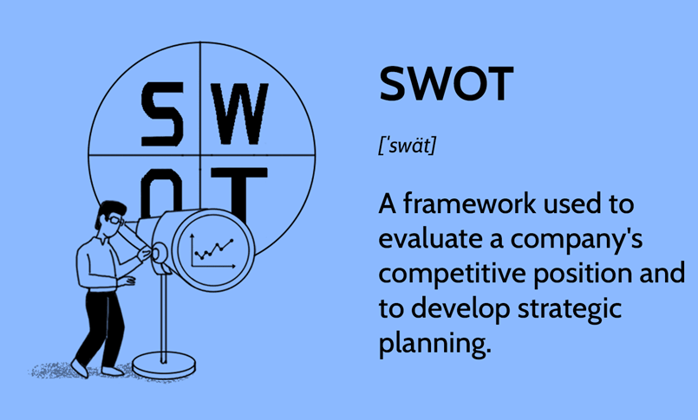
SWOT

Slide 56

CLASS ACTIVITY:
HOW TO DO A SWOT ANALYSIS FOR KFC

Slide 57

CLASS DISCUSSION
- Do a SWOT analysis for Coke
Email: jason@stanfort.edu.sg

Slide 58
SWOT ANALYSIS - DANGERS
A SWOT exercise can generate very long lists of apparent strengths, weaknesses, opportunities and threats, whereas what matters is to be clear about what is really important and what is less important.
There is a danger of overgeneralisation - identifying a very general explanation of strategic capability does not explain the underlying reasons for that capability.
  SWOT analysis is not a substitute for more rigorous, insightful analysis

Slide 59
PESTLE ANALYSIS

Slide 60
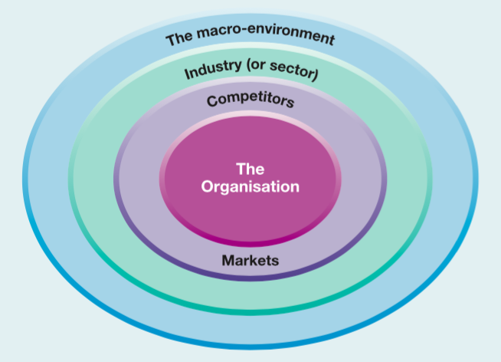
Layers of the business environment
Explain in next ppt….

Slide 61
THE MACRO-ENVIRONMENT
The highest-level layer
Consists of broad environmental factors that impact to a greater or lesser extent on almost all organisations
Here the PESTEL framework can be used to identify how future trends in the political, economic, social, technological, environmental (‘green’) and legal environments might impinge on organisations.
  PESTEL analysis provides the broad ‘data’ from which to identify key drivers of change
These key drivers can be used to construct scenarios of possible futures.
Scenarios consider how strategies might need to change depending
on the different ways in which the business environment might change.

Slide 62
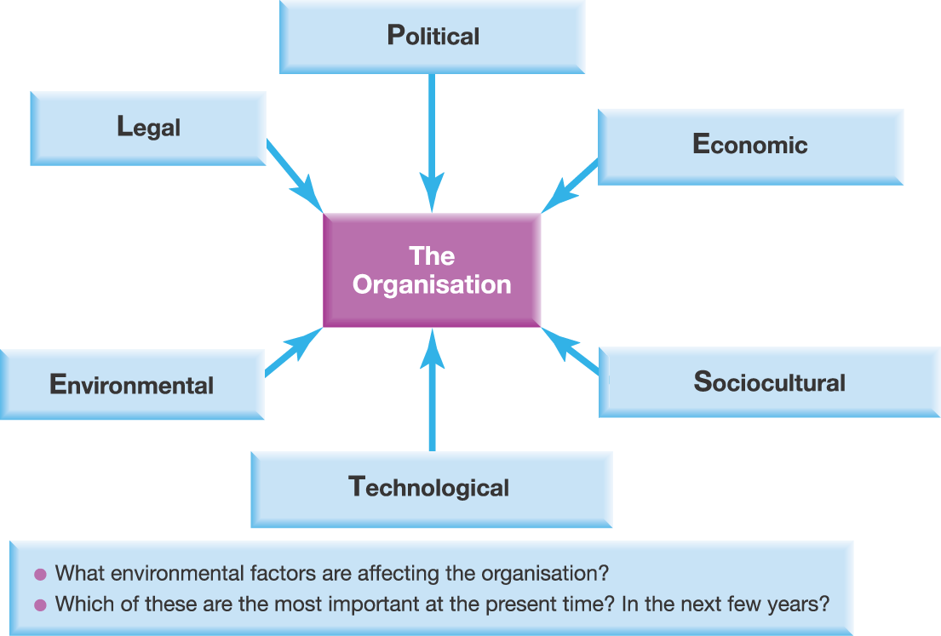
Macro-environment Analysis – PESTLE
source: Johnson, Whittington and Scholes (2011) Exploring Strategy, 9th Edition, Pearson Education, Chapter 2

Slide 63
PESTLE ANALYSIS
Politics - highlights the role of governments
Economics - refers to macro-economic factors such as exchange rates, business cycles and differential economic growth rates around the world
Social influences - include changing cultures and demographics, for example ageing populations in many societies
Technological influences - refer to innovations such as the Internet, nanotechnology or the rise of new composite materials
Environmental - stands specifically for ‘green’ issues, such as pollution and waste
Legal - embraces legislative constraints or changes, such as health and safety legislation or restrictions on company mergers and acquisitions

Slide 64
PESTLE ANALYSIS
Managers need to analyse how these factors are changing now and how they are likely to change in the future
Draw implications for the organisation
Many of these factors are linked together.
  technology developments may simultaneously change economic factors (creating new jobs), social factors (facilitating more leisure) and environmental factors (reducing pollution)

Slide 65
PESTLE – Key Drivers for Change
Analysing PESTLE factors and their interrelationships can produce long and complex lists
To avoid overwhelm – identify the key drivers for change
  High-impact factors likely to affect significantly the success or failure of strategy
Vary by industry or sector
  A clothing retailer (may be primarily concerned with social changes driving customer tastes and behaviour, for example forces encouraging out-of-town shopping e.g. borders opening
  A computer manufacturer is likely to be concerned with technological change (increases in microprocessor speeds)

Slide 66
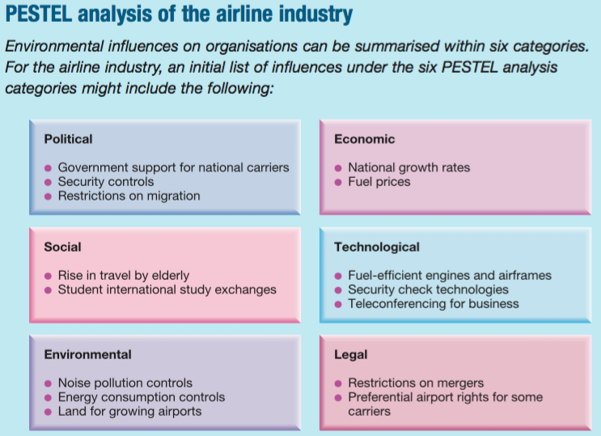
噪声污染控制
Zàoshēng wūrǎn kòngzhì
source: Johnson, Whittington and Scholes (2011) Exploring Strategy, 9th Edition, Pearson Education

Slide 67
PESTEL analysis of the airline industry
What additional environmental influences would you add to this initial list for the airline industry?
From your more comprehensive list, which of these influences would you highlight as likely to be the ‘key drivers for change’ for airlines in the coming five years?

Slide 68
USING THE PESTEL FRAMEWORK
Focus is on future impact of emerging trends - not a historic list
Apply selectively – think widely and then identify specific factors which impact on the industry, market and organisation in question.
Identify factors which are important currently but also consider which will become more important in the next few years.
Use data to support the points and analyse trends using up to date information
Identify opportunities and threats – the main point of the exercise!
source: Johnson, Whittington and Scholes (2011) Exploring Strategy, 9th Edition, Pearson Education, Chapter 2

Slide 69

CLASS ACTIVITY
Do a PESTLE analysis of the WALMART in USA
Jason@stanfort.edu.sg

Slide 70
PORTER'S FIVE FORCES FRAMEWORK
“The state of competition in an industry depends on five basic competitive courses ... The collective strength of these five forces determines the ultimate profit potential in the industry
where profit potential is measured in terms of long-run returns on invested capital...
The forces range from intense in industries like tires, paper and steel - where no firm earns spectacular returns - to relatively mild like oil-field equipment and services, cosmetics and toiletries - where high returns are quite common.”
(Michael Porter, 1980)

Slide 71
Industry Analysis: Structural Determinants of Competition and Profitability
Porter's Five Forces Framework
(Adapted from Robert Grant, 1998)
SUPPLIER POWER
Factors determining power of suppliers
relative to producers; same as those
determining power of producers
relative to buyers - see “Buyer Power”
box
THREAT OF ENTRY
INDUSTRY RIVALRY
THREAT OF SUBSTITUTES
Economies of scale
Capital requirements
Experience curve
Product differentiation
Access to supply / distribution
channels
Government and legal channels
Retaliation by established
producers
Concentration
Diversity of competitors
Product differentiation
Excess capacity and exit
barriers
Cost conditions
Buyer propensity to substitute
Relative ratio of price to performance
of substitutes
Extra-industry effects
BUYER POWER
Where these five forces are high, then industries are not attractive to compete in.
Price Sensitivity
Product
differentiation
Competition
between buyers
Bargaining Power
Size & concentration
of buyer relative to
suppliers
Buyers’ switching costs
Buyers’ information
Buyers’ ability to
backward integrate

Slide 72
IMPLICATIONS OF FIVE FORCES ANALYSIS
Identifies the attractiveness of industries – which industries/markets to enter or leave.
Identifies strategies to influence the impact of the forces, for example, building barriers to entry by becoming more vertically integrated.
The forces may have a different impact on different organisations e.g. large firms can deal with barriers to entry more easily than small firms.
source: Johnson, Whittington and Scholes (2011) Exploring Strategy, 9th Edition, Pearson Education, Chapter 2

Slide 73
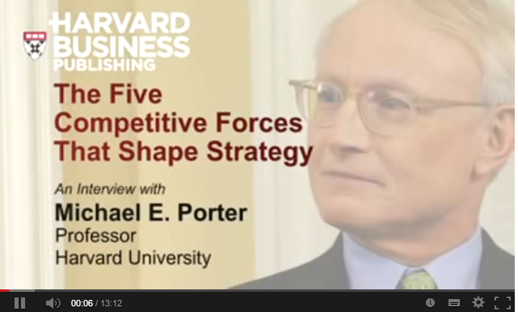
Michael Porter interview
Click here for link
http://www.youtube.com/watch?v=mYF2_FBCvXw&feature=youtu.be
Up to 5 mins 30 “something this article has developed in much more detail”
Stop before “you conceived this framework nearly 3 decades ago”.

Slide 74

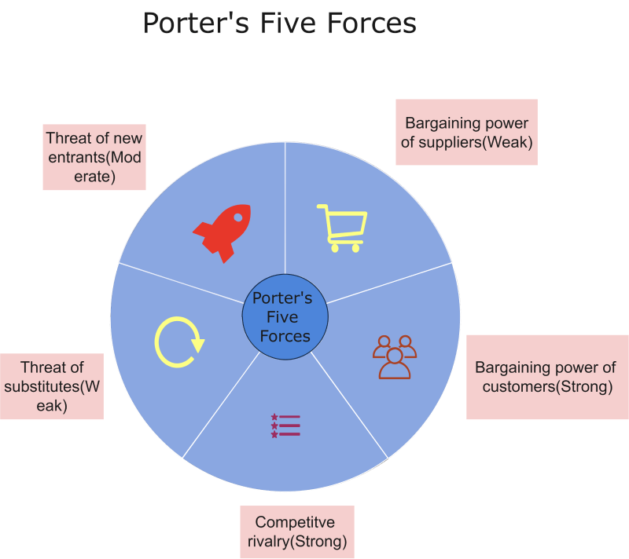

供应商的议价能力
新进入者的威胁
- many potential suppliers with adequate supply
- Apple has volume
Huge investment needed
Big investment in branding
替代品的威胁
strong force due to
low switching cost.
客户的议价能力
Apple has erected many barriers
竞争性

Slide 75

CLASS DISCUSSION
PROVIDE A 5 FORCES ANALYSIS OF STARBUCKS

