Slide 1
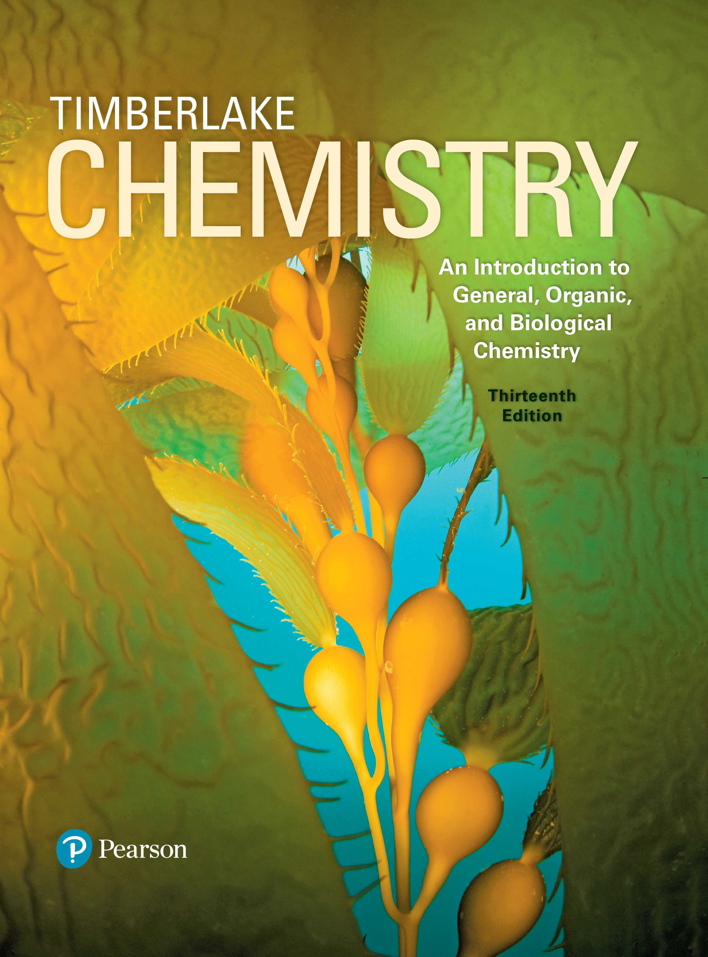
Chemistry: An Introduction to General, Organic, and Biological Chemistry
Thirteenth Edition
Chapter 15
Lipids
Copyright © 2018, 2015, 2012 Pearson Education, Inc. All Rights Reserved
Notes:
If this PowerPoint presentation contains mathematical equations, you may need to check that your computer has the following installed:
1) MathType Plugin
2) Math Player (free versions available)
3) NVDA Reader (free versions available)

Slide 2
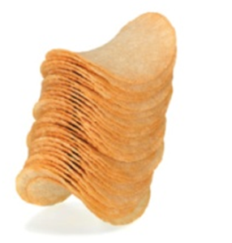
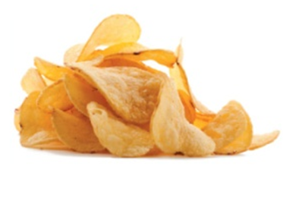
15.2 Fatty Acids
We might think of saturated fatty acids as chips with regular shapes that stack closely together in a can.
Similarly, irregularly shaped chips would be like unsaturated fatty acids that do not fit closely together.
Learning Goal Draw the condensed structural or line-angle formula for a fatty acid and identify it as saturated or unsaturated.

Slide 3

Fatty Acids
Fatty acids are
long, unbranched carbon chains with a carboxylic acid group at the end
typically 12– to 18–carbon atoms long
insoluble in water because of the long carbon chain
saturated when they do not contain
double bonds
in the carbon chain
unsaturated when they contain
double bonds in the
carbon chain

Slide 4
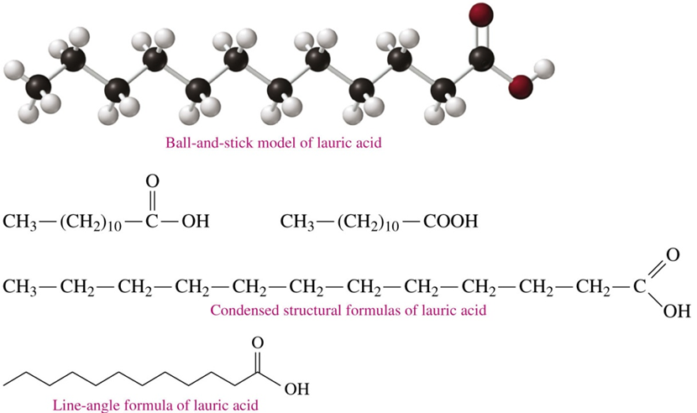
Drawing Fatty Acids
In a skeletal formula of a fatty acid, the ends and bends of the line are the carbon atoms.
The structural formula of lauric acid can be drawn in several forms.

Slide 5
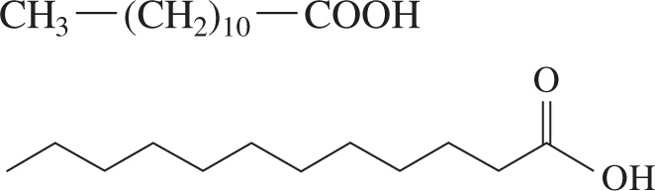
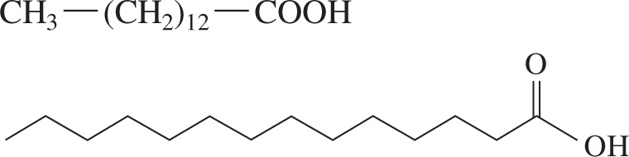
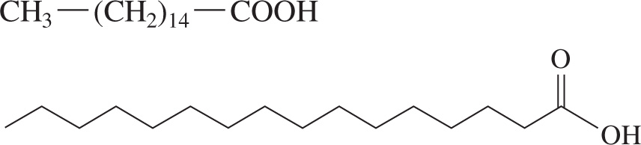
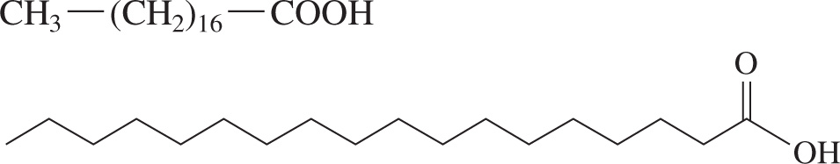
Saturated Fatty Acids
Fatty acids can be saturated, with only
single bonds in the
carbon chain.
Table 15.1 Structures and Melting Points of Common Fatty Acids
Name | Carbon Atoms: Double Bonds | Present in | Melting Point (°C) | Structures
Saturated Fatty Acids | blank | blank | blank | blank
Lauric acid | 12:0 | Coconut | 44 | C H 3, single bond, left parenthesis, C H 2, right parenthesis, sub 10, single bond, C O O H. A 12 carbon chain is given that ends with O H and where C 12 is double bonded to O.
Myristic acid | 14:0 | Nutmeg | 55 | C H 3, single bond, left parenthesis, C H 2, right parenthesis, sub 12, single bond, C O O H. A 14 carbon chain is given that ends with O H and where C 14 is double bonded to O.
Palmitic acid | 16:0 | Palm | 63 | C H 3, single bond, left parenthesis, C H 2, right parenthesis, sub 14, single bond, C O O H. A 16 carbon chain is given that ends with O H and where C 16 is double bonded to O.
Stearic acid | 18:0 | Animal fat | 69 | C H 3, single bond, left parenthesis, C H 2, right parenthesis, sub 16, single bond, C O O H. An 18 carbon chain is given that ends with O H and where C 18 is double bonded to O.

Slide 6
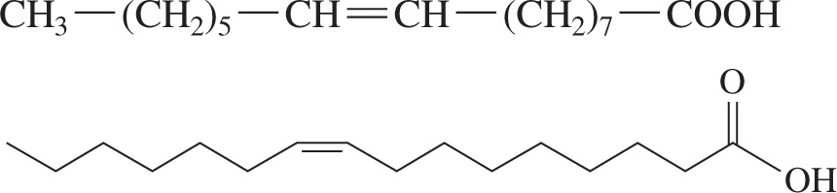
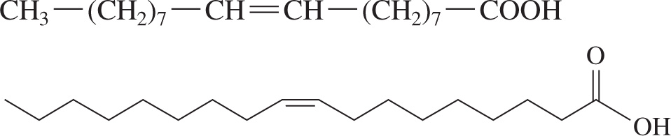
Monounsaturated Fatty Acids
Fatty acids can be monounsaturated, with only one double
bond in the carbon chain.
Table 15.1 Structures and Melting Points of Common Fatty Acids
Name | Carbon Atoms: Double Bonds | Present in | Melting Point (°C) | Structures
Monounsaturated Fatty Acids | blank | blank | blank | blank
Palmitoleic acid | 16:1 | Butter | 0 | C H 3, single bond, left parenthesis, C H 2, right parenthesis, sub 5, single bond, C H, double bond, C H, single bond, left parenthesis, C H 2, right parenthesis, sub 7, single bond, C O O H. This gives a 16 carbon chain that ends with O H and where C 16 is double bonded to O. C 7 and C 8 are double bonded, and that bonds changes the zigzag pattern of the chain.
Oleic acid | 18:1 | Olives, pecan, grapeseed | 14 | C H 3, single bond, left parenthesis, C H 2, right parenthesis, sub 7, single bond, C H, double bond, C H, single bond, left parenthesis, C H 2, right parenthesis, sub 7, single bond, C O O H. This gives an 18 carbon chain that ends with O H and where C 18 is double bonded to O. C 9 and C 10 are double bonded, and that bonds changes the zigzag pattern of the chain.

Slide 7
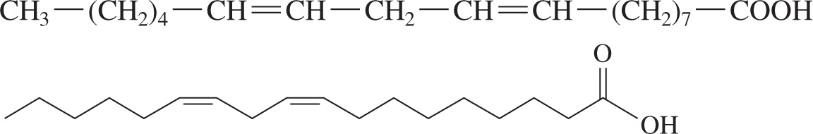
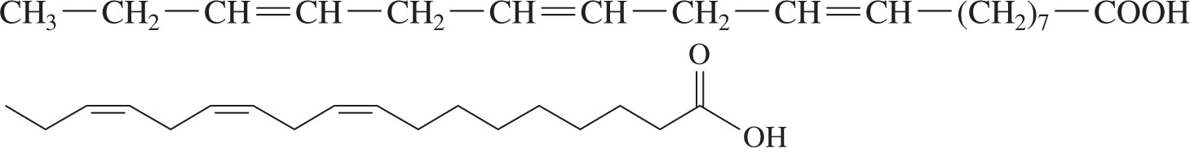
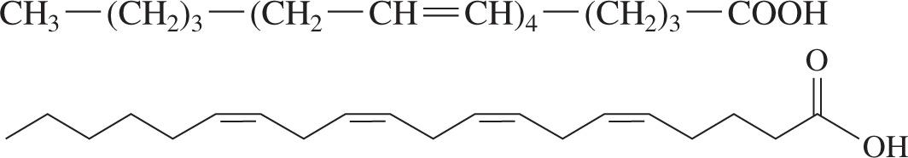
Polyunsaturated Fatty Acids
Fatty acids can be polyunsaturated, with at least two double
bonds in the carbon chain.
Table 15.1 Structures and Melting Points of Common Fatty Acids
Name | Carbon Atoms: Double Bonds | Present in | Melting Point (°C) | Structures
Polyunsaturated Fatty Acids | blank | blank | blank | blank
Linoleic acid | 18:2 | Soybean, safflower, sunflower | −5 | C H 3, single bond, left parenthesis, C H 2, right parenthesis, sub 4, single bond, C H, double bond, C H, single bond, C H 2, single bond, C H, double bond, C H, single bond, left parenthesis, C H 2, right parenthesis, sub 7, single bond, C O O H. This gives an 18 carbon chain that ends with O H and where C 18 is double bonded to O. C 6 and C 7, and C 9 and C 10 are double bonded, and those bonds change the zigzag pattern of the chain.
Linolenic acid | 18:2 | Corn | −11 | C H 3, single bond, C H 2, single bond, C H, double bond, C H, single bond, C H 2, single bond, C H, double bond, C H, single bond, C H 2, single bond, C H, double bond, C H, single bond, left parenthesis, C H 2, right parenthesis, sub 7, single bond, C O O H. This gives an 18 carbon chain with 3 double bonds.
Arachidonicacid | 20:4 | Meat, eggs, fish | −50 | C H 3, single bond, left parenthesis, C H 2, right parenthesis, sub 3, single bond, left parenthesis, C H 2, single bond, C H, double bond, C H, right parenthesis, sub 4, single bond, left parenthesis, C H 2, right parenthesis, sub 3, single bond, C O O H. This gives a 20 carbon chain with 4 double bonds.

Slide 8
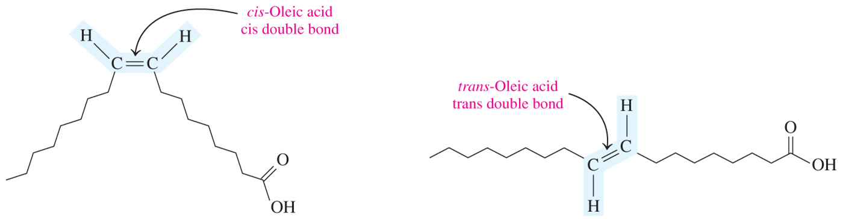
Cis and Trans Unsaturated Fatty Acids
Unsaturated fatty acids can be drawn as cis and trans isomers.
Oleic acid is a monounsaturated fatty acid found in olives, with one double bond at carbon 9.
Almost all naturally occurring unsaturated fatty acids have one or more cis double bonds.

Slide 9
Essential Fatty Acids
Humans
are capable of synthesizing some fatty acids from carbohydrates or other fatty acids
cannot synthesize sufficient amounts of polyunsaturated fatty acids such as linoleic acid, linolenic acid, and arachidonic acid
Because these polyunsaturated fatty acids must be obtained from the diet, they are known as essential fatty acids.

Slide 10
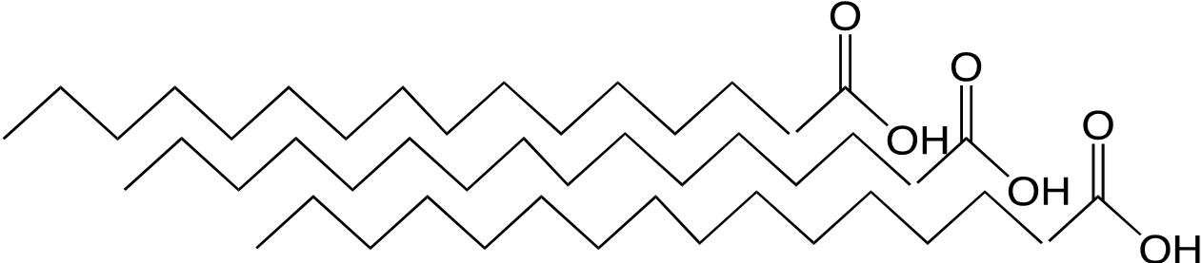
Properties of Saturated Fatty Acids (1 of 2)
Saturated fatty acids
contain only single
bonds and fit close together in
a regular pattern
have strong dispersion forces between long carbon chains
have higher melting points and are usually solids at room temperature

Slide 11
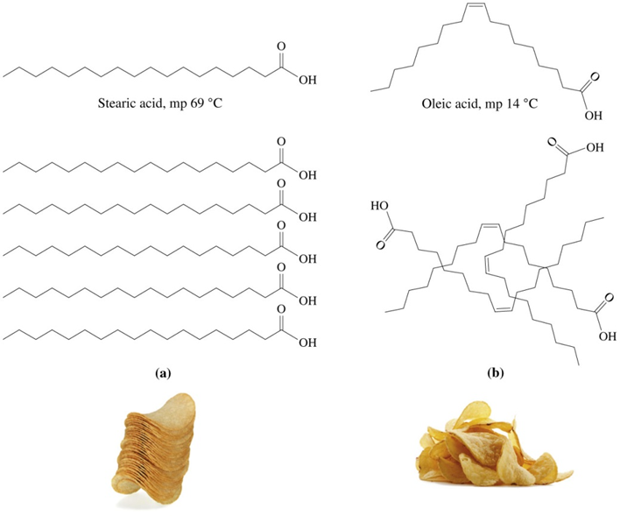
Properties of Saturated Fatty Acids (2 of 2)
In unsaturated fatty acids, the cis double bonds cause the carbon chain to bend or kink, giving the molecules an irregular shape and allowing fewer interactions between molecules.
The reduced interactions in fatty acids with cis bonds reduces the melting point of the molecules.

Slide 12
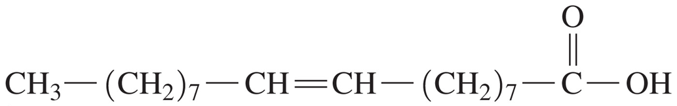
Learning Check 1
Consider the condensed structural formula for oleic acid.
A. Why is this molecule an acid?
B. How many total carbon atoms are in oleic acid?
C. Is this a saturated, monounsaturated, or polyunsaturated fatty acid?
D. Is it likely to be a solid or liquid at room temperature?
E. Would it be soluble in water?

Slide 13
Solution 2 (1 of 2)
Consider the condensed structural formula for oleic acid.
A. Why is this molecule an acid?
It contains a carboxylic acid functional group.
B. How many total carbon atoms are in oleic acid?
Oleic acid contains 18 carbon atoms.

Slide 14
Solution 2 (2 of 2)
Consider the condensed structural formula for oleic acid.
C. Is this a saturated, monounsaturated, or polyunsaturated fatty acid?
Oleic acid is a monounsaturated fatty acid.
D. Is it likely to be a solid or liquid at room temperature?
It is a liquid at room temperature.
E. Would it be soluble in water?
The long carbon chain makes it insoluble in water.

Slide 15
Prostaglandins (1 of 2)
Prostaglandins
are hormone-like substances produced in cells
are also known as eicosanoids, formed from arachidonic acid, a polyunsaturated fatty acid with 20 carbon atoms
differ by the substituents attached to the five-carbon ring
have many functions, such as lowering or raising blood pressure and stimulating contraction and relaxation of the smooth muscle of the uterus

Slide 16
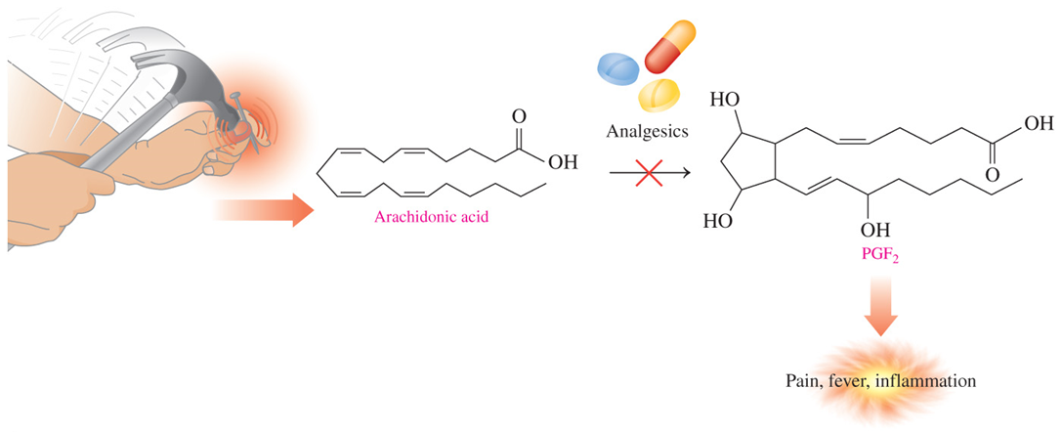
Prostaglandins (2 of 2)
When tissues are injured, arachidonic acid is converted to prostaglandins that produce inflammation and pain in the area.
Nonsteroidal anti-inflammatory drugs (N S A I D s), such as aspirin, block the production of prostaglandins.

Slide 17
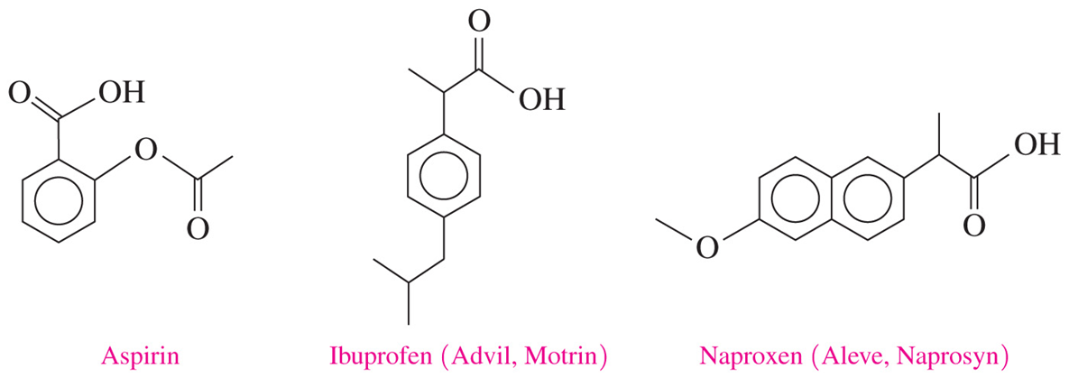
Prostaglandins: N S A I Ds
Nonsteroidal anti-inflammatory drugs (N S A I Ds) block production of prostaglandins, decreasing pain and inflammation.
N S A I D s include naproxen (Aleve and Naprosyn), ketoprofen (Actron), and nabumetone (Relafen).

Slide 18
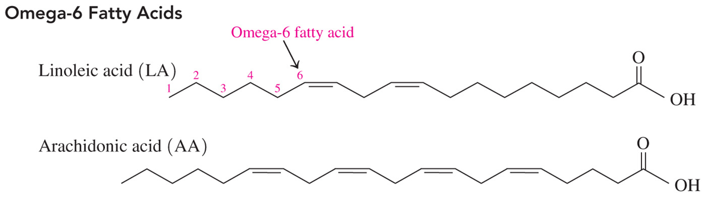
Chemistry Link to Health: Omega-3 Fatty Acids in Fish Oils (1 of 4)
Unsaturated fats such as those in vegetable oils and fish are recognized as more beneficial to health than saturated fats.
Vegetables contain omega-6 acids, meaning the first double bond occurs at carbon 6 counting from the methyl end of the carbon chain. Examples of omega-6 acids are linoleic and arachidonic acids.

Slide 19
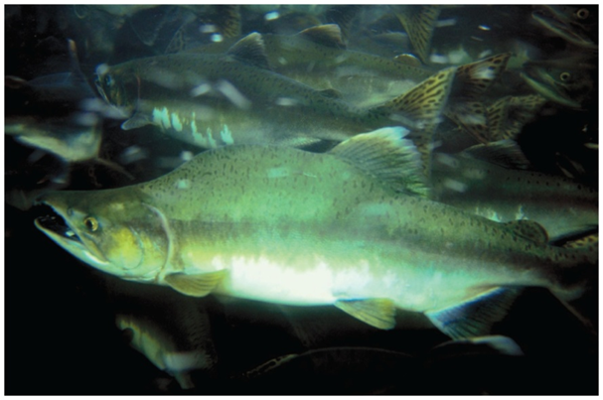
Chemistry Link to Health: Omega-3 Fatty Acids in Fish Oils (2 of 4)
Fish has high levels of omega-3 acids, meaning the first double bond occurs at carbon 3, counting from the methyl end of the chain.
Cold-water fish are a source of omega-3 fatty acids.

Slide 20
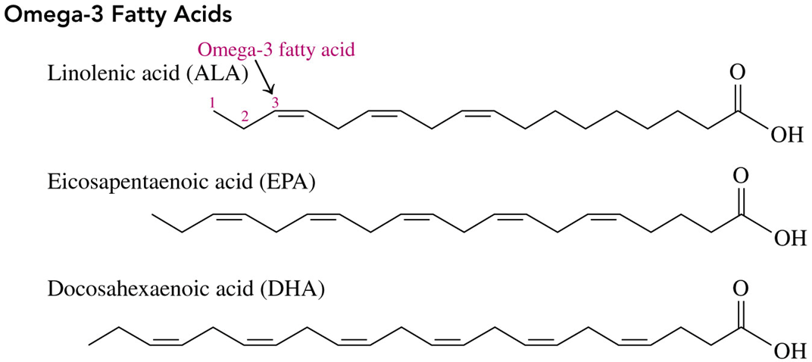
Chemistry Link to Health: Omega-3 Fatty Acids in Fish Oils (3 of 4)
Examples of omega-3 acids include linolenic, eicosapentaenoic, and docosahexaenoic acids.

Slide 21
Chemistry Link to Health: Omega-3 Fatty Acids in Fish Oils (4 of 4)
In atherosclerosis and heart disease,
cholesterol forms plaques that adhere to the walls of the blood vessels
blood pressure rises as blood has to squeeze through a smaller opening in the blood vessel
more plaque forms; there is also a possibility of blood clots blocking the blood vessels and causing a heart attack
Omega-3 fatty acids lower the tendency of blood platelets to stick together, reducing the possibility of blood clots.

Slide 22
Learning Check 2
Label each of the following fatty acids as saturated, monounsaturated, or polyunsaturated.
A. linolenic acid
B. palmitoleic acid
C. stearic acid

Slide 23
Solution 2
Label each of the following fatty acids as saturated, monounsaturated, or polyunsaturated.
A. linolenic acid
polyunsaturated
B. palmitoleic acid
monounsaturated
C. stearic acid
saturated

Slide 24

Copyright
This work is protected by United States copyright laws and is provided solely for the use of instructors in teaching their courses and assessing student learning. Dissemination or sale of any part of this work (including on the World Wide Web) will destroy the integrity of the work and is not permitted. The work and materials from it should never be made available to students except by instructors using the accompanying text in their classes. All recipients of this work are expected to abide by these restrictions and to honor the intended pedagogical purposes and the needs of other instructors who rely on these materials.

