Slide 1
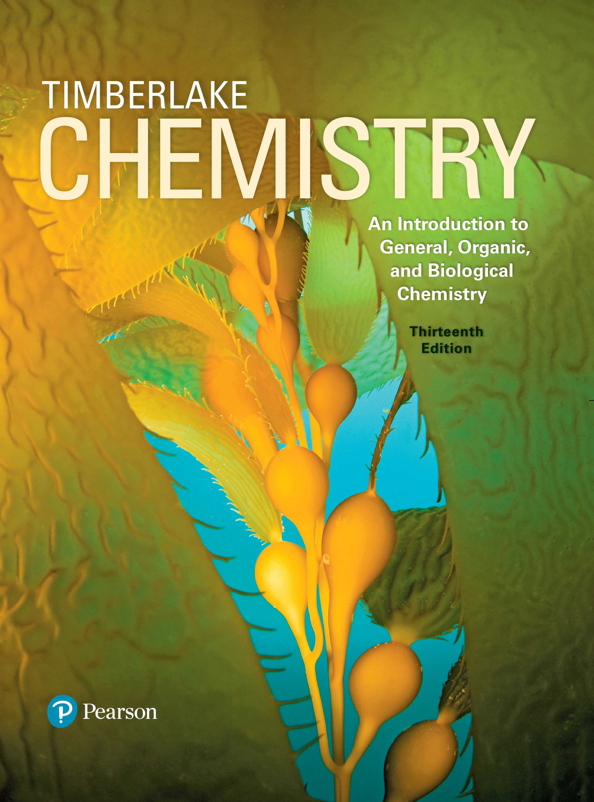
Chemistry: An Introduction to General, Organic, and Biological Chemistry
Thirteenth Edition
Chapter 13
Carbohydrates
Copyright © 2018, 2015, 2012 Pearson Education, Inc. All Rights Reserved
Notes:
If this PowerPoint presentation contains mathematical equations, you may need to check that your computer has the following installed:
1) MathType Plugin
2) Math Player (free versions available)
3) NVDA Reader (free versions available)

Slide 2
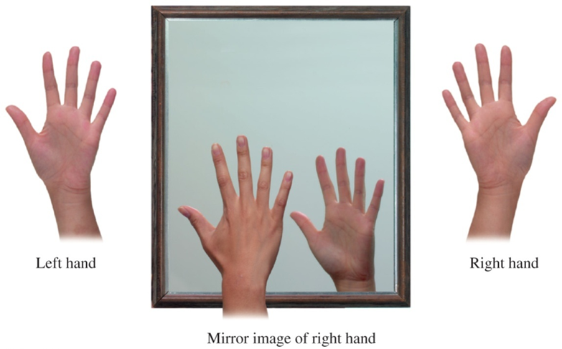
13.2 Chiral Molecules
Left and right hands are chiral because they have mirror images that cannot be superimposed on each other.
Learning Goal Identify chiral and achiral carbon atoms in an organic molecule. Identify D and L enantiomers.

Slide 3
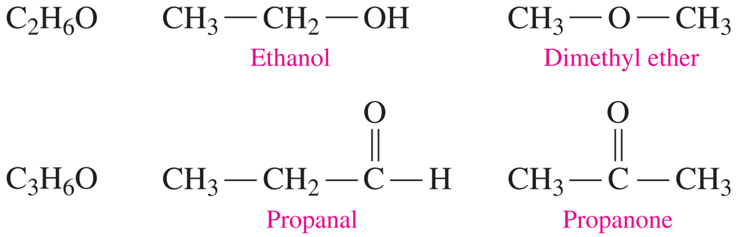
Structural Isomers
Molecules are structural isomers when they have the same molecular formula but different bonding arrangements.

Slide 4
Stereoisomers
Stereoisomers have identical molecular formulas
and are not structural isomers
with atoms bonded in the same sequence but differ in the way they are arranged in space
When the mirror images of organic molecules cannot be completely matched, they are
nonsuperimposable
chiral (pronunciation 'kai-rel)

Slide 5
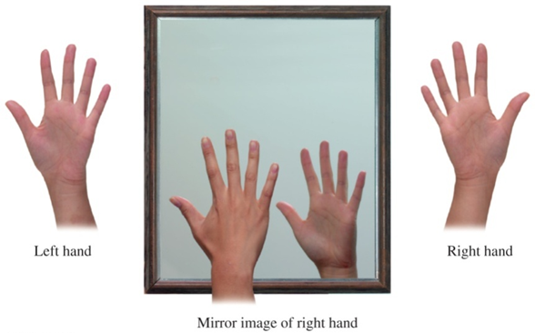
Chirality
Chiral molecules have
the same number of atoms but are arranged differently in space
a nonsuperimposable mirror image
Hands are like chiral molecules—they are mirror images and cannot be superimposed.
When the mirror images of molecules are identical and superimposable, the molecules are achiral.

Slide 6
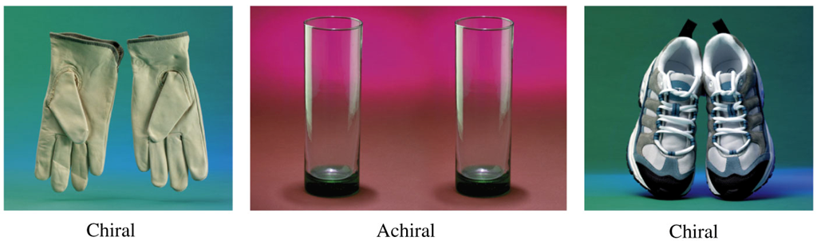
Everyday Objects, Chiral and Achiral

Slide 7
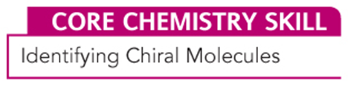
Chiral Carbon Atoms (1 of 2)
Molecules are chiral when they have
at least one or more chiral carbon atoms
a carbon atom, bonded to four different groups
nonsuperimposable mirror images

Slide 8
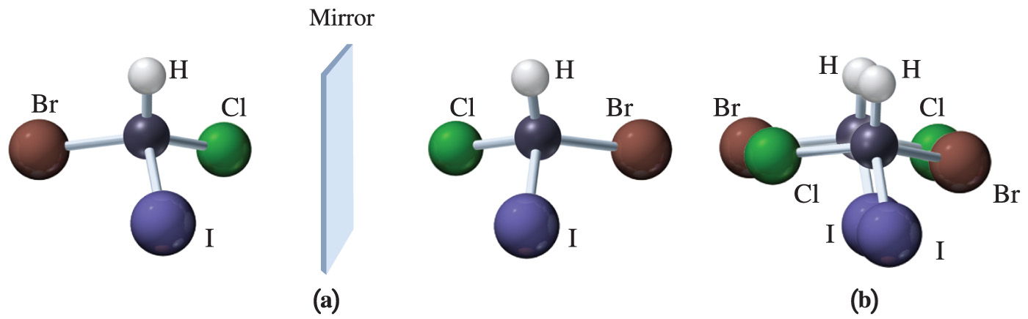
Chiral Carbon Atoms (2 of 2)
The mirror image of a chiral compound cannot be superimposed.
When stereoisomers cannot be superimposed, they are called enantiomers.

Slide 9
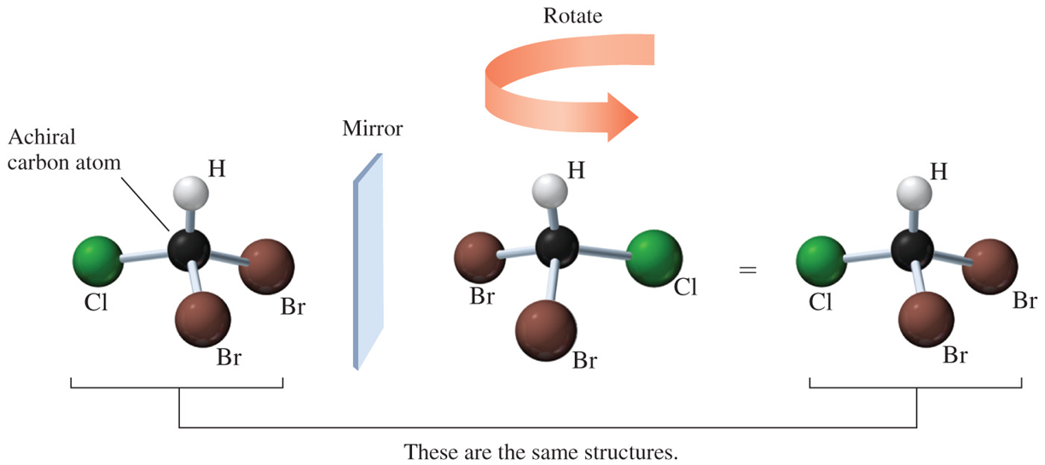
Achiral Carbon Atoms
When the mirror image of an achiral structure is rotated, and the structures can be aligned with each other, their mirror images are said to be superimposable.

Slide 10
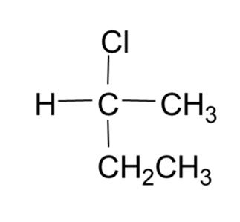
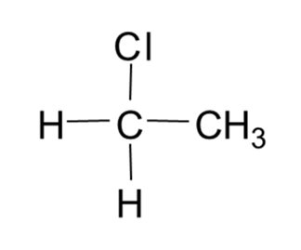
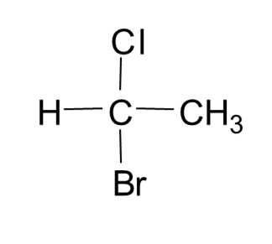
Learning Check 1
Identify each as a chiral or an achiral compound.
A.
B.
C.

Slide 11
Solution 1
Identify each as a chiral or an achiral compound.
A.
chiral
B.
achiral
C.
chiral

Slide 12
Drawing Fischer Projections
A Fischer projection
is a two-dimensional representation of a three-dimensional molecule
places the most highly oxidized carbon group at the top
uses vertical lines in place of dashes for bonds that go back
uses horizontal lines in place of wedges for bonds that come forward

Slide 13
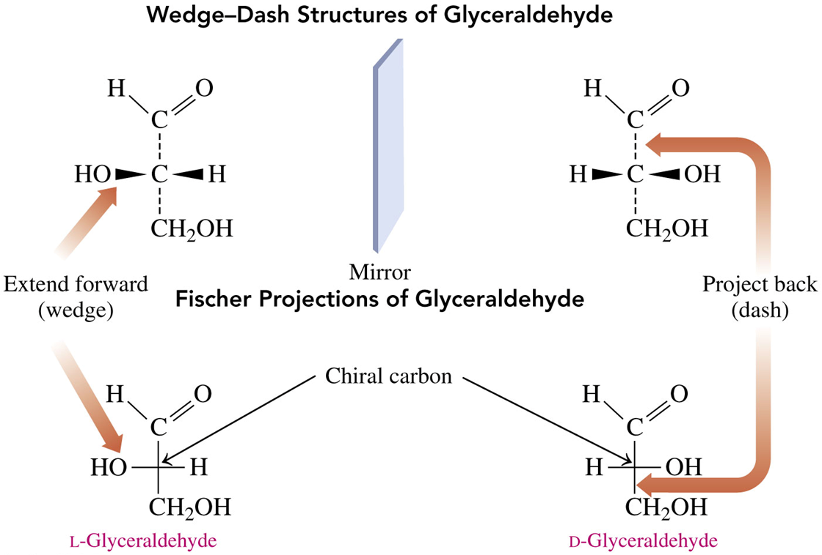
Chiral Carbon, Fischer Projections

Slide 14
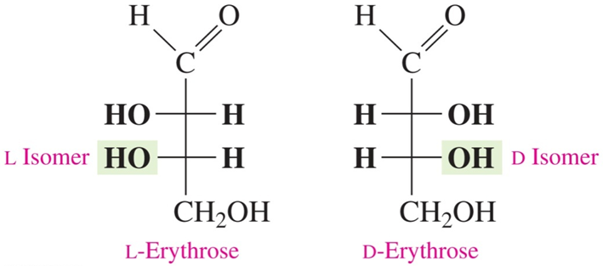
D and L Notations
D or L isomers are assigned according to the position of the
on the chiral carbon farthest from the carbonyl
carbon.
The letter L is assigned to the structure with the
on the left.
The letter D is assigned to the structure with the
on the right.

Slide 15
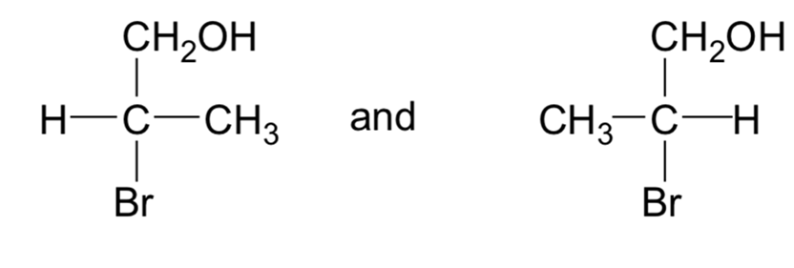
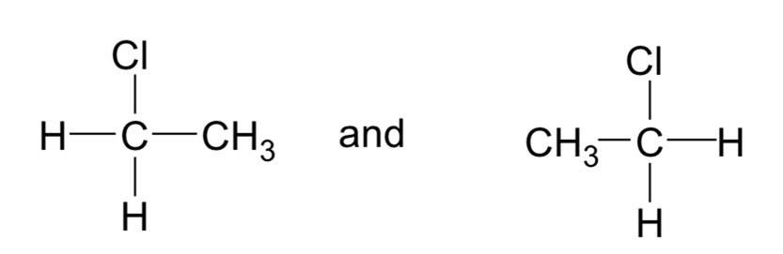
Learning Check 2
Indicate whether each pair is a mirror image that cannot be superimposed (enantiomers).
A.
B.

Slide 16
Solution 2
Indicate whether each pair is a mirror image that cannot be superimposed (enantiomers).
A.
Yes
B.
No

Slide 17
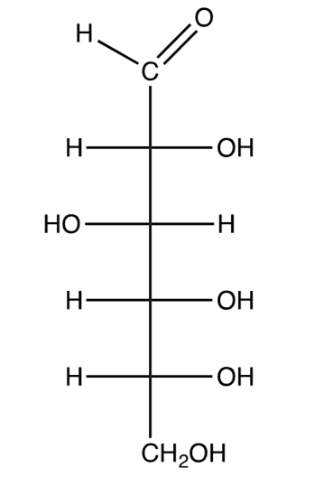
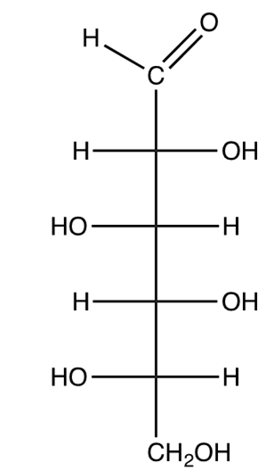
Learning Check 3
Identify the following Fischer projections L or D isomers:
A.
B.

Slide 18
Solution 3
Identify the following Fischer projections L or D isomers:
A.
B.
D-Isomer;
L-Isomer;
is on the right.
is on the left.

Slide 19
Chemistry Link to Health: Enantiomers in Biological Systems (1 of 4)
Many compounds in biological systems have only one enantiomer that is active. This happens because
the enzymes and cell surface receptors on which metabolic reactions take place are themselves chiral
only one enantiomer interacts with its enzymes or receptors; the other is inactive
the chiral receptor fits the arrangement of the substituents in only one enantiomer; its mirror image does not fit properly

Slide 20
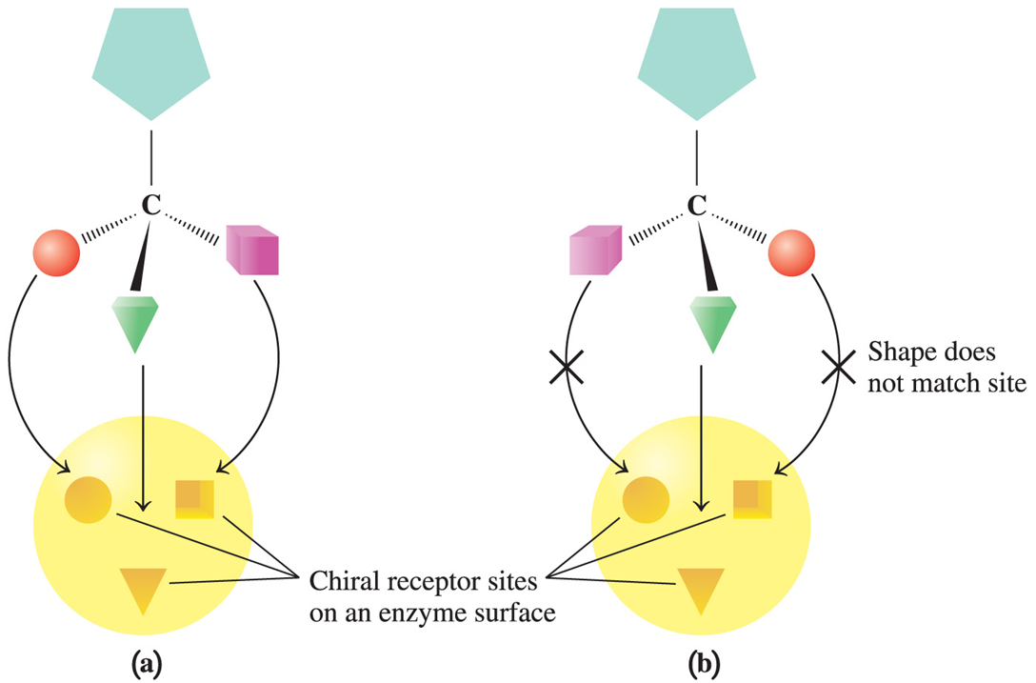
Chemistry Link to Health: Enantiomers in Biological Systems (2 of 4)

Slide 21
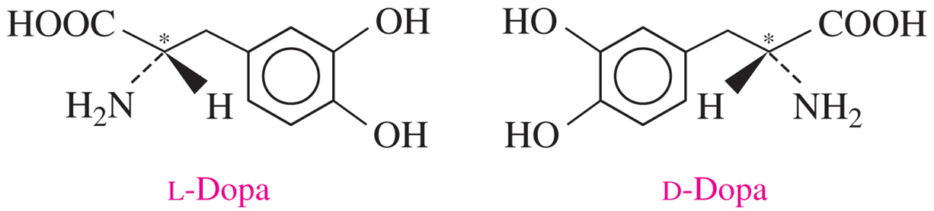
Chemistry Link to Health: Enantiomers in Biological Systems (3 of 4)
A substance used to treat Parkinson’s disease is L-dopa, which is converted to dopamine in the brain, where it raises the serotonin level.
The enantiomer, D-dopa, is not effective for the treatment of Parkinson’s disease.

Slide 22
Chemistry Link to Health: Enantiomers in Biological Systems (4 of 4)
For many drugs, only one of the enantiomers is biologically active.
However, for many years, drugs have been produced that were mixtures of their enantiomers.
Today, drug researchers are using chiral technology to produce the active enantiomers of chiral drugs.

Slide 23

Copyright
This work is protected by United States copyright laws and is provided solely for the use of instructors in teaching their courses and assessing student learning. Dissemination or sale of any part of this work (including on the World Wide Web) will destroy the integrity of the work and is not permitted. The work and materials from it should never be made available to students except by instructors using the accompanying text in their classes. All recipients of this work are expected to abide by these restrictions and to honor the intended pedagogical purposes and the needs of other instructors who rely on these materials.

