Slide 1
MARKETING PLANNING

Slide 2




Module Overview
9. International
1. Introduction
8. Market Entry
Sales (Producrts v
Strategies
Services ) B2C &
B2B
2. The Global
7. Delivering Value
10. Marketing and
Marketplace
(Channelnomics)
the impact of
Digital
3. Segmentation,
11. The New
Targeting,
6.Pricing Value
Customer Path
Positioning
(Connected consumers )
4. Developing
5.Communicating
12. Summary & Planning
Value
Value
Application
londonmet.ac.uk

Slide 3
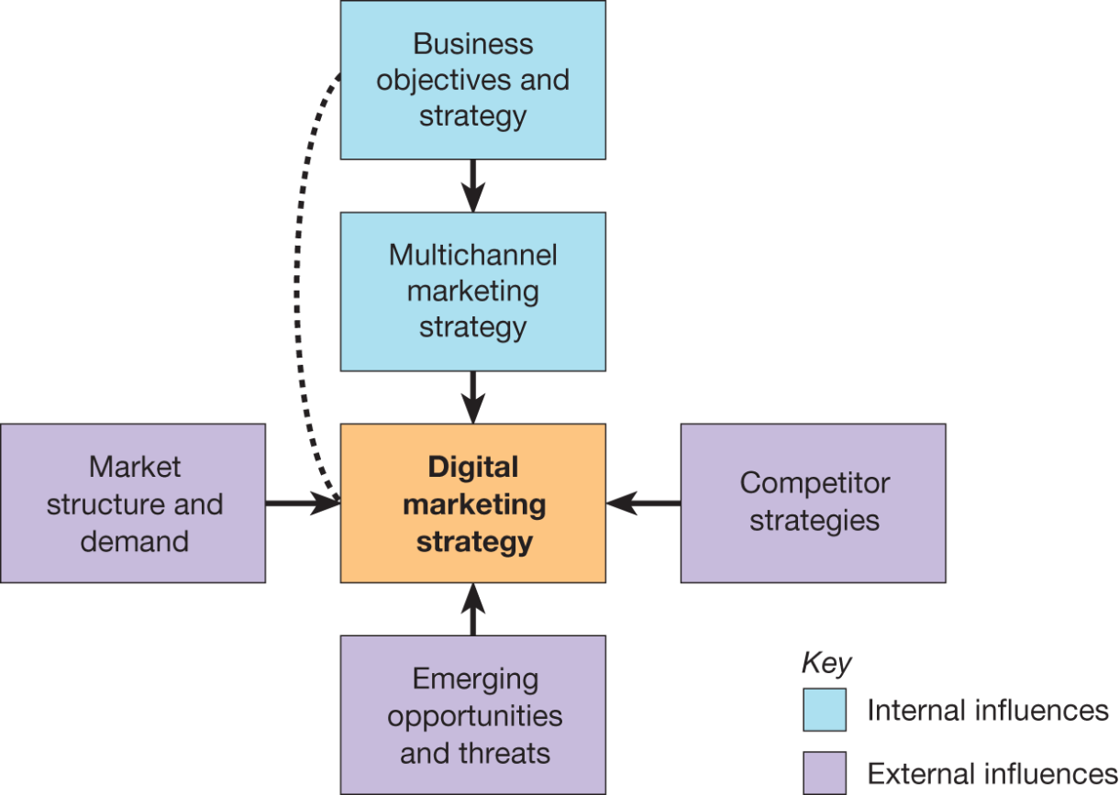
Digital marketing strategy and channel strategy management

Slide 4
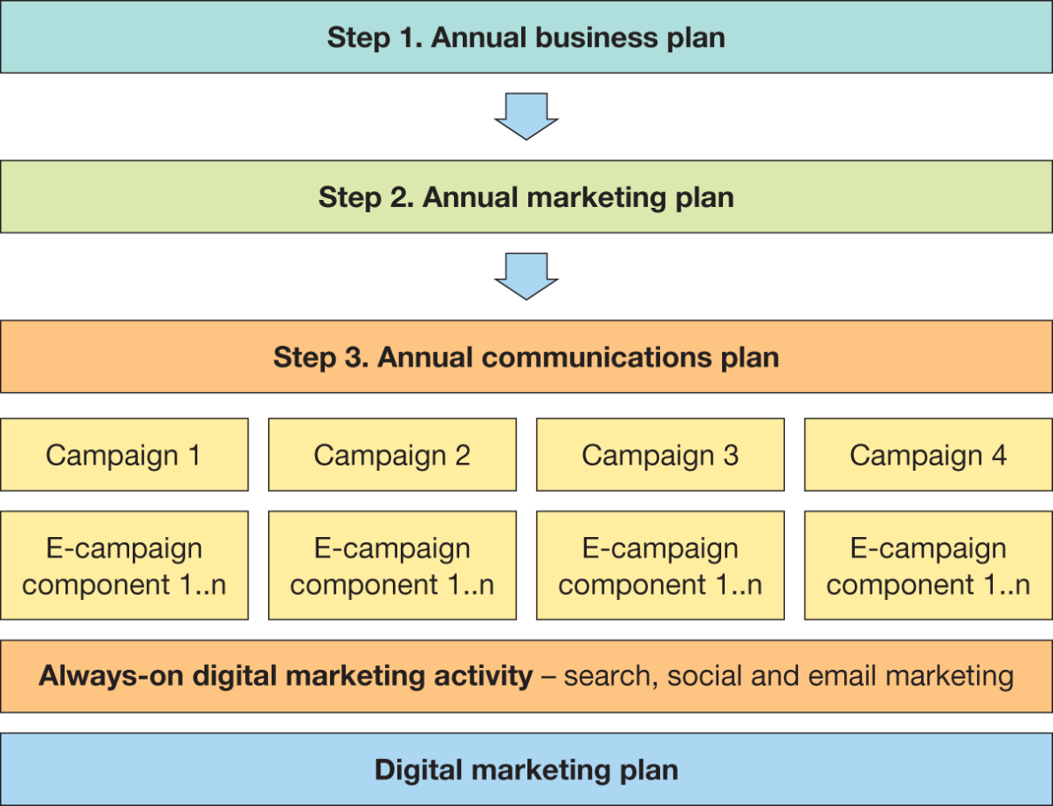
Importance of integrated digital marketing strategy

Slide 5
Digital Marketing Planning: issues and solutions
Potential issues | Potential solution
Underestimated customer demand for online services Intense competition from existing and new market entrants who may spark digital disruption in sector through new business or revenue models Duplication of resources Insufficient resources and capabilities | Research demand, set objectives, allocate sufficient resources Analyse the market, especially the intensity of rivalry, anticipate competitive responses, plan a clear market entry strategy or potential changes to business and revenue models Improve internal communications to avoid different parts of the marketing organisation purchasing different tools or different agencies for performing similar online marketing tasks Ensure budget and specific specialist digital skills are available to support the strategic initiatives including ‘always-on’ activities to continuously engage audiences using search, social and email marketing

Slide 6
Digital Marketing Planning :
Issues and solutions (Continued)
POTENTIAL ISSUES | POTENTIAL SOLUTION
Relevant customer data not collected or utilised Lack of control Lack of senior management support | Research to ensure best possible knowledge of target customers; integrate customer data into existing systems Measure and analyse regularly to take corrective action to ensure achievement of objectives Ensure support for a long-term digital transformation plan as this will be needed to drive major strategic initiatives

Slide 7
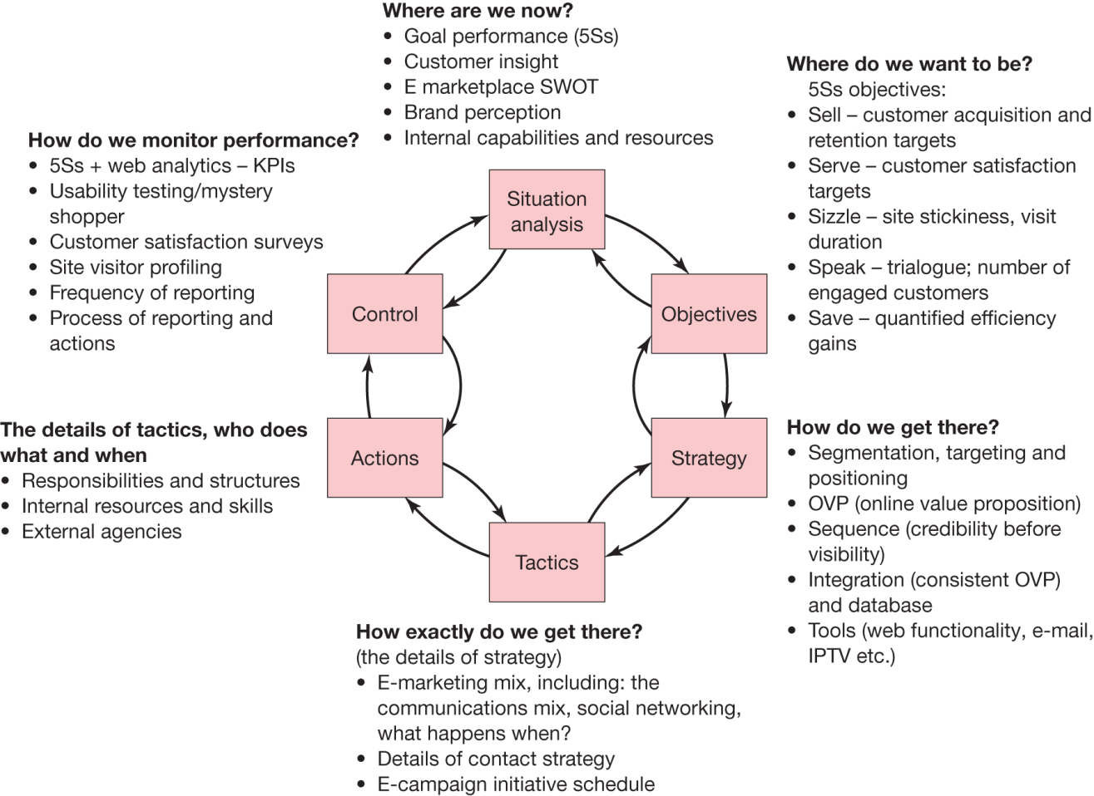
STRUCTURING A DIGITAL MARKETING STRATEGY : MANY MODELS
Source: Chaffey and Smith (2019)

Slide 8
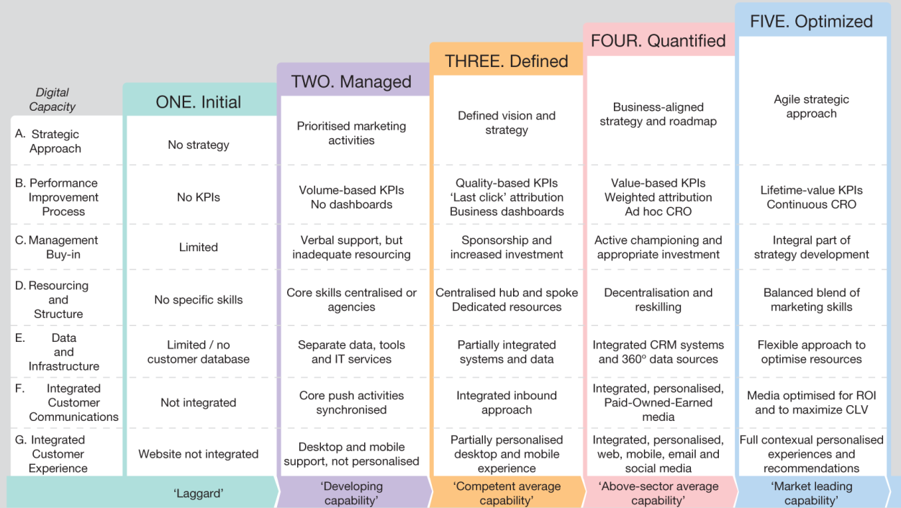
SITUATION ANALYSIS
Source: Smart Insights (http://bit.ly/smartbenchmarking)

Slide 9
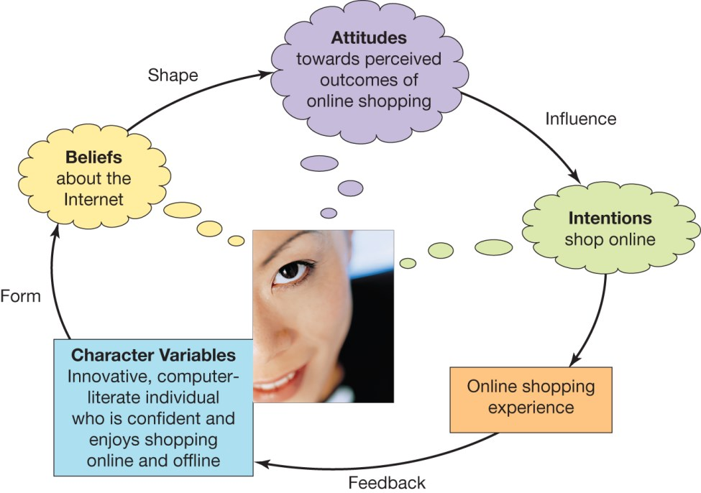
CONSUMER PROFILES : KNOW THE COLOUR OF THEIR EYES !

Slide 10
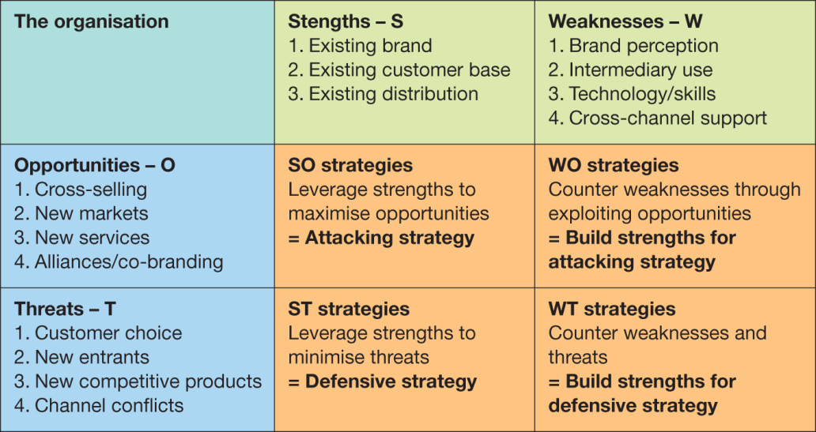
COMPETITOR ANALYSIS : FOR EACH MARKET TARGETED
Intermediary analysis
Assessing opportunities and threats

Slide 11
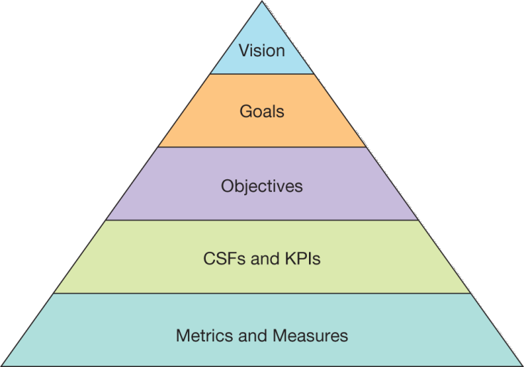
SETTING GOALS AND OBJECTIVES: FOR EACH MARKET
The online revenue contribution
Setting SMART objectives
Framework for objective setting

Slide 12
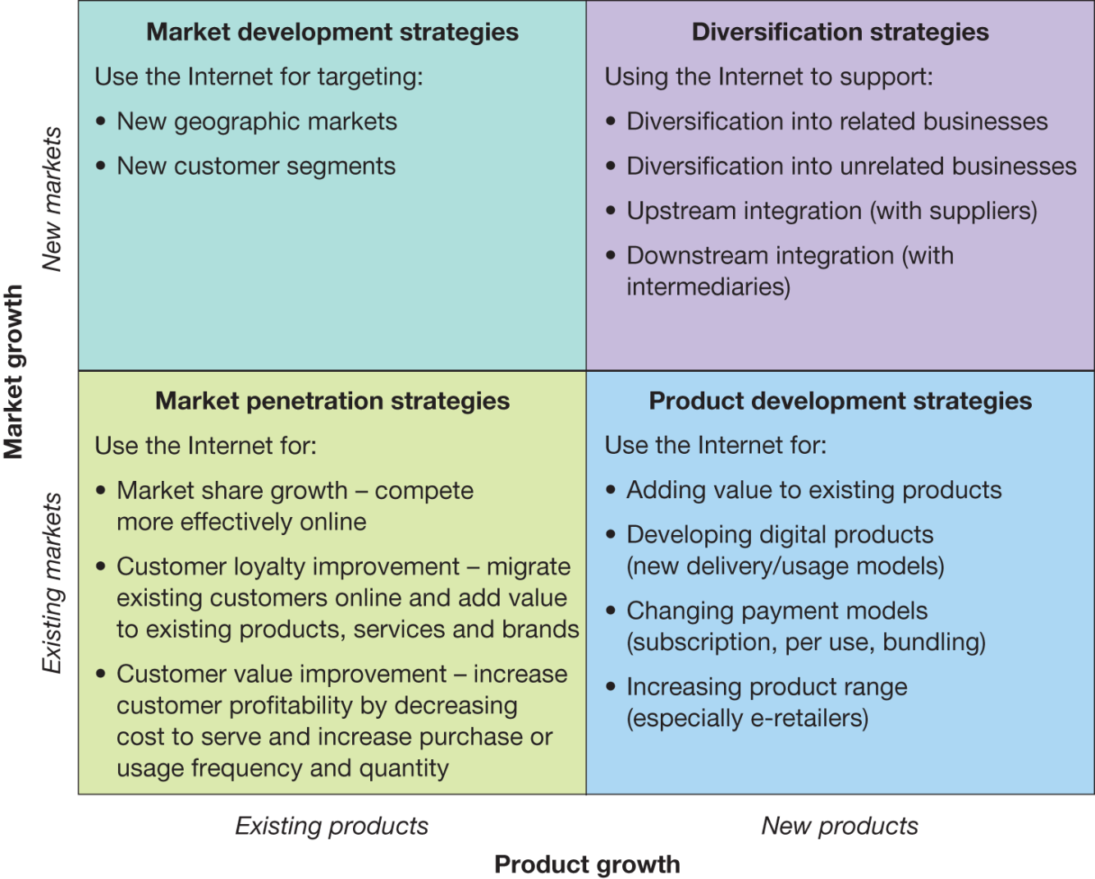
STRATEGY FORMULATION AND IMPLEMENTATION :
FOR EACH MARKET TARGETED

Slide 13
Key decisions in strategy development
Market and product strategies
Business and revenue model strategies
Target marketing strategy
Positioning (and differentiation)
Customer engagement and social media strategy
Multichannel distribution strategy
Multichannel communication strategy
Online communication mix and budget
Organisational capabilities and governance to support digital transformation

Slide 14
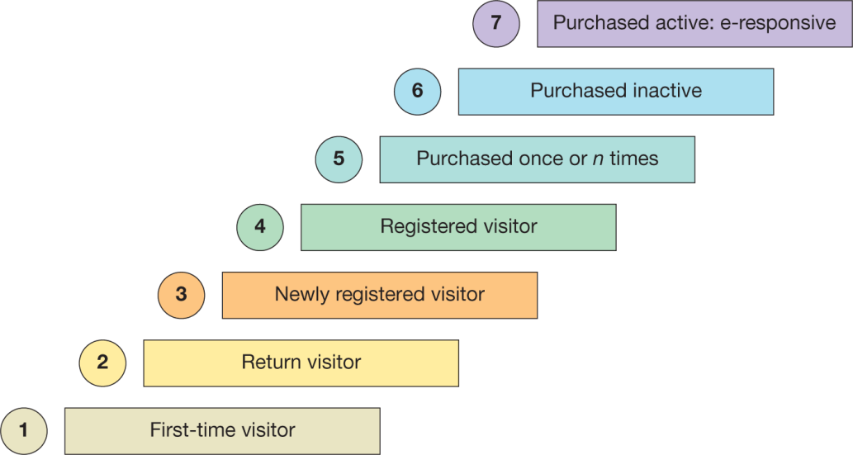
CUSTOMER LIFECYCLE SEGMENTATION

Slide 15
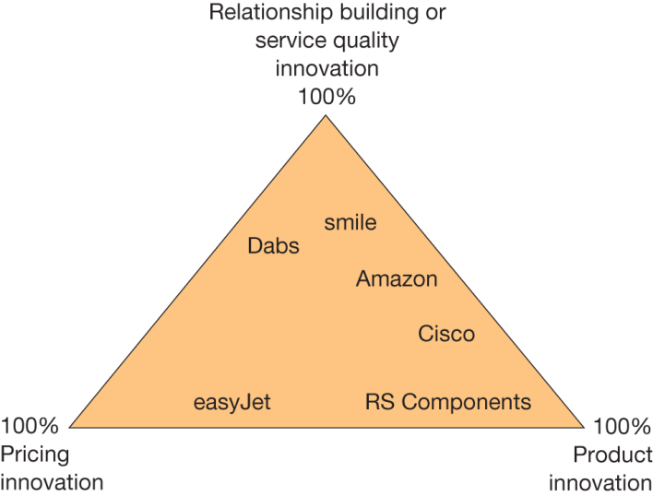
DIFFERENTIAL ADVANTAGE

Slide 16
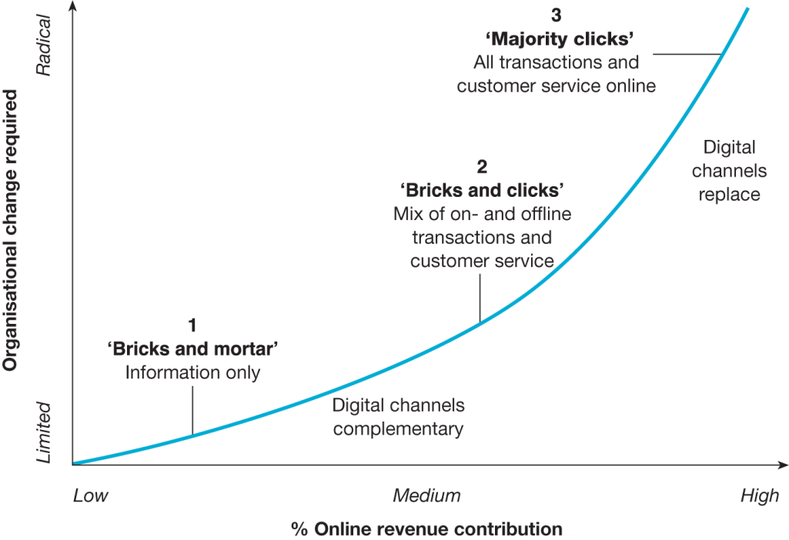
INFLUENCES ON CUSTOMERS OF OMNI CHANNEL DECISION MAKING
Source: adapted from Dholakia et al. (2010)

Slide 17
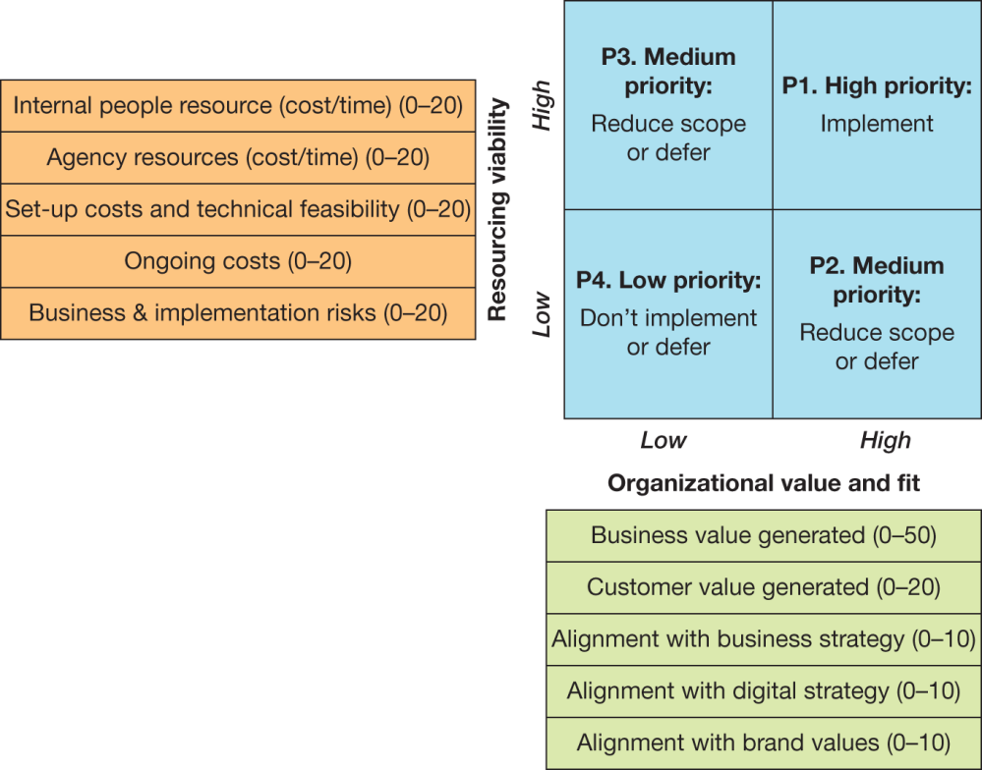
A MATRIX FOR EVALUATING DIGITAL MARKETING BUSINESS INVESTMENT ALTERNATIVES

Slide 18
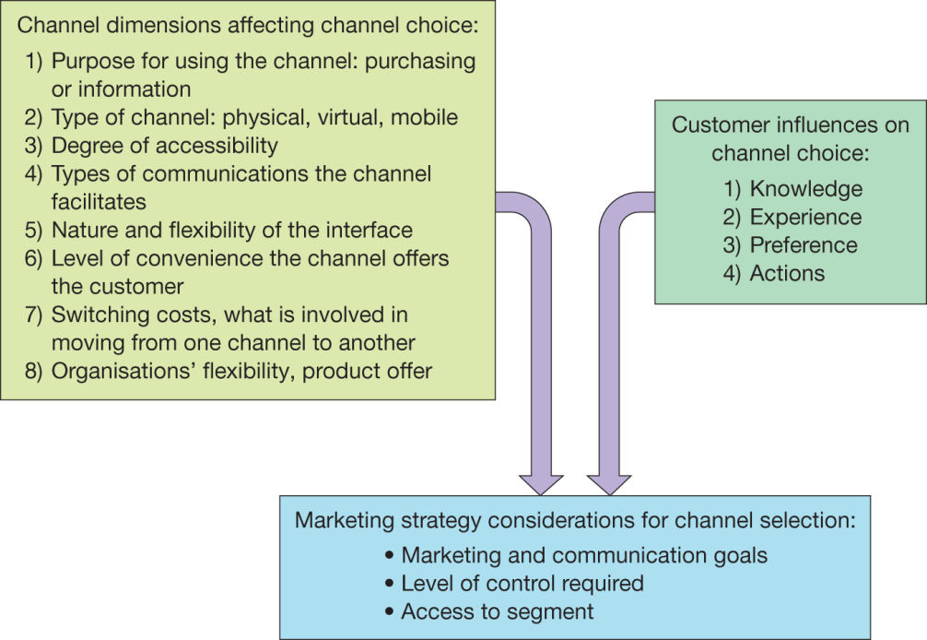
Influences on customers of multichannel decision making
Source: adapted from Dholakia et al. (2010)

Slide 19
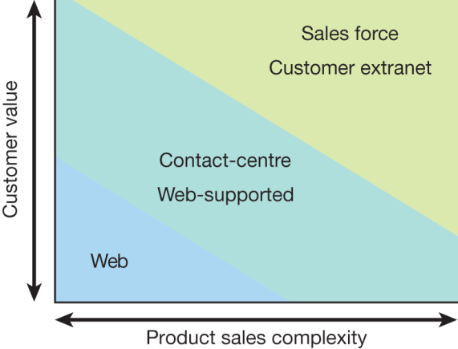
CHANNEL COVERAGE MAP
Company’s preferred strategy for communications with different customer segments and different value

Slide 20
STRATEGIC COMPETITIVE ADVANTAGE
SAME PRODUCT, LOWER PRICE
Cost leadership is a competitive advantage businesses often attempt to gain. Happens when a business is able to offer the same quality product as its competitors, but at a lower price. Gained by using production methods or utilize resources in a more efficient manner than competitors or by using proprietary technology. Classified as an offensive strategy - drive competitors out of the market
Four Methods of Competitive Advantages. (2019, January 28). Small Business - Chron.com. https://smallbusiness.chron.com/four-methods-competitive-advantages-32344.html

Slide 21
STRATEGIC COMPETITIVE ADVANTAGE
DIFFERENT PRODUCTS WITH DIFFERENT ATTRIBUTES
A strategy used to set apart from competitors.
Low cost is only one of many possible factors that may set aside a business from competition. Business that differentiate themselves typically look for one or more marketable attributes that they have that can set them apart from their competitors. They then find the segment of the market that finds those attributes important and market to them.
Four Methods of Competitive Advantages. (2019, January 28). Small Business - Chron.com. https://smallbusiness.chron.com/four-methods-competitive-advantages-32344.html

Slide 22
STRATEGIC COMPETITIVE ADVANTAGE
HOLD POSITIONS THROUGH DEFENSIVE STRATEGIES
This strategy allows the business to further distance itself from its competition by maintaining a competitive advantage it has previously gained. This strategy is closely related to differentiation and cost leadership.
Four Methods of Competitive Advantages. (2019, January 28). Small Business - Chron.com. https://smallbusiness.chron.com/four-methods-competitive-advantages-32344.html

Slide 23
STRATEGIC COMPETITIVE ADVANTAGE
POOL RESOURCES THROUGH STRATEGIC ALLIANCES
Competitive advantages can also be gained by businesses that seek strategic alliances with other businesses in related industries or within the same industry.
Strategic alliances similar to joint ventures that businesses use to pool resources and gain themselves exposure at the expense of other competitors not in the alliance.
Four Methods of Competitive Advantages. (2019, January 28). Small Business - Chron.com. https://smallbusiness.chron.com/four-methods-competitive-advantages-32344.html

Slide 24
STRATEGIC COMPETITIVE ADVANTAGE: WHAT IT TAKES TO WIN WITH DIGITAL MARKETING?
Personalization: Data-driven insights facilitates the understanding of what potential customers want, categorize them, provide personalized communications and offers based on their preferences. Advantages: Personalization is critical to satisfying customer expectation and drives higher conversion rates.
Omni-channel experience: In the multi-device world, users expect a seamless buying journey across all channels (e.g., social media, company apps, websites).
Automation for cost reduction: Facilitates a clear understanding of different customer profiles and the economies of scale that social media and other channels provide. Overall acquisition costs can be drastically lower than with traditional forms of advertising.
Competitive advantage through digital marketing | Research &amp; insight | Capgemini. (2023, July 13). Capgemini. https://www.capgemini.com/insights/research-library/competitive-advantage-through-digital-marketing

Slide 25
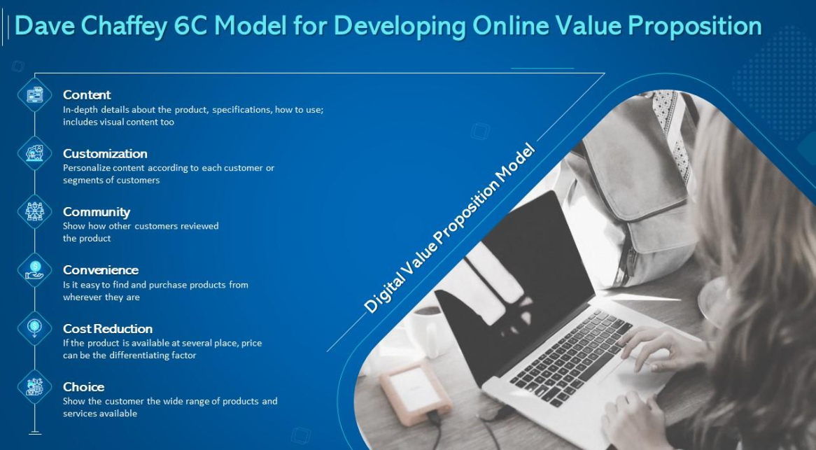

Slide 26
BRINGING THE MARKETING MIX TOGETHER
HOW TO PUT THE 4Ps TOGETHER?
Communicate the benefits that the product offers potential customers.
Demonstrate how the product's value matches the price.
Place the product where your target audience is most likely to encounter it.
Promote the product in ways that resonate with your target audience.
Shehu, A. (n.d.). The 4 Ps of Marketing: How to Apply Them to Your Business. https://learn.g2.com/4-ps-of-marketing

Slide 27
BRINGING THE MARKETING MIX TOGETHER
PRODUCT:
A product is a value the company creates and what customers are willing to pay for. Tangible (e.g. goods) or intangible (e.g. consulting services).
Competition are myriad and there are often a plethora of options available to customers.
Apple’s strategy for a competitive product = user friendly
Don’t just build great products, build products that satisfy the customer’s needs and wants
In-depth market research is needed before product launch
Shehu, A. (n.d.). The 4 Ps of Marketing: How to Apply Them to Your Business. https://learn.g2.com/4-ps-of-marketing

Slide 28
BRINGING THE MARKETING MIX TOGETHER
PRICE
Price = how you capture your product’s value. The amount your product or service is worth or how much the market is willing to pay for it.
How to determine the right pricing for your product
To prevent underpricing and overpricing your product:
Know your niche
Check your competitors' prices and how they change over time. Understand what your target audience thinks about your product.
Set the goal for your pricing
Are you looking to penetrate a competitive market or establish yourself as an industry leader?
If new to an industry, start with a low-pricing strategy. If selling a premium product, a higher price will appeal to target audience.
Calculate costs
You incur direct and indirect costs when creating a product. Before determining price, make sure to
covers these costs.
Think about other factors
Value-added tax (VAT)? Add-on? Accessories? Warranty?

Slide 29
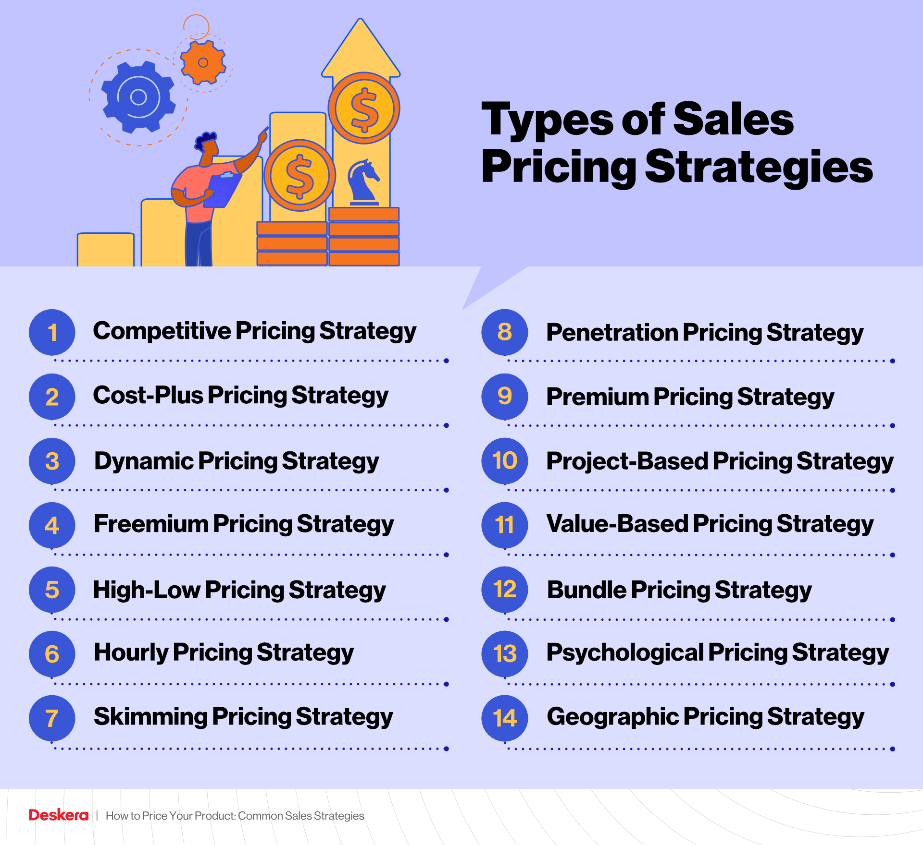
BRINGING THE MARKETING MIX TOGETHER
Samani, N. (2021, November 12). How to Price Your Product: Common Sales Strategies. Deskera Blog. https://www.deskera.com/blog/sales-pricing/
Notes:
cost-plus strategy focuses only on the COGS. Marking up products based on the profit they would like to earn.
Freemium pricing is when the companies offer a basic version of their product, hoping that their customers will be ready to pay to upgrade or access more features.
A high-low sales pricing strategy is where the company initially sells a product at a high price but lowers it once its novelty or relevance starts to drop.
A skimming sales pricing strategy is where the companies charge the highest possible price for a new product but lower it over time as its popularity starts waning. The difference between skimming and high-low pricing strategy is that unlike in the case of high-low pricing strategy where the prices are reduced abruptly, they are reduced gradually and overtime under skimming pricing strategy.
A value-based pricing strategy is a sales pricing strategy where the companies price their products or services based on their customers' willingness to pay.
Psychological pricing strategy is a sales pricing strategy that targets human psychology to boost sales e.g. $1.99

Slide 30
BRINGING THE MARKETING MIX TOGETHER
PLACE is where you sell your product and the distribution channels you use to get it to your customer.
Consider:
Where will you sell your product? Ecommerce sites?
Where does your target audience shop? B2B? B2C?
What distribution channels are best to reach your target market?
Shehu, A. (n.d.). The 4 Ps of Marketing: How to Apply Them to Your Business. https://learn.g2.com/4-ps-of-marketing

Slide 31
BRINGING THE MARKETING MIX TOGETHER
PROMOTION is how you advertise your product or service.
Through promotional activities coupled with an effective marketing campaign, it will resonate with your target audience.
Some questions to consider :
What is the best time to reach target audience?
What marketing channels are most effective? Upsell? Cross sell? Reddit? HWZ?
What marketing messages would most resonate with target audience?
What advertising approaches are most persuasive to target audience?
Shehu, A. (n.d.). The 4 Ps of Marketing: How to Apply Them to Your Business. https://learn.g2.com/4-ps-of-marketing

Slide 32
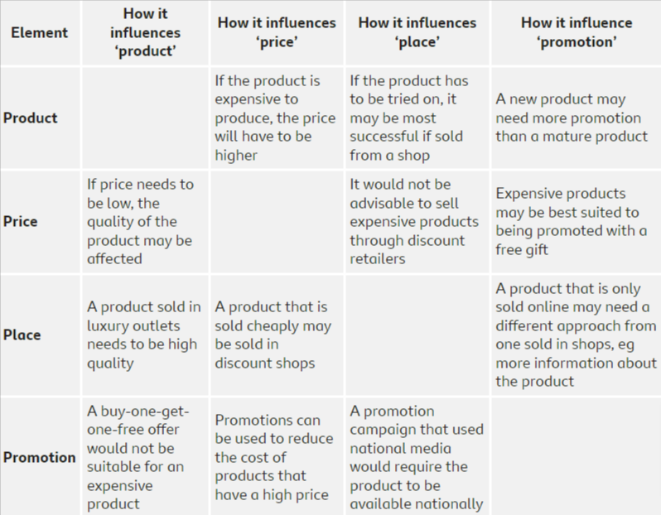
BRINGING THE MARKETING MIX TOGETHER
Source: How the four Ps of the marketing mix work together - The marketing mix - OCR - GCSE Business Revision - OCR - BBC Bitesize. (n.d.). BBC Bitesize. https://www.bbc.co.uk/bitesize/guides/zj9rgwx/revision/5

Slide 33
MARKETING IN THE DIGITAL ERA
DEVELOP YOUR DIGITAL MARKETING STRATEGY:
Build your buyer personas
Identify your goals and the digital marketing tools
Evaluate existing digital channels and assets.
Audit and plan media campaigns

Slide 34
MARKETING PLAN IN THE DIGITAL ERA
In the digital era, organisations will need to formulate a Digital Marketing Plan.
The plan will focus on the methods intended for communicating information about the company's offerings to its target market.
The Digital Marketing Plan will:
  Set goals to determine who they want to reach and how the organization plan to do it.
  Include essential components of an effective plan, strategies, timelines, schedules and a budget for implementing and maintaining a digital marketing campaign.
  Evaluation metrics to assess campaign effectiveness
Reed FIDM, D., 2014. SOSTAC: The guide to the perfect digital marketing plan. Journal of Direct, Data and Digital Marketing Practice, 16(2), pp.146-147.

Slide 35
MARKETING PLAN IN THE DIGITAL ERA
BENEFITS OF HAVING A PLAN FOR DIGITAL MARKETING:
Identify a target market and competitors
Establish specific strategies for reaching customers
Determine channels to use for promotion
Help team members stay on schedule
Evaluate the performance of your campaign
Use financial resources efficiently
Document successes and areas of improvement
Reed FIDM, D., 2014. SOSTAC: The guide to the perfect digital marketing plan. Journal of Direct, Data and Digital Marketing Practice, 16(2), pp.146-147.

Slide 36
DIGITAL MARKETING FRAMEWORK
Digital marketing strategy: How to structure a plan? (2023, July 12). Smart Insights. https://www.smartinsights.com/digital-marketing-strategy/

Slide 37
ELEMENTS TO INCLUDE IN A PLAN FOR DIGITAL MARKETING
Content marketing:
  Emails
  Website content
  Social media posts
  Podcasts
  White papers
  Case studies
  Infographics
  Webinars
Reed FIDM, D., 2014. SOSTAC: The guide to the perfect digital marketing plan. Journal of Direct, Data and Digital Marketing Practice, 16(2), pp.146-147.

Slide 38
ELEMENTS TO INCLUDE IN A PLAN FOR DIGITAL MARKETING
Social media marketing
Email marketing
Mobile marketing
Reputation marketing
Video marketing
SEO
Web analytics
Paid search
Reed FIDM, D., 2014. SOSTAC: The guide to the perfect digital marketing plan. Journal of Direct, Data and Digital Marketing Practice, 16(2), pp.146-147.

Slide 39
ELEMENTS TO INCLUDE IN A PLAN FOR DIGITAL MARKETING
SOCIAL MEDIA MARKETING
Create a strategy: each platform (IG, Tiktok, Little Red Book) needs a different strategy
Be consistent: while posting consistency depends on the platform, posting content regularly is always a good rule of thumb to follow
Create Engaging & Interesting Content
Engagement
Track and Analyze Metrics.
Reed FIDM, D., 2014. SOSTAC: The guide to the perfect digital marketing plan. Journal of Direct, Data and Digital Marketing Practice, 16(2), pp.146-147.

Slide 40
ELEMENTS TO INCLUDE IN A PLAN FOR DIGITAL MARKETING
Email marketing:
Create segmented and targeted lists of recipients.
Understand subscribers’ preferences so that the promotional emails can be made relevant to have the maximum impact on them.
Identify the goals for your campaign to create emails that help achieve the marketing goals you have set.
Use an email planning template to plan your email marketing activities
Define the timeline of your email campaign to ensure relevancy
Make sure your subject lines are engaging, interesting, and click-worthy.
Use visual content to make your promotional emails more engaging for readers.
Include call to action
Reed FIDM, D., 2014. SOSTAC: The guide to the perfect digital marketing plan. Journal of Direct, Data and Digital Marketing Practice, 16(2), pp.146-147.

Slide 41
ELEMENTS TO INCLUDE IN A PLAN FOR DIGITAL MARKETING
MOBILE MARKETING:
Responsive Website Design that is Optimized for Mobile.
Mobile-friendly Content and Copy.
Opt-In (and Opt-Out) Forms.
SMS/Text Message Marketing.
Paid Social Media Ads.
GIFs and Video Content.
Location-based Marketing Techniques.
Voice Search Optimization.
Reed FIDM, D., 2014. SOSTAC: The guide to the perfect digital marketing plan. Journal of Direct, Data and Digital Marketing Practice, 16(2), pp.146-147.

Slide 42
ELEMENTS TO INCLUDE IN A PLAN FOR DIGITAL MARKETING
REPUTATION MARKETING:
Evaluate your brand's current reputation. ...
Determine your improvement areas. ...
Monitor and respond to reviews. ...
Implement an action plan for negative feedback. ...
Encourage others to promote your brand. ...
Maintain a positive online presence.
Reed FIDM, D., 2014. SOSTAC: The guide to the perfect digital marketing plan. Journal of Direct, Data and Digital Marketing Practice, 16(2), pp.146-147.

Slide 43
ELEMENTS TO INCLUDE IN A PLAN FOR DIGITAL MARKETING
VIDEO MARKETING:
Decide on your platform(s) e.g. youtube, IG, tiktok, Douyin, FB
Select your video types: educational? Interviews? Behind-the-scene?
Plan content production: script? Props?
Know what post-production entails: add hashtags? Subtitles?
Schedule and promote the videos.
Understand and analyze metrics: Sprout reporting? Tiktok analytics?
Reed FIDM, D., 2014. SOSTAC: The guide to the perfect digital marketing plan. Journal of Direct, Data and Digital Marketing Practice, 16(2), pp.146-147.

Slide 44
ELEMENTS TO INCLUDE IN A PLAN FOR DIGITAL MARKETING
SEO:
Make your site interesting and useful.
Know what your readers want (and give it to them)
Make expertise and authoritativeness clear.
Provide an appropriate amount of content for your subject.
Avoid distracting advertisements.
Use links wisely.
Reed FIDM, D., 2014. SOSTAC: The guide to the perfect digital marketing plan. Journal of Direct, Data and Digital Marketing Practice, 16(2), pp.146-147.

Slide 45
ELEMENTS TO INCLUDE IN A PLAN FOR DIGITAL MARKETING
WEB ANALYTICS:
Setting goals. ...
Collecting data. ...
Processing data. ...
Identifying key performance indicators (KPIs). ...
Developing a strategy. ...
Experimenting and testing.
Reed FIDM, D., 2014. SOSTAC: The guide to the perfect digital marketing plan. Journal of Direct, Data and Digital Marketing Practice, 16(2), pp.146-147.

Slide 46

ELEMENTS TO INCLUDE IN A PLAN FOR DIGITAL MARKETING
PAID SEARCH:
Create a Search campaign in Google Ads
Adjust your campaign settings like targeting, bidding, and ad assets.
Create ad groups. Ad groups are sets of keywords that are grouped together based on the way your customers shop. ...
Create your ads.
Set your budget
Reed FIDM, D., 2014. SOSTAC: The guide to the perfect digital marketing plan. Journal of Direct, Data and Digital Marketing Practice, 16(2), pp.146-147.

Slide 47
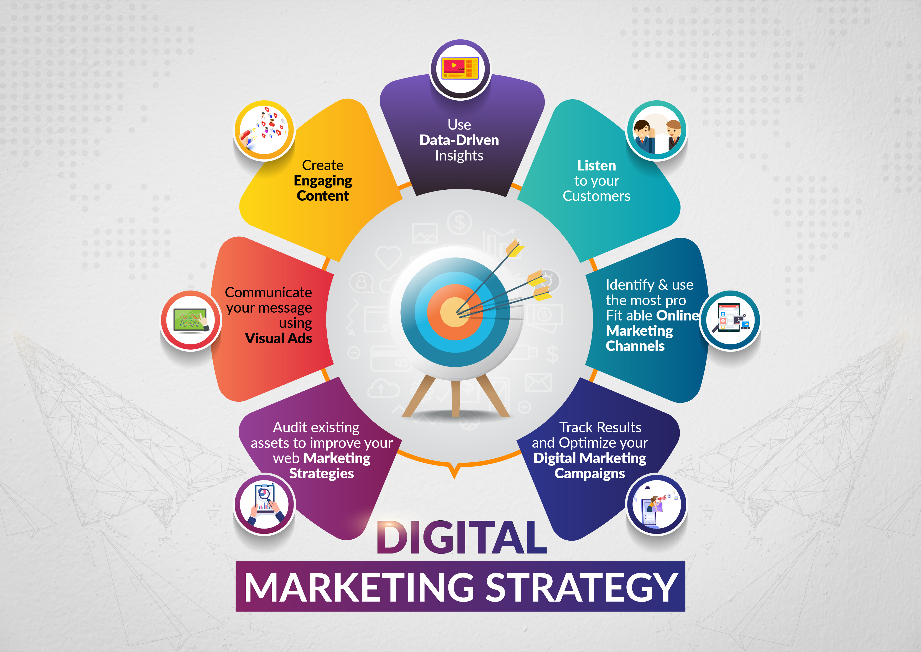
WHAT MAKES A GOOD
DIGITAL MARKETING STRATEGY?
How to structure a successful digital marketing plan? - GC Media |G.C Media Pvt.Ltd. (n.d.). https://www.gcmedia.in/blog/how-to-structure-a-successful-digital-marketing-plan

Slide 48
CONTROL AND MONITOR
YOUR MARKETING STRATEGY
Reasons to track marketing campaigns
Tracking marketing campaigns can provide a variety of benefits, including:
Measure marketing efforts: When you track a campaign, you can find out numbers, ratios and costs related to specific marketing tactics or initiatives. This data may help you objectively assess which factors of your marketing campaign are successful.
Monitoring and adjusting marketing campaigns as needed: Tracking gives you data in real time as the campaign occurs. Based on this real-time data, you can modify and optimize your existing marketing campaigns.
Planning for future campaigns: Tracking data can show you which aspects of your marketing efforts may benefit from improvements prior to your next advertising campaign. This allows you to design data-driven approaches for your future marketing initiatives.
Creating a more cost-effective marketing budget: Most companies track marketing statistics related to finances, such as the cost of converting a lead into a customer. Knowing which efforts are the most cost-effective can help you create a marketing budget that reduces costs and increases revenue.
16 Key Marketing Metrics That Are Important to Track. (n.d.). Planful. https://planful.com/blog/key-marketing-metrics/

Slide 49
WAYS TO TRACK MARKETING CAMPAIGNS
Website analytics
Customer relationship management tracking
Call tracking : software allows you to track the original source of various phone calls from prospective clients.
Ad network conversion tracking : help you determine the effectiveness of various marketing channels for your different segments of customers. E.g. you might discover that some of your target audience engages more with social media while another segment prefers paid search engine results.
Key performance indicator (KPI) dashboard: gather and analyze data through multiple marketing channels. Collect data from phone calls, websites, major ad networks and CRM software. The KPI dashboard can then synthesize this data and provide information about the most successful aspects of the campaign's different channels and strategies.
Customer feedback
Forms
Social media monitoring: Likes, Views, Click-through rate
16 Key Marketing Metrics That Are Important to Track. (n.d.). Planful. https://planful.com/blog/key-marketing-metrics/

Slide 50
KEY MARKETING METRICS
Brand Awareness Metrics: First-page keyword rankings, Social media engagement metrics Pipeline Metrics
Sales qualified leads: deals closed from marketing, pipeline progression, Conversion rate
$ value per visit
Marketing Performance Metrics: Cost per lead, Net promoter score (NPS) – likelihood of recommending customers
16 Key Marketing Metrics That Are Important to Track. (n.d.). Planful. https://planful.com/blog/key-marketing-metrics/

Slide 51
RISK MANAGEMENT
WHAT ARE THE RISK IN MARKETING?
Pricing a product incorrectly
Choosing the wrong channel to advertise to a target audience
Distribution delays
Negative feedback via social media or review sites
Employee turnover
External environment changes
What Is Marketing Risk Management? | Wrike Marketing Guide. (n.d.). https://www.wrike.com/marketing-guide/faq/what-is-marketing-risk-management/

Slide 52
RISK MANAGEMENT
1. IDENTIFYING RISKS
enables the identification and definition of hurdles the marketing team might encounter.
By understanding the risks, you can make the right decisions to avoid the threat or mitigate the negative effects.
2. ANALYZING RISKS
Gain significant insights into the risk you are set to encounter during the planning phase
Analyzing each potential risk = estimating how likely they are to occur, magnitude and frequentcy.
3. PLANNING RISK RESPONSES
Most threats are unique, and each challenge needs to be mitigated differently.
4. MONITORING RISKS
Keeping track of all threats means you are less likely to fall victim to them.
Predict when the threat will turn into a serious problem and put measures in place to counter it.
Lynch, K. (n.d.). Risk Management in Marketing | Ranky. https://www.ranky.co/growth-hacking-and-inbound-marketing-blog/4-ways-a-risk-management-plan-can-help-your-marketing-strategy

Slide 53
HOW TO WRITE A MARKETING PLAN?

Slide 54
Executive Summary
A Marketing Plan is at the core of directing and coordinating all marketing efforts within a firm.
It usually operates at two levels, strategic and tactical: strategic to identify the overall market play and tactical to execute on the marketing plan.
A Marketing Plan does not need to be long or expensive to put together. If it is carefully researched, thoughtfully considered, and evaluated, it will help your firm achieve its goals.

Slide 55
A GOOD MARKETING PLAN
A good Marketing Plan details what you want to accomplish and helps you meet your objectives.
A Marketing Plan should:
  Explain (from an internal perspective) the impact and results of past marketing decisions.
  Explain the external market in which the business is competing.
  Set goals and provide direction for future marketing efforts.
  Set clear, realistic, and measurable targets.
  Include deadlines for meeting those targets.
  Provide a budget for all marketing activities.
  Specify accountability and measures for all activities.

Slide 56
OVERALL PLANNING PROCESS
You should create and implement your Marketing Plan.
Some major steps involved in this process are:
  Planning
    Define your corporate mission
    Establish business units
    Assign resources to business units
    Assess growth opportunities
  Implementing
  Gaining Feedback and Control
    Measuring results
    Diagnosing results
    Taking corrective action
Feedback and Control Process
MONITOR
MEASURE
INPUT
CORRECT
SIGNOFF

Slide 57
The Marketing Challenge
Ask yourself these five critical questions:
  What is unique about your business idea? What is the general need that your product or service aims to meet?
  Who is your target buyer? Who buys your product or service now, and who do you really want to sell to?
  Who are your competitors? How can your small business effectively compete in your chosen market?
  What positioning message do you want to communicate to your target buyers? How can you position your business or product to let people know about your product?
  What is your sales strategy? How will you get your product or service in the hands of your customers?

Slide 58
The 10 Elements of a Good Marketing Plan
A good Marketing Plan includes these 10 elements:
  Describe Your Business
  Conduct a Situation Analysis
  Define Your Customer
  Strategize Your Market Entry
  Forecast your Sales or Demand Measurement
  Define Your Marketing Budget
  Integrate Your Marketing Communication
  Identify Sales Channels
  Track Marketing Activities
  Evaluate Your Progress

Slide 59
1. Describe Your Business
Small business owners often describe themselves by their product or services; however, business must be viewed as a customer-satisfying process, not goods-producing.
Describe your business in detail and clearly identify goals and objectives.
Answer the following questions:
  What is your product or service?
  How will your product benefit the customer?
  What is different about the product your business is offering?
  Is it a new business, a takeover, or an expansion?
  Why will your business be profitable?
  What are the growth opportunities?
  What is your geographic marketing area?

Slide 60
2. Conduct a Situation Analysis
A situation analysis details the context for your marketing efforts by considering internal and external factors that could influence your marketing strategy.
This section of the plan could include a SWOT analysis to summarize your Strengths, Weaknesses, Opportunities and Threats.
Strengths | Weaknesses
Opportunities | Threats
  Strengths: assets or a resources that can be used to improve your business’ competitive position.
  Weaknesses: resources or capabilities that may cause your business to have a less competitive position.
  Opportunities: situations or conditions arising from a business’ strengths, or set of positive externalities.
  Threats: problems that focus on your weaknesses and which can create a potentially negative situation.

Slide 61
3. Define Your Customers (STP)
Defining your market does not need to be a difficult process. You do not need a huge market base, but you need to be realistic and your market needs to be well-defined.
  Who are your competitors, and who do they target?
  Who is your perfect customer and client base?
  What is your current customer base (in terms of age, sex, income, and geographic location)?
  What habits do your customers and potential customers share? Where do they shop, what do they read, watch, listen to?
  What prospective customers are you currently not reaching? How can you reach them?
  What qualities do your customers value most about your product or service? Do they value selection, convenience, service, reliability, availability, or affordability?
  What qualities about your product or service do you need to improve? How can they be adjusted to serve your customers better?

Slide 62
4. Strategize Your Market Entry
Once you have identified what is unique about your business and who your target buyers are, focus on your competition:
  Identify your direct competitors and learn what they do.
  Sharpen your decisions about the best business category and market segment in which to compete.

Slide 63
5. Forecast Sales or Demand Measurement
Sales forecasting provides the basis for comparison over a period of time.
Market demand is the total volume that could be bought by a defined customer group in, a defined geographical area, in a defined time period, and under a defined marketing program.
You should:
  Correctly identify and estimate current demand by considering total market potential, market share, and expected sales.
  Estimate future demand by considering past sales patterns, consumer trends, and overall market projections.

Slide 64
DEFINE YOUR MARKETING BUDGET
Marketing budgets, especially in small and mid-sized businesses, are often arbitrarily set as either x% of planned revenue or y% over the prior year's marketing budget.
Use targeted budgeting to more intelligently set your budget based on company objectives.

Slide 65
6. Define Your Marketing Budget
Answer the following questions:
  What previous marketing methods have been most effective?
  What are your costs compared to sales?
  What is your cost per customer?
  What marketing methods will you use to attract new customers?
  What percentage of profits can you allocate to your marketing campaign?
  What marketing tools (i.e. - newspapers, magazines, Internet, direct mail, telemarketing, event sponsorships) can you implement within your budget?
  What methods are you using to test your marketing ideas?
  What methods are you using to measure results of your marketing campaign?

Slide 66

7. Integrate Your Marketing Communication
Integrate marketing communication to consolidate marketing tools, approaches, and resources within a company to maximize impact and gain edge over the competition.
Build on a "Marketing Mix“ and include the following:
  4P’s: Product, Price, Promotion, and Place
  Marketing & Advertising
    Internet
    Events
    Direct
    Database
  Public Relations
A COLLABORATIVE APPROACH

Slide 67
8. Identify Sales Channels
Part of the challenge of marketing is figuring out which distribution method to use for your business.
Include all relevant distribution channels:
  Retail: Stores selling to final consumer buyers (one store, or a chain of stores).
  Wholesale: An intermediary distribution channel that usually sells to retail stores.
  Direct mail: Generally catalog merchants that sell directly to consumers.
  Telemarketing: Merchants selling directly to consumer buyers at retail via phones.
  Cyber-Marketing: Merchants selling directly to consumer buyers at retail prices, or business-to-business products and services at wholesale prices via computer networks.
  Sales force: Salaried employees of a company or independent commissioned representatives who usually sell products for more than one company.

Slide 68
9. Track Marketing Activities
Tracking helps monitor the effectiveness of each marketing activity and is especially helpful with your overall program evaluation.
Include procedures for tracking each type of marketing activity you are using.
Some examples are:
  Display advertising: With traditional consumer publications, tracking can be done through the use of different phone numbers, special offers (specific to that advertisement or publication), or reference to a specific department.
  Internet marketing: Usually, this is easily tracked by monitoring web traffic.
  Trade shows: A trade show’s effectiveness can be tracked by collecting the right information at the show and following up on it.
  Database: Before your Marketing Plan is kicked off, make sure you have the database structure in place to record this information.
The tabulated results and customer information is very valuable information.

Slide 69
10. Evaluate Your Progress
Identify how you will measure your success and in what ways your objectives have been met. Then, use these metrics to determine the success of your marketing efforts.
Answer the following questions:
  Did we reach our goals?
  Was the marketing campaign successful?
  Were we able to determine Return on Investment (ROI)?
  Did our efforts result in conversion? In other words, were we able to convert an inquirer to a visitor, a visitor to a customer?
  Can we utilize our database to survey, capture additional information, or establish a more comprehensive customer relationship program?

Slide 70
INCLUDE SOURCES AND CITATIONS
Kotler & Keller, Marketing Management
David Cravens, Strategic Marketing
Business Owners Toolkit, Total Know-How for Small Businesses
Small Business Administration, Marketing to Federal Agencies and Prime Contractors
Shirleen Glasin, ProSidian Consulting, Developing a Marketing Plan
All Business, Dun & Bradstreet Company, Three Steps for Developing a Marketing Plan for Your Small Business
Entrepreneur.com, Small Business Encyclopedia, How to Create a Marketing Plan
Business Know How, Small Business and Home Business Ideas, 8 Keys to a Strong Marketing Strategy

