Slide 1
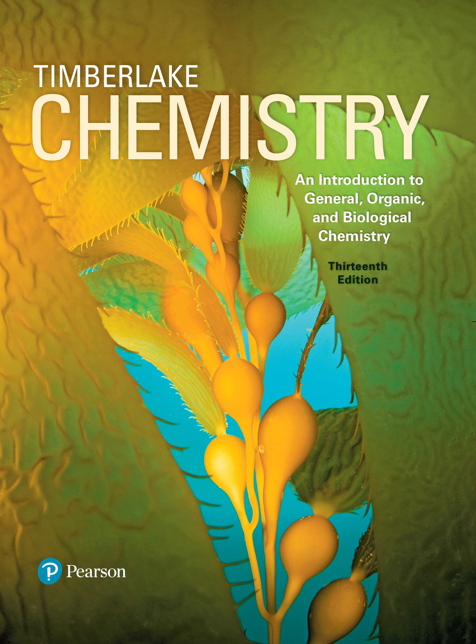
Chemistry: An Introduction to General, Organic, and Biological Chemistry
Thirteenth Edition
Chapter 11
Introduction to Organic Chemistry: Hydrocarbons
Copyright © 2018, 2015, 2012 Pearson Education, Inc. All Rights Reserved
Notes:
If this PowerPoint presentation contains mathematical equations, you may need to check that your computer has the following installed:
1) MathType Plugin
2) Math Player (free versions available)
3) NVDA Reader (free versions available)

Slide 2
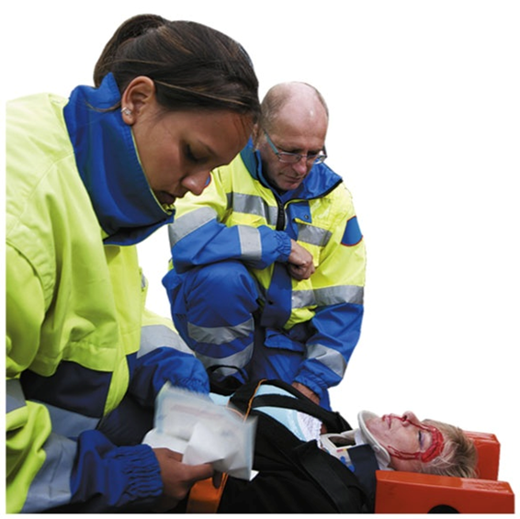
Introduction to Organic Chemistry: Hydrocarbons
Firefighters/emergency medical technicians must be knowledgeable about fire codes, arson, and the handling and disposal of hazardous materials.
Since firefighters/emergency medical technicians also provide emergency care for sick and injured people, they need to be aware of emergency medical and rescue procedures, as well as the proper methods for controlling the spread of infectious disease.

Slide 3
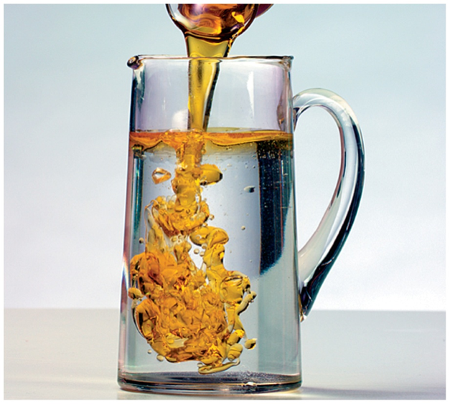
11.1 Organic Compounds
Organic chemistry is the study of carbon compounds.
Organic compounds such as vegetable oil contain carbon and hydrogen.
Learning Goal Identify properties characteristic of organic or inorganic compounds.

Slide 4
Organic Compounds
An organic compound
is a compound made from carbon and hydrogen atoms
may also contain other nonmetals such as oxygen, sulfur, nitrogen, phosphorus, or a halogen
is often found in common products such as gasoline, medicines, shampoos, plastics, and perfumes
The formulas of organic compounds are written with carbon first, followed by hydrogen, and then any other elements.

Slide 5

Properties of Organic Compounds
Organic compounds typically
have covalent bonds
have low melting and boiling points
are flammable and undergo combustion
are not soluble in water
Vegetable oil is a mixture of organic compounds and is not soluble in water.

Slide 6
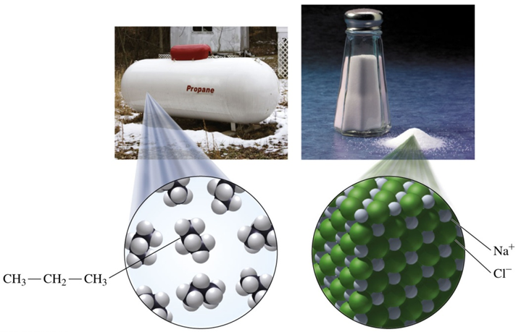
Organic and Inorganic Compounds
Many inorganic compounds have high melting and boiling points.
Inorganic compounds that are ionic are usually soluble in water, and most do not burn in air.
Propane, C ₃ H ₈, is an organic compound used as a fuel. Salt, N a C l, is an inorganic compound composed of N a ⁺ and C l ⁻ ions.

Slide 7
Comparing Organic and Inorganic Compounds
Table 11.1 Some Properties of Organic and Inorganic Compounds
Property | Organic | Example: C ₃ H ₈ | Inorganic | Example: N a C l
Elements Present | C and H, sometimes O, S, N, P, or C l (F, B r, I) | C and H | Most metals and nonmetals | N a and C l
Particles | Molecules | C ₃ H ₈ | Mostly ions | N a⁺ and C l⁻
Bonding | Mostly covalent | Covalent | Many are ionic, some covalent | Ionic
Polarity of Bonds | Nonpolar, unless a strongly electronegative atom is present | Nonpolar | Most are ionic or polar covalent, a few are nonpolar covalent | Ionic
Melting Point | Usually low | −188 °C | Usually high | 801 °C
Boiling Point | Usually low | −42 °C | Usually high | 1413 °C
Flammability | High | Burns in air | Low | Does not burn
Solubility in Water | Not soluble unless a polar group is present | No | Most are soluble unless nonpolar | Yes

Slide 8
Learning Check 1
Identify each characteristic as most typical of compounds that are inorganic or organic.
A. It has a high melting point.
B. It is not soluble in water.
C. It has the formula
D. It has the formula M g C l ₂.
E. It burns easily in air.
F. It has covalent bonds.

Slide 9
Solution 1
Identify each characteristic as most typical of compounds that are inorganic or organic.
A. It has a high melting point.
inorganic
B. It is not soluble in water.
organic
C. It has the formula
organic
D. It has the formula M g C l ₂.
inorganic
E. It burns easily in air.
Organic
F. It has covalent bonds.
organic

Slide 10
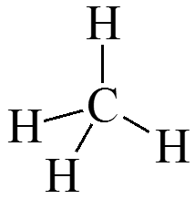
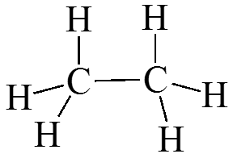
Hydrocarbons
Hydrocarbons are organic compounds that contain only carbon and hydrogen.
In organic molecules, every carbon has four bonds.
Saturated hydrocarbons contain only single bonds.

Slide 11
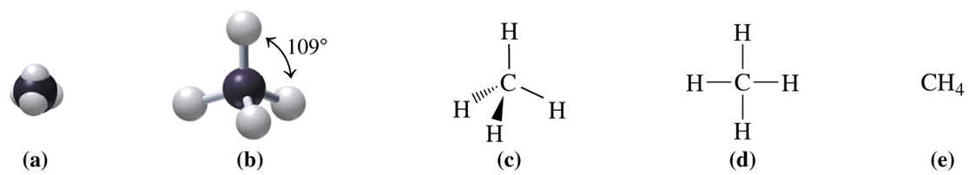
Carbon Compounds: Methane (C H ₄)
In methane, C H ₄, carbon forms four covalent bonds to hydrogen. Methane is tetrahedral and has bond angles of 109°.
Two-dimensional and three-dimensional representations of methane, C H ₄:
a. space-filling model
b. ball-and-stick model
c. wedge-dash model
d. expanded structural formula
e. condensed structural formula

Slide 12
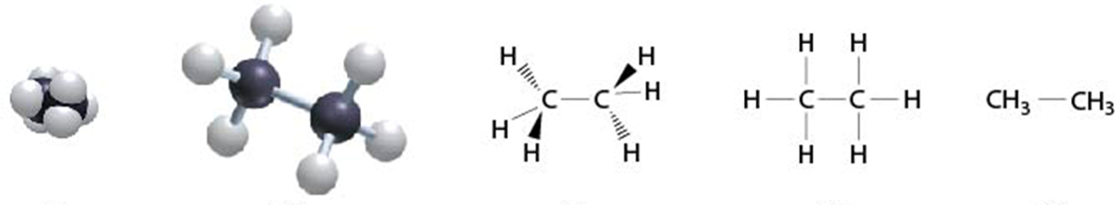
Carbon Compounds: Ethane (C ₂ H ₆)
In ethane, C ₂ H ₆, each tetrahedral carbon forms three covalent bonds to hydrogen and one to the other carbon.
Two-dimensional and three-dimensional representations of methane, C ₂ H ₆:
a. space-filling model
b. ball-and-stick model
c. wedge-dash model
d. expanded structural formula
e. condensed structural formula

Slide 13
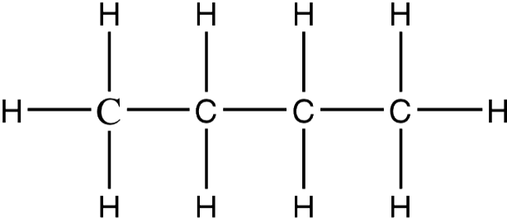
Learning Check 2
In the butane molecule, C ₄ H ₁₀, predict the shape around each carbon atom.

Slide 14
Solution 2
In the butane molecule, C ₄ H ₁₀, predict the shape around each carbon atom.
Each carbon atom has four single covalent bonds and, therefore, a tetrahedral shape.

Slide 15

Copyright
This work is protected by United States copyright laws and is provided solely for the use of instructors in teaching their courses and assessing student learning. Dissemination or sale of any part of this work (including on the World Wide Web) will destroy the integrity of the work and is not permitted. The work and materials from it should never be made available to students except by instructors using the accompanying text in their classes. All recipients of this work are expected to abide by these restrictions and to honor the intended pedagogical purposes and the needs of other instructors who rely on these materials.

