Slide 1
MARKETING AND THE IMPACT OF THE DIGITAL REVOLUTION

Slide 2




Module Overview
9. International
1. Introduction
8. Market Entry
Sales (Producrts v
Strategies
Services ) B2C &
B2B
2. The Global
7. Delivering Value
10. Marketing and
Marketplace
(Channelnomics)
the impact of
Digital
3. Segmentation,
11. The New
Targeting,
6.Pricing Value
Customer Path
Positioning
(Connected consumers )
4. Developing
5.Communicating
12. Summary & Planning
Value
Value
Application
londonmet.ac.uk

Slide 3
Activity
What do you understand by Digital Marketing?
In pairs please provide two or three sentences to describe this.

Slide 4
WHAT IS DIGITAL MARKETING?
Digital marketing is the term for marketing of products and services using digital technologies, mainly on the internet using mobile phones, digital displays and other digital meduims

Slide 5
BENEFITS OF DIGITAL MARKETING
Time and effort saving
Economical
Impactful
Flexibility
Instant feedback and analysis

Slide 6
OBJECTIVES OF DIGITAL MARKETING
Reach the right audience
Engage the audience
Motivate target audience to take action
Maximize ROI

Slide 7
“ Achieving Marketing Objectives through Digital Technology”
Or
The application of internet and related Digital technologies in conjunctions with traditional communications to achieve marketing objectives.
(Chaffey, 2013)

Slide 8
Platforms
Desktop Browser platforms - web access through the consumers browser of choice e.g. Internet explorer, chrome, safari or desk top apps e.g. through Apple Lion.
Video Marketing Platforms – e.g. streamed video or television channels streamed over the internet known as e.g. IPTV
Mobile Operating Systems Browser- mobile browsers integrated through the operating systems
Mobile based Apps – E.g. include iOS, Google Android . Please note that Content can be delivered through the browser

Slide 9
Applications of Digital Marketing
As an Advertising Medium – as a “pop up”
As a Direct Response Medium – e.g. chat lines
As a Lead Generation Method – e.g. get customer’s email
Distribution Channels e.g. Apple iTunes & Netflix
As a Customer Service Mechanism – e.g. receive customer’s concerns and respond very quickly

Slide 10
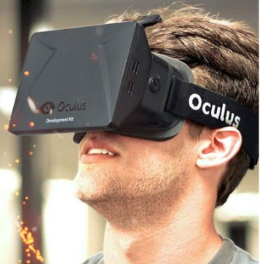
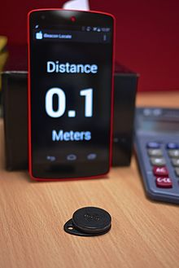
Digital Innovations
Oculus Rift - virtual reality headset
Sold for $2bn to Facebook
IBeacons
http://www.theguardian.com/technology/2014/mar/31/oculus-rift-facebook-virtual-reality

Slide 11
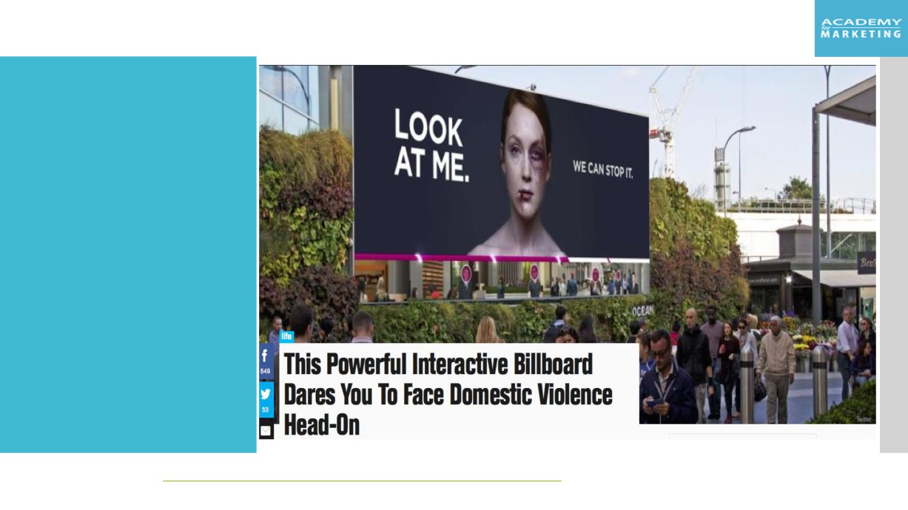
Digital Innovations

Slide 12
Internet of Things (IoT)
Extending the current Internet and providing connection, communication, and inter-networking between devices and physical objects, or "Things," is a growing trend that is often referred to as the Internet of Things (IoT)
“The technologies and solutions that enable integration of real world data and services into the current information networking technologies are often described under the umbrella term of the Internet of Things (IoT)”

Slide 13
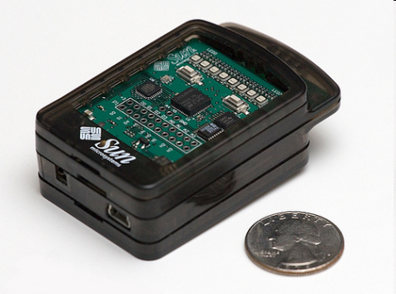
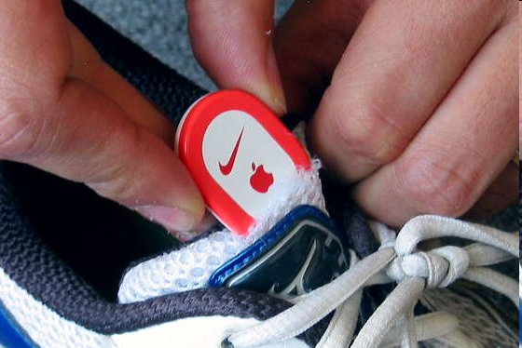
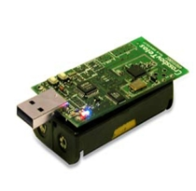
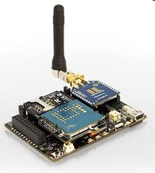
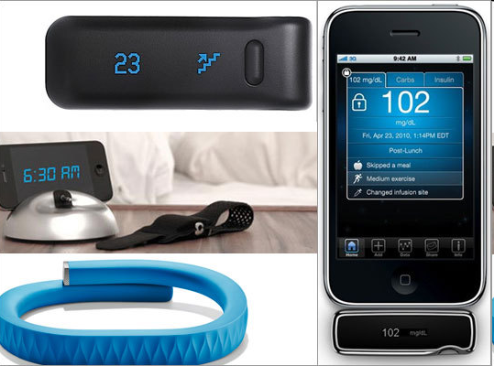
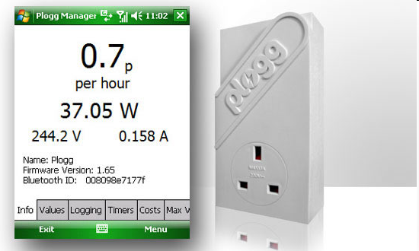
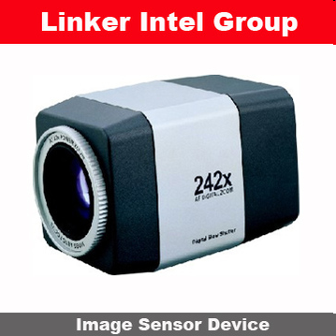
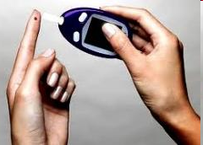
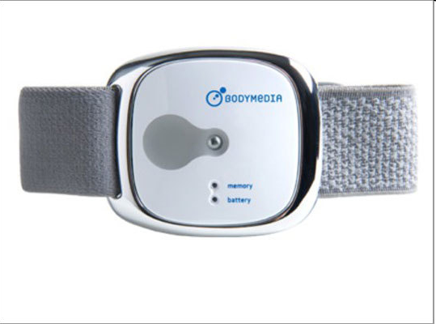
SENSOR DEVICES ARE BECOMING WIDELY AVAILABLE
- Programmable devices
- Off-the-shelf gadgets/tools

Slide 14
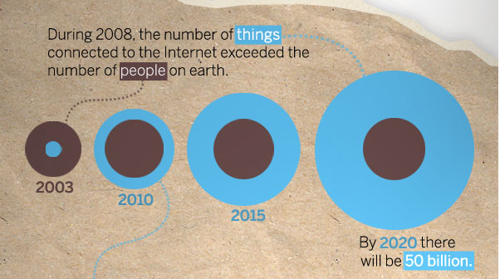
Things connected
Things connected
Things connected

Slide 15
COMPONENTS OF DIGITAL MARKETING
SEM
CONTENT MARKETING
DIGITAL MARKETING
APP DEV
BRANDING
WEB
DESIGN
SEO
YOUTUBE
MARKETING
EMAIL MARKETING
SOCIAL MEDIA

Slide 16
DIFFERENCE BETWEEN TRADITONAL
AND DIGITAL MARKETING
TRADITIONAL MARKETING: NEWSPAPERS, FLYERS, MAGAZINES, POSTERS ETC
DIGITAL MARKETING: SOCIAL MEDIA, WEBSITES, EMAIL ETC

Slide 17
DISADVANTAGES OF
TRADITIONAL MARKETING
High cost
Low interaction
Lack customisation options
Slow to update
Poor campaign measurement

Slide 18
ADVANTAGES OF DIGITAL MARKETING
Higher level of customer engagement
Measurements of success are available real-time
Bigger audience range
Less expensive
Targeted marketing via SEO
Connects with digital savvy audience

Slide 19
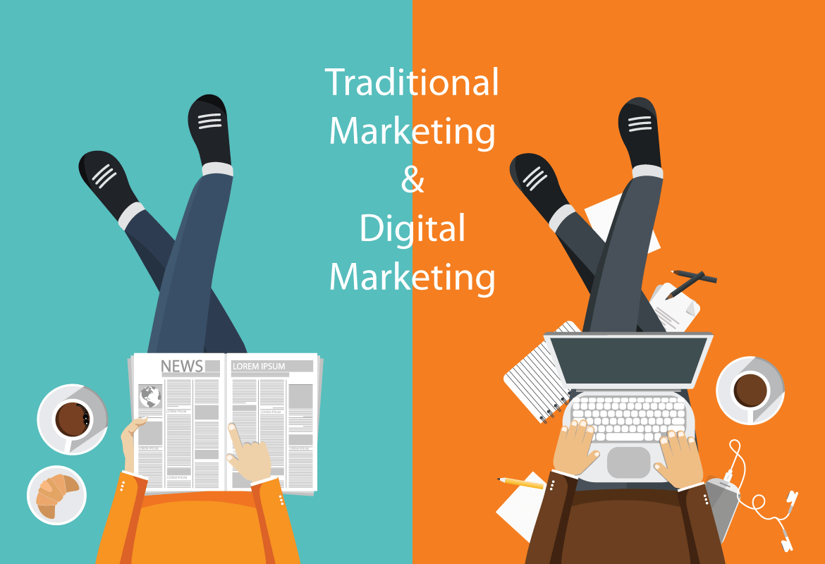
HOW TO INTEGRATE TRADITONAL
AND DIGITAL MARKETING?
WHY INTEGRATE TRADTIONAL AND DIGITAL MARKETING?
Both mediums offer different results, depending on the product being marketed. To generate the best, most effective results, it is a good idea to market both online and offline. This approach will also attract and convert more people than just marketing in one medium. Not everyone is online all the time so this is where traditional marketing comes in to fill the gap.
Companies relying solely on traditional or digital marketing lose a lot of potential customers because each media only covers a portion of the target audience and make their customers feel alienated.
Many people still listen to the radio, watch television and read the newspaper and magazines. Traditional marketing is not dead.
Therefore, companies need to incorporate both online and offline marketing methods in order to tie all marketing efforts together.

Slide 20
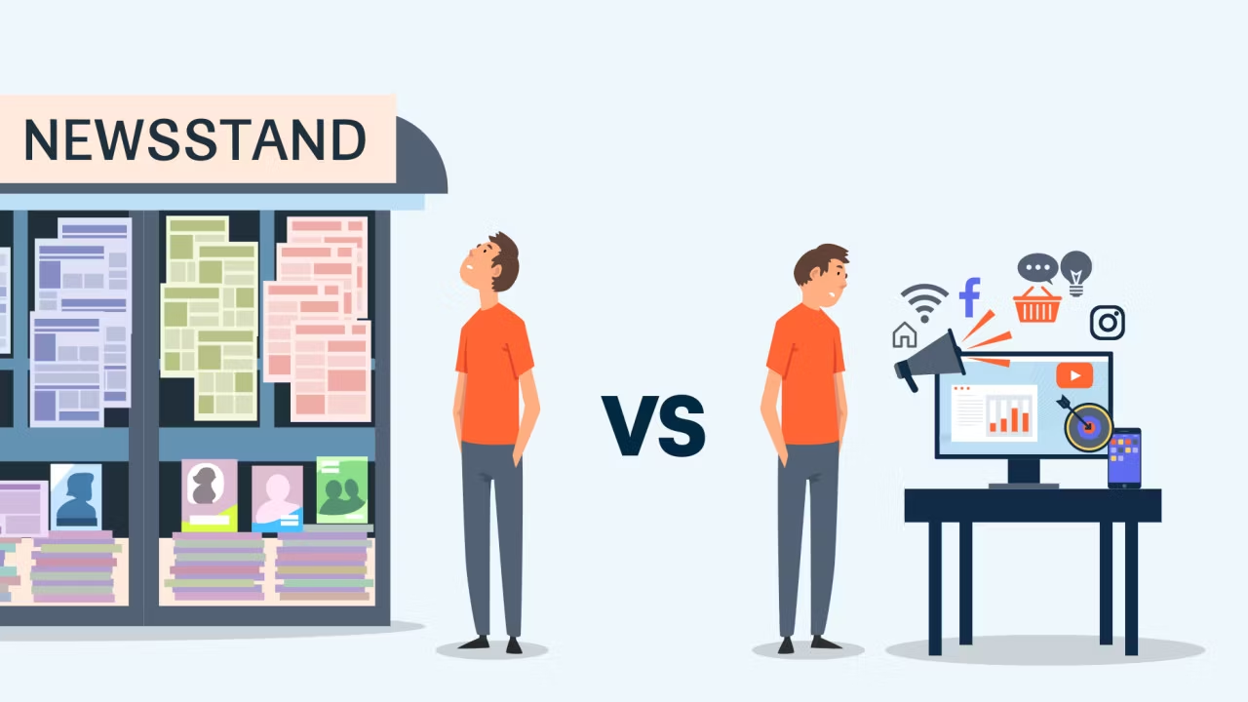
HOW TO INTEGRATE TRADITONAL
AND DIGITAL MARKETING?
Use one medium to promote the other
Encourage your offline customers to go online
Set up relevant types of dedicated tracking to track online traffic
Use a consistent design across all platforms
Use incentives to attract specific audiences
Develop a mobile app

Slide 21
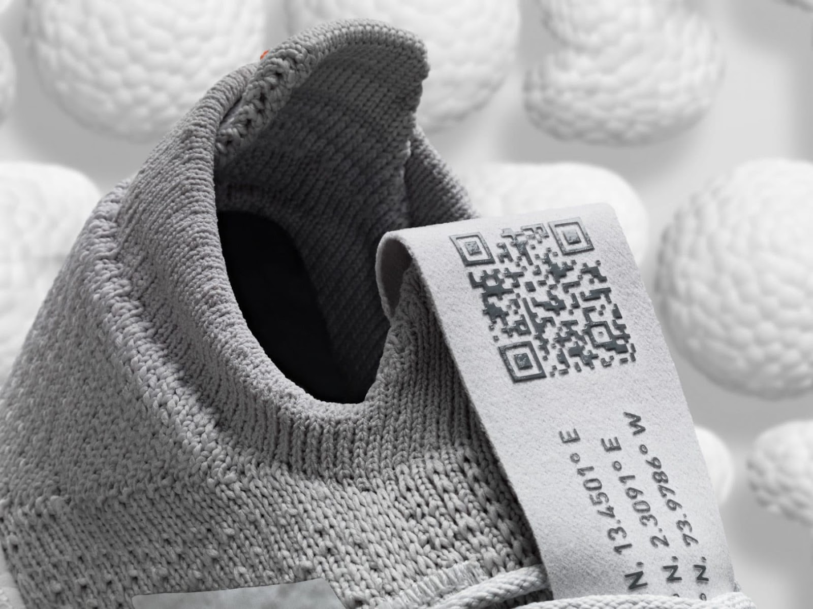
HOW TO INTEGRATE TRADITONAL
AND DIGITAL MARKETING?
Try to mix digital content and print media
When publishing an advertisement in a newspaper or magazine, lead readers to your site using a QR code.

Slide 22

HOW TO INTEGRATE TRADITONAL
AND DIGITAL MARKETING?
Combine geo-targeted advertising and billboards. Geo-targeting is working with data about the user’s location, determined by the IP address. Advertising offers for the user are formed based on the customer’s location.

Slide 23
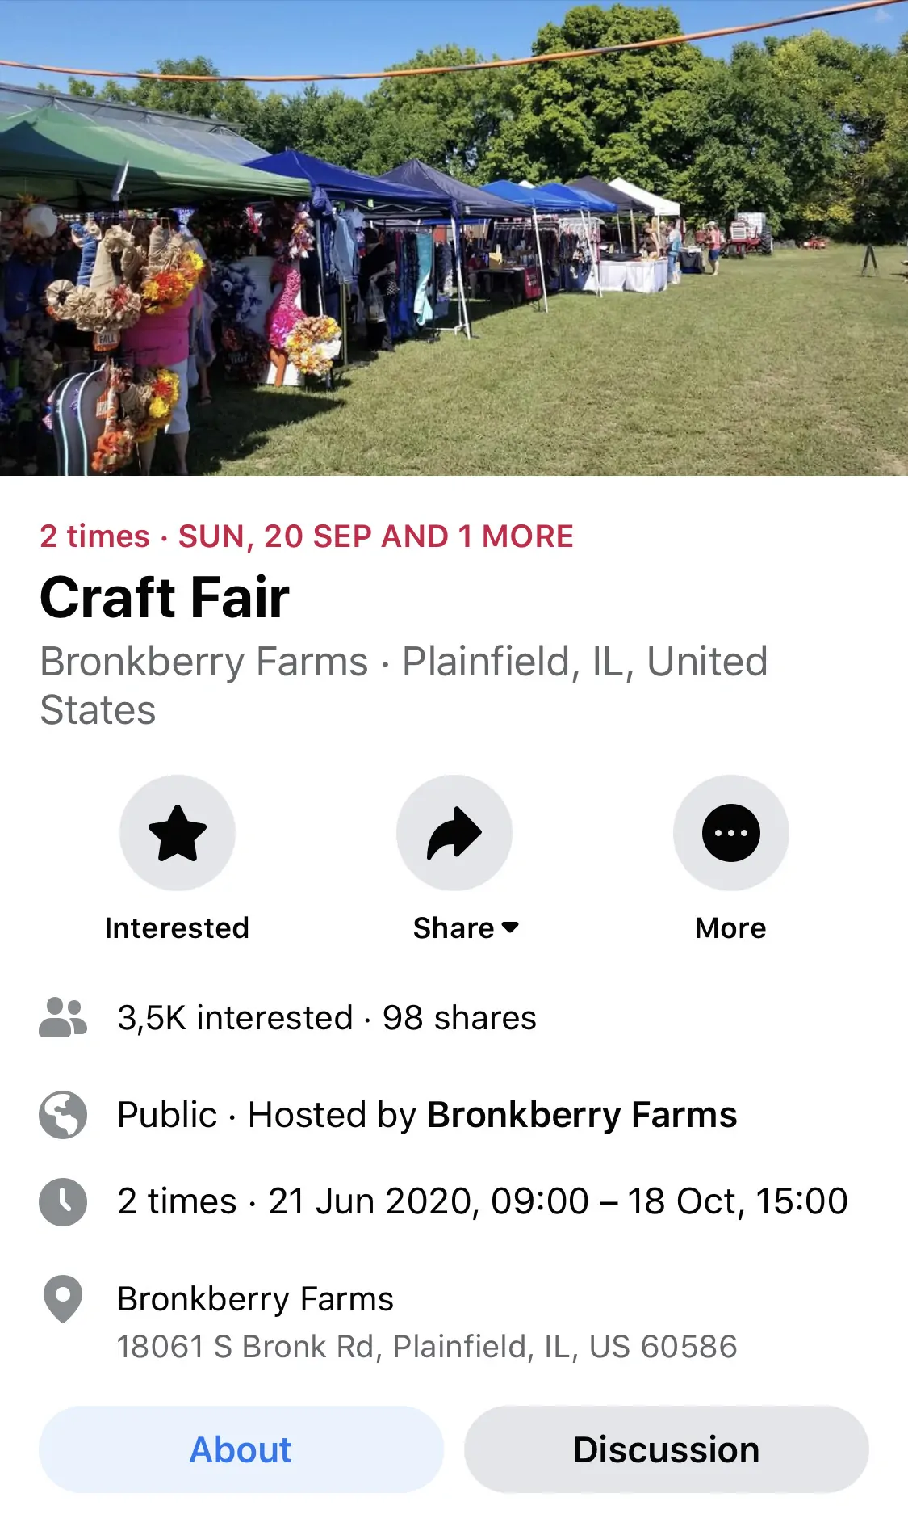
HOW TO INTEGRATE TRADITONAL
AND DIGITAL MARKETING?
Promote local events online

Slide 24
HOW TO INTEGRATE TRADITONAL
AND DIGITAL MARKETING?
  Use Traditional Media to Advertise Your Digital Channels
  Promote your social media and websites during face-to-face seminars
  Use The Same Content on Both Types of Media To Maximize Outreach
  Combine a company’s communication channel into mix media types in order to meet its marketing goals e.g. stream TV ads on youtube
  Build a email subscriber list through social media, in-store promo or website signups
  Use Google Adwords to bring traffic to your physical store

Slide 25
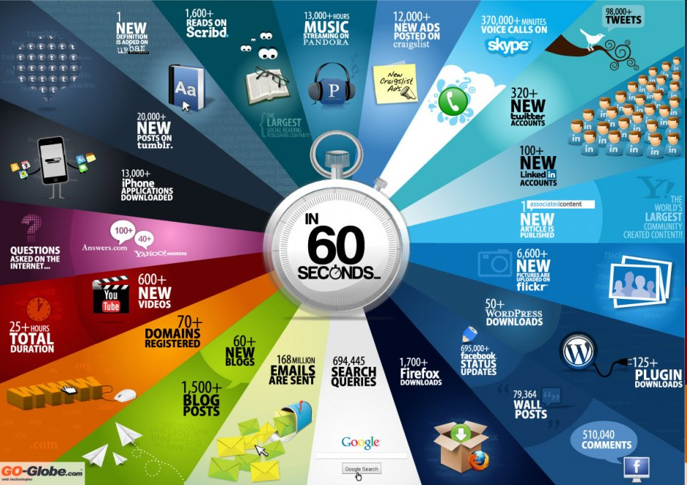
Notes:
This slide just illustrates what is happening online every minute i.e. the scale of the information and messages being transmitted.

Slide 26
Applications of Digital Marketing
As an Advertising Medium – as a “pop up”
As a Direct Response Medium – e.g. chat lines
As a Lead Generation Method – e.g. get customer’s email
Distribution Channels e.g. Apple iTunes & Netflix
As a Customer Service Mechanism – e.g. receive customer’s concerns and respond very quickly

Slide 27
Digital Innovations
Oculus Rift - virtual reality headset
Sold for $2bn to Facebook
IBeacons
http://www.theguardian.com/technology/2014/mar/31/oculus-rift-facebook-virtual-reality

Slide 28
Digital Innovations

Slide 29
Internet of Things (IoT)
Extending the current Internet and providing connection, communication, and inter-networking between devices and physical objects, or "Things," is a growing trend that is often referred to as the Internet of Things (IoT)
“The technologies and solutions that enable integration of real world data and services into the current information networking technologies are often described under the umbrella term of the Internet of Things (IoT)”

Slide 30
Sensor devices are becoming widely available
- Programmable devices
- Off-the-shelf gadgets/tools

Slide 31
Things connected
Things connected
Things connected

Slide 32
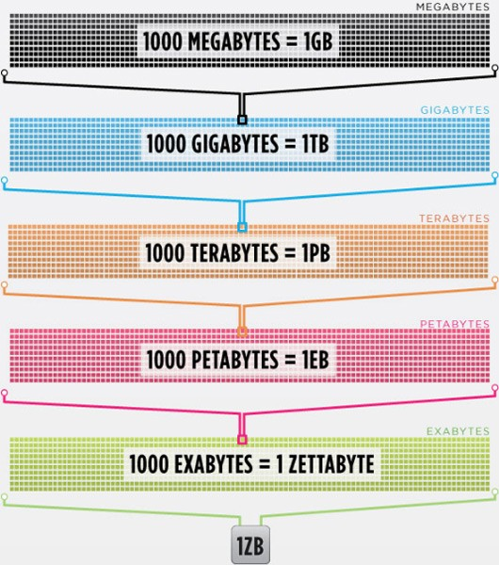
What is big data?
Every day, we create 2.5 quintillion bytes of data — so much that 90% of the data in the world today has been created in the last two years alone. This data comes from everywhere: sensors used to gather climate information, posts to social media sites, digital pictures and videos, purchase transaction records, and cell phone GPS signals to name a few.
  This data is “big data.

Slide 33
Huge amount of data
There are huge volumes of data in the world:
  From the beginning of recorded time until 2003, we created 5 billion gigabytes of data.
  In 2011, the same amount was created every two days
  In 2013, the same amount of data is created every 10 minutes.

Slide 34
Why is data important
Segmentation of audience
Tailoring products/services to individuals
Understanding buyer behaviour
Customer Engagement

Slide 35
Questions
In pairs:
What future do you think the Internet of things holds for us?
And how might that be commercialised?

Slide 36
Digital Marketing is Dead!
Notes:
ALL marketing is digital!!

Slide 37
Digital Marketing Planning Process

Slide 38
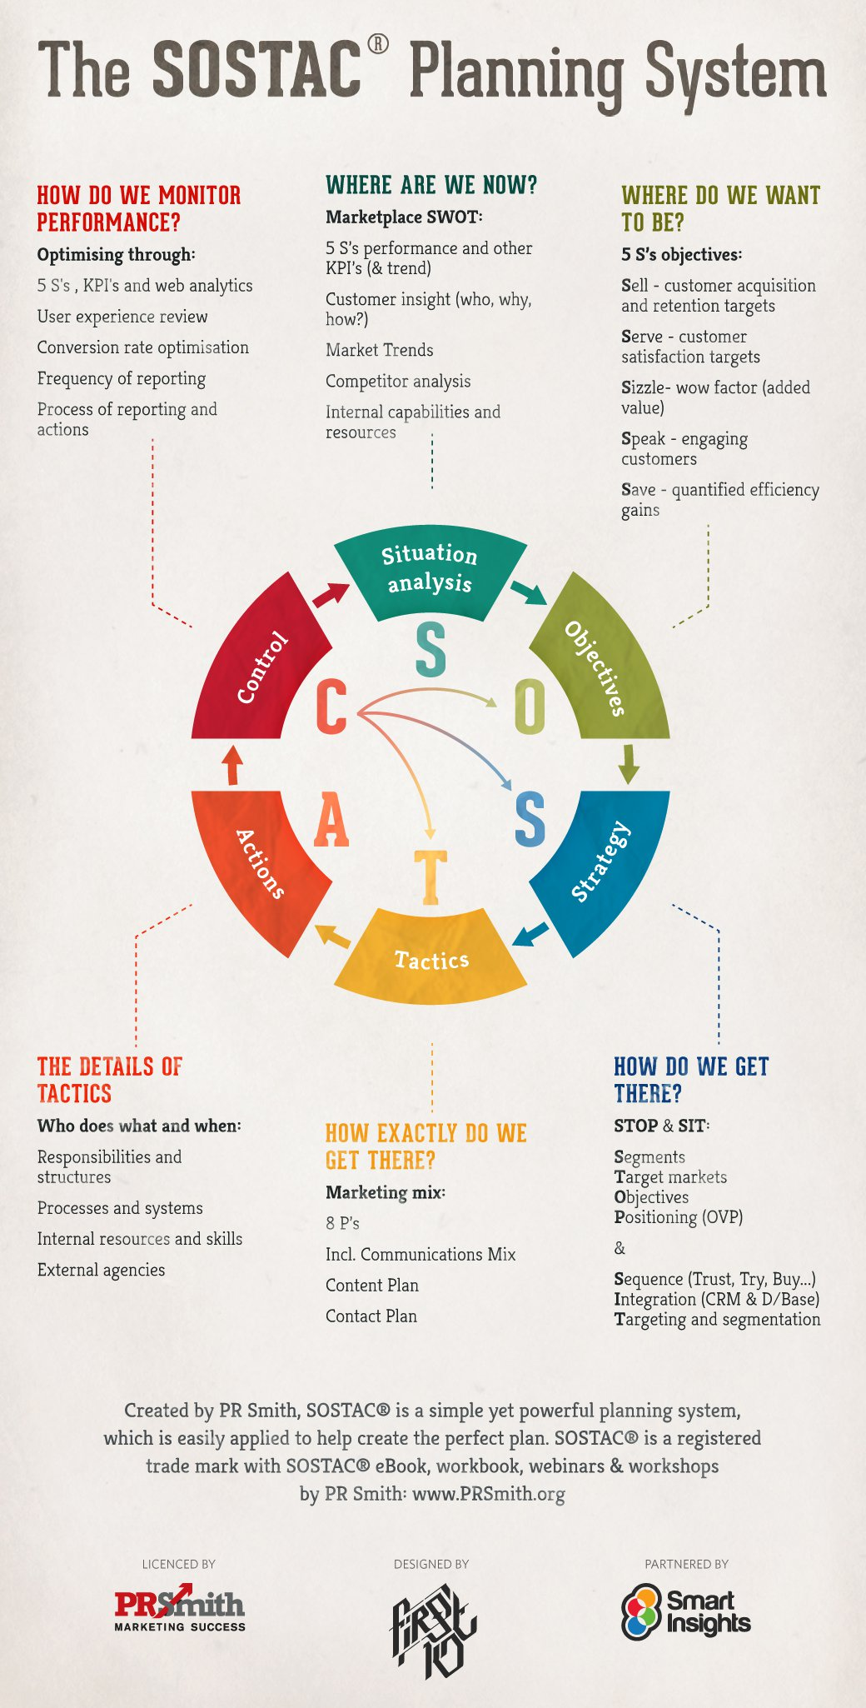
Marketing
Planning
process

Slide 39
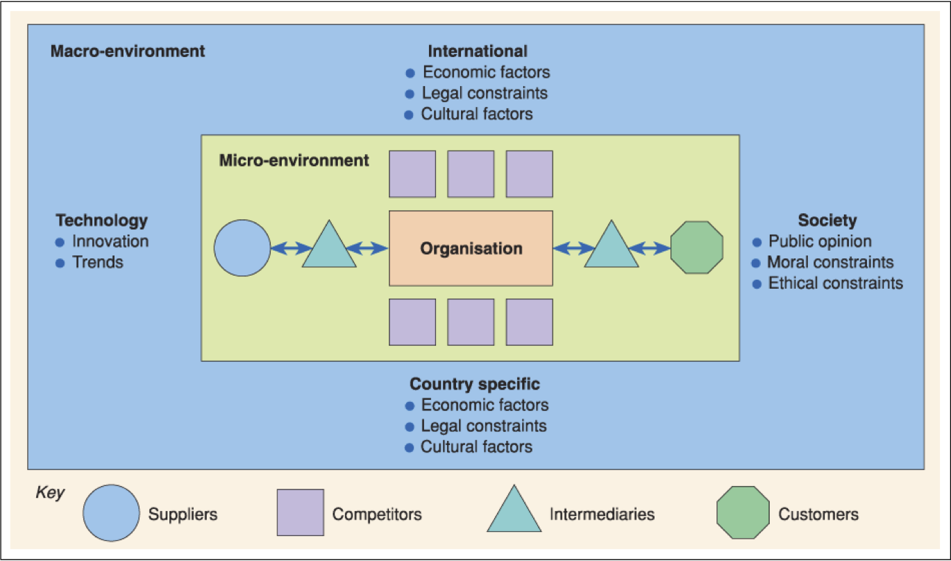
Situational Analysis

Slide 40

HAS DIGITAL TRANSFORMED MARKETING ?
Digital marketing is about:
Audiences
Digital devices
Digital platforms
Digital media
Digital data
Digital technology
Measurability
Through enabling Technologies

Slide 41
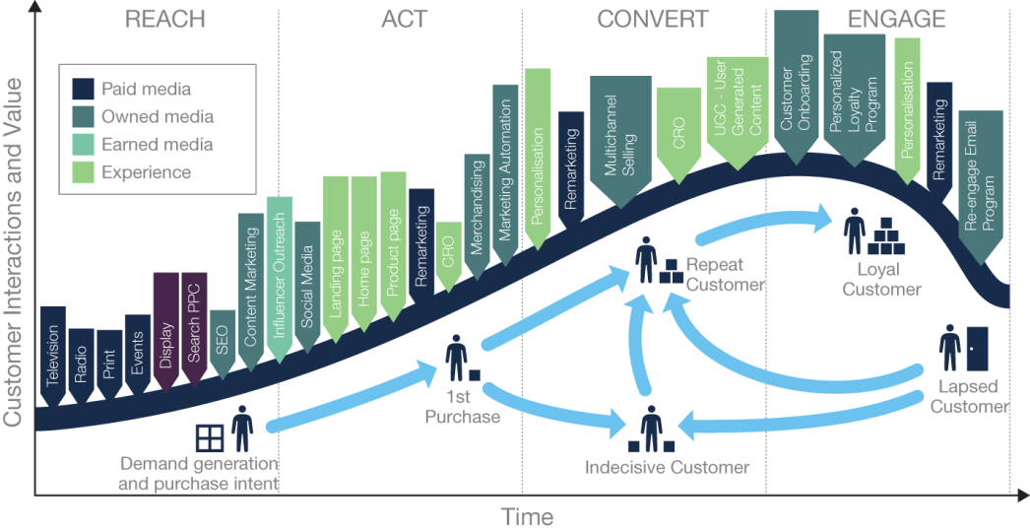
Customer lifecycle marketing touchpoint summary for a retailer

Slide 42

What are digital and multichannel marketing?
Digital marketing can be defined as:
Achieving marketing objectives through applying digital media data and technology

Slide 43
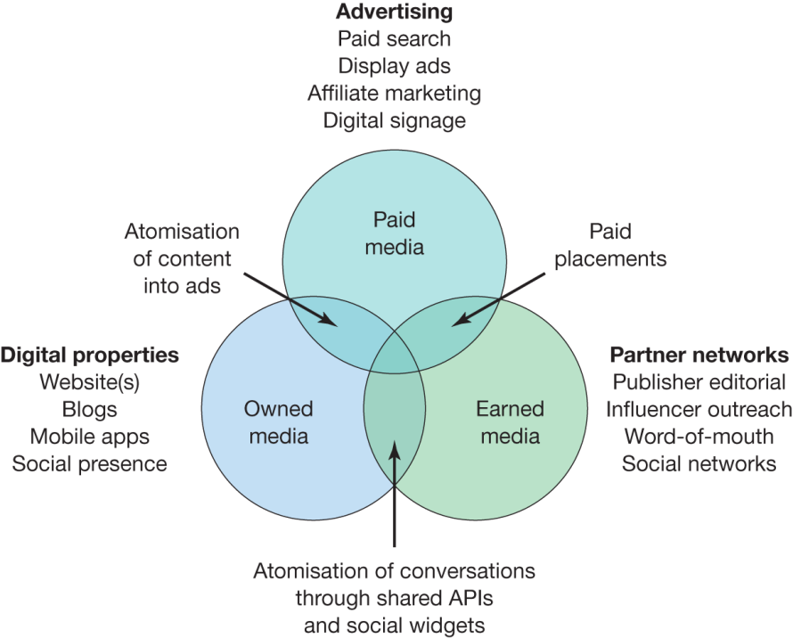
PAID, OWNED AND EARNED MEDIA

Slide 44
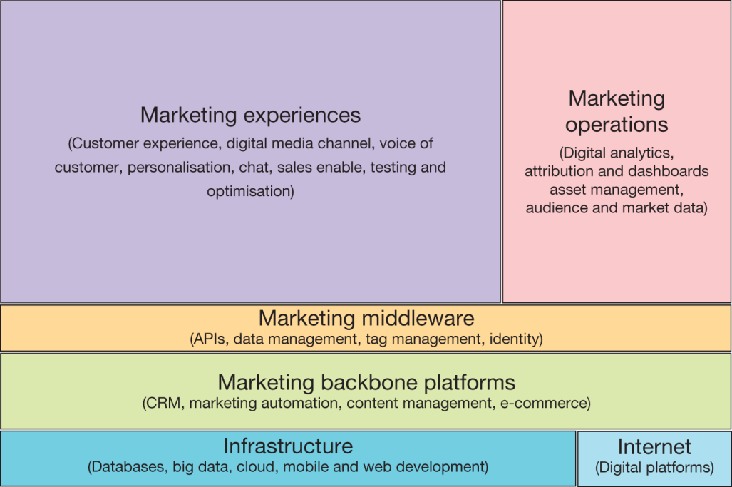
THE MARKETING TECHNOLOGY LANDSCAPE

Slide 45

INTRODUCTION TO DIGITAL MARKETING STRATEGY
Key considerations:
Key features of digital marketing strategy
Applications of digital marketing
Benefits of digital marketing

Slide 46
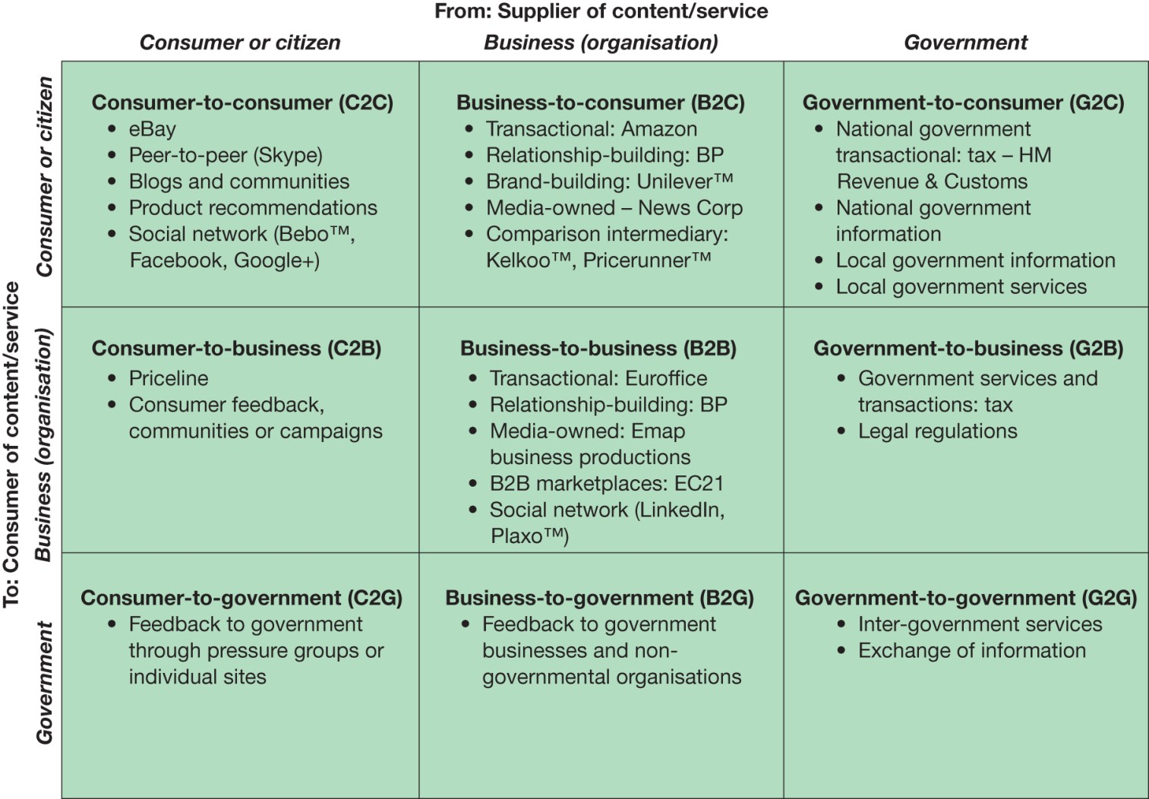
EXAMPLES OF TRANSACTION ALTERNATIVES BETWEEN BUSINESSES, CONSUMERS AND GOVERNMENTAL ORGANISATIONS

Slide 47
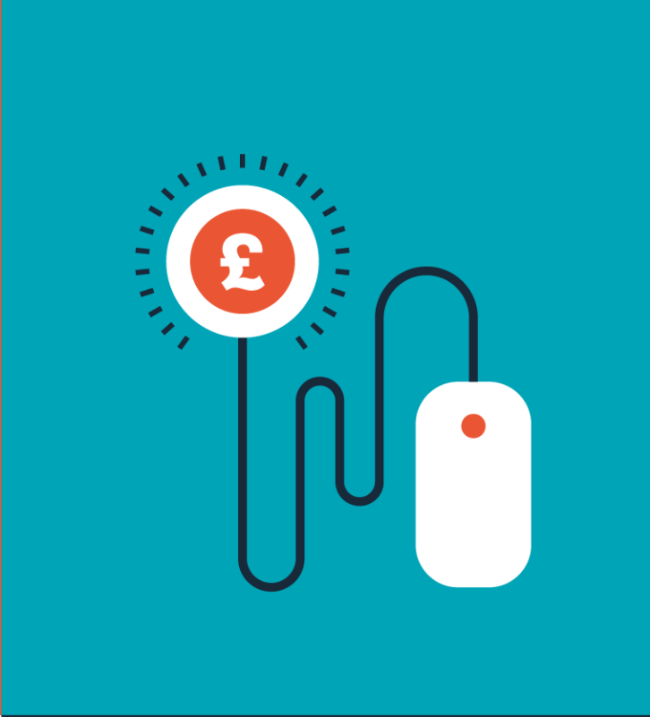
SUMMARY OF CHALLENGES IN
DIGITAL MARKETING
Strategy
Structure
Systems
Staff
Style
Skills
Smarketing !

Slide 48
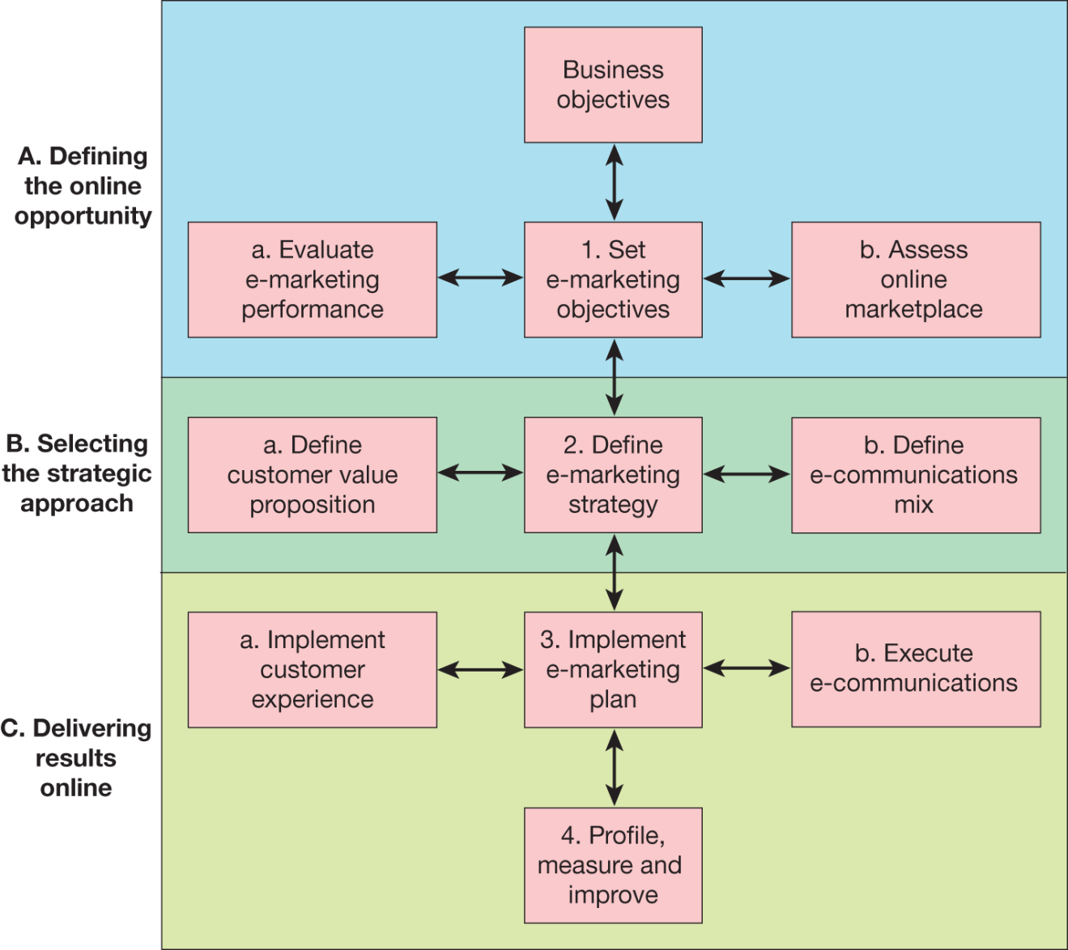
A GENERIC DIGITAL MARKETING STRATEGY
DEVELOPMENT PROCESS

Slide 49
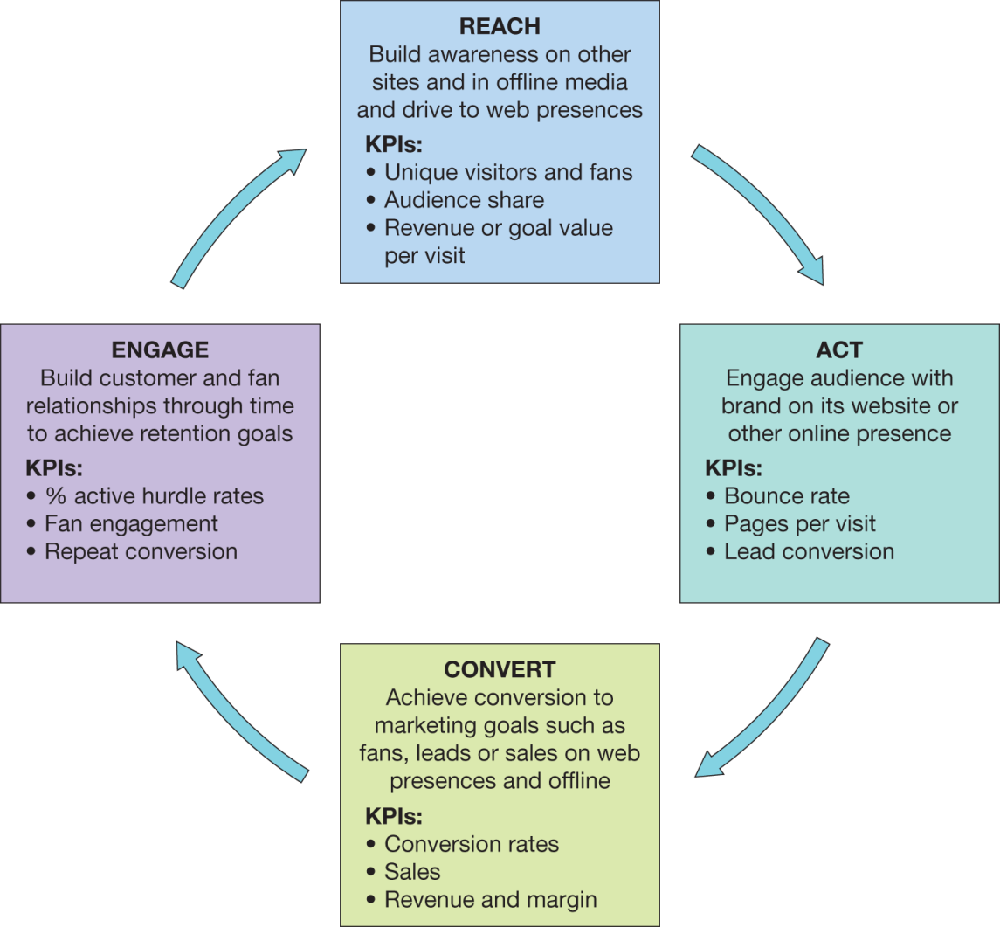
DIGITAL MARKETING COMMUNICATIONS

Slide 50
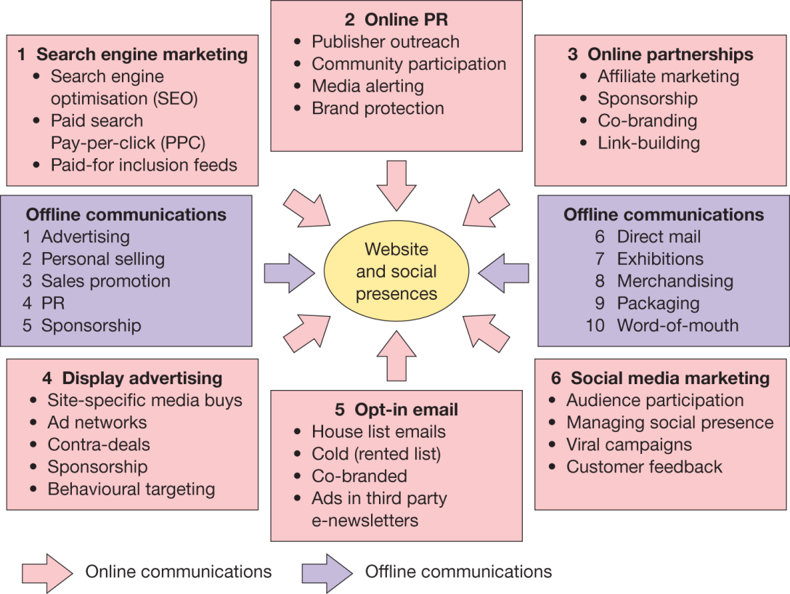
Key digital communications tools or
media channels
Source: Chaffey and Smith(2017)

Slide 51
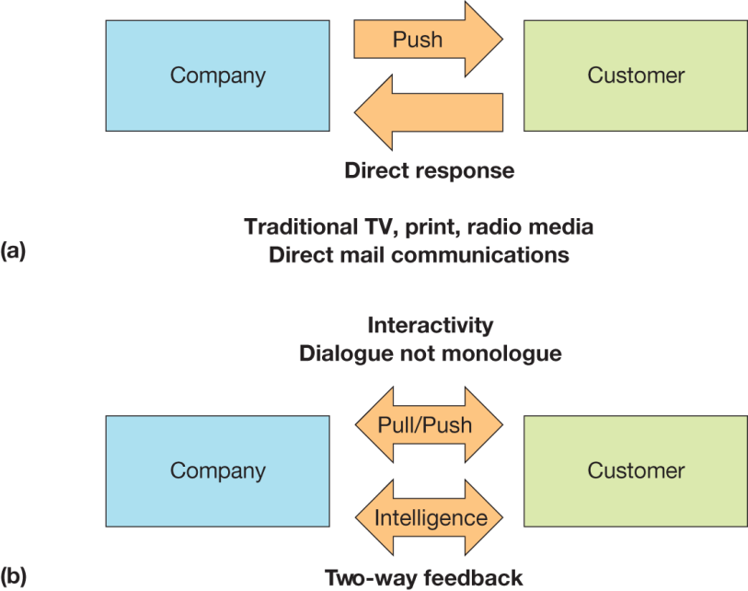
TRADITIONAL VS NEW MEDIA

Slide 52
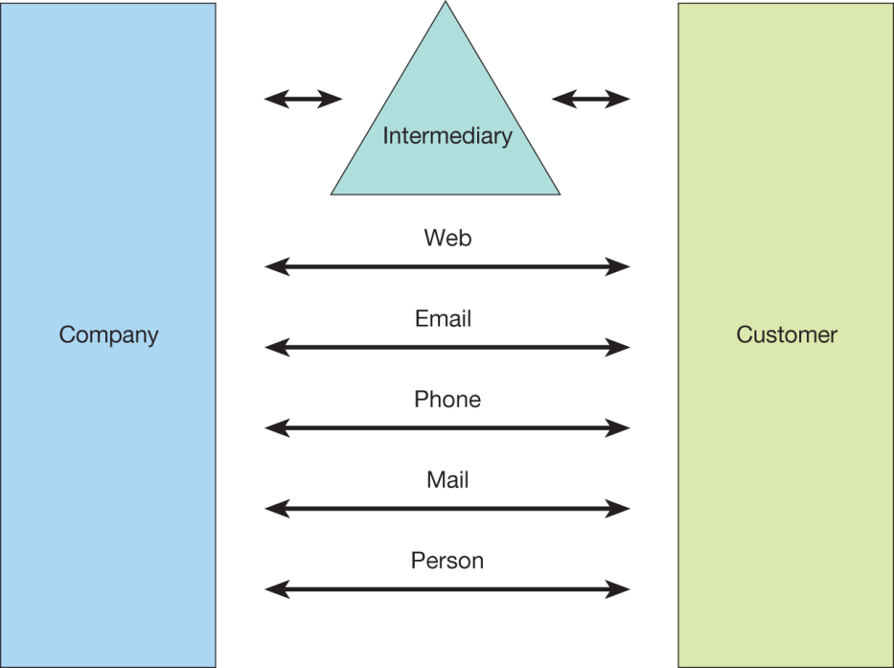
CHANNELS REQUIRING INTEGRATION

Slide 53
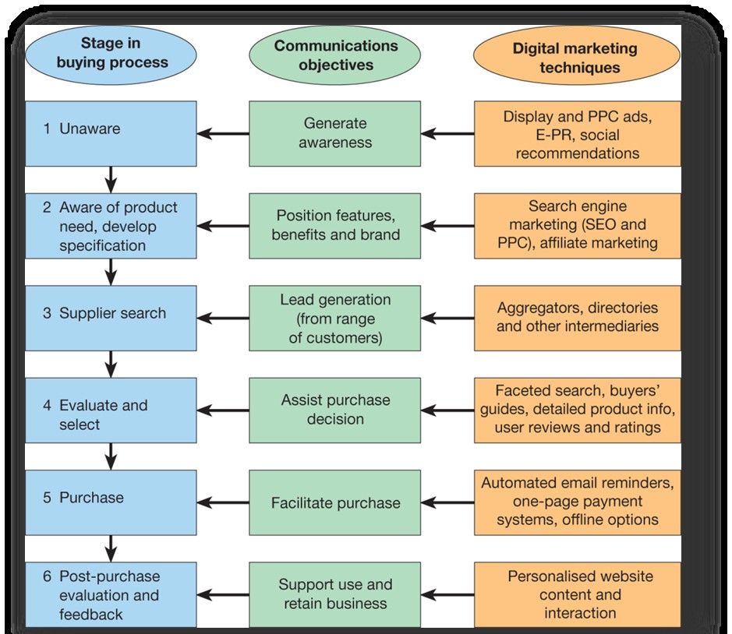
DIGITAL MEDIA IMPACT ON THE BUYING PROCESS

Slide 54
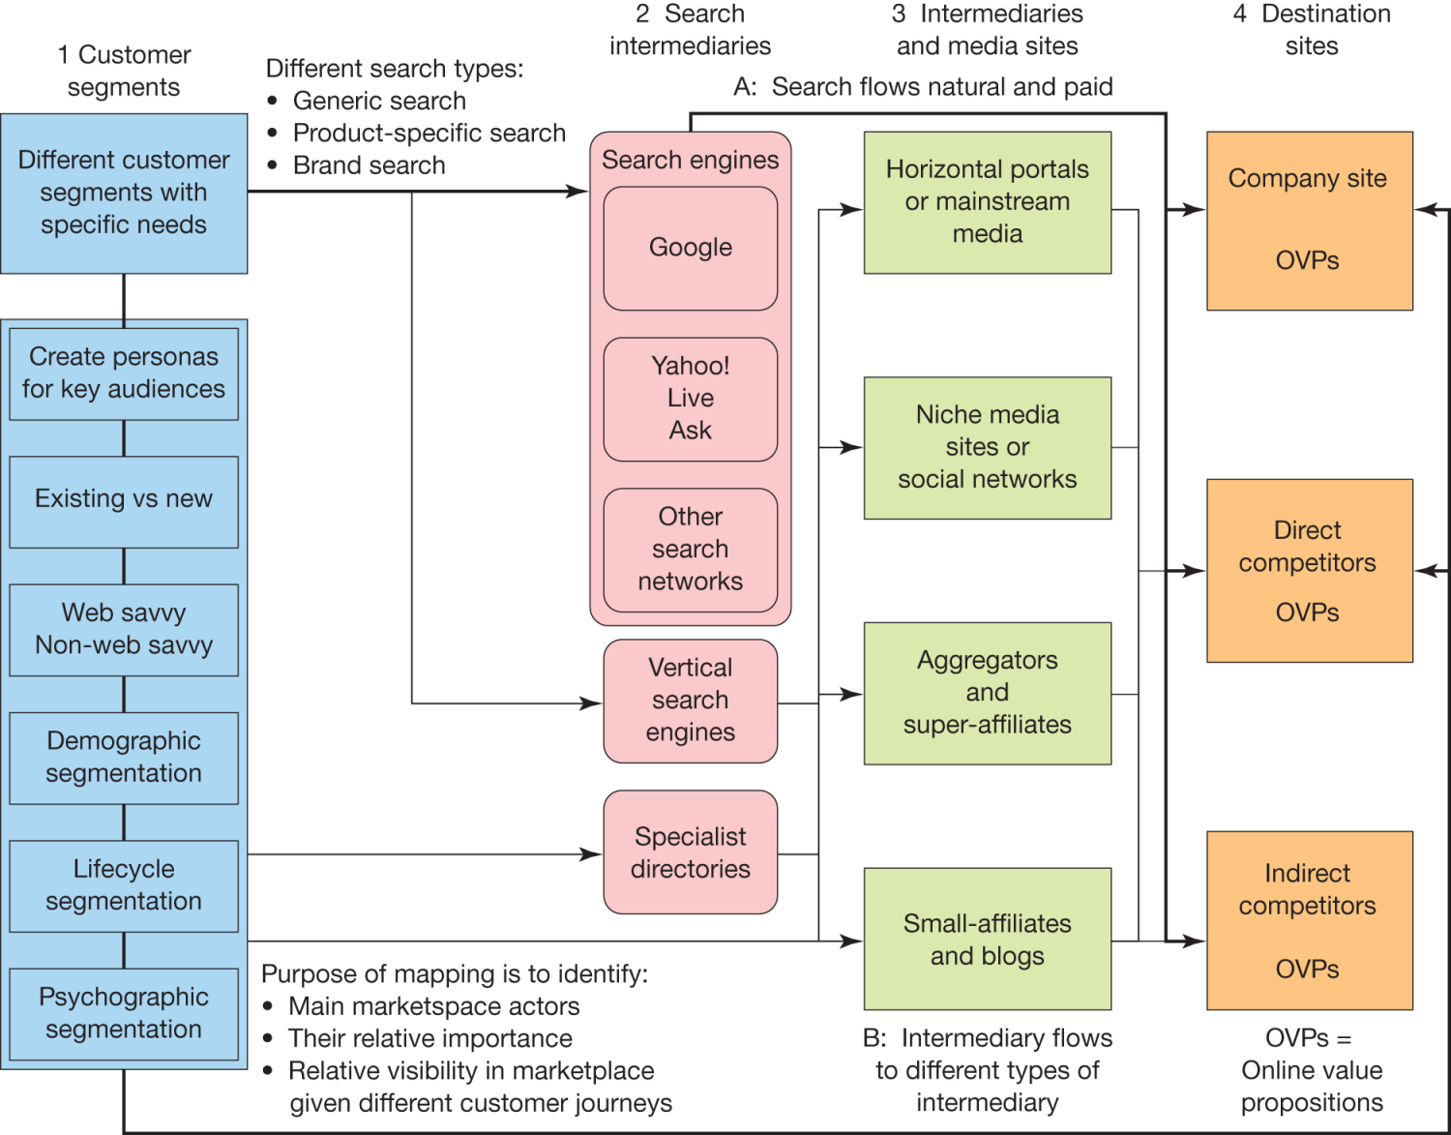
ONLINE MARKETPLACE

Slide 55
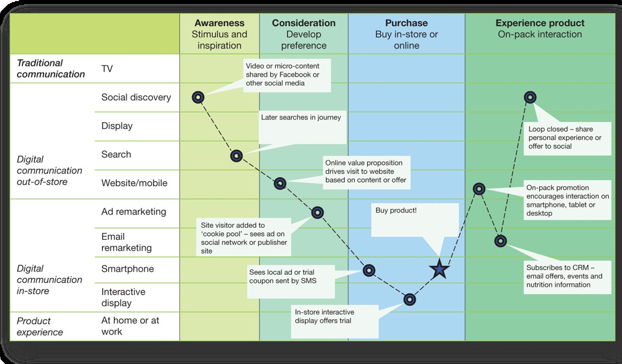
A CUSTOMER JOURNEY MAP

Slide 56
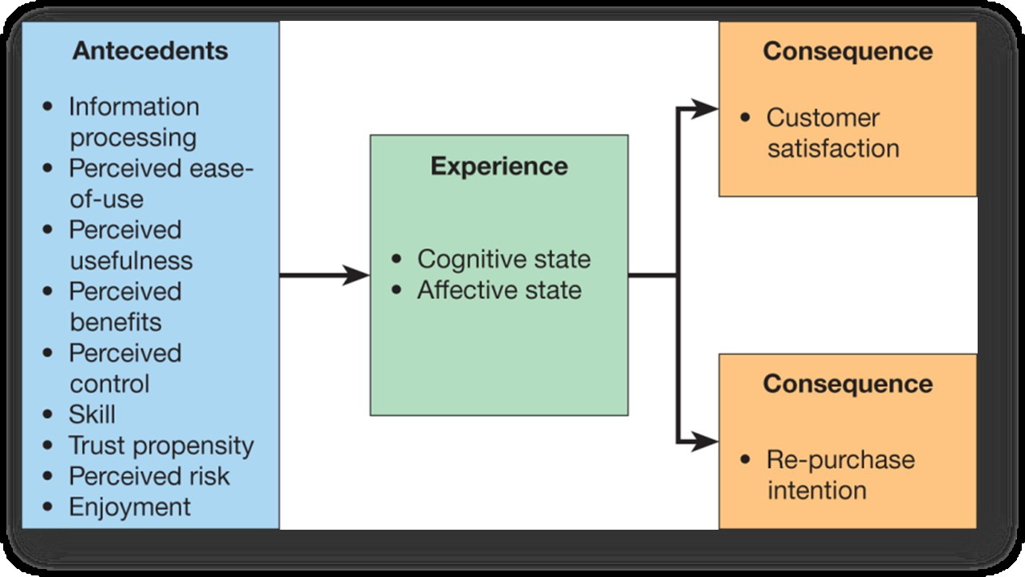
FRAMEWORK FOR UNDERSTANDING ONLINE CUSTOMER EXPERIENCES

Slide 57
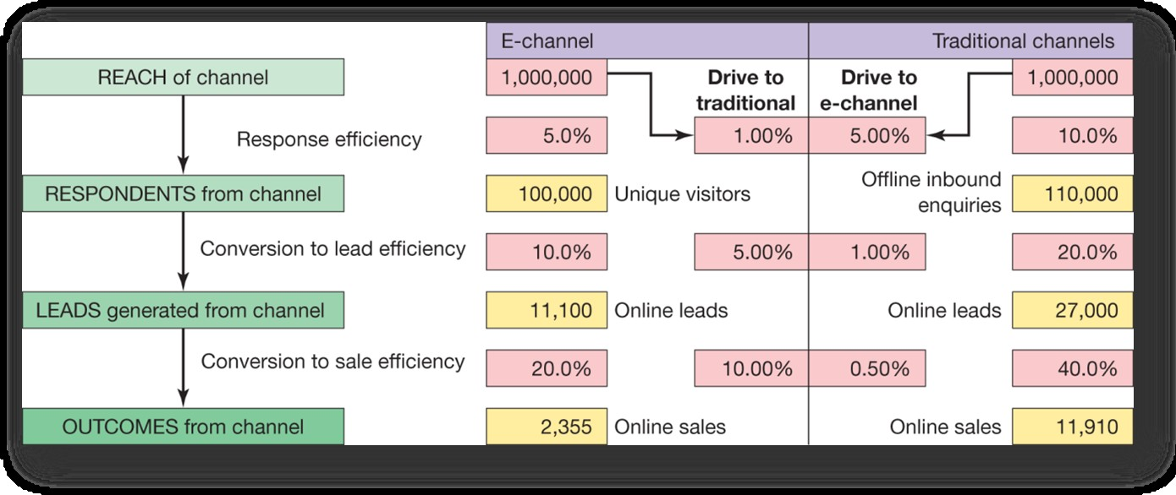
CONVERSION BETWEEN DIGITAL
AND TRADITIONAL CHANNELS

Slide 58

Comprises technologies and processes that enable marketers to collect, measure, analyse, and assess marketing effectiveness.

Slide 59
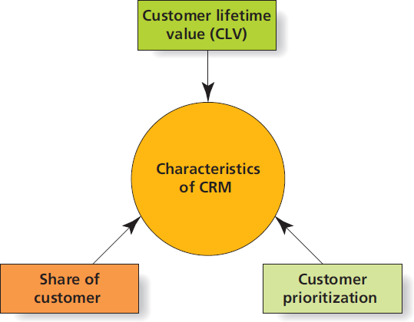
Customer-Related
Metrics

Slide 60
SHARE OF CUSTOMER
Its easier and less expensive to keep a current customer than it is to acquire a new one.
  Many firms look to increase share of customer, instead of share of market.
Share of customer is the percentage of a given
customer’s purchases in a category over time.
  Enables company to grow sales and profits at a lower cost, relative to new customer acquisition.
  Example : Bank card issuers’ share of wallet

Slide 61
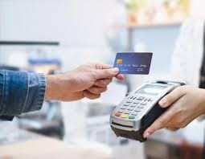


CUSTOMER EQUITY AND LIFETIME VALUE
Lifetime value of a customer is how much profit a firm will make on a customer.
Customer equity is financial value of a customer relationship.
  Takes into account monetary investments to
acquire and maintain relationship

Slide 62
CUSTOMER PRIORITISATION
Not all customers are equal … at least, not in terms
of profitability!
CRM systems enable marketers to identify priority customers and customise communications and special offers accordingly.
  For example, a firm may emphasise personal selling for contacting high-volume customers, while using direct mail or telemarketing to communicate to low- volume customers.

Slide 63
CRM:
Transforming Customers into
Corporate Assets
CRM leverages database technologies to customise customer interactions based on:
  Share of customer
  Lifetime value
  Customer equity
  Customer prioritisation
Are their limitations, or even dangers, to viewing
customers as financial assets?

Slide 64
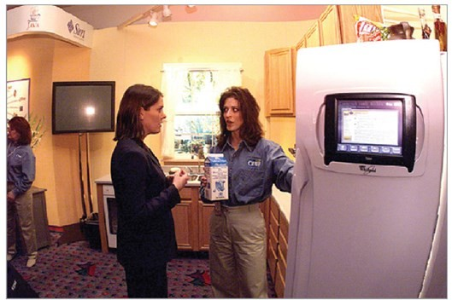
BIG DATA: TERABYTES RULE
Big data is a popular term to describe the exponential growth of structured and unstructured data.
  Internet data can be hard to analyse using traditional approaches.
  Internet of Things

Slide 65
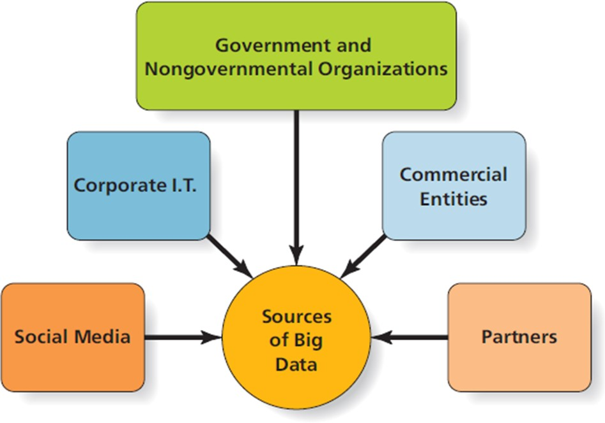
INSIGHTS FROM BIG DATA
Big Data can provide competitive advantages in three main areas:
  Identifying new opportunities
  Transforming insights into better products
  Delivering timely information more efficiently and effectively

Slide 66
SOURCES
Social Media Sources
Web scraping
Sentiment analysis
  Measuring brand attitude by assessing the context or emotion of online comments
Brand mapping
Corporate IT Sources
CRM Databases
Web Analytic Databases
Enterprise Resource Planning (ERP) Databases
Accounting-Related Databases

Slide 67
SOURCES
Government and NGO Sources
Increased types and amounts of government-generated data are accessible to enterprising marketers.
Commercial Entity Sources
Many companies today collect data in large quantities to sell to other organisations.
  Credit card purchase data
  Supermarket scanner data
Data sold in aggregate form
May be a primary or secondary source of revenue for the firm

Slide 68
SOURCES
Partner Database Sources
Two-way information exchange between purchasing
organisation and suppliers (GE…)
Provides benefits to buyers and sellers
  Real-time demand signals
  Replace inventory with information
  Fewer stock-outs
Data Mining
The biggest data challenge for many firms is determining what to do with it all!
Data mining refers to process by which analysts sift through Big Data to identify patterns of behaviour.

Slide 69
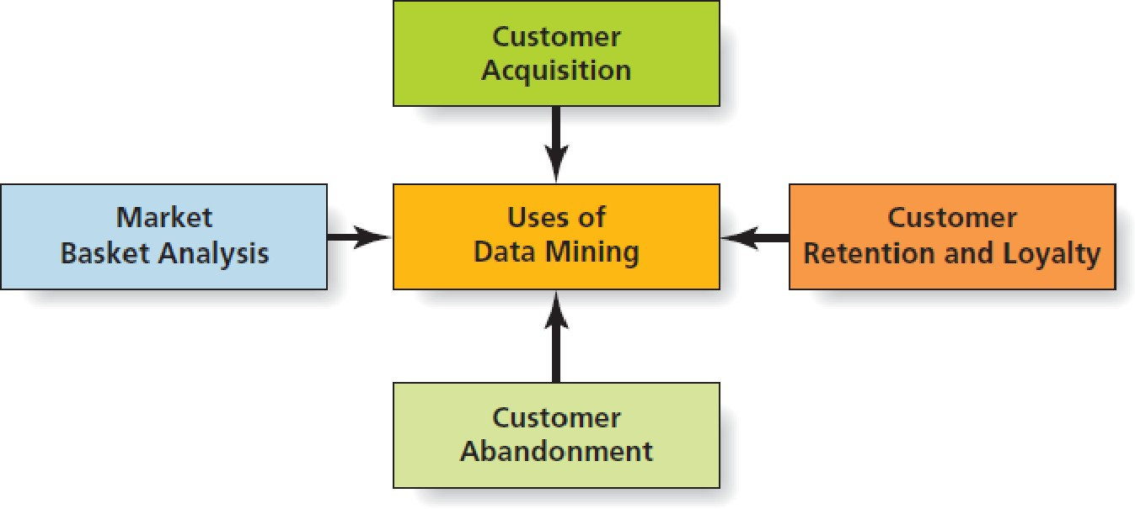
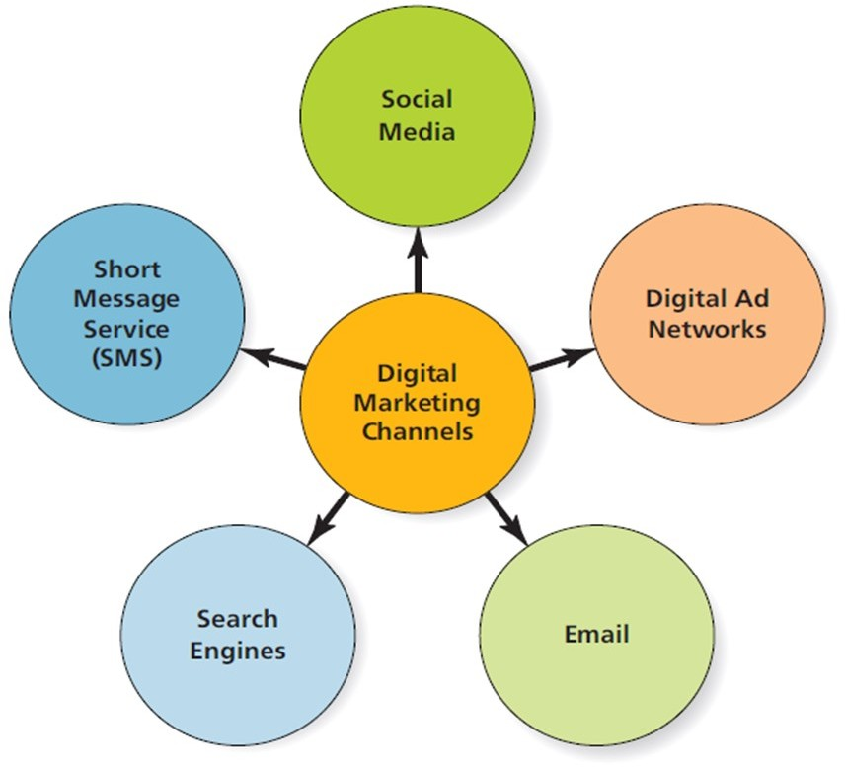
DATA MINING & CHANNELS

Slide 70

VALUE OF DIGITAL
MARKETING INVESTMENT
Cost-per-click
Advertiser is charged only when user clicks on ad.
More expensive, requires greater interaction
Cost-per-impression
Advertiser is charged each time ad shows up on user
page.
Less expensive, but not as easy to measure
Search engine optimisation (SEO)
Compare average cost per customer transaction

Slide 71
ADDITIONAL READING

Slide 72
METRICS & PREDICTIVE ANALYTICS
Discussion of marketing analytics has focused on validating prior investments.
Predictive analytics use large quantities of data to more accurately predict future outcomes.
Marketing metrics enable firms to assess performance of current initiatives.
Predictive analytics is a “crystal ball” through which marketers can predict the success of future initiatives.

Slide 73
Metrics for Marketing Control
Marketing control means the ability to identify variance in expected performance – both positive and negative – as soon as they occur.
  Enables marketers to adjust their actions before greater losses or inefficiencies are accumulated

Slide 74
KEY MARKETING METRICS
Click-through rate
(click-throughs /impressions) * 100
Conversion rate
# of goal achievements/# of website visitors
Cost per order advertising costs/orders
Margin of sales
selling price per unit (£) - cost per unit (£)
Churn rate
(# of customers lost at end of prior period/# of customers at beginning of prior period) * 100

Slide 75
Typical Digital Objectives
Growth
Acquisition
Conversion
Retention
All objectives must be SMART

Slide 76
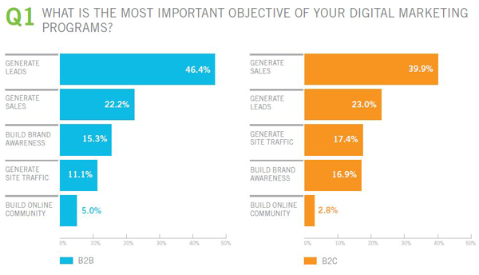
DIGITAL OBJECTIVES

Slide 77
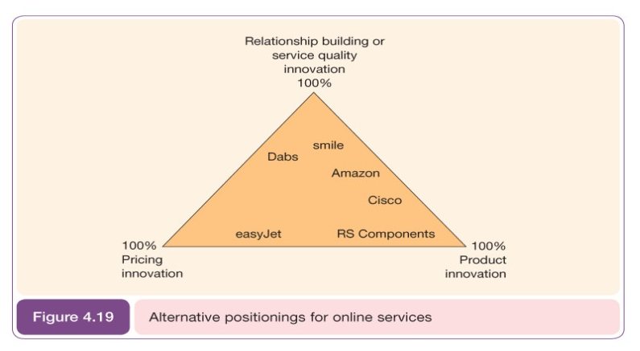
Strategy - Positioning

Slide 78
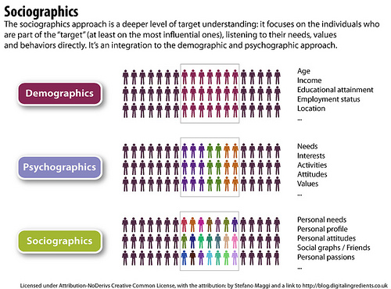
Strategy - Segmentation

Slide 79
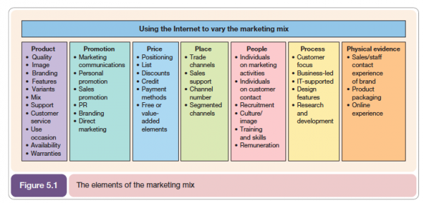
Tactics 7P’s adapted for Digital Marketing
8th P = Partnerships

Slide 80
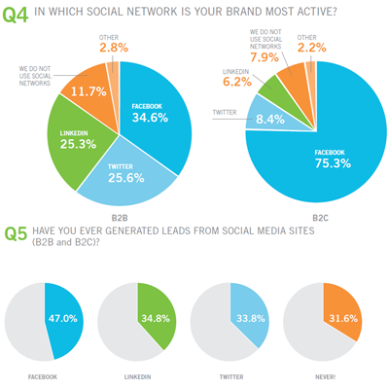
Digital Channels

Slide 81
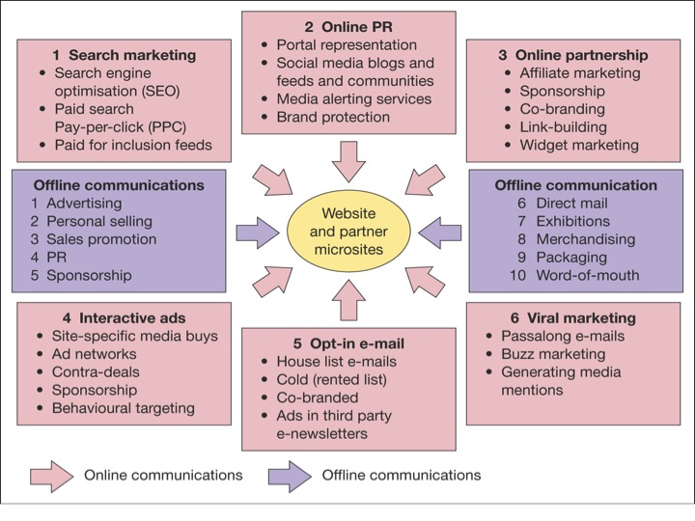
Digital Channels

Slide 82
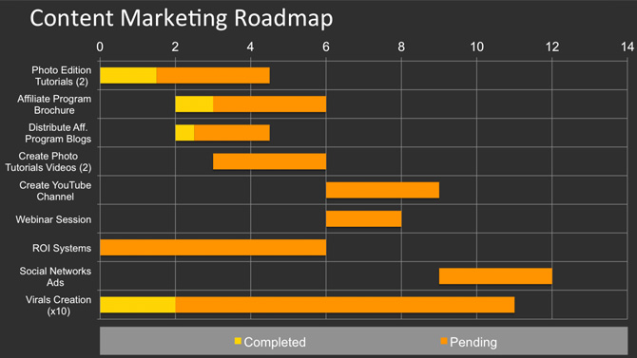
Actions - Gantt Chart

Slide 83
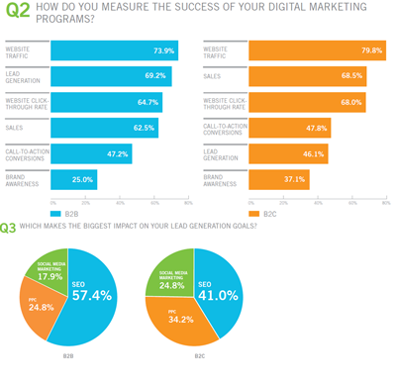
Control

Slide 84

Control

Slide 85
Activity
Working in pairs try to identify TWO points for each of the 6 planning stages below for one or other of your business ideas:
NOTE: 6 planning stages are:
Situation analysis – where are we now?
Objectives – where do we want to be?
Strategy – how do we get there?
Tactics – how exactly do we get there?
Actions – the details of tactics
Control – how do we monitor performance?

